Slide 1
Semantic based representing and organizing surveillance big data using video structural description technology
Zheng Xu, Yunhuai Liua , Lin Mei, Chuanping Hua , Lan Chena
The Journal of Systems and Software(2015)

Slide 2
Outline
Introduction
Objective
Contribution
System
Case Study

Slide 3
Introduction
Big data is beyond the ability of commonly used software tool to capture, manage, and process the data within tolerable elapsed time.
It’s a challenge to understand vast amount of videos solely based on the visual appearance.
The rapid increase number of video brought a need to represent and annotate the video intelligently
The processing and analysing video surveillance data follow the 4 V feature of big data: (i) variety, (ii) volume, (iii) velocity, and (iv) value

Slide 4
Objective
Enable users to search the related events from the huge number of video resources.
Propose a semantic based model, which solving the representing and annotating need for object and spatial/temporal relations.
The proposed model is named Video Structural Description (VSD)

Slide 5
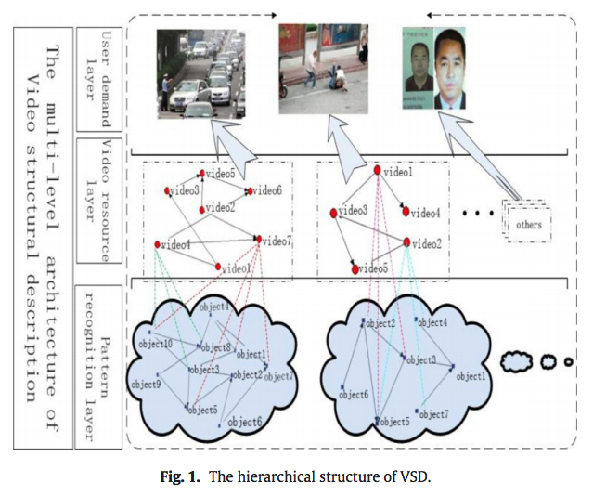
System (Overview)
Pattern recognition layer
VSD extract and represent the content of the single video.
Use domain ontology including concepts, event, relation.
Define the spatial and temporal relation in the event and concept definitions.
Video resource layer
Link the videos with their semantic relation.
User demands layer
Process the need of users ad return the clustering, integrated, and related resources.

Slide 6
System (supporting technologies)
Computer vision
Semantic link network
Nodes: any object
Link: interaction between nodes
Space: a classification hierarchy of concepts and a set of rules for reasoning and inferring links
Self-organized network since any node can link to others
Cloud computing

Slide 7
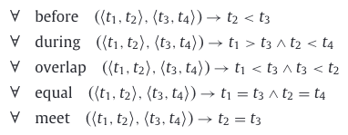
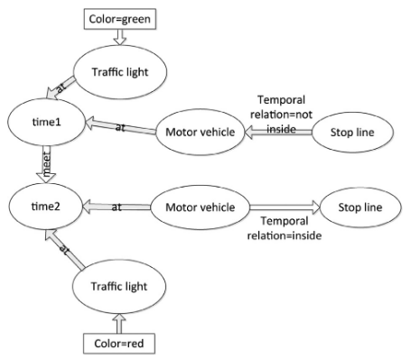
System
Pattern recognition layer
Definition:
Object => Extracted component from a video
Concept => Standard taxonomy of object of a domain
Attributed => Visual feature of the object from video
Temporal Relation => Timing relation between the different time intervals of a video
Spatial Relation => Position relation between objects of a video
Event => Combination of the objects and their spatial-temporal relation
Example case

Slide 8
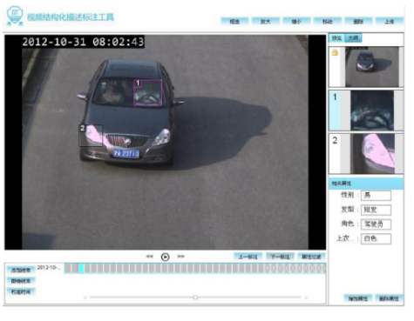
System
Video resource layer
Definition
Objection Relation: Semantic relation between the objects in different videos
Video Spatial Relation: Spatial relation between the different videos
Video Temporal Relation: Temporal relation between the different videos
User demands layer
Applications on annotating and searching of video resources.
Use Protégé and TBC to build annotation ontologies.
User interface of video annotation and search module

Slide 9
Case study
Illegal cars using other licenses:
Task: Finding the illegal cars using other licenses.
Dataset: 1.19 billion data from the traffic speed camera, including the licence number, GIS information of car, and catching time of the traffic speed camera.
Data processing: Use ten server to store and process these 1.19 billion data
Mapreduce: map function to classify the car into the different time and reduce function to classify the cars by license number
Rules: Setting “The distance between the cars of the same licence should lower than 15 km in 10 minutes”
Results: 394 cars are selected and filter by the car information. (e.g., brand, color,...)

Slide 10
Contribution
Building domain ontology of VSD, including additional rule definitions.
Define a number of concepts and relations, allow users to use them to detect the video traffic events.
Utilize Semantic link network to mine and organize video reosource based on their association
Implement a semantic video annotation tool for annotate and organizing video based on annotaiton ontology.

Slide 11
Conclusion
The increasing need of video based applications issues the importance of parsing and organizing the content in videos.
Define a numbers of concepts, spatial, temporal, and their relation to represent video traffic event unambiguous
This paper propose a semantic based model for representing and organizing the content in big data of videos.

