Slide 1
Smart Manufacturing Scheduling with Edge Computing Using Multiclass Deep Q Network
Chun-Cheng Lin, Der-Jiunn Deng* , Yen-Ling Chih, and Hsin-Ting Chiu
Published in: IEEE Transactions on Industrial Informatics ( Volume: 15 , Issue: 7 , July 2019 )

Slide 2
Outline
Introduction
Related work
Problem Description
Deep Q Network
Solution
  MDQN method
Experiment Results
Conclusion
Future work

Slide 3
Introduction
As the era of Industry 4.0 has arrived, smart factory can automatically make complex and real-time decisions.
Compared to conventional approach, edge computing allocates a lot of computing resources to the edge of the production.
Manufacturing is involved with complex job shop scheduling problems (JSP).

Slide 4
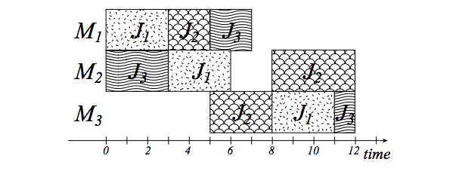
Introduction
JSP considers a set of jobs, each of which has a set of tasks needed to be processed by machines in a specific order.
http://www.kecl.ntt.co.jp/as/members/yamada/galbk.pdf

Slide 5
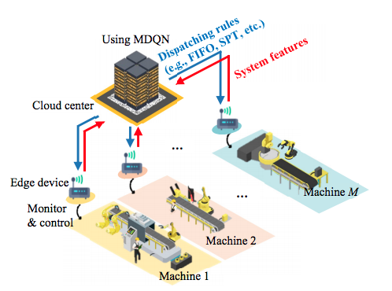
System framework
Machine : Process a task of each job, and is of various functions.
Edge device : Collecting system features of the controlled machine, and transmits them to a centralized cloud center.
Cloud center : Determining dispatching rules of all machines, which are then sent to all edge devices

Slide 6
Problem description
Given a number of customer orders each of which includes J jobs, each job has a set of tasks needed to be processed by M machines in a specific order.
Find a method to determine the starting time when each task processed by corresponding machine, and so that the makespan is optimized.
Determine dispatching rule of each machine rather than assigning scheduling result directly.

Slide 7
Related work
Y. Wang, “A new hybrid genetic algorithm for job shop scheduling problem,” Comput. Oper. Res., vol. 39, no. 10, pp. 2291-2299, 2012.
P. J. Van Laarhoven, E. H. Aarts, and J. K. Lenstra, “Job shop scheduling by simulated annealing,” Oper. Res., vol. 40, no. 1, pp. 113-125, 1992.
M. E. Aydin and E. Öztemel, “Dynamic job-shop scheduling using reinforcement learning agents,” Robot. Auton. Syst., vol. 33, no. 2-3, pp. 169-178, 2000.
L. Tang, W. Liu, and L. Liu, “A neural network model and algorithm for the hybrid flow shop scheduling problem in a dynamic environment,” J. Intell. Manuf., vol. 16, no. 3, pp. 361-370, 2005.

Slide 8
Contribution
Investigating the JSP under a smart factory framework with edge computing.
To make decisions on dispatching rule for all edge device, different from classical DQN only consider one decision.

Slide 9
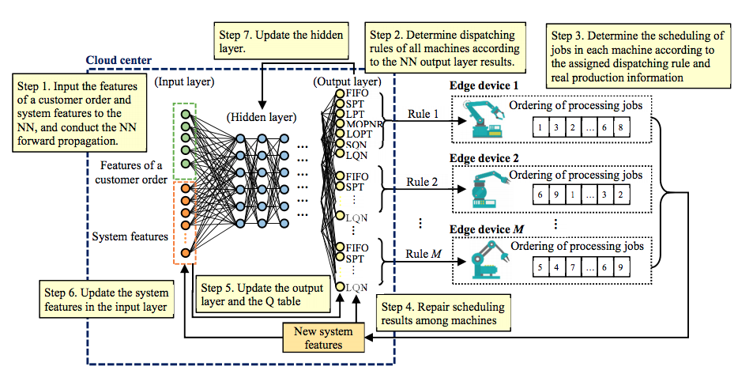
Solution
MDQN = Multiple Dispatching Rules (MDR) + Deep Q Network (DQN)

Slide 10
Q-learning
In the initial state, look up the Q table and pick up the action.
Update the Q table with reward, learning rate, and discounting rate.
Enter next state, and repeat until terminate.
Q-table | a1 | a2
s1 | -1 | 2
s2 | 0 | 1
learning rate
reward
discounting rate

Slide 11
Deep Q Network

Slide 12
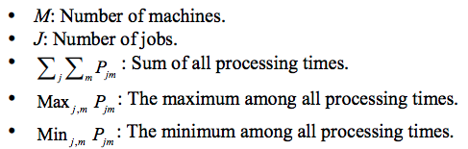
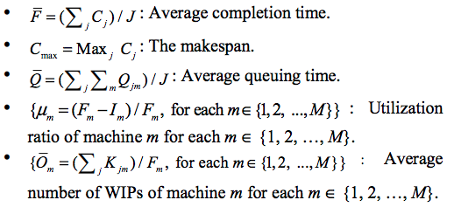
MDQN algorithm
The input layer : ( 5 features of the customer order ) + ( 3 + 2 ⋅ M system features )= 8 + 2 ⋅ M neurons

Slide 13
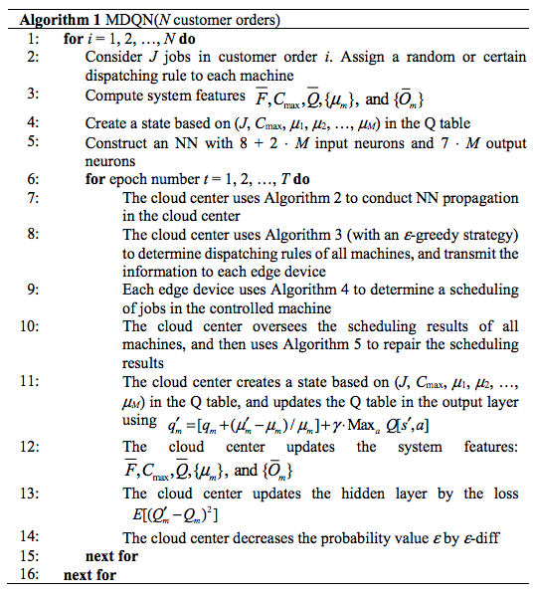
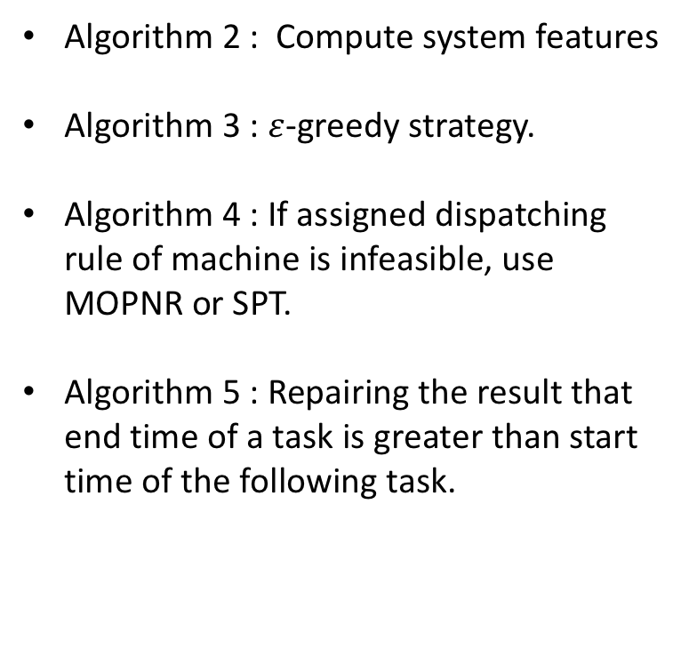
MDQN algorithm
Algorithm 2 : Compute system features
Algorithm 3 : $ε$-greedy strategy.
Algorithm 4 : If assigned dispatching rule of machine is infeasible, use MOPNR or SPT.
Algorithm 5 : Repairing the result that end time of a task is greater than start time of the following task.

Slide 14
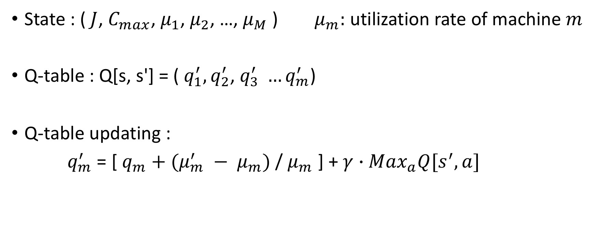
MDQN algorithm
State : ($J$, $C_{max}$, $μ_{1}$, $μ_{2}$, …, $μ_{M}$ ) $μ_{m}:$ utilization rate of machine $m$
Q-table : Q[s, s'] = ( $q_{1}^{′},q_{2}^{′}$, $q_{3}^{′} …q_{m}^{′}$)
Q-table updating :
$q_{m}^{′}$ = [ $q_{m}+(μ_{m}^{′} − μ_{m})$ / $μ_{m}$ ] + $γ∙$ ${Max}_{a}Q[s^{′},a]$
learning rate

Slide 15
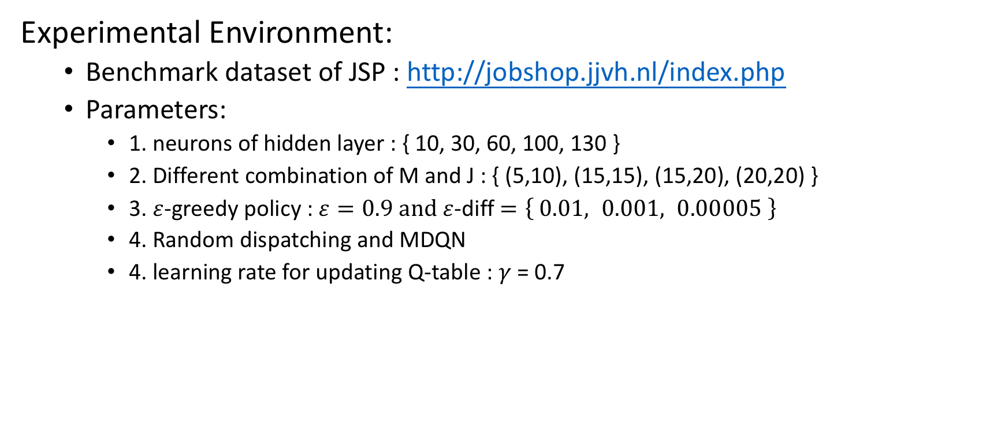
Experiment Results
Experimental Environment:
  Benchmark dataset of JSP : http://jobshop.jjvh.nl/index.php
  Parameters:
    1. neurons of hidden layer : { 10, 30, 60, 100, 130 }
    2. Different combination of M and J : { (5,10), (15,15), (15,20), (20,20) }
    3. $ε$-greedy policy : $ε=0.9 and ε$-diff $=\left\{ 0.01, 0.001, 0.00005 \right\}$
    4. Random dispatching and MDQN
    4. learning rate for updating Q-table : $γ$ = 0.7

Slide 16
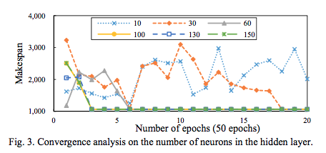
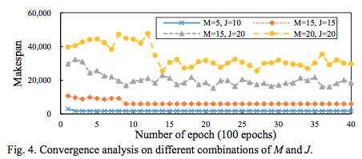


Experiment Results
Convergence Analysis
M=5 J=10 $ε$=0.9 $ε$-diff=0.2
$ε$=0.9 $ε$-diff=0.2

Slide 17
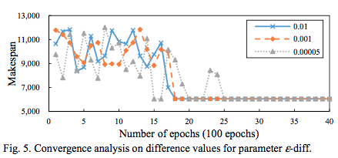
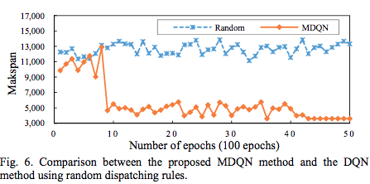


Experiment Results
Convergence Analysis
M=5 J=10 $ε$=0.9
M=5 J=15 $ε$=0.9 $ε$-diff=0.2

Slide 18
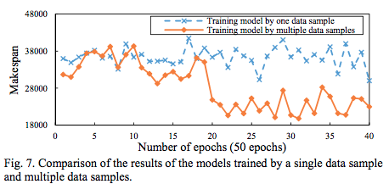
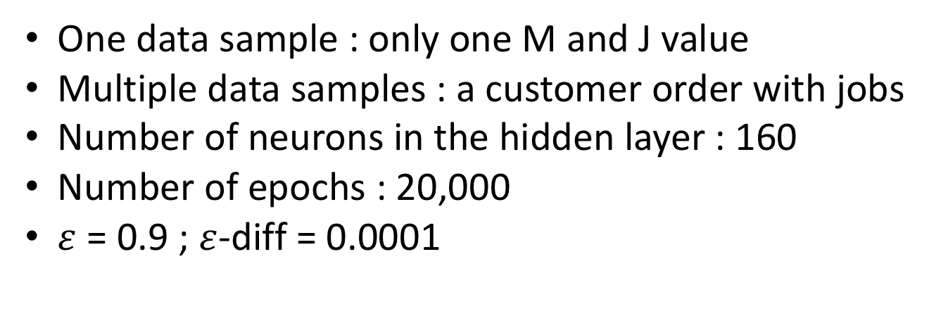
Experiment Results
One data sample : only one M and J value
Multiple data samples : a customer order with jobs
Number of neurons in the hidden layer : 160
Number of epochs : 20,000
$ε$ = 0.9 ; $ε$-diff = 0.0001

Slide 19
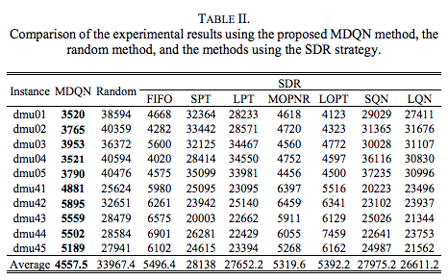
Experiment Results
M=15 J=20

Slide 20
Conclusion
Dynamically determine one of seven dispatching rules of processing jobs.
Experimental results show the convergence effects under a variety of parameter setting.
The performance of multiple data sample is better than single one.
MDQN with MDR strategy performed better than the method using the SDR.

Slide 21
Future work
Designing a different Q-table scheme
Designing a reward scheme
Adopting a different NN type
Changing the MDR strategy to directly find the detailed scheduling result

