Slide 1
SMAR CITY: Definition and Evaluation of Key Performance Indicators
PICIOROAGĂ, Irina-Ioana; EREMIA, Mircea; SĂNDULEAC, Mihai., 2018 International Conference and Exposition on Electrical And Power Engineering (EPE). IEEE

Slide 2
Motivation
How to evaluate the “smartness” of a smart city
Smart city consistes of increased citizen participation
—> Huge amount of data in open database
—> Leads to confusing instead of clarifying
—> Defining a pracital and efficient evaluation system

Slide 3
What is Considered to Evaluate a Smart City
Focusing on energy and environment concerns
Using Key Performance Indecators (KPI)
Compare among multiple smart cities

Slide 4
Evaluation Model
KPI - Literature research reveals a vast collection of indecators system
Difficult to compare with each other
Specialized International Standards:
ISO 37120 —> Indecators for city services and quality of life
World Council on City Data (WCCD) are developing new standards
E.g. ISO 37122 (Indecators of Smart Cities), 37123 (Indecators for Resilient Cities)

Slide 5
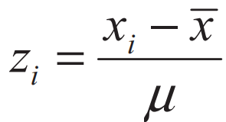
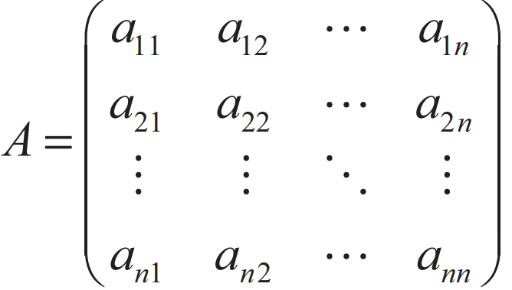
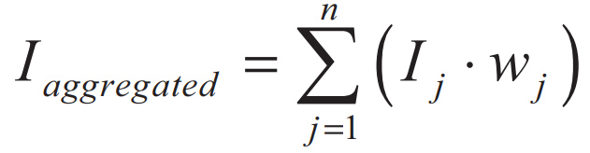
Methdology
Z-transformation
Analytic Process
Judging Matrix, each criterion is scale from 1 to 9
aij = importance of ith criterion according to j criterion
Result synthesis

Slide 6
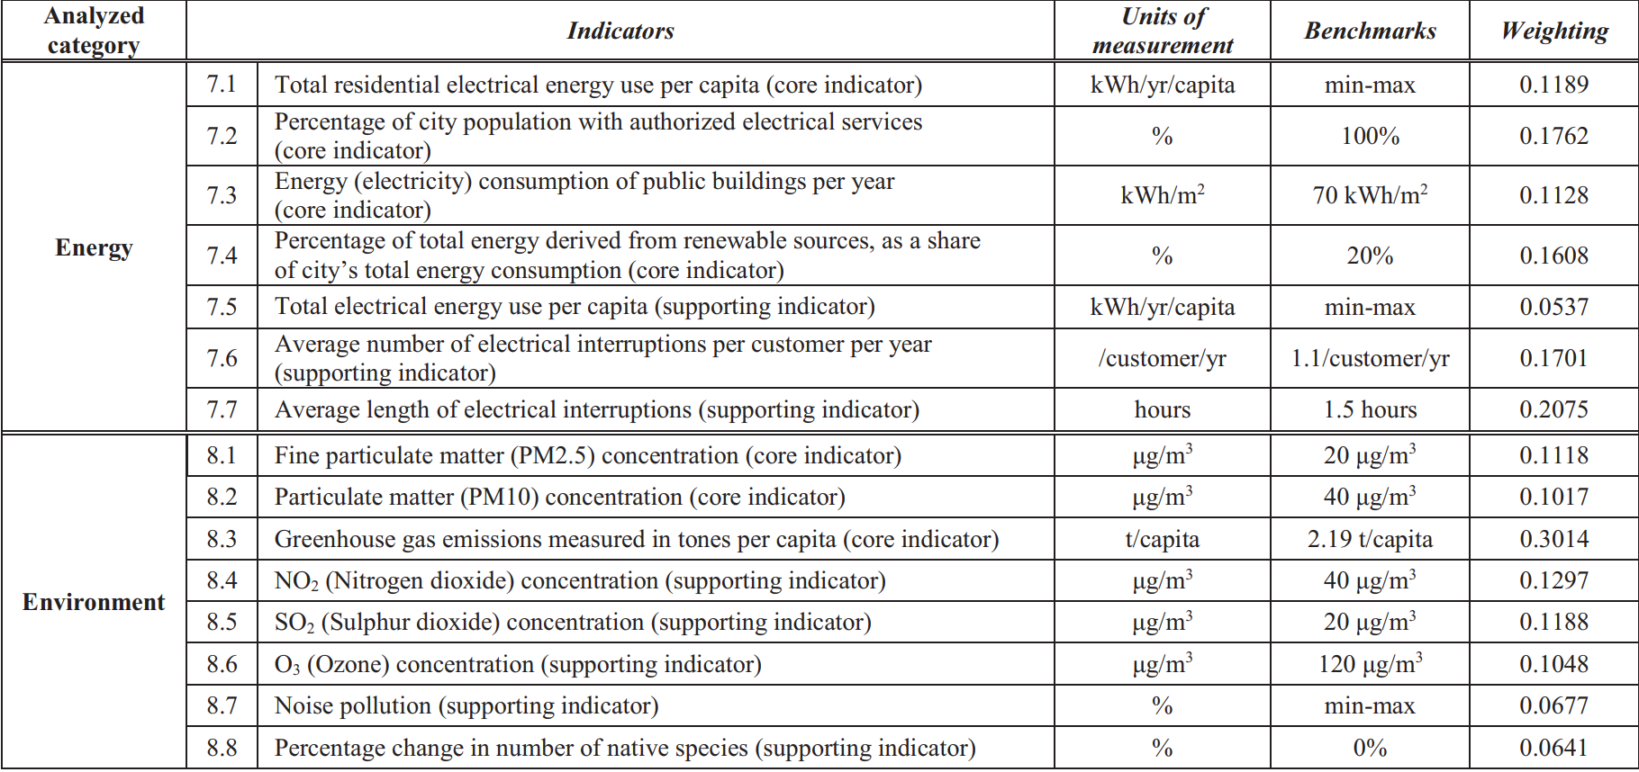
Case Analysis

Slide 7
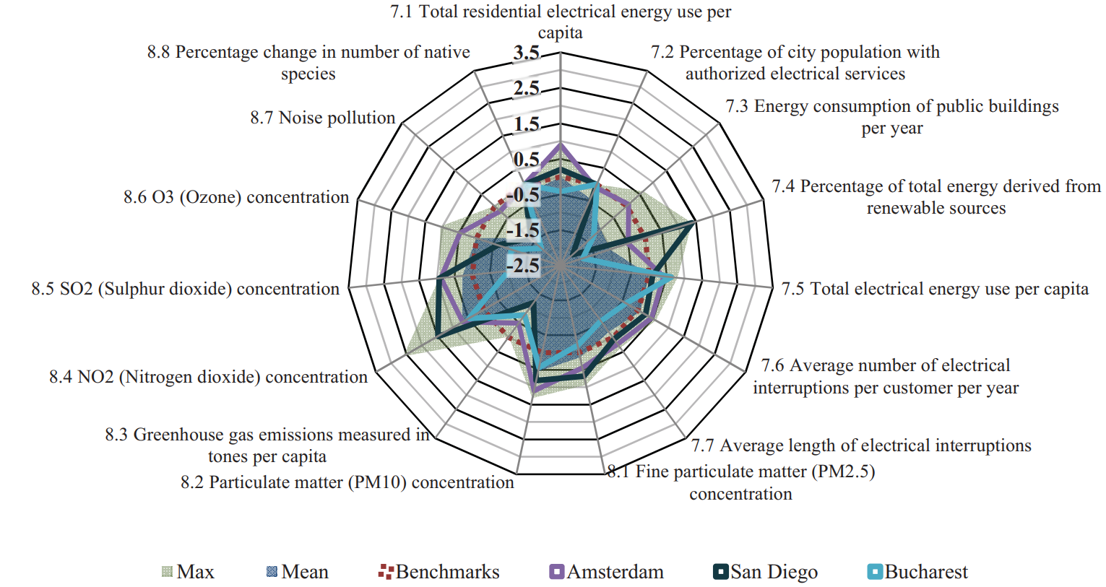
Case Analysis
Amsterdam:
above average and close to maximum
Bucharest:
presents numerous energy and environmental issues, such as renewable sources lacking, disconnections in energy supplying, harmful substances
San Diaego:
energy revolution started very
early with electric vehicles
—> high score in multiple cases

Slide 8
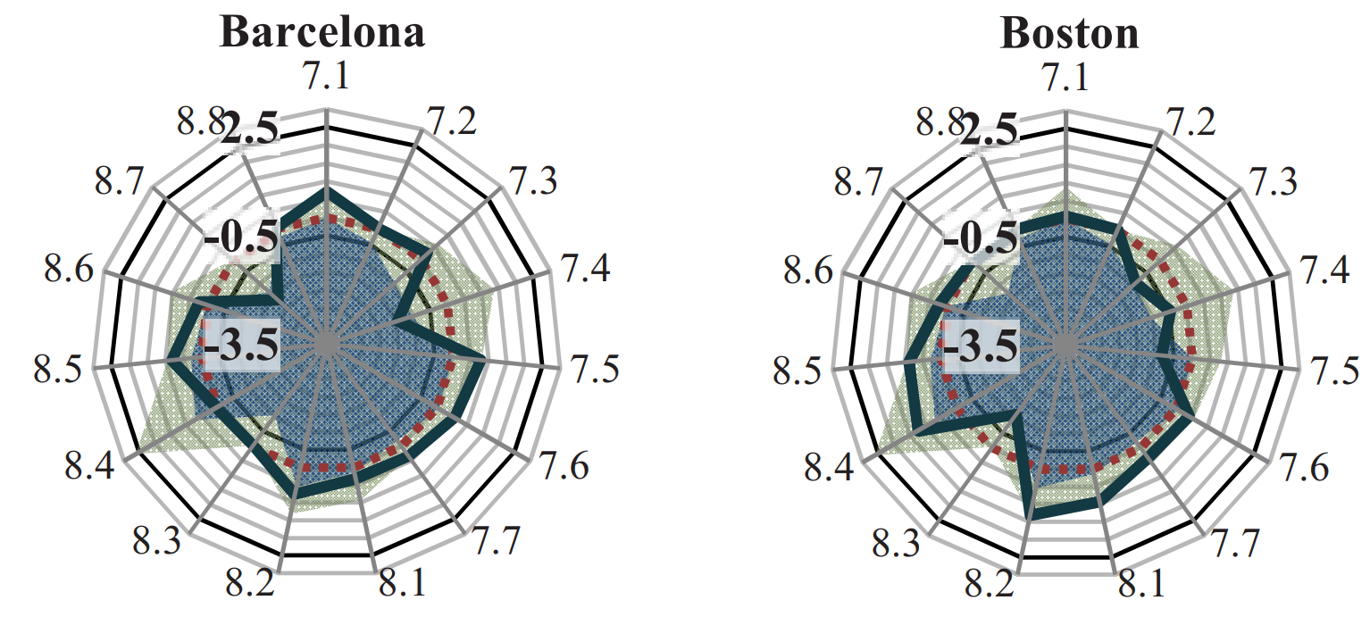
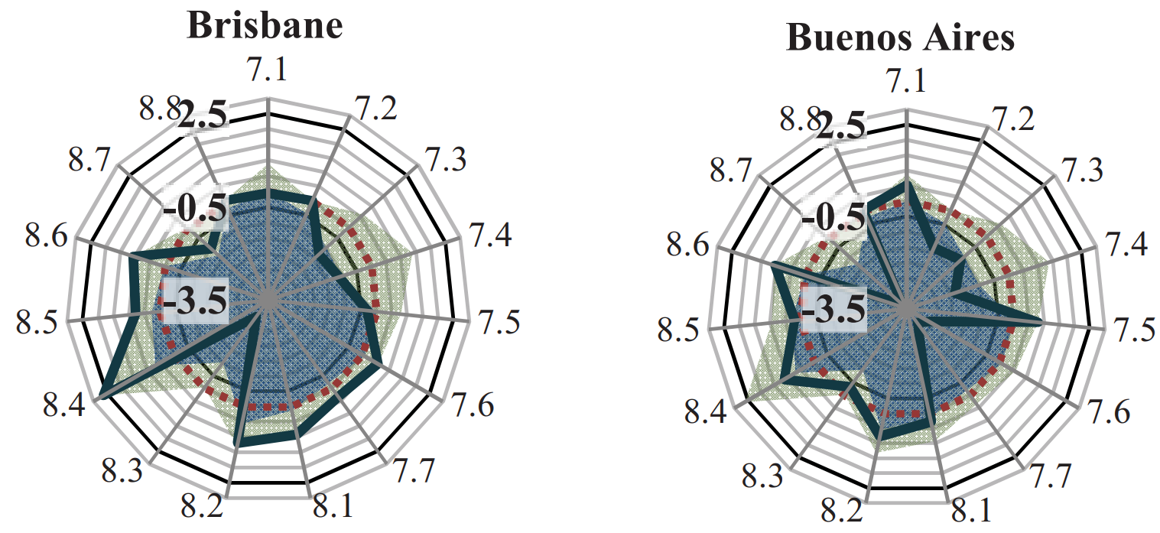
Case Analysis
Barcelona:
outperforms by overtakes 100+ active smart city projects, involving smart traffic lights, LED streetlamps, public WiFi, etc
Boston:
Great performance in environmental aspects and energy infrastructure reliability
Brisbane:
Scoring great results in terms of environment but still have several energy issues
Buenos Aires:
Good result in energy consumptions but less renewable energy sources

Slide 9
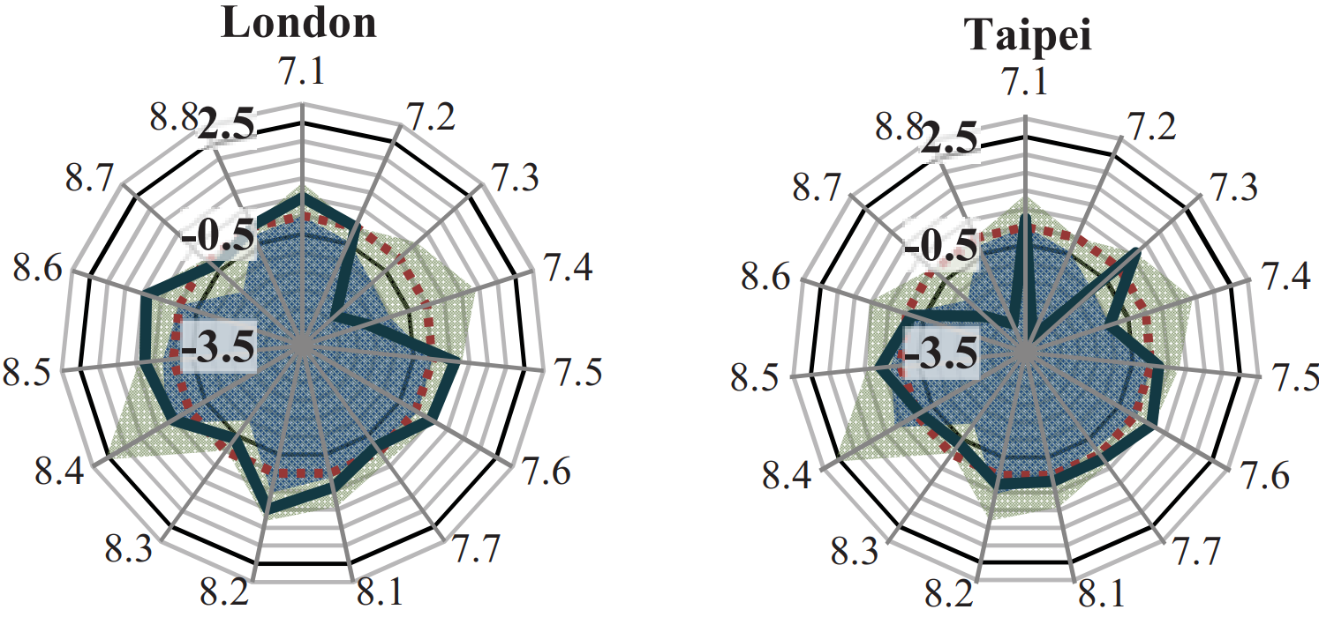
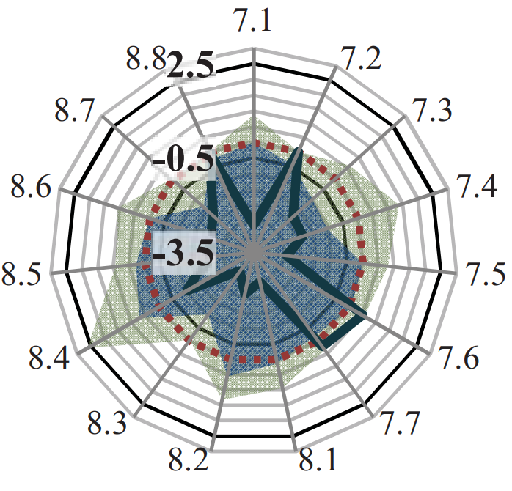
Case Analysis
London:
Perform great in energy consumption, reliability of power supply, etc
Taipei:
Performs average in some indecators
Dubui:
The city’s emissions of pollutants still overpass the proposed limits, low percentage of energy derived from renewable sources
Dubai

Slide 10
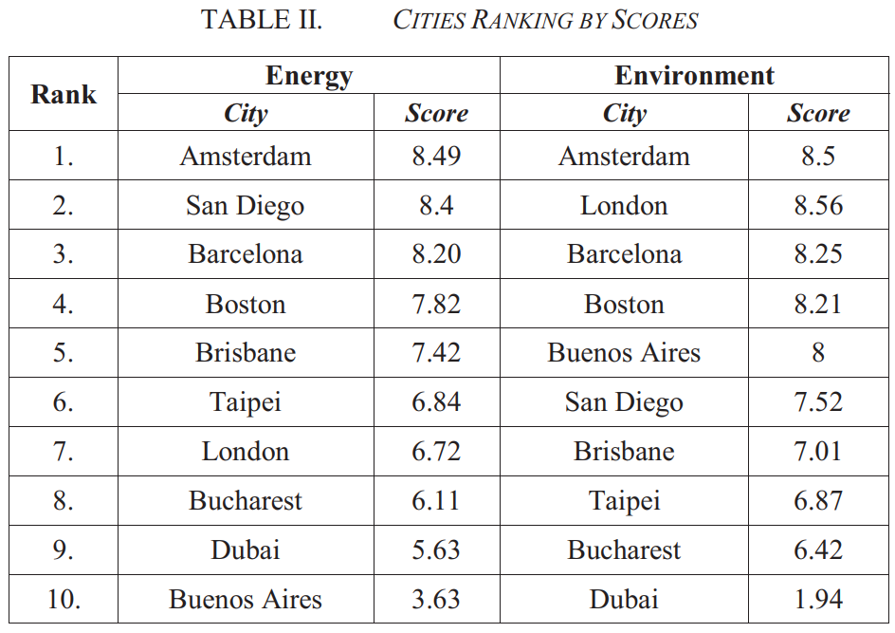
Overall Results Conclusion
Ranking does not reflect the inferiority of cities in terms of smartness
KPI proves themselves useful tools for guiding urban development
An evaluation model based on z-transformation has been applied to obtain an accessible profiling of the analysed cities and emphasize the problematic areas of each case
Proposped model provides a systematic compaison and ranking of the examined cases

