Slide 1
Recursive Quantum Repeater Networks
METER Rodney VAN, Joe TOUCH, and Clare HORSMAN. Progress in Informatics 8 (2011): 65. Crossref. Web

Slide 2
Recursive Quantum Repeater Networks
Introduction
TCP/ IP protocol layers networks v.s. recursive networks
Quantum network
Recursive quantum request
Implements
Notes:
454545

Slide 3
Propose a unifying quantum framework that can be used with all existing repeater designs

Slide 4
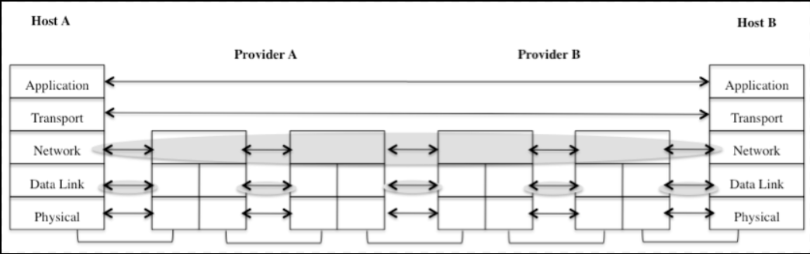
TCP/ IP protocol layers networks
Static layering: physical layer, data layer, network layer, transport layer, application layer
Both inter-domain and intra-domain routing have to happen within the network layer
Addressing and routing problems

Slide 5
Recursive networks
Subset of a network represented as a single node at a different layer of that network
Without requiring requesters to understand the detailed topology or technology of the network
Transit networks
The networks that may form part of the path, but do not include nodes that are part of the requested state

Slide 6
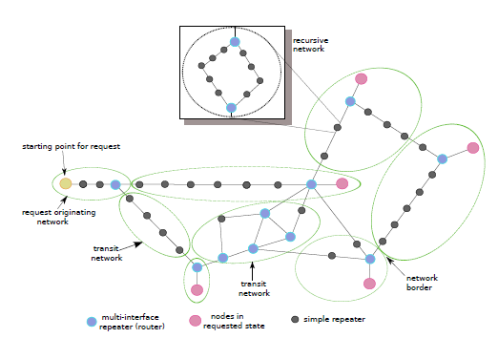
Transit networks
To external requesters: appears as a single node
Internally, nodes within the network can in turn be networks, in recursive fashion.

Slide 7
Quantum network
Qubits loss and degrade fidelity in optical channels
Purifications
Use repeaters proposed to be placed at short distance to connect
Teleporting data hop-by-hop by repeaters is unworkable because imperfect local gates and memories
Create the end-to-end entangled state by entanglement swapping
Transmit not quantum data itself, but request for the execution of operations which will create new distributed, entangled states.

Slide 8
Recursive quantum request
States
Repeaters will make both independent and coordinated decisions about which states to purify, swap, error correct, forward, buffer, and discard, as they build states that satisfy users’ requests.
Naming a State
Nodes must be able to name states such that other repeaters will understand: “do operation U on this particular state we share.”
Defining Quantum Requests
For a specific state, spanning a named set of nodes.

Slide 9
Naming a State
The tuple (N,A), where N is the node name and A is the physical qubit address within the node, is not workable. As three keys:
Each node can move the logical state of a qubit from one physical qubit to another
Physical qubits are reused after being freed
Request may need to refer to the qubit by name even before physical resources for it are allocated

Slide 10
Naming a State
Request may need to refer to the qubit by name even before physical resources for it are allocate
Ex. Request for a gate to be executed may be issued at the sametime as the initial entangling pulse
virtual address
Allowing the original requesting node to assign a virtual address
Mapping on the node privately

Slide 11
Defining Quantum Requests
No-less-than for the element corresponding to the desired state
Set Min fidelity (F)
Ensure closeness to state we want
No-more-than for the elements corresponding to undesired states.
Set max entropy (S)
Filter out returned states that may be non-trivially entangled with other nodes in the system
Encoding method of the quantum state (EA)

Slide 12
Defining Quantum Requests
The tuple specifying a request:
ID is transaction identifier assigned by the requester,
((Ni,Ai)) is the set of nodes that are requested to comprise the state and the virtual addresses Ai

