Slide 1
A Scanner Darkly: Protecting User Privacy From Perceptual Applications
Suman Jana, Arvind Narayanan, Vitaly Shmatikov
2013 IEEE Symposium on Security and Privacy

Slide 2
Introduction
Perceptual application continuously monitoring the enviroment, which raises privacy risks.
Some privacy risks hirarchical categories:
Overcollection and aggregation
Even just collecting information from environment is a violation to privacy
Inference
Analyzing the sensitive information that are leaked from individual frame
Semantic
Gestures, movements … can also leads to privacy leaks.
This paper proposed Darkley to mitigate the possible privacy leaks above while maintaining the functionality of the application(analytics)

Slide 3
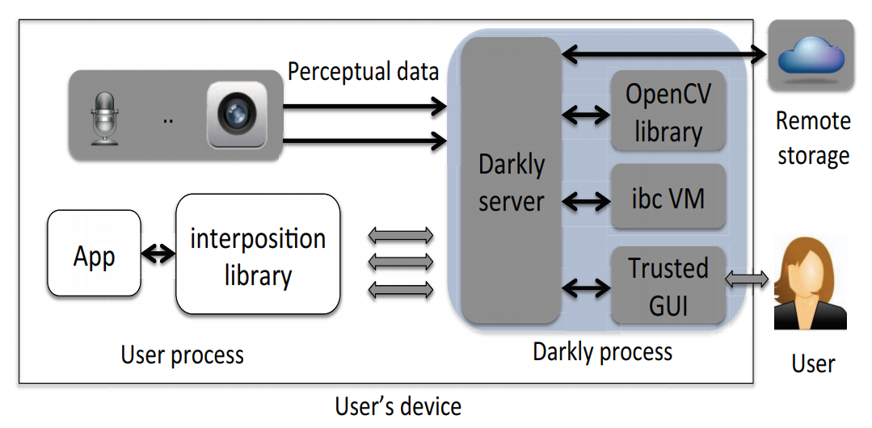
System Overview
Darkly server act as a privileged user that can access the sensor and the “Real” OpenCV Library,
interposition library is a modified OpenCV library that redirect OpenCV’s function to Darkly server.
Darkly also provided a GUI in order to let user decides their privacy level.
Remote storage is used to save file from the app but prevent app from accessing it.

Slide 4
Design principles
Perceptual applications can be classified to:
Do not access the perceptual input
Access through specific, library-provided features
Execute their own code on raw inputs
Darkly follows this classification and for each class, they propose a solution to protect privacy.

Slide 5
Implementation
Opaque reference
To prevent untrusted applications accessing the real data
With Opaque reference, application cannot deference to know the location of real input.
It can be used in the Darkly server which has the deference information.
Interposition
To support unmodified applications, Darkly interpose the OpenCV library by modifying and replace the dynamic linked library of OpenCV
With Interposing, The request from the applications can be redirected to Darkly.
The problem of this solution is mainly C++, where they have to modified virtual function tables to redirect to the Darkly Server properly.

Slide 6
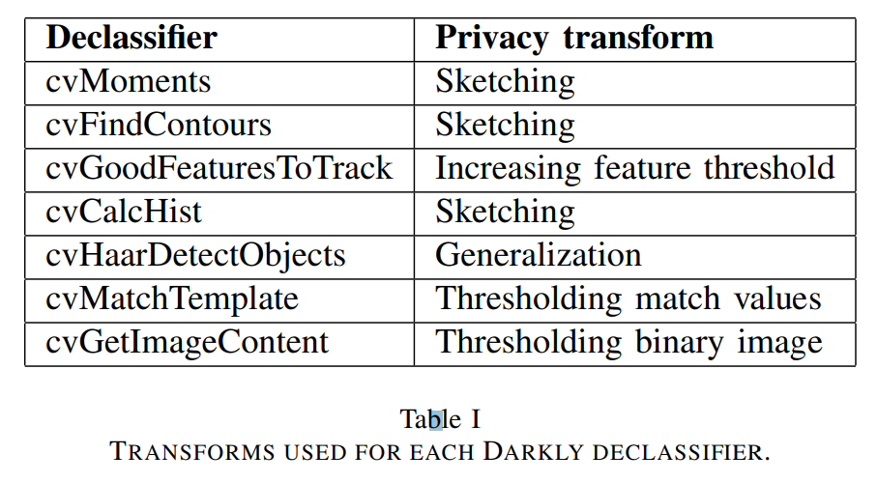
Implementation
Privacy transformation
According to the privacy level user provide, sending the correspond modified input to mitigate privacy leaks.
They use sketching and thresholding to mitigate the leak.

Slide 7
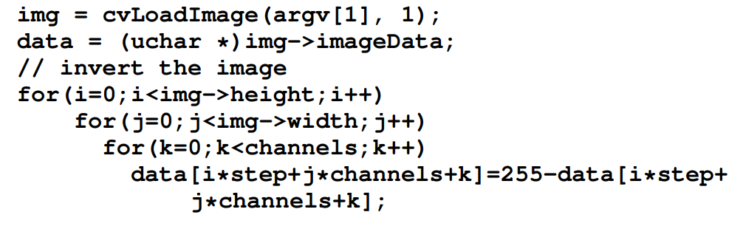
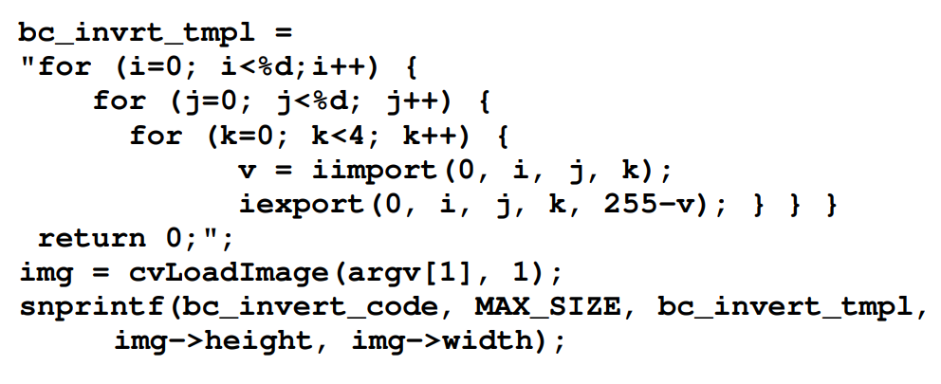
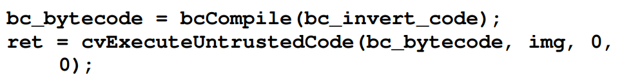
Implementation
ibc compiler
They proposed a compiler ibc, which is based on GNU bc.
With this language, it allows applications to do calculation on real input but still under protection of Darkly since all the internal state of Darkly and OpenCV cannot be accessed

Slide 8
Privacy Transform
Sketching
Blurring the image using box filter
Contour detection
A low pass filter that filter those contour that the mean radius of curvature is greater than a threshold. It will remove the contour that are too small or to much entropy.
Blurring and the low pass filter after contour detection can be adjusted by user selection of privacy level

Slide 9
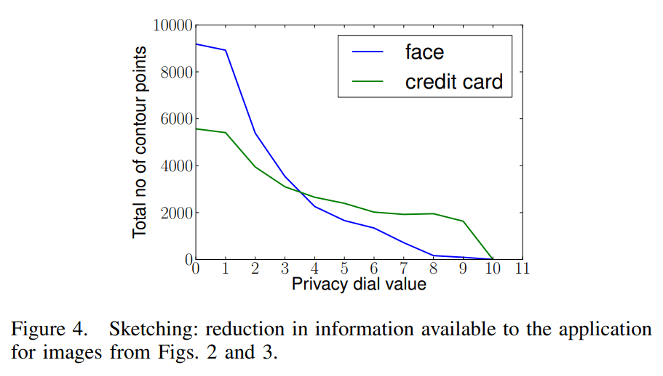
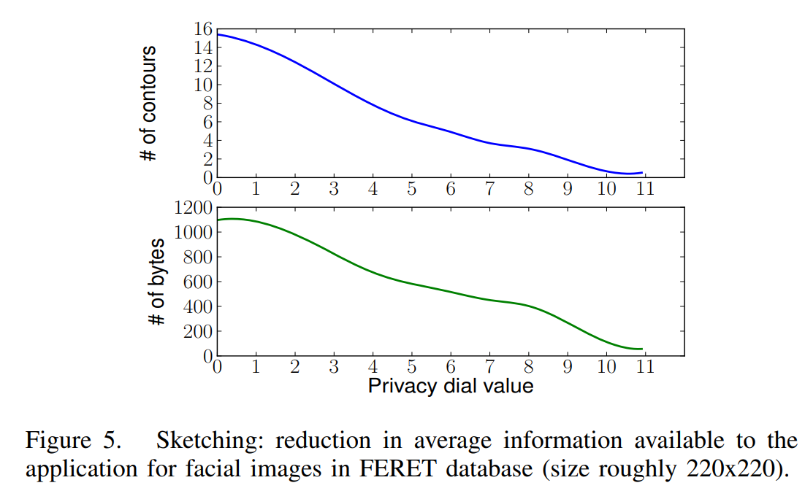
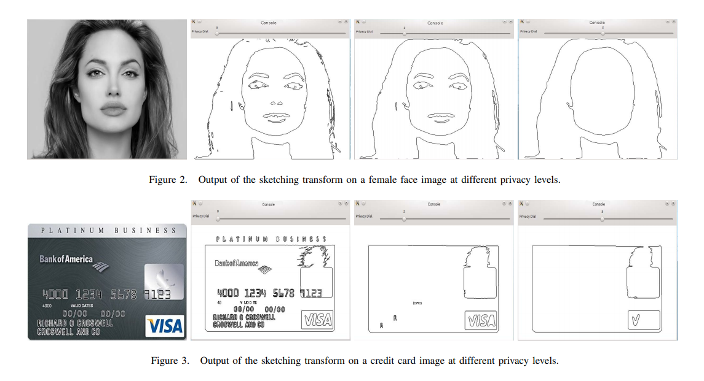

Slide 10
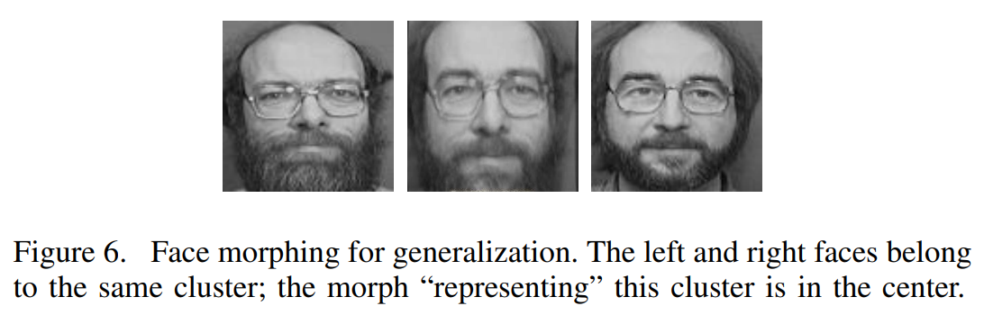
Privacy Transform
Generalization: using face generalization as an example
Generalizing input prevents application from inference the user’s face
They proposed a technique call cluster-morphic to do generalization
start from a database of images, finding the eigenfaces by applying Principal Component Analysis (PCA), and produce the basis vector of the images.
Represent faces as linear combination of the basis vector (eigen-decomposition)
Truncating the decomposition to the first (say)30 principal components
Cluster faces using Euclidean distance. They use hierarchical agglomerative clustering to let user adjust the accuracy of the generalized face.
In the end, morphing the faces in the same cluster to create a canonical faces

Slide 11
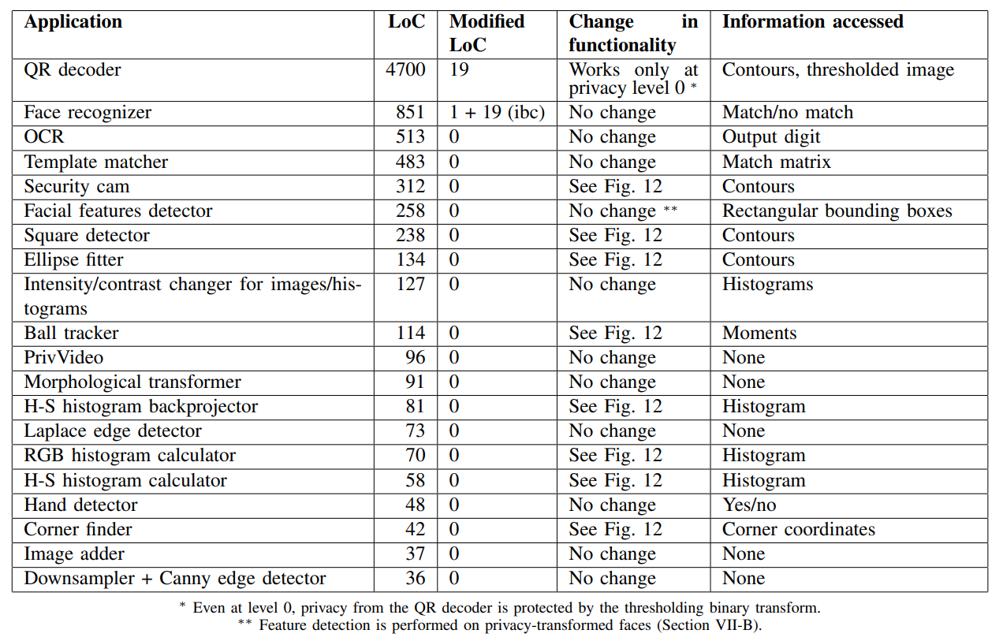
Evaluation

Slide 12
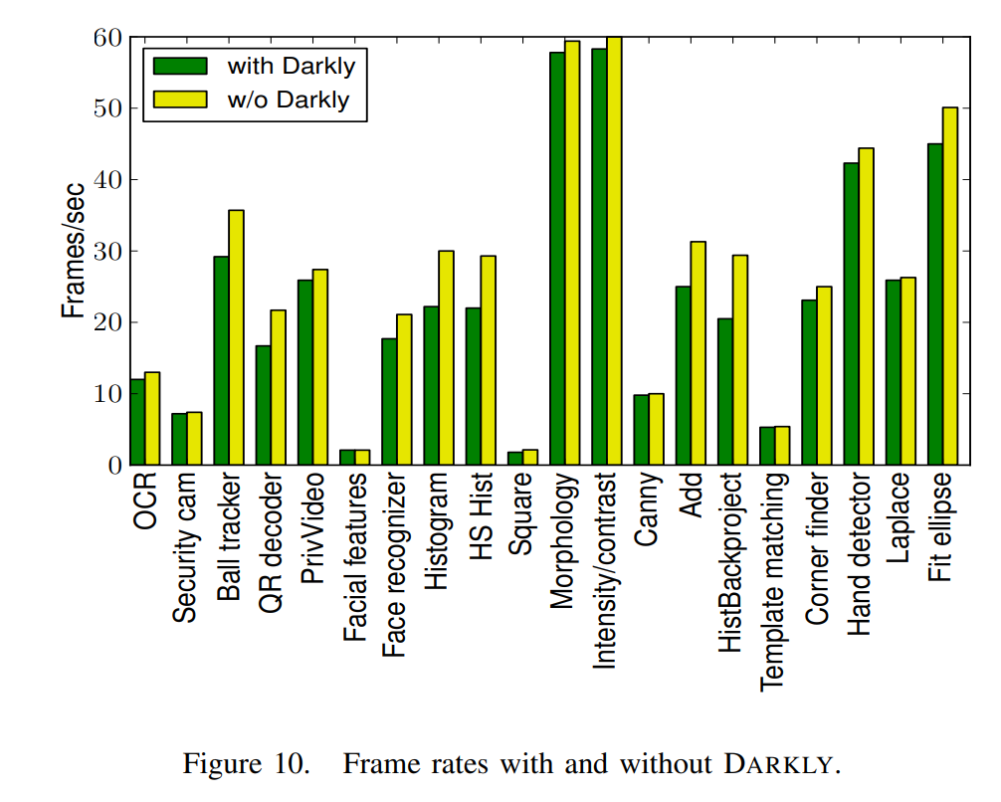
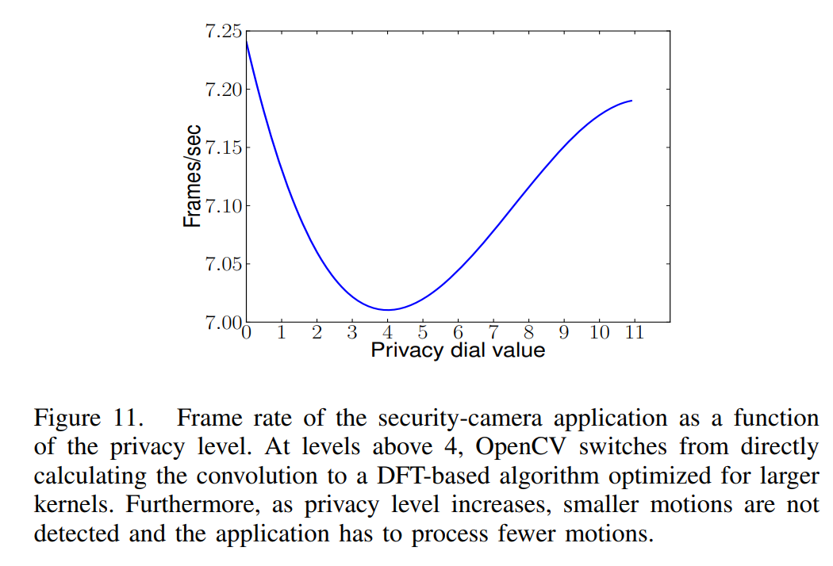
Evaluation

Slide 13
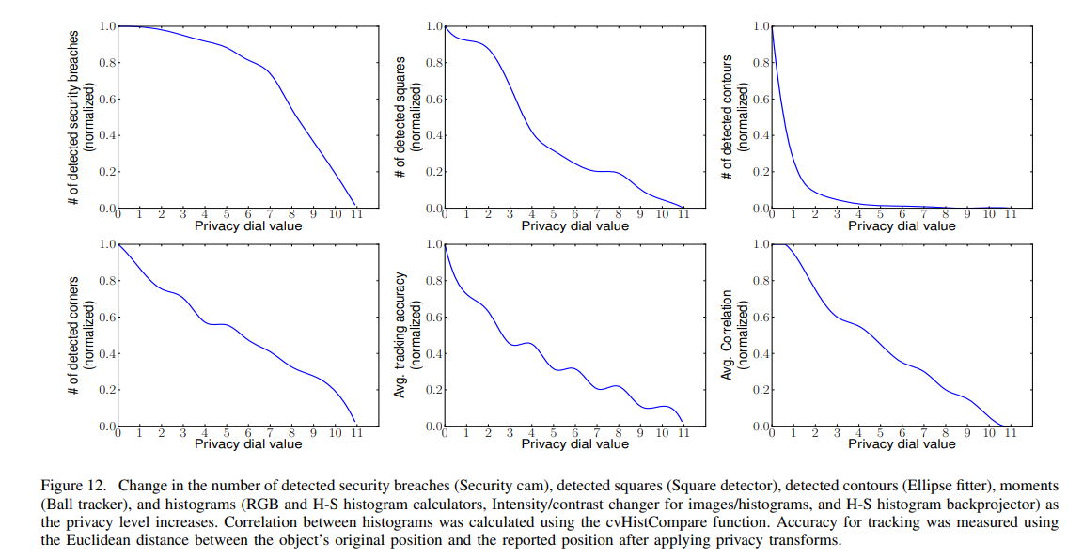
Evaluation

Slide 14
Conclusion
This Paper proposed Darkly, a privacy protection platform for untrusted application.
Analyzing the privacy risk and the structure of perceptual applications
Implementing Darkly using opaque references, sketching, generalization and ibc compiler
Evaluate the overhead and tradeoff between utility and privacy.

