Slide 1
A 360-Degree Video Analytics Service for In-Classroom Firefighter Training (CPS-ER'22)
Ayush Sarkar, Anh Nguyen, Zhisheng Yan, Klara Nahrstedt
University of Illinois Urbana-Champaign, George Mason University

Slide 2
Motivation
Recent firefighting education uses 2D video-based tools which suffers from limited viewing angles ⇒ Replace 2D cameras with 360 cameras
Challenges:
How to prioritize the events in 360 firefighting videos
How to develop a service pipeline that can automatically analyze the recording 360 videos

Slide 3
Contributions
Propose a novel 360 video analytics service framework that will be used in a training tool for incident commanders (ICs)
Conduct interviews with an expert in Illinois Fire Service Institute (IFSI) to study important events and objects during firefighting operations
Conduct a study to understand how accurately existing object detectors developed for generic 2D videos can perform on 360◦ firefighting videos

Slide 4
Objects and Events Identifying
Interview
What objects and events require an alert during firefighter operations?
What are your requirements for remote incident command systems? What types of information signals would you prefer, and what would be the preferred frequencies and durations of these signals?
What is the priority of objects/events that you would like to highlight for firefighter trainees?
Should environmental events be flagged and differentiated from events involving people?

Slide 5
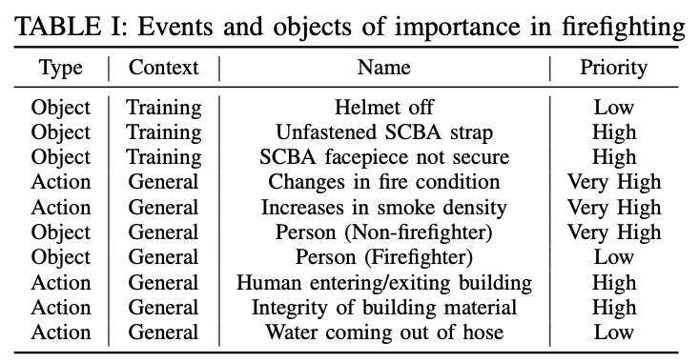
Objects and Events Identifying
Classified results
General objects and events
Events that involved occupants are always considered to be the highest priority
Environmental events are considered to be differentiate from events that involving people
Training-specific object and events ⇒ Related to the errors that trainees often commit during their lessons

Slide 6
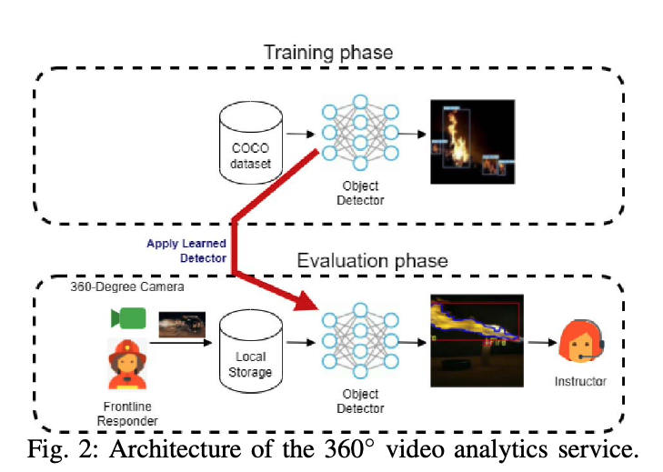
Firefighting Objects Detection
Challenges
Fire presents radically different textures, shape, and color from everyday objects
Additional complexity even for the same typical objects, e.g., humans
Distorted objects in 360◦ videos may confuse the object detectors
Solutions: Transfer learning (YOLOv3)
From everyday objects to firefighting objects
From 2D videos to 360 videos
Dataset: COCO dataset + IFSI dataset + sample 360 videos

Slide 7
Results
Use mAP scores to benchmark the accuracy
Inputs: predicted bounding box and the ground-truth bounding box
Normal conditions ranges from 13 to 44 points higher than that of hazard conditions ⇒ Significant impact of factors such as light condition and fire/smoke
Normal conditions aren’t far from the typical performance of YOLOv3 on the COCO dataset ⇒ Proving the potential of transfer learning

Slide 8
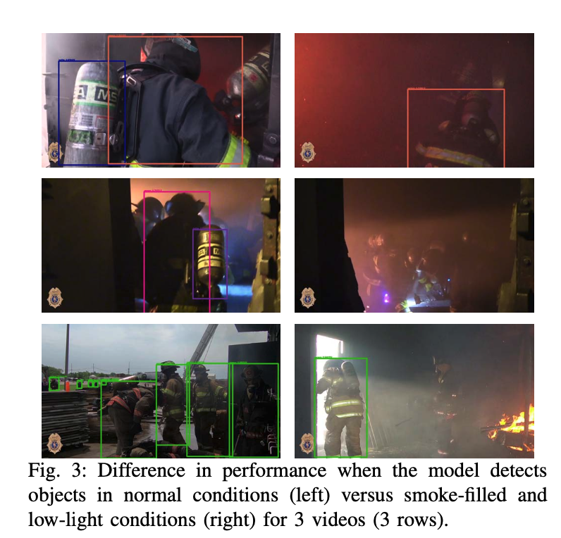
Problems on Hazard Conditions
Confidence score for humans dropped or even undetected when entered the smoke-filled environment
Failed to track the breathing air cylinders

Slide 9
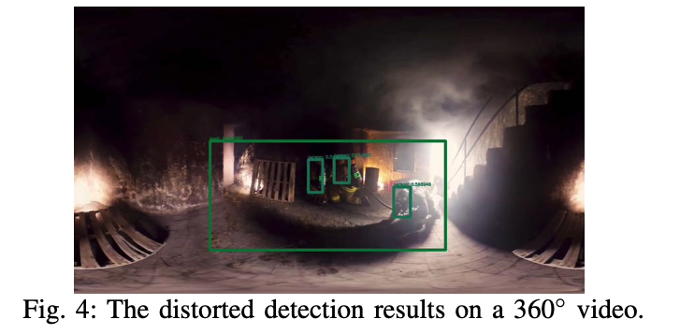
Preliminary Results on 360 Videos
Perform detection tasks on a publicly available 360 fire safety video stored as equirectangular format
Errors due to the distortion of 360 videos
Misclassified crawling human as a motorbike
Misclassified elongated curvature of shadow as boot

Slide 10
Discussion
Improving Event-Object Detectors
Force YOLOv3 to learn features for hazardous environments and distorted objects in 360 videos
Collect and manually annotate new dataset for 360 firefighting videos
Employ a multi-directional projection (MDP) technique
Transform the frames into other format, e.g., YUV, instead of RGB
Detecting time-dependent events
Future System Architecture ⇒ Bring the 360◦ video analytics service into real world situations, e.g., deploy online for active firefighting operations

Slide 11
Conclusion
Perform a thorough interview process to identify objects/events relevant to search/rescue in firefighter training
Propose a framework to combine the advantages of 360 cameras and deep learning to help the IC in teaching firefighting operations ⇒ Show the potential of the detector trained on generic 2D video datasets to detect firefighting objects on both 2D and 360 videos

