Slide 1
A Blind Streaming System for Multi-client Online 6-DoF View Touring
NMSL@NTHU
Networking and Multimedia Systems Lab
ShengMing (shengming0308@gapp.nthu.edu.tw) Advisor: Cheng-Hsin Hsu Networking and Multimedia Systems Lab, CS, National Tsing Hua University

Slide 2
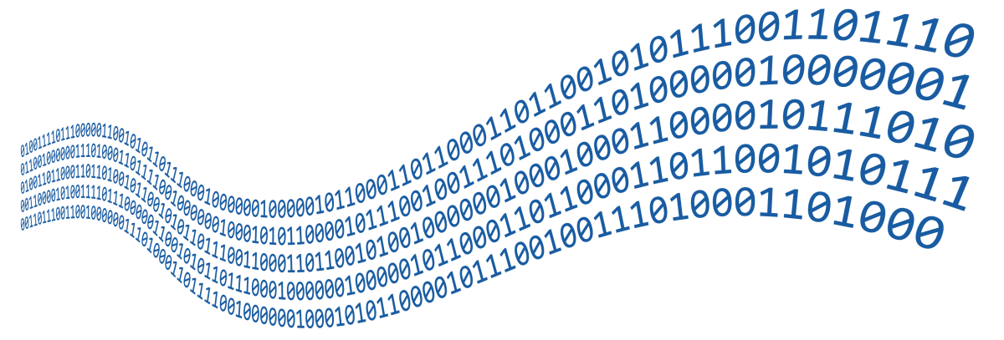
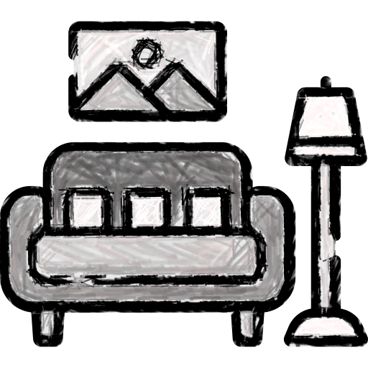
Outline
Inspiration
Goal & Challenges
Related Work
System Design
Novel View Optimization
Cloud Service Provider
Pose Predictor
Candidate Generator
Coverage Estimator
Solver & Algorithms
Implementation
Evaluations
Conclusion & Future Work

Slide 3
Intellectual Property Leakage
Inspiration
Mesh based
3D content (mesh)
Content leakage
Content creators
6-DoF clients
RGB-D images based
We only reveal partial 3D content by images!
RGB-D images
6-DoF clients
Content creators

Slide 4
Bandwidth Saving and No Mesh Streaming
Inspiration
Frame-by-Frame Streaming
…
view streams
Only sends a small number of source views to serve many clients
Content creators
6-DoF clients
RGB-D source view (image) based
small number of source views
6-DoF clients
Content creators

Slide 5
Novel View Synthesis
Inspiration
Color
Novel view synthesizer
RGB source views
Describe color information
D source views
Describe partial content geometry
Geometry
?
Limitations
Not light enough to run on Head Mounted Displays (HMDs) in real-time
Reference View Synthesizer (RVS)[RVS]
[RVS] Bart Kroon and Gauthier Lafruit. 2018. Reference View Synthesizer (RVS) 2.0 manual. Taipa, Macao

Slide 6
Outline
Inspiration
Goal & Challenges
Related Work
System Design
Novel View Optimization
Cloud Service Provider
Pose Predictor
Candidate Generator
Coverage Estimator
Solver & Algorithms
Implementation
Evaluations
Conclusion & Future Work

Slide 7
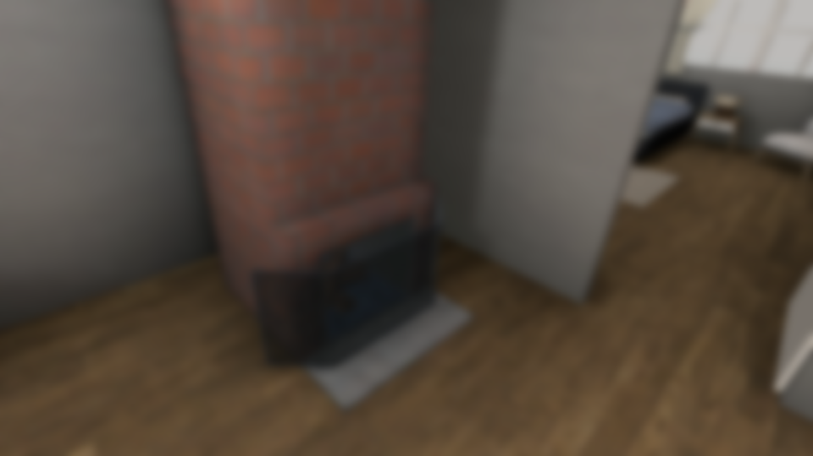
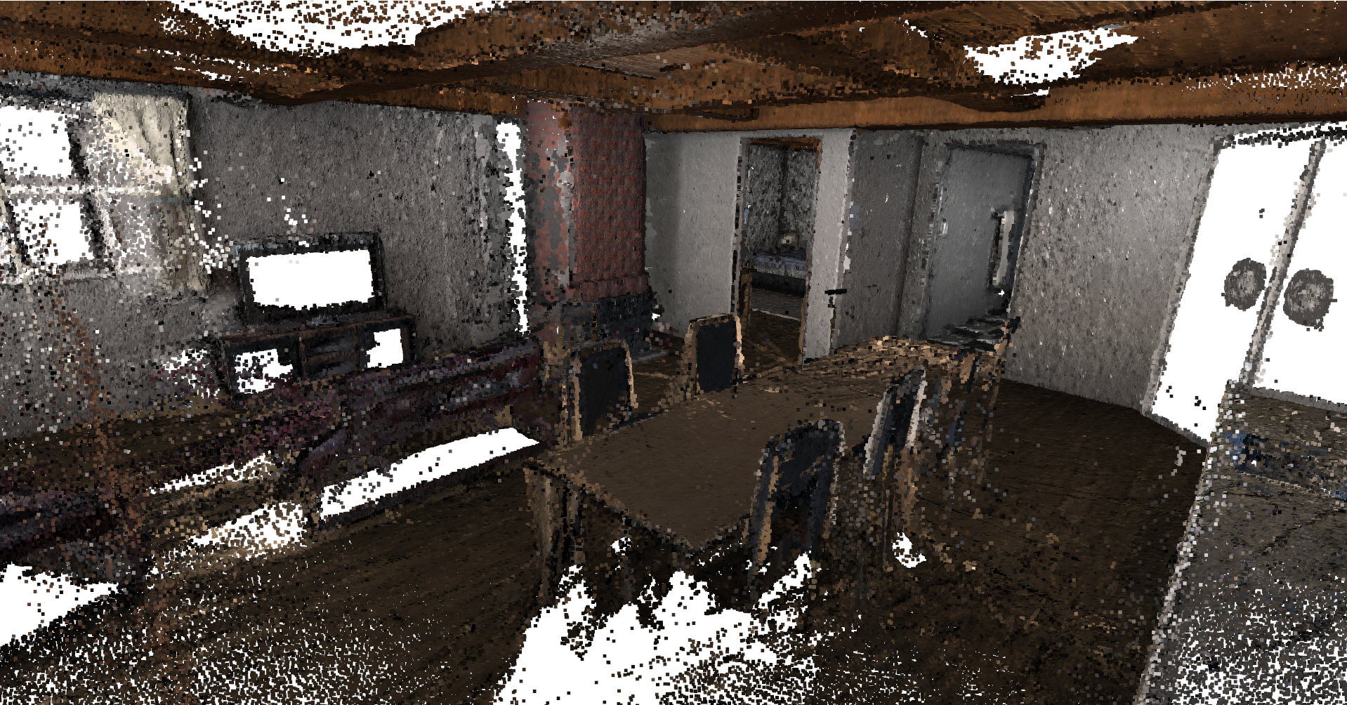
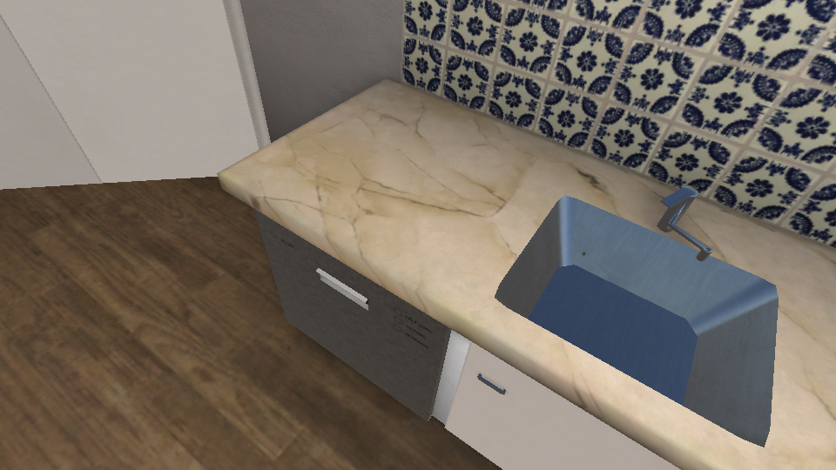
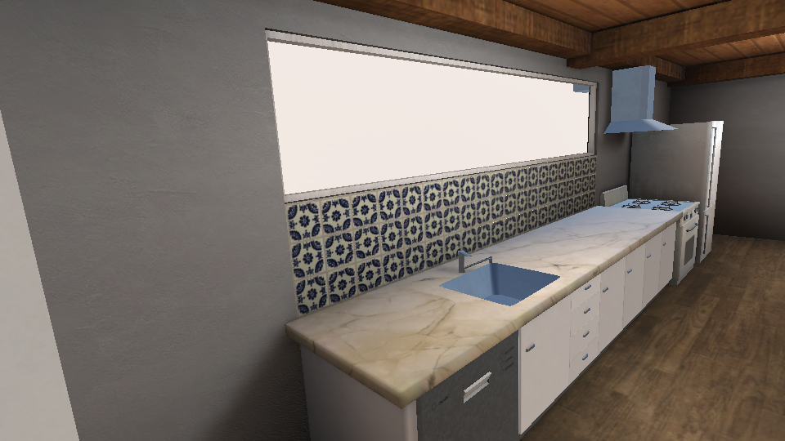
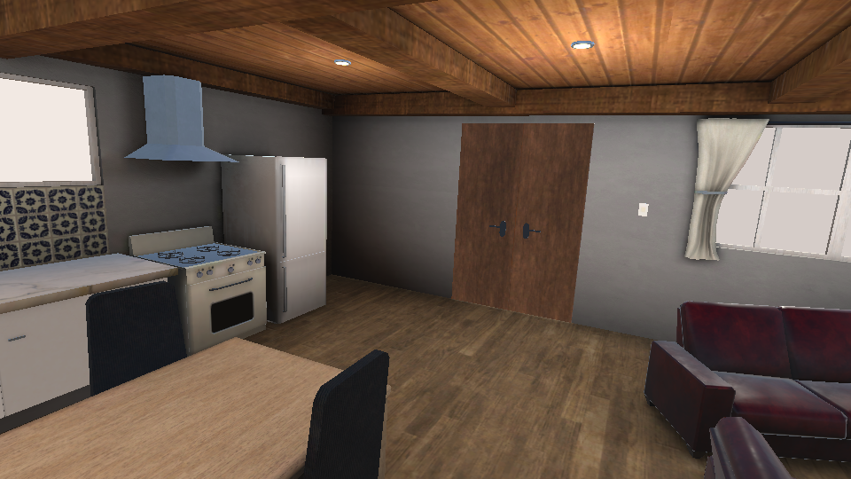
Goal & Challenges
Goal:
Synthesize high quality views for all clients
Constraints:
Source view budgets (no. of source views allowed)
Content observation budgets
Blurred
Challenges:
No direct access to 3D content
No close form representation of quality prediction
Defense against Structure-from-Motion
View Requests
??

Slide 8
Outline
Inspiration
Goal & Challenges
Related Work
System Design
Novel View Optimization
Cloud Service Provider
Pose Predictor
Candidate Generator
Coverage Estimator
Solver & Algorithms
Implementation
Evaluations
Conclusion & Future Work

Slide 9
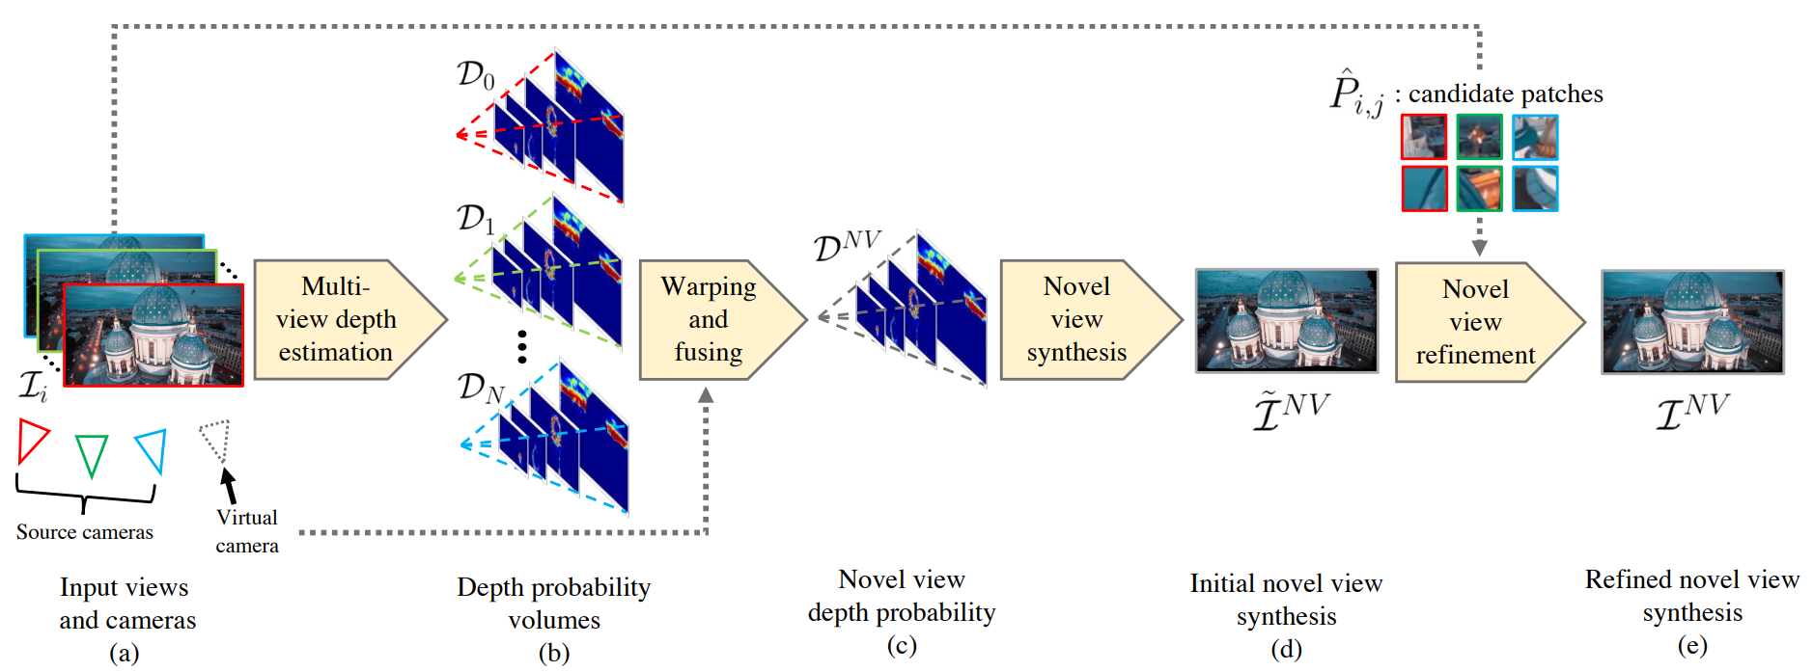
Novel View Synthesis
Related Work
1.
Hladky et al. invented QuadStream to synthesize view within a pre-defined view cell
Requires 3D content
Choi et al. generalized scalar depth prediction from multiple cameras to refine synthesized views
Attal et al. transform ${360}^{∘}$ stereo videos to multi-sphere images to synthesize 6-DoF views
2.
3.
Jozef Hladky, Michael Stengel, Nicholas Vining, Bernhard Kerbl, Hans-Peter Seidel, and Markus Steinberger. 2022. QuadStream: A Quad-Based Scene Streaming Architecture for Novel Viewpoint Reconstruction. ACM Transactions on Graphics 41, 6 (November 2022), 1–13.
Inchang Choi, Orazio Gallo, Alejandro Troccoli, Min Kim, and Jan Kautz. 2019. Extreme View Synthesis. In Proc. of IEEE/CVF International Conference on Computer Vision (ICCV’19). Seoul, Korea.
Benjamin Attal, Selena Ling, Aaron Gokaslan, Christian Richardt, and James Tompkin. 2020. MatryODShka: Real-time 6DoF video view synthesis using multi-sphere images. In Proceedings of European Conference on Computer Vision (ECCV’20). Glasgow, United Kingdom, 441–459

Slide 10
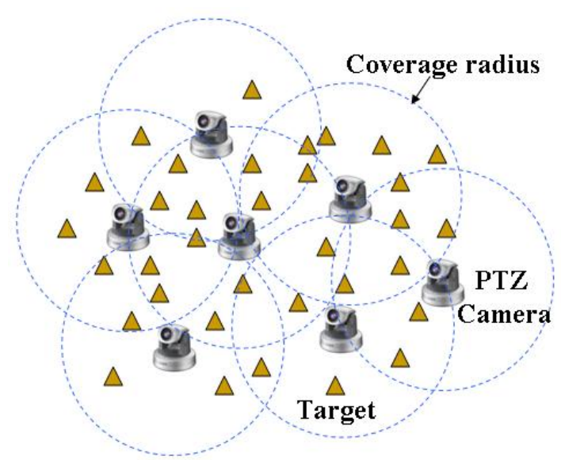
Coverage optimization
Related Work
1.
Suresh et al. solved 2D terrain coverage problem
Greedy based, discretized pose
Abu-Ghazaleh maximized the number of covered targets given a fixed number of cameras
Peng and Isler computed optimal flying paths for aerial 3D reconstruction
2.
3.
Sumi Suresh, Athi Narayanan, and Vivek Menon. 2020. Maximizing Camera Coverage in Multicamera Surveillance Networks. IEEE Sensors Journal 20, 17 (September 2020), 10170–10178
Vikram Munishwar and Nael Abu-Ghazaleh. 2010. Scalable Target Coverage in Smart Camera Networks. In Proc. of ACM/IEEE International Conference on Distributed Smart Cameras (ICDSC’10). Atlanta, GA, 206–213.
heng Peng and Volkanr Isler. 2019. Adaptive View Planning for Aerial 3D Reconstruction. In Proc. of IEEE International Conference on Robotics and Automation (ICRA’19). Montreal, Canada, 2981–2987.

Slide 11
Outline
Inspiration
Goal & Challenges
Related Work
System Design
Novel View Optimization
Cloud Service Provider
Pose Predictor
Candidate Generator
Coverage Estimator
Solver & Algorithms
Implementation
Evaluations
Conclusion & Future Work

Slide 12
Blind Streaming
System Design
6-DoF clients
Transmit pose trajectories
Pairs of position & orientation $(p, q)$
Novel view synthesis
Cloud service provider
Collect pose trajectories
On behalf of 6-DoF clients
Novel view optimization algorithms
Content creator
Serve view requests

Slide 13
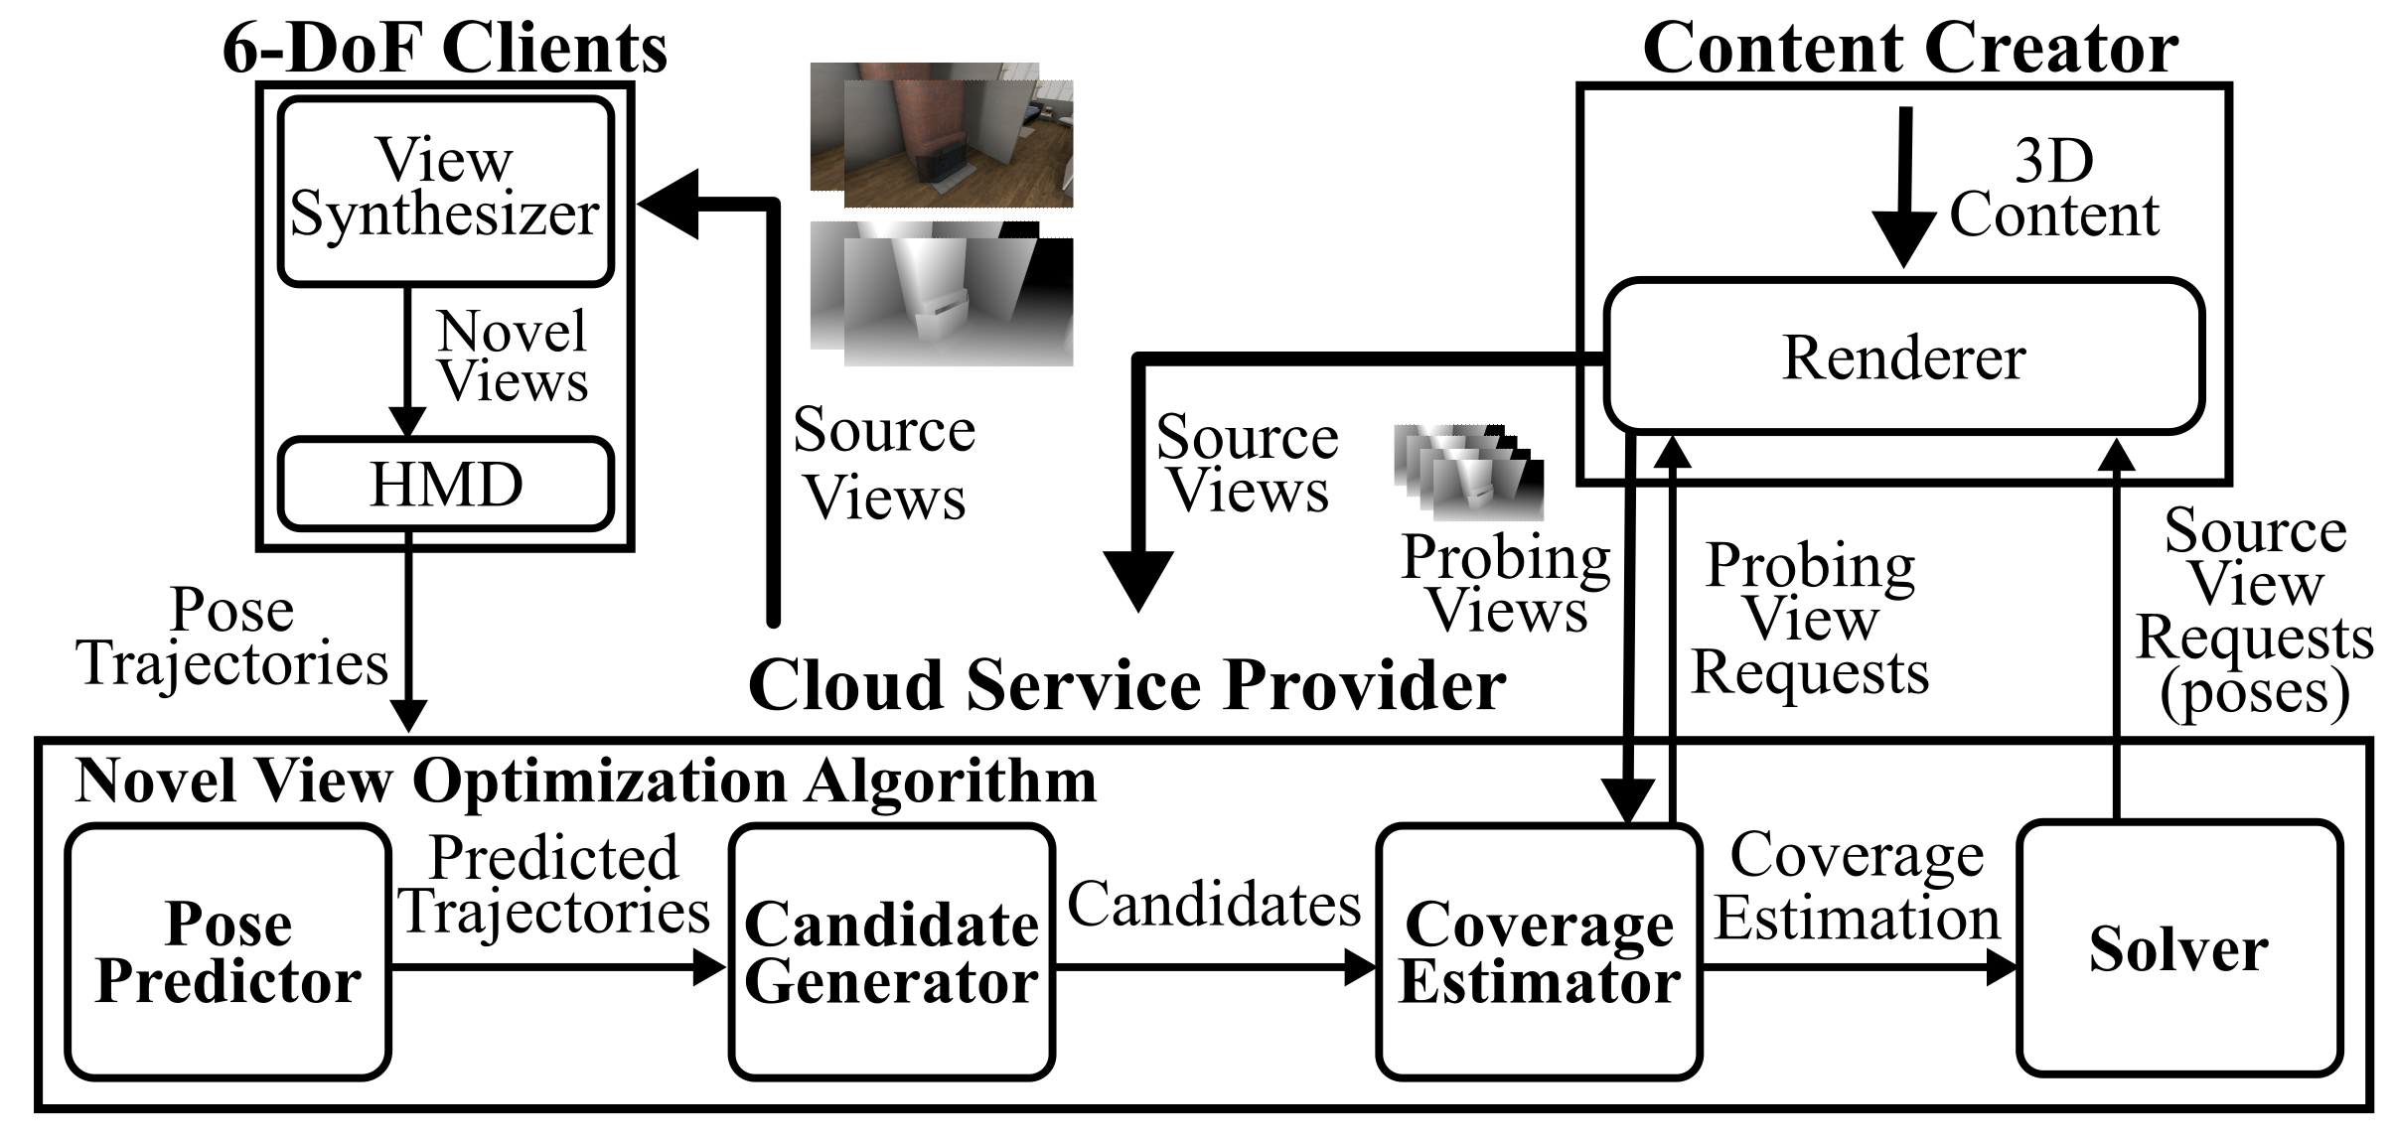
Component Diagram of Each Party
System Design
Probing view: Low resolution depth image (1/16 of original)
Update source views every second

Slide 14
Outline
Inspiration
Goal & Challenges
Related Work
System Design
Novel View Optimization
Cloud Service Provider
Pose Predictor
Candidate Generator
Coverage Estimator
Solver & Algorithms
Implementation
Evaluations
Conclusion & Future Work

Slide 15
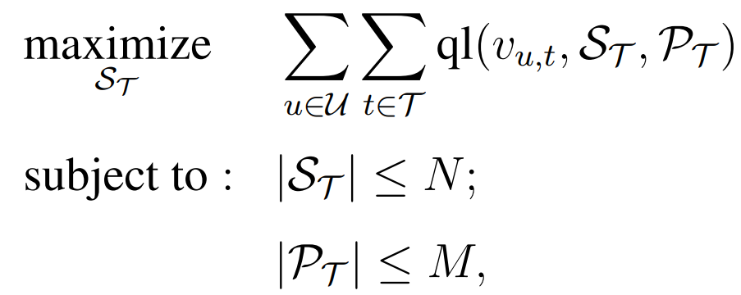
Summation of Expected Quality over Novel Views and 6-DoF clients
Novel View Optimization
expected quality of a novel view v
choose the optimal set of source views
for all clients and all novel views
source view budgets
probing view budgets

Slide 16
Outline
Inspiration
Goal & Challenges
Related Work
System Design
Novel View Optimization
Cloud Service Provider
Pose Predictor
Candidate Generator
Coverage Estimator
Solver & Algorithms
Implementation
Evaluations
Conclusion & Future Work

Slide 17
Compensate for Latency
Pose Predictor
predicted
history
Take history pose trajectory to predict future ones
Compute source views beforehand
Mature work
Kalman filter based (Serhan et al.)
LSTM based (Hou et al.)
Assume perfect prediction
S. Gul, S. Bosse, D. Podborski, T. Schierl, and C. Hellge. Kalman filter-based head motion prediction for cloud-based mixed reality. In Proc. of ACM International Conference on Multimedia (MM’20), page 3632–3641, Seattle, WA, October 2020
X. Hou and S. Dey. Motion prediction and pre-rendering at the edge to enable ultralow latency mobile 6dof experiences. IEEE Open Journal of the Communications Society, 1:1674–1690, 2020

Slide 18
Outline
Inspiration
Goal & Challenges
Related Work
System Design
Novel View Optimization
Cloud Service Provider
Pose Predictor
Candidate Generator
Coverage Estimator
Solver & Algorithms
Implementation
Evaluations
Conclusion & Future Work

Slide 19
Tradeoff between Runtime and Optimality
Candidate Generator
Procedure:
Concatenate all poses from all 6-DoF clients
Cut partitions from the concatenated pose trajectory
Generate a source view candidate from each partition
Candidates as representatives (leverage temporal locality)
The pose at least covers nearby poses
poses
poses
...
poses
concatenated poses
...
How many ?
p
p
p
p
p
p
p
To be determined:
How many partitions (poses) should we have?
How to generate a candidate from a partition?
How?
candidate generation
...
0
1
2
3
4
.
.
19

Slide 20
Strike Optimal Number of Partitions (Step 1)
Candidate Generator
P seats
Random arbitrary-number selection Analysis
(Relaxed to selection of $≥N$ source views)
$N, M$ are no. of source views and partitions
$k=M/N$, redundant factor
$m=N/P$, source view budget
$l=rm$, computational load
$h=\frac{M}{P}+rm$, candidate overhead + computational load
Select M candidates out of P poses at random
Always assume N optimal candidates are among P poses
$\operatorname{Pr}\left(step 1\right)=\frac{M}{P}\frac{M−1}{P−1}…\frac{N−1}{P−\left(N−1\right)}≥\frac{{\left(M −\left(N−1\right)\right)}^{N}}{P^{N}}={\left((mP\left(k−1\right)+1)/P\right)}^{mp}$
Seats for M candidates
0
1
2
3
4
5
.
.
.
P-1
…
pick one of them
0
an optimal pose

Slide 21
Strike Optimal Number of Partitions (Step 2)
Candidate Generator
Seats for M candidates
Random arbitrary-number selection Analysis
2. N optimal ones are included in the N+ source views
A candidate is selected if it says an “yes”
$\operatorname{Pr}\left(\text{yes}\right)$ of an optimal source view is a linear function of $l$
$\operatorname{Pr}\left(\text{yes}\right)=1/k$, when $l=0$
$\operatorname{Pr}\left(\text{yes}\right)=1$, when $l=k−1$
$\operatorname{Pr}\left(\text{yes}\right)$ of a sub-optimal source view is not important
0
1
2
3
4
5
.
.
.
M-1
says an “yes” or “no”
yes
no
0
1
3
.
.
.
2
4
.
.
.
N+ source views

Slide 22
Strike Optimal Number of Partitions (Step 3)
Candidate Generator
$N, M$ are no. of source views and partitions
$k=M/N$, redundant factor
$m=N/P$, source view budget
$l=rm$, computational load
$h=\frac{M}{P}+rm$, candidate overhead + computational load
Random arbitrary-number selection Analysis
3. $\operatorname{Pr}\left(success\right)= \operatorname{Pr}\left(step 1\right)×{\operatorname{Pr}\left(step 2\right)}^{N}$
Select M candidates out of P poses at random & N optimal ones are included in the N+ source views
Maximize $Pr⁡(success)$ with respect to $k$
Constraint:$0≤l≤mk$
$k=\sqrt{\frac{\left(m+h\right)\left(mP−1\right)}{m^{2}P}}≈\frac{\sqrt{m+h}}{\sqrt{m}}$ as $P→∞$
m, h are constant in an experiment
Such policy is used for deriving $k$
$$Pr⁡(step 1)$$
$${\operatorname{Pr}\left(step 2\right)}^{N}$$
Derived from $0≤l≤mk$

Slide 23
Strike Optimal Number of Partitions
Candidate Generator
Random arbitrary-number selection analysis to determine $k$
(Relaxed to selection of $≥N$ source views)
$N, M$ are no. of source views and partitions
$k=M/N$, redundant factor
$m=N/P$, source view budget
$l=rm$, computational load
$h=\frac{M}{P}+rm$, candidate overhead + computational load
Select M candidates out of P poses at random
Select $≥N$ source views from M candidates
$k=\sqrt{\frac{\left(m+h\right)\left(mP−1\right)}{m^{2}P}}≈\frac{\sqrt{m+h}}{\sqrt{m}}$ as $P→∞$
...
poses
poses
poses
m, h are constant in an experiment
concatenated poses
How many ?
...
p
p
p
p
p
p
p
candidate generation
...
0
1
2
3
4
.
.

Slide 24
Generate a Candidate from a Partition
Candidate Generator
poses
poses
...
poses
Consider position and orientation separately
Average pose of a partition of size $L$ as a candidate
$\overline{p}$: average position = $(\overline{x}, \overline{y}, \overline{z})$
Vector mean
$\overline{q}$: average orientation = $\overline{q_{w}}+\overline{q_{x}}\hat{i}+\overline{q_{y}}\hat{j}+\overline{q_{z}}\hat{k}$
Unit quaternion to avoid rotation order ambiguity
Solve a maximum eigenvalue problem of a 4x4 matrix
concatenated poses
...
p
p
p
p
p
p
p
How?
candidate generation
...
c
c
c
c
c
c
c
$L$ is the length of a partition

Slide 25
Outline
Inspiration
Goal & Challenges
Related Work
System Design
Novel View Optimization
Cloud Service Provider
Pose Predictor
Candidate Generator
Coverage Estimator
Solver & Algorithms
Implementation
Evaluations
Conclusion & Future Work

Slide 26
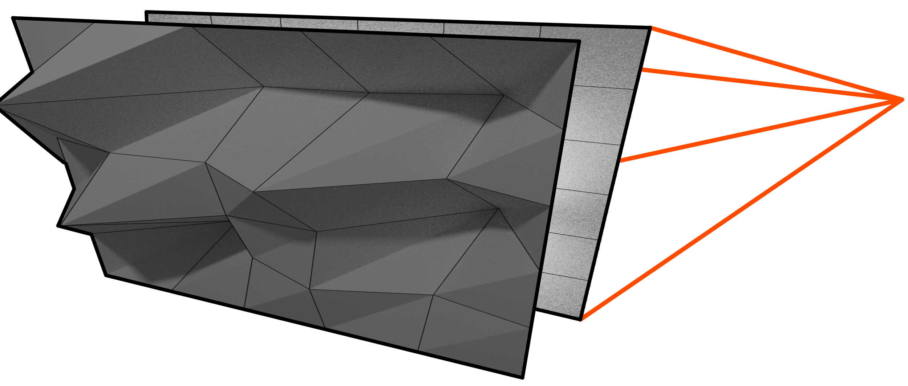
Mesh Creation
Coverage Estimator
Create a image plane mesh of WxH vertices seen from $cdd_{1}$
Move the vertices along the projection lines according to their depth
Vertex connections are kept
Linear interpolation of depth between vertices
Transform the mesh to $cdd_{2}$
projection lines
$$cdd_{1}$$
image plane mesh
$$m_{1}$$
linear interpolation

Slide 27
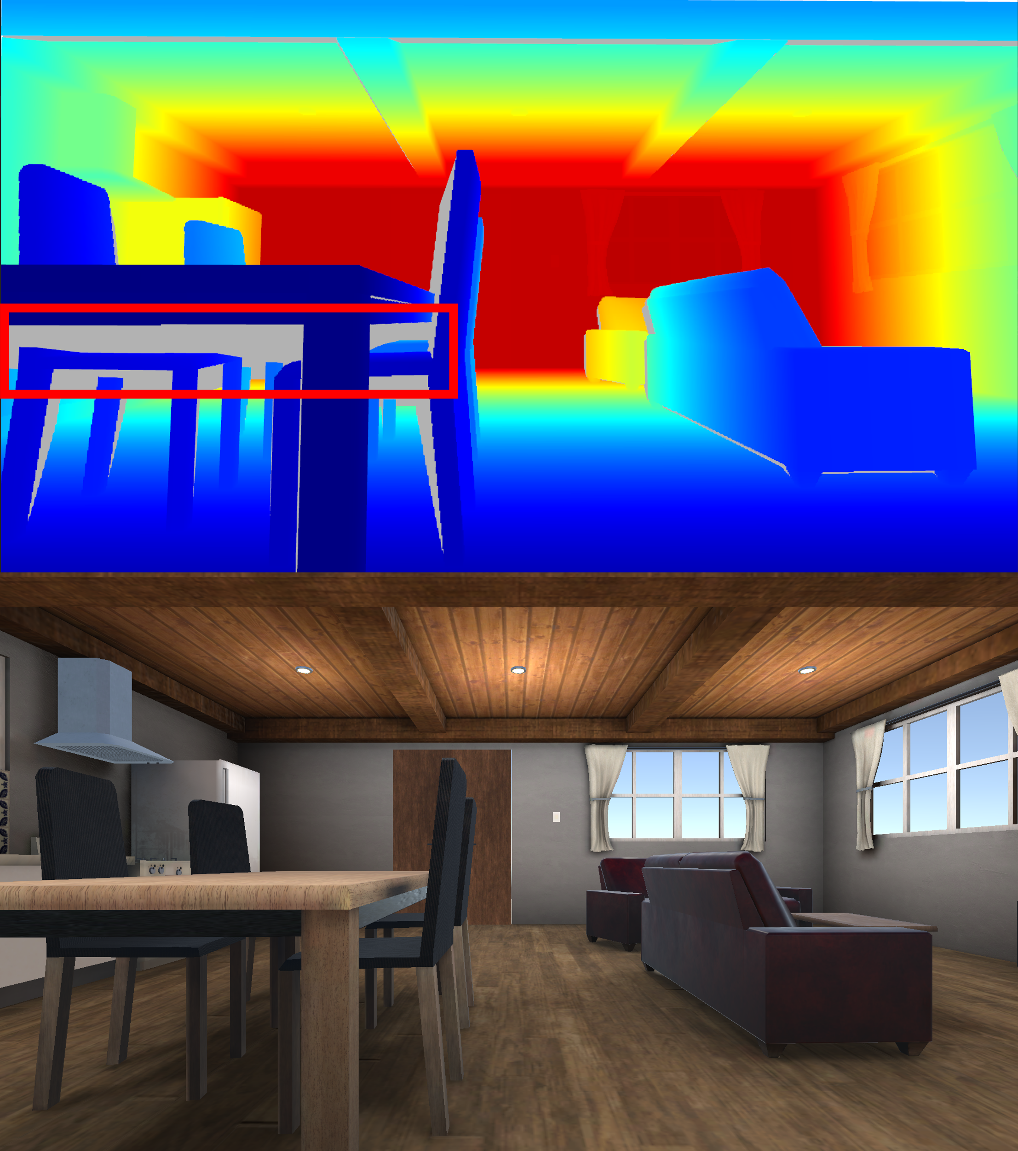
Disocclusion Removal
Coverage Estimator
Analyze how $cdd_{1}$ covers $cdd_{2}$
Values in $d_{1,2}$ should be consistent with $d_{2}$ unless:
$cdd_{1}$ does not cover that pixel →Infinity depth
That part is disoccluded
Disocclusion removal:
Compute $d_{abs}=| d_{1,2}−d_{2}|$
Remove those $≥$threshold in $d_{abs}$
Colored parts from $cdd_{1}$
Gray parts are disocclusion
Color view

Slide 28
Compute Coverage Map of $cdd_{1}$ on $cdd_{2}$, $C_{1,2}$
Coverage Estimator
For all pairs of candidates:
Repeat the procedure of computing $C_{j, i}$ for all candidates
Result in $M$ probing views (low resolution depth images)
For a pair of candidates:
Request depth images, $d_{1}$ and $d_{2}$
Create mesh $m_{1}$ from $d_{1}$
Re-project $m_{1}$ to $cdd_{2}$ as $d_{1,2}$
Remove disocculusion of $d_{1,2}$ by comparing with $d_{2}$

Slide 29
Outline
Inspiration
Goal & Challenges
Related Work
System Design
Novel View Optimization
Cloud Service Provider
Pose Predictor
Candidate Generator
Coverage Estimator
Solver & Algorithms
Implementation
Evaluations
Conclusion & Future Work

Slide 30
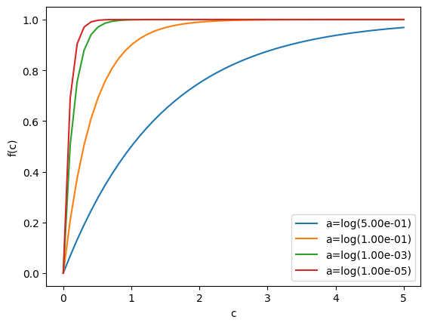
Pixel Contribution Function $f(c)$
Solver
Saturates fast and bounded
Describe contribution of a pixel:
$f\left(c\right)=1 −e^{ac}$ for $a<0, c∈Z$
$c$ : coverage count
$a=\log\left({10}^{−5}\right)$
Zero coverage: $f\left(c\right)=0, c=0$
Bounded quality: $f\left(c\right)→1, c→∞$
Monotonic increase: $f\left(c_{1}\right)≥f(c_{2})$ for $c_{1}≥c_{2}$
Quality saturation: $f^{′}\left(c_{1}\right)≤f′(c_{2})$ for $c_{1}≥c_{2}$
We don’t use Boolean modeling:
$b\left(c\right)=1$ for $c>0$
$b\left(c\right)=0$ for $c≤0$
because we seek for improvement from multiple coverage

Slide 31
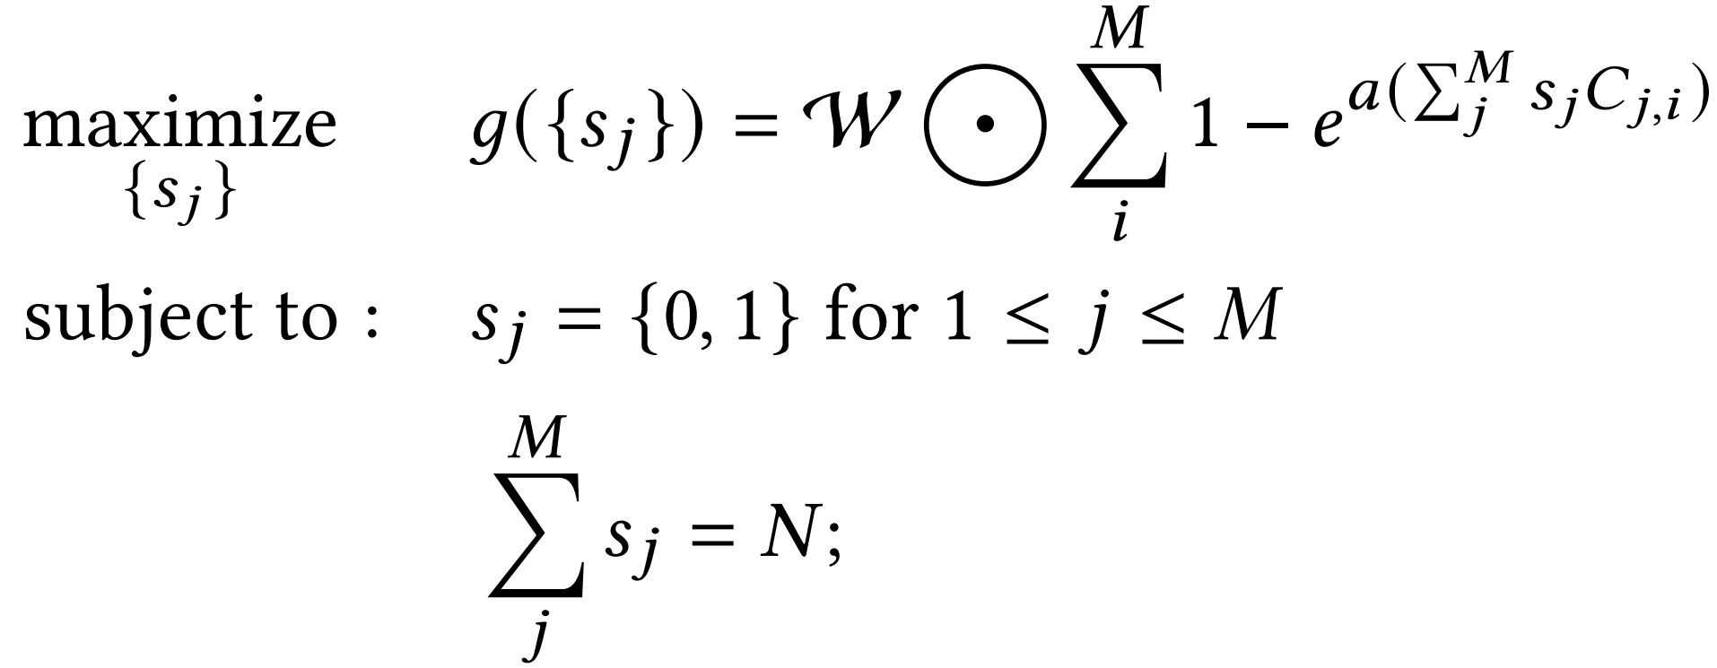
Optimization Objective
Solver
average over all candidates
coverage count of $cdd_{i}$
matrix version of $f(c)$
select or not
We will call it $g$ value in the following discussion
source view budget
$C_{j,i}$ : coverage map of how $cdd_{j}$ covers $cdd_{i}$
$\left\{s_{j}\right\}$: Boolean decision variables
$s_{j}=1$ indicates the $j^{th}$ candidate is selected
$W$: weighting mask (averaging mask)
$⨀$: element-wise multiplication and summation

Slide 32
Uniform Solver (Uni)
Solver
Pick candidates every fixed skips
Guarantees uniform source view distribution across temporal axis and 6-DoF clients
No need for coverage estimation
Runs fast
✔
✔
✔
0
1
2
3
4
5
.
.
.
Source view candidates

Slide 33
Branch & Bound Solver (BB)
Solver
Start from $\left\{s_{j}\right\}=0$, mark all $s_{j}$ as “undetermined”
$ub\left(\left\{s_{j}\right\}\right)=g$ value of setting all “undetermined” $s_{j}$ to 1
Branch
Set one of the 0s to 1 such that $g$ value increases the most
Mark the corresponding 0 in Branch 1. as “determined”
Bound
$lb:$ $g$ value of the best sequence
Remove from list if $ub\left(\left\{s_{j}\right\}\right)≤lb$
$$\{?, 0, …, ?, ?, 1, …\}$$
set to 1
set to 0
$$\{?, 0, …, 1, ?, 1, …\}$$
$$\{?, 0, …, 0, ?, 1, …\}$$
Their upper bounds
$$g(\left\{1,0, …, 1, 1, 1, …\right\})$$
$$g(\left\{1, 0, …,0, 1, 1, …\right\})$$

Slide 34
Uniform & Modify Solver (UM)
Solver
Start from $\left\{s_{j}\right\}=Uni()$
Always iterate in the terminal sequences
Terminal sequence: $∑s_{j}=N$
Clear-than-set iteration
Clear one of the 1s to 0 such that $g$ value decreases the least
Set one of the 0s to 1 such that $g$ value increases the most
Duplicated $\left\{s_{j}\right\}$ are ignored
A terminal sequence
$$\left\{1, 1, 0, 1, 0, 1, …0, 0\right\}$$
$$\left\{0, 1, 0, 1, 0, 1, …0, 1\right\}$$
Set
Clear
$$\left\{0, 1, 0, 1, 0, 1, …0, 0\right\}$$

Slide 35
Component Diagram of Each Party
System Design
Probing view: Low resolution depth image (1/16 of original)
Update source views every second

Slide 36
Outline
Inspiration
Goal & Challenges
Related Work
System Design
Novel View Optimization
Cloud Service Provider
Pose Predictor
Candidate Generator
Coverage Estimator
Solver & Algorithms
Implementation
Evaluations
Conclusion & Future Work

Slide 37
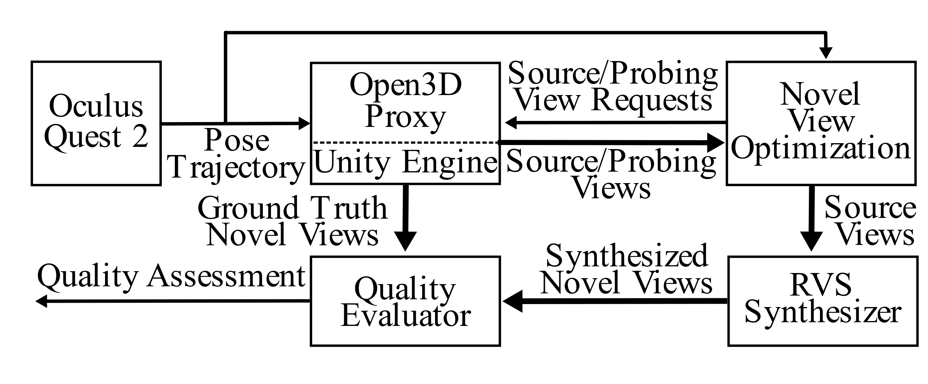
Testbed
Implementation
Render depth images using an Open3D renderer
Offload RVS synthesizer to PC
Unity Engine as high quality source view provider

Slide 38
Outline
Inspiration
Goal & Challenges
Related Work
System Design
Novel View Optimization
Cloud Service Provider
Pose Predictor
Candidate Generator
Coverage Estimator
Solver & Algorithms
Implementation
Evaluations
Conclusion & Future Work

Slide 39
Comparison Algorithms / Candidate Generator (IXR’22)
Evaluations
Content creator provides scalar coverage ratio from a pose to another
S-Cdd
Generate a candidate if a pose cannot cover 75+% of the previous candidates
C2I: Integer programming solver
C2G: Greedily select the best 2 candidates at a time
Opt
Select all the source views
Highest performance given candidates
source view budgets
$s$: Boolean column vector denote a selection
Matrix approximation of set union operations

Slide 40
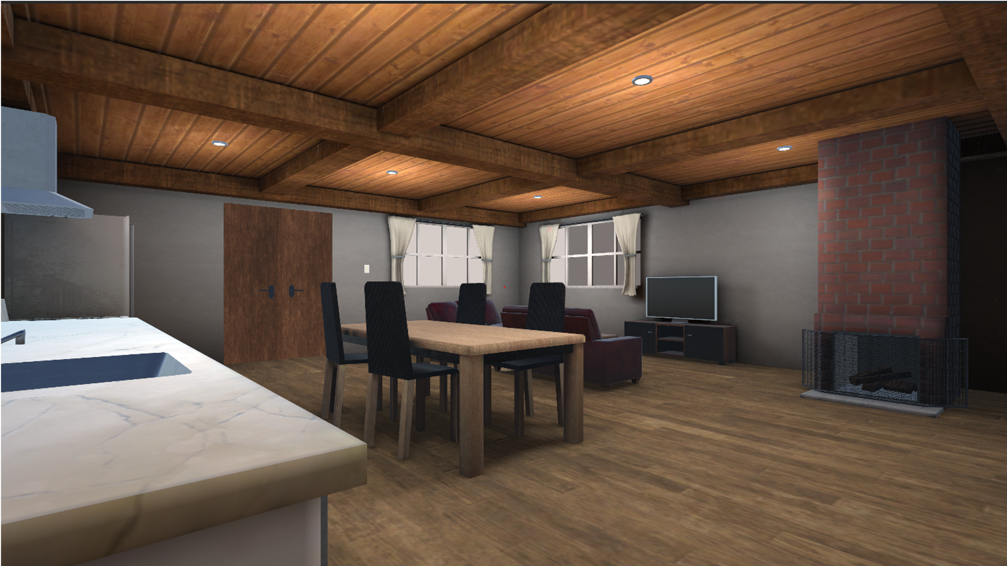
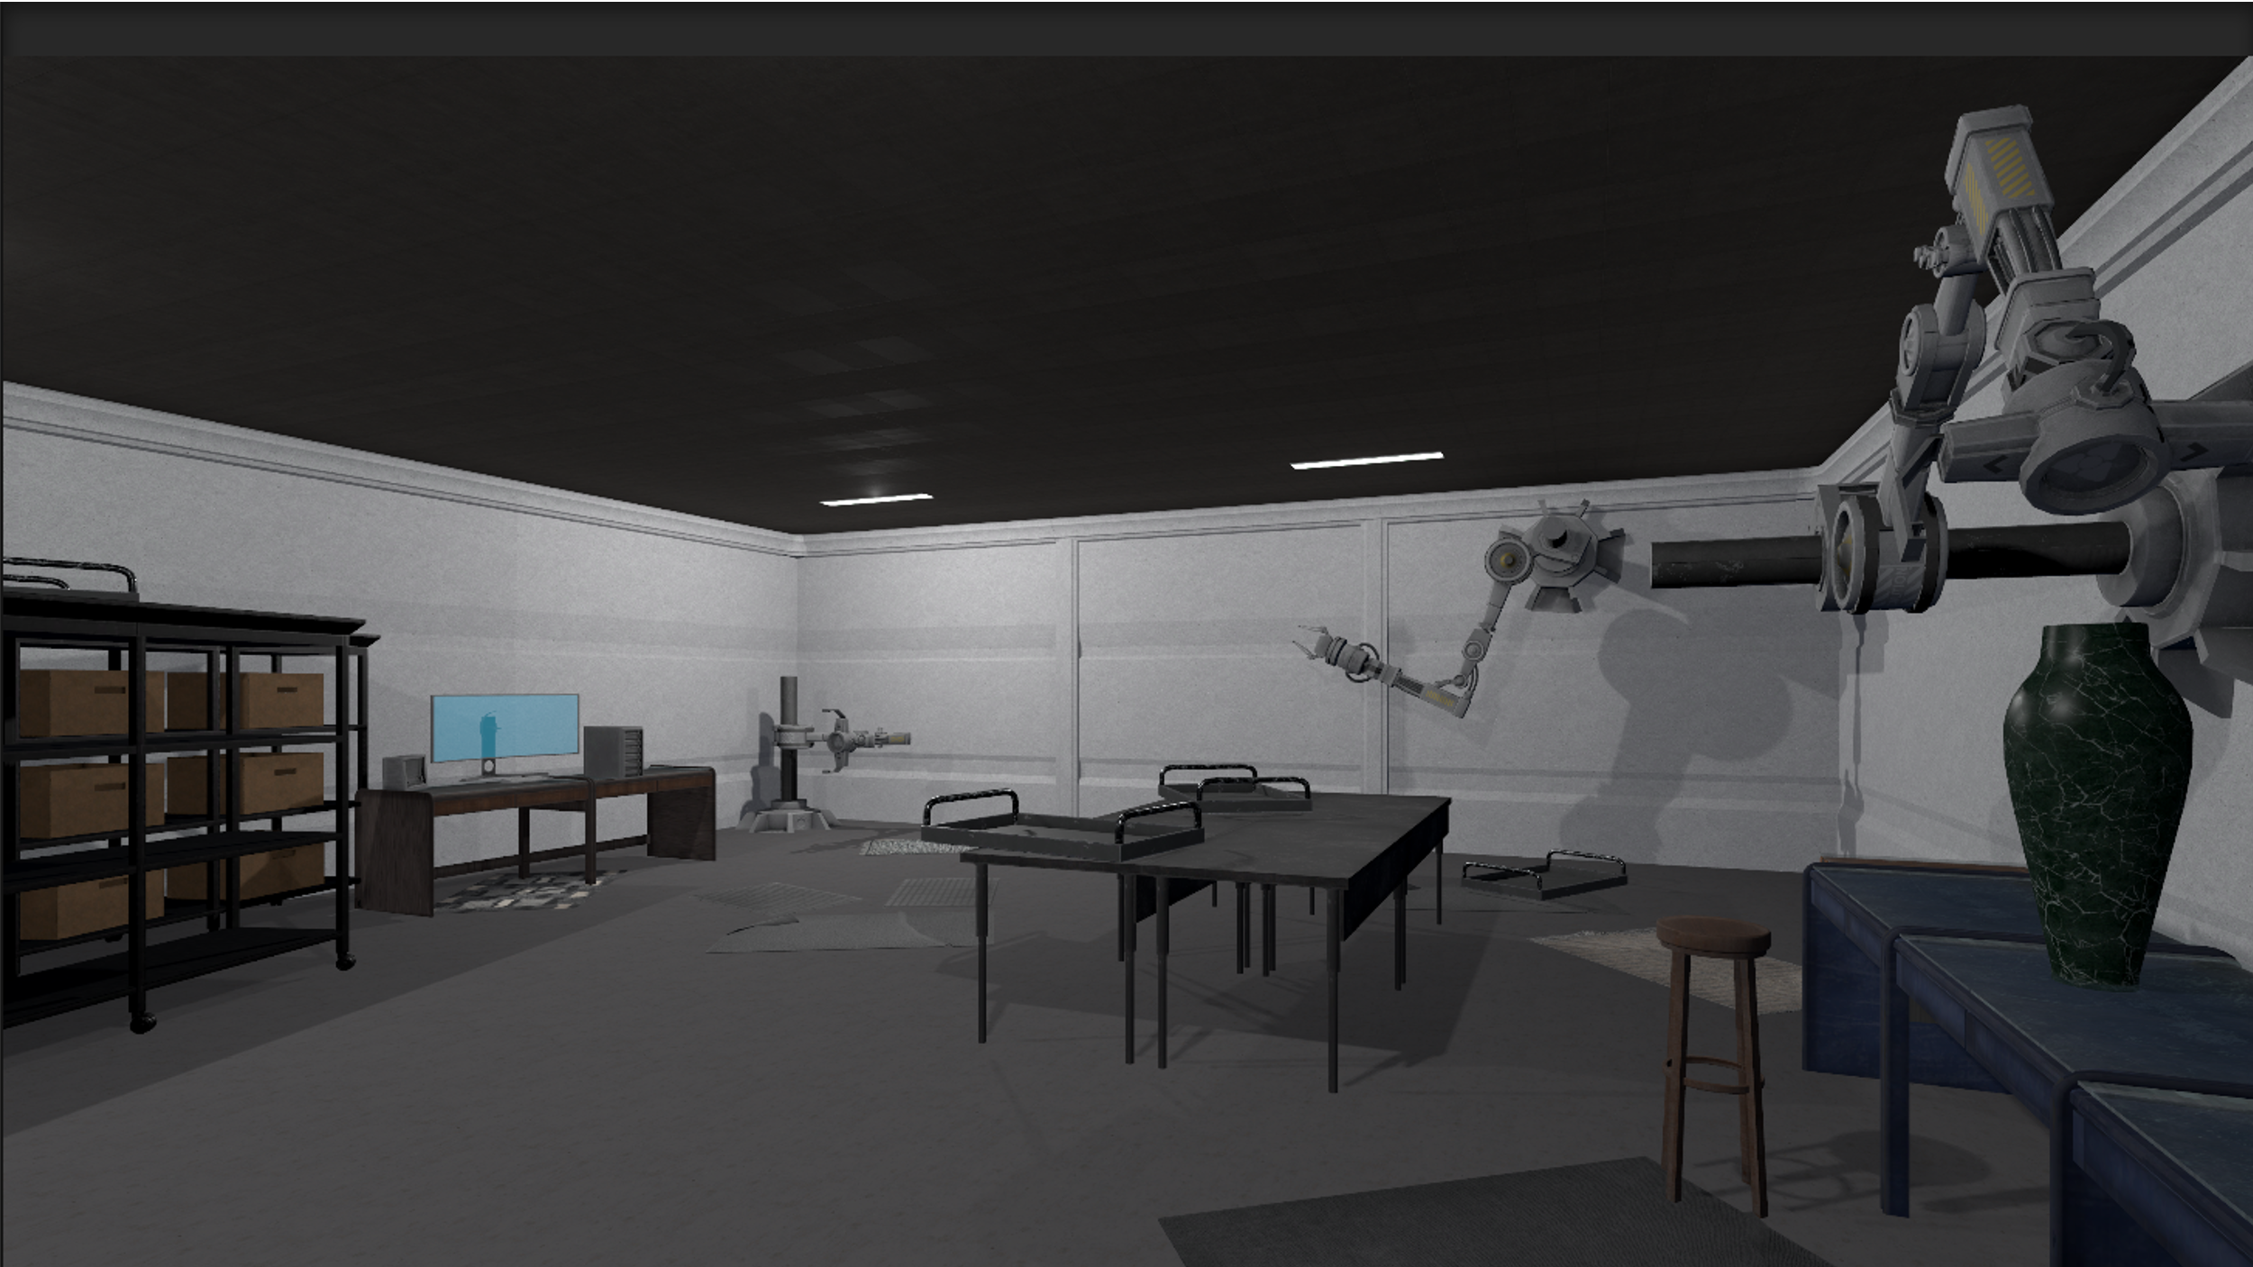
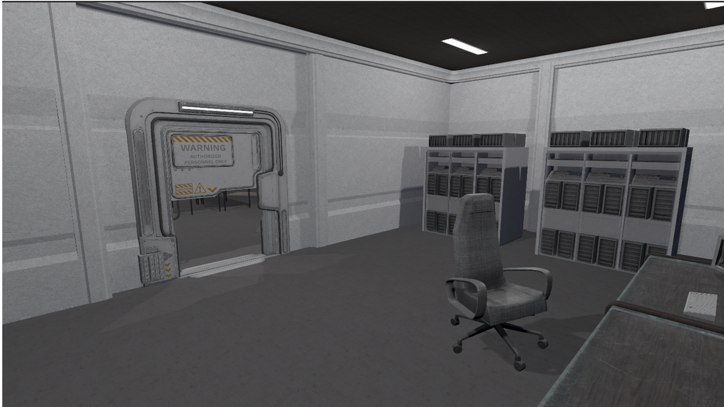
Setup
Evaluations
SSIM
Content
Default parameters
Number of 6-DoF clients = 16
Source view budgets $N∈\left\{8, 16, 24, 32, 40\right\}$
Candidates $M∈\{32, 32, 48, 64, 80\}$
Solver $∈\{C2G, C2I, Uni, BB, UM, Opt\}$
Candidate generator $∈$ $\{$S-Cdd, proposed$\}$
House
Device specification
CPU: AMD Ryzen 7 5700X 8-core
GPU: NVIDIA Geforce RTX 3090 Ti
Big Room
Quality Metrics
Peak Signal to Noise Ratio (PSNR) = $20 log⁡(255/\sqrt{MSE})$
Structural Similarity (SSIM)
Video Multi-Method Assessment Fusion (VMAF)
Small Room

Slide 41
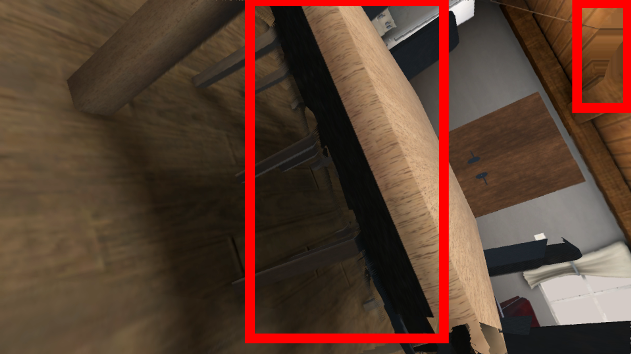
Sample results
Evaluations
Best frame in PSNR from a random synthesized video
Worst frame in PSNR from a random synthesized video
Artifacts: blur, distortion
See demo videos

Slide 42
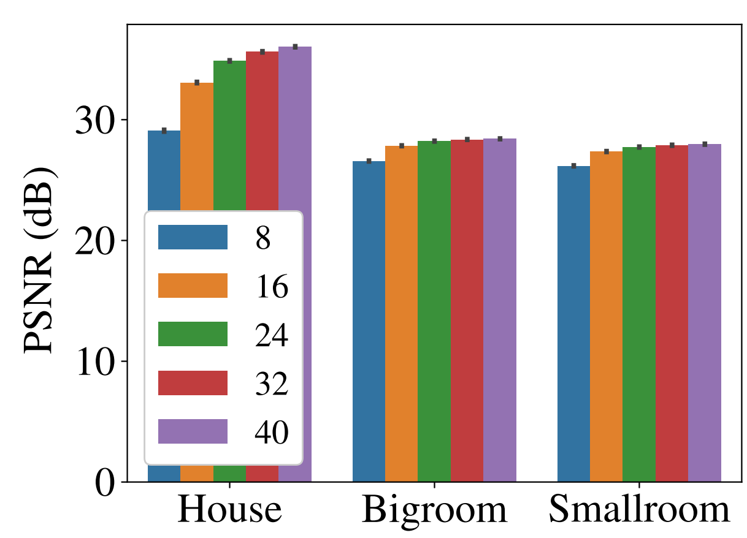
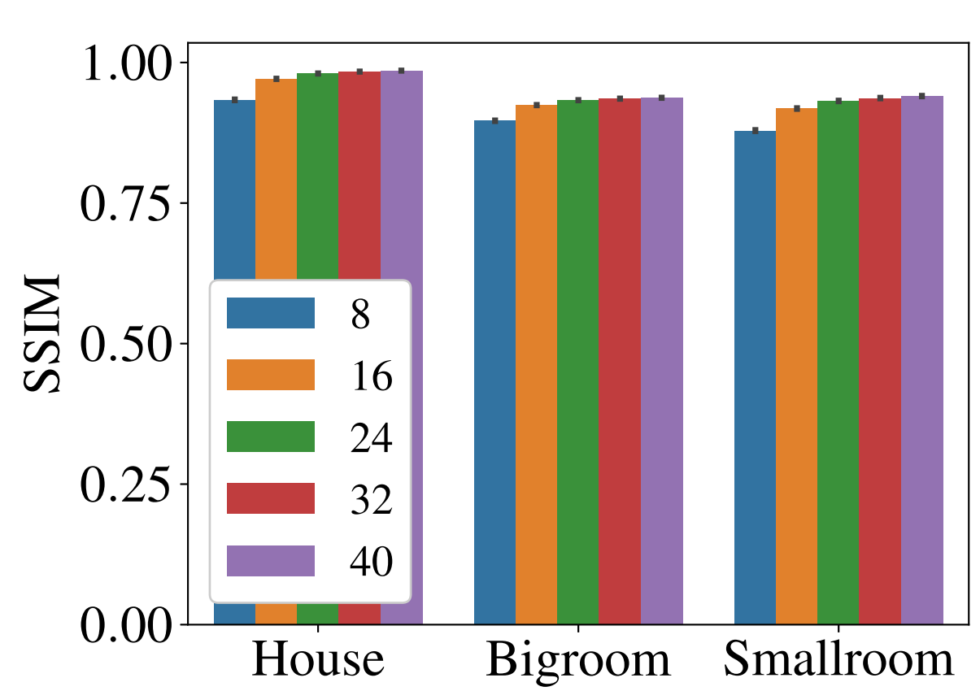
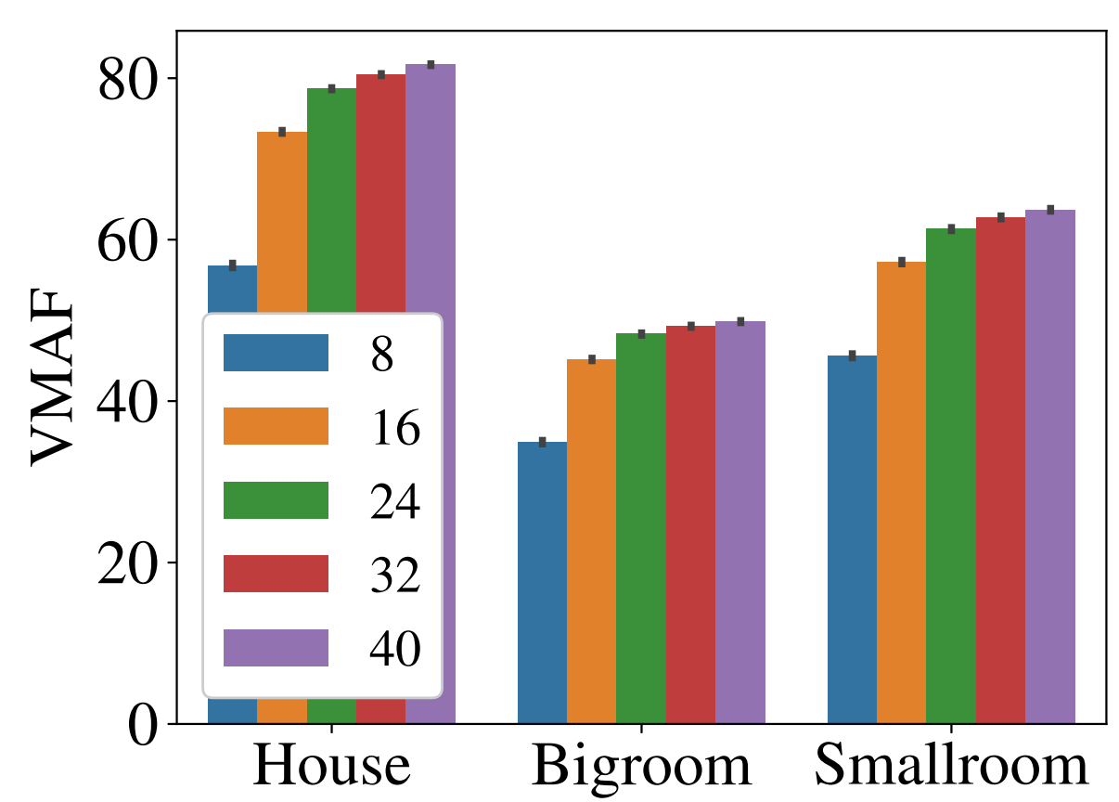
Quality Saturates as $N$ increases
Evaluations
Quality saturates when $N=24$
VMAF performs relatively worse
Our formulation does not consider temporal continuity

Slide 43
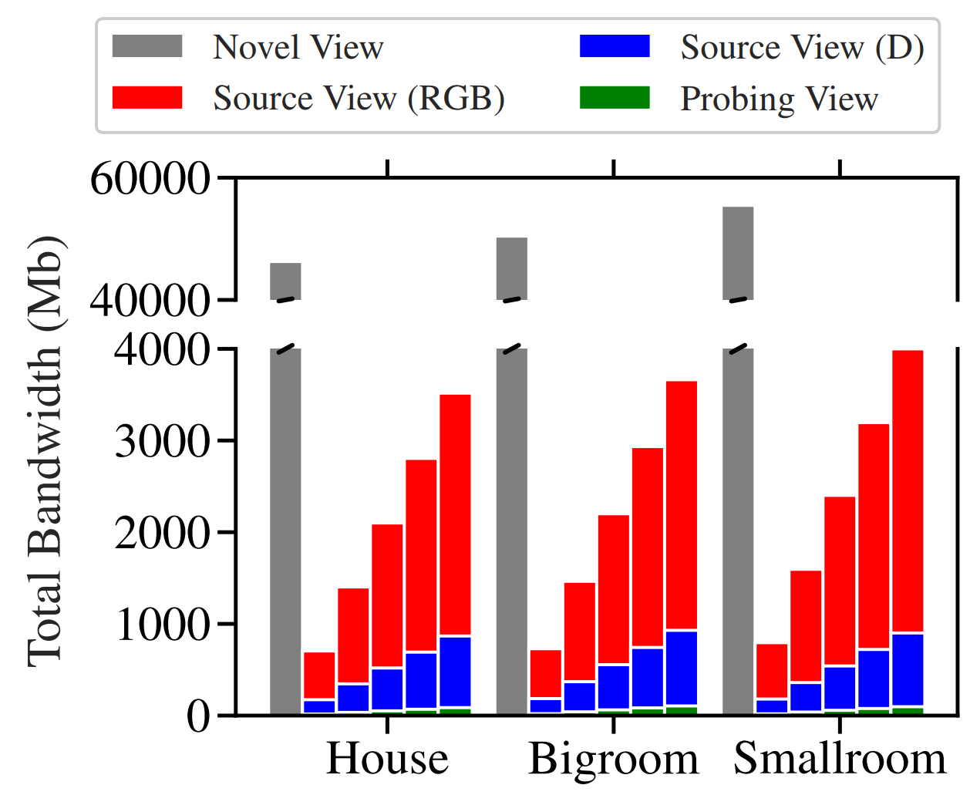
Bandwidth Reduction
Evaluations
H.264 encoder, quantization parameter (QP) = 0
Encode ground truth video at 50 fps
Encode source views separately
Save 94% of bandwidth consumption
$$N=\{8, 16, 24, …, 40\}$$

Slide 44
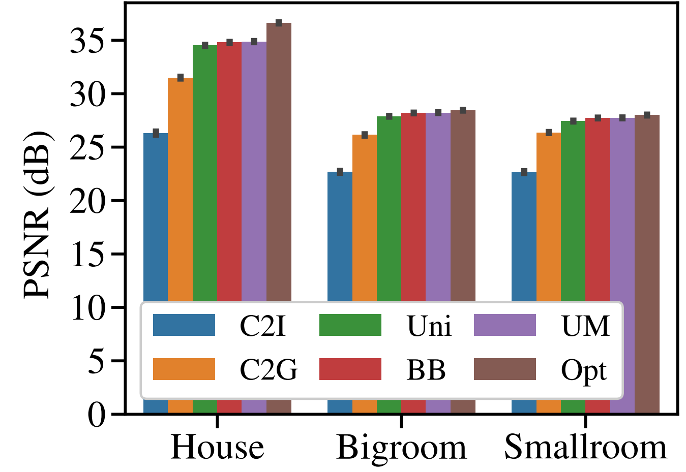
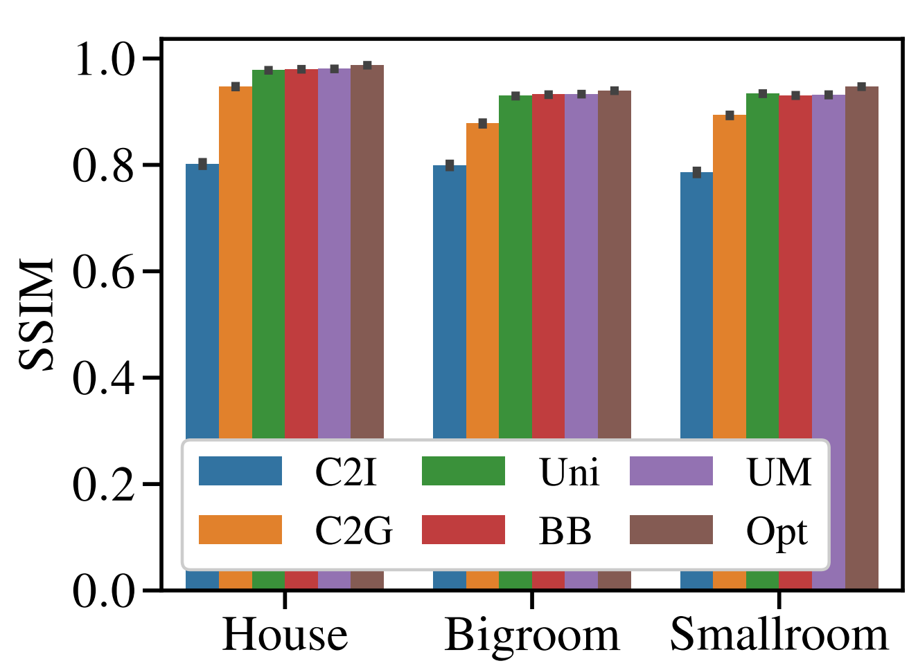
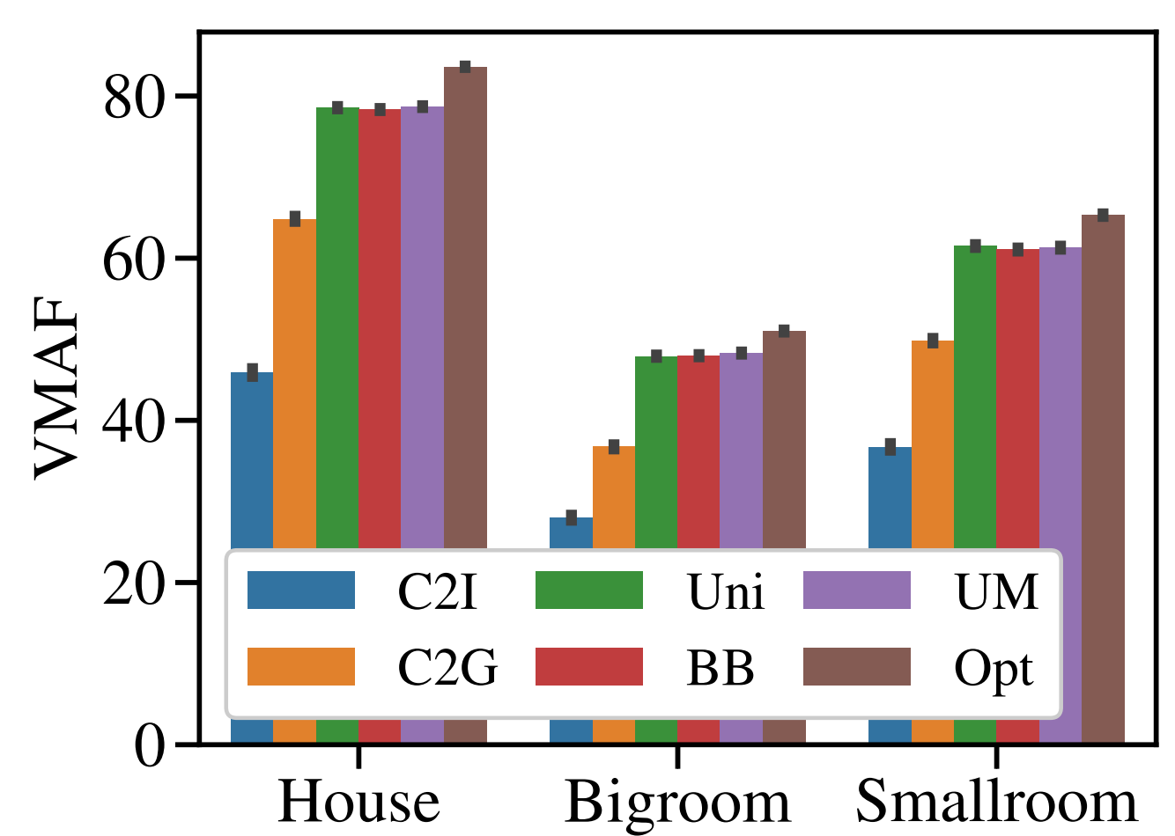
Solver Comparison
Evaluations
C2I, C2G only have scalar coverage ratio information
Uni, BB, UM outperform C2I, C2G
Uni, UM seek for improvement over Uni in PSNR

Slide 45
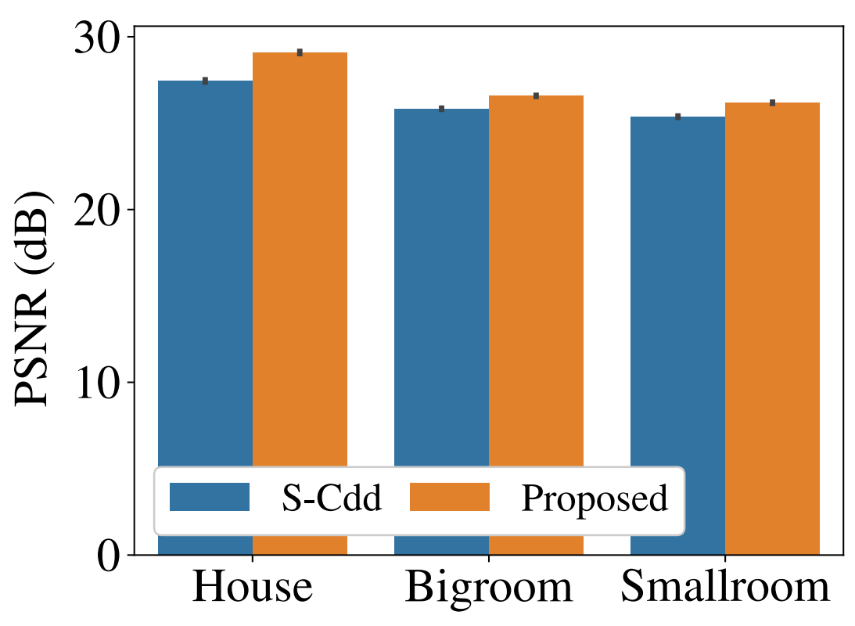
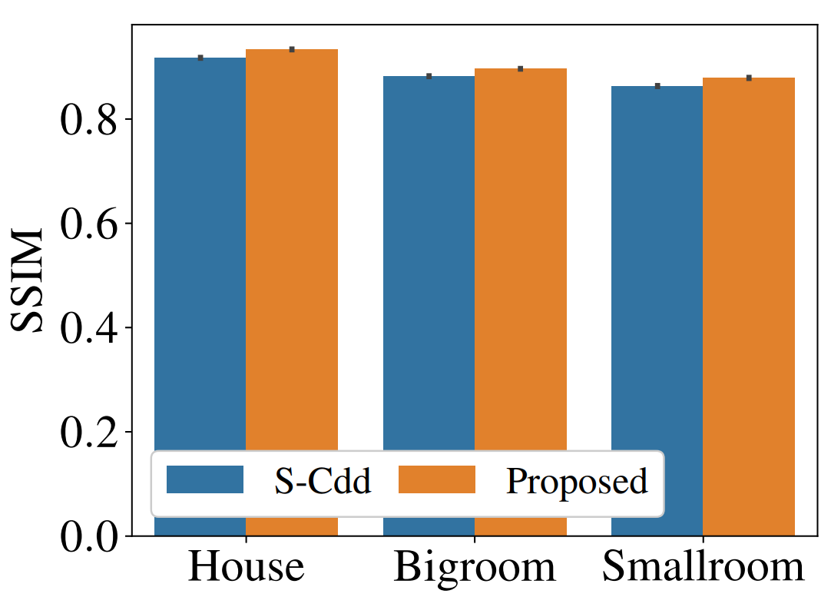
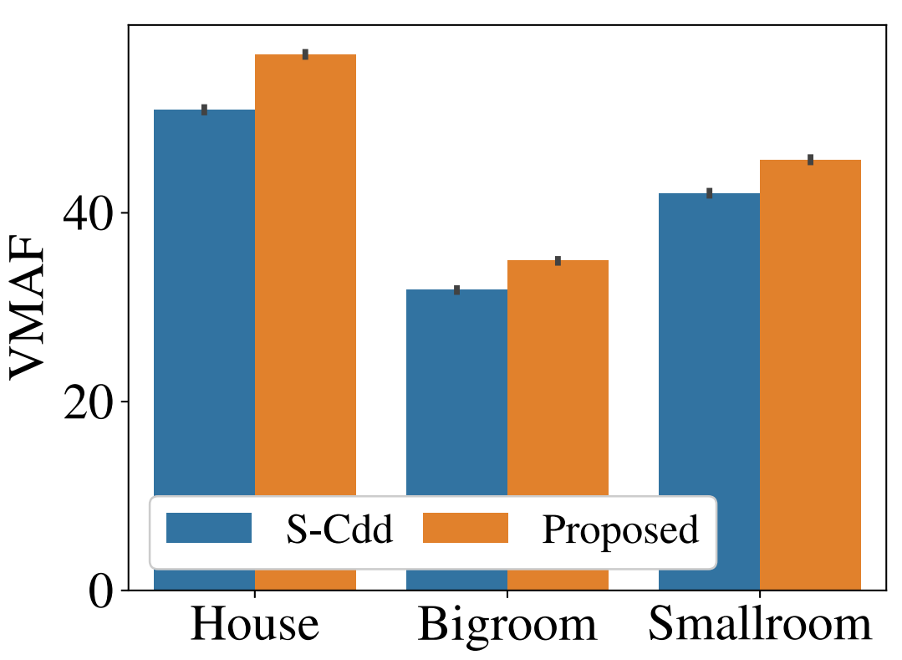
Candidate Generator Comparison
Evaluations
Solver = UM
Proposed generator consistently outperforms S-Cdd
Proposed generator feeds high quality inputs to the pipeline

Slide 46
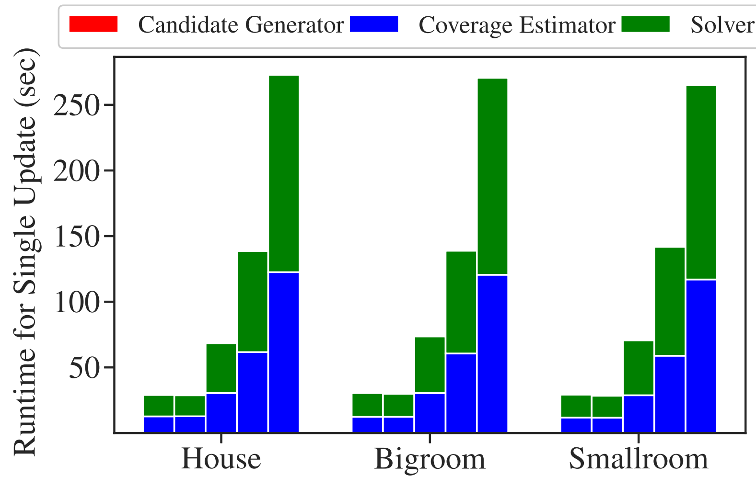
Runtime Distribution
Evaluations
Solver = UM
Number of iterations = 128
Candidate generator runs fast
Coverage estimator is implemented in CPU
Solver is implemented in GPU
Frequently evaluate $g$ value

Slide 47
Outline
Inspiration
Goal & Challenges
Related Work
System Design
Novel View Optimization
Cloud Service Provider
Pose Predictor
Candidate Generator
Coverage Estimator
Solver & Algorithms
Implementation
Evaluations
Conclusion & Future Work

Slide 48
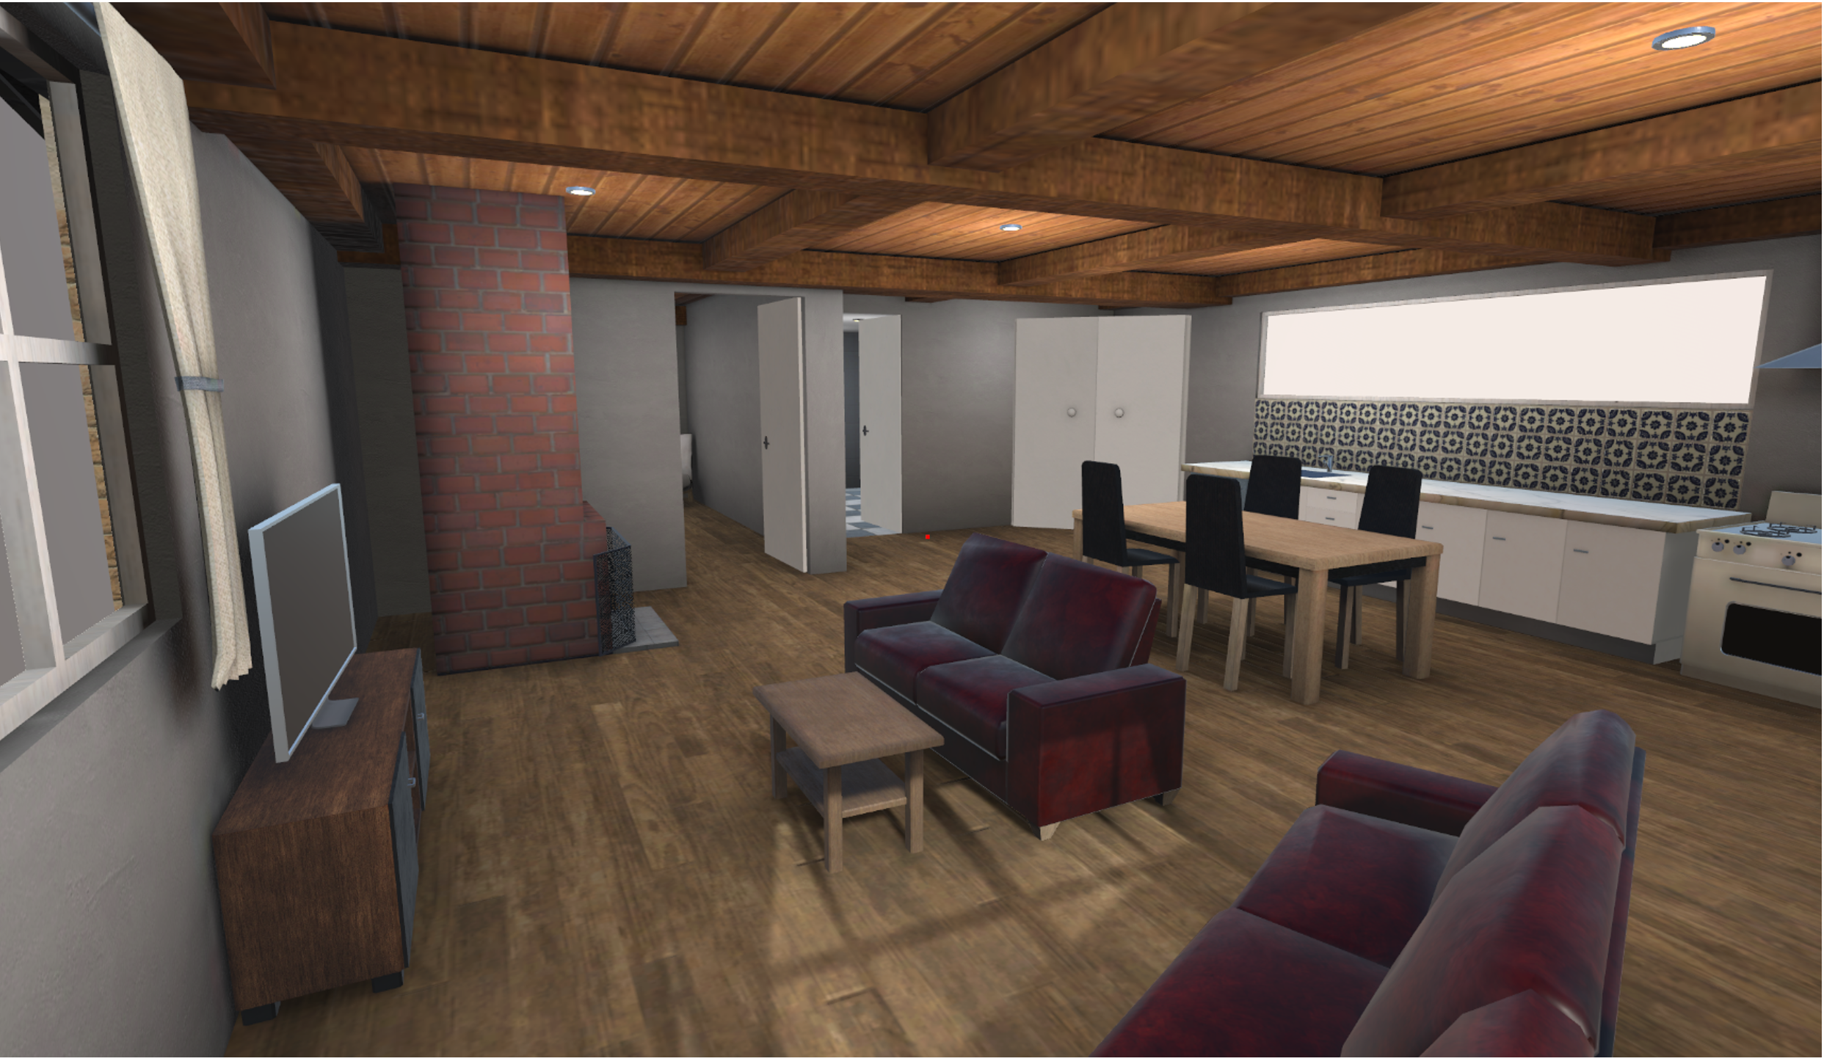
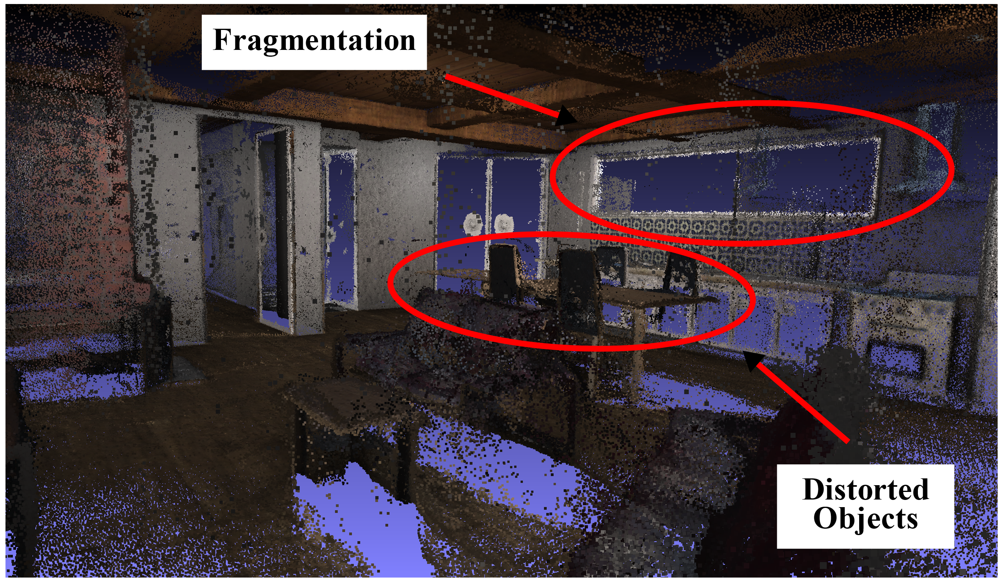
Defense against Structure-from-Motion (SfM)
Conclusion & Future Work
Colmap
J. L. Schonberger and J.-M. Frahm. Structure-from-motion revisited. In ¨ Proc. of IEEE Conference on Computer Vision and Pattern Recognition (CVPR’16), Las Vegas, NV, June 2016.
720 color images with 960x540 resolution, 10+ GPU hours

Slide 49
Remarks
Conclusion & Future Work
Conclusion
Propose a content creator friendly blind streaming system
Compute coverage maps without access to 3D content
Improve quality by 2.27 dB in PSNR, 12 in VMAF compared to scalar coverage ratio blind streaming system
Future work
Parallelism in frequently-evaluated $g$ values
Employ real-time view synthesis in HMDs
Formulate optimization objective that considers temporal continuity

Slide 50
Thank you for your attention!
Sheng-Ming Tang (shengming0308@gapp.nthu.edu.tw)
Thanks for the help of Prof. Hsu, the committees,
Ching-Ting Wang, Yuan-Chun Sun, Jia-Wei Fang, Kuan-Yu Lee, and all lab mates.
Publications:
S. Tang, Y. Sun, J. Fang, K. Lee, C. Wang and C. Hsu, ”Optimal Camera Placement for 6 Degree-of-Freedom Immersive Video Streaming Without Accessing 3D Scenes”, in Proc. of Interactive eXtended Reality (IXR’22), Lisbon, Portugal, October 2022.
S. Tang, C. Hsu, Z. Tian, and X. Su, ”An Aerodynamic, Computer Vision, and Network Simulator for Networked Drone Applications”, in Proc. of ACM Annual International Conference on Mobile Computing and Networking (MobiCom’21), New Orleans, USA, February 2022, Poster Paper.
Y. Sun, S. Tang, C. Wang, and C. Hsu, ”On Objective and Subjective Quality of 6DoF Synthesized Live Immersive Videos”, in Proc. of ACM Multimedia Workshop on Quality of Experience in Visual Multimedia Applications (QoEVMA’22), Lisbon, Portugal, October 2022.

