Slide 1
Error Concealment of Dynamic LiDAR Point Clouds for Connected and Autonomous Vehicles
Guihua Shi (shigh1102@gmail.com)
Advisor: Cheng-Hsin Hsu
Networking and Multimedia Systems Lab,
ISA, National Tsing Hua University

Slide 2
Outline
Introduction
Motivations
Related Work
Problem
Solutions
Experimental Setup
Results
Conclusion
Future Work

Slide 3
introduction
Notes:
img from: https://www.flaticon.com/

Slide 4
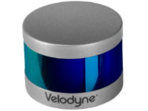
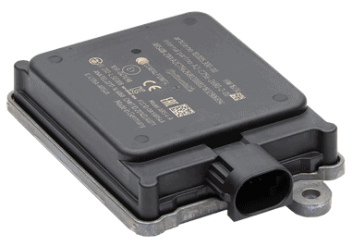
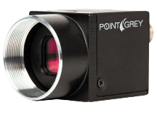
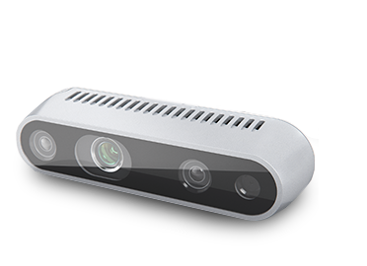
Sensors in CAVs
Connected and Autonomous Vehicles (CAVs)
1
2
3
4
Sensor | Max. Distance | H-FoV | V-FoV | FPS
LiDAR | 180 m | 360° | 26.8° | 20 Hz
mmWave LiDAR | 70 m | 90° | 30° | 17 Hz
RGB Camera | 250 m | 90° | 60° | 15 Hz
RGBD Camera | 10 m | 58° | 58° | 90 Hz
Notes:
Velodyne HDL-64E S2
conti-4 ARS408
Point Grey Flea 2 (FL2-14S3C-C)
Intel RealSense D415
img from: https://www.flaticon.com/
https://zhuanlan.zhihu.com/p/514851290
https://morioh.com/p/42234dd7d6d9

Slide 5
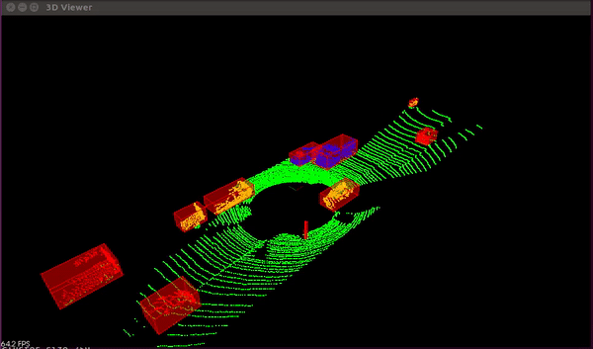
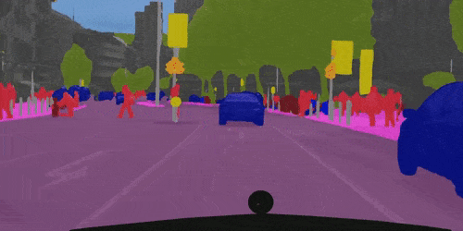
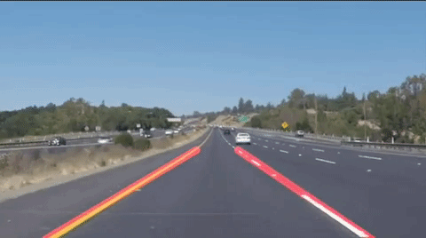
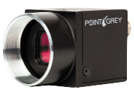
Applications for Driving Automations
Object Detection
Obstacle detection
Congestion analysis
Semantic Segmentation
Refined analysis
Obstacle detection
Lane Detection
Lane keeping
Route planning

Slide 6
Point Cloud Characteristics
Dimension: A set of points in 3D space, and each point has three coordinates, which are high-dimensional data
Unordered: The points are not in order, and modifying the order will not affect the result
Interaction between points: A single point is meaningless, and the features need to consider its structure and context
Invariance under transformations: For points in the point cloud, their absolute position does not matter, and the overall rotation, transformation, and scaling does not modify the structure

Slide 7
MOTIVATIONS

Slide 8
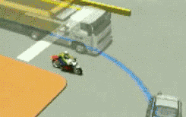
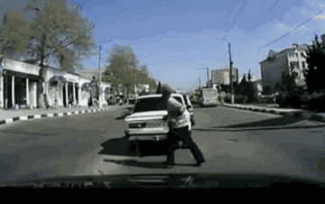
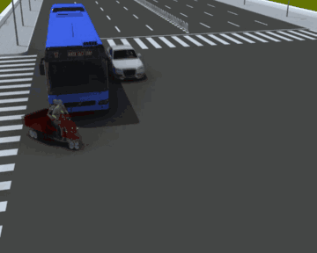
Cooperative Perception
The field of view from the single vehicle is always limited:
Blind spot
Obstacle occlusion
CAVs can obtain additional information by data sharing:
Sensor data [1]
Features [2]
High-level results [3]
[1] Zhang X, Zhang A, Sun J, et al. Emp: Edge-assisted multi-vehicle perception[C]//Proceedings of the 27th Annual International Conference on Mobile Computing and Networking. 2021: 545-558.
[2] Chen Q, Ma X, Tang S, et al. F-cooper: Feature based cooperative perception for autonomous vehicle edge computing system using 3D point clouds[C]//Proceedings of the 4th ACM/IEEE Symposium on Edge Computing. 2019: 88-100.
[3] Arnold E, Dianati M, de Temple R, et al. Cooperative perception for 3D object detection in driving scenarios using infrastructure sensors[J]. IEEE Transactions on Intelligent Transportation Systems, 2020, 23(3): 1852-1864.

Slide 9
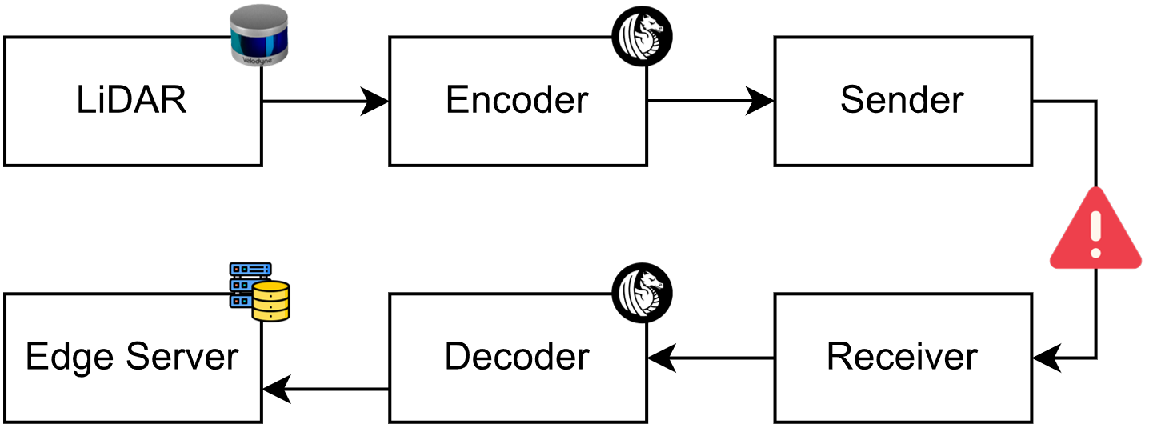
Point Cloud more than 100 Mbps
More than 1 million points per second [1]
Streaming uncompressed dynamic point cloud dictates more than 100 Mbps
Difficult to support multiple vehicles [2]
1
2
3
6
5
4
[1] Geiger A, Lenz P, Stiller C, et al. Vision meets robotics: The kitti dataset[J]. The International Journal of Robotics Research, 2013, 32(11): 1231-1237.
[2] Zhang X, Zhang A, Sun J, et al. Emp: Edge-assisted multi-vehicle perception[C]//Proceedings of the 27th Annual International Conference on Mobile Computing and Networking. 2021: 545-558.

Slide 10
Internet of Vehicles Limitations
C-V2X (Cellular Vehicle-to-Everything)
LTE (4G)
NR (5G)
DSRC (Dedicated Short-Range Communication)
5.9 GHz (IEEE 802.11p)
60 GHz (IEEE 802.11ad)
Network | Data Rate | Bandwidth | Latency | Max. Distance
LTE-V2X | <50 Mbps | 10 MHz | 50 ms | 250 m
NR-V2X | <1 Gbps | 100 MHz | 5 ms | 500 m
5.9 GHz | <27 Mbps | 10 MHz | 150 ms | 250 m
60 GHz | <7 Gbps | 2 GHz | 10 ms | 150 m

Slide 11
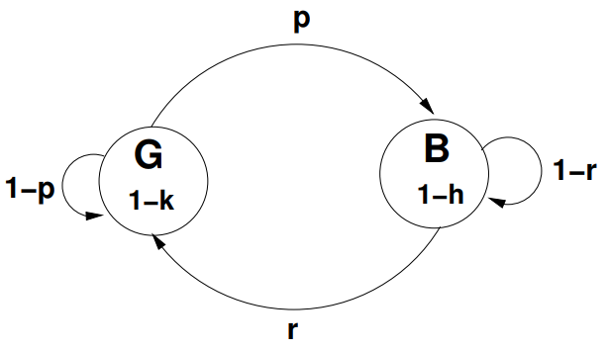
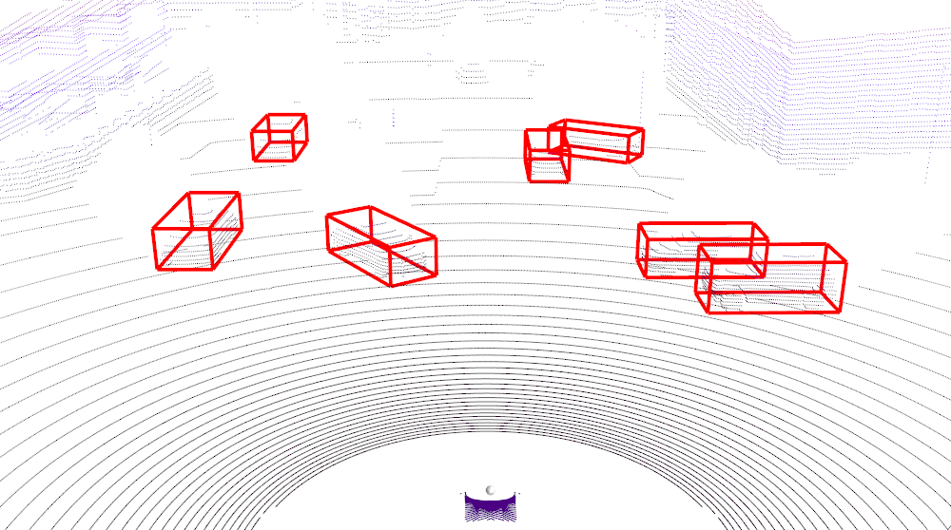
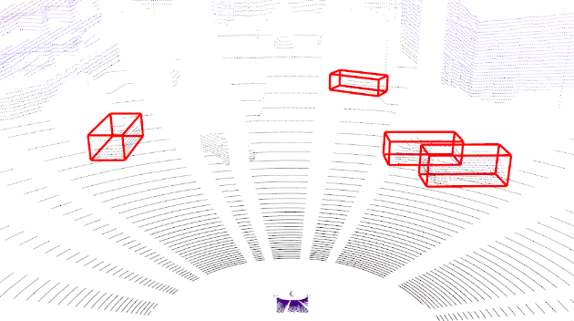
Packet Loss may lead to misclassification
Packet loss will generate incomplete point cloud frame
Incomplete frames may will produce misclassification
Only 71.43% and 42.85% of vehicles are detected when one-fourth and one-third of packets are lost
0%
25%
33%

Slide 12
Goals and Challenges
Goals
Minimize the Chamfer distance between the concealed and original point cloud frames
Challenges
Vehicles are moving, which complicates the transformation
Some incomplete frames may contain too many lost sectors, Spatial Interpolation (SI) less effective
Incomplete frame degrades the performance of such interpolation

Slide 13
Related Work

Slide 14
Point Cloud Caching
Eliminates high latency due to full-scans
Point clouds copy [3]
Iterative closest point (ICP) [4]
No consideration of LiDAR moving
[3] Han W, Zhang Z, Caine B, et al. Streaming object detection for 3-d point clouds[C]//Computer Vision–ECCV 2020: 16th European Conference, Glasgow, UK, August 23–28, 2020, Proceedings, Part XVIII. Cham: Springer International Publishing, 2020: 423-441.
[4] Qu C, Shivakumar S S, Liu W, et al. Llol: Low-latency odometry for spinning lidars[C]//2022 International Conference on Robotics and Automation (ICRA). IEEE, 2022: 4149-4155.

Slide 15
Point Cloud Completion
Focus on upsampling sparse point clouds
Estimate the complete geometry of objects and scenes
Mostly by deep learning
No consideration of communication loss
Rely on semantic labels for object extract
PoinTr [5]
[5] Yu X, Rao Y, Wang Z, et al. Pointr: Diverse point cloud completion with geometry-aware transformers[C]//Proceedings of the IEEE/CVF international conference on computer vision. 2021: 12498-12507.

Slide 16
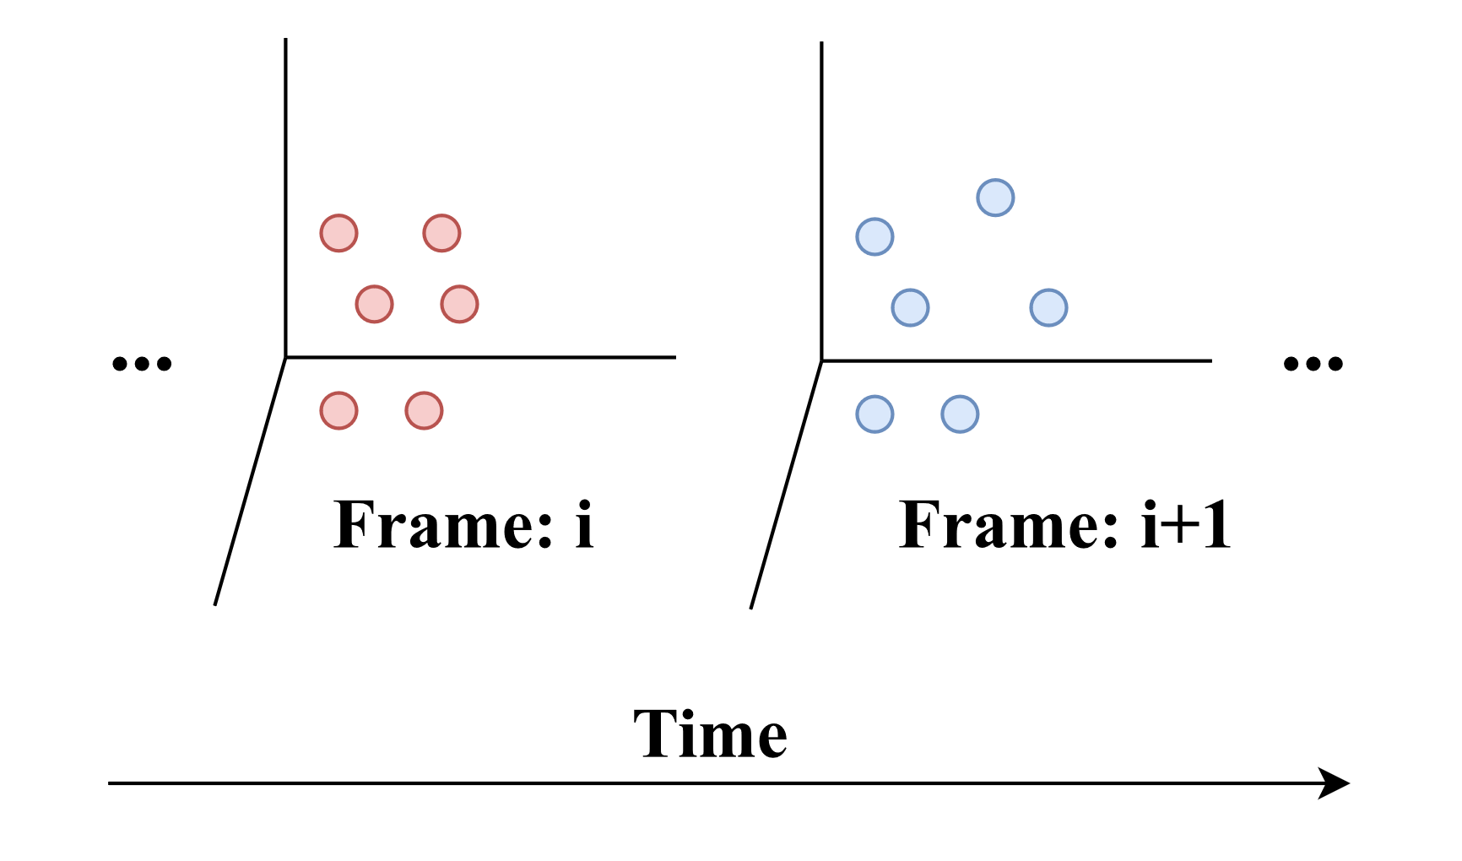
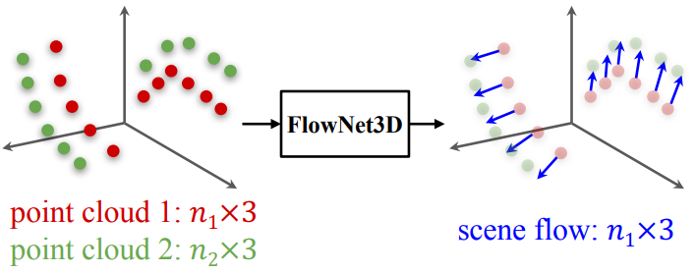
Point Cloud Interpolation
Use consecutive frames to generate intermediate frame to improve frame rate
Nearest-point query (KD-tree)
Mid-point prediction
Scene flow estimation [5]
Rely on complete frame
[5] Liu X, Qi C R, Guibas L J. Flownet3d: Learning scene flow in 3d point clouds[C]//Proceedings of the IEEE/CVF Conference on Computer Vision and Pattern Recognition. 2019: 529-537.

Slide 17
Problem

Slide 18
Measurements of LiDAR
LiDAR samples evenly in horizontal and vertical directions
Calculate distance by the response time of reflected laser
We can transform $p.β$, $p.γ$, and $p.r$ into $p.x$, $p.y$, and $p.z,$ mutually
We can know the orientation of each point before scanning!
Notes:
CHECK POINT #1

Slide 19
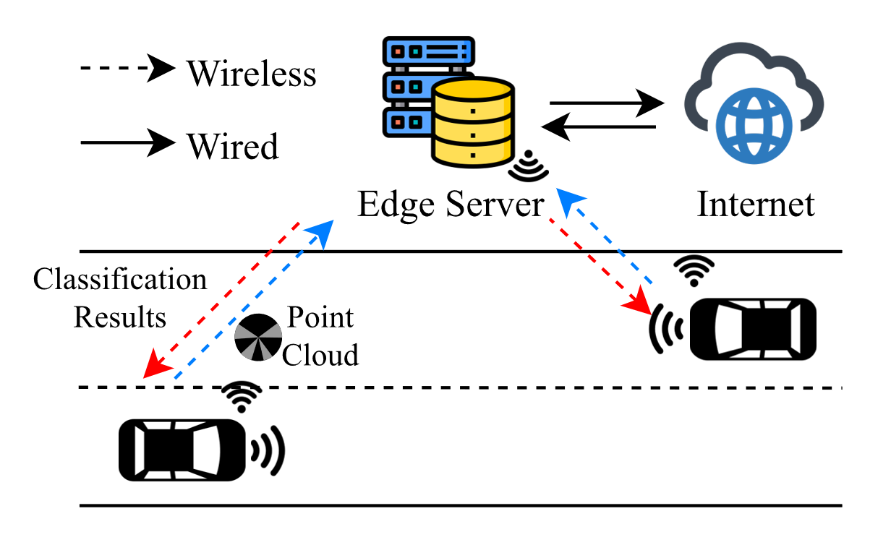
Problem Statement
A complete frame $f_{i}$ is split into multiple equal-size sectors $s_{i,j}$ for transmission
Each sector is encapsulated in one packets before being streamed
Packet loss will cause sector loss
Our usage scenarios

Slide 20
SOLUTIONS

Slide 21
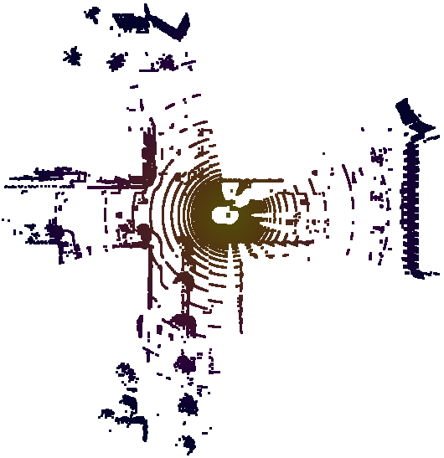
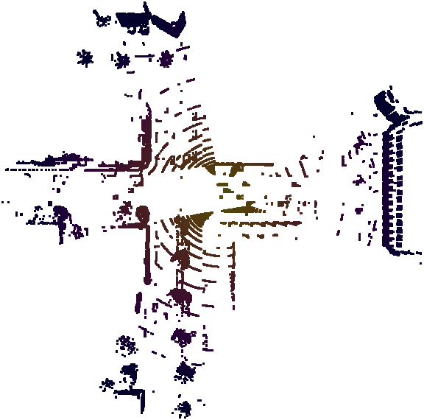
System Overview
Original
Decoded
Ground removal
RANSAC (Random Sample Consensus) [6]
Encoder/Decoder
Draco [7]
Classifier
Object detection [8]
[6] Fischler M A, Bolles R C. Random sample consensus: a paradigm for model fitting with applications to image analysis and automated cartography[J]. Communications of the ACM, 1981, 24(6): 381-395.
[7] Google. Draco (3D DATA COMPRESSION), 2023. https://github.com/google/draco
[8] Shi S, Wang X, Li H. Pointrcnn: 3d object proposal generation and detection from point cloud[C]//Proceedings of the IEEE/CVF conference on computer vision and pattern recognition. 2019: 770-779.

Slide 22
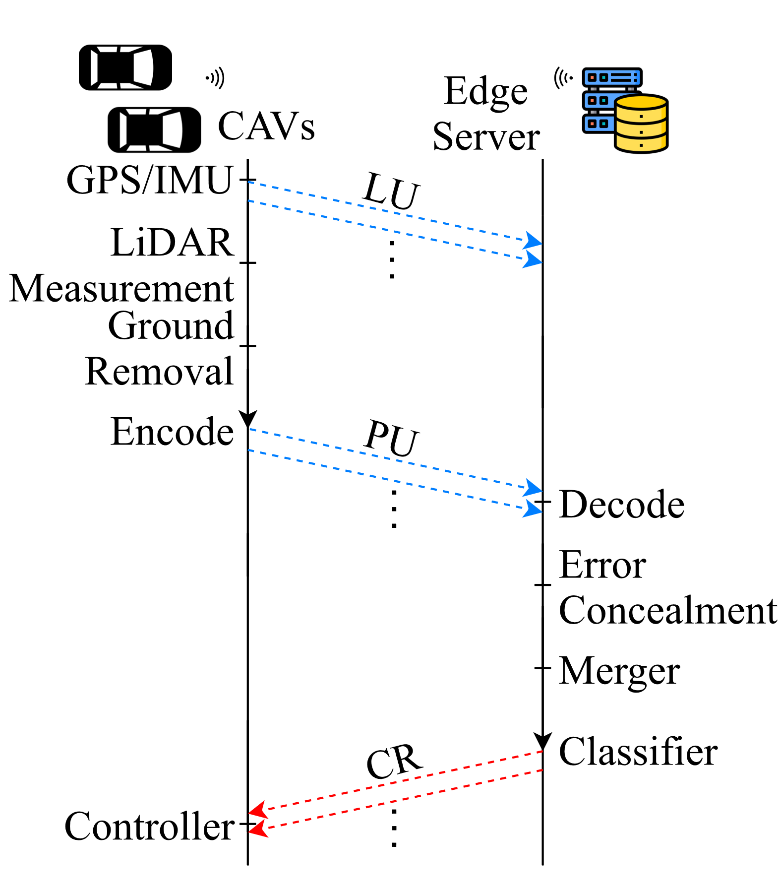
Message Types
Location Update (LU): reports the latest LiDAR center location from GPS and IMU
Point Update (PU): contains the point clouds of a sector, which is sent once the points in that sector are encoded
Classification Result (CR): contains the classification outcomes produced at the edge server

Slide 23
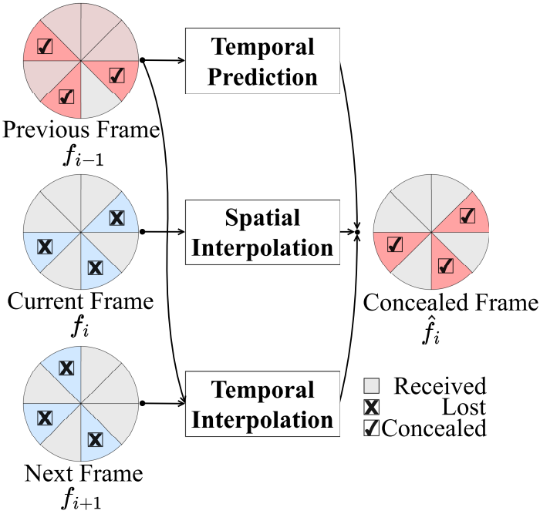
Error Concealment Approaches
Temporal Prediction (TP)
Use previous frame
Least latency
Spatial Interpolation (SI)
Use incomplete current frame
Highest applicability
Temporal Interpolation (TI)
Use previous and next frames
Richest information
1
2
3
Previous frame always complete!

Slide 24
Temporal Prediction (TP)
Selectively copies points from sectors of previous frame to conceal the lost sectors of current frame.
Copyover Prediction (CP):
Let $\hat{s} _{i,j}$ =${ s}_{i−1,j}$, for any lost sector $s_{i,j}$
Motion-compensated Prediction (MP):
Consider the location/orientation difference between LiDARs
Let $M_{i}$ be the transformation matrix from $f_{i−1}$ to $f_{i+1}$
Let $\hat{s} _{i,j}$= $s_{i−1}M_{i}$, for any lost sector $s_{i,j}$

Slide 25
Spatial Interpolation (SI)
Employs the points in the current frame to estimate the measured distance $p.r$ for every given pitch $p.β$ and yaw $p.γ$
Nearest Neighbor (NN):
Find the closest point $p^{∗}$ from all received sectors for each point of lost sector $s_{i,j}$
Let $p.r$ = $p^{∗}.r$
Least Square (LS):
Fit all received points in frame $f_{i}$ to $p.r=w_{1}p.β+ w_{2}p.γ+ w_{3}$
Use this equation to estimate $p.r$ for all points in lost sectors $s_{i,j}$

Slide 26
Temporal Interpolation (TI) (1/2)
Analyze frames $f_{i−1}$ and $f_{i+1}$ to locate the closest point, using each pair of points to conceal the lost sectors
Point Matching (PM):
Find the closest point in $f_{i+1}$ for each point in $f_{i−1}$. Each pair of points is used to estimate a point in the concealed frame $f_{i}$
Iterative Closest Point (ICP):
Compute a transform matrix from $f_{i−1}$ to $f_{i+1}$, denoted as ${M′}_{i}$
Let ${M′′}_{i}$ be the transformation matrix that shifts/rotates half of the displacement/angles of ${M′}_{i}$
Any lost sector $s_{i,j}$ can be concealed by $\hat{s} _{i,j}= s_{i−1,j}{M′′}_{i}$

Slide 27
Temporal Interpolation (TI) (2/2)
Scene Flow (SF):
Use FlowNet3D [9] to compute scene flows from $f_{i−1}$ to $f_{i+1}$, denoted as ${M′}_{i}$
Let ${M′′}_{i}$be the transformation matrix that shifts/rotates half of the displacement/angles of ${M′}_{i}$
Any lost sector $s_{i,j}$ can be concealed by $\hat{s} _{i,j}= s_{i−1,j}{M′′}_{i}$
Bidirectional Scene Flow (BSF):
Use PointINet [10] computes scene flows from $f_{i−1}$to $f_{i+1}$ and $f_{i+1}$ to $f_{i−1}$
Fuses the two temporally interpolated frames
[9] Liu X, Qi C R, Guibas L J. Flownet3d: Learning scene flow in 3d point clouds[C]//Proceedings of the IEEE/CVF Conference on Computer Vision and Pattern Recognition. 2019: 529-537.
[10] Lu F, Chen G, Qu S, et al. Pointinet: Point cloud frame interpolation network[C]//Proceedings of the AAAI Conference on Artificial Intelligence. 2021, 35(3): 2251-2259.

Slide 28
LiDAR Error Concealment (LEC)
Adaptively apply one of the three concealment approaches (TP, SI, TI) by incomplete ratios
Determining the cut-off thresholds is no easy task
Using ML algorithms
Decision Tree (DT)
Support Vector Machine (SVM)
Random Forest (RF)
Using machine learning algorithms as our decision model
Incomplete Ratios: packet loss rates of previous, current, and next frames
Notes:
CHECK POINT #2

Slide 29
Experimental Setup

Slide 30
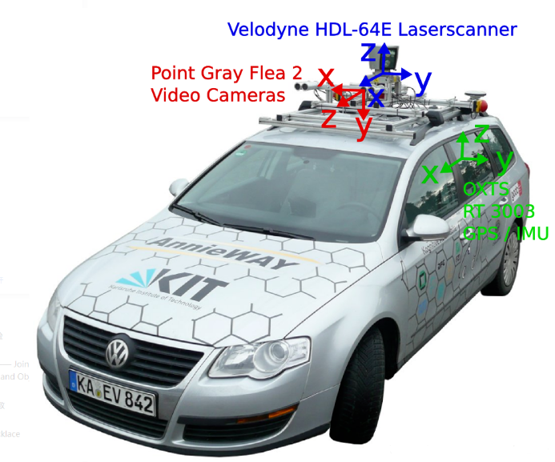
Pre-recorded dataset
KITTI Odometry Dataset
Captured in real life
Only one LiDAR-equipped for each sequence
Not propose object detection labels
Can not reflect interactions among nearby vehicles
For 3-vehicles evaluation:
Duplicate trajectory in sequence 0 three times
Time-shift it by 10 and 20 seconds to create a 3-vehicle dataset
Use 4071 frames from sequence 8 for LEC model training

Slide 31
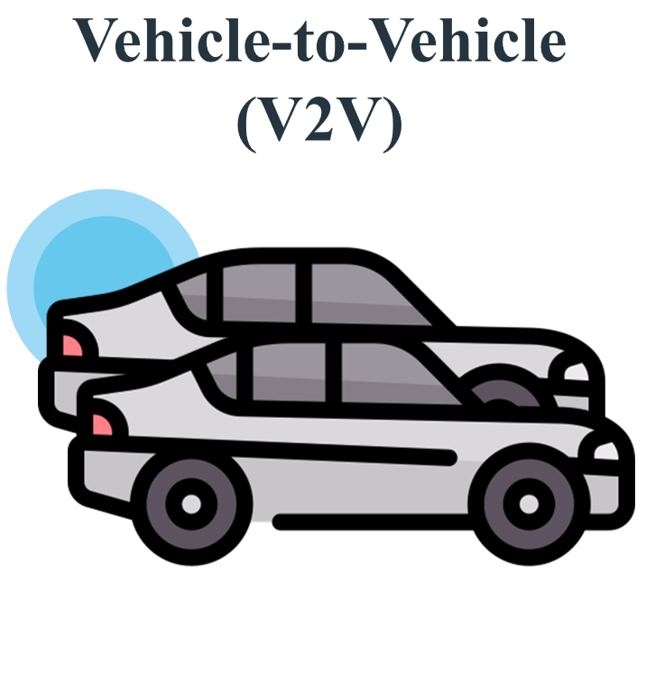
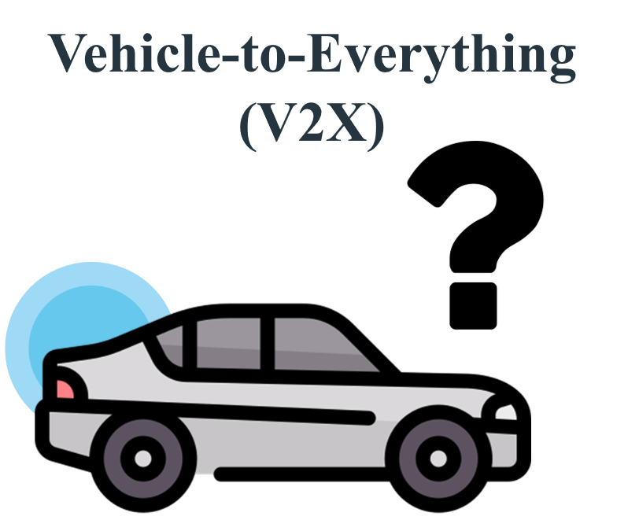
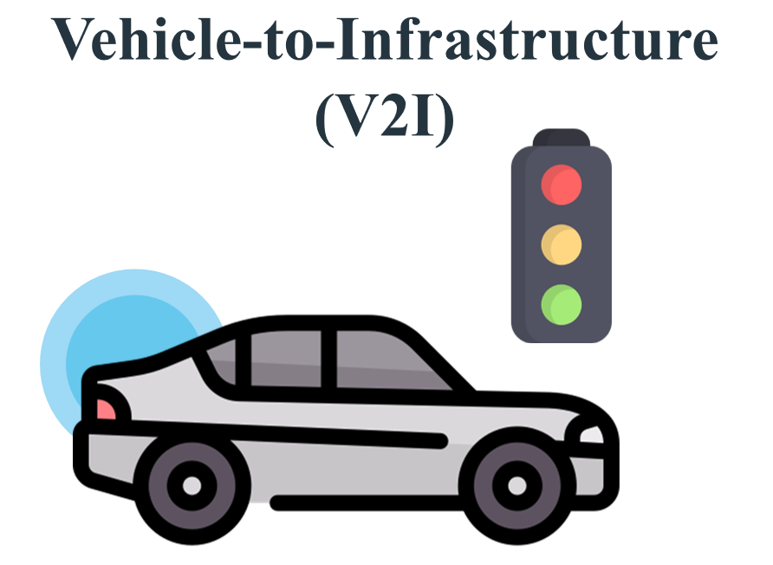
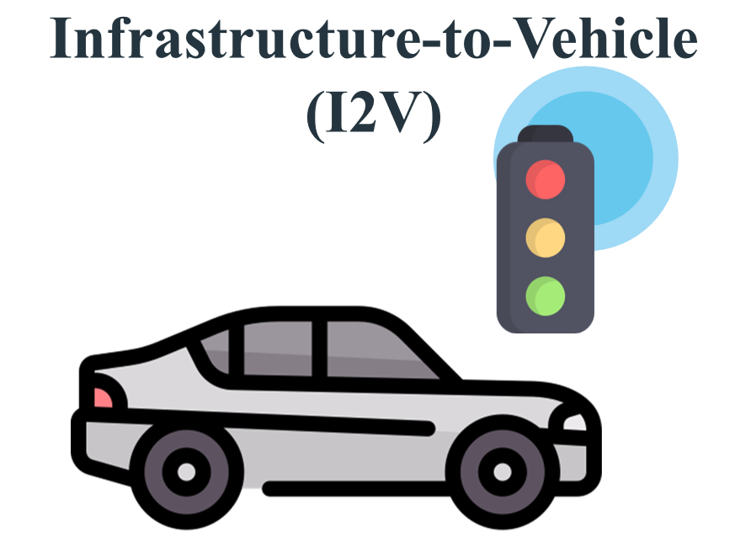
Co-Simulator
We designed and implemented a co-simulator to evaluate our error concealment algorithms:
CARLA
NS-3
ZeroMQ
Our co-simulator support:
Real-time KITTI-compatible and Semantic3D-compatible ground truth frames
V2V, V2X, V2I, I2V, etc. communication modes
Multiple network protocol, 5.9GHz DSRC, and NR C-V2X

Slide 32
Workflow of Co-Simulator (1/2)

Slide 33
Workflow of Co-Simulator (2/2)
CARLA
ZMQ
NS-3

Slide 34
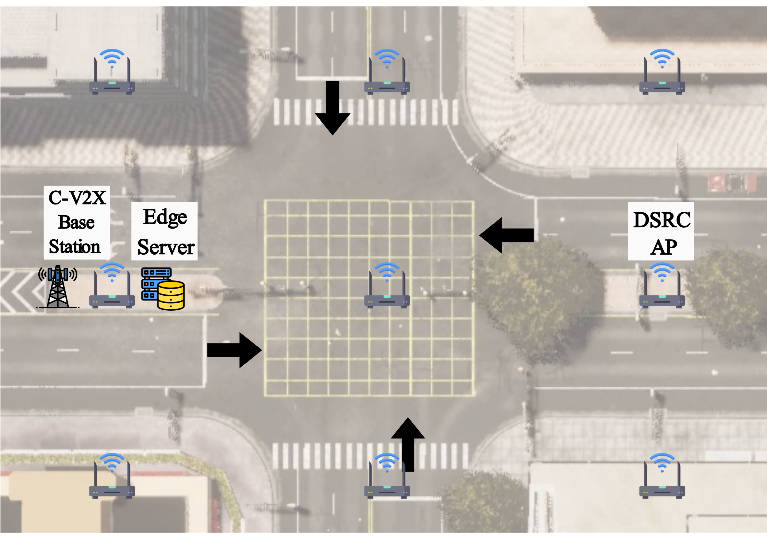
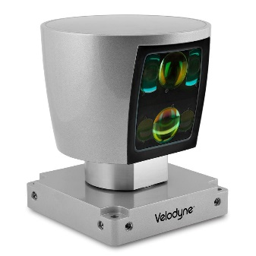
Experimental Setup
Datasets:
Co-simulator
KITTI Odometry (real-life)
Networks:
NR C-V2X:
Station next to the edge server
DSRC:
APs separated by 20 m
Vehicles:
{1, 3, 5, 7}
Velodyne HDL-64E S2 (Ψ=2°)
Benchmark:
Optimal (OPT): selects the smallest Chamfer distance among all TP, SI, and TI algorithms
We repeat each simulation 10 times and report the average results from a random vehicle.

Slide 35
Performance Metrics
Low-Level
Chamfer distance (m): The average shortest distance between the points in the target and ground truth frame
Hausdorff distance (m): The maximal shortest distance
High-Level
Intersection-over-Union (%): We use the pre-trained PointRCNN [9] to detect vehicles in front of CAVs
Detection Accuracy (%): The fraction of detected vehicles
Running Time (s)
The lower the better
The higher the better
The lower the better
We include 95% confidence intervals whenever possible.
[9] Shi S, Wang X, Li H. Pointrcnn: 3d object proposal generation and detection from point cloud[C]//Proceedings of the IEEE/CVF conference on computer vision and pattern recognition. 2019: 770-779.

Slide 36
Results

Slide 37
Training of LEC algorithm (1/2)
Use our co-simulator to generate 10,000 consecutive frames and randomly simulate packet loss rates between 0% - 100% for each frame
Carry out 5-fold cross-validation to find the best hyperparameters
80% of the frames are used for training and 20% for validation
Decision Tree (DT)
maximal tree depth: {1, 5, 10, 15, 20}
Support Vector Machine (SVM)
Kernel: {linear, poly, rbf, sigmoid, precomputed}
Regularization: {1, 5, 10, 25, 20}
Random Forest (RF)
maximal tree depth: {1, 5, 10, 25, 20}
number of trees: {10, 50, 100, 150, 200}

Slide 38
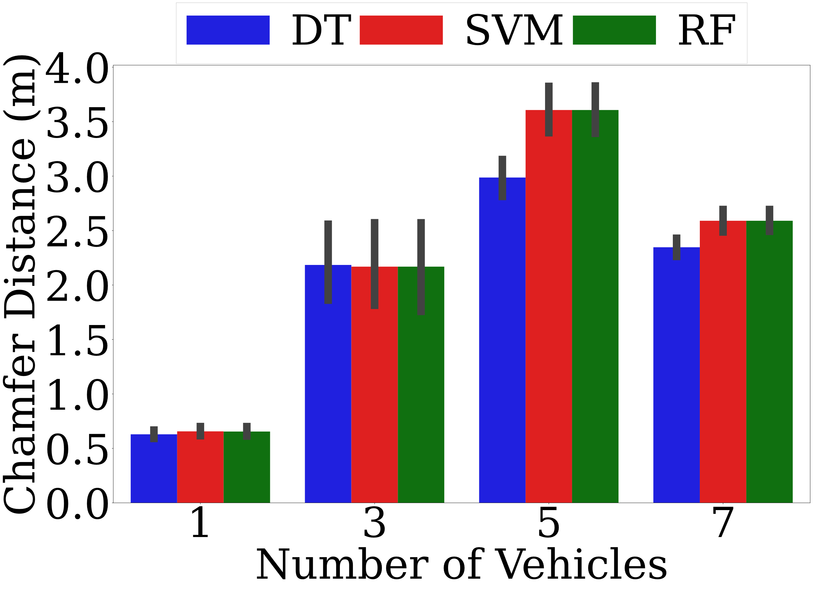
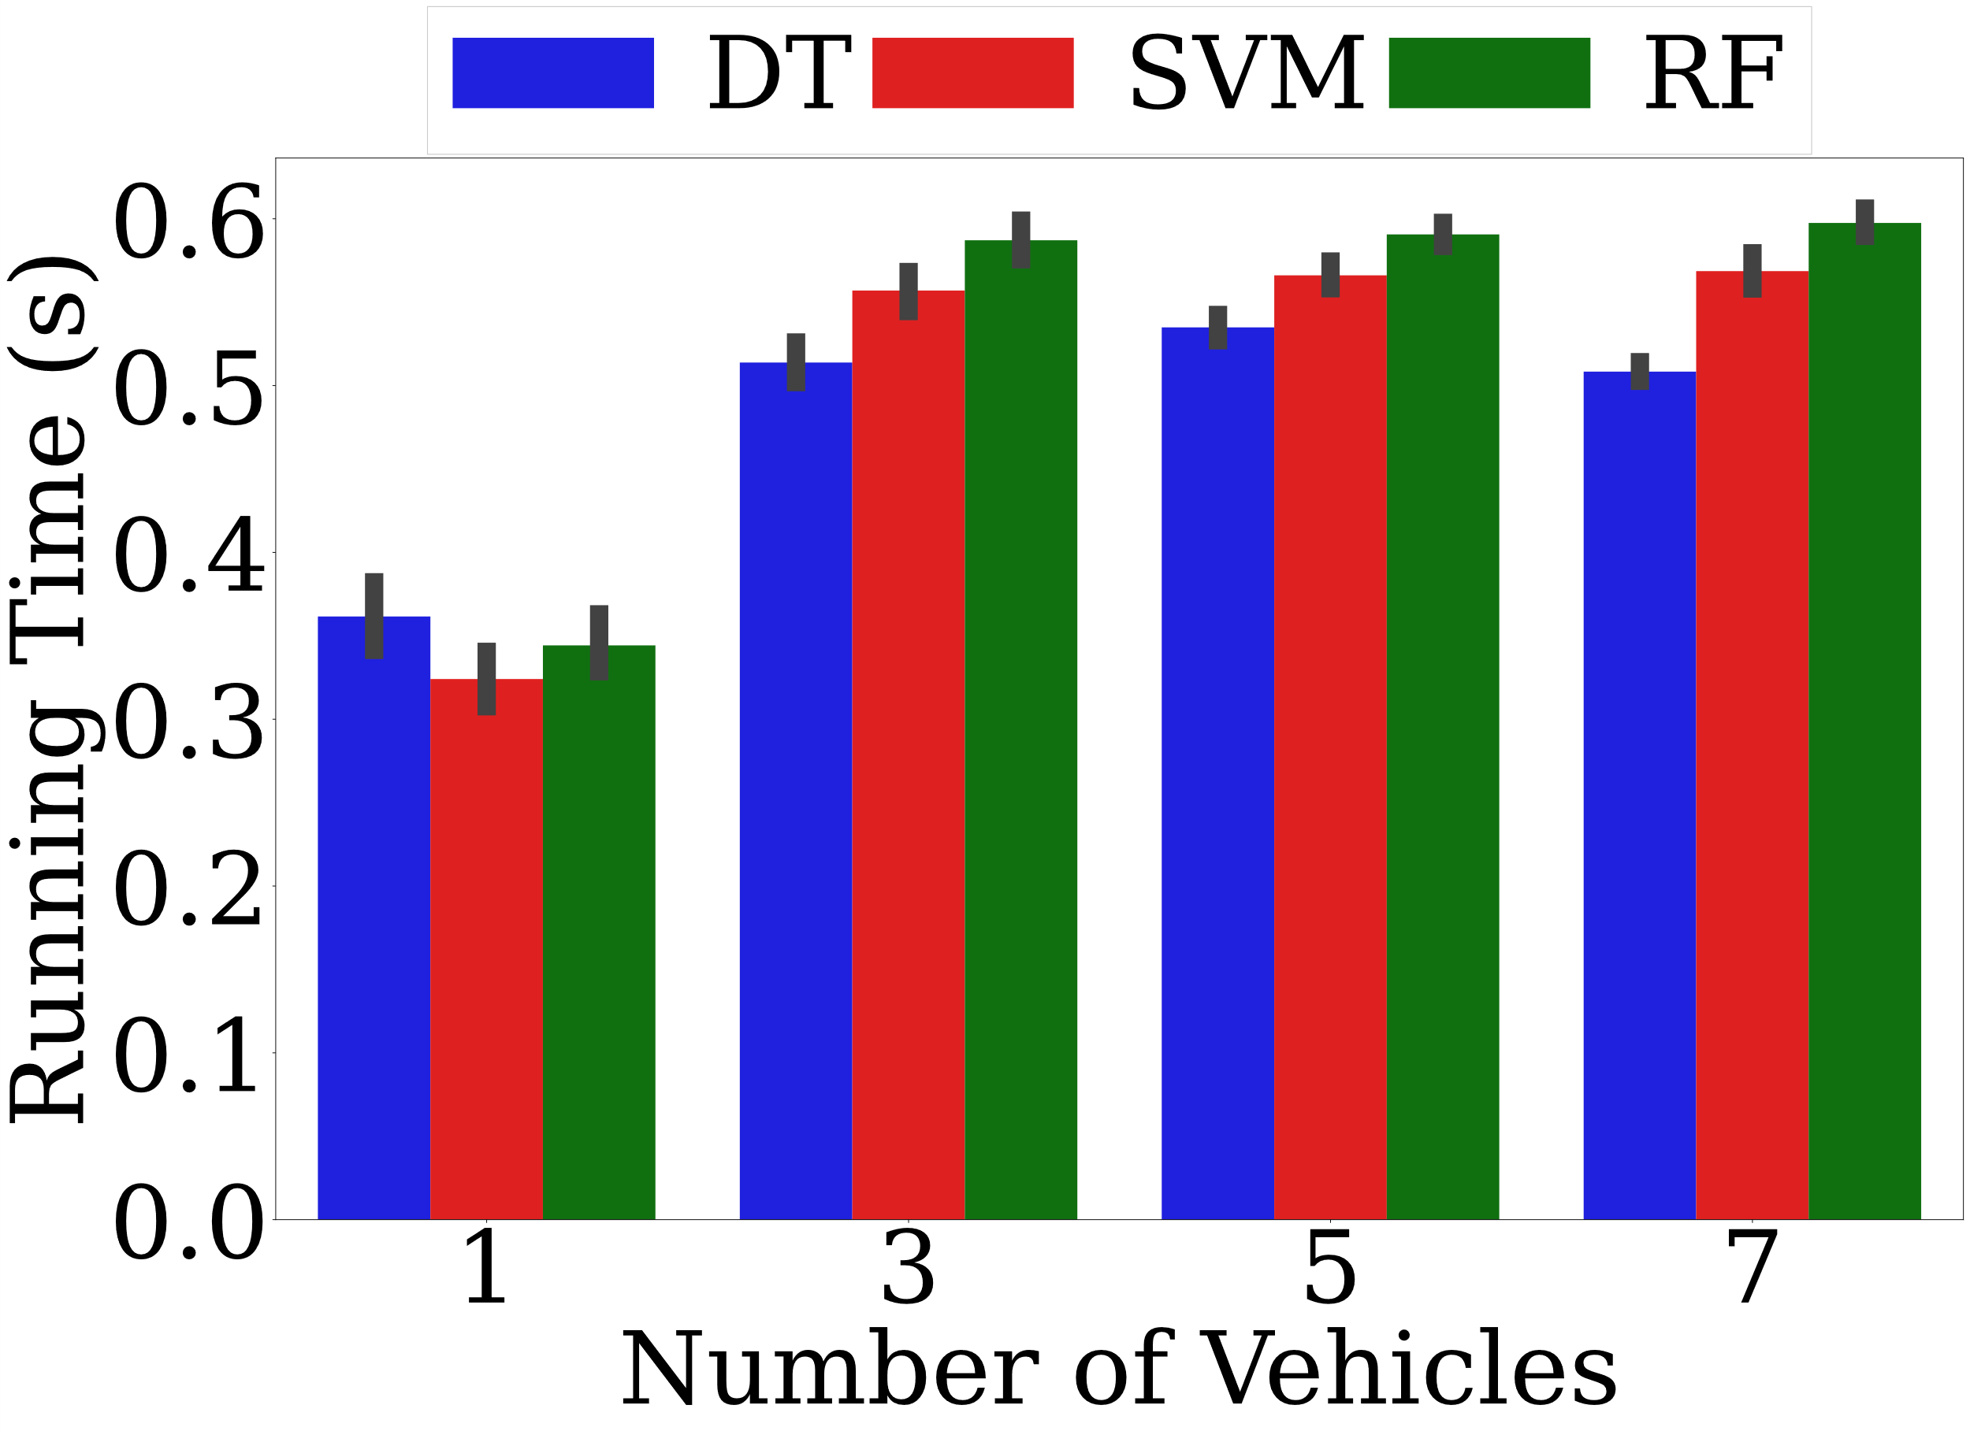
Training of LEC algorithm (2/2)
DT outperforms both SVM and RF by up to 17.17%, and can save 10.53% and 15.00% running time
Adopts DT as the decision model
38

Slide 39
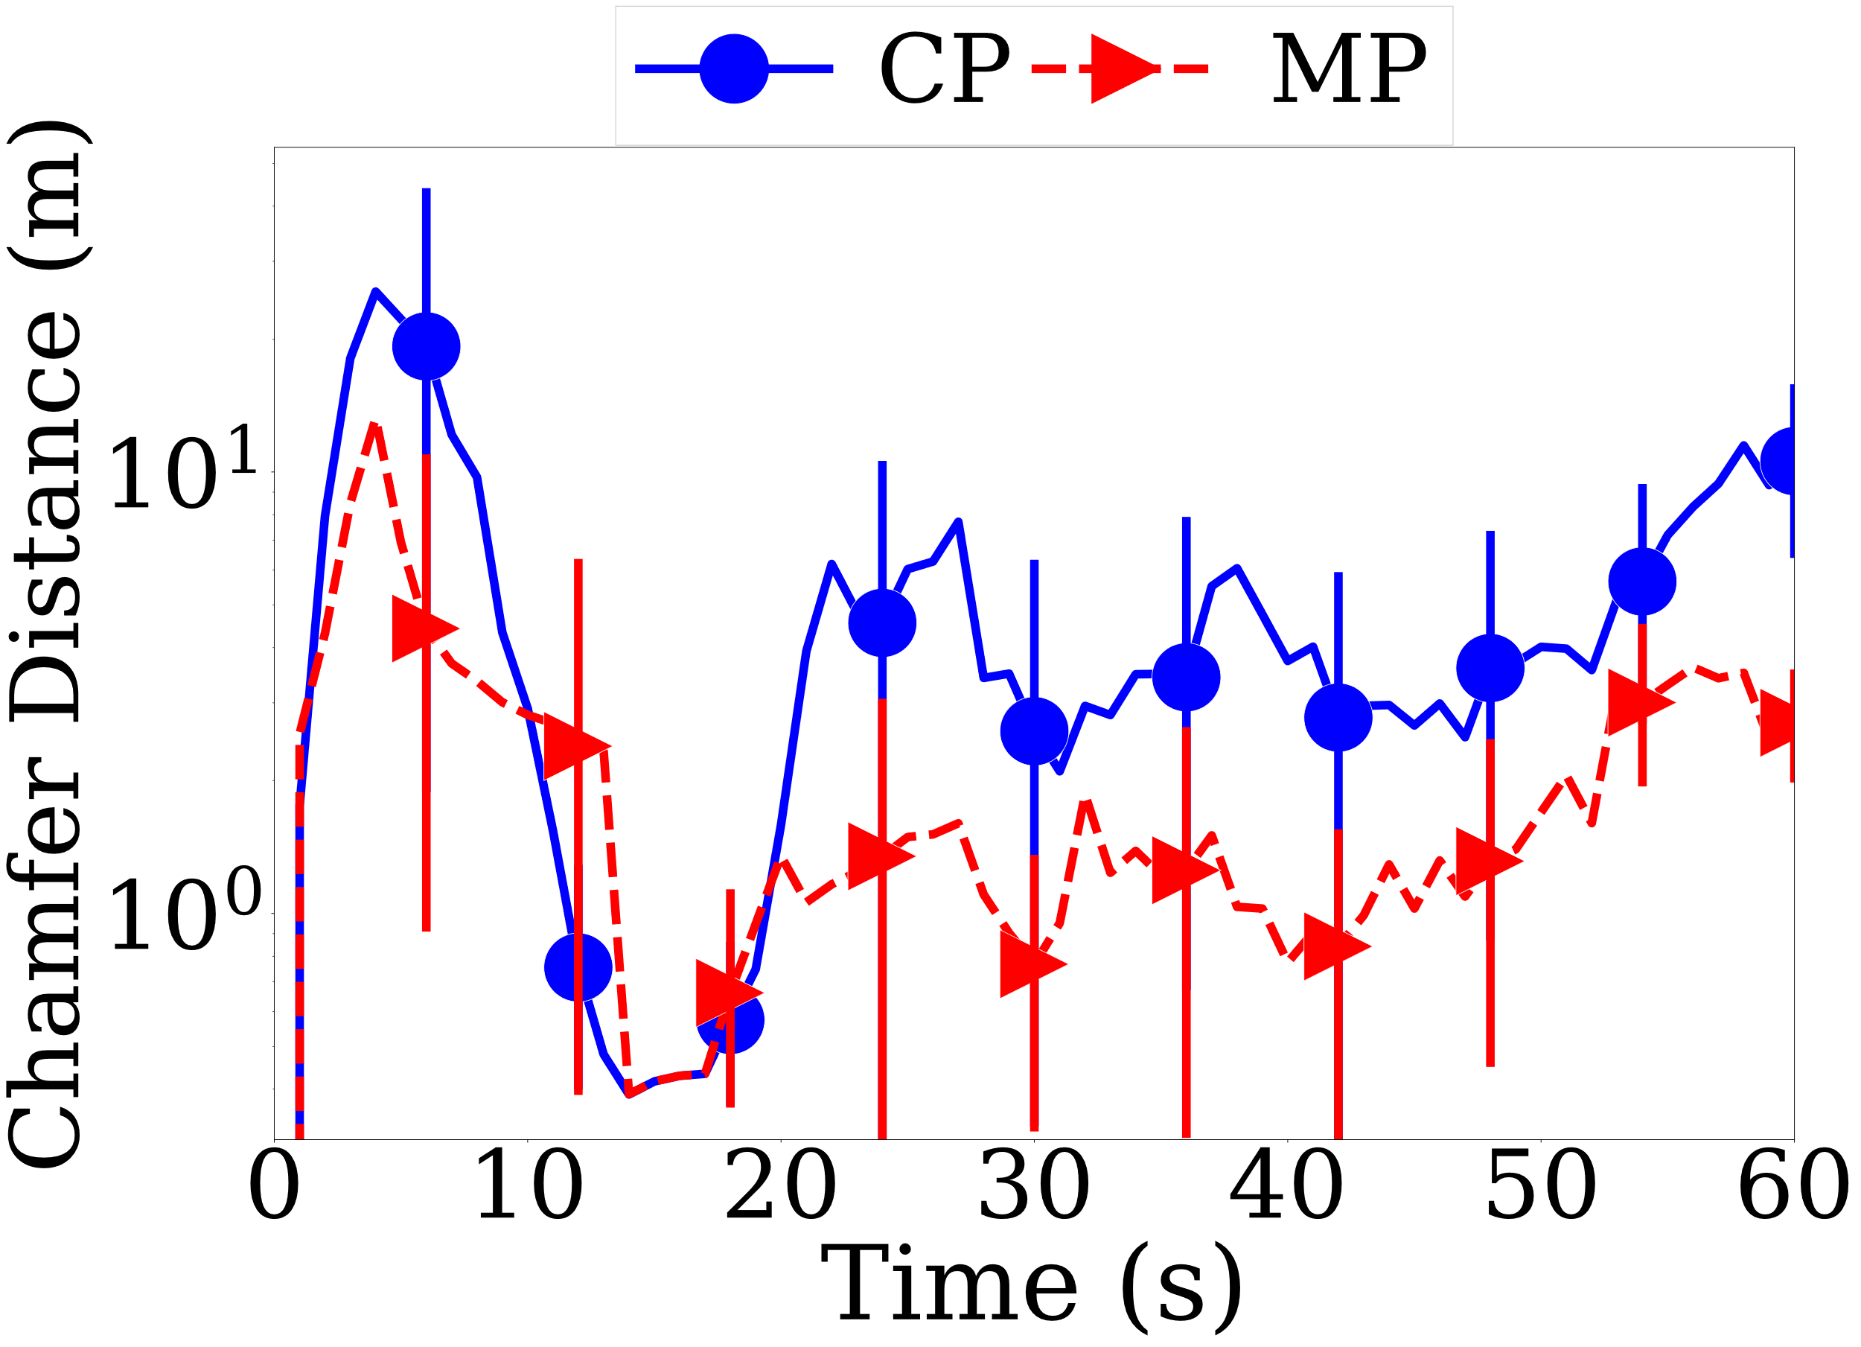
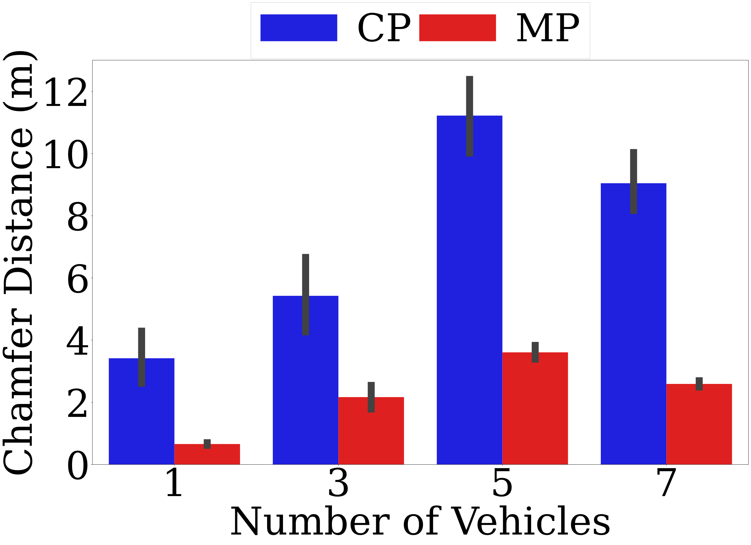
Design decision of concealment approaches (1/3)
CP reduce the Chamfer distance by up to 73.28% compared to MP
We recommend using MP in TP approach
39

Slide 40
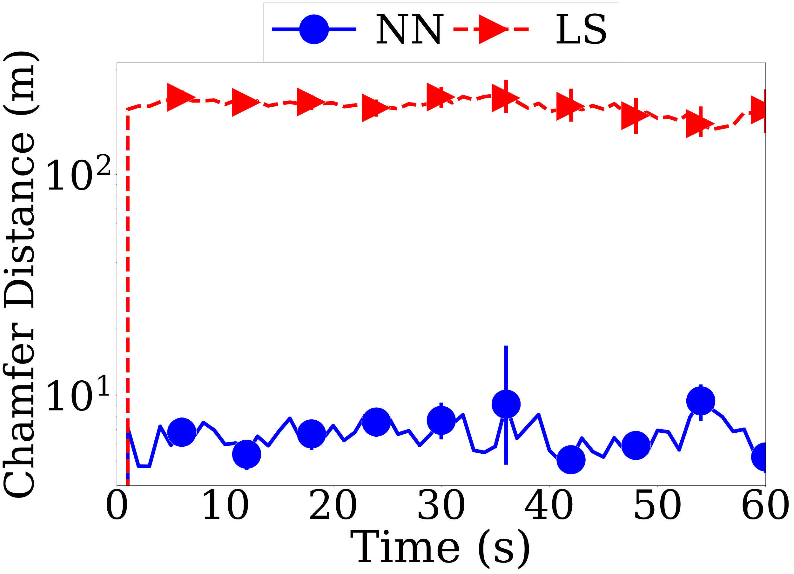
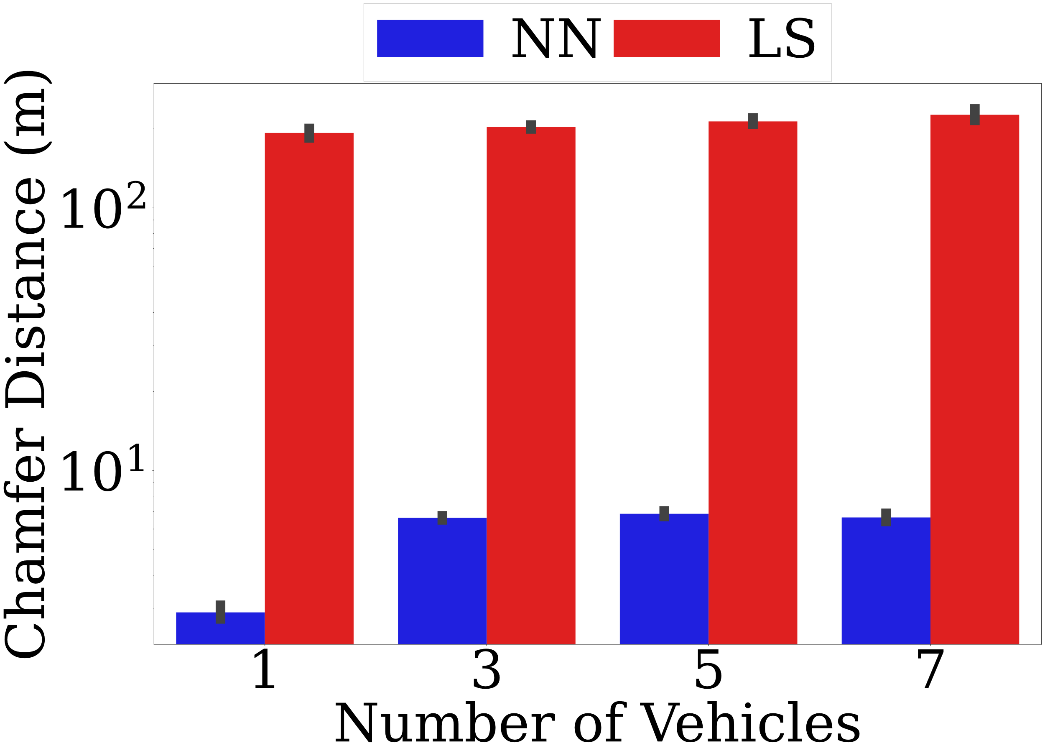
Design decision of concealment approaches (2/3)
NN reduce the Chamfer distance by up to 98.48% compared to LS
We recommend using NN in SI approach
40

Slide 41
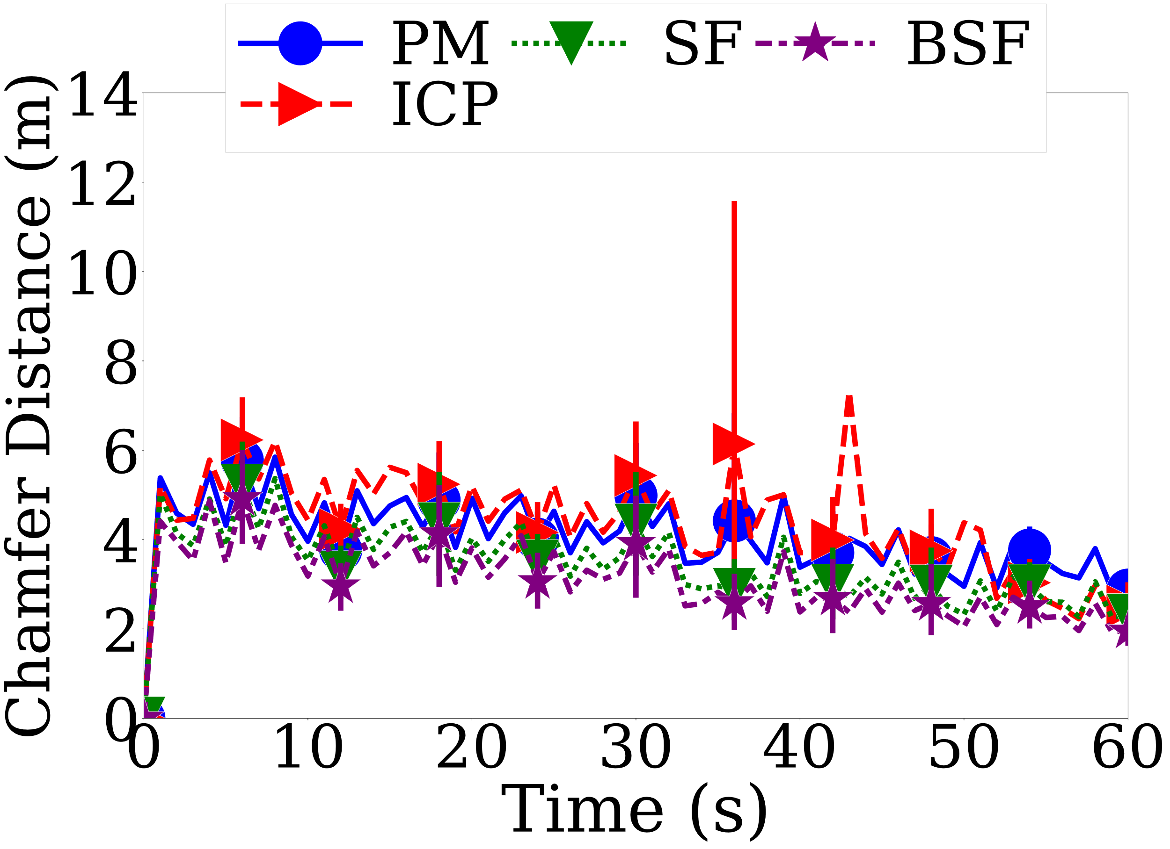
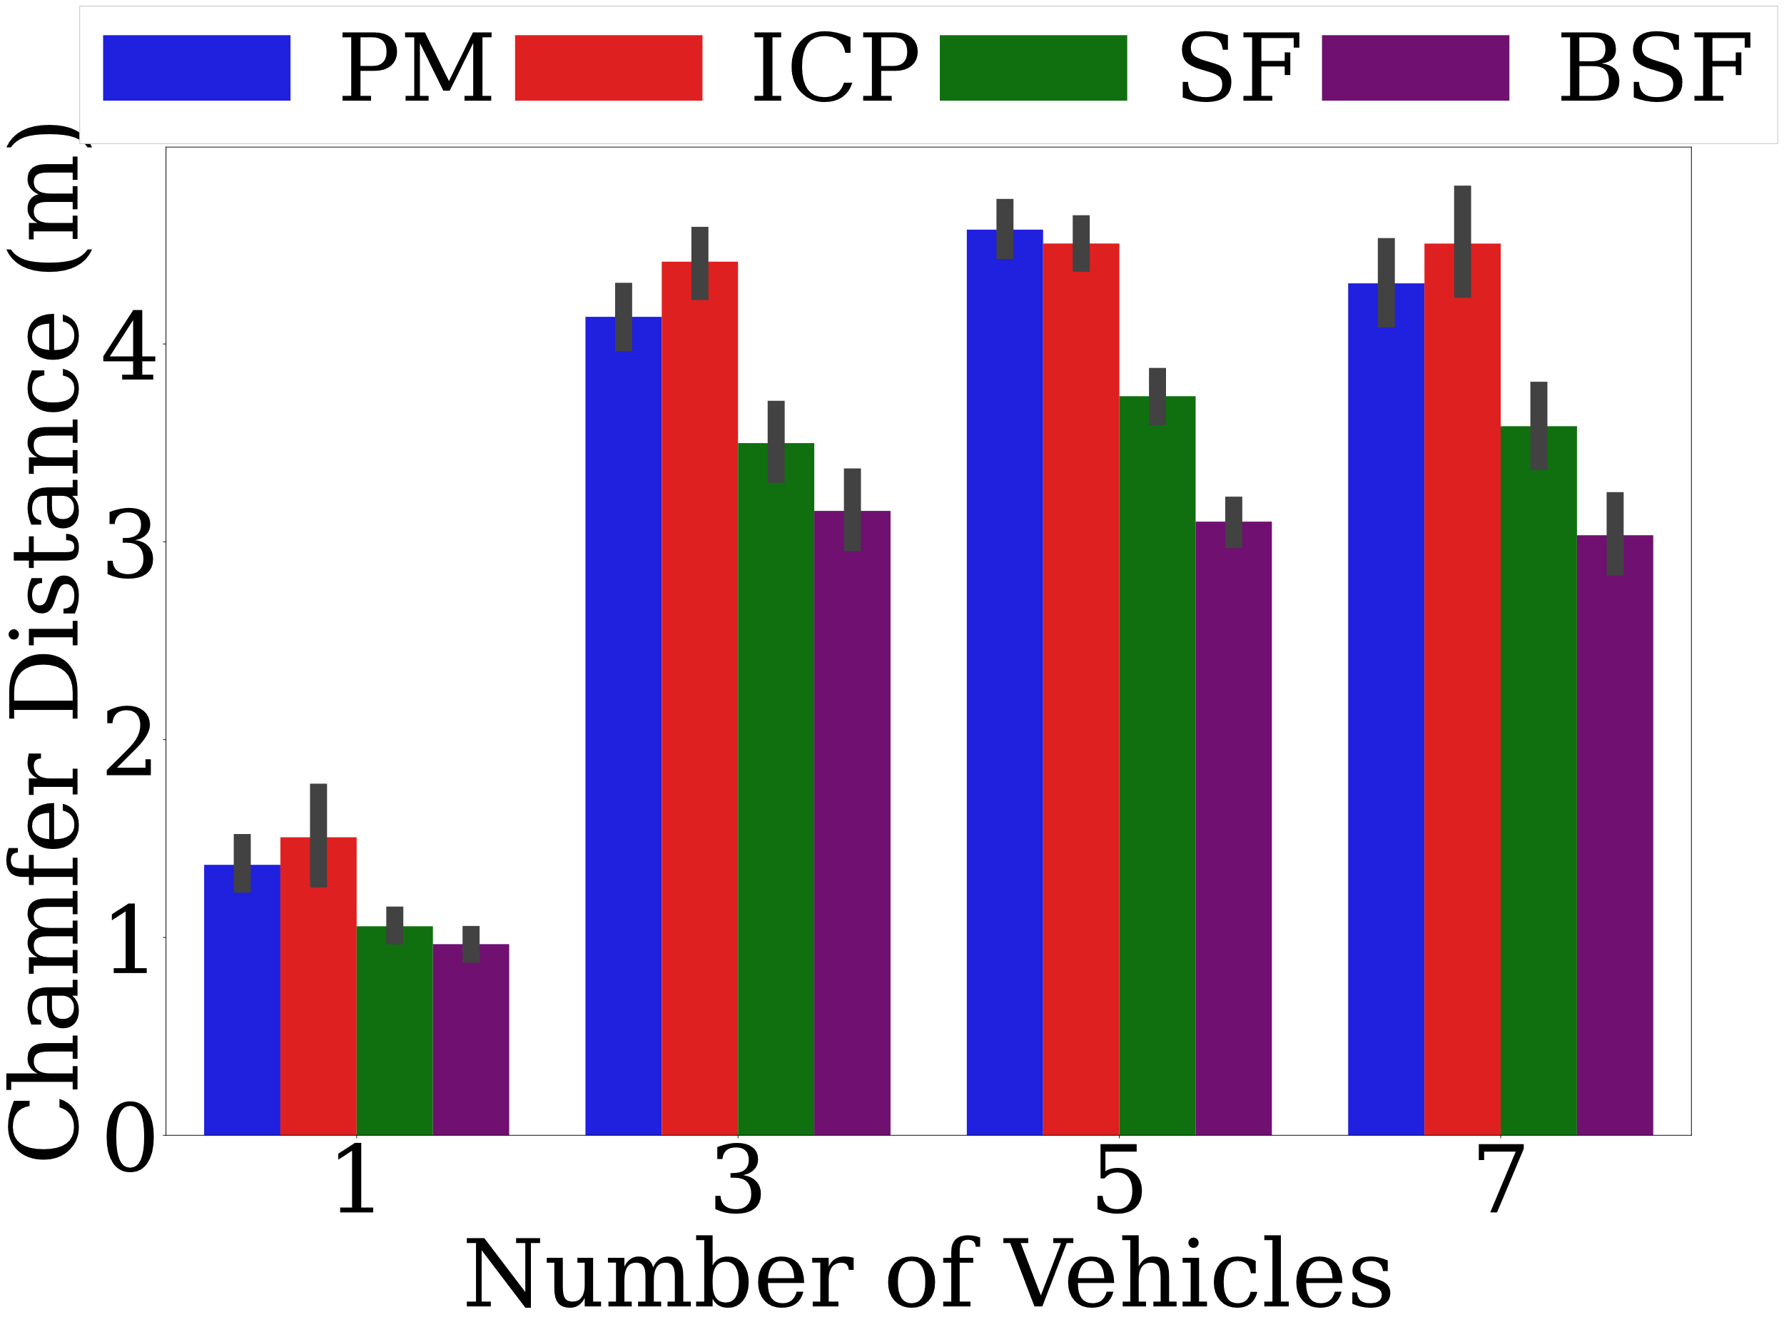
Design decision of concealment approaches (3/3)
BSF reduce the Chamfer distance by up to 71.48% compared to other algorithms in TI approach.
We recommend BSF in TI approach
41

Slide 42
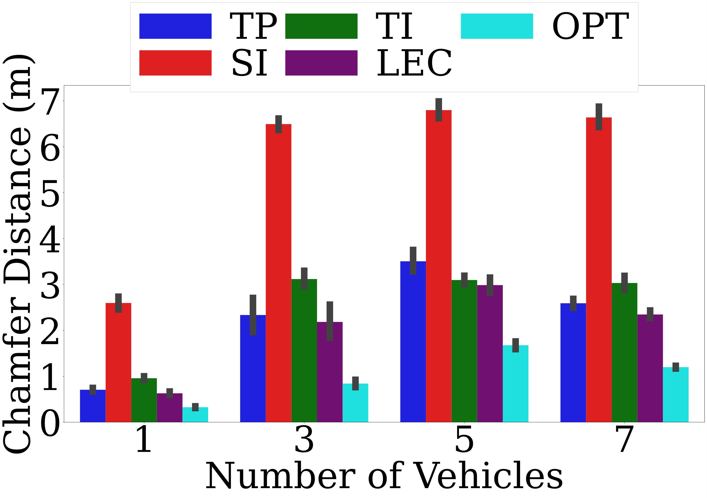
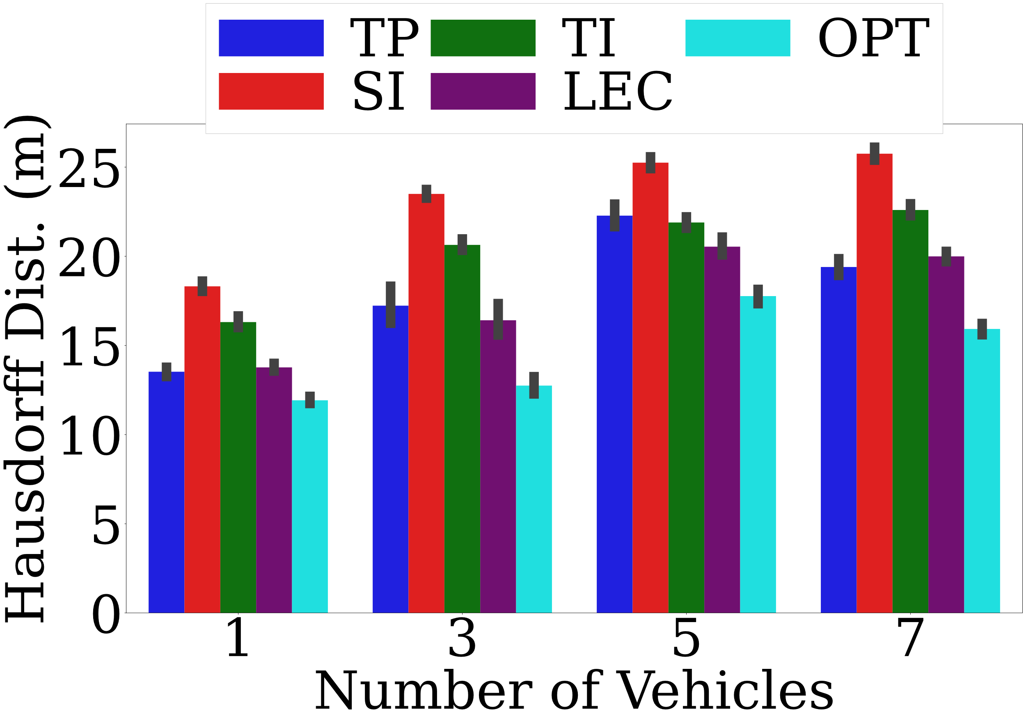
Low-level Performance of LEC with the co-simulator dataset.
Our LEC algorithm:
Reduce the Chamfer distance by up to 75.77%
Cuts the Hausdorff distance by up to 30.17%
With a small gap of at most 25.55% in Hausdorff distance

Slide 43
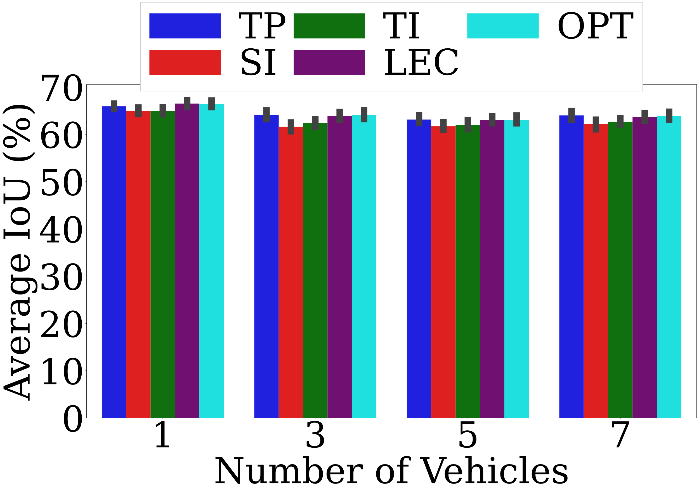
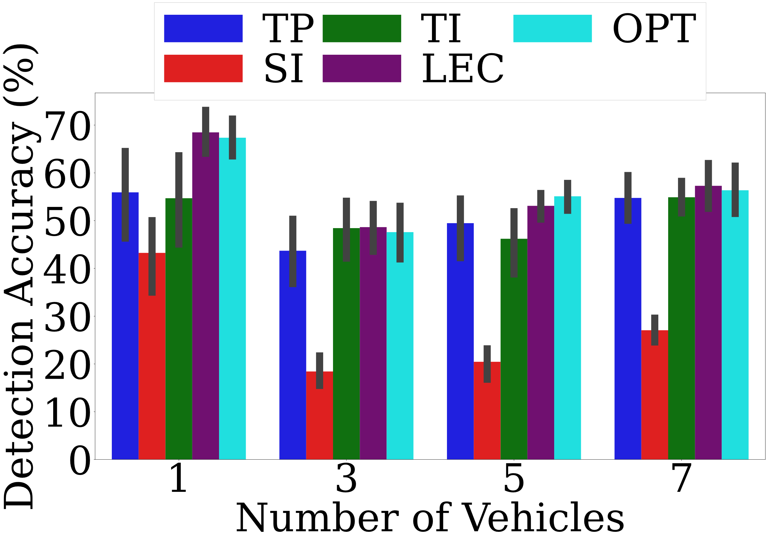
High-level Performance of LEC with the co-simulator dataset.
Our LEC algorithm:
Improves the detection accuracy by at most 33.31%
With a tiny gap of at small as 0.75% than OPT in detection accuracy
With a small gap of at most 0.04% than OPT in average IoU

Slide 44
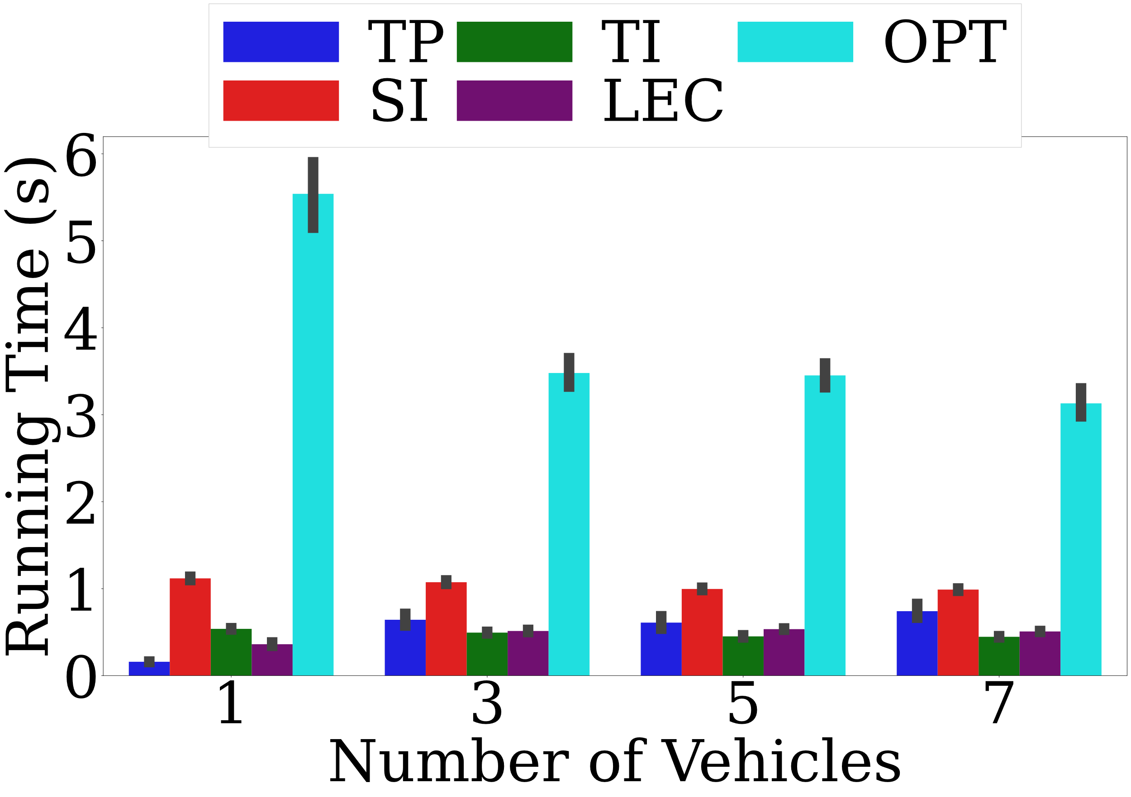
Running Time of LEC with the co-simulator dataset.
Our LEC algorithm terminates in 360-570 ms throughout our evaluations.
Our LEC algorithm can run faster and achieves small gaps from OPT
The running time of OPT is underestimated!

Slide 45
Performance of LEC in a DSRC network
Compared to C-V2X, DSRC network often causes longer inter-packet intervals
Our LEC algorithm outperforms TP, SI, and TI in Chamfer and Hausdorff distances by 12.25%-87.43% and 2.46%-66.58%, respectively.

Slide 46
Performance of LEC in pre-recorded KITTI dataset
Our LEC algorithm
outperforms TP, SI, and TI in Chamfer and Hausdorff distances by 2.56%-92.49% and 0.58%-62.48%, respectively
saves 70.72% of the running time compared to OPT, with small gaps of 5.56% and 2.59% in Chamfer and Hausdorff distances

Slide 47
CONCLUSION & FUTURE WORK

Slide 48
Conclusion
Studied the uninvestigated problem of error concealment for dynamic LiDAR point clouds
Implemented a comprehensive co-simulator of CARLA and NS-3
NR C-V2X and DSRC networks
Proposed our LEC algorithm to adaptively select the most promising error concealment approach using an ML model.
Significantly outperform the TP, SI, TI and with a small gap for OPT
1
2
3
4

Slide 49
Future Work
1
Smarter ML models
2
3
Multi-vehicles feature extraction
Large-scale and more simulations

Slide 50
Q&A
Thank you for listening!
Thanks for the help of Prof. Hsu, Chih-Chun Wu, Ching-Ting Wang and all lab mates.
Publications:
Guihua Shi, Chih-Chun Wu, Cheng-Hsin Hsu. Error Concealment for Dynamic LiDAR Point Clouds for Connected and Autonomous Vehicles[C]//GLOBECOM 2023-2023 IEEE Global Communications Conference. IEEE, 2023. (under review)

Slide 51
Levels of Autonomous Driving vehicles

Slide 52
2D Sensor Limitations in CAVs
Limited field of view
Influence of light and weather
Lack of depth information
Recognition of dynamic objects

Slide 53
Future Work
Use smarter ML models, such reinforcement learning (RL), incremental model, etc.
Multi-vehicles feature extraction and fusion for error concealment
Transmit LU and CR messages for large-scale and more simulations
1
2
3

Slide 54
Map of Town-10
Notes:
Img:
https://carla.readthedocs.io/en/latest/map_town10/

