Slide 1


A Multi-Tenant System for Deploying Deep Neural Networks in a
Thing-to-Cloud Continuum
NMSL@NTHU
Networking and Multimedia Systems Lab
Chia-Ying Hsieh
cyinghsieh@gmail.com
Advisor: Cheng-Hsin Hsu
Networking and Multimedia Systems Lab, CS, National Tsing Hua University
Notes:
提供一個系統 他可以決定ＤＮＮ layer 跑在哪裡 來最大化服務用戶數量

Slide 2
Outline
Motivations
Challenges & Goal
Related Work
System Overview
Planning Phase
Operation Phase
Implementations
Evaluations
Conclusion & Future Work

Slide 3
Motivations

Slide 4
Numbers of IoT Sensors are Growing Rapidly
“By 2025, there will likely be more than 27 billion IoT connections.” [1]
The data generated from the sensors need to be analyzed to export the information
  IoT analytics are needed
  DNNs are popular for analyzing data
[1] Satyajit Sinha. (2021) State of IoT 2021: Number of connected IoT devices growing 9% to 12.3 billion globally, cellular IoT now surpassing 2 billion. [Online]. Available: (https://iot-analytics.com/number-connected-iot-devices/)
Notes:
愈來愈多sensor被佈建在我們的生活日常中，比如十字路口的監視器、老人院裡的motion sensor、水裡的酸鹼值偵測器等等
Sensor產生的資料需要經過ioT analytics的分析才能變成人類用得了的資訊
深度神經網路常被用在實作iot analytics來達到智慧分析

Slide 5

DNN Deployment Problem
Thing-to-Cloud Continuum
Deploying DNN
  On IoT device: computing latency
  On cloud server: transmission latency
DNN deployment decision becomes a key research problem to guarantee the Quality-of-Service (QoS) of IoT analytics
  Trade-offs between analytics accuracy, computation and transmission latencies, network overhead, etc.
Cloud
Edge
Thing
Computing
Latency
Notes:
深度神經網路需要龐大的運算資源
在哪裡執行它就變成了一個研究問題
放在iot可能因為運算資源不足導致運算延遲過長
都放到cloud的話可能因為資料量太大反而造成trans lat上升
在如今的infrastructure常見的thing-to-cloud continuum中，也就是包含iot dev, edge server以及cloud server的架構下，愈往上com lat愈低，但trans lat就會愈高
在這樣的架構下決定ＤＮＮ應該怎麼被deploy才能達到最好的performance

Slide 6
Goals and Challenges

Slide 7
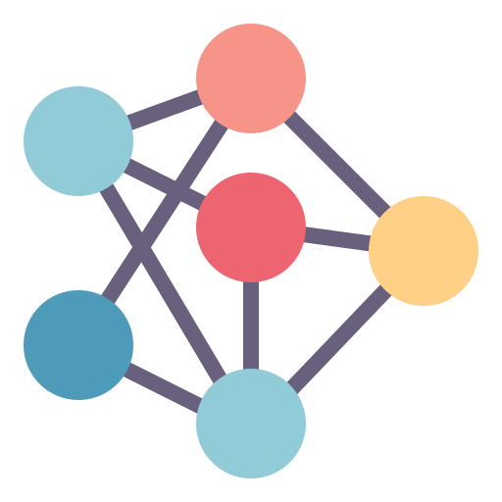

Goals and Challenges
Goals
  Maximize # served requests
  Dynamically choose, deploy, monitor, and control IoT analytics under resource constraints
Challenges
  Limited resources
  Diverse QoS requirements
  Different request arrival patterns
  Dynamic environments
Notes:
為了因應iot sensor以及iot analytics需求的上升，我們需要一個可以最大化服務的req數量的系統，這個系統會動態決定哪些ＤＮＮ應該被佈建 怎麼deploy deploy後表現的怎麼樣

Slide 8



Observations
Multiple analytics could share the same sensor data or even some common prefix layers of their DNNs
Notes:
十字路口的應用可能都是分析同一個監視器的資料
ＤＮＮ前半部feature extration的layers，比方說把人跟車抓出來這樣的部分，是一樣的

Slide 9




Proposed Thing-to-Cloud (T2C) System Features
Limited resources
Diverse QoS requirements
Different request arrival patterns
Dynamic environments
Multi-task [ML’97]
Early exit [ICPR’16]
Hitchhiking
Reconfiguration [CC’14]
[ML’97] R. Caruana. Multitask learning. Springer Machine Learning, 28(1):41–75, July 1997.
[ICPR’16] S. Teerapittayanon, B. McDanel, and H. Kung. Branchynet: Fast inference via early exiting from deep neural networks. In Proc. of IEEE International Conference on Pattern Recognition (ICPR’16), pages 2464–2469, Cancun, Mexico, December 2016.
[CC’14] L. Yang, J. Cao, S. Tang, D. Han, and N. Suri. Run time application repartitioning in dynamic mobile cloud environments. IEEE Transactions on Cloud Computing, 4(3):336–348, September 2014.
Notes:
四個challenges
首先資源受限的狀況下我們應該極力避免資源的浪費
基於剛剛說的共用的layer，我們提出使用multi-task，也就是讓一些應用共用前面的layers，來避免重複執行相同的分析
接著我們利用early exit，也就是在ＤＮＮ的架構中添加一些可以中斷的結束點，如果accuracy達到要求就可以提前結束
根據使用者需求節省不必要的資源浪費
第三個是hitchhiking，如果今天有一個新的Req進來，我們可以先檢查之前有沒有人要求過這個東西，有的話就可以利用已經在執行中的model來服務這個req
最後我們提出使用reconfiguration，也就是在ＤＮＮ被deploy之後動態的決定是否要更改決定
比方說 這個model跑到一半的時候中間這台機器overload了，我們可以把某些layer移到別的機器上來減少他的workload

Slide 10
Related Work

Slide 11
DNN-based IoT Analytics Deployment
Name | Multi-tenant | Distributed Inference | Early Exit | Multi-task | Reconfiguration
[MobiSys’17] | ✔️
[SIGARCH’17] |  | ✔️
[WC’19] |  | ✔️ | ✔️
[ATC’18] |  |  |  | ✔️
[SEC’20] |  | ✔️ | ✔️ | ✔️
[IC2E’21] |  | ✔️ |  |  | ✔️
Ours | ✔️ | ✔️ | ✔️ | ✔️ | ✔️
Topology of thing-edge-cloud has not been fully studied yet
Focus on one-time request
Notes:
沒有考慮users一起來要求resource的時候該怎麼處理
並沒有考慮到thing-to-cloud continuum與raw data遠近的的特性
做完決定之後沒有追蹤這個決定的成果

Slide 12
Reference
[MobiSys’17] DeepEye: Resource efficient local execution of multiple deep vision models using wearable commodity hardware. In Proc. of the Annual International Conference on Mobile Systems, Applications, and Services (MobiSys’17), pages 68–81, Niagara Falls, New York, June 2017.
[SIGARCH’17] Y. Kang, J. Hauswald, C. Gao, A. Rovinski, T. Mudge, J. Mars, and L. Tang. Neurosurgeon: Collaborative intelligence between the cloud and mobile edge. ACM SIGARCH Computer Architecture News, 45(1):615–629, April 2017.
[WC’19] E. Li, L. Zeng, Z. Zhou, and X. Chen. EdgeAI: On-demand accelerating deep neural network inference via edge computing. IEEE Transactions on Wireless Communications, 19(1):447–457, October 2019
[ATC’18] A. Jiang, D. Wong, C. Canel, L. Tang, I. Misra, M. Kaminsky, M. Kozuch, P. Pillai, D. Andersen, and G. Ganger. Mainstream: Dynamic stem-sharing for multi-tenant video processing. In Proc. of Internatioal USENIX Annual Technical Conference (ATC’18), pages 29–42, Boston, MA, July 2018.
[SEC’20] M. Chao, R. Stoleru, L. Jin, S. Yao, M. Maurice, and R. Blalock. AMVP: Adaptive CNN-based multitask video processing on mobile stream processing platforms. In Proc. of IEEE/ACM Symposium on Edge Computing (SEC’20), pages 96–109, Virtual, November 2020.
[IC2E’21] A. Majeed, P. Kilpatrick, I. Spence, and B. Varghese. NEUKONFIG:Reducing edge service downtime when repartitioning DNNs. In in Proc. of IEEE International Conference on Cloud Engineering (IC2E’21), pages 118–125, San Francisco, CA, October 2021

Slide 13
System Overview

Slide 14
System Design
Controller
Manage requests
Monitor system
Make deployment decisions
Computing devices (device/edge/cloud)
Execute DNN layers
Notes:
這是我們提出的系統架構
主要可以分成兩部分

Slide 15
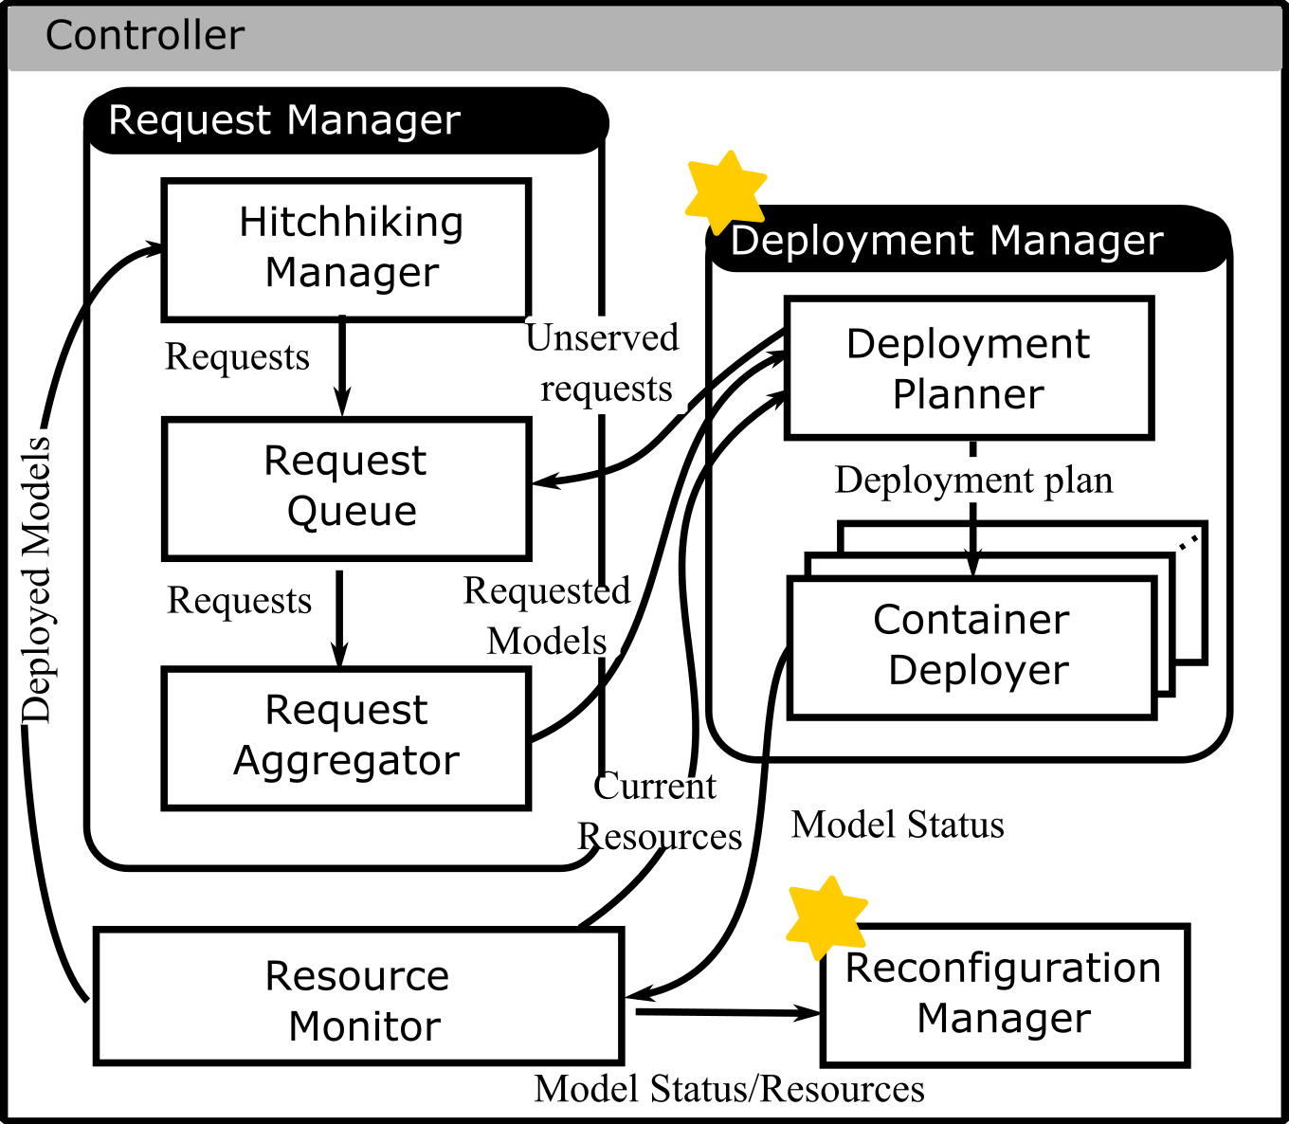
Controller
1
1
Request manager: handle requests
  Hitchhike requests to deployed models
  Store requests
  Aggregate requests
Hitchhiking
Manager
x
Request Queue
request
request
O
deployed model’s results
A1: accident detection
A3: pedestrian counting
B2: fall detection
Request1:
{task A1, accuracy 70%, latency 0.2}
Request2:
{task A1, accuracy 65%, latency 0.3}
Request3:
{task A3, accuracy 90%, latency 0.25}
Request4:
{task B2, accuracy 80%, latency 0.3}
Model A (Intersection)
task A1
task A3
requests 1, 2, 3
Model B (Senior house)
task B2
request 4
Request
Aggregator
Notes:
request manager會接收user的request，然後先做hitchhikin的檢查
前面有人已經問過接下來一個小時的車流狀況，後面有人來問接下來十分鐘的狀況的話，就可以直接取用現有的答案
沒有的話才把req放進queue裡面
queue裡面的Req會定期被整合
要求accident detction跟pedestrian counting的req可以被同一個model serve

Slide 16
Controller
3
2
Resource monitor: keep track of the system
  Deployed models
  Computing/Networking resources
Deployment Manager: make deployment decisions and deploy the models
Reconfiguration manager: check runtime performance of deployed models and make reconfiguration decision
3
4
2
4
Request Queue
Model A
task A1
task A3
requests 1, 2, 3
Model B
task B2: accuracy 80%
requests 4
request 1
Container Deployer A
Deployment Planner
Container Deployer
Model A
deployment decision
Model B
deployment decision
computing/network resources
Notes:
Res monitor會紀錄有哪些被deployed過的model，現在的運算資源，比方說edge還能被deploy幾個Model，網路資源，edge-cloud中間的網路狀況如何等
deployment manager會根據res monitor跟他說的資源狀況來決定aggregator給他的model req應該怎麼被deploy
container deployer通知computing devices去執行那些DNN layers
如果有不能被Serve的req，就會被丟回queue裡面
Reconfig檢查被deploy的model如何，如果latency突然暴增，可能代表某個link現在塞住了，挪動layer減少往那邊送的資料量

Slide 17
Computing Devices
5
Agent: Manage DNN partition
  Communicate with controller (model status / reconfiguration command, etc.)
  Receive raw / intermediate data from other computing devices
  Send intermediate data to other computing devices
  Send inference results to users
Partition: execute assigned DNN layers
6
5
Model A
latencies = {0.2, 0.3, 0.25…}
status: running/finished/reconfiguring
6
Notes:
agent負責跟controller溝通
也會負責接收跟傳送資料

Slide 18
Research Problems

Slide 19
Goals of DNN Deployment
Derive the optimal deployment plans for the DNNs that serve the most requests
Deployment plan
  Determine where to deploy the
  DNN model partitions and
  which exit point to run
Challenges
  Resource demands of DNNs are
  heterogenous
  Resource availability in the
  thing-to-cloud continuum is
  diverse and limited
  Environment at runtime is
  dynamic
Notes:
根據剛剛的系統架構
我們接下來要解決的就是DNN該怎麼被ｄｅｐｌｏｙ
兩個星星

Slide 20
Deployment Plan Decision-Making Process
We devide the deployment plan decision-making process into two phases
Planning phase: genearte deployment plan given resource levels -> Deployment planning problem
Operation phase: check the QoS of deployed models and reconfigure the deployment plan at runtime if needed
-> Dynamic reconfiguration problem
Aggregate requests
Deploy models
Terminate models
Planning phase
Operation phase

Slide 21
Planning Phase

Slide 22
Multi-task Model Requests
Requests
Request Aggregator
Planning Phase
Operation Phase
Each model contains several tasks
Each task contains a multiple exit points and layers
Each tasks has several requests with accuracy and latency requirements
Model
Requests:
{AD, 70%, 0.25}
{AD, 60%, 0.3}
{PC, 75%, 0.2}
x2
8
9
Accident
Detection
1
2
3
4
5
6
7
x2
x1
x1
Pedestrian
Counting

Slide 23

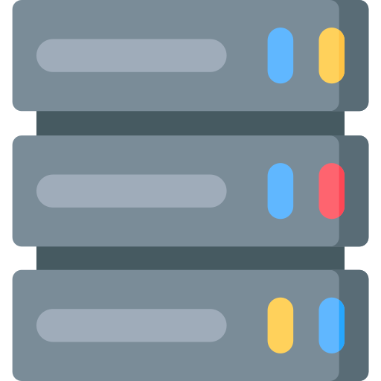
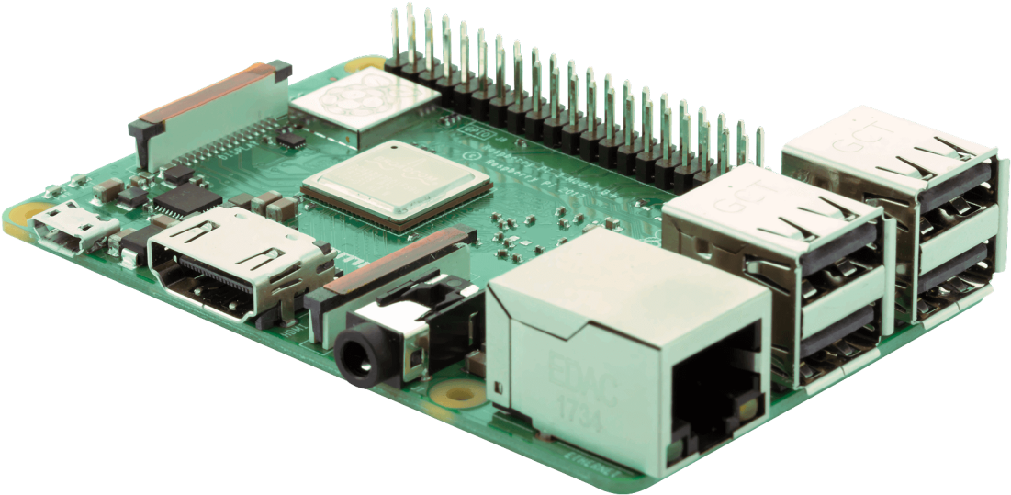

Resource Status
Requests
Request Aggregator
Planning Phase
Operation Phase
Computing powers indicate the number of partitions that can be deployed on that device
Network resources
  Bandwidth capacity
  Runtime throughput
Bandwidth
capacity
c = 2
c = 1
c = 4
Runtime throughput
Notes:
C=2代表IoT device還可以被放兩個container

Slide 24
Deployment Planning Problem
Model 3
Model 2
Model 1
Requests:
{AD, 70%, 0.25}
{AD, 60%, 0.3}
{PC, 75%, 0.2}
x2
8
9
Accident Detection
We have a set of models to
deploy
Select exit points and
partition points for each
model
Maximize the number of
served requests
1
2
3
4
5
6
7
x2
Pedestrian Counting
x1
x1
How to determine a request is served?
c = 2
c = 1
c = 4
M3
M1
Partition 1
M2
Partition 1
M1
Partition 2
M2
Partition 2

Slide 25
Performance Prediction
Requests
Request Aggregator
Planning Phase
Operation Phase
A request is considered served if both latency and accuracy requirements are met
Latency
  Computing latency (lookup table)
    Layers
    Exit layers
  Transmission latency
Accuarcy
  Based on exit point:
  task1 x1 -> 75%
  task2 x2 -> 90%
Model
Requests:
{AD, 70%, 0.25}
{AD, 60%, 0.3}
{PC, 75%, 0.2}
x2
8
9
Accident Detection
1
2
3
4
5
6
7
x2
Pedestrian Counting
x1
x1

Slide 26
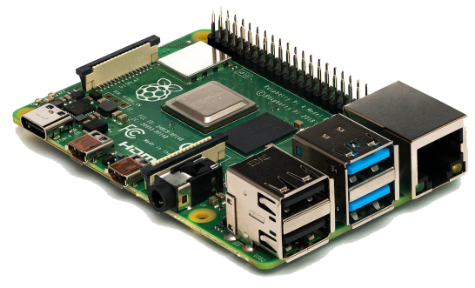
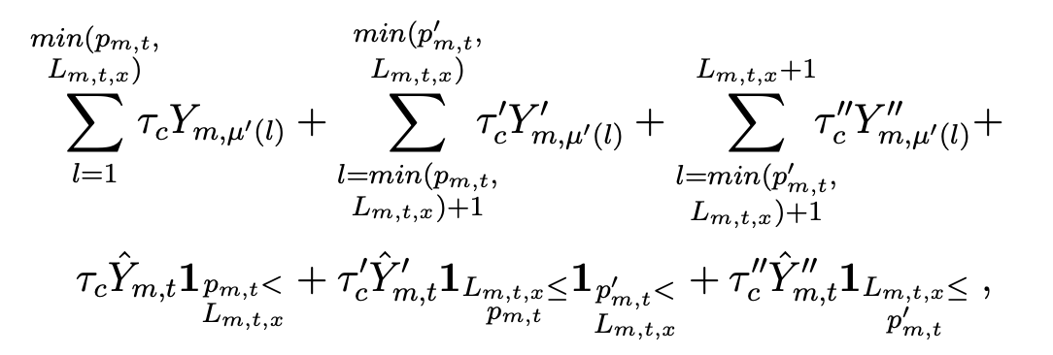
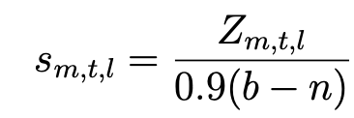




Scaling Factors
$$τ_{c}=mean(\{τ_{1}, …τ_{n}\})$$
Lookup table may not capture the impact of runtime environment
Leverage historical logs to update the prediction at runtime
Model 1
Predicted latency: $δ_{1}$
Run time latency: $δ_{1}^{′}$
$$τ_{1}=δ_{1}^{′}/δ_{1}$$
Model n
Predicted latency: $δ_{n}$
Run time latency: $δ_{n}′$
$$τ_{n}=δ_{n}^{′}/δ_{n}$$
Latency Prediction
Y: lookup table value of computing latency
…
Computing latency
on Device
Computing latency
on Edge
Computing latency
on Cloud
Computing latency
Transmission latency
Identify the layers running on device/edge/cloud based on partition points
Layer output size
Computing latency of exit layers
Capacity-throughput, 0.9 makes room for background traffic

Slide 27

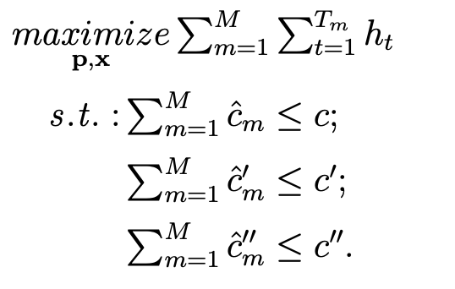
Throughput
Requests
Request Aggregator
Planning Phase
Operation Phase
Number of served requests
Maximize throughput under computing resource constraints
Latency Accuracy
Formulation
Device
Edge
Cloud
Based on partition points, we can determine if a computing device is participate in the execution of model m
Notes:
Np-hard “multiple knapsack problem”
解她太花時間，可能當下res狀況就又變了

Slide 28
Deployment Planning Algorithm
Requests
Request Aggregator
Planning Phase
Operation Phase
Serve models with more requests first
Satisfy accuracy requirements (exit points) and choose the latency (partition points) with highest throughput
Model 3
Model 2
Model 1
Requests:
{AD, 70%, 0.25}
{AD, 60%, 0.3}
{PC, 75%, 0.2}
x2
8
9
Accident Detection
Sort models by number of requests
For each model
  (1) Select exit point based on accuracy requirements
  (2) Select partition points with max satisfied #requests
  (3) Update available resources
1
2
3
4
5
6
7
x2
x1
x1
Pedestrian Counting
If there are multiple partition points with the same throughput,
select the one with lowest latency
Notes:
因為我們是想要serve愈多req愈好，所以讓有比較多req的model先選資源

Slide 29
Operation Phase

Slide 30

Dynamic Reconfiguration Problem
Requests
Request Aggregator
Planning Phase
Operation Phase
A performance drop is detected on a deployed model $m$
Select new exit points and partition points to maxmize the throughput
The computing resources
are limited to those already
assigned in the planning
phase
Model 1
Requests:
{AD, 70%, 0.25}
{AD, 60%, 0.3}
{PC, 75%, 0.2}
x2
8
9
Accident Detection
Search space is reduced to single model and fixed devices
1
2
3
4
5
6
7
x2
Pedestrian Counting
x1
x1

Slide 31
Dynamic Reconfiguration Algorithm
Requests
Request Aggregator
Planning Phase
Operation Phase
Find optimal decision
Find all possible exit points
  (i) Select partition points with lowest latency
  (ii) Predict throughput
Return the exit points and partition points with
highest throughput
Model 1
Requests:
{AD, 70%, 0.25}
{AD, 60%, 0.3}
{PC, 75%, 0.2}
x2
8
9
Accident Detection
1
2
3
4
5
6
7
x2
x1
x1
Pedestrian Counting
Candidate 2
Candidate 3
Candidate 1
Candidate 4
Notes:
8-27組

Slide 32
Implementations

Slide 33
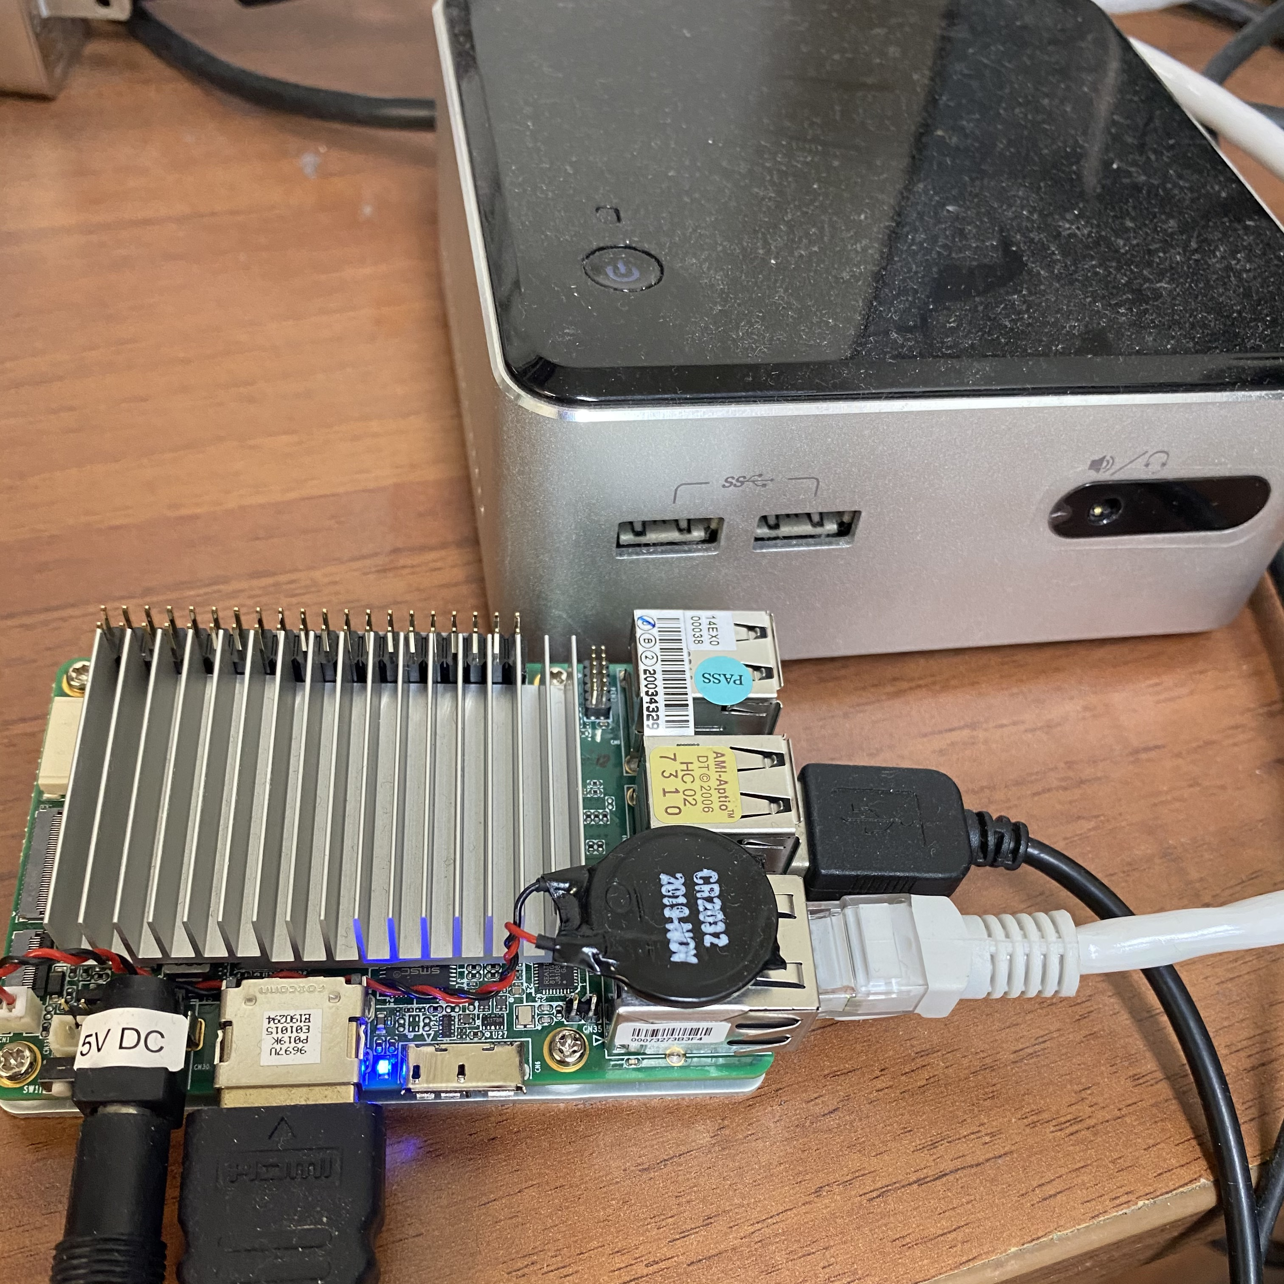



Testbed
NUC
Computation devices
  IoT Device (Upboard): Intel Atom CPU @1.44 GHz and
  4 GB RAM
  Edge (NUC): Intel i3 CPU @1.7 GHz and 16 GB RAM
  Cloud (PC): Intel i7 CPU @3.4 GHz and 24 GB RAM
Open-sources tools
  Kubernetes
  Docker
  ZeroMQ
Network topology
  System communicates to the computing devices via control plane
  Computing devices send data
  via data plane
Upboard

Slide 34
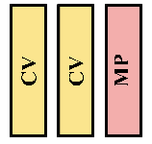
Multi-task Networks
Pytorch based Age-Smile-Gender multi-task DNNs [Informatica’18]
Enable early exits with BranchyNet [ICPR’16] structure
Run inference for 100 times and use the average computing time to build the lookup table
Create 5 models by varying the number of convolution
and max-pooling layers
Model 5
Model 3
Model 4
Model 2
Model 1
[Informatica’18] S. Viet and C. Bao. Effective deep multi-source multi-task learning frameworks for smile detection, emotion recognition and gender classification. Informatica, 42(3), September 2018.
[ICPR’16] S. Teerapittayanon, B. McDanel, and H. Kung. Branchynet: Fast inference via early exiting from deep neural networks. In Proc. of IEEE International Conference on Pattern Recognition (ICPR’16), pages 2464–2469, Cancun, Mexico, December 2016.
Notes:
為了讓不同的task有不同的workload，我們train了五組model

Slide 35
Compared Algorithms
Baselines
  Neurosurgeon (NEU) [SIGARCH’17]: select partition points for shortest latency
  Edgent [WC’19]: select exit points with highest accuracy that has partition points achieving required latency requirement (we forced it to choose the exit points that satisfying the accuracy requirements)
T2C with different features
Algms Features | NEU | Edgent | T2C_{M} | T2C_{MH} | T2C_{MHE} | T2C_{MHER}
Multi-task |  |  | ✔️ | ✔️ | ✔️ | ✔️
Hitchhiking |  |  |  | ✔️ | ✔️ | ✔️
Early exit |  | ✔️ |  |  | ✔️ | ✔️
Reconfiguration |  |  |  |  |  | ✔️
[SIGARCH’17] Y. Kang, J. Hauswald, C. Gao, A. Rovinski, T. Mudge, J. Mars, and L. Tang. Neurosurgeon: Collaborative intelligence between the cloud and mobile edge. ACM SIGARCH Computer Architecture News, 45(1):615–629, April 2017.
[WC’19] E. Li, L. Zeng, Z. Zhou,and X. Chen. EdgeAI: On-demand accelerating deep neural network inference via edge computing. IEEE Transactions on Wireless Communications, 19(1):447–457, October 2019.

Slide 36
Evaluations

Slide 37
Evaluation Setup
Experiment duration: 5 min
Run (# repeats): 5
# Models: 5
Sliding window of scaling factors: 1 min
Aggregation period
  Planning phase: 10 s
  Operation phase: 20 s
Reconfiguration period: 45 s
Request arrival rate (Poisson arrival rate of a Public 311 call trace)
  Planning phase: {1X, 20X, 40X, 60X, 80X}
  Operation phase: {40X, 60X, 80X, 100X, 120X}
Network link:
  Sensor-IoT (Bluetooth): 1 Mbps, latency 1ms
  IoT-Edge (WiFi): 24 Mbps, latency 3ms
  Edge-Cloud (Broadband): 40 Mbps, latency 5 ms
Computing powers:
  Device: 3
  Edge: 3
  Cloud: 7

Slide 38
Perforamance Metrics
Throughput: the number of served requests
Satisfied ratio: the % of requests meeting both accuracy and latency requirements
Latency: the inference time of IoT analytics
Accuracy: the accuracy of IoT analytics
Queuing time: the waiting time of a each request in the request queue
CPU utilization: the fraction of algorithm running time on our Intel i7 PC @3.6 GHz
Deployment time: time difference between deployment plan generation and container launch
Data plane throughput: the bandwidth consumption among DNN partitions
Control overhead: the bandwidth consumption of control messages
Notes:
Objectives
Performance
Overhead

Slide 39
Results:
Planning Phase

Slide 40
Multi-task and Hitchhiking Improve Throughput without Sacrificing Satisfied Ratio
Planning Phase
Operation Phase
M: multi-task
H: hitchhiking
E: early exit
T2C_{M} and T2C_{MH} achieves 2.34X and 2.44X of throughput compared to NEU
T2C_{MHE} delivers 2.74X of throughput compared to Edgent
Our algorithms satisfy > 97% requests at runtime

Slide 41
Early Exits Reduce
Latency while Satisfying Accuracy Requirements
Planning Phase
Operation Phase
M: multi-task
H: hitchhiking
E: early exit
T2C_{MHE} and Edgent result in 3.85% lower latency compared to NEU and 7.68% lower latency compared to T2C_{M}
Notes:
aggregate之後選擇的acc不一樣所以acc不一樣

Slide 42
Our System Incurs Acceptable Overhead
Planning Phase
Operation Phase
M: multi-task
H: hitchhiking
E: early exit
All algorithms incur ~1Mbps control overhead
-> Acceptable
T2C_{MHE} obtains 37.86% and 42.86% of CPU utilization compared to NEU and Edgent

Slide 43
Our System Scales
Well under Heavy
Workload
Operation Phase
Planning Phase
M: multi-task
H: hitchhiking
E: early exit
T2C_{MH} and T2C_{MHE} achieve at most 5.4X and 6.8X of throughput compared to NEU
Queuing time of T2C algorithms is as low as 12.21% of that of NEU

Slide 44
Results:
Operation Phase

Slide 45
T2C_{MHER} Obtains Highest Throughput and Satisfied Ratio
Planning Phase
Operation Phase
MHE: Without reconfiguration
MHER: With reconfiguration
To trigger reconfiguration, we increase the workload and aggregation period to accumulate more requests in a model
We cut network bandwidth by half to emulate network congestion after the 1st deployment decisions are made (@20s)

Slide 46
Reconfiguration Improves Satisfied Ratio
Planning Phase
Operation Phase
MHE: Without reconfiguration
MHER: With reconfiguration
Zoom into the performance of a single model
Light workload: 4 models
Heavy workload: up to 13 models
Light workload
Heavy workload
10%
54%
35%
50%
Trigger reconfiguration

Slide 47
T2C_{MHER} Incurs
Acceptable Overhead
Operation Phase
Planning Phase
MHE: Without reconfiguration
MHER: With reconfiguration
T2C_{MHER} has a CPU utilization of ≤ 5%, which is only a few ms for each invocation
T2C_{MHER} consumes extra bandwidth for reconfiguration, but the average throughput is < 1.5 Mbps

Slide 48

Summary
Multi-task and Hitchhiking
improve throughput
Early exit
reduces latency
Reconfiguration
increases satisfied ratio
T2C_{MHE} achieves 6.8X throughput at low latency
T2C_{MHER} improves up to 35% satisfied ratio

Slide 49
Conclusion & Future Work

Slide 50
Conclusion
Propose the T2C system for deploying DNNs in a thing-to-cloud continuum
Leverage multi-task, hitchhiking, early exits, and reconfiguration
Divide the deployment decision-making process into planning and operation phase
Solve the deployment planning problem and dynamic reconfiguration problem
T2C_{MHE} achieves 6.8X throughput at low latency
T2C_{MHER} improves up to 35% satisfied ratio

Slide 51




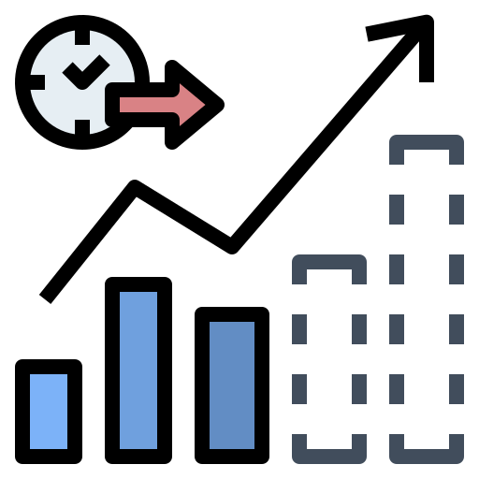

Future Work
Cost of reconfiguration
Multiple devices
in each infrastructure layer
Adaptive aggregation period
Notes:
Consider the cost of reconfiguration
Service downtime v.s. satisfied ratio improvement
Include multiple computing devices in each infrastructure layer
Predict workload and adaptively adjust aggregation period
Longer aggregation period is suitable for heavier workload

Slide 52
Thank you for listening
Chia-Ying Hsieh (cyinghsieh@gmail.com)
Thanks for the help of Prof. Hsu, Prof. Venkatasubramanian, Praveen Venkateswaran, Tung-Chun Chang, Chao-Wen Chen, Kuan-Yu Lee, and all lab mates
Publications
  C. Hsieh, P. Venkateswaran, N. Venkatasubramanian, and C. Hsu T2C: A Multi-User System for Deploying DNNs in a Thing-to-Cloud Continuum. In Proc. of IEEE International Conference on Mobility, Sensing and Networking (MSN’22), December 2022, invited paper.
  P. Venkateswaran, K. Benson, C. Hsieh, C. Hsu, S. Mehrotra, and N. Venkatasubramanian REAM: A Framework for Resource Efficient Adaptive Monitoring of Community Spaces. Pervasive and Mobile Computing, September 2021.
  T. Chang, G. Bouloukakis, C. Hsieh, C. Hsu, and N. Venkatasubramanian SmartParcels: Cross-Layer IoT Planning for Smart Communities. In Proc. of ACM/IEEE Conference on Internet of Things Design and Implementation (IoTDI’21), May 2021.
  T. Chang, G. Bouloukakis, C. Hsieh, C. Hsu, and N. Venkatasubramanian SmartParcels–A What-if Analysis and Planning Tool for IoT-Enabled Smart communities. In Proc. of ACM/IEEE Conference on Internet of Things Design and Implementation (IoTDI’21), Demo Session, May 2021.
  C. Hsieh, Y. Li, C.Hsu, Y.Kuo, C. Chen, C. Hsu, and J. Sheu Stream Processing of Software-Defined Video Analytics on a Smart Campus. In Proc. of IEEE International Conference on Big Data Intelligence and Computing (DataCom’19), Demo Session, Kaohsiung, Taiwan, October 2019.

Slide 53
Multi-task Networks
Originally proposed to share weights of prefix layers of different tasks [ML’97]
Trained several DNNs for multiple video analytics with different number of shared layers to trade accuracy and complexity [ATC'18]
Trained popular networks and replaced the classifier (fully-connected layers) and some of the convolution layers with that of the target tasks [SEC’20]
Deploy multi-task model in the thing-to-cloud continuum has not been thoroughly studied
[ML’97] R. Caruana. Multitask learning. Springer Machine Learning, 28(1):41–75, July 1997.
[ATC’18] A. Jiang, D. Wong, C. Canel, L. Tang, I. Misra, M. Kaminsky, M. Kozuch, P. Pillai, D. Andersen, and G. Ganger. Mainstream: Dynamic stem-sharing for multi-tenant video processing. In Proc. of Internatioal USENIX Annual Technical Conference (ATC’18), pages 29–42, Boston, MA, July 2018.
[SEC’20] M. Chao, R. Stoleru, L. Jin, S. Yao, M. Maurice, and R. Blalock. AMVP: Adaptive CNN-based multitask video processing on mobile stream processing platforms. In Proc. of IEEE/ACM Symposium on Edge Computing (SEC’20), pages 96–109, Virtual, November 2020.

Slide 54
Early Exits and Deployment
Infer with prefix layers as long as the accuracy reaches the target [ICPR'16]
Dynamically selected partition and exit points between an IoT device and an edge server [WC’19]
Partitioned the DNNs and guaranteed that the local device has at least an exit point [MobiCom’20]
Only considered the decision between thing-edge or edge-cloud, the topology of thing-edge-cloud has not been fully studied yet
Focus on one-time request
[ICPR’16] S. Teerapittayanon, B. McDanel, and H. Kung. Branchynet: Fast inference via early exiting from deep neural networks. In Proc. of IEEE International Conference on Pattern Recognition (ICPR’16), pages 2464–2469, Cancun, Mexico, December 2016.
[WC’19] E. Li, L. Zeng, Z. Zhou, and X. Chen. EdgeAI: On-demand accelerating deep neural network inference via edge computing. IEEE Transactions on Wireless Communi- cations, 19(1):447–457, October 2019
[MobiCom’20]S. Laskaridis, S. I. Venieris, M. Almeida, I. Leontiadis, and N. D. Lane. Spinn: synergistic progressive inference of neural networks over device and cloud. In Proc. of the Annual International Conference on Mobile Computing and Networking (Mobi- Com’20), pages 1–15, London, UK, April 2020.

Slide 55
Reconfiguration
Reconfigured mobile apps during cloud offloading to maximize the execution speed [CC’14]
Investigated if reconfiguration of DNN is useful [CLOUD’21]
Reduced service downtime of reconfiguration [IC2E’21]
Reconfiguration of DNNs has not been integrated in a deployment system
[CC’14] L. Yang, J. Cao, S. Tang, D. Han, and N. Suri. Run time application repartitioning in dynamic mobile cloud environments. IEEE Transactions on Cloud Computing, 4(3):336–348, September 2014.
[CLOUD’21] F. McNamee, S. Dustdar, P. Kilpatrick, W. Shi, I. Spence, and B. Varghese. The case for adaptive deep neural networks in edge computing. In Proc. of IEEE International Conference on Cloud Computing (CLOUD’21), pages 43–52, Chicago, IL, September 2021.
[IC2E’21] A. Majeed, P. Kilpatrick, I. Spence, and B. Varghese. NEUKONFIG:Reducing edge service downtime when repartitioning DNNs. In in Proc. of IEEE International Conference on Cloud Engineering (IC2E’21), pages 118–125, San Francisco, CA, October 2021.

Slide 56
Overhead under Different Workload Compared to NEU
T2C algorithms do not incur significantly more overhead when workload is heavier
Our system scales well under heavy workload

Slide 57
Latency Reduction by Reconfiguration
T2C_{MHER} changes the partition points to reduce latency
7.67% lower
10.28% lower

Slide 58
Performance under Different Workload
T2C_{MHER} always achieves better satisfied ratio under different workload
Higher control overhead but still < 1.5 Mbps

