Slide 1

On Error Concealment of Dynamic 3D Point Cloud Streaming
Tzu-Kuan Hung (hungtzukuan@gmail.com)
Advisor: Cheng-Hsin Hsu
Networking and Multimedia Systems Lab,
CS, National Tsing Hua University

Slide 2
Outline
Introduction
Motivations
Related Work
Problem
Solutions
Experimental Setup
Objective Results
Subjective Results
Conclusion
Future Work

Slide 3
introduction

Slide 4
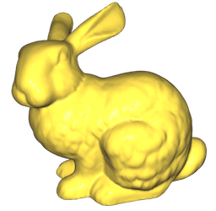
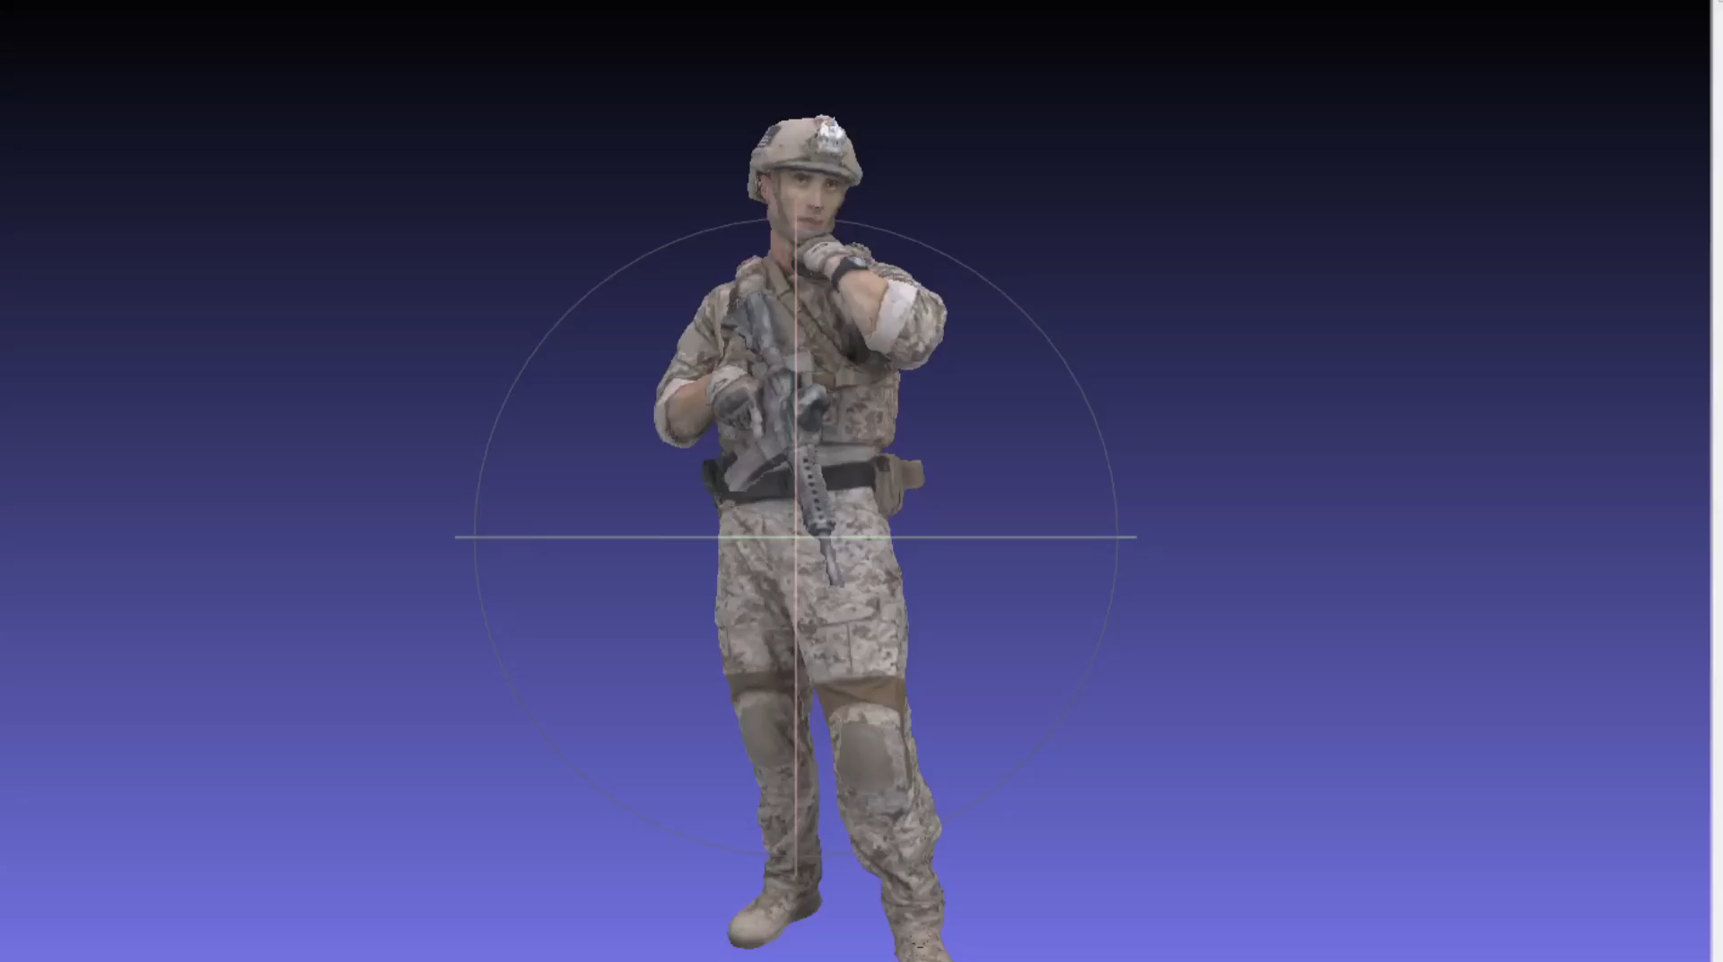
3D Representations
Hard to edit in real time
Meshes
Points, edges, and faces
Not native output data types of any capturing sensors
Point Clouds
Mandatory: 3D coordinates
Optional: attributes, such as colors
Native data format from some sensors
Light-weight data format
Applications:
Extended Reality (XR)
Entertainments
Teleconference
…….
Notes:
We firstly introduce the two popular 3D representations, meshes, and point clouds
Meshes are composed of not only three D points, but also, edges, and faces
Although pipelines of rendering meshes are quite mature
Meshes are not native output data type of any sensors. Make it hard to run in real time
On the other hand, point cloud is a light weight data format
With mandatory geometry information, for example the X, Y, Z coordinates
And the optional attributes like colors, for example the R, G, B values
It’s easier to edit and interact with point cloud in real time
We are interested in 3D point clouds

Slide 5
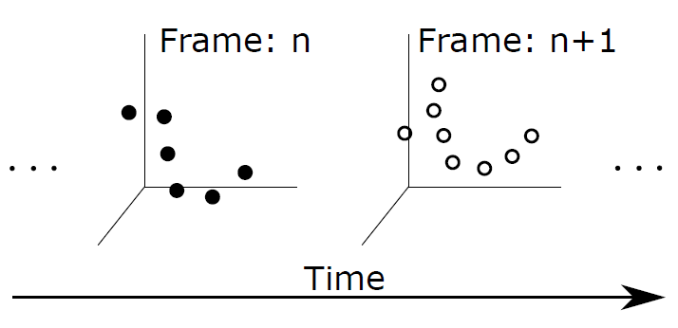
Point Cloud Characteristics
No connectivity among points
No edge or face information
More points are needed compare to meshes
Unordered
No specific order among points
No 1-1 matches among points across frames
Heterogeneity
Sparseness levels
Optional attributes
Dense point clouds
with colors
Notes:
And let’s discuss more characteristics for point cloud
Point cloud doesn’t have edge information. Make it easier to edit or interactive in real time
But it require more points to achieve comparable rendering quality to meshes
And the point clouds have neither specific order within a frame.
Nor 1 to 1 match between points in the different frames
The point number can also be different
And the point clouds has heterogeneous sparseness levels and optional attributes
For different applications

Slide 6
MOTIVATIONS

Slide 7
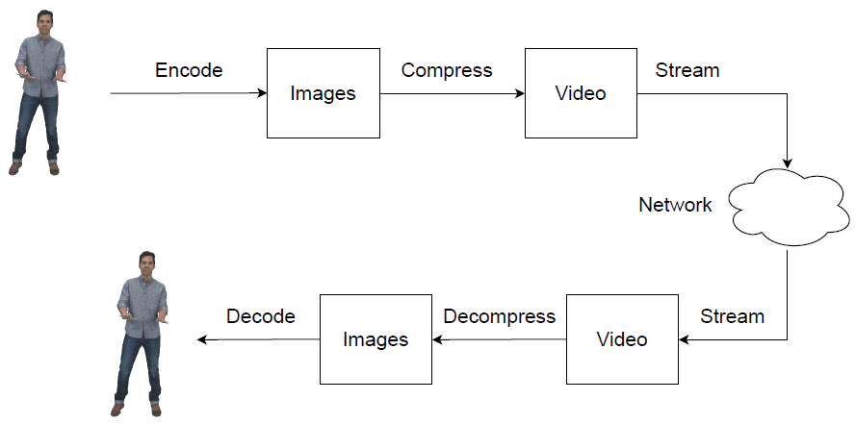
Issue of Dynamic Point Cloud Streaming (1/3)
More than 0.5 M points [1]
Streaming uncompressed dynamic point cloud dictates more than 4 Gbps
Compression before streaming is essential
[1] C. Cao, M. Preda, and T. Zaharia, “3D point cloud compression: A survey,” ACM International Conference on 3D Web Technology (Web3D’19), pages 1–9, July 2019.
Notes:
It’s reported half a million points are required to represent an acceptable quality human avatars
However streaming a single avatar of uncompressed dense point cloud may consume more that 4 Giga bits per second
Which is not supported by contemporary network infrastructures
So compression before streaming is a must

Slide 8
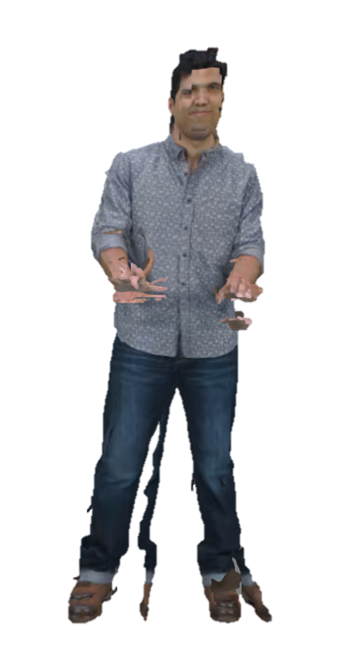
Issue of Dynamic Point Cloud Streaming (2/3)
Lost or late packets of encoded bitstreams degrade visual quality
Notes:
Unfortunately, lost or late packets of encoded bitstream could lead to catastrophic distortion on quality of decoded point clouds

Slide 9
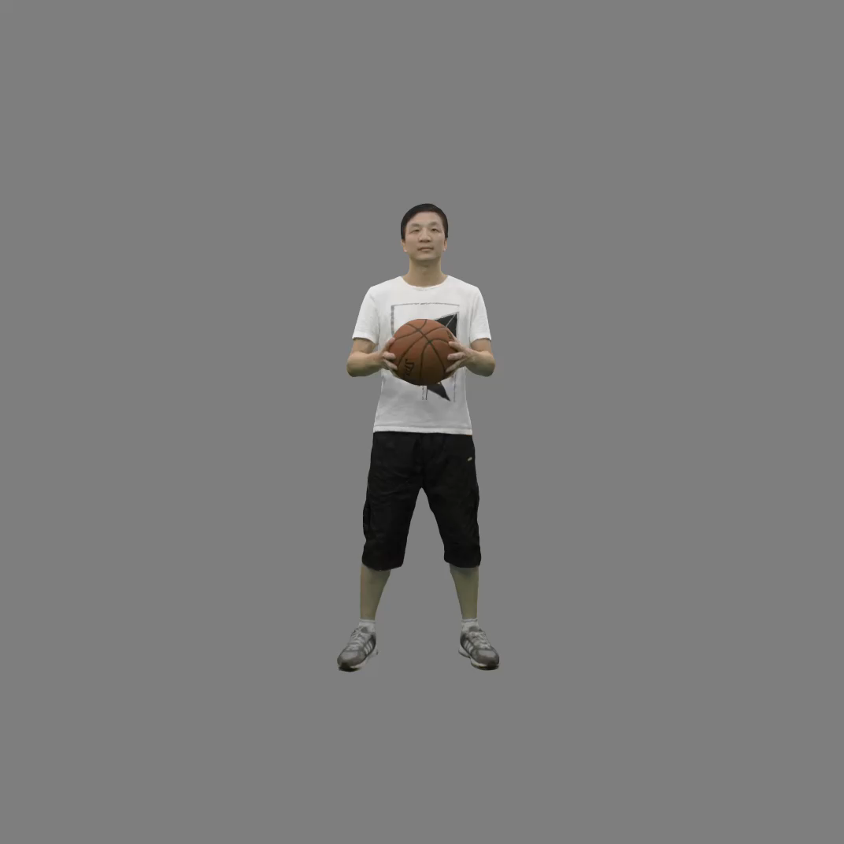
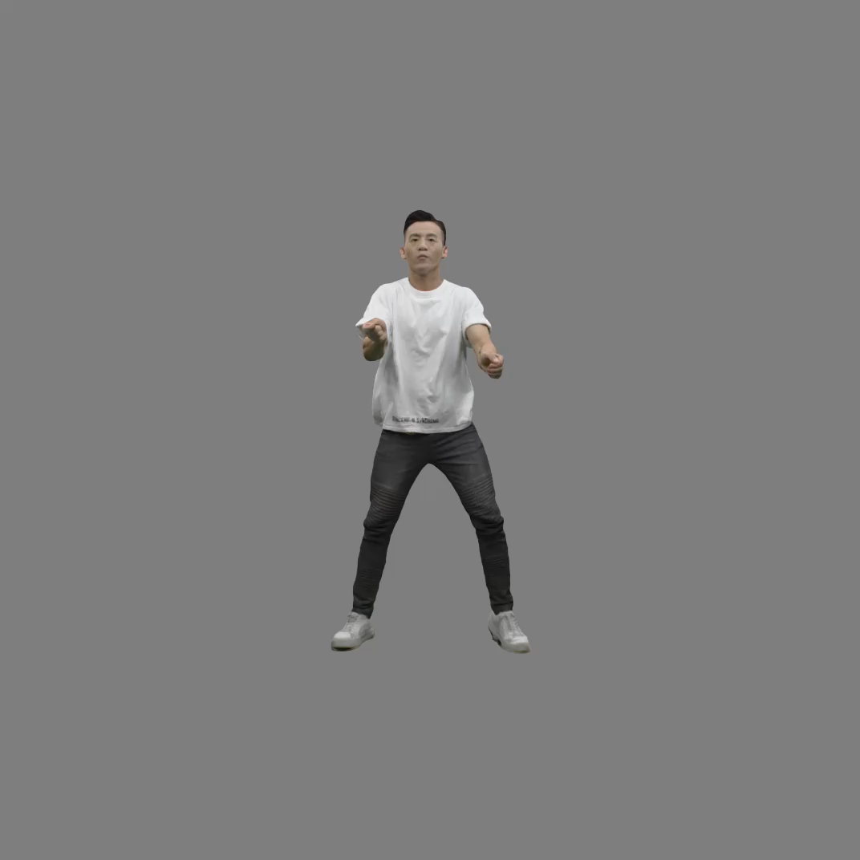
Issue of Dynamic Point Cloud Streaming (3/3)
Lost or late packets of encoded bitstreams degrade visual quality
That’s why we need error concealment
Notes:
That’s when error concealment comes in handy
And our problem is like what the video shows
We are going to conceal the transmission distortion caused by late or loss packets

Slide 10
Related Work

Slide 11
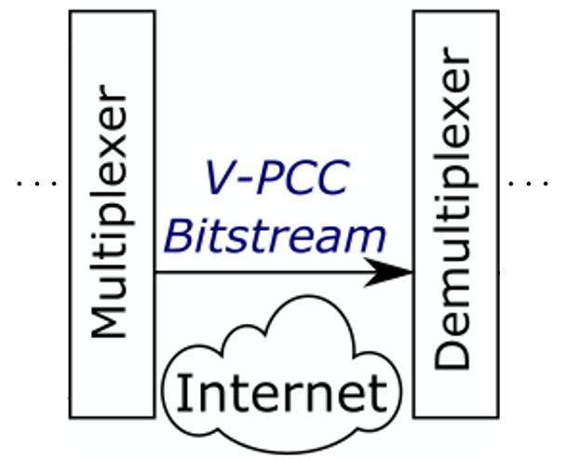
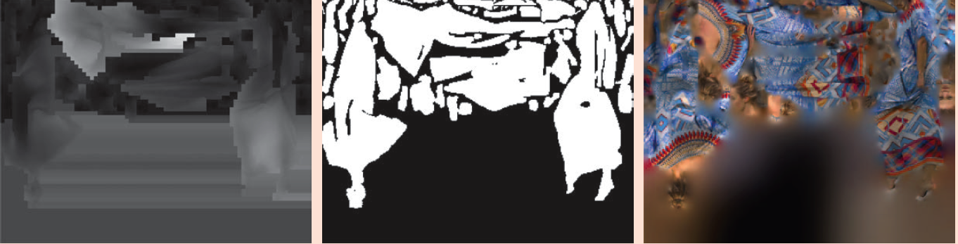
MPEG Video-based Point Cloud Compression (V-PCC)
V-PCC[2]
Project each point cloud into:
Geometry (Near and Far map)
Attribute (Near and Far map)
Occupancy
Metadata and parameters
Encode sub-bitsream by HEVC
Reference codec used in our work
GVD
GVD
AVD
AVD
OVD
OVD
Header
Header
[2] MPEG 3DGC. V-PCC codec description v12. International Organization for Standardization Meeting Document ISO/IEC JTC1/SC29/WG7 MPEG/N0012, 2020. Meeting held online.
Notes:
Let first take a look into video-based point cloud compression standard, proposed by MPEG
It project geometry and attribute into 2D images
The gap of projected patches are filled with values derived from nearby patches for better compression efficiency, so it needs an extra occupancy map
multiplexer packs all three bitstreams with auxiliary information and parameter sets into a V-PCC bitstream

Slide 12
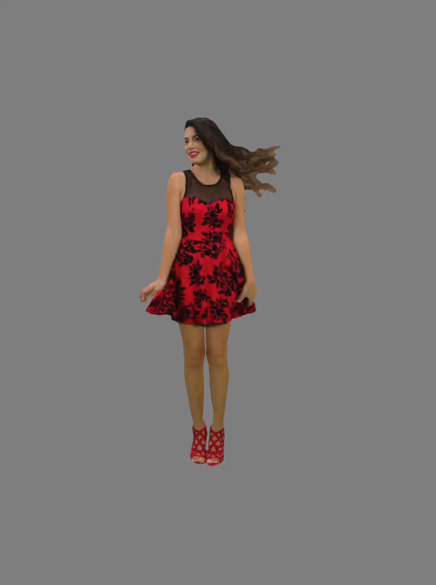
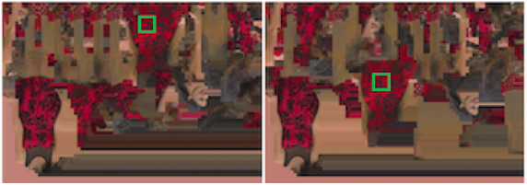
Error Concealment for 2D Videos
Reduce the distortion by:
Frame copy
Temporal concealment
Spatial concealment
Can we apply them to V-PCC?
No! Patches are at different places[3]
[3] L. Li, Z. Li, V. Zakharchenko, J. Chen and H. Li, "Advanced 3D Motion Prediction for Video-Based Dynamic Point Cloud Compression," in IEEE Transactions on Image Processing, vol. 29, pp. 289-302, 2020, doi: 10.1109/TIP.2019.2931621.
Notes:
Next we move on to error concealment for 2D video
When loss or late packet occurs, we can perform either naively frame copy by unaffected frame
Or using temporal information from nearby frames
Or using spatial information from nearby blocks
So, can we apply 2D error concealment for V-PCC?
Unfortunately, the projected patches of near by frames can be placed in totally different positions

Slide 13

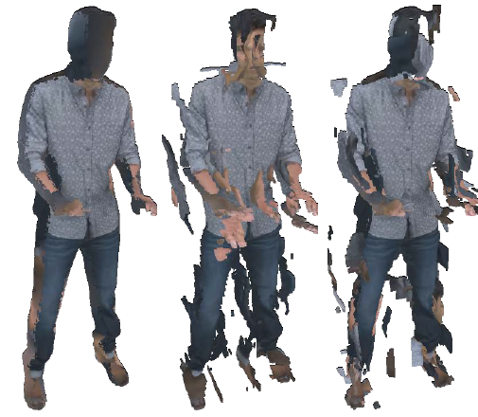
Error Concealment for 3D Point Clouds
Point cloud completion
Estimate the complete geometry of objects and scenes
Mostly by deep learning
Inpainting[4]
Reduce cracks
Self-similarity blocks
Inter-frame consistency
Computationally expensive
Not applicable to catastrophic distortion
Not for streaming
Too slow!
due to imperfect data acquisition
[4] Wei Hu, Zeqing Fu, and Zongming Guo. 2019. Local frequency interpretation and non-local self-similarity on graph for point cloud inpainting. IEEE Transactions on Image Processing 28, 8 (2019), 4087–4100.
Notes:
Related work of error concealment for 3D point cloud exist
Like point cloud completion applied Deep neural network to estimate the missing geometry of the objects and scenes
And inpainting techniques search the similar cube temporally and spatially
and use the best matching cubes as the source to fill cracks

Slide 14
Problem

Slide 15
Create V-PCC Loss Patterns
Bitstreams consist of Network Abstraction Layer Units (NALUs)
Geometry Video Data (GVD)
Attribute Video Data (AVD)
Occupancy Video Data (OVD)
Simulate packet loss
Encode 5 frames as a Group of Frame (GoF)
Mark NALUs of 3rd frame to drop
Overwrite NALUs with zeros
Decode corrupted bitstreams with V-PCC
V-PCC header
V3C Parameter Set
Headers
Notes:
To study the loss patterns of V-PCC, we parsed encoded V-PCC bitstreams and encoder logs
to identify individual Network abstraction units, which is essentially network packets
Notice that aside from the aforementioned geometry, attribute and occupancy map,
there are headers and parameter sets, we assume these crucial packet is protected by, for example Forward Error Correction
We simulate packet loss by the following steps
Firstly we encode a group of frame with 5 frames
We mark the 3rd frame then parse the bitstream again and replaced marked packets with zero
Then finally we decode corrupt bitstreams by V-PCC

Slide 16
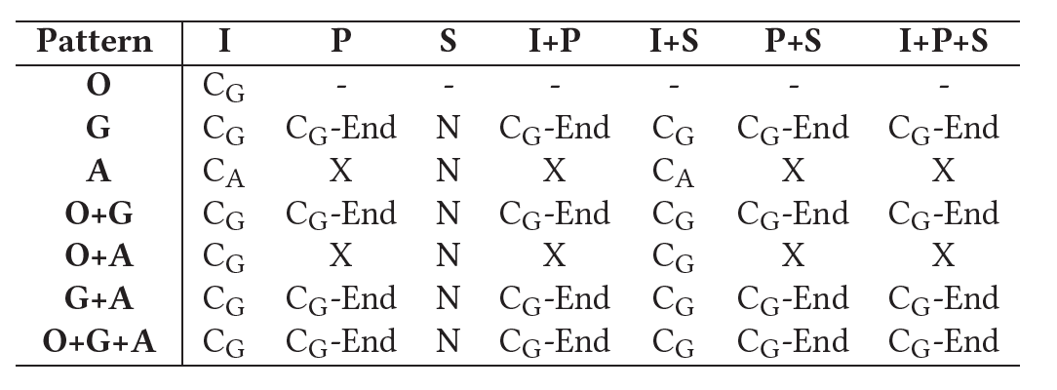
Results from Loss Pattern
I: Near map, P: Far map
S: Supplemental Enhancement Information (SEI)
Outcomes
N: No clear visual impairment
C_{𝐴}: Point cloud frame 3 is distorted in attributes only
C_{𝐺}: Distorted in both geometry and attributes
C_{𝐺}-End: 3-5 frames are distorted
X: Not decoded due to assertion errors of V-PCC
Notes:
N means no clear visual impairment

Slide 17
Concealment Strategies
Strategy
N: No concealment required
C_{𝐴}: Attribute Concealment
C_{𝐺}: Geometry Concealment
C_{𝐺}-End: Geometry Concealment
X: Geometry Concealment
Notes:
The strategy is as follows, except for Attribute only distortion, that we need to do attribute concealment only
We need to go geometry concealment for the others

Slide 18
SOLUTIONS

Slide 19
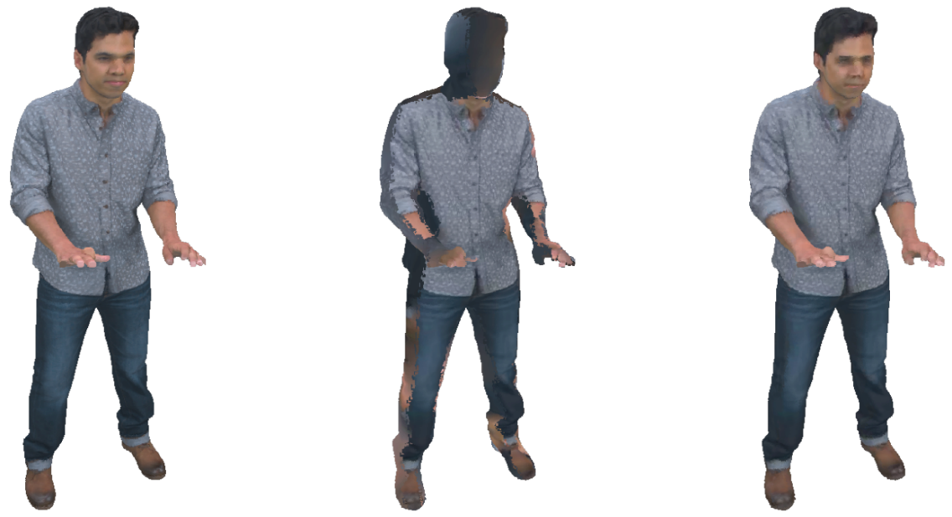
Nearest Point (NP)
Conceal point cloud frames without attribute (color) data only
For each point in the current frame
Search for the closest point in the previous point cloud frame
Copy the attributes over
Notes:
The first algorithm is to deal with only missing the color information
We use the previous frame as source search the nearest neighbor in the previous frame
And copy the attributes over from matched points in the previous frame to current frame

Slide 20
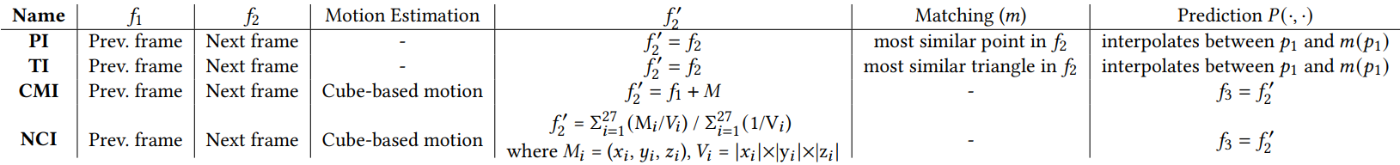
Error Concealment Schemes
We propose a suite of error concealment algorithms for geometry distortion
Assume all geometry and attribute data are lost
Catastrophic distortion for decoded point clouds with V-PCC
Point-base (first 2) and cube-based (next 2) algorithms
Notes:
The first algorithm is to deal with only missing the color information
We use the previous frame as source search the nearest neighbor in the previous frame
And copy the attributes over from matched points in the previous frame to current frame

Slide 21
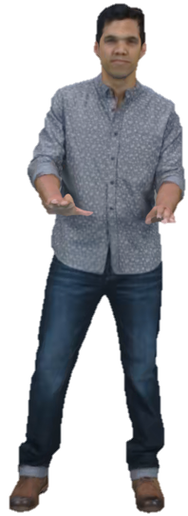
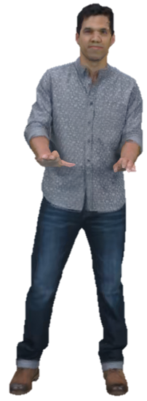
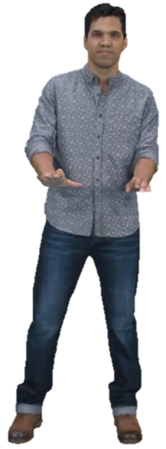
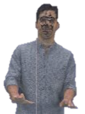
Point-to-Point Interpolation (PI)
Conceal point cloud frames without geometry data
If geometry data are distorted or missing, the attribute data become useless
For each point in the previous frame
Interpolate with the point in the future frame within a specific radius
Δ(p, q) = αΔg(p, q)+(1−α)Δa(p, q)
Notes:
For geometry concealment
Firstly we propose point to point interpolation algorithm
For each point in the previous frame, we interpolate the point in the future frame within some specific radius
If we didn’t limit the search radius
The output would like the bottom left one
There would be many cracks

Slide 22
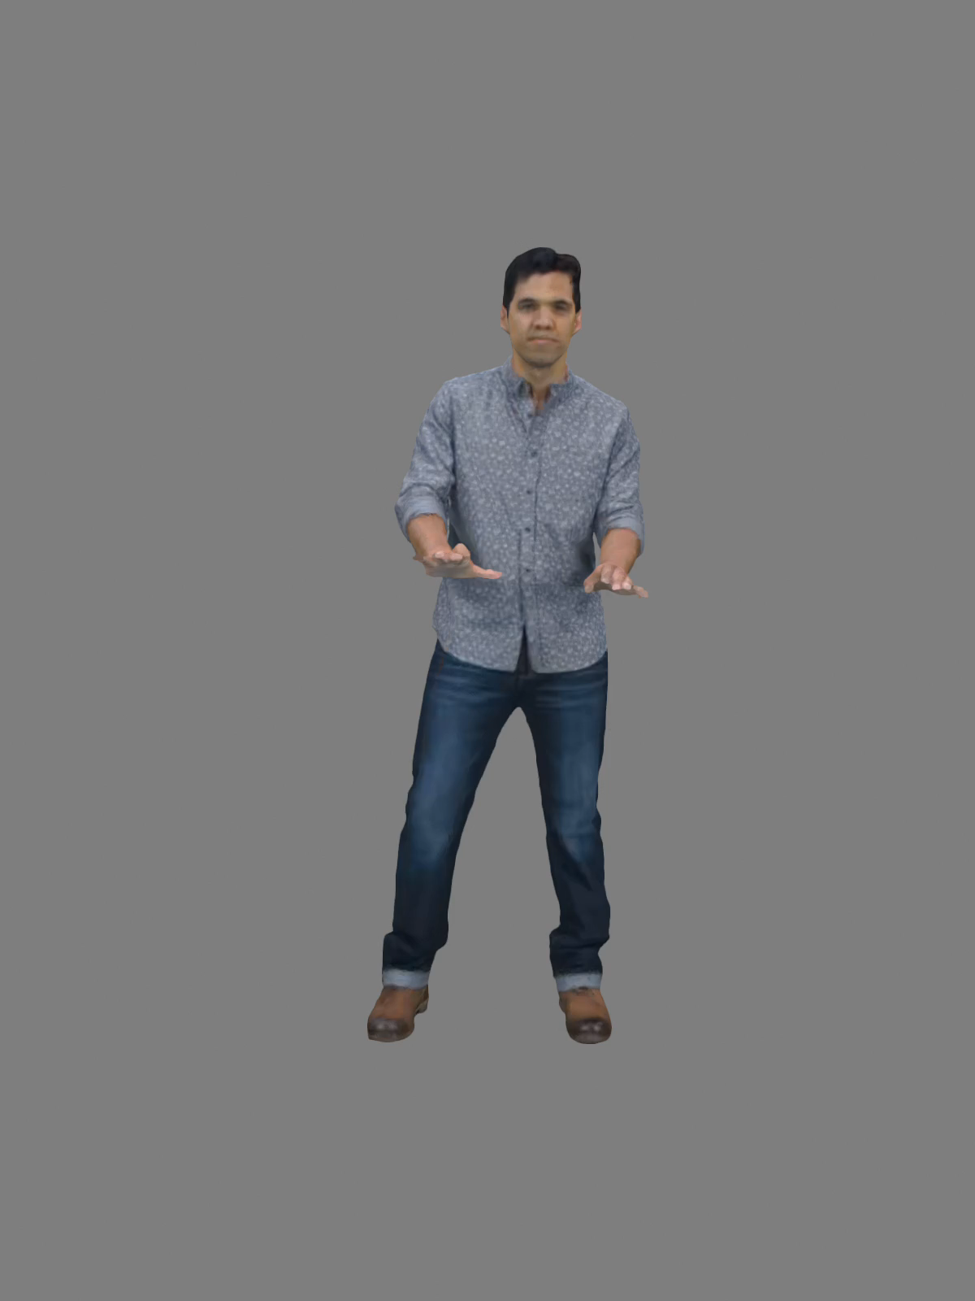
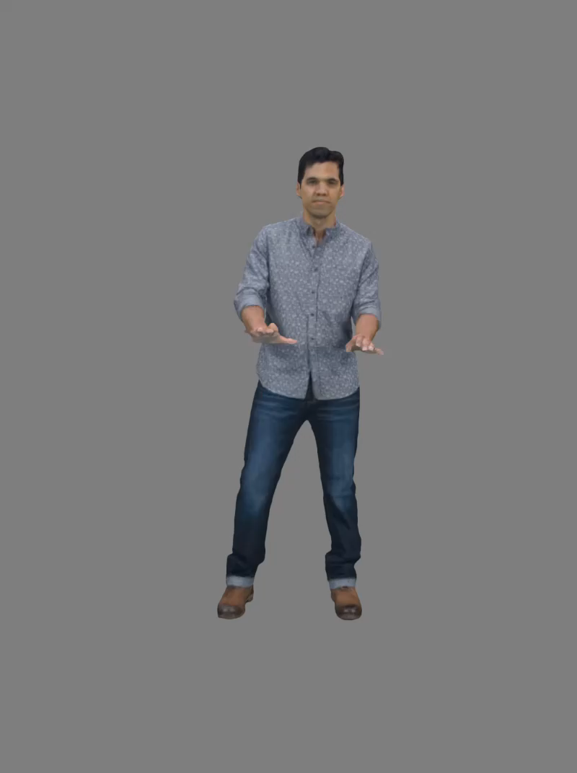
VPCC
PI
Notes:
Actually point to point matching and triangular matching looks similar in the concealed video
And triangular matching is only able to reduce size of the cracks, not completely conceal them

Slide 23
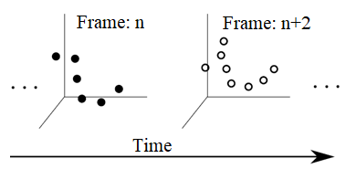
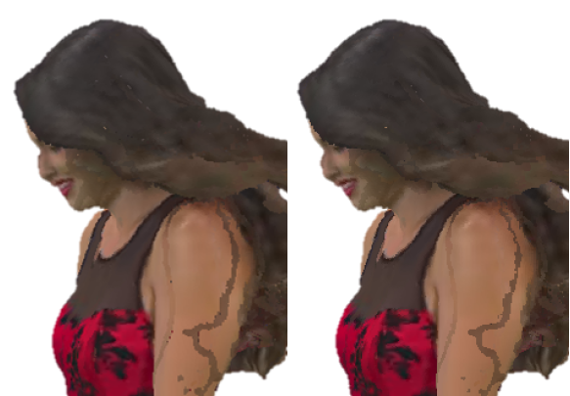
Triangular Interpolation (TI)
Matching subroutine is done among triangles instead of points
PI (left)
TI (right)
Smaller cracks
No cracks
Notes:
The next is the triangular interpolation algorithm
Similar to point-to-point interpolation
except that we match 3 points at once
TI algorithm can lead to smoother surfaces and remove many small
cracks in the model

Slide 24

VPCC
TI
Notes:
Actually point to point matching and triangular matching looks similar in the concealed video
And triangular matching is only able to reduce size of the cracks, not completely conceal them

Slide 25
Cube-based Motion Interpolation (CMI)
Divide point clouds into non-overlapped cubes with the same dimension
Average all point-to-point outcomes within a cube for a rigid motion vector of the whole cube
Enlarge cubes when gap happens
Let 𝑙 be the length of each cube 𝐶
Dist. between every center to neighbor cube is exactly 𝑙
After interpolation, if dist. of centers between any adjacent cubes 𝑙 ‘ > 𝑙, we enlarge length of the cube from 𝑙 to 𝑙’
TI’s cracks
Notes:
So our next algorithm ensures a block of the points moves in a consistent direction
We avoid creating cracks in the reconstructed frames
The rigid transformation for each block is the average of each point to point matching
But the gap happened when adjacent cubes moves far away from each other
Let 𝑙 be the length of each cube 𝐶. In the source frame, the
distance between every center of every cube is exactly 𝑙 . If, after
interpolation, the center of two adjacent, interpolated, has a length
𝑙 ′ larger than 𝑙 , then there is a possibility of visible gaps in the 3D
point cloud.We thus enlarge the size of 𝐶, from 𝑙 to 𝑙 ′,

Slide 26


VPCC
CMI
Notes:
We can see Cube-based Motion Interpolation ensure
A cube of the points moves in a consistent direction to avoid creating cracks in the generated frames
And we can prevent gaps between cubes, but

Slide 27

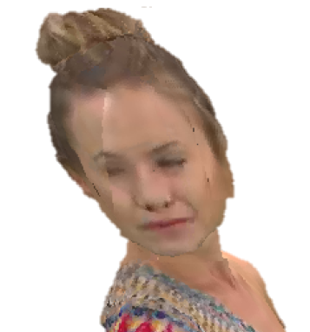
Neighbor Cube-based Motion Interpolation (NCI)
Use the same method to divide cubes and derive motion vectors for each cube
Interpolate each point by inversely proportional to volume of vectors to 27-neighbors’ centers
Get 27 vectors from each point to center of 27-neighbor cubes
Get volume of each vector (x_{i}, y_{i}, z_{i}) by (|x_{i}| * |y_{i}| * |z_{i}|)
Weighted sum by inverse volume of each vector
CMI’s extrusion
Notes:
So similar to previous algorithm, we also compute rigid transformation of each cube
But we loop each point again
Get 27-vectors from each point to 27-neighbor cube center
And weighted sum by inverse volume of each vector

Slide 28

VPCC
NCI
Notes:
We can see Cube-based Motion Interpolation ensure
A cube of the points moves in a consistent direction to avoid creating cracks in the generated frames
And we can prevent gaps between cubes, but

Slide 29
Experimental Setup

Slide 30
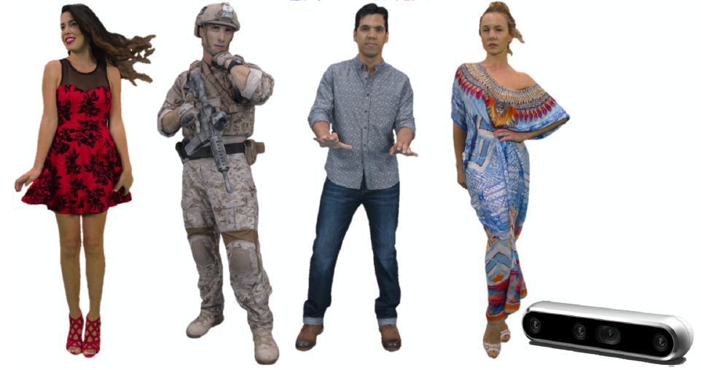
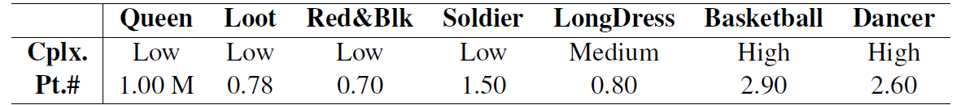
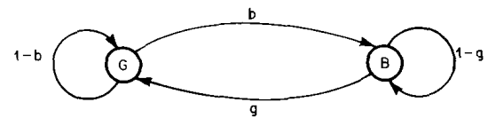
Experimental Setup
Datasets
MPEG dynamic 3D point cloud sequences
Gilbert-Elliot Models[5] parameters
5%, 10%, 15%
Baseline
2D frame copy (2DFC): naive frame copy mechanism by V-PCC codec
3D frame copy (3DFC): copy the nearest undistorted frame over
[5] M. Mushkin and I. Bar-David, "Capacity and coding for the gilbert-elliott channels," in IEEE Transactions on Information Theory, vol. 35, no. 6, pp. 1277-1290, Nov. 1989, doi: 10.1109/18.45284.
Notes:
We use seven MPEG dynamic 3D point cloud sequences with different complexity levels for our experiments
We use Gilbert Elliot to simulate the packet loss of 5%, 10%, and 15%
We choose the baseline of 2D frame copy, which is in the codec
The 3D frame copy is just to copy the nearest available frame

Slide 31
Performance Metrics
3D Visual Metrics
GPSNR - The PSNR of Chamfer distance between pair-wise closest points in the target and ref. frames
Hausdorff distance: The maximal shortest distance between the points in the target and ref. frames
CPSNR: The luminance component of color distortion between the nearest points in the target and ref. frames
2D Visual Metrics
PSNR: The PSNR of the foreground object (avatar) only
SSIM: The luminance SSIM of the foreground object only
VMAF: Predicts subjective video quality consider the whole video sequences
Running time
The lower the better
The lower the better

Slide 32
Objective Results

Slide 33
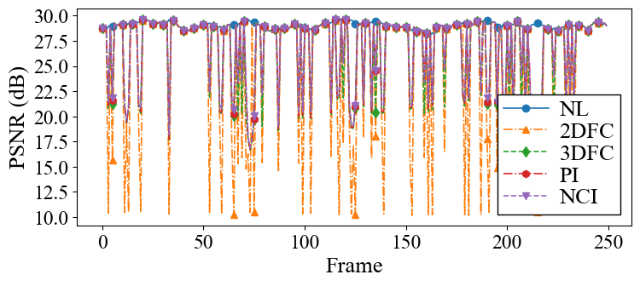
Per-Frame Line Figure
10% lost
Key observations:
NCI > PI > 3DFC > 2DFC in PSNR
the quality drops as high as 12 dB in PSNR
Limitations of the current 2DFC method
Notes:
Note that we didn’t plot the frame that cannot be decoded by 2DFC
And if not mentioned, we will use intermediate complexity of dataset Redandblack, and intermediate packet loss rate 10%
We show the limitation of 2DFC

Slide 34
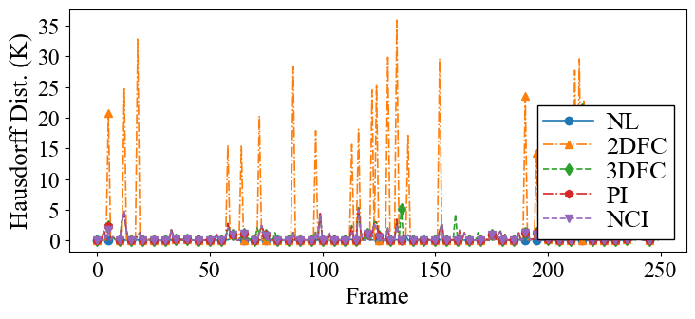
Per-Frame Line Figure
10% lost
Key observations:
2DFC > 3DFC > PI > NCI in Hausdorff distance
the quality surges as high as 35K in Hausdorff distance
Limitations of the current 2DFC method
Notes:
And also for Hausdorff distance
This metrics is the lower the better

Slide 35
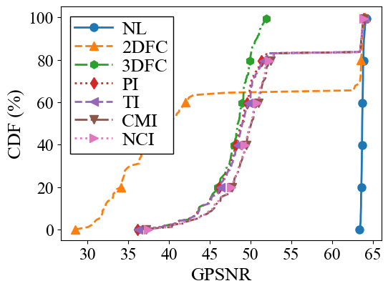
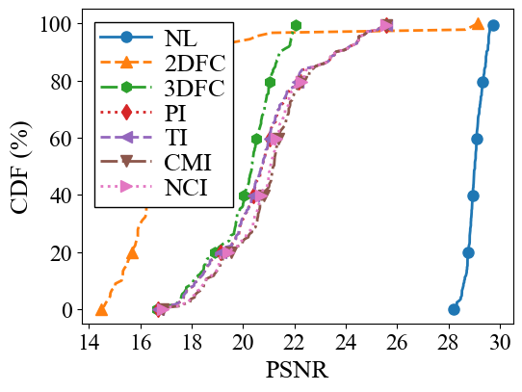
Cumulative Distribution Function (CDF)
Key obserbations:
2DFC still results low in as low as 30 dB in GPSNR
Clustered into (3DFC), (PI, TI), and (CMI, NCI)
20% best performing of (CMI, NCI) is 52⁺ dB
20% best performing of (3DFC) is 49⁺ dB
10% lost
Notes:
We have the key observation that 2DFC still results low in as low as 30 dB in GPSNR
In contrast the 20% best performing frames achieved by our CMI and NI are above 52 dB
And 3DFC at the same level is about 49 dB

Slide 36
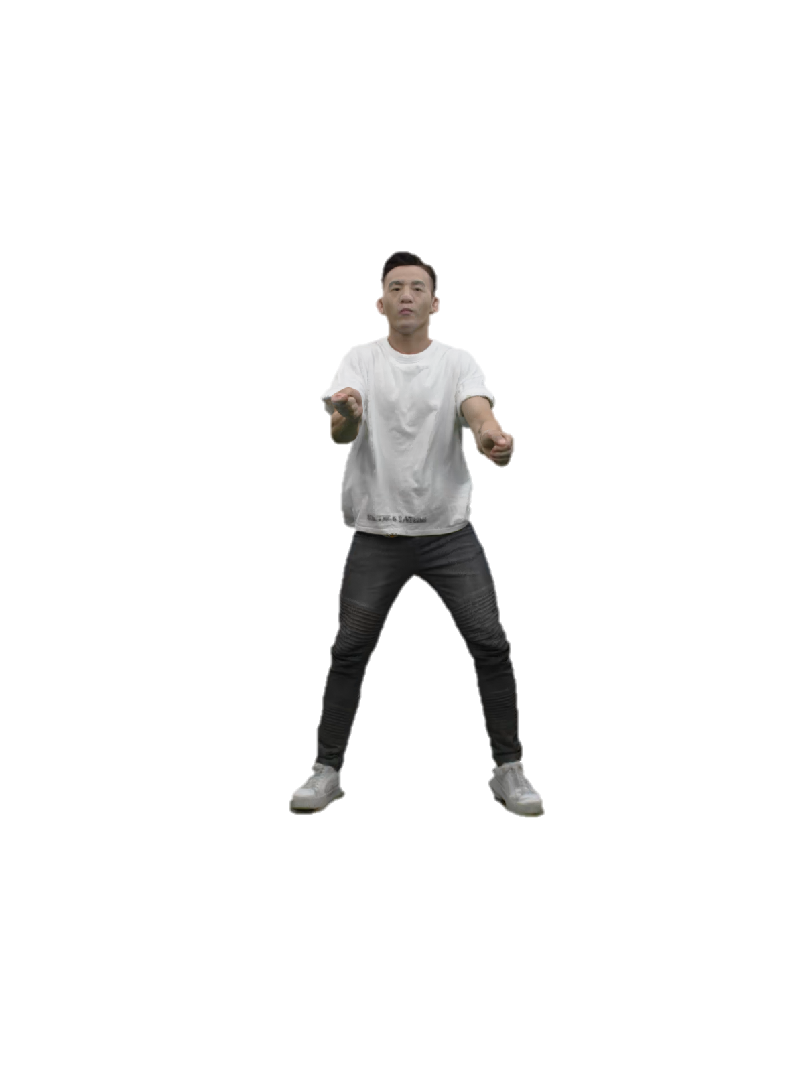
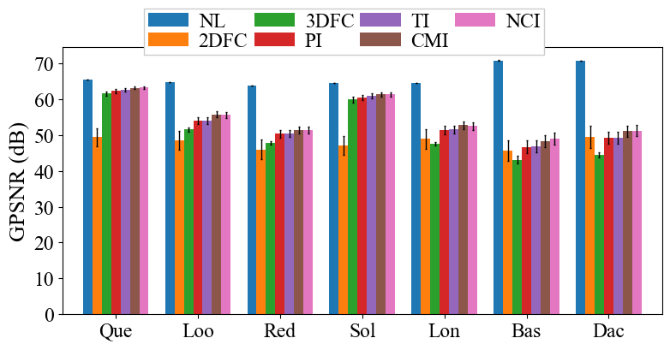
Overall Quality of GPSNR
Our algorithms always outperform 3DFC
CMI and NCI consistently outperform others
Best: +7 dB in Dancer
10% lost
Notes:
Next we plot bar chart of different concealment algorithm for all dataset
We have 2 main observation Number one: We always outperform 2DFC and 3DFC in GPSNR
Number two: Cube based motion interpolation always outperform others

Slide 37
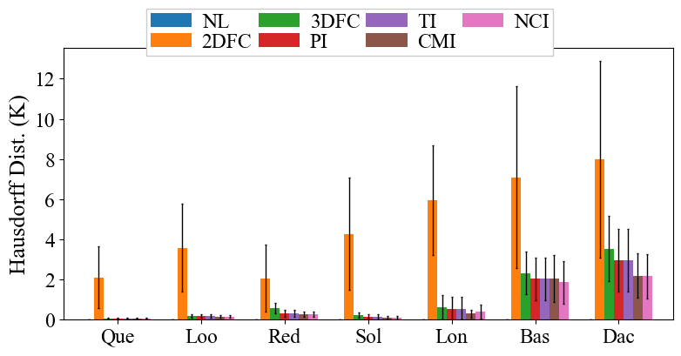
Overall Quality of Hausdorff Distance
Our algorithms always outperform 3DFC
CMI and NCI consistently outperform others
Best: -1.5 K in Dancer
10% lost
Notes:
The similar observation can be found in this figure
The lower the better

Slide 38
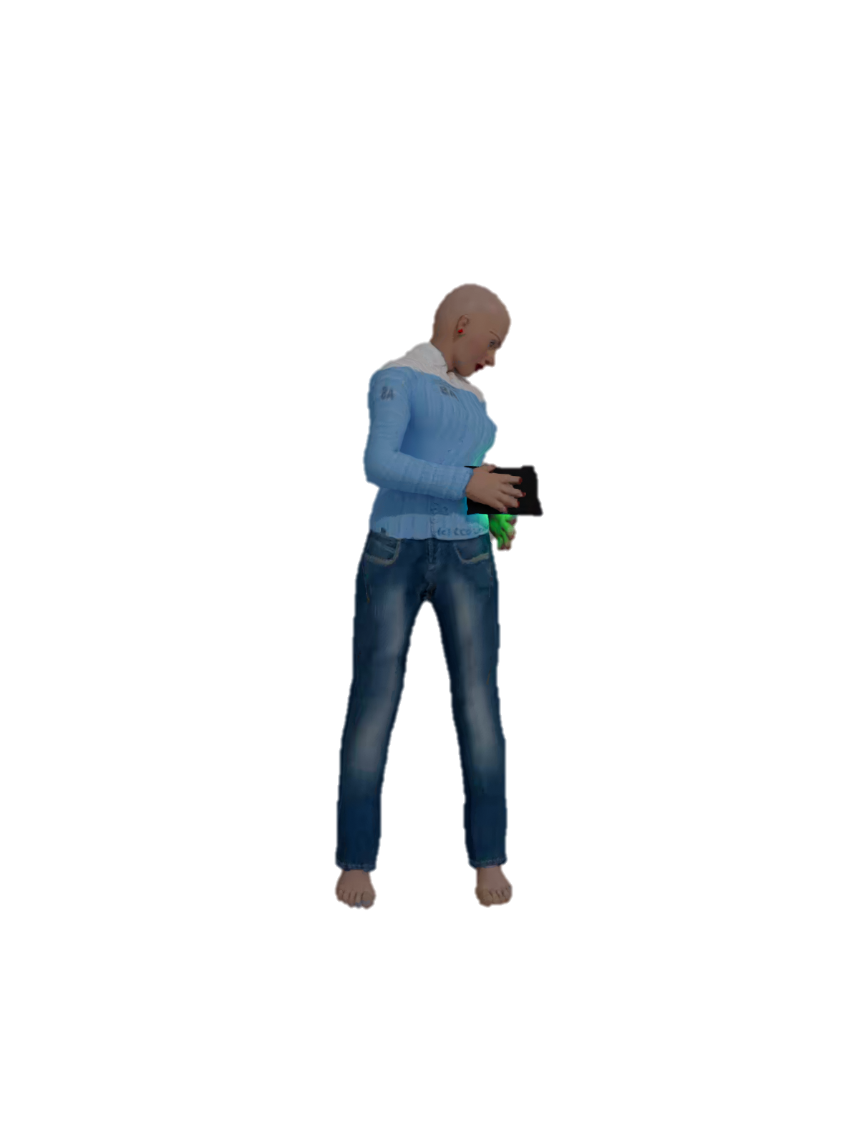
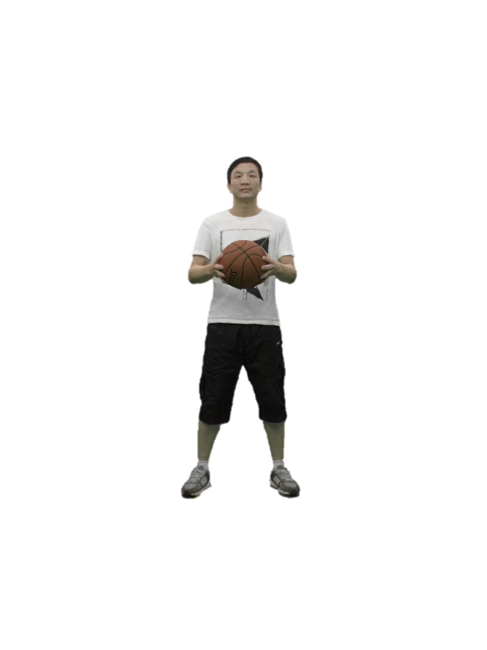
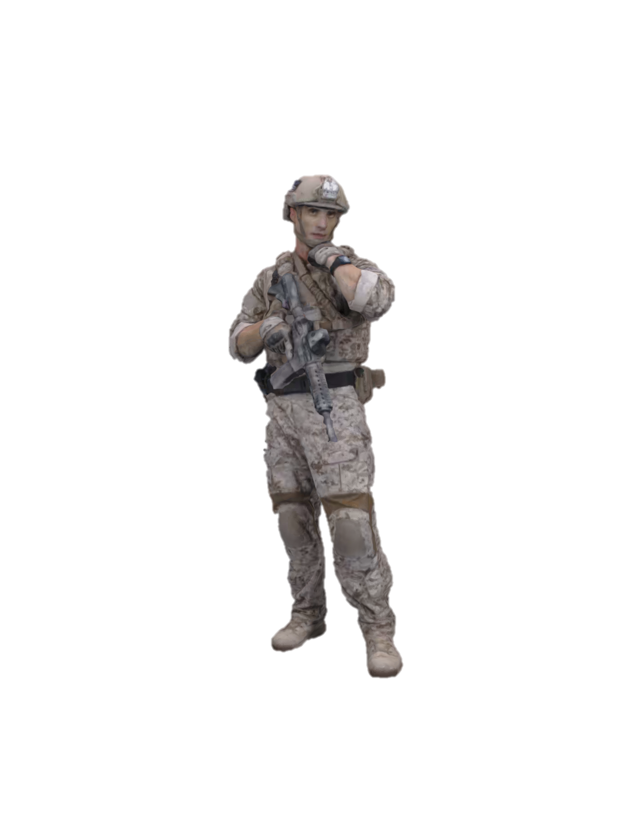
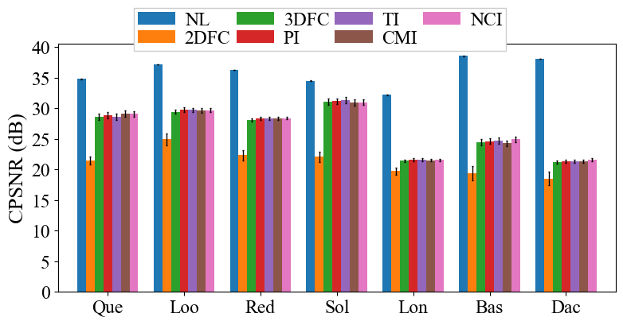
Overall Quality of CPSNR
Our algorithms may not outperform others
CMI and NCI may not outperform others
Best: +1 dB in Queen
Worst: Soldier and Basket
10% lost
Notes:
Next we plot bar chart of different concealment algorithm will all dataset
We have 2 main observation Number one: We always outperform 2DFC and 3DFC
Number two: Cube based motion interpolation always outperform others

Slide 39
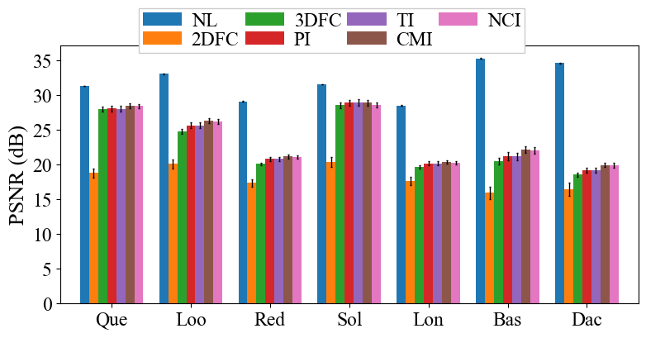
Overall Quality of PSNR
Our algorithms outperform 3DFC in PSNR in most cases
NCI may not outperform others
Best: +2 dB in Loot
Worst: Soldier
Notes:
Then let’s move on overall quality of 2D metrics

Slide 40
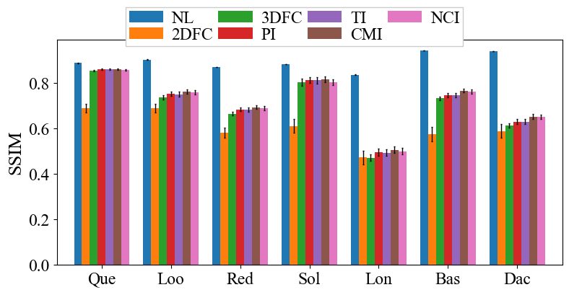
Overall Quality of SSIM
Our algorithms outperform 3DFC in SSIM in most cases
NCI may not outperform others
Best: +0.05 dB in Dancer
Worst: Soldier
Notes:
Especially for basketball and soldier

Slide 41
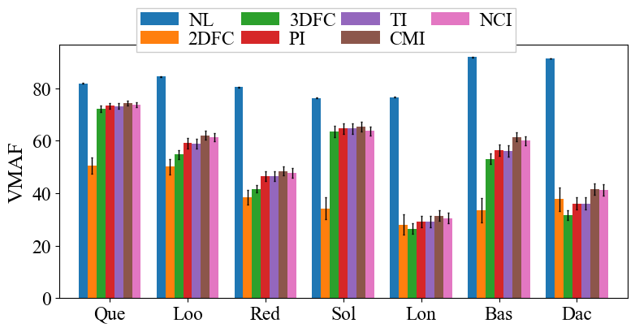
Overall Quality of VMAF
Our algorithms outperform 3DFC in VMAF in most cases
NCI may not outperform others
Best: +9 in Dancer
Worst: Soldier
Notes:
But for VMAF metrics proposed by Netflix, considering motion smoothness
CMI and NCI perform better than previous 2D metrics
But NCI for soldier is still bad

Slide 42
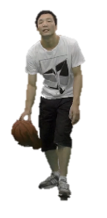

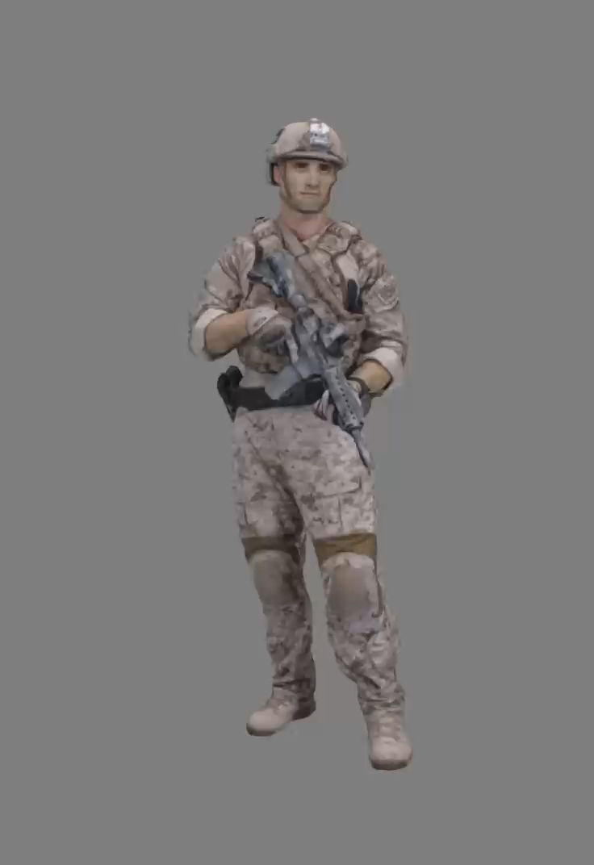
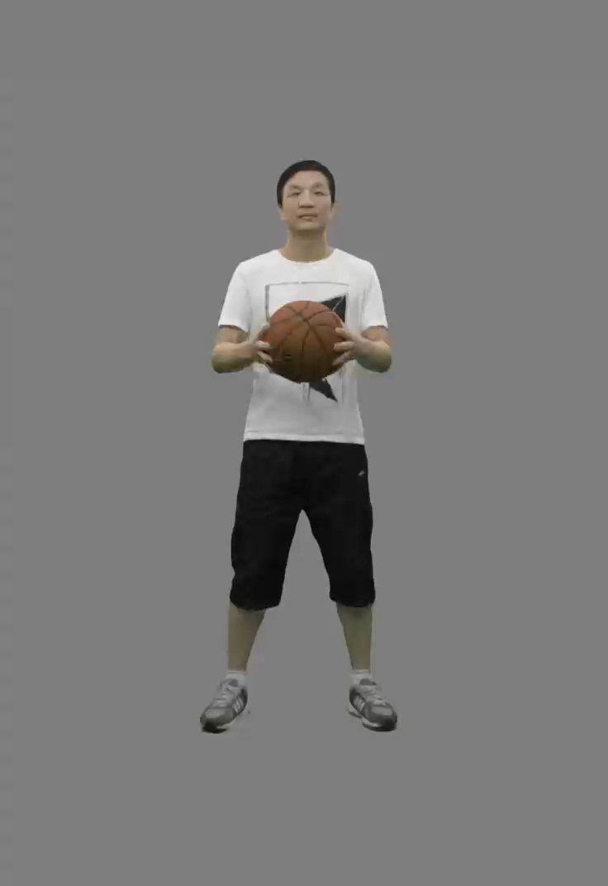
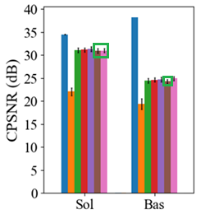
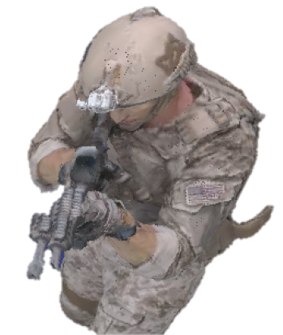
Sequences with Inferior Quality
Example of artifacts from Soldier and Basketball sequences with CMI and NCI algorithms
Notes:
We find that our algorithms don’t perform well especially for avatars holding extra items

Slide 43
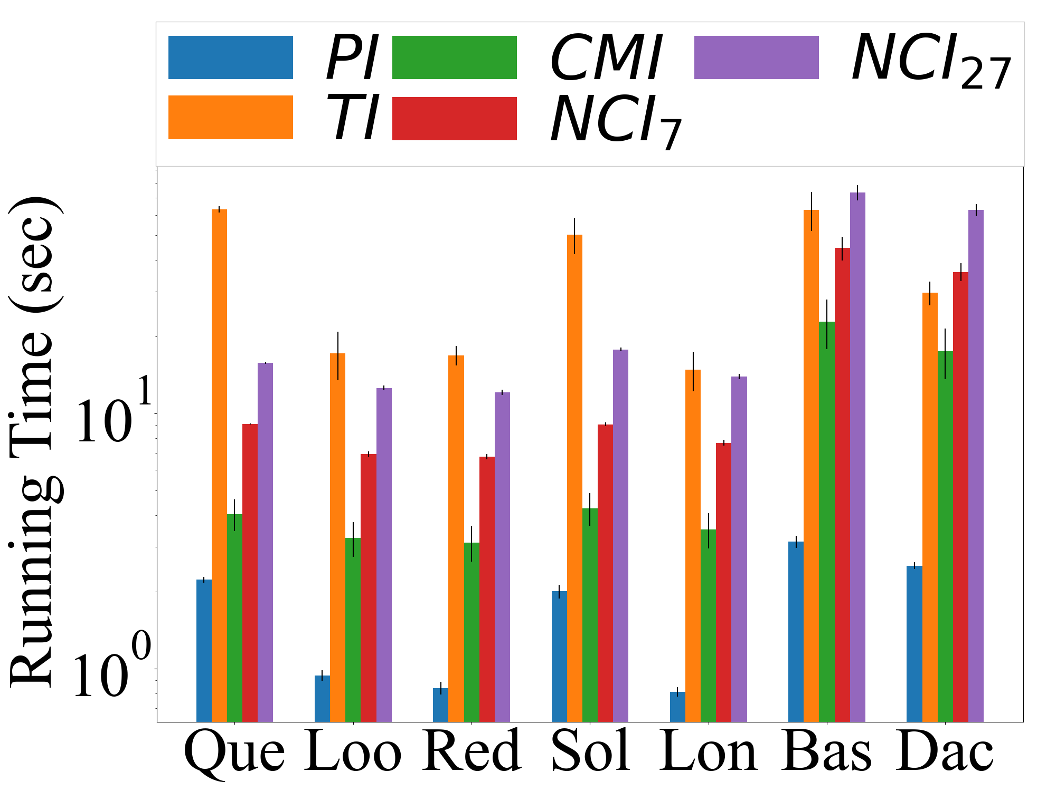
Per-frame Running Time
Select 24 random point cloud frames from total 250 frames
PI run the fastest
CMI and NCI runs slower on high-complexity sequences
NCI runs slower on Dancer and Basketball player sequences
Absolute running time is still long
Notes:
We select
24 random point cloud frames from each considered sequence and
measure the running time of our algorithms.
Among the three algorithms, PI is the fastest
The running time of CMI and NCI becomes longer compared to TI when the complexity level of sequences increases.
We also calculate 7 neighbors and 27 neighbors for NCI
I haven’t report the

Slide 44
Subjective Results

Slide 45
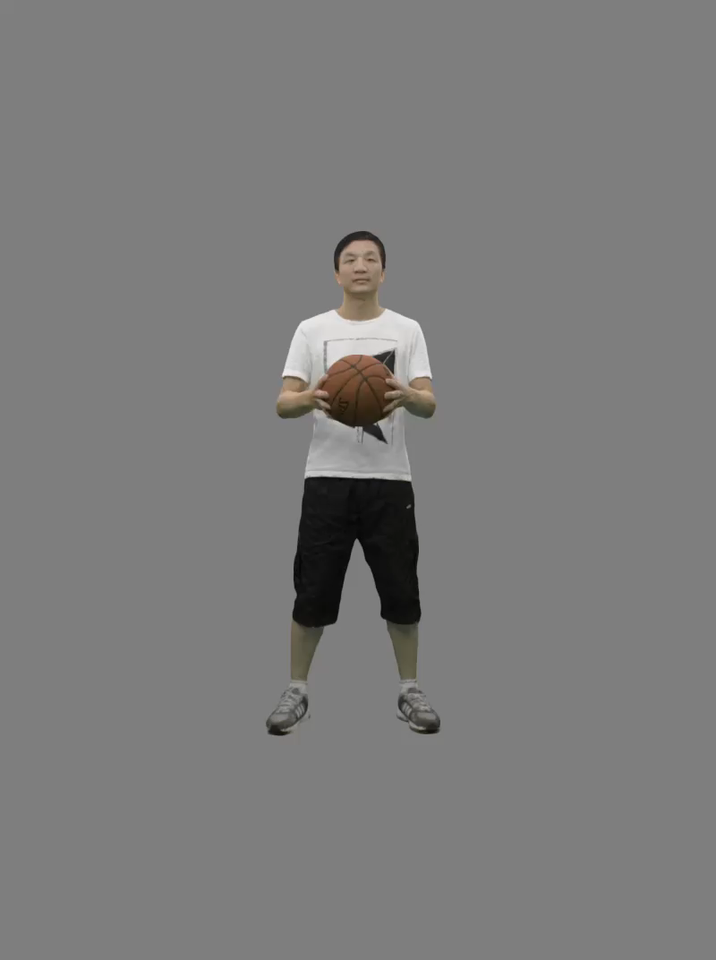
Experimental Setup
Head-to-head video comparison
No. subjects: 12
Three questions:
Which video was smoother?
Which video had better image quality?
Which video did you prefer?
Derive head-to-head comparison to MOS between 0 to 1
Transform by Plackett-Luce model[6]
Normalize to [0, 1]
250 frames, 20 fps
[6] H. L. Turner, J. van Etten, D. Firth, and I. Kosmidis, “Modelling rankings
in R: The PlackettLuce package,” Computational Statistics, pp. 1–31, 2020.
Notes:
We use seven MPEG dynamic 3D point cloud sequences with different complexity levels for our experiments
We use Gilbert Elliot to simulate the packet loss of 5%, 10%, and 15%
We choose the baseline of 2D frame copy, which is in the codec
The 3D frame copy is just to copy the nearest available frame

Slide 46
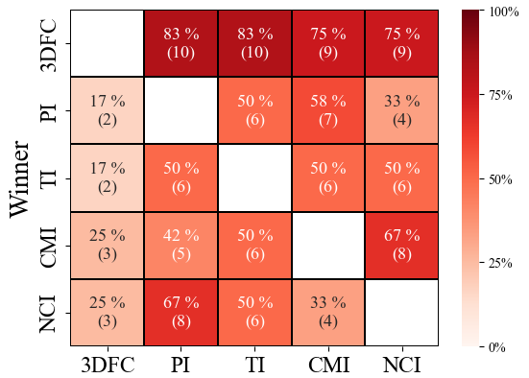
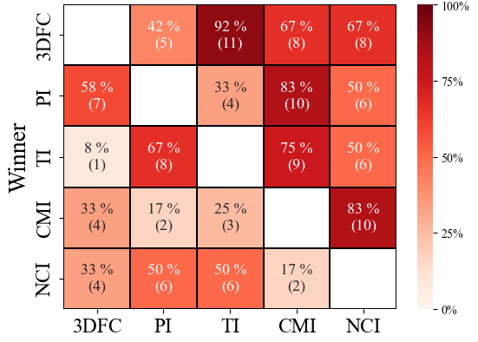


Subjective Results - Basketball
Quality
Smoothness
Preference
Notes:
But for VMAF metrics proposed by Netflix, considering motion smoothness
CMI and NCI perform better than previous 2D metrics
But NCI for soldier is still bad

Slide 47




Subjective Results - Queen
Quality
Smoothness
Preference
Notes:
But for VMAF metrics proposed by Netflix, considering motion smoothness
CMI and NCI perform better than previous 2D metrics
But NCI for soldier is still bad

Slide 48




Subjective Results - Soldier
Quality
Smoothness
Preference
Need more investigations for most suitable algorithms on each sequences
Notes:
But for VMAF metrics proposed by Netflix, considering motion smoothness
CMI and NCI perform better than previous 2D metrics
But NCI for soldier is still bad

Slide 49
CONCLUSION

Slide 50
Conclusion
Studied the uninvestigated problem of error concealment for 3D point cloud streaming
Proposed error concealment algorithms
PI, TI, CMI, and NCI
Significantly outperform the baseline 2DFC and usually outperform 3DFC
Report computational time for tradeoff
CMI and NCI usually outperform others except for Basketball and Soldier sequences
Issue for avatars carrying objects
3DFC performs well in the user study
Hypothesis: Subjects are accustomed to stalls rather than cracks
Notes:
We study the uninvestigated problem of error concealment for 3D point cloud streaming
By proposing the following algorithms
Firstly, the point to point interpolation
Then, Triangular interpolation matching 3 points at once
all of them outperform the baseline 2DFC and 3DFC
And we have one algorithm, the cube-base motion interpolation method always outperform others
We also report the computational time for tradeoff between quality and running time

Slide 51
Future Work
Exploit parallelization of Graphic Processing Unit (GPU)
Improve matching for cubes across frames
Formulate problem of motion estimation
Consider the rotation
Address issue for avatars with extra items
Implement real streaming system
Implement spatial concealment
Notes:
Finally, this work can be extended and improved in multiple directions.
Firstly, our c++ implementation is not fully-optimized. Parallel ability of GPU can be adopted to reduce execution time.
Then we want to improve our temporal concealment with better matching of cubes across target and reference frame
By diving into motion estimation and formulate the problem of motion estimation. And we will also consider the rotation of cubes.
Then we want to implement a real system with adaptive bitrate mechanism
instead of the current simulated Gilbert Elliot models.
Last, we only consider the temporal concealment.
We assume all point cloud frames are lost. Which may not be always the case.
There can still be useful information in the distorted frame for spatial concealment.

Slide 52
Publications and Cooperators
T. Hung, I. Huang, S. Cox, W. Ooi, and C. Hsu, “Error Concealment of Dynamic 3D Point Cloud Streaming,” In submission of ACM International Conference on Multimedia (MM’22), Under Review.
C. Wu, C. Hsu, T. Hung, C. Griwodz, W. Ooi, and C. Hsu, “Quantitative comparison of point cloud compression algorithms with PCC Arena,” IEEE Transactions on Multimedia, pages 1–16, February 2022. Accepted to Appear.
I. Huang, S. Cox, Y. Shi, T. Hung, W. Ooi, and C. Hsu, “Trajectory-driven error concealment of dynamic 3D point cloud streaming for interactive applications,” In preparation for IEEE Transactions on Multimedia.
I-Chun Huang, National Tsing Hua University
Sam Cox, National Tsing Hua University
Young Shi, National Tsing Hua University
Chen-Hao Wu, Synopsys
Wei Tsang Ooi, National University of Singapore
Carsten Griwodz, University of Oslo
Chih-Fan Hsu, National Yang Ming Chiao Tung University

Slide 53
Q&A
Thank you for listening

Slide 54



Applications on Point Clouds
Sparse Point Clouds
Human activity analysis
Fall detection
Cylindrical Point Clouds
Civil engineering inspection
Obstacle detection
Dense Point Clouds
Entertainment
Teleconference
Our usage scenario
Notes:
And let’s see examples,
With tens to hundreds of points captured by millimeter wave radar.
The points don’t reveal human identity, can be apply to human activity analysis and fall detection
Without compromise the privacy
For cylindrical ‘sɪˈlɪndrɪk(ə)l’ point clouds captured by Lidars, they have high horizontal resolution but sparse in vertical resolution
For dense point clouds, they can be used in Head Mounted Display interaction like Virtual Reality and teleconference
Virtual Reality, Augmented Reality, Mixed Reality

Slide 55




Subjective Results - Dancer
Quality
Smoothness
Preference
Notes:
But for VMAF metrics proposed by Netflix, considering motion smoothness
CMI and NCI perform better than previous 2D metrics
But NCI for soldier is still bad

Slide 56




Subjective Results - Loot
Quality
Smoothness
Preference
Notes:
But for VMAF metrics proposed by Netflix, considering motion smoothness
CMI and NCI perform better than previous 2D metrics
But NCI for soldier is still bad

Slide 57




Subjective Results - Longdress
Quality
Smoothness
Preference
Notes:
But for VMAF metrics proposed by Netflix, considering motion smoothness
CMI and NCI perform better than previous 2D metrics
But NCI for soldier is still bad

Slide 58




Subjective Results - Redandblack
Quality
Smoothness
Preference
Notes:
But for VMAF metrics proposed by Netflix, considering motion smoothness
CMI and NCI perform better than previous 2D metrics
But NCI for soldier is still bad

Slide 59
Why don’t we use ML
NN-based PCC algorithms runs at least 10 times slower than SP-based ones
C.-H. Wu, C.-F. Hsu, T.-K. Hung, C. Griwodz, W. T. Ooi, and C.-H. Hsu. Quantitative
comparison of point cloud compression algorithms with PCC Arena. IEEE
Transactions on Multimedia, pages 1–16, February 2022. Accepted to Appear

Slide 60
Why use V-PCC as the ref SW
Proposed by a well known ISO/IEC standards organization group: MPEG
SP-based PCC algorithm
Suitable for point cloud videos
Well documented
S. Schwarz, M. Preda, V. Baroncini, M. Budagavi, P. Cesar, P. A. Chou,
R. A. Cohen, M. Krivoku´ca, S. Lasserre, Z. Li et al., “Emerging MPEG
standards for point cloud compression,” IEEE Journal on Emerging and
Selected Topics in Circuits and Systems, vol. 9, no. 1, pp. 133–148,
2018.

Slide 61

PC MB/s
C. Cao, M. Preda, and T. Zaharia, “3D point cloud compression: A survey,” ACM International Conference on 3D Web Technology (Web3D’19), pages 1–9, July 2019.

Slide 62


NCI

Slide 63

GPSNR

