Slide 1

HPFL: Federated Learning by Fusing Multiple Sensor Modalities with Heterogeneous Privacy Sensitivity Levels
Yuan-Jie Chen
Advisor: Cheng-Hsin Hsu

Slide 2
Outlines
Introduction
Related Work
Heterogeneous Privacy Federated Learning
Multi-Modal Representation Learning
Experiment Setup
Experiment Results
Conclusion and Future Work

Slide 3
Introduction

Slide 4




Multi-modal Sensing
A variety of professional sensors are gradually attracting attention
Depth cameras
Thermal cameras
mmWave radars
LiDARs
Provides multi dimensions information than single modal sensing
Self-driving cars
Health cares
Robot systems
Smart agricultures
Notes:
By develop of ML
Depth -> 3D modeling, thermal-> anomaly detection

Slide 5
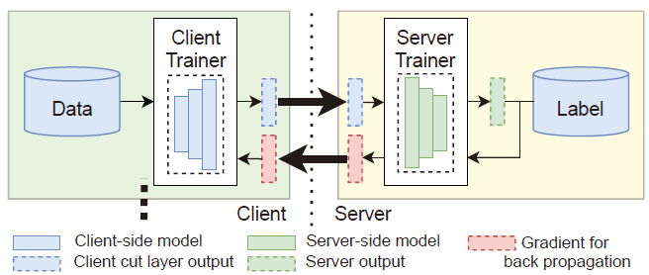
Privacy Concern
Collecting data from widely used RGB cameras incurs privacy risk
Encryption methods
Distributed Cooperative Machine Learning (DCML) [1]
Homomorphic encryption and differential privacy
Advanced privacy protection techniques
High computation and communication overhead
Split Learning (SL [2]) and Federated Learning (FL [3])
SL and FL provide source data protection DCML
SL is slower than FL
SL usually works under organizations (data providers, computing resource providers)
[1] Scaling up machine learning: Parallel and distributed approaches. Cambridge University Press, 2011.
[2] Vepakomma P, Gupta O, Swedish T, et al. Split learning for health: Distributed deep learning without sharing raw patient data[J]. arXiv preprint arXiv:1812.00564, 2018.
[3] McMahan B, Moore E, Ramage D, et al. Communication-efficient learning of deep networks from decentralized data[C]//Artificial intelligence and statistics. PMLR, 2017: 1273-1282.
Notes:
All applications based on ML
Regular centralized learning method
RGB-D/T camera is cheap, widely used
Parallel SL has same performance of FL, hard implement

Slide 6
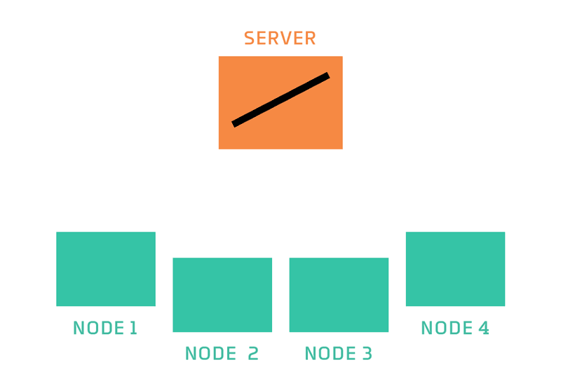
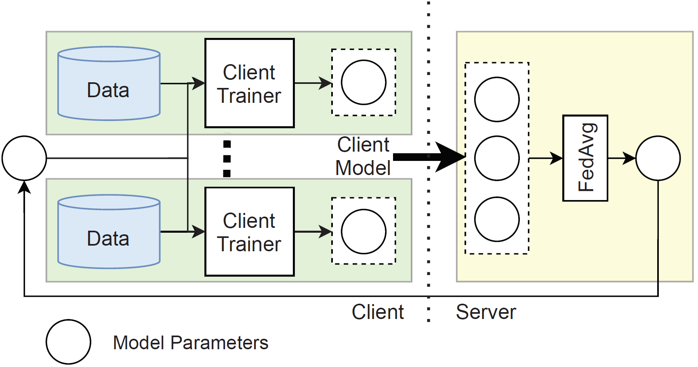
Federated Learning
[2]
Federated learning [1] workflow (FedAvg)
Distribute server model
Client training
Upload client model
Aggregation
Advantage: Protects client’s privacy and reduces communication cost
Disadvantage: low model performance and convergence speed caused by data incompleteness
Non-independent-identically distributed (non-i.i.d.): concept drift/shift, covariate shift
[1] McMahan B, Moore E, Ramage D, et al. Communication-efficient learning of deep networks from decentralized data[C]//Artificial intelligence and statistics. PMLR, 2017: 1273-1282.
[2] http://vision.cloudera.com/wp-content/uploads/2018/11/2018-10-31-181344-federated_learning_animated_labeled.gif
Notes:
*Horizontal FL -> same feature
Vertical FL -> same label
Cannot see all training data
Drift -> same label
Shift1 -> same feature, NLP emotion in different sentiments shift2-> different sample distribution

Slide 7
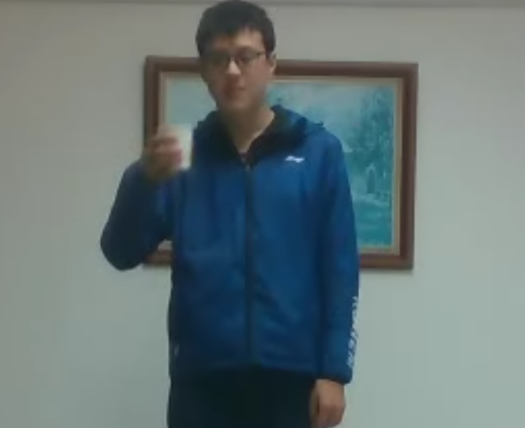
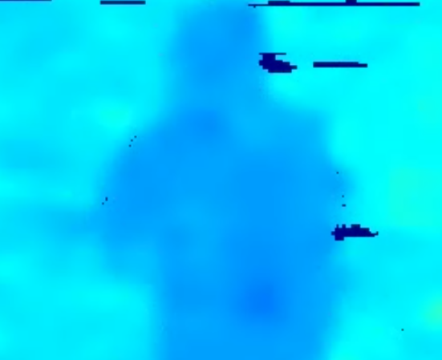
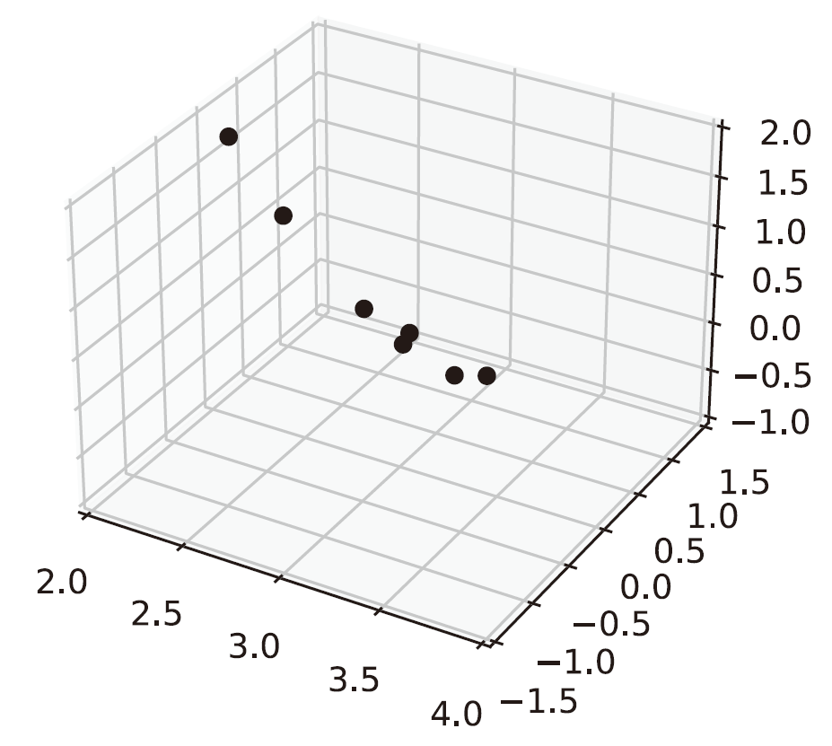
Motivation
Multiple sensors generate data that has diverse degrees of privacy concerns
RGB images → privacy-sensitive
Depth images, mmWave point clouds → privacy-insensitive
The root cause of the performance degradation of FL models: data incompleteness
Scattered data
Non-i.i.d. data
The utilization of privacy-insensitive data has never been considered
RGB image Depth image mmWave point cloud
Notes:
RGB image contains more data

Slide 8
Problem Statement
Target
Utilize the privacy-insensitive data to improve FL model performance
Reduce the impact of non-i.i.d. data on the model
Condition
Each clients has a multi-modal dataset with heterogeneous degrees of privacy levels
No obviously privacy risk
Lower communication and computation overhead
Solution
Request all clients upload privacy-insensitive data to the server
Add an additional model fine-tuning at the server

Slide 9
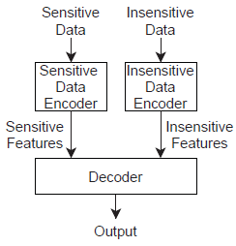
Challenges
Utilization of insensitive data for improving model performance
No similar work in the literature
Multi-modal models require multi type data as inputs
Privacy-sensitive data are not available at the server
Training with single insensitive data can bias the models
An example multi-modal model
Notes:
Send one modality = train single modal model

Slide 10
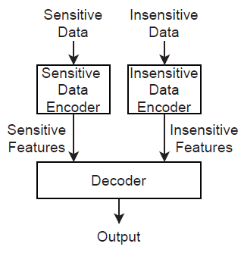
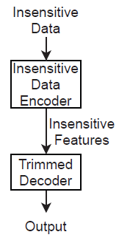
High Level Solution
All clients upload insensitive data to server
Create a distillation model at the server
Train distillation model with all insensitive data
Merge distillation model back to aggregation model (the FedAvg output)
Remove weights
Aggregation model
Distillation model

Slide 11
Contributions
We are the first group who considered multi-sensor (or multi-modal) classification problems, in which sensor data have diverse privacy sensitivity levels
We apply HPFL on a semantic segmentation network, an emotion recognition network, and get 18.2% improvement in foreground accuracy and 4.2% in F1-score, compared to FedAvg
HPFL outperforms state-of-the-art advanced FL optimization algorithms, FedProx, FedAdam, FedDyn, FedCon, 12.4%-17.7% improvement in foreground accuracy and 2.54%-4.1% in F1-scores

Slide 12
Related wORK
Notes:
From our core idea

Slide 13
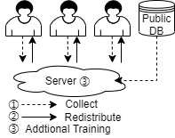
Data Sharing
To overcome the inference of non-iid data distribution
Redistribute the data that collect from clients or public dataset to balance local data (①, ②)
Employ the collected data to carry out additional training after the client training (①, ③)
Summary
Not realize the heterogeneous privacy sensitivity levels data
Still have privacy concern
Unable to confront strong non-iid degree, performance improvement is small (2%~5%)
Notes:
Public dataset distribution ~ local dataset FL 假设原本的资料全部是sensitive data
fore data region and usage situations
Classify cat/dog hospital

Slide 14
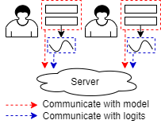
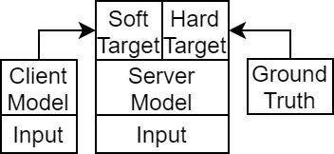
Distillation and Federated Distillation
Distillation was initially proposed to compress neural networks
Federated distillation was proposed for two targets:
Trade model accuracy for lower communication cost
Server-side distillation for better server model performance and compatible heterogeneous client model structure
We only collect insensitive data to server, so, we cannot perform the offline distillation at server
Notes:
Our target: client model guide server training avoid to similar single modal
Client-side distillation: 1% comm. Cost compared to FedAvg, higher computation resource, lower performance
Server-side distillation, include some data share distillation, public dataset, we have same domain data for KD

Slide 15
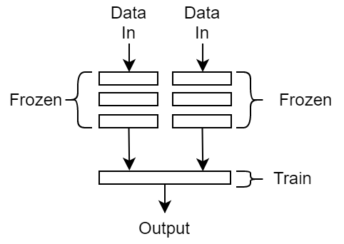
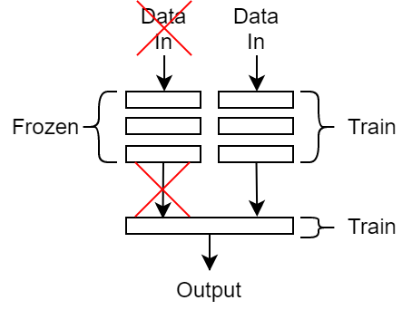
Federated Transfer Learning
Transfer learning focuses on transferring a domain knowledge to a different but similar domain
FTL belongs to personalization FL
The server model may not adapt to every participating client
FTL freezes the parameters related to high-level features, but HPFL freezes the parameters related to sensitive data
FTL focuses on optimizing client model but HPFL focuses on optimizing server model
FTL HPFL

Slide 16
Advanced FL Algorithms
Common target: improve server model performance in FL
Optimize client trainer:
FedProx [1]: add a L2-regularize term on client trainer → reduce the distance between client and server model
FedDyn [2]: consider history updates and distance to server model → smooth updating
FedCon [3]: consider the feature learned by client model and server model need to be similar → fast converge
Optimize server aggregator:
FedAdam [4]: use Adam optimizer to replace average aggregator in FedAvg → fast converge
[1] Sahu A K, Li T, Sanjabi M, et al. On the convergence of federated optimization in heterogeneous networks[J]. arXiv preprint arXiv:1812.06127, 2018, 3: 3.
[2] Acar D A E, Zhao Y, Navarro R M, et al. Federated learning based on dynamic regularization[J]. arXiv preprint arXiv:2111.04263, 2021.
[3] Li Q, He B, Song D. Model-contrastive federated learning[C]//Proceedings of the IEEE/CVF Conference on Computer Vision and Pattern Recognition. 2021: 10713-10722. [4] Reddi S, Charles Z, Zaheer M, et al. Adaptive federated optimization[J]. arXiv preprint arXiv:2003.00295, 2020.
Notes:
主要关注与我们相同目标与client环境的算法，最近几年的state of the art
FedCon similar to server model, far to last round model
Beta1, beta2 in Adam

Slide 17
Heterogeneous Privacy Federated Learning

Slide 18
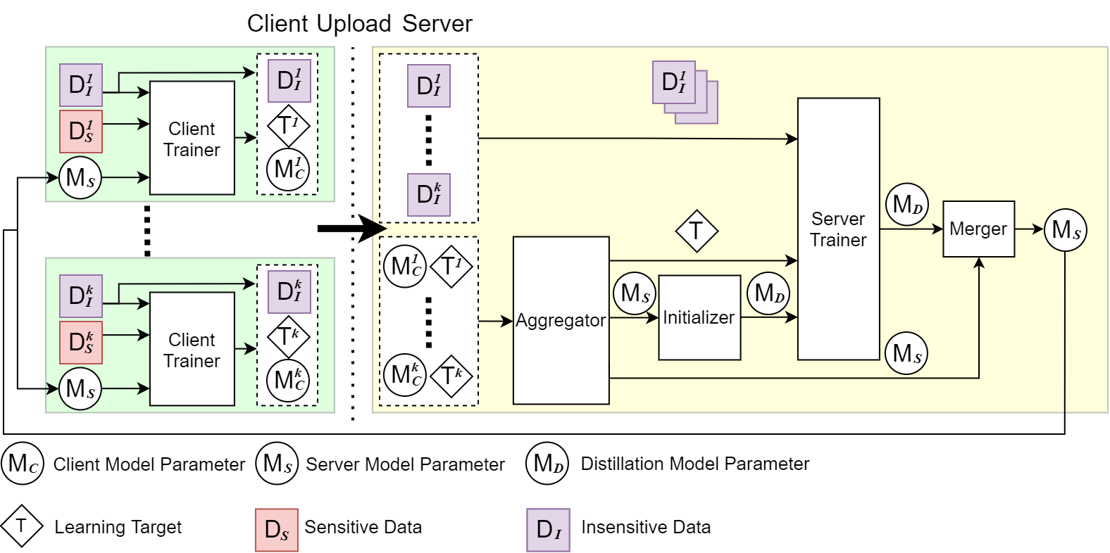
HPFL Workflow
Client model: used by the clients to train with locally collected sensor data
Server model: aggregated from models sent by all clients
Distillation model: trained by insensitive data from all clients at the server
Notes:
Client-side server-side learning target

Slide 19
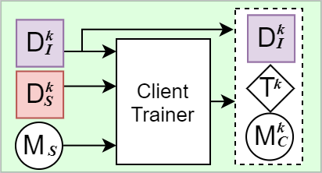
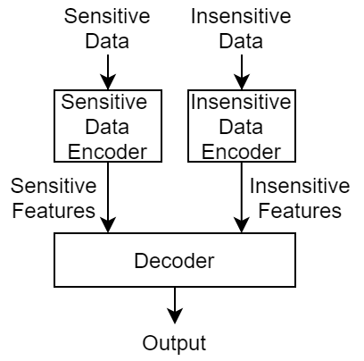
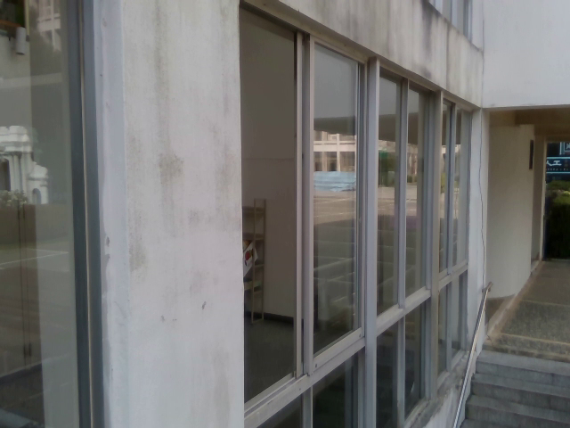

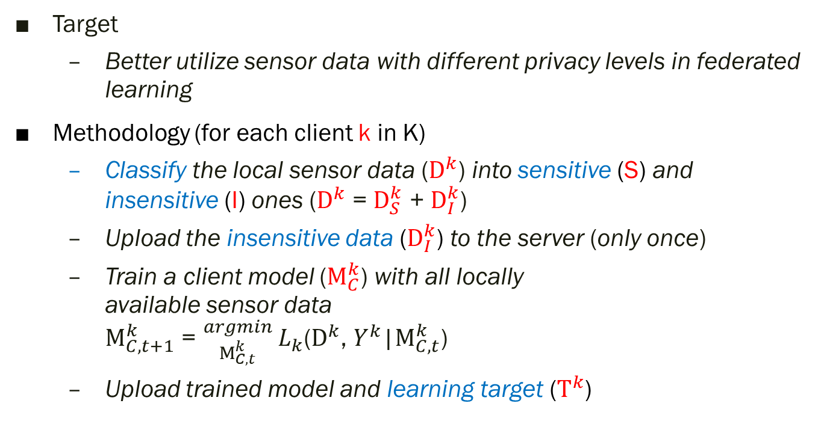
Client Side Design
Target
Better utilize sensor data with different privacy levels in federated learning
Methodology (for each client k in K)
Classify the local sensor data ($D^{k}$) into sensitive (S) and insensitive (I) ones ($D^{k}$ = $D_{S}^{k}$ + $D_{I}^{k}$)
Upload the insensitive data ($D_{I}^{k}$) to the server (only once)
Train a client model ($M_{C}^{k}$) with all locally available sensor data $M_{C,t+1}^{k}$ = ${}_{M_{C,t}^{k} }^{argmin} L_{k}$($D^{k}$, $Y^{k}$|$M_{C,t}^{k}$)
Upload trained model and learning target ($T^{k}$)
①
②
③
④
Sensitive data
(RGB)
Insensitive data
(Thermal)
General client model
Notes:
Target: Lower computation resource consumption
Client train full model

Slide 20
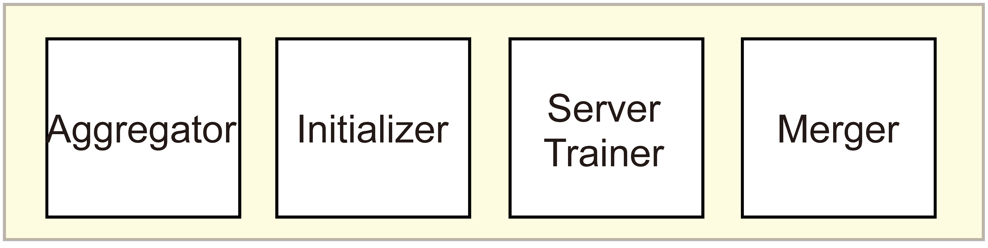
Server Side Design
Better utilize the insensitive data to reduce the negative impacts caused by non-i.i.d. sample distribution
The complete model needs sensitive and insensitive data as input, but no sensitive data is available
Methodology
Aggregator: aggregate (e.x. FedAvg) the model and learning target that received from the client
Initializer: initialize the distillation model parameters
Server Trainer: optimize the distillation model with insensitive data and learning target
Merger: merge distillation model and server model for next round
Notes:
Server-side is the core design of HPFL
Modularized HPFL

Slide 21
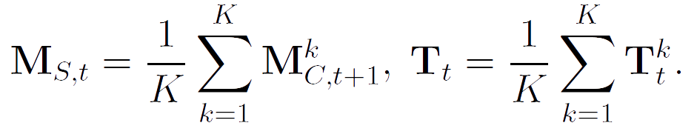
Aggregator
Compute a server model and average learning target based on all client model and learning target
The default aggregator is FedAvg
HPFL can generalizes for advanced aggregator
Notes:
We will show in experiments

Slide 22
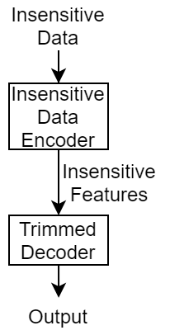
Initializer
Target
Generate the distillation model from server model for training with insensitive data
Remove the model parameters relevant to sensitive data
Remove parameters
Server model
Distillation model
Notes:
Server-side cannot access sensitive data
Server model from average client model
Decided by specific application and model

Slide 23

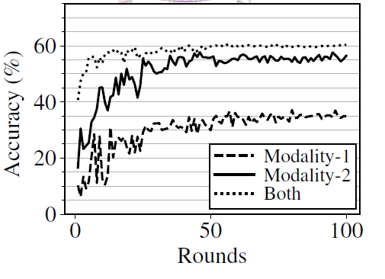





Baseline Trainer
Baseline algorithm (HP): server trainer trains distillation model with insensitive data
Train multi-modal model with single modality data causes performance drop
Distillate the knowledge from client models to distillation model
Knowledge
Distillation
$$M_{C}$$
$$M_{C}$$
$$M_{C}$$
$$M_{C}$$
$$M_{C}$$
Client models
Distillation model

Slide 24
Learning Target
Improved federated distillation:
The server only has insensitive data and cannot perform regular distillation
We propose to have clients upload some layer outputs as learning target to guild the server for distillation
Decoder Distillation (HPD) uses the outputs of the last decoder layer as learning targets
Encoder Distillation (HPE) uses the outputs of all last insensitive data encoder layer as learning targets
Passive inputs: (HPP) uses the outputs of all last sensitive data encoder layer as learning targets.
Notes:
Distillation model training with insensitive data only cause bias
Comm. cost
Regular distillation = offline distillation
Client model -> teacher, distillation model -> student
Decided by model structure
In HPP distillation model decoder same with server model

Slide 25
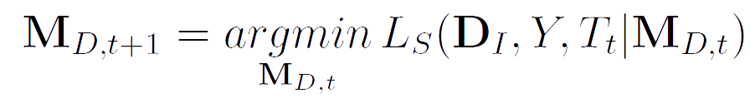
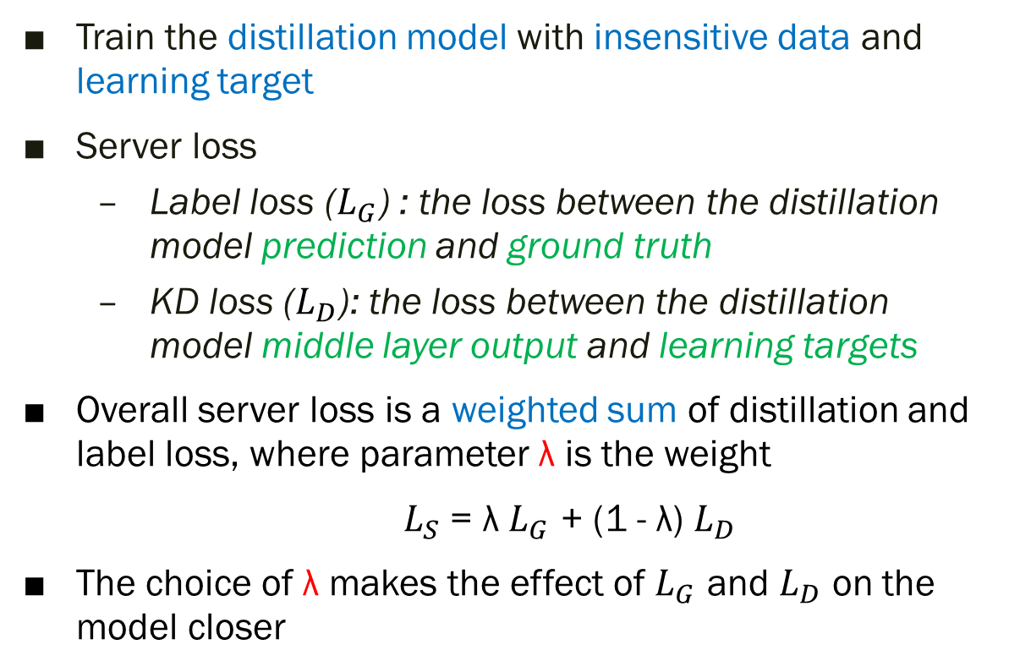
Server Trainer
Train the distillation model with insensitive data and learning target
Server loss
Label loss ($L_{G}$) : the loss between the distillation model prediction and ground truth
KD loss ($L_{D}$): the loss between the distillation model middle layer output and learning targets
Overall server loss is a weighted sum of distillation and label loss, where parameter λ is the weight
$L_{S}$ = λ $L_{G}$ + (1 - λ) $L_{D}$
The choice of λ makes the effect of $L_{G}$ and $L_{D}$ on the model closer

Slide 26

Merger
Clients need a complete multi-modal model for next round training
Merge the trained distillation model back to the server model
The merged part depends on different application models
The contribution of the distillation model to the server model is controlled by parameter α
$M_{S}$ = α $M_{S}$ + (1 - α) $M_{D}$
α 1 - α
Adaptive selection
Server model Distillation model
Notes:
not all trained part will be merged

Slide 27
Multi-Modal Representation Learning

Slide 28
Multi-modal Representation Learning
The HPFL can be applied to many machine learning tasks
MMRL [1] has become a hot topic due to the growth of multiple sensors and data
Video classification
Emotion recognition
Activity detection
Sentiment analysis
Semantic segmentation
We choose the emotion recognition and semantic segmentation as sample applications
[1] Zhang C, Yang Z, He X, et al. Multimodal intelligence: Representation learning, information fusion, and applications. IEEE Journal of Selected Topics in Signal Processing, 2020, 14(3): 478-493.

Slide 29
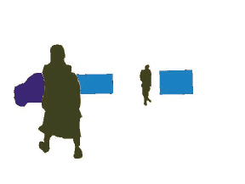
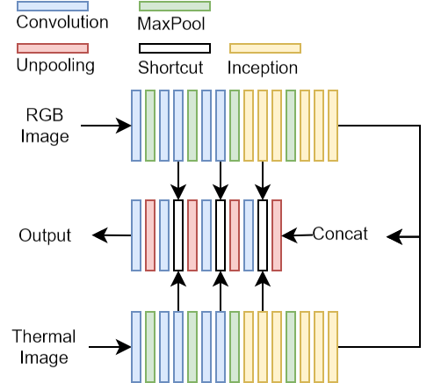

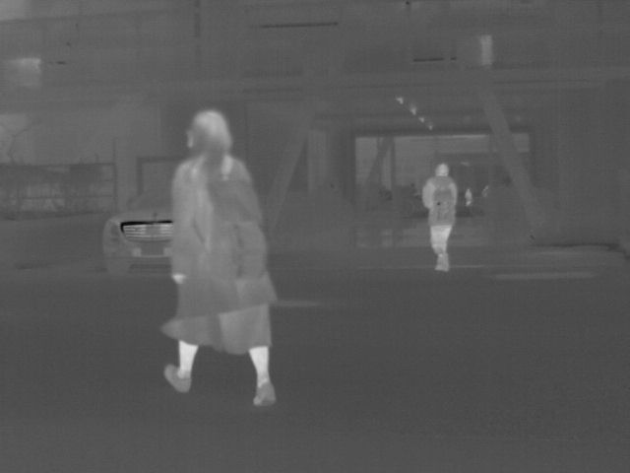
Semantic Segmentation
Labels each pixel of an image with one or multiple classes
We choose MFNet [1] as a semantic segmentation task example
We consider RGB image as sensitive data, thermal image as insensitive data
RGB input Thermal input
[1] Ha Q, Watanabe K, Karasawa T, et al. MFNet: Towards real-time semantic segmentation for autonomous vehicles with multi-spectral scenes[C]//2017 IEEE/RSJ International Conference on Intelligent Robots and Systems (IROS). IEEE, 2017: 5108-5115.
Notes:
Inception -> merge 2 parallel conv. results

Slide 30
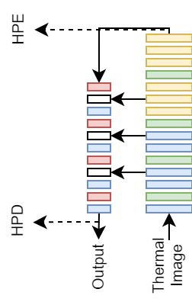
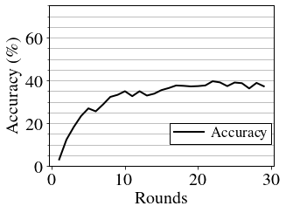
Distillation Model for Semantic Segmentation
We remove the encoder of RGB image input (sensitive data encoder)
We put the work point of HPD and HPE in distillation model
HPP does not work well with MFNet
Distillation model Results of HPP
Notes:
Select multiple parameter combination and merge methods

Slide 31
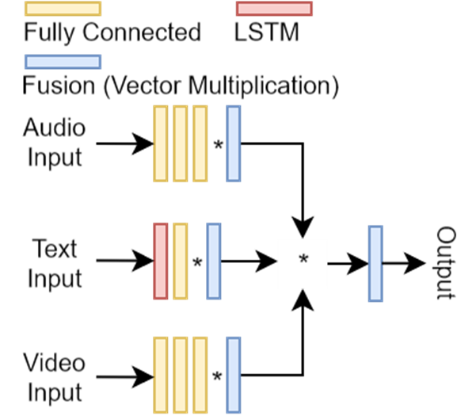




Emotion Recognition
We choose LMF [1] as a emotion recognition task example
We consider video and text as sensitive data, audio as insensitive data
Data provided by IEMOCAP [2] dataset are preprocessed for features
[1] Liu Z, Shen Y, Lakshminarasimhan V B, et al. Efficient low-rank multimodal fusion with modality-specific factors[J]. arXiv preprint arXiv:1806.00064, 2018.
[2] Busso C, Bulut M, Lee C C, et al. IEMOCAP: Interactive emotional dyadic motion capture database[J]. Language resources and evaluation, 2008, 42(4): 335-359.
Notes:
MLP
Vector multiplication

Slide 32
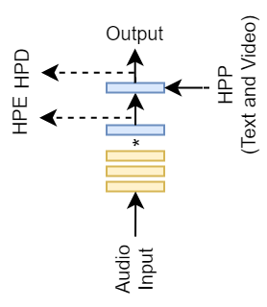
Distillation Model for Emotion Recognition
We remove the encoder of text and video input (sensitive data encoder)
We put the work point of HPD and HPE in distillation model
The learning target of HPP contains averaged text and video encoder output from clients

Slide 33
Experiment Setup

Slide 34
Benchmarking Algorithms
FedAvg [1]: the earliest federated learning algorithm
FedProx [2]: optimize client trainer by proximal term
FedAdam [3]: add an Adam optimizer on aggregator
FedDyn [4]: optimize client trainer by linear and quadratic penalty
FedCon [5]: optimizes the client trainer to decrease the distance between representation learned from client model and server model
[1] McMahan B, Moore E, Ramage D, et al. Communication-efficient learning of deep networks from decentralized data[C]//Artificial intelligence and statistics. PMLR, 2017: 1273-1282.
[2] Sahu A K, Li T, Sanjabi M, et al. On the convergence of federated optimization in heterogeneous networks[J]. arXiv preprint arXiv:1812.06127, 2018, 3: 3.
[3] Acar D A E, Zhao Y, Navarro R M, et al. Federated learning based on dynamic regularization[J]. arXiv preprint arXiv:2111.04263, 2021.
[4] Li Q, He B, Song D. Model-contrastive federated learning[C]//Proceedings of the IEEE/CVF Conference on Computer Vision and Pattern Recognition. 2021: 10713-10722.
[5] Reddi S, Charles Z, Zaheer M, et al. Adaptive federated optimization[J]. arXiv preprint arXiv:2003.00295, 2020.

Slide 35
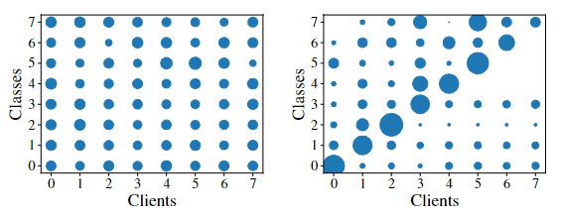
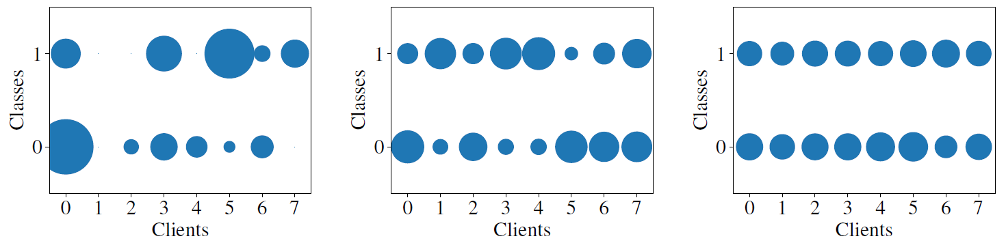
Dataset and Data Distribution
MFNet: totally 1600 and 300 pairs of RGB and thermal images in the training and testing sets
LMF: totally 3515 and 938 triplets of video, audio, and text data in the training and testing sets
We utilize the Dirichlet distribution to generate three sample distribution degrees
0.1
1
10
Notes:
Author provide dataset
Each client get same amount of dataset, default 8 clients
In segmentation, each image has multi class
Different non-iid data distributions affect HPFL

Slide 36
Parameters
Distillation model contribution: α ∈ {0.0, 0.1, 0.3, 0.5, 0.7}
Loss balance parameter: λ ∈ {0.05, 0.1, 0.2}
Distillation method ∈ {HP, HPD, HPE, HPP*}
Data distribution ∈ {i.i.d., non-i.i.d.} or ∈ {0.1, 1, 10}.
Number of clients ∈ {8, 16, 32}
Neural network parameters and baseline algorithm parameters have been tuned and fixed
The merge part selection experiments were omitted
* HPP only works on emotion recognition problem
Notes:
Alpha = 0.1 works worse in MFNet
Learning rate, epoch is fixed

Slide 37
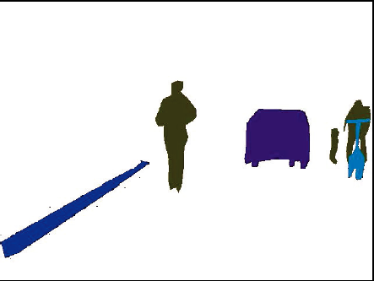
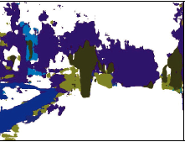
Metrics
Background accuracy: The ratio of background pixels that are correctly classified in the semantic segmentation problem.
Foreground accuracy: The ratio of non-background pixels that are correctly classified in the semantic segmentation problem.
F1-score: The weighted F1-score in the emotion recognition problem.
Throughput: The network resource consumption for transmitting model parameters and learning targets.
CPU time: The time taken by each client in a round.
Background pixels
Low background
Accuracy
Foreground pixels

Slide 38
Experiment ResultS

Slide 39
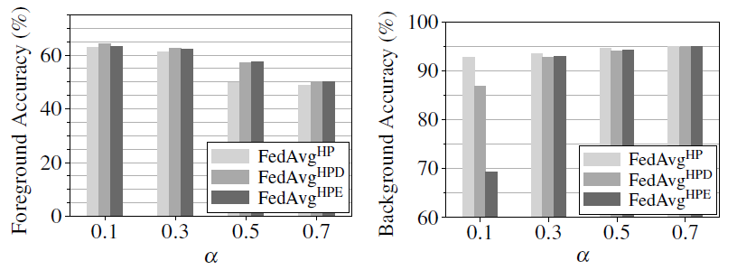
MFNet: α = 0.5 is a Better Choice
Smaller α values lead to slightly higher foreground accuracy but much lower background accuracy
Omit the α = 0.0 experiments in MFNet
α = 0.5 gives 57.59% on foreground accuracy and 94.27% on background accuracy
Notes:
HPP destroy too many data link

Slide 40
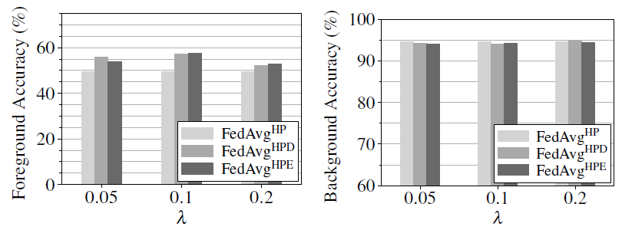
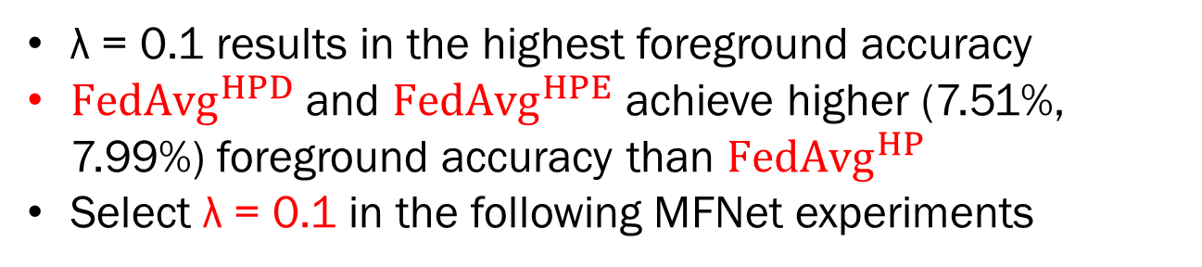
MFNet: λ = 0.1 is a Better Choice
λ = 0.1 results in the highest foreground accuracy
${FedAvg}^{HPD}$ and ${FedAvg}^{HPE}$ achieve higher (7.51%, 7.99%) foreground accuracy than ${FedAvg}^{HP}$
Select λ = 0.1 in the following MFNet experiments

Slide 41
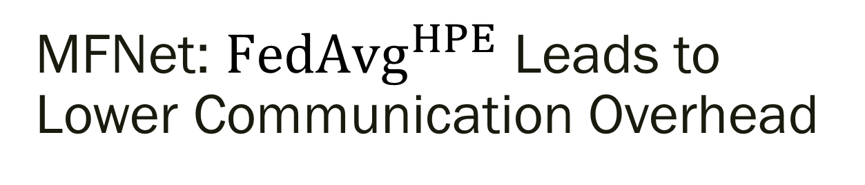
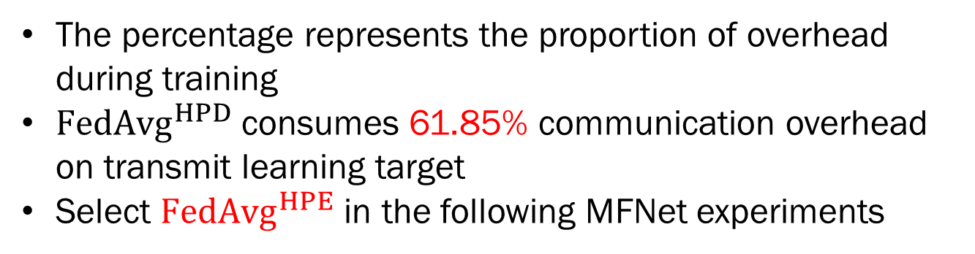
MFNet: ${FedAvg}^{HPE}$ Leads to Lower Communication Overhead
 | Method | Model |  | Insensitive data |  | Learning target
MFNet | HP | 5.96 MB | 96.62% | 6.25 MB | 3.38% | / | /
 | HPD |  | 36.86% |  | 1.29% | 10 MB | 61.85%
 | HPE |  | 94.05% |  | 3.29% | 169 KB | 2.67%
The percentage represents the proportion of overhead during training
${FedAvg}^{HPD}$ consumes 61.85% communication overhead on transmit learning target
Select ${FedAvg}^{HPE}$ in the following MFNet experiments
Notes:
Compressed by jpeg with quality 80
No accuracy decrease

Slide 42
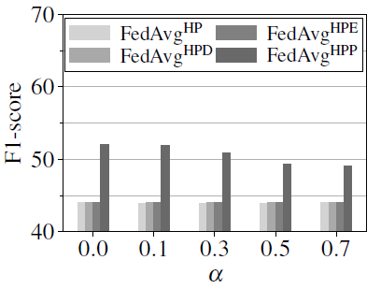
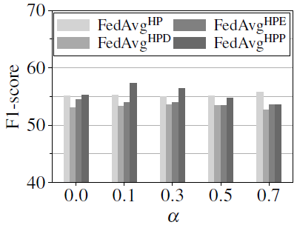
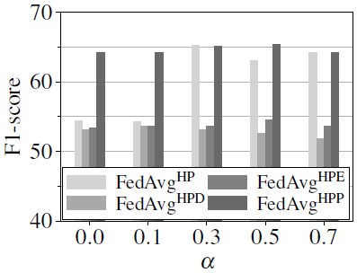
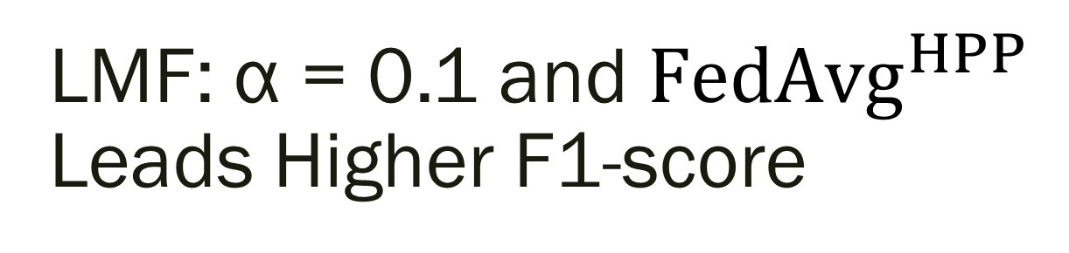
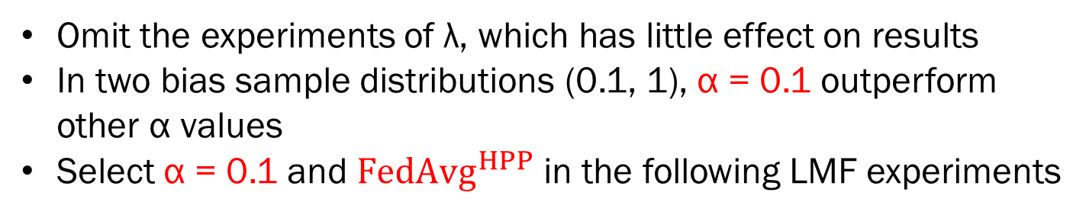
LMF: α = 0.1 and ${FedAvg}^{HPP}$ Leads Higher F1-score
Omit the experiments of λ, which has little effect on results
In two bias sample distributions (0.1, 1), α = 0.1 outperform other α values
Select α = 0.1 and ${FedAvg}^{HPP}$ in the following LMF experiments
Notes:
HPD, HPE all bad in different λ

Slide 43
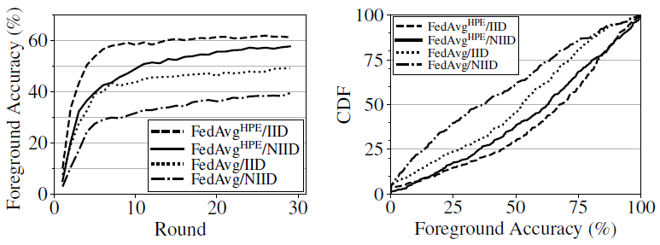
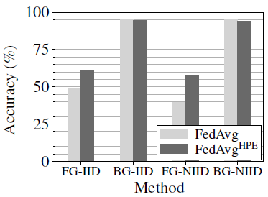
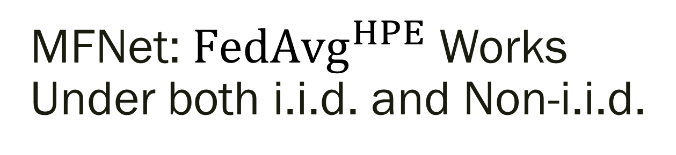

MFNet: ${FedAvg}^{HPE}$ Works Under both i.i.d. and Non-i.i.d.
3.54%
${FedAvg}^{HPE}$ achieves higher foreground accuracy under two sample distributions
${FedAvg}^{HPE}$ results 40.05%, 37.34% test samples with 75%+ foreground accuracy under two sample distributions
${FedAvg}^{HPE}$ only losss 3.54% foreground accuracy from i.i.d. to non-i.i.d.

Slide 44




MFNet, LMF: ${FedAvg}^{HPE/P}$ Works with Different No. Clients
0.81%
14.42%
8.41%
${FedAvg}^{HPE}$ outperforms FedAvg by at least 14.42% on foreground accuracy (MFNet)
The background accuracy loss is negligible 0.81%
${FedAvg}^{HPP}$ outperforms FedAvg 8.41% on F1-score (LMF)
HPFL improves the robustness with more clients
Notes:
Each client get fewer data

Slide 45





LMF: ${FedAvg}^{HPP}$ Works with Different non-i.i.d. Deg.
3.07%
7.90%
4.2%
0.1
1
10
${FedAvg}^{HPP}$ outperforms FedAvg 3.07% ~ 7.9% on F1-score
Select the hardest distribution 1 in the following experiments

Slide 46




HPFL Outperforms Other Advanced FL Algorithms
0.64%
12.39%
2.55%
${FedAvg}^{HPE}$ outperforms all state-of-the-art advanced FL algorithms at least 12.39% on foreground accuracy (MFNet)
${FedAvg}^{HPE}$ losses negligible 0.64% on background accuracy (MFNet)
${FedAvg}^{HPP}$ also outperform all state-of-the-art advanced FL algorithms by 2.55% on F1-score (LMF)
Notes:
Close to centralized learning
We will show the inference result later

Slide 47








Qualitative Results
FedAvg HPFL Ground Truth Centralized
FedProx FedDyn FedAdam FedCon

Slide 48

HPFL Applies on Advanced FL Algorithms
Update the client trainer to implement FedProx, FedDyn, and FedCon
Replace the aggregator with Adam to implement FedAdam
Apply HPFL on most of advanced FL algorithms can obtain performance improvement

Slide 49
HPFL Incurs Low Communication and Computation Overhead
 | Methods | Model |  | Insensitive data |  | Learning target
MFNet | HP | 5.96 MB | 96.62% | 6.25 MB | 3.38% | / | /
 | HPD |  | 36.86% |  | 1.29% | 10 MB | 61.85%
 | HPE |  | 94.05% |  | 3.29% | 169 KB | 2.67%
LMF | HP | 1.07 MB | 99.87% | 413 KB | 0.13% | / | /
 | HPP |  | 99.85% |  | 0.13% | 0.26 KB | 0.02%
Methods | HPFL | FedAvg | FedAdam | FedProx | FedDyn | FedCon
Computation Overhead* | 100% | 100% | 100% | 114% | 124% | 120%

Slide 50
Conclusion
First considered multi-sensor classification problems in the FL setup, where sensor data have diverse privacy sensitivity levels
Proposed HPFL algorithm to utilize privacy-insensitive data at server-side for reduce the performance gap between FL and centralized ML
Conducted an extensive comparison of HPFL and other state-of-the-art advanced FL algorithms:
HPFL causes no client-side computation overhead and little communication overhead

Slide 51



Future Work
Optimization on communication and performance
Convergence and privacy analysis
Support complex model structure

Slide 52
Publication and Cooperators
Y. Chen, C. Hsu, C. Tsai, and C. Hsu, “HPFL: Federated Learning by Fusing Multiple Sensor Modalities with Heterogeneous Privacy Sensitivity Levels” ACM Multimedia, October 2022, Submitted to ACM.
Y. Wu, Y. Chen, S. Shirmohammadi, and C. Hsu, “AI-Assisted Food Intake Activity Recognition Using 3D mmWave Radars” ACM International Workshop on Multimedia Assisted Dietary Management, October 2022, In-Preparing submission.
Y. Wu, Y. Chen, and C. Hsu, “Heterogeneous Privacy Distributed Learning: Collaborative Concept and Applications” IEEE Transactions on Multimedia, 2022, In-Preparing submission.
Chih-Fan Hsu, National Yang Ming Chiao Tung University
Chung-Chi Tsai, Qualcomm Inc.
Shervin Shirmohammadi, University of Ottawa
Thanks for Your Listening

Slide 53
Q ‡ A

Slide 55


Future Work
Support complex model structure
Optimization on Communications and Computations
Deep privacy analysis
Convergence analysis
Server-side offline distillation
Generalization for split learning

Slide 56
Backup slides

Slide 57
Limitation
Dataset
HPFL can only work on multi-modal dataset and application
Distillation model generation
All performance gain comes from distillation model
No obvious standard to generate distillation model
Hard to generate distillation from complex model structure
System optimization
HPFL introduces extra tunable parameters
Client and serve-side optimization are inferencing each one
Notes:
Special structure– client – server training inference each other

Slide 58
Support more Complex Multi-modal Network Structures
We only consider the popular joint representation structures in our experiments
Generating distillation model from complex models is challenging for HPFL
We will select more representative multi-modal structures, and apply HPFL on them
We will propose a generalize rules about applying HPFL on multi-modal model and selecting HPD, HPE, and HPP

Slide 59
Optimization on Communications and Computations
HPFL system requires a powerful server
The insensitive data and learning target transmit may cause network congestion
The HPFL server requires about 6 times of training time than clients
We will develop a efficient learning target and insensitive data sharing algorithm under limited network resource
We will consider more efficiency training scenario
Notes:
(learning target/insensitive data取决于应用)

Slide 60
Deeper Privacy Analysis
Privacy leakage risk from: insensitive data, learning target, model parameters
Multi-modal machine translation may break the gap between sensitive and insensitive data (depth, thermal images…)
We will provide completely privacy analysis and apply some privacy-prevention technology (DP) on HPFL
We will explore the performance impact of these privacy-preserving technologies on HPFL
Notes:
Focus on insensitive data and learning target

Slide 61

Convergence Analysis
Target function:
Merger:
Difficulties
The merge part (distillation model) is various in different models
No such reference work did the similar prove
Hybrid Federated and Centralized Learning [2] merges the same client and server model
Ref: [2] Elbir A M, Coleri S, Mishra K V. Hybrid federated and centralized learning[C]//2021 29th European Signal Processing Conference (EUSIPCO). IEEE, 2021: 1541-1545.
Notes:
FedAvg, centralized learning has proved
HFCL: no convergence analysis

Slide 62

Server-side Distillation Method
Apply learning target (HPD, HPE) has little performance improvement (MFNet, LMF)

Slide 63
Generalization for Split Learning
Split learning (SL) significantly reduces client computing overhead
Similar but different to SL, HPFL cut the model based on diverse privacy-sensitive levels
We target to distributed train sensitive data at client-side and centralized train insensitive data at server-side

Slide 64

Full Algorithm

