Slide 1
Internet of Things and Safety Assurance of Cooperative Cyber-Physical Systems: Opportunities and Challenges
Sohag Kabir
Notes:
IEEE Internet of Things Magazine

Slide 2
Outline
Introduction
The CPSs and their safety assurance
Problems
Apporach
Example
Challange
Conclusion

Slide 3
Introduction
Cyber-physical systems (CPSs) are widely using in industial.
CPSs are expected to operate in highly dynamic and unpredictable environments, where the systems will learn from their internal and external environments.
CPSs are often safety-critical systems and they are increasingly being deployed to perform safety-critical activities in public and private spaces
When the situation changes to unpredictable, it has a problem of “Safety Assurance”
Interacting with IoT devices may be a solution to slove the problem
Notes:
Cyber-physical systems (CPSs) are widely using in industial and nowadays they want to use this in modern live like automate car, hospital etc…
safety-critical - may cause critical result like harm the people or enviroments if they failed. Situations will exist such that, while performing safety-critical tasks within the vicinity of humans, the systems will autonomously make their own decisions and take critical actions with minimal human intervention. Therefore, their failure has the potential to cause enormous harm to people and the environment.

Slide 4
About the safety assurance
In traditional systems, safety assurances are provided based on design time analysis.
Fixed system, devices and the connection are connected physically (cable)
The failure can be predicted and simulated
Solutions to handle the failure are fixed
Notes:
where system configurations are assumed to be known and the behavior of the systems are deemed to be fixed. it means that the scale and the result are all limited and the connection between devices are physically cabled

Slide 5
Problems
the traditional way to check whether the system is safe-assurance can’t fit the system
The scale of the system is changing
The solution to deal with the problem is not fixed
Need to be always monitoring
Notes:
The solution to deal with the problem is based on the AI cloud
We also can’t ensure that the way provided from ai and what it learned from incident is correct

Slide 6
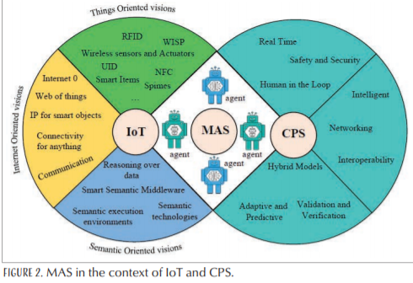
Approach
MAS (Multi-agant System)
The conbination of IoT and CPS
CPS with many sub system of IoT devices
Notes:
CPS is a center that using AI to handle problem
IoT get senser can communicate with each other

Slide 7
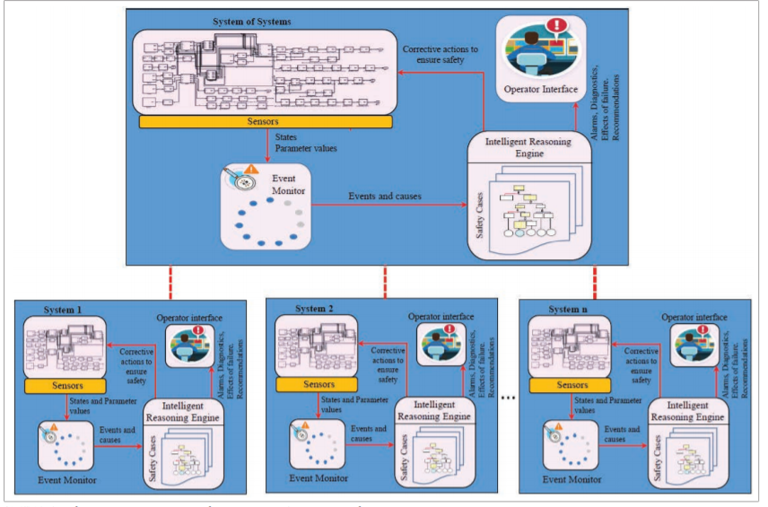
Approach
A cooperate system of systems
Each system can monitor itself and also communicate with each other

Slide 8
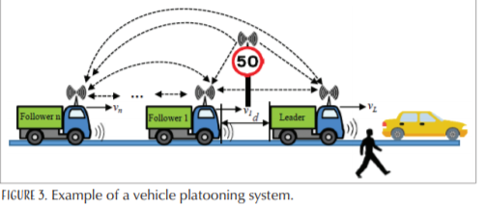
Example
Automate car platoon
Each car communicate with each other
Leader car drive by the computer itself
followers follow the leader by information.
Notes:
Each car will contain many senser like radar and camera, etc...

Slide 9
Challange
Communicate by wireless network
Safety problem.
Failure handling between urgent incident or common incident.
Signal can’t be blocked.
Differences of devices
Need the same format to transmit the information to communicate to each device.
Failure Handling efficiency
Procedure time can’t take long

Slide 10
Conclusion
Though still have some problems, combining cloud IoT system and CPSs can approach safety assurance.
Guaranteeing real-time compliance of IoT-enabled agent-based solutions would be an important milestone to achieve.
Even in such a hybrid approach, resource utilization (e.g. load balancing) should be considered carefully as it will play a crucial role in their successful deployment

