Slide 1
Ensemble Distillation for Robust Model Fusion in
Federated Learning
34th Conference on Neural Information Processing Systems (NeurIPS 2020)
Tao Lin, Lingjing Kong, Sebastian U. Stich, Martin Jaggi.
MLO, EPFL, Switzerland

Slide 2
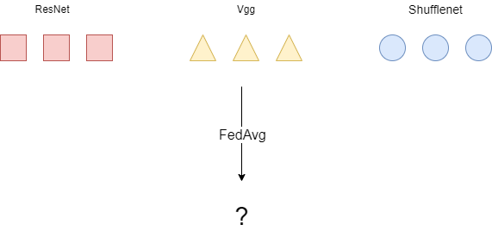
Motivation
In FedAvg, directly averaging model not always work in heterogenous clients

Slide 3
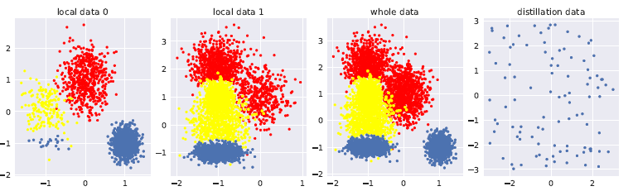
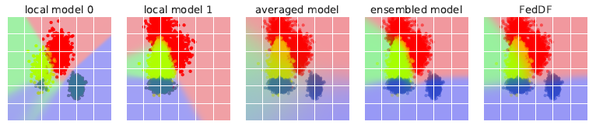
Problem exists
Toy example of a 3-class classification
Data:
Model:
Centralized

Slide 4
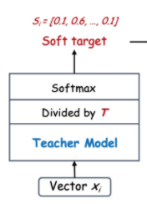
Knowledge distillation
Make teacher model
A model compress technique
Train a teacher model with big amount of data
Use unlabeled dataset to get soft target
T is an optimal parameter

Slide 5
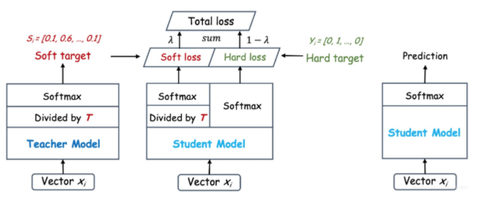
Knowledge distillation
Distillation
Use same dataset as student model input
Loss type | Soft loss | Hard loss
Input | Output of student model, divided by T, calculate distribution by softmax | Output of student model, calculate distribution by softmax
Target | Soft target [0.1, 0.6, …, 0.1] | Hard target [0, 1, …, 0]
Loss function | KLDivergence | Crossentropy

Slide 6
Related work
Federated learning optimize
  FedMA: layer-wise communication
  FedProx: incorporates a proximal term for local training
Knowledge distillation (federated distillation):
  Share logits: Federated distillation
  Share model parameters
Comparison with close FL work
  One-shot fusion
  Federated distillation
  Cronus
  FedMD

Slide 7
Related work
Similar work
One-shot fusion:
  Take enough epochs at client
  Select best client model to upload
  Run FedAvg or distillation
  Different to this work: clients must be homogeneous
FedMD and Cronus:
  Exchange logits rather than model parameters
  Cronus is designed for robust FL under poisoning attack
  FedMD is for personalized FL

Slide 8
Contribution
Proposed distillation framework allows heterogeneous client models and data
Train faster, require fewer communication round than any existing FL technique

Slide 9
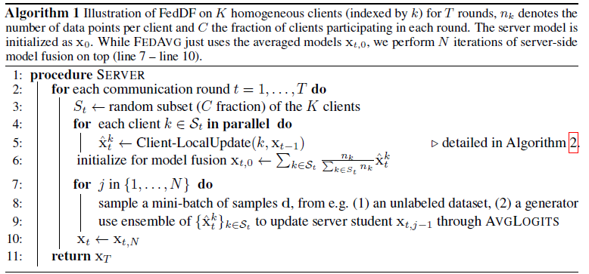

Algorithm
1 model type
$S_{t}$: client model set
No hard target here
FedAvg
Distillate N epoch

Slide 10
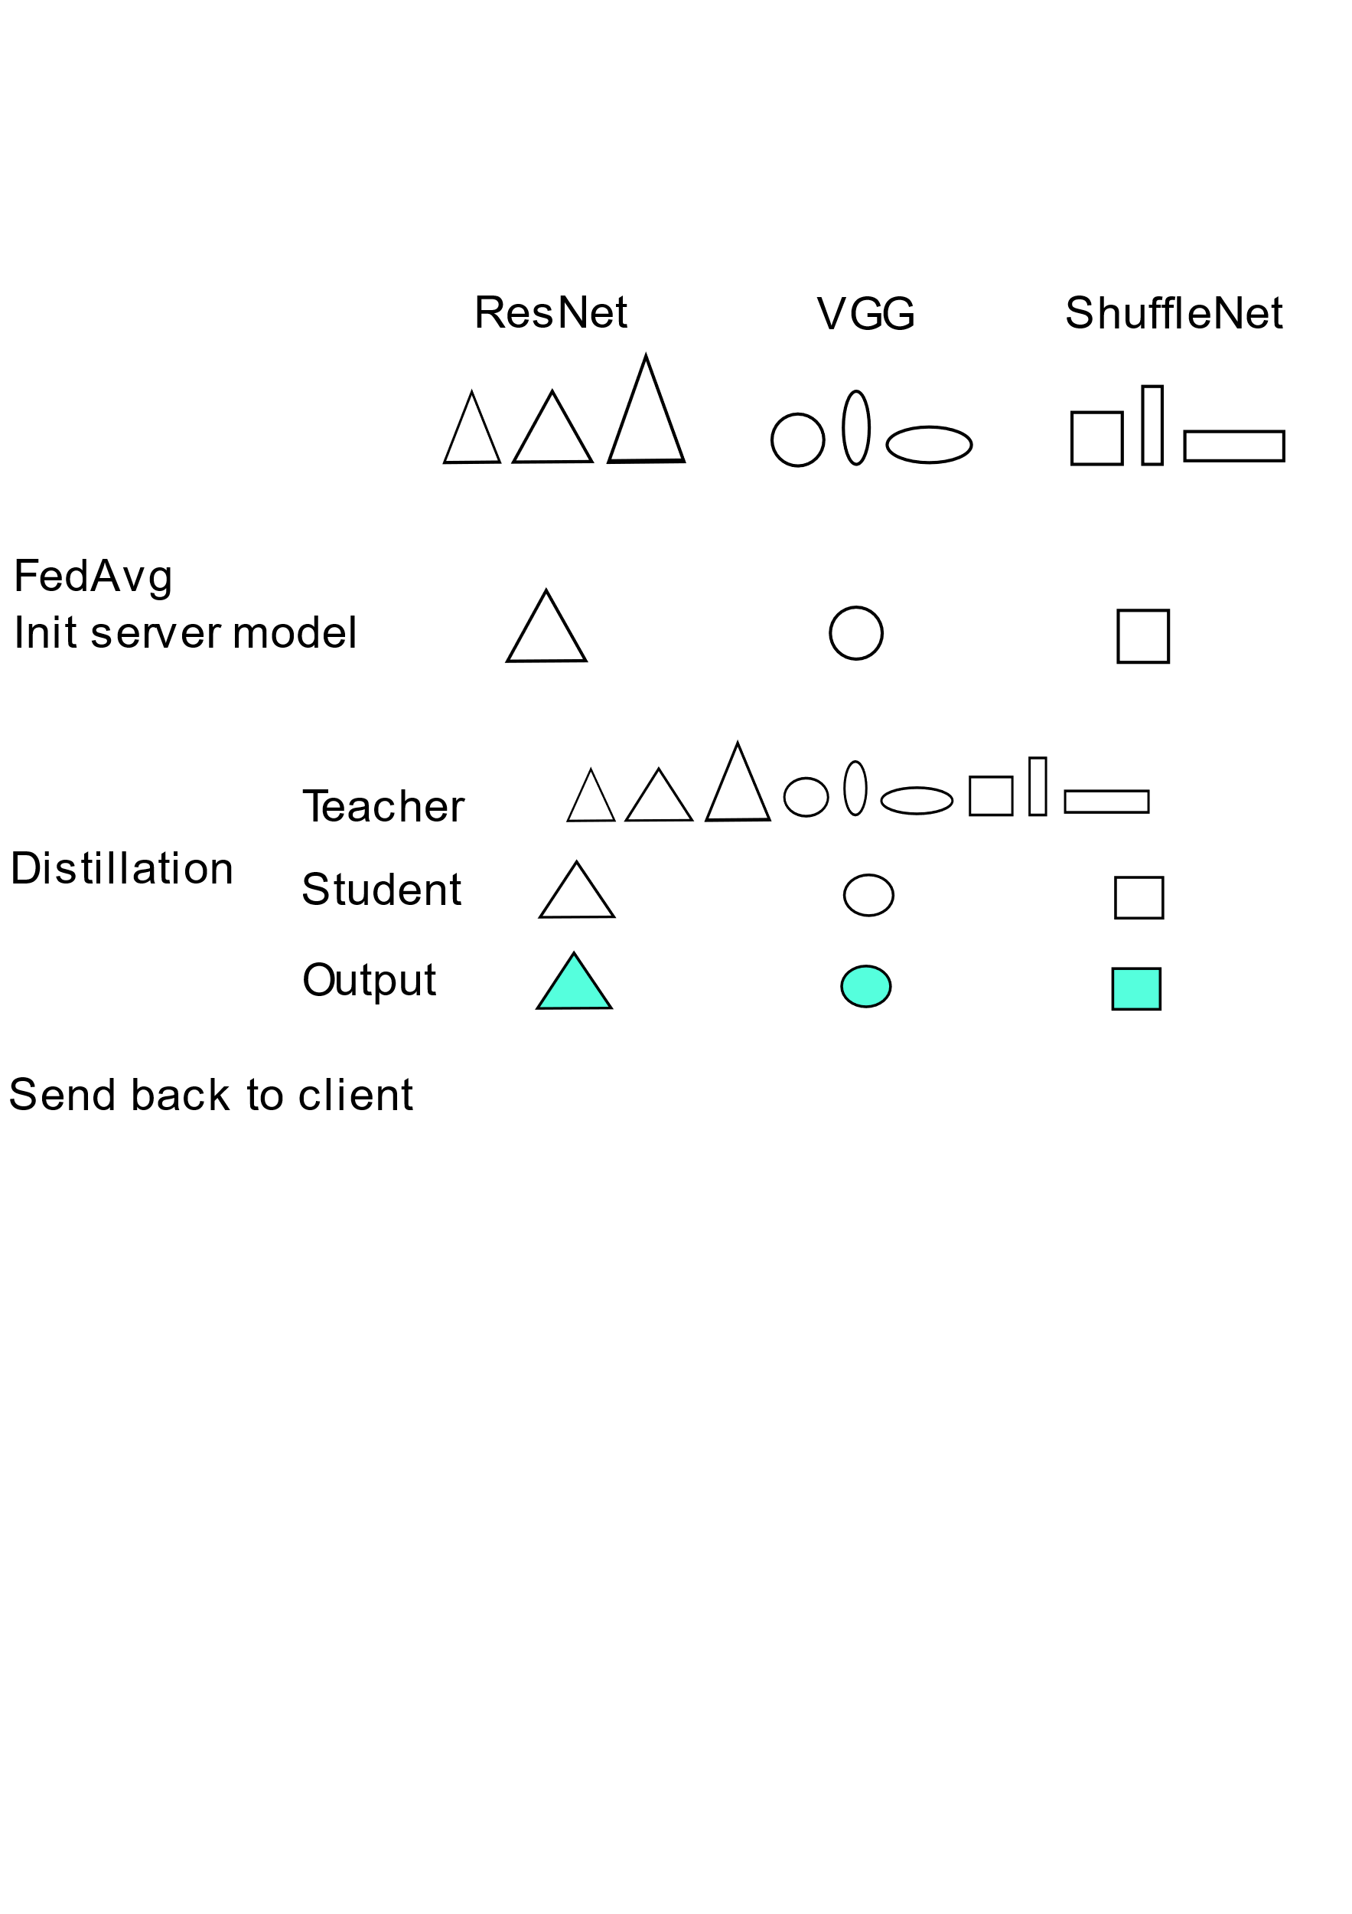
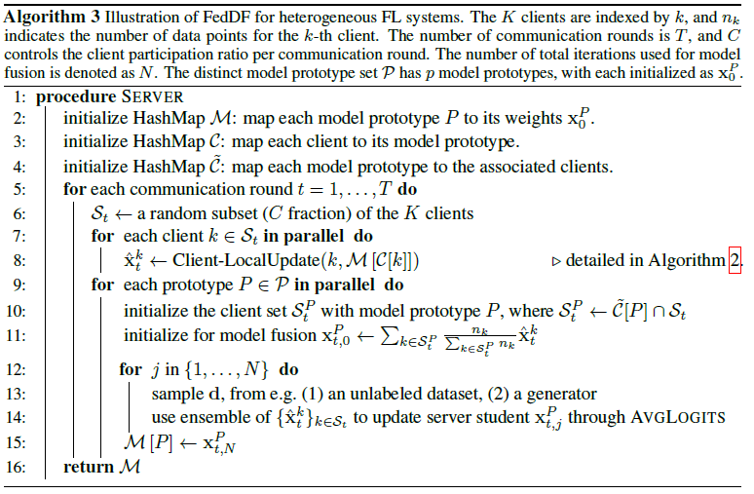
Algorithm
Heterogeneous FL system
Taking FedAvg between
same model type
For each initial model,
distillation from any type
of client models
Send back the model of
same type to user

Slide 11
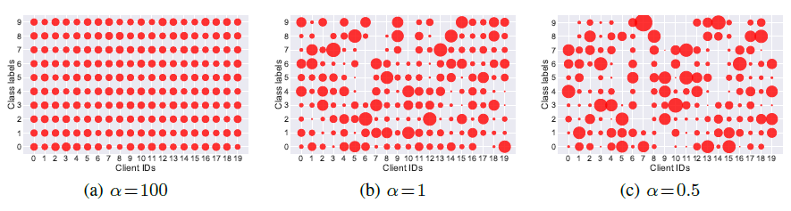
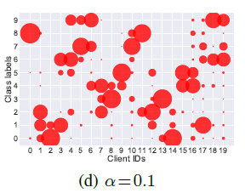
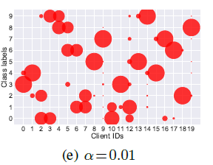
Experiment setup
Model : ResNet, Vgg, ShuffleNetV2, DistillBERT
Dataset: CIFAR-10/100, ImageNet, AG News, SST2
α: control non-iid degree
Validation set: 10%, 1%, 1% of CIFAR-10/100, ImageNet, SST2 respectively
Default distillation dataset: CIFAR100, ImageNet

Slide 12
Experiment setup
Baselines
FedAvg
FedProx
FedAvgM
FedMA

Slide 13
Experiment list
Compare with common FL settings
The advantage of FedDF
Compatibility Experiment with other methods
Case study
Understanding FedDF

Slide 14
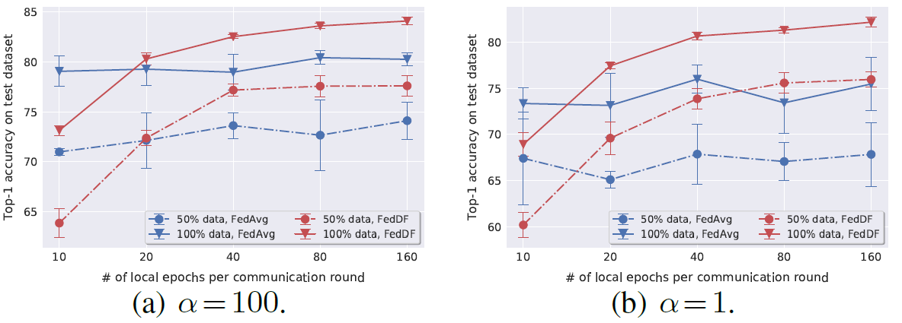
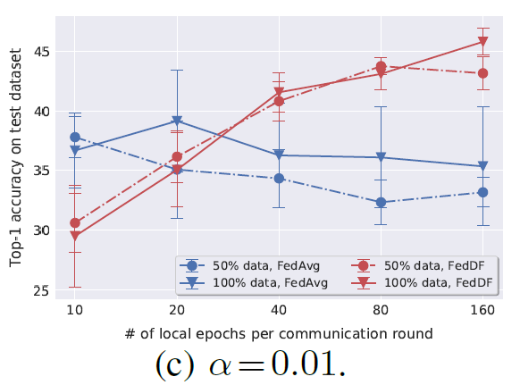
Experiment on common FL settings
FedAvg
FedDF benefits from larger local epochs
Performance of FedDF decided by the number of local epochs

Slide 15
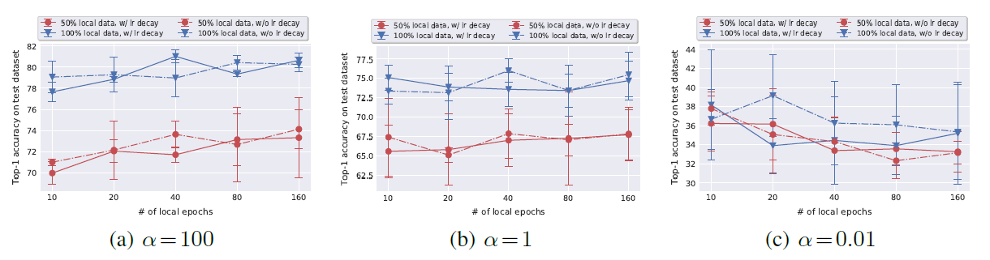
Experiment on common FL settings
Learning rate decay
Baseline FedAvg, CIFAR-10, ResNet-8
We cannot observe the benefits of decaying the learning rate
Turn off the learning rate decay for the experiments

Slide 16
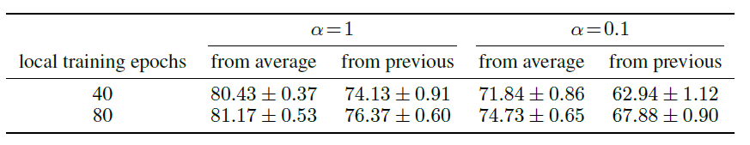
The Advantages of FedDF
Ablation study: Model initialization
Average: Distillation model initial from the uniformly averaged model of this communication round
Previous: Distillation model initial from the previous communication round

Slide 17
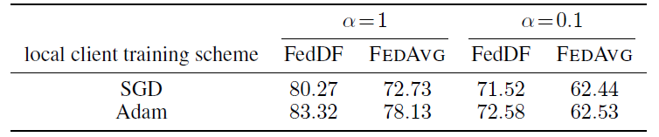
The Advantages of FedDF
Ablation study: Local training optimizer
FedDF robust to data heterogeneity
FedDF also get the benefit from Adam

Slide 18
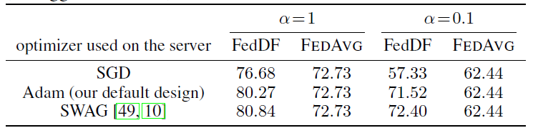
The Advantages of FedDF
Ablation study: Distillation optimizer
SWA (Stochastic Weight Averaging): Improved SGD optimizer

Slide 19
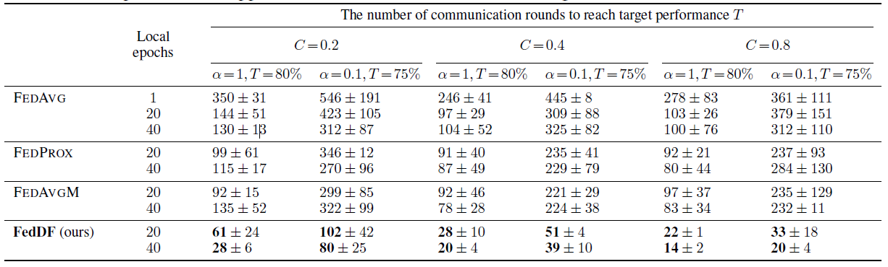
The Advantages of FedDF
Comparison of FedDF with other methods
Increase local epochs can reduce communication round significantly

Slide 20
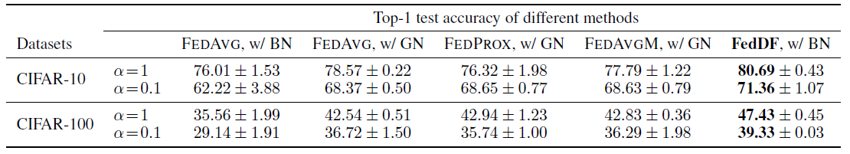
Compatibility Experiment
Batch norm, Group norm
Group norm: GN has better performance than BN on heterogeneous training data

Slide 21
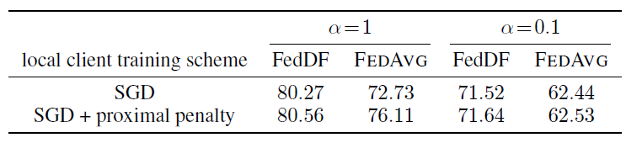
Compatibility Experiment
Proximal regularizer
Add local proximal regularizer to avoid over-fitting

Slide 22
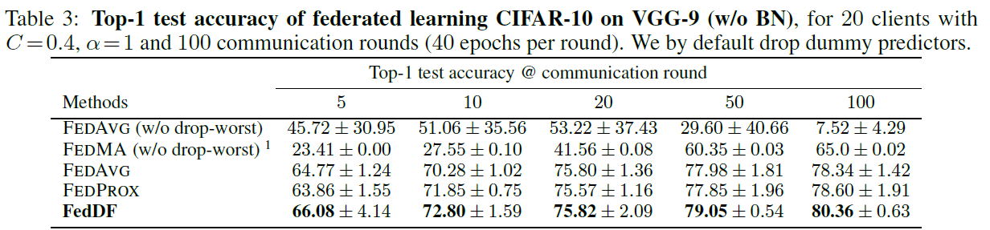
Compatibility Experiment
VGG-9 (Not design for BN)
Apply drop worst method to filter the worst ( Acc < 10% ) model before FedAvg (initial distillation model)
FedMA does not support drop-worst operation

Slide 23
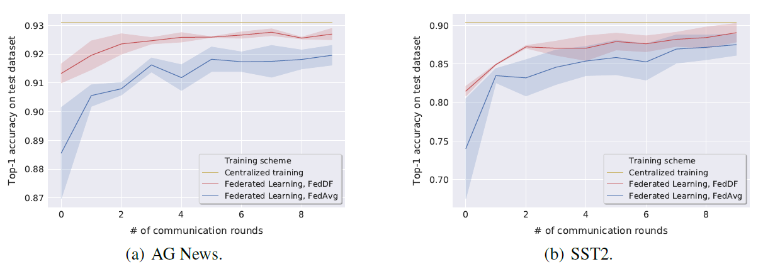
Compatibility Experiment
NLP task
The 50% of dataset for training, another 50% for distillation

Slide 24
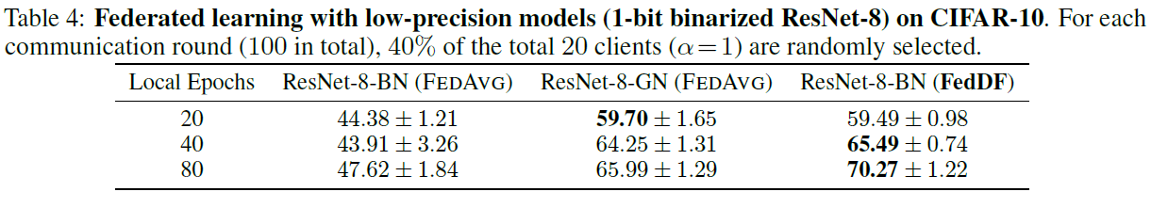
Case study
Low-precision models (Quantization)
FedDF consistently outperforms other methods

Slide 25
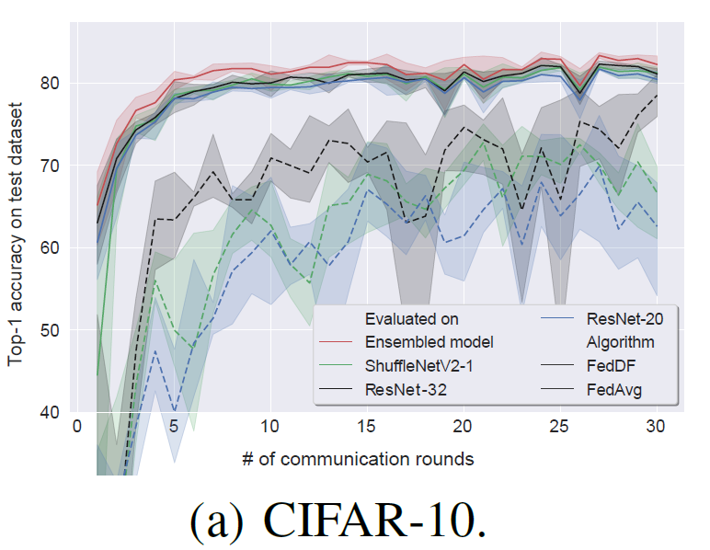
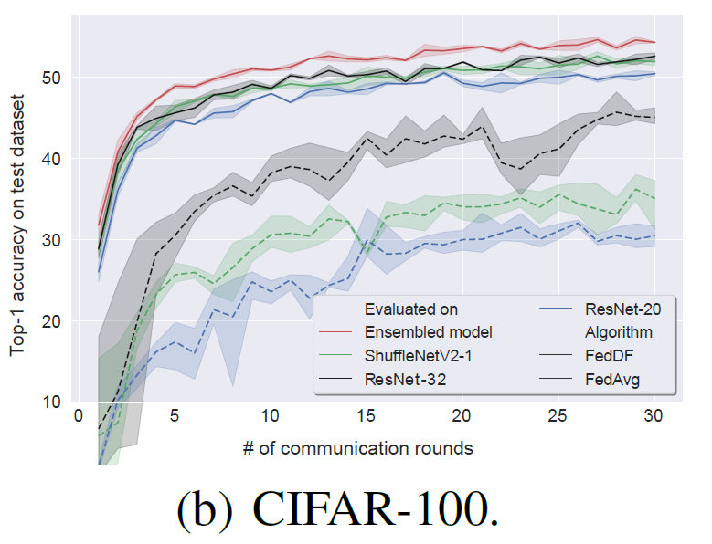
Case study
Heterogeneous systems
Distillation dataset: use CIFAR-100, STL-10 respectively

Slide 26
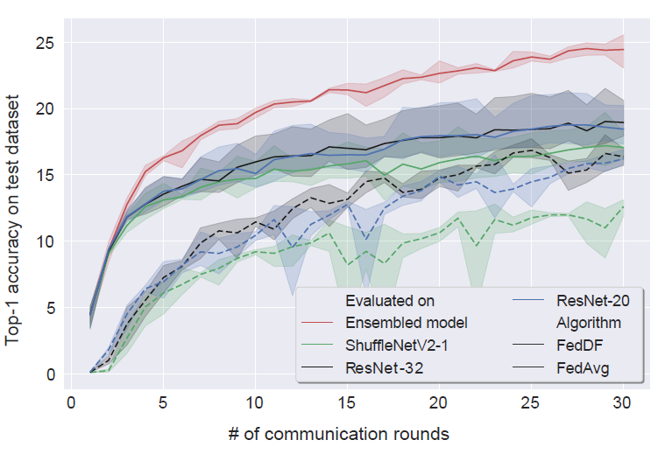
Case study
Heterogeneous systems
Distillation dataset:
STL-10
Training dataset contains
much number of classes
than distillation dataset

Slide 27
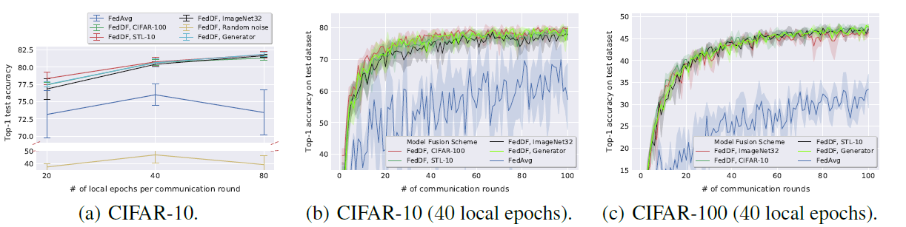
Understanding FedDF
Different distillation datasets (Out-of-domain distillation)
Show the result in the same training dataset, different distillation datasets

Slide 28
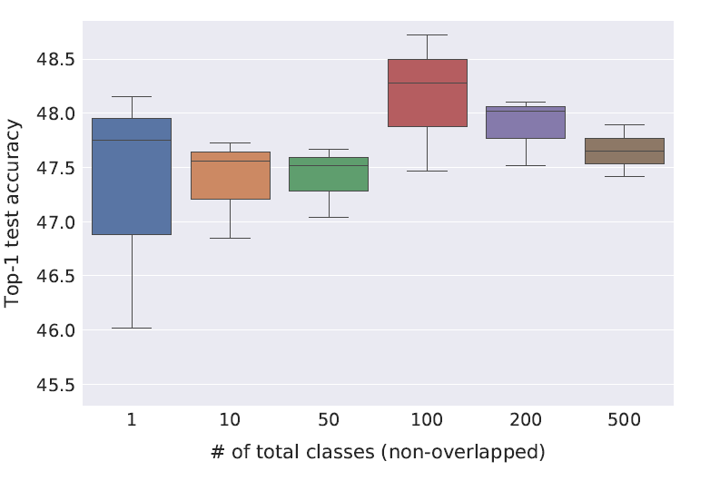
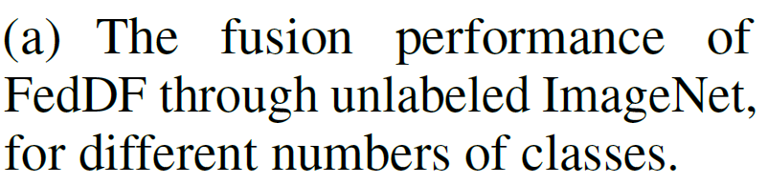
Understanding FedDF
The diversity of the distillation data

Slide 29
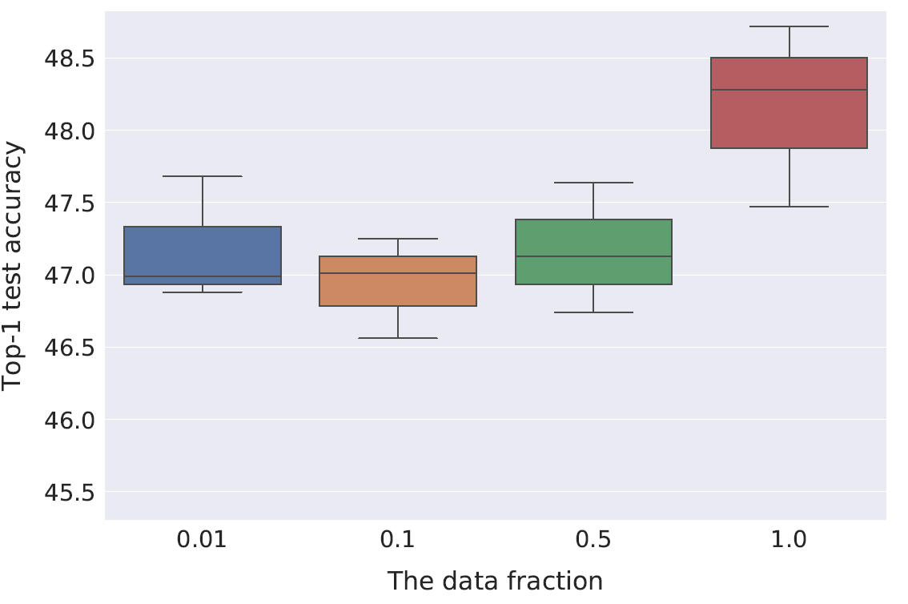
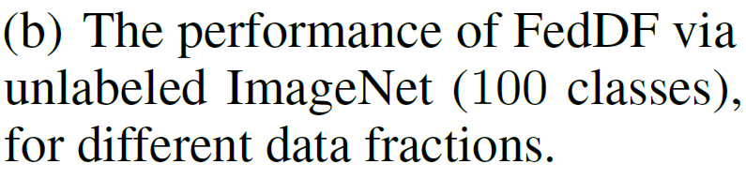
Understanding FedDF
Different data fractions

Slide 30
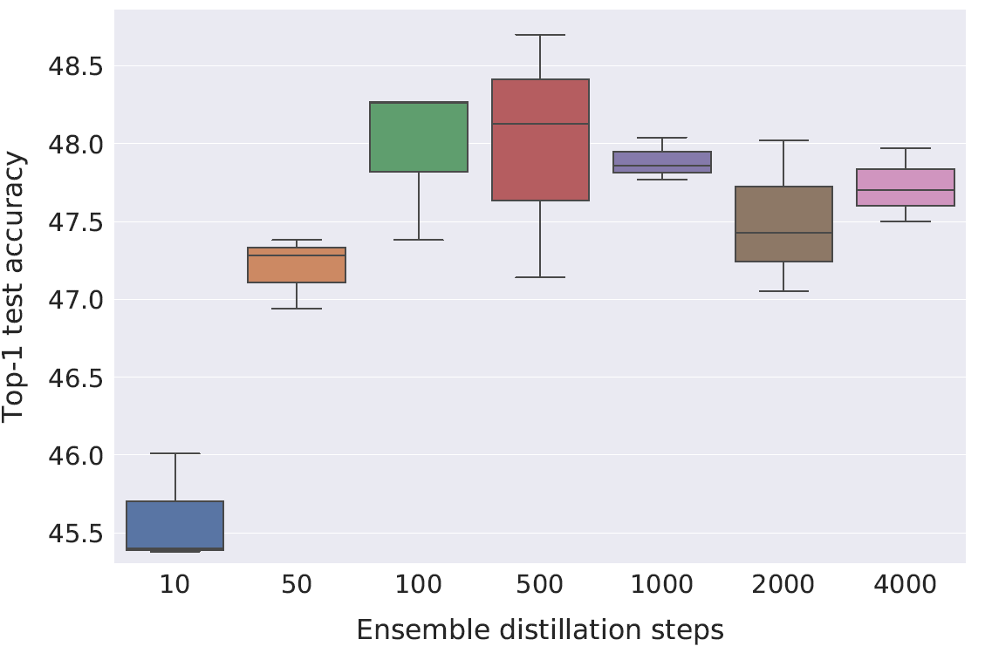
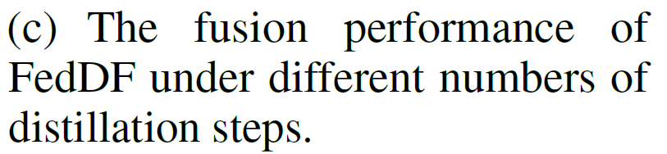
Understanding FedDF
Distillation steps

Slide 31
No conclusion in this paper

