Slide 1
AirSim-W: A Simulation Environment for Wildlife Conservation with UAVs
Elizabeth Bondi1, Debadeepta Dey2, Ashish Kapoor2, Jim Piavis2, Shital Shah2, Fei Fang3, Bistra
Dilkina1, Robert Hannaford4, Arvind Iyer4, Lucas Joppa2, Milind Tambe1
Proceedings of the 1st ACM SIGCAS Conference on Computing and Sustainable Societies
2018

Slide 2
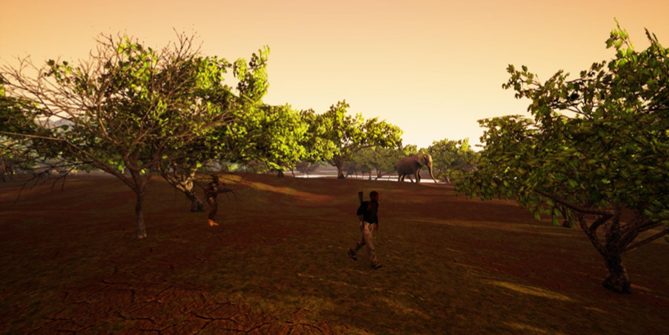
Motivation
Solve the problem of wildlife poaching
Why AI + UAVs?
AI can assist park rangers in:
  Planning their patrols
  Creating strategies to detect poaching or signs of poaching activities
Unmanned aerial vehicles (UAVs) play a role in patrolling by:
  Deterring poaching through the use of signaling
  serving a lookout for park rangers
  acting as a seperate patroller with the ability to detect objects of interest (OOI)

Slide 3
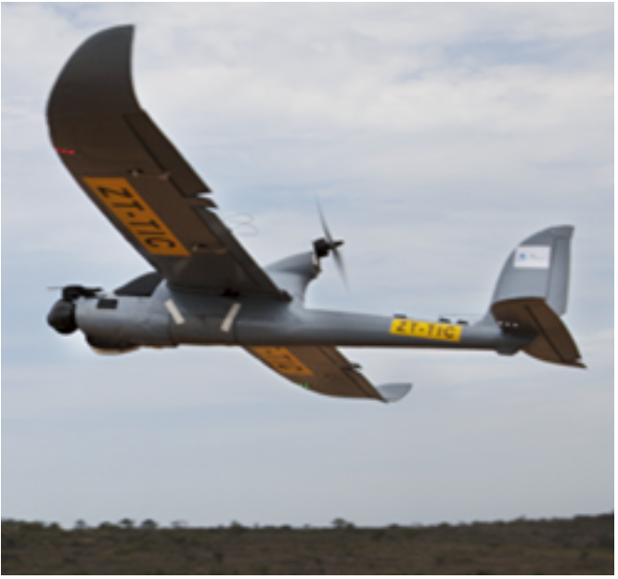
Motivation (Cont.)
Why UAV + thermal?
  The size of humans and animals in UAV is small
  Poaching often happens at night
Hard to collect real dataset
  Previous work: Air Shepherd + Thermal camera → 70 2 hr-videos
  Fly on the pre-programmed paths, fly manuaaly when finding OOI
  Problem:
    Additional process time before labeling:
      Do not have OOI in most videos
      Cannot detect OOI
    800 hours to labeling
    Money-consuming to fly UAVs
Notes:
Air Shepherd:
flying at night
pre-programmed paths
follow OOI manually
do not have many IIO

Slide 4
Motivation (Cont.)
Why simulation?
  Need more data
    SPOT: tranind by the collected frames → detect poachers or animals
    Problem
      Detecting results are not good enough
      Can not follow OOIs automatically
  Costly to test autonomous flights
  With simulation:
    Augment dataset of labeled thermal infrared videos efficiently
    Provide a testing environment for future autonomous flight

Slide 5
Unreal Engine + AirSim
Unreal Engine
  Support hardware-in-the-loop (ex. Xbox controller) or Python API for moving
AirSim
  Veheicle model for the UAV
  Environment model made of gravity, magnetic field, and air pressure
  Density model, a physics engine for the linear and an- gular drag, accelerations, and collisions
  A sensor model for the barometer, gyroscope and accelerometer, magnetometer, and GPS.
  Scene, segmentation, and depth images can be collected

Slide 6
Related Work
Automatic detection of wildlife and humans in UAVs videos
  RGB images in high resolution
  Do not consider real-time detection
  → SPOT won!
Data augmentation → more data
  Do not account for thermal infrared imagery
  Do not consider the physical process that are involved in image capture
Simulation → more data
Train models with simulated data, test models with real data
→ improve semantic segmentation
  Few radiometric models for thermal simulation

Slide 7
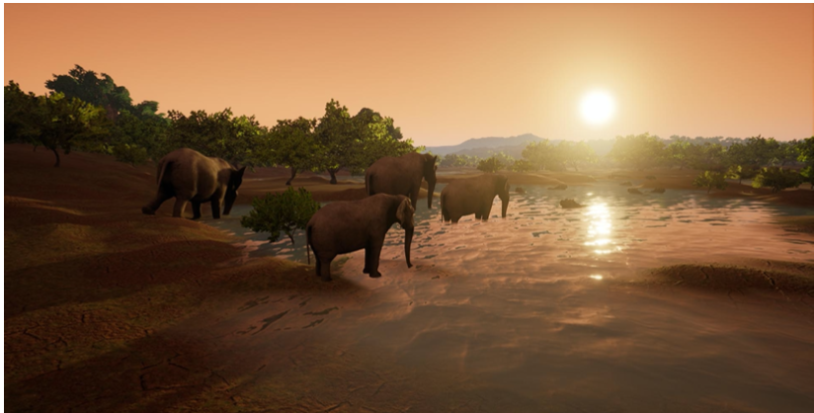
What they did
Creation of an African savanna environment
Integration of a new thermal infrared model based on radiometry
API code extensions to follow objects of interest or fly in zig-zag patterns to generate simulated training data
Demonstrated detection improvement using simulated data generated by AirSim-W

Slide 8
Africa Savana Environment
Representative biome: wide-open space, dense forest, a mid-density area, a water feature, road access, and poachers and appropriate animals
Creating step:
  Get the model of the correct plants, animals, and humans
  Create a terrain, and sculpt it in hills and depressions for water
  Spline-based movement of the actors
  Dress the scene (textures → real-time video cpature)
Three generic areas of vegetation density
Three sets of poachers
  3 characters/set
  Follow a spline in a large loop
  Intersected the poacher loops with elephants on spline loops
Zebras were scattered across the environment
Animals were clustered around the watering hole
Notes:
3 week $5000 180 hours
transfer learning
UE with models
relatively low cost based on this environment

Slide 9
Expansion from RGB to Thermal Infrared

Slide 10
Physical Modeling Assumptions
For thermal imagery
Sources of thermal infrared photons (TIP) to the camera on a UAV:
  Upwelled: direct from atmosphere
  Downwelled: TIP from atmosphere reflected by the target
  Direct: direct from the target
  Background radiance: TIP from nearby objects reflected by the target
To simplify model in Africa savanna:
  Clear, dry, cool atmosphere → X Upwelled, downwelled
  Flat terrain → X Background radiance
  Dominant contribution: Direct → Modeled by Planck’s Law
  Assumptions:
    Objects emit energy uniformly
    Camera lens has perfect transmission and no falloff

Slide 11
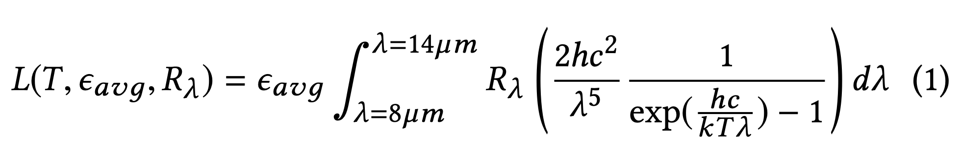
Planck’s Law
How they simulate the thermal sensor
L: radiance
T: temperature
ε_{avg}: avg emissivity over the bandpass
R_{λ}: peak normalized camera spectral response
h: Planck’s constant
c: the speed of light
λ: the wavelength
k: the Boltzman constant
Get the pixel locations of OOI
Measure the temperature and emissivity of OOI
Use Planck’s Law to estimate the resulting radiance at the sensor
Normalize the result to create an 8-but thermal image

Slide 12
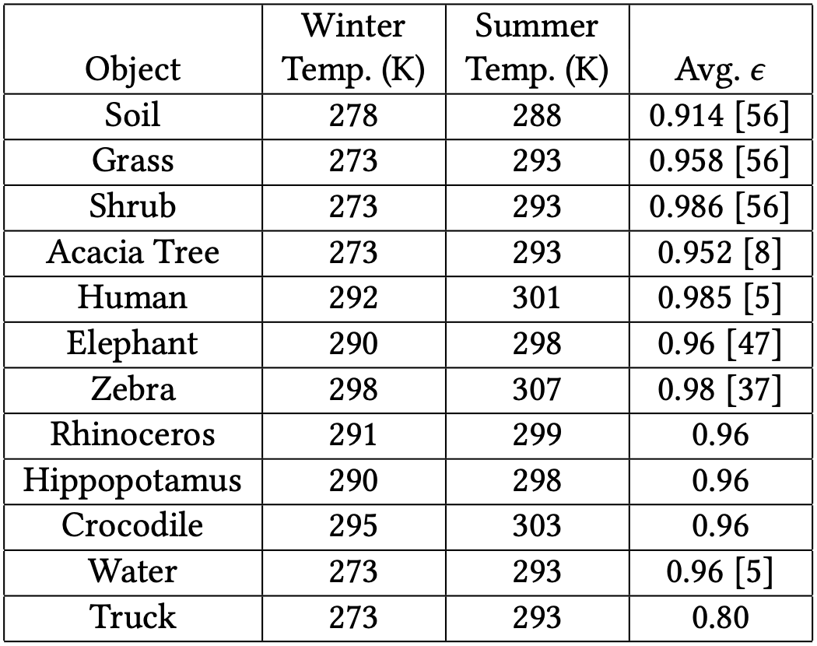
Database
How they estimate the temperatures and emissivities of OOI
Emissity: apply in all seasons
  Human and animals: skin
  Truck: oxidized steel
  Plant: from some studies
Temperature: depend on the air temperature
  Winter vs. Summer
  Temp. in Winter is more accurate than Summer
  External temp. in Winter from studies
  → Find a linear fit for the increasing temp in Summer.

Slide 13
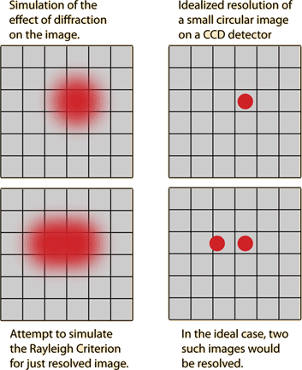
Blur and Noise
Blur
  The image system will be diffraction-limited
  Point spread function (PSF): describe the response of an imaging system to a perfect point of radiance
  → Gaussian distribution (can be replaced to real model)
Noise
  Johnson noise: the resistor nature → white Gaussian noise
  Flicker noise: flaws in the material surface
  Thermal noise: heat exchange with the environment → white Gaussian noise → Gaussian 1/f noise
  Fixed pattern noise (FPN): each microbolometer has a slightly different resistance for the same incoming thermal infrared photons → uniform random noise

Slide 14
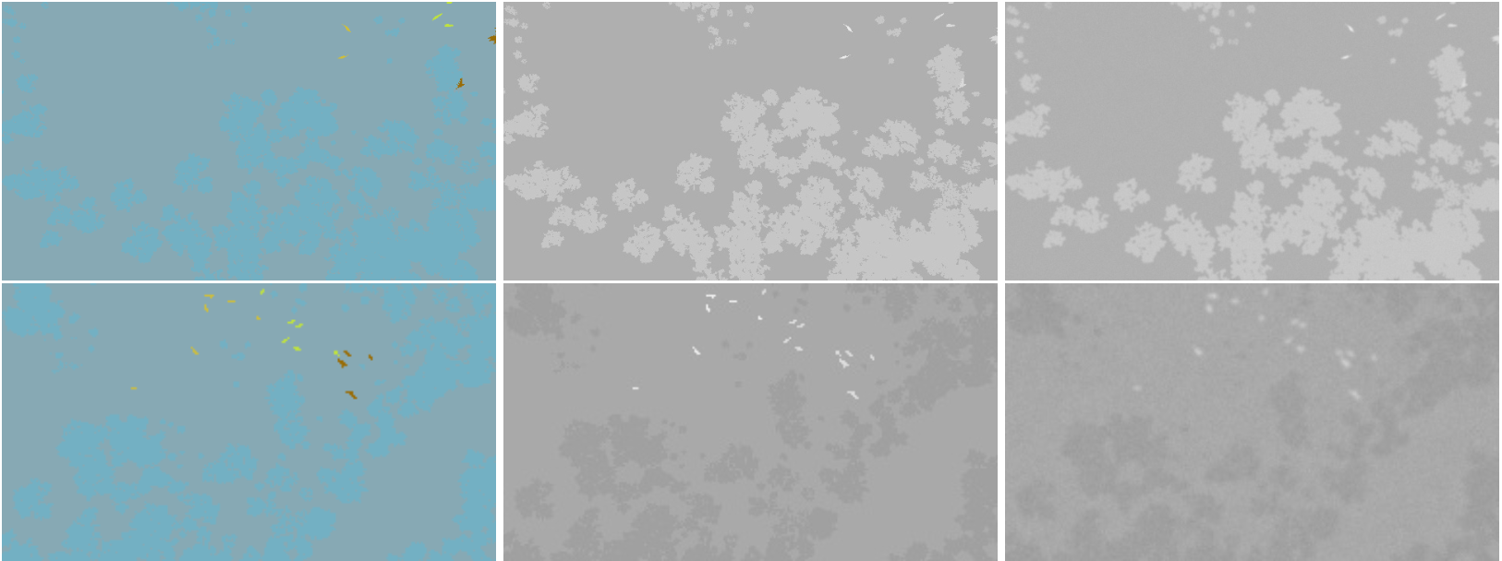
Process
A segmentation map from the RGB simulation
A thermal infrared digital count associated with all of the objects
A simple model for blur and noise
Segmentaion
thermal infrared
noise, blur
Summer
Winter

Slide 15
Utilizing AirSim-W for Poacher and Animal Detection

Slide 16
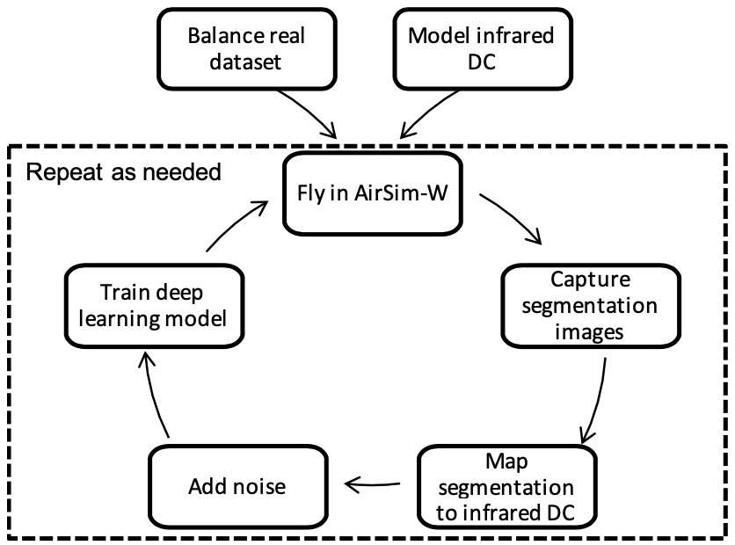
Generating Training Dta with AirSim-W
Set up parameters
  Adjust flight altitude and look angle using Computer Vision Mode
  Adjust the season to determine which digital counts should be used
Balance real dataset
Fly
  Zig-zag pattern
  Following an object of interest
Capture the segmentation image in each time step.
Convert this image into the thermal infrared image for the time step
12 flights, 6 summer, 6 winter
30 min/flight

Slide 17
Balancing Data (real data)
Class: {small, medium, large} x {animal, poacher}
Cannot randomly sample full videos for use in traning set
  Full videos to stay consistently
  Individual frames that may contain multiple OOI from different classes
Mixed-integer linear program (MILP)
  Targets:
    Use as many different train videos as possible
    Provide the algorithm with samples with more variety
  Frame types: a six-dimensional vector, indicating the number of objects from each class, ex. (1, 0, 0, 2, 0, 1)
  Method:
  Randomly select the specified # of frames from each frame type in each video → Balanced dataset

Slide 18
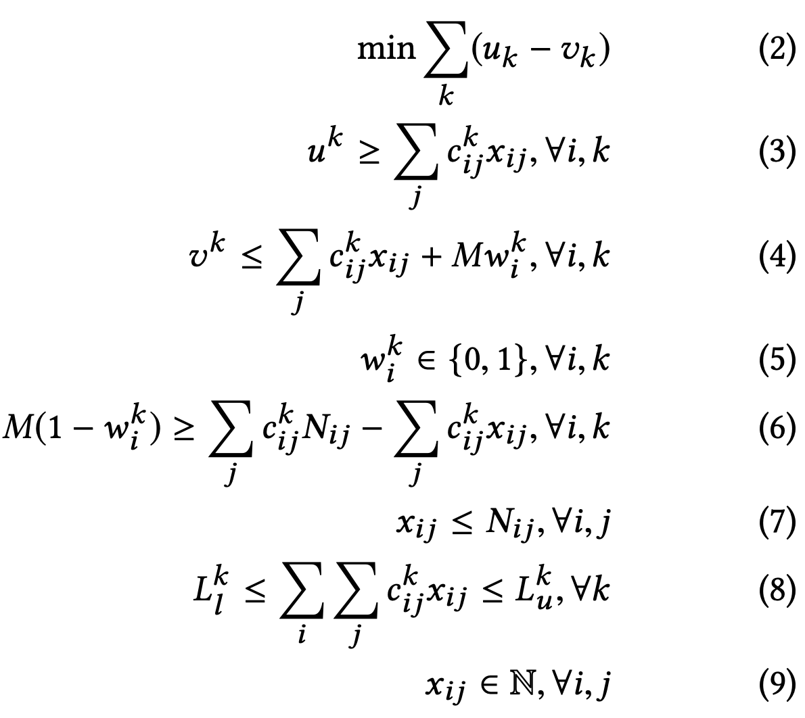
Parameters Definition
i: the index of the video
j: the index of the frame type
k: the index of the label type
c_{ij}^{k}: # of the k label in the j frame in the i video
N_{ij}: # of the j frame in the i video
L_{l}^{k}, L_{u}^{k}: the lower and the upper bound of the desired # of the k label
x_{ij}: # of the j frame in the i video that are sampled or selected
u^{k}, v^{k}: max and min of the k label among videos (X videos without k, k from the videos are all selected)
w_{i}^{k}: binary indicator, if all k labels in video i are selected

Slide 19
Formulations of Data Balancing
(2) Objective function: minimize the difference in the # labels of each type selected from videos
(3), (4): the definition of the variables in (2)
(5), (6): for M w_{i}^{k}
(7): ensure that the # of sampled frames <= # of frames in a video
(8): ensure that we are within the desired # of samples based on our frame choices
(9): ensure the # of frames sampled is integer
Min (2) → ↑ v_{k} → w_{k} = 1
# of selected label k in video i

Slide 20
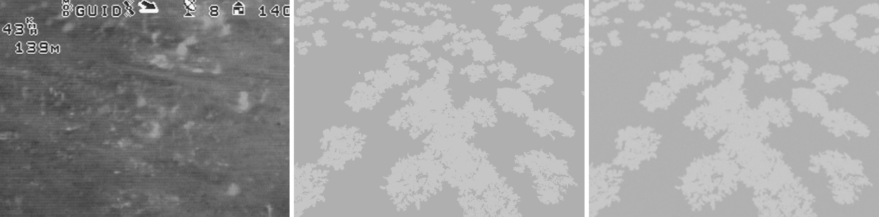
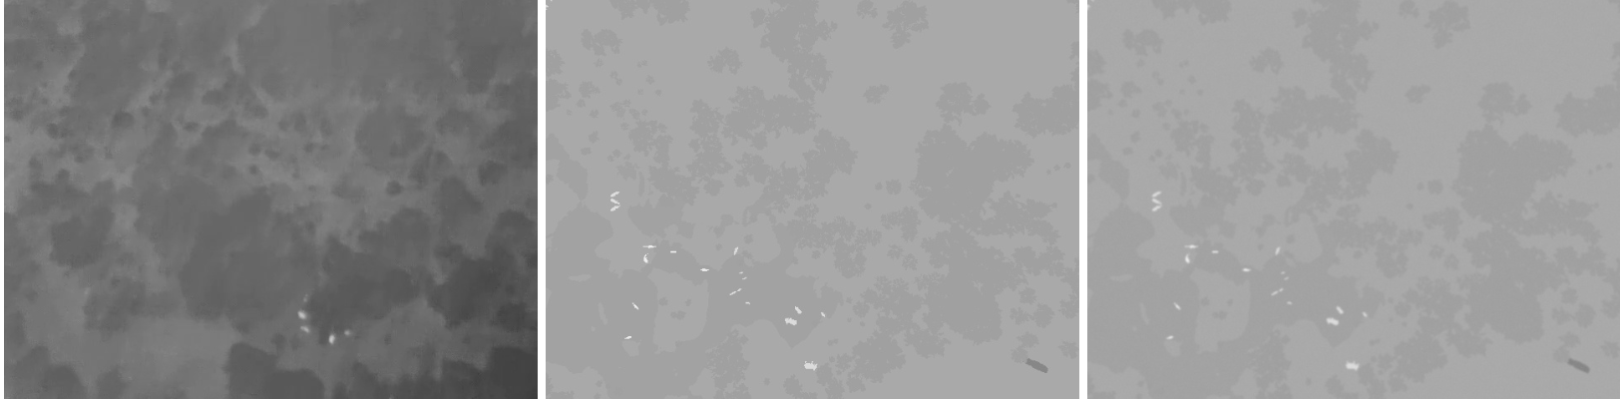
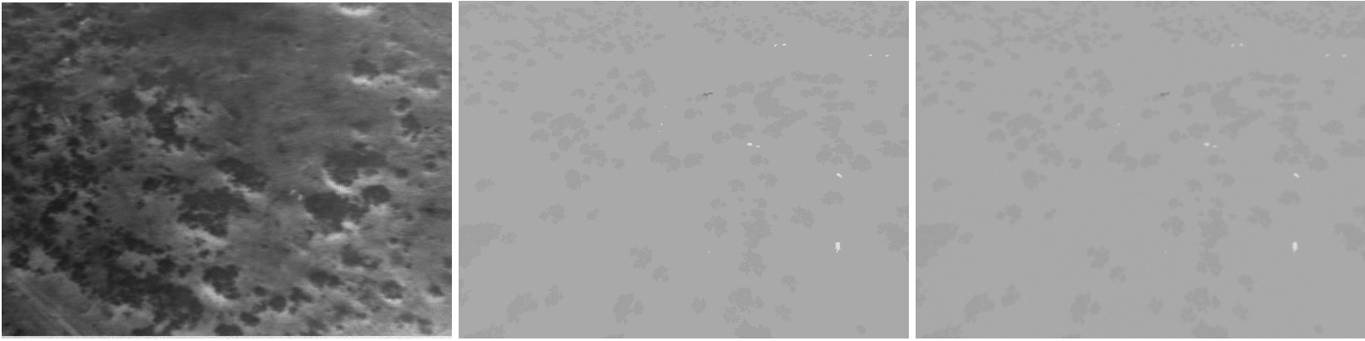
Evaluation --- Qualitative tests
Real frames
thermal infrared simulated frames
noisy simulated frames
Summer
Winter
Winter

Slide 21
Evaluations --- Quantitative Tests
Scenario: detect animals and poachers
The effects of balancing the real data
  Initialize using pre-trained ImageNet weights for Faster RCNN
  Fine-tune using the 651 balanced frames
The effects of adding simulated data
  Types of simulated data: i) regular, and ii) + blur and noise
  Initialize using pre-trained ImageNet weights for Faster RCNN
  Fine-tune using the simulated data (only with small-medium OOI)
  Fine-tune with the real data
    balanced real dataset
    SPOT unbalanced dataset
Baseline: SPOT, trained with various model and selected the best one
  SA, MA, LA: fine-tuned by the SPOT animal model
  MP, LP: fine-tuned by the SPOT poacher model
Testing set: 6 real videos (X SP)

Slide 22
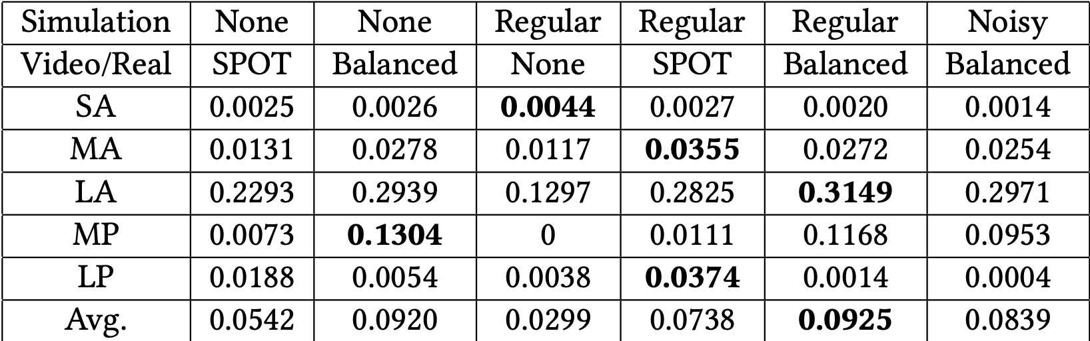
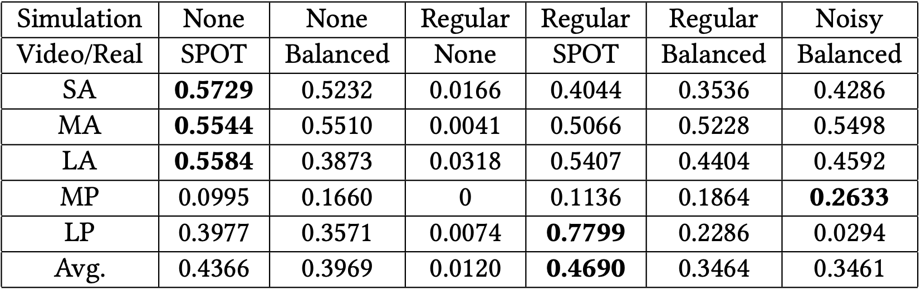
Evaluations --- Discussion
Using simulated data:
  the best recall in 4 classes and avg
  + SPOT: the best precision on avg
SPOT Without simulated data:
  Best precisions: SA, MA, LA
  Selected the best animal models in SPOT
  Large amounts of real data (18480 frames)
  Lack of large simulated animal examples
With noise:
  Good to have perfect images for initial training
  Necessary to have a more sophisticated noise model
Recall
Precision

Slide 23
Evaluations --- Discussion
Balanced data (651) performed comparably to SPOT (22663)
  Variety → less data
  Label only a few frames per video in the future
  Consider different distinctions
Simulate + Real is comparable to real only
→
  Generate large amounts of simulated data
  Reduce labeling burden
  Better collection, less costly
Recall
Precision

Slide 24
Conclusion
Creation of an African savanna environment
Integration of a new thermal infrared model based on radiometry
API code extensions to follow objects of interest or fly in zig-zag patterns to generate simulated training data
Demonstrated detection improvement using simulated data generated by AirSim-W

