Slide 1
Communication-Efficient Federated Deep Learning With Layerwise Asynchronous Model Update and Temporally Weighted Aggregation
IEEE Transactions on Neural Networks and Learning Systems ( Volume: 31, Issue: 10, Oct. 2020)
Yang Chen , Xiaoyan Sun, Member, IEEE, and Yaochu Jin , Fellow, IEEE

Slide 2
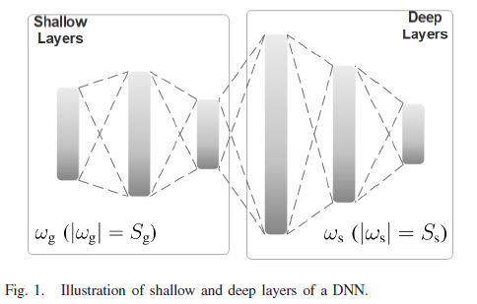
Introduction / Motivation
Target : reduce communication cost in FL
Shallow layers learning general features in DNN
Deep layers learning specific features related to dataset
Sg << Ss

Slide 3
Related work
Konecny et al : structured updates and sketched updates
(compression and reconstruction)
Gayer et al : client-sided differential privacy
Reducing the number of parameters to upload

Slide 4
Contribution
Layerwise asynchronous model learning
Layerwise asynchronous model update (reduce comm. cost)
Temporally weighted aggregation (increase convergence speed)

Slide 5
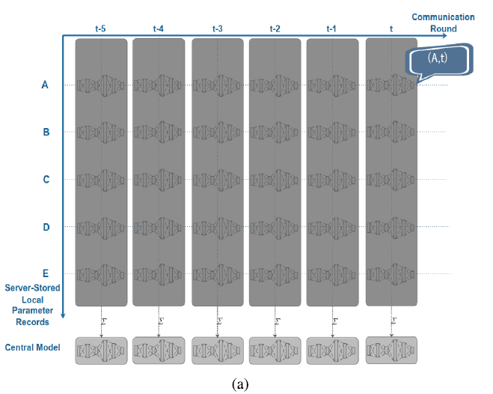
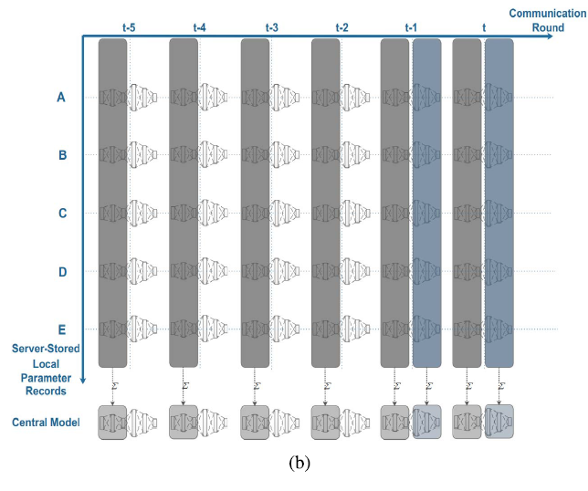
Layerwise asynchronous model update

Slide 6
Temporally Weighted Aggregation
More recently updated model have larger weights
t = current round
${Timestamp}^{k}$ = newest model $w^{k}$ updated
$\frac{n^{k}}{n}$ = traditional update staggery based on data amount
K = client number

Slide 7
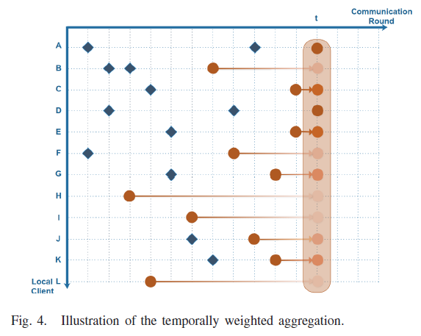
Temporally Weighted Aggregation

Slide 8
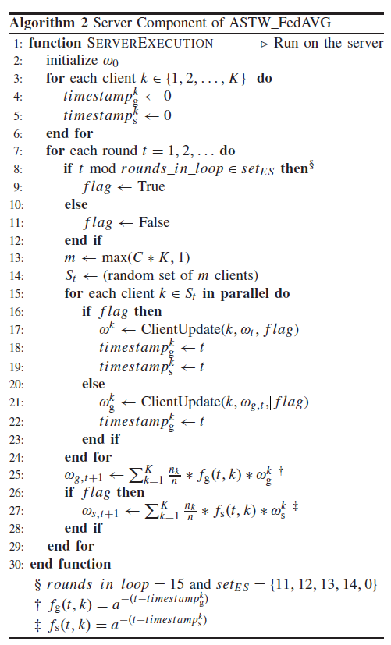
Totally algorithm
Update deep layers round
Client selection
Shallow layers timestamp
Deep layers timestamp

Slide 9
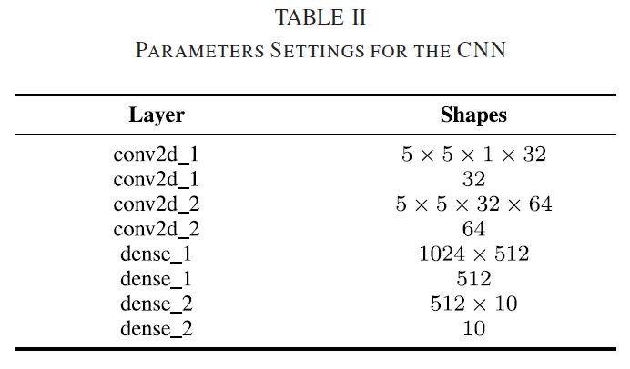
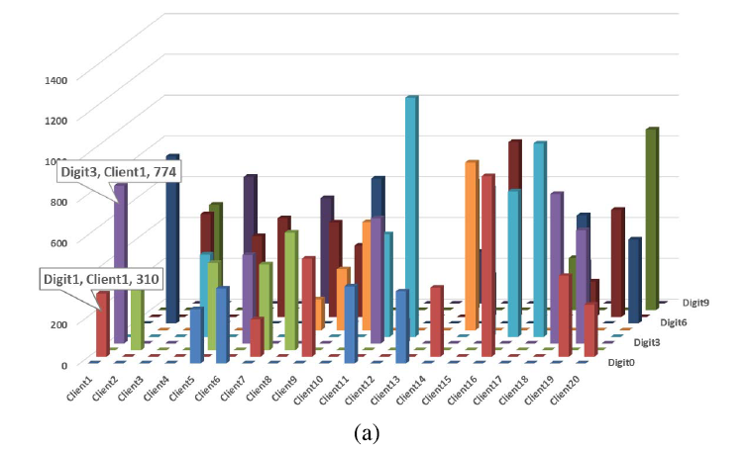
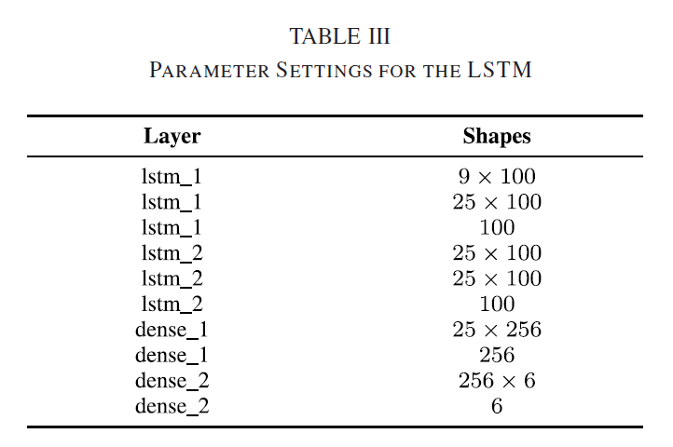
Experiment setting
Non-iid MNIST

Slide 10
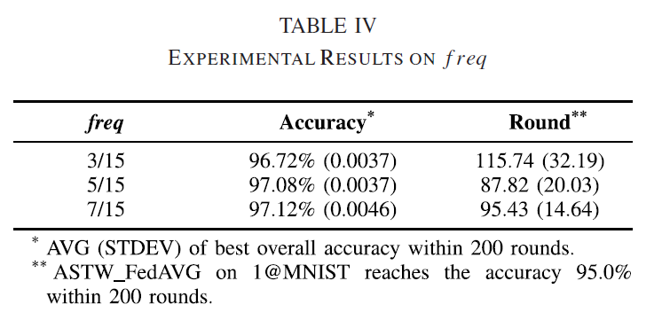
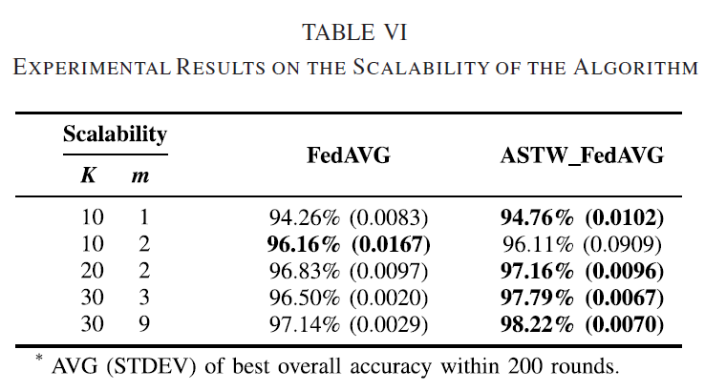
Experiment result hyperparameter
Freq : deep layer update frequency
A: timestamp influence parameter
K: total number of clients
M: clients per round

Slide 11
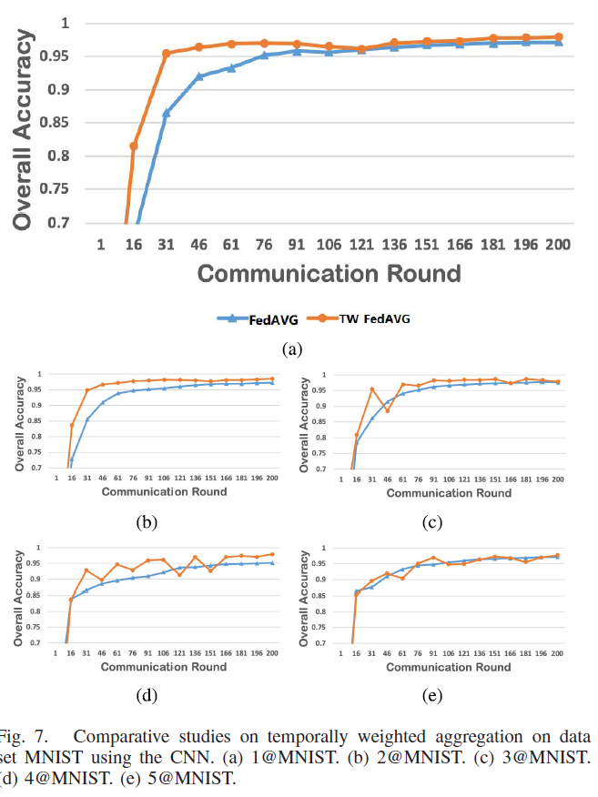
Experiment result TW_FedAVG

Slide 12
Experiment result

Slide 13
Conclusion
Asynchronous model update strategy and temporally weighted aggregation method get better performance and comm. Costs than FedAVG
Assumption All clients have same local models and parameters

