Slide 1
User Centered Adaptive Streaming of Dynamic Point Clouds with Low Complexity Tiling
MM’20

Slide 2
Outline
Intro
Tiling Strategy
Experiment
Result
Conclusion

Slide 3
Intro
Contribution
  Tiled-based point cloud DASH streaming strategy
    4 non-overlapped tiles for a single dynamic point cloud object
  Dataset
    MPEG 8i
    User is freely observe point cloud objects
    Recording the navigation for rate adaptation experiments
Codec-agnostic

Slide 4
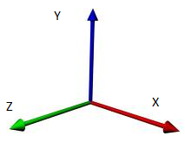
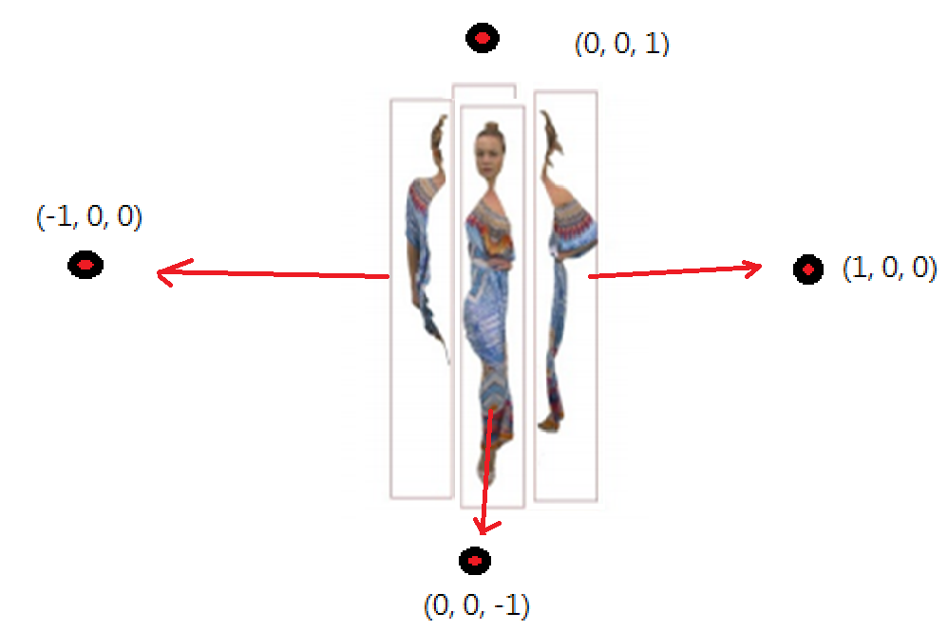
Tiling Strategy
4 Virtual Camera in quadrilateral shape
Assume the point cloud object presents convex hull
Draw a vector from centroid to each point
  Dot product with camera orientation
  to assign point to each tile
Notes:
Assume the point cloud object presents convex hull

Slide 5
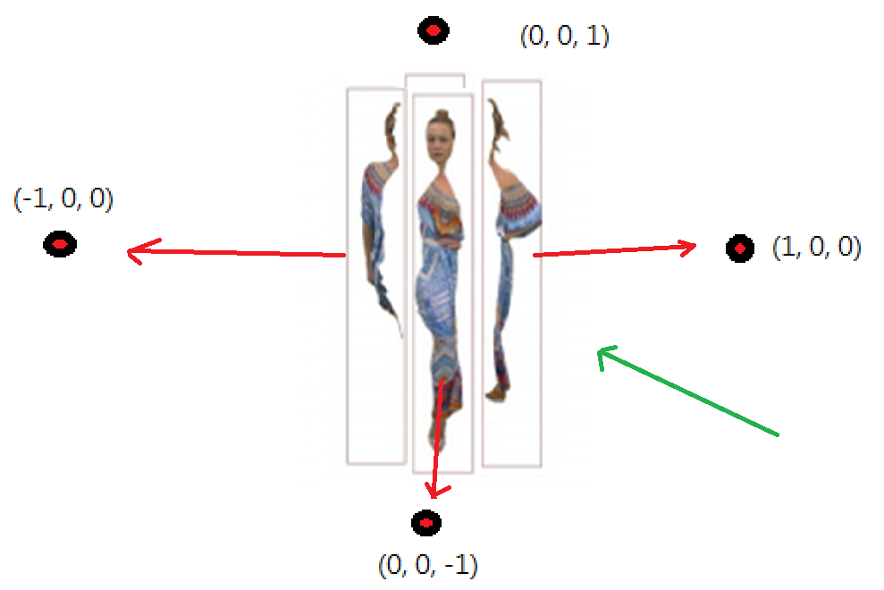

Playback Strategy
U(Ti) =
  Ti is visible if U(Ti) > 0
  Vo is the viewing angle
  Ti is the orientation of the tile
Bitrate allocation
  Greedy – Highest utility tile get the highest quality first (5, 1, 1, 1)
  Uniform – Every tile increases quality one step at a time(3, 2, 2, 2)
  Hybrid – Tiles with positive Utility uniformly increased first
  (4, 4, 1, 1)
Notes:
Probability density function will be the future work

Slide 6

Experiments
MPEG anchor codec
  Octree space partitioning structure to encode point cloud geometry
  Color is mapped and encoded as 2D grid and applying JPEG compression
  JPEG quantization parameter from 55 to 95 in increments of 10
Budget
  The encoded size for the Common Test Condition compression profiles supplied with the MPEG V-PCC Codec at each decision point
  Pre-recorded navigation patterns
  Computing PSNR on the YUV channel
  Background RGB[0, 177, 85]
    Providing maximal contrast with respect to the content
Notes:
Anchor 2016

Slide 7
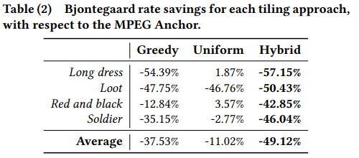
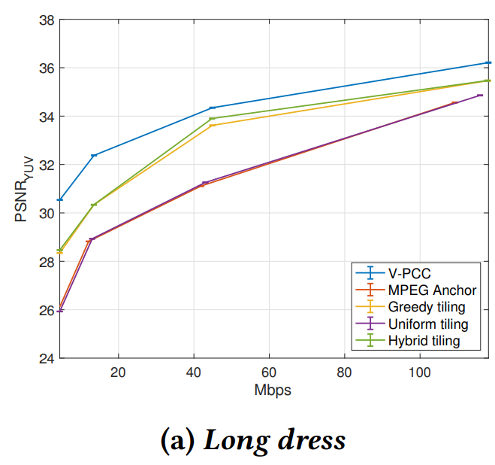
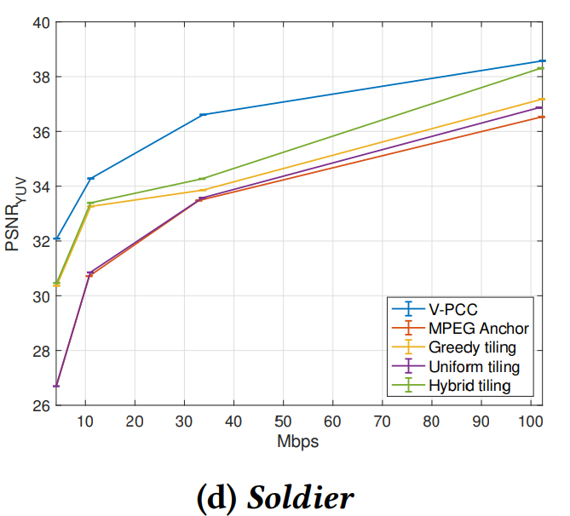

Slide 8
Conclusion
Tiling point cloud objects into 4 non-overlapped pieces
Use utility function to evaluate visibility and evaluate 3 bitrate allocation strategy
Limitation
  Assume client has omniscient knowledge of user
  Assume convex hull
  Cannot use teleport
  Static bitrate
Future work
  Tiling approach with network adaptation in multi-user 6DoF telepresence application

