Slide 1
Uncertainty Based Camera Model Selection

Slide 2
Introduction
The quality and speed of Structure from Motion (SfM) methods depend significantly on the camera model chosen for the reconstruction
The best way of model selection is to choose the simplest model that have the similar predictive or explanatory power with other candidate models
In this paper, they proposed a way that based on uncertainty to automatic select camera model instead of choosing by user.
Notes:
measurement uncertainty is the expression of the statistical dispersion of the values attributed to a measured quantity

Slide 3
contribution
For sfm model selection:
  Information Criteria (IC) Proposed accuracy-based criteria (AC) and an AC-based camera model Selection method(ACS)
  Fine-tune reprojection error thresholds by learning a camera model selection classifier (LACS) from ACS evaluations
  In experiments, They show a significant increase in the reconstruction quality and speedup of the reconstruction process. Moreover, they use of the accuracy of observations improves the inlier/outlier classification
Notes:
IC choose the model that estimate have minimize imformation loss
camera model selection in SfM by standard Information Criteria (IC) may not work for several reasons
First, the reconstruction has a singular statistical model due to the gauge freedom [21], i.e. the likelihood function of having a ”good” model cannot be derived using the normal distribution [48]. Secondly, the prior distribution of the reconstruction parameters (e.g. camera poses and 3D points) is not known and thus Bayesian methods cannot be used either. Third, for different camera models and different reprojection thresholds, the final 3D reconstruction contains different numbers of registered 3D points and cameras, i.e. the size of data is not constant. Finally, standard ICs assume that residuals depend only on the selected model. However, camera model selection also depends on physical properties (e.g. lighting and view angle)
radial distortion:When light enters the lens, the light entering from the edge will be more deflected than the light entering from the center. This is the main cause of radiation distortion, and the smaller the lens, the more obvious this phenomenon will be.

Slide 4


Problem formulation
Goal:
  Design a scoring function , and given a finite models
  The most accurate reconstruction should get the highest score
The reconstruction for model i consist of cameras, 3D points, and radial distortion parameters
Running SfM for all considered camera models from M may be computationally extremely expensive
  evaluate the proposed criterion for smaller sub-reconstructions with a fixed number of registered cameras
  the estimated parameters of these sub-reconstructions were estimated by an SfM pipeline ,i.e COLMAP
  are observations of the 3D point Xm in the camera Pl

Slide 5




Problem formulation (cont.)
Observations that satisfy are the inliers of the model
  assume that the sub-reconstructions contain inliers only
Distortion correction function:
  uˆ_ is the projection in the image plane before applying radial distortion, f^ is focal length , pp^ is principal point (usually at centra of image)
  rational function (model)- (with the first B non-zero parameters kˆj and the first D non-zero parameters dˆl):

Slide 6

Accuracy-based criterion (AC)
Assume the residual follows a zero-mean Normal distribution with covariance matrix
  The covariance matrix is found for each keypoint which is described by an affine region that found by DSP- SIFT detector.
  The covariance matrix of all observations Σu is composed of blocks Σul,m on the diagonal.
The accuracy of observations (information matrix) is the inversion of the covariance matrix
To compare values of reconstruction
  specify the gauge of the coordinate systems
  specify the gauge of the covariance matrix
Notes:
The covariance matrix for each affine region is computed as the scaled inversion of the Structure Tensor.
The number of reconstruction parameters kˆ(i) varies for different initial pairs of the reconstruction, different reprojection error thresholds δ, and different camera models.
specify the gauge of the coordinate systems
choose one reference reconstruction, transform the coordinate system of each reconstruction to minimize:
the distances of the centres of cameras
the angles between the optical axes of cameras in these reconstructions to the centres and the optical axes of the corresponding cameras in

Slide 7



specify the gauge of the covariance matrix
    Define a subset of parameters theta A which are common to all the reconstructions
    The parameters of all reconstruction can be decomposed as
    Propagate the accuracy of observation to reconstruction
      JA denote the propagation of the jacobian of p w.r.t. theta A
    Apply S-transformation S(i) for each reconstruction so that the imformation sub-matrix of all reconstruction would have same dimension

Slide 8
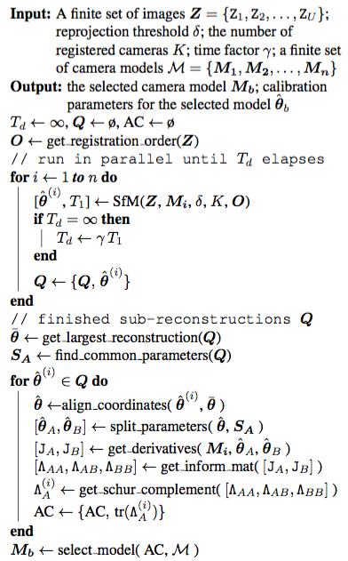
Camera model selection method (ACS)
According to our experiments, it is sufficient to use 5 ≤ K ≤ 15 registered cameras to estimate the camera model reliably
applies SfM with camera model Mi and reprojection error threshold δ until K images from the queue O are registered or time limit Td is exceeded.
  ,T1 is the fastest reconstruction time, γ is set empirically
  The models that were not able to register K images within Td time are discarded.

Slide 9
Learned threshold (LACS)
For different thresholds, different camera models may be selected, Here we propose a learning-based ACS method (LACS).
  It will take the values of the AC criteria for different thresholds as input and will output the “best” camera model which have the highest AC score.
  (number of tested camera models n) × (number of assumed thresholds Nthr), are the input to our shallow neural network and it will output the “best” camera model
Notes:
The model selected by ACS depends on a threshold on the weighted residuals
This network consisting of 4 hidden fully connected layers each followed by leaky ReLU

Slide 10
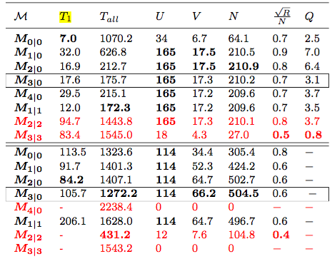
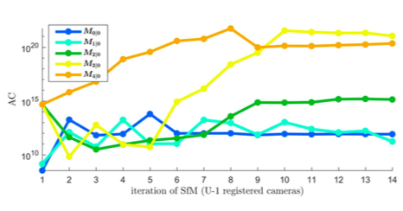
Real Experimental and result
compares results of the COLMAP pipeline with and without the proposed camera model selection methods
Notes:
pipeline as below:
Select the initial pair and the order of the images for registration into the partial reconstructions.
COLMAP registers new cameras, triangulates 3D points and optimizes the partial reconstruction using Bundle Adjustment (BA) ,
The partial reconstruction is checked for degeneracies and 3D points are filtered if they do not satisfy several conditions, e.g. a minimal triangulation angle, an absolute re- projection error.
the registered cameras are filtered if they do not contain enough 2D-3D correspondences.

Slide 11
Conclusion
In the experiment, they found more complex camera models or by repetitive cycles of adding, optimizing, and removing of 3D points would cause overfitting and increased the reconstruction time.
Proposed methods ACS and LACS overcome these problems by automatic selection of the camera model.

