Slide 1
Objective
Allow user to update their DNN
Split the DNN and deploy in the IoT network
Monitor the computing resource and network among all the nodes
Dynamically change the deploy configuration according to the resource usage

Slide 2
TensorFlow Model Partition
SAF
Create tensor to execute the DNN with specified input and output layer
Adaptive DNN
Use TF api to copy each layer to create 2 part of the model

Slide 3
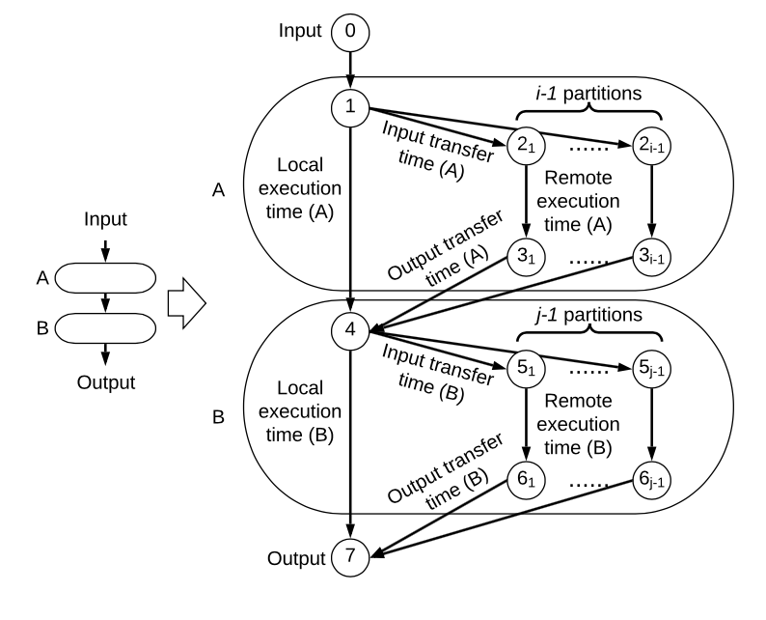
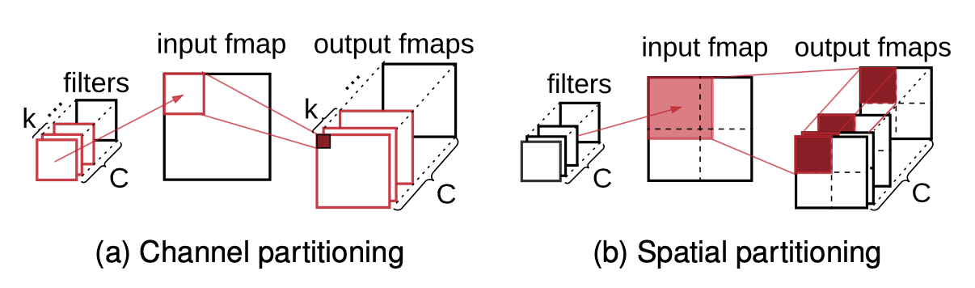
DNN Distributing
Zhou, Li, et al. "Distributing deep neural networks with containerized partitions at the edge." 2nd {USENIX} Workshop on Hot Topics in Edge Computing (HotEdge 19). 2019.

Slide 4
Container Orchestration Tools
Docker Swarm
An administrator with exposed APIs to deploy containers
Select the node with lowest container set
Apache Mesos
Master node assigns workload to slave based on available CPU/RAM
Slave node always inform master about their free resources
Google Kubernetes
The smallest deploy unit is pod instead of container
Score each node for scheduling

Slide 5
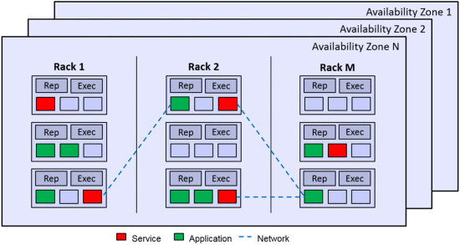
Locality scheduling
D. Zhao, M. Mohamed and H. Ludwig, "Locality-Aware Scheduling for Containers in Cloud Computing," in IEEE Transactions on Cloud Computing, vol. 8, no. 2, pp. 635-646, 1 April-June 2020, doi: 10.1109/TCC.2018.2794344.

Slide 6
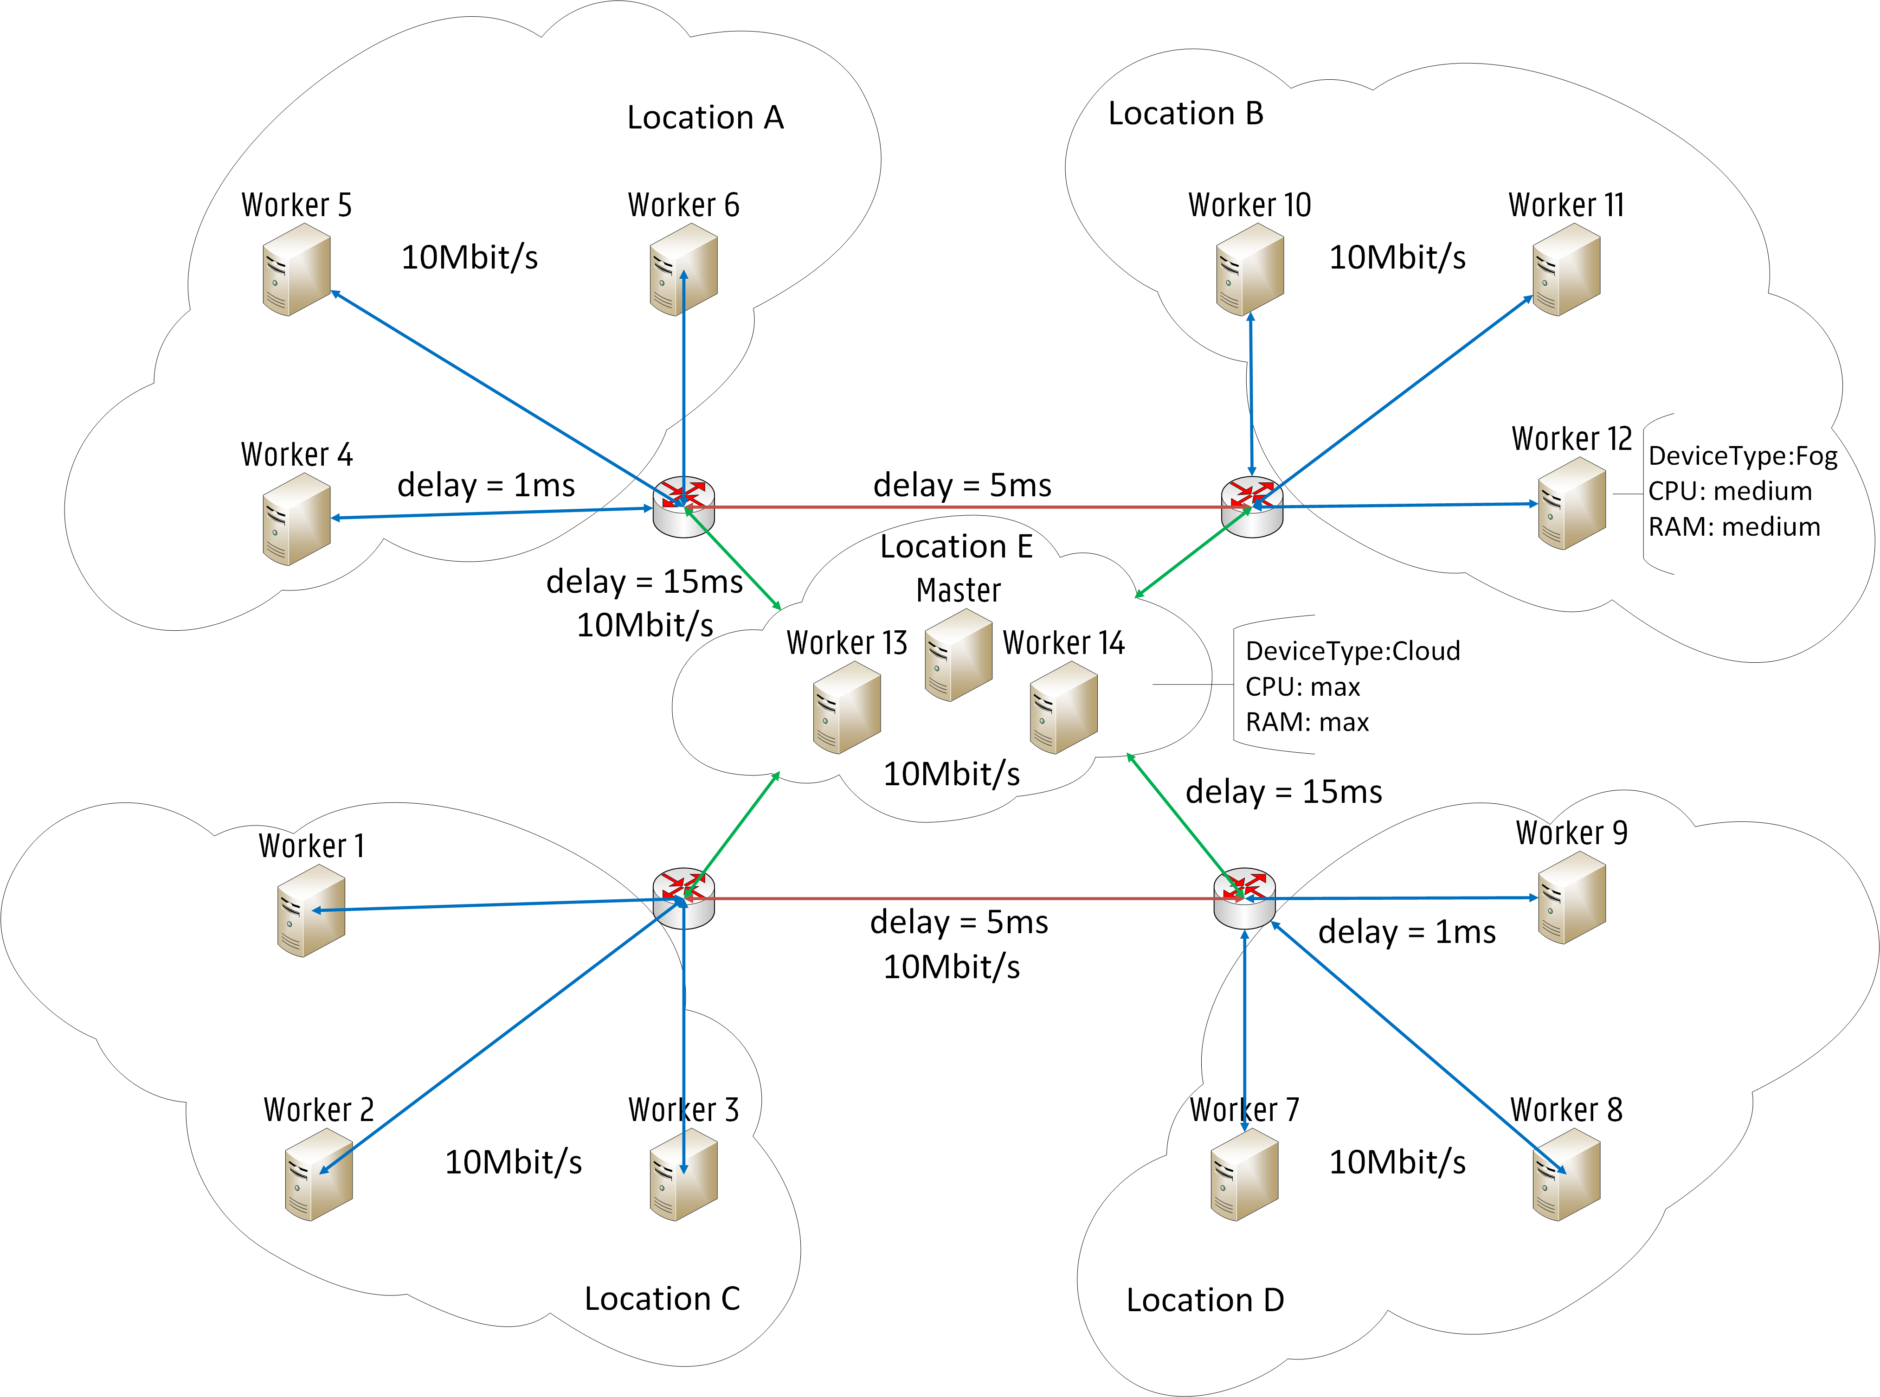
Network Resource Provisioning
Label the network link among the fog
Filter regular scheduler to find least RTT deployment
J. Santos, T. Wauters, B. Volckaert and F. De Turck, "Towards Network-Aware Resource Provisioning in Kubernetes for Fog Computing Applications," 2019 IEEE Conference on Network Softwarization (NetSoft), Paris, France, 2019, pp. 351-359, doi: 10.1109/NETSOFT.2019.8806671.

Slide 7
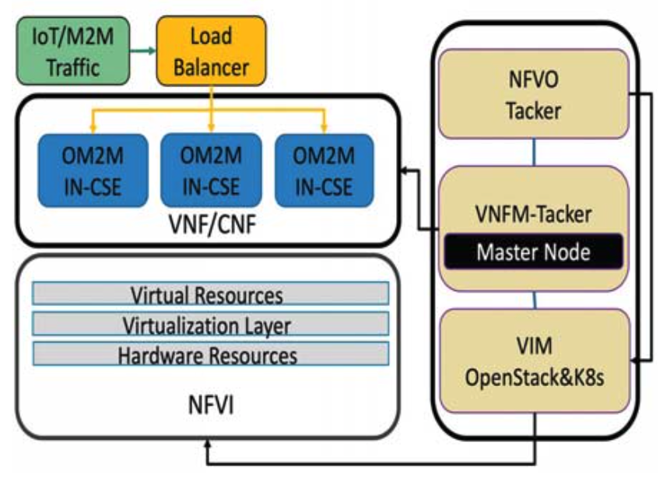
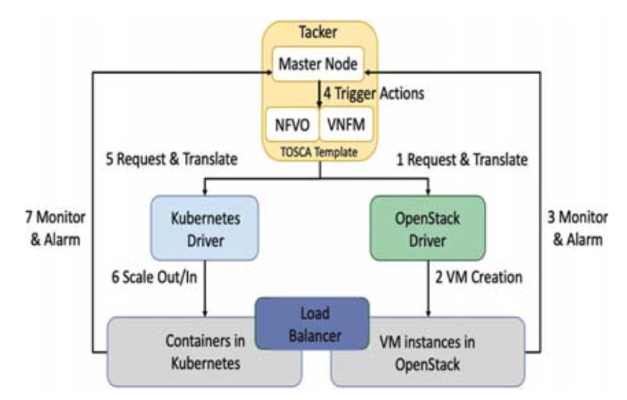
IoT Platform with NFV MANO
H. Chen and F. J. Lin, "Scalable IoT/M2M Platforms Based on Kubernetes-Enabled NFV MANO Architecture," 2019 International Conference on Internet of Things (iThings) and IEEE Green Computing and Communications (GreenCom) and IEEE Cyber, Physical and Social Computing (CPSCom) and IEEE Smart Data (SmartData), Atlanta, GA, USA, 2019, pp. 1106-1111, doi: 10.1109/iThings/GreenCom/CPSCom/SmartData.2019.00188.

Slide 8
Conclusion
There are already some tools to help us split a DNN
Locality-aware scheduling in cloud has been done
People usually define RTT and bandwidth among each node in advanced
IoT platform with NFV MANO support has been done
Many partition and deployment algorithms has been done and tested in simulator

