Slide 1
Dynamic Adaptive DNN Surgery for Inference Acceleration on the Edge
Hu, C., Bao, W., Wang, D. and Liu, F., 2019, April. Dynamic adaptive DNN surgery for inference acceleration on the edge. In IEEE INFOCOM 2019-IEEE Conference on Computer Communications (pp. 1423-1431). IEEE.

Slide 2
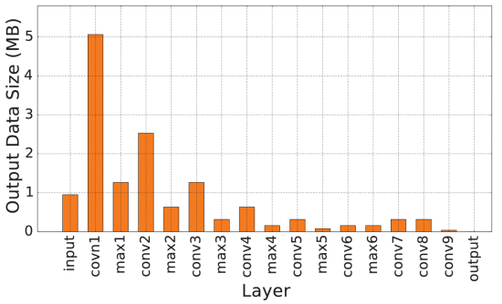
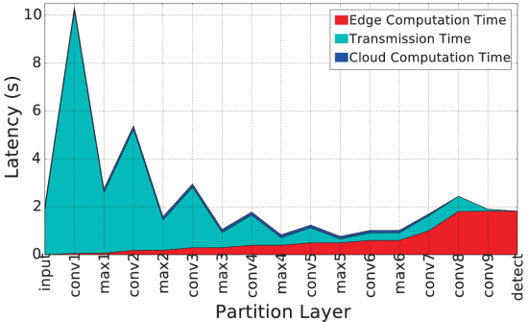
Introduction
Cloud computing
Video streaming generates a huge
amount of data
Google’s self-driving car generates data at
rate 750 Mbps
Fatest 4G uplink rate is 5.85 Mbps
Edge computing
Limited by the resources constraints
Solutions
DNN’s intermediate results are smaller
Compute part on the edge and the rest on
the cloud

Slide 3
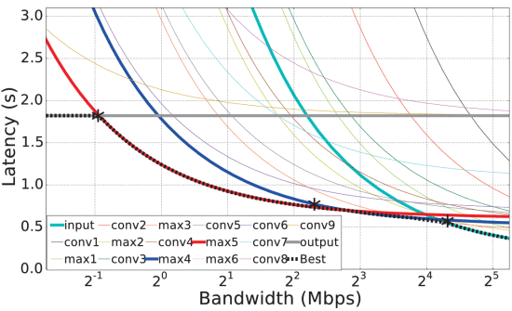
Challenges
Tradeoff between computation and transmission
Splitting DNN depends on network conditions
  High-throughput: offload DNN earlier
  Low-throughput: decrease the amount of data to transmitt
DNN is not limited to a chain topology, DAG is getting popular now
18 Mbps
4 Mbps

Slide 4
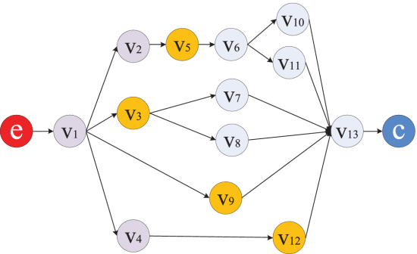
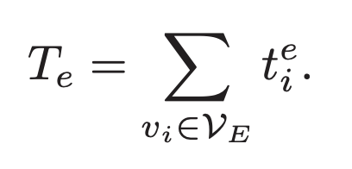
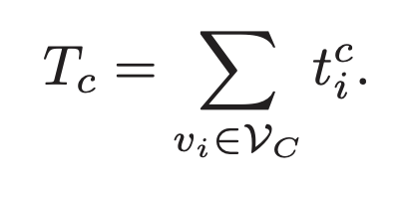
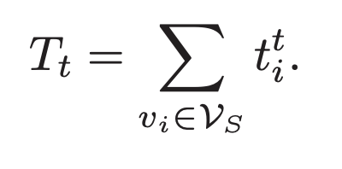
ECDI model
Video frame
  Sampling rate = Q
DNN as a graph
DNN partitioning
  V_E = V_E’ + V_S = edge set
  V_S = cut set
  V_C = cloud set
Delay components
Edge Cloud Transmission

Slide 5
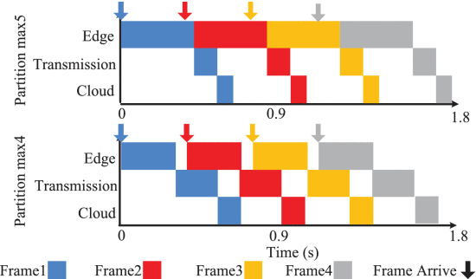
Workload impact on DNN partition
Frames are processed in pipeline every 1/Q
if (Te+Tc+Tt > 1/Q): system congests
Light loaded system: minimize Te+Tc+Tt
Haveily loaded system: maximize throughput (minimize max{Te, Tc, Tt})

Slide 6
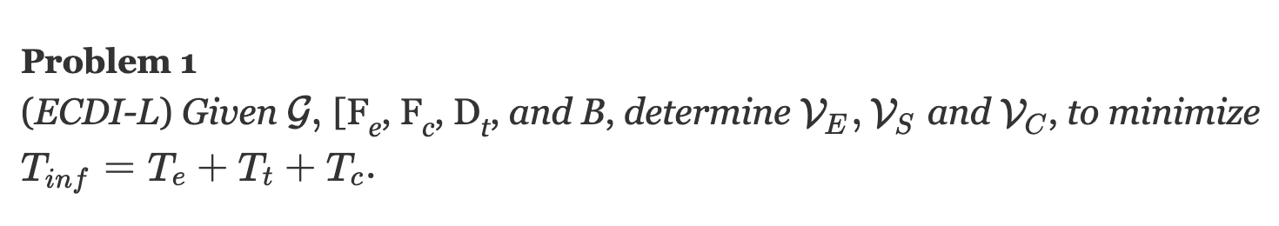
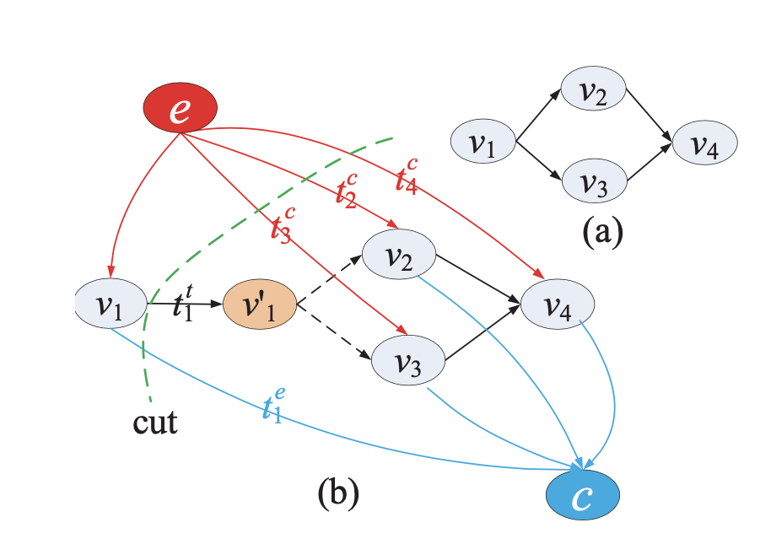
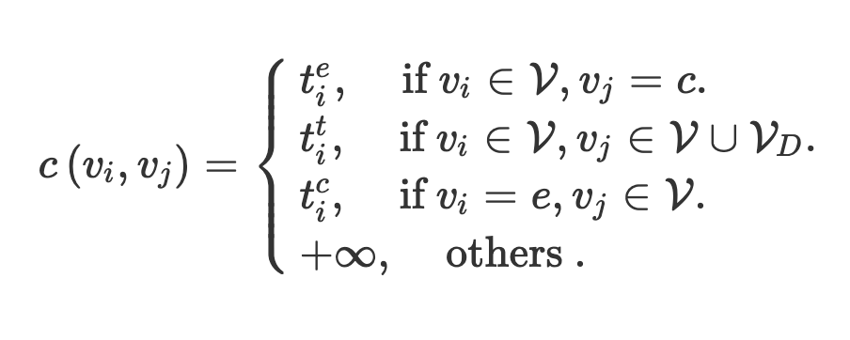
Light Workload Partitioning Algorithm
Convert the problem to minimum weighted s-t cut problem

Slide 7
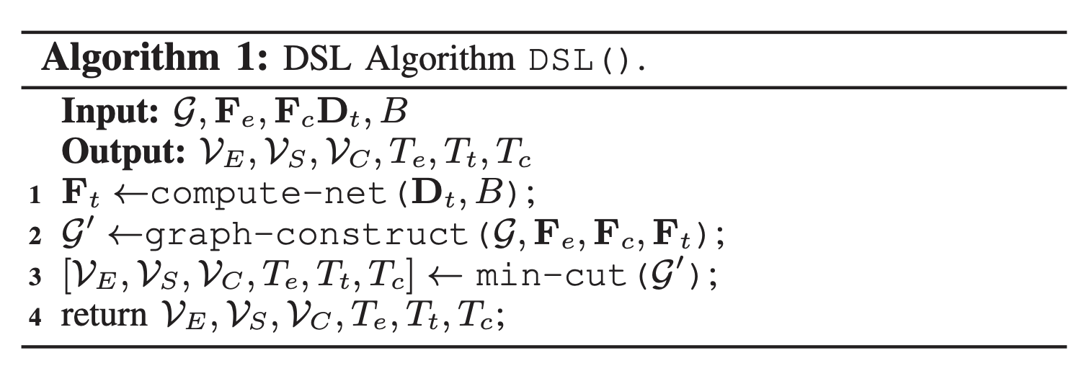
DSL
O(|V| + |L|) = O(n+m)
O((m+n)n^2)

Slide 8
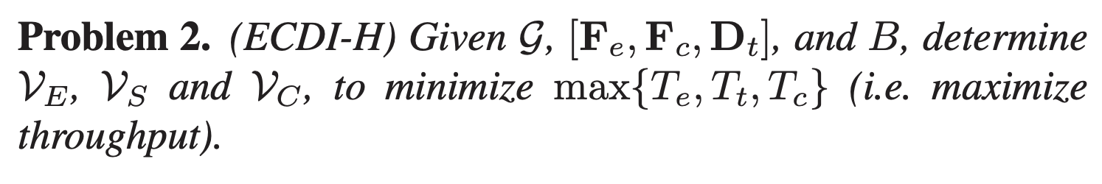
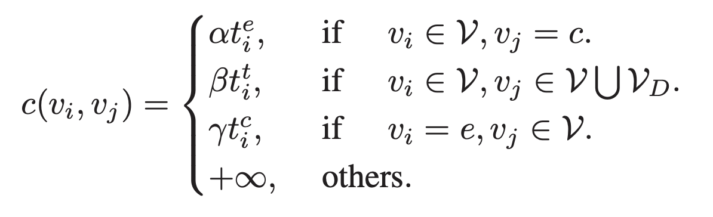
Heavy Workload Partitioning Algorithm
NP-hard: reducing from the smallest component of the most balanced minimum st-vertex cut problem
-> acheive local optimium, approximation ratio = 3
search the best alpha, beta, and gamma (non-negative) tuple

Slide 9
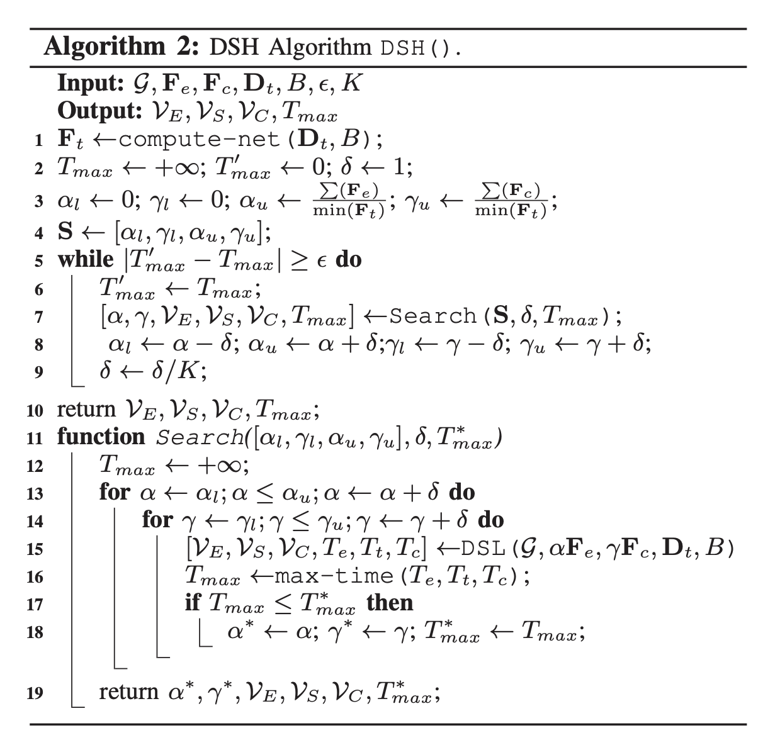
search on the given space S with a granularity δ
narrows down the search space S (line 8) to the neighborhood of the best α and γ for the current iteration, and adjusts δ to a finer granularity
terminate when the improved performance is smaller than a threshold ε

Slide 10
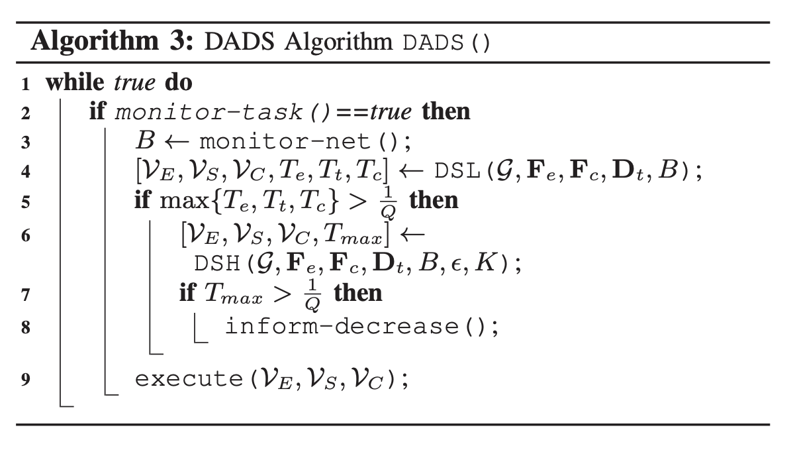
Dynamic Adaptive DNN Surgery (DADS)

Slide 11
Difference from Related Work
Does not modify DNNs
Can handle DAG topology
Considers a sequence of tasks
Handles dynamic network condition to reduce the inference latency rather than communication overhead only

Slide 12
Implementation
Edge server: Raspberry Pi 3 model B
  Extract video to the sampling rate Q
  Make partition decision
  Process the layers for edge
  Inform the cloud the partition decision and send the intermediate results
Cloud server: Cloud Ali with 8 cores of 2.5 GHz and a total memory of 128 GB
  Receive the partition decision and intermediate results
  Execute the layers for cloud
Link: WiFi

Slide 13
Evaluation Setup
[1] Kang, Y., Hauswald, J., Gao, C., Rovinski, A., Mudge, T., Mars, J. and Tang, L., 2017. Neurosurgeon: Collaborative intelligence between the cloud and mobile edge. ACM SIGARCH Computer Architecture News, 45(1), pp.615-629.
Dataset: BDD100K self-driving dataset
Workload
  Light: video sampling rate = 0.1 fps
  Heavy: video sampling rate = 20 fps
Communication parameters: average uplink rate of mobile Internet for different wireless networks, i.e. CAT1, 3G, 4G and WiFi
Benchmarks
  Chain topology: NiN, tiny YOlOv2 and VGG16
  DAG topology: AlexNet and ResNet-18
Evaluation Criteria
  Compare against Edge only, Cloud only, and Neurosurgeon [1]
  For Neurosurgeon: transfrom to chain topology before running DAG
Notes:
cloudcom17 v.s. 6 state-of-art table
DAG? or not
What’s the closest work (tensorflow + optimal cut + real testbed + real analytics)

Slide 14
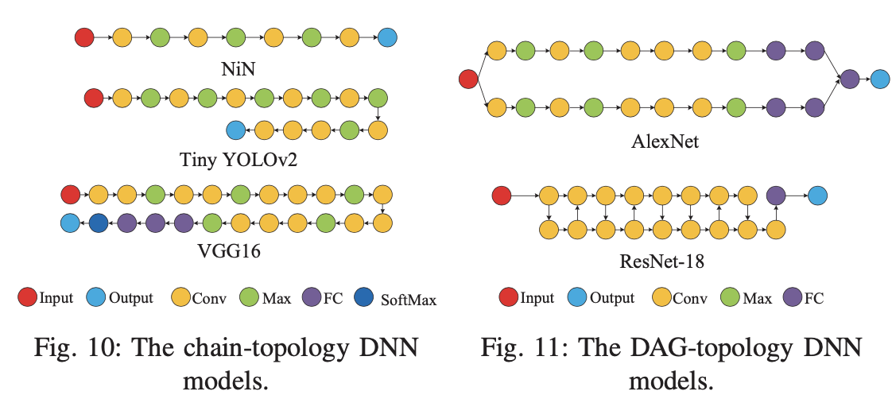
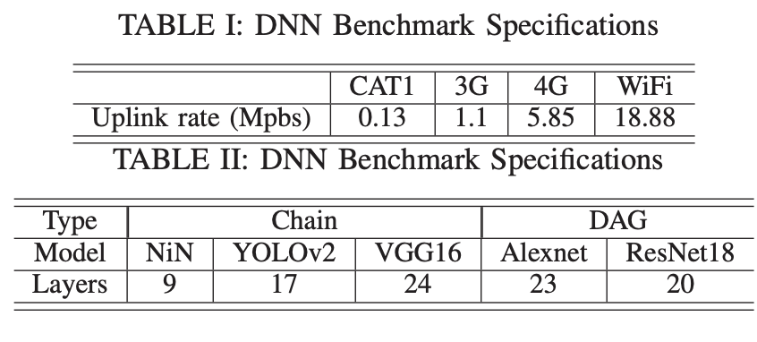

Slide 15
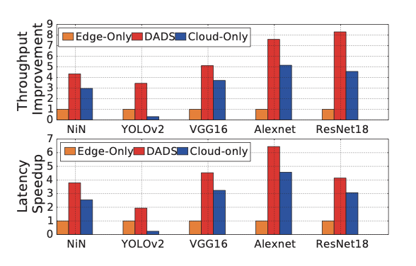
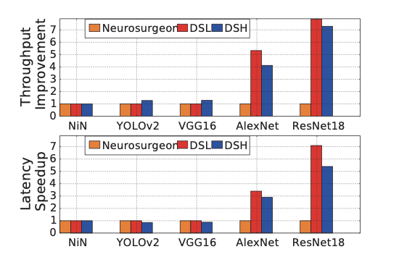
Light mode
Edge
1.91–6.45x speedup
3.45–8.31x throughput
Cloud
1.35–8.08x speedup
1.46–11.13x throughput
Heavy mode
Edge
1.66– 5.19x speedup
4.34–9.14x throughput
Cloud
1.07–6.92x speedup
1.46–14.10x throughput

Slide 16
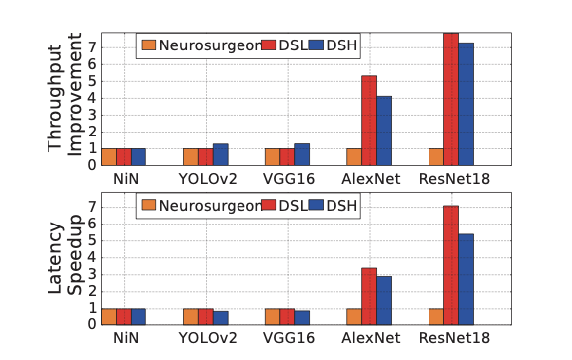
For DAG topology models, DADS has a latency speedup 66%–86% and throughput gain of 76%–87% compared with Neurosurgeon

Slide 17
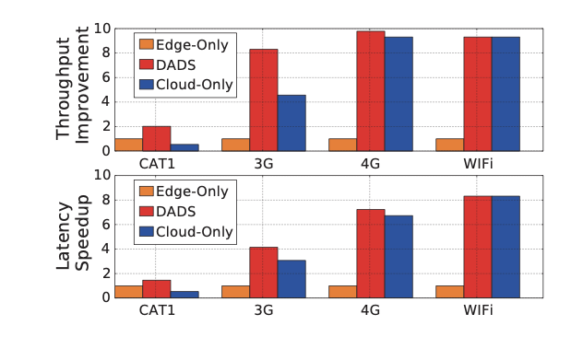
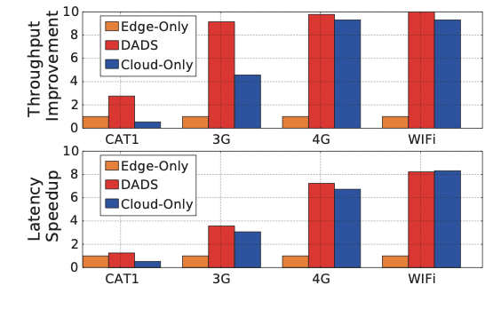
Light Heavy
Edge-Only is only good for low data rate; Cloud-Only is only good for high data rate

Slide 18
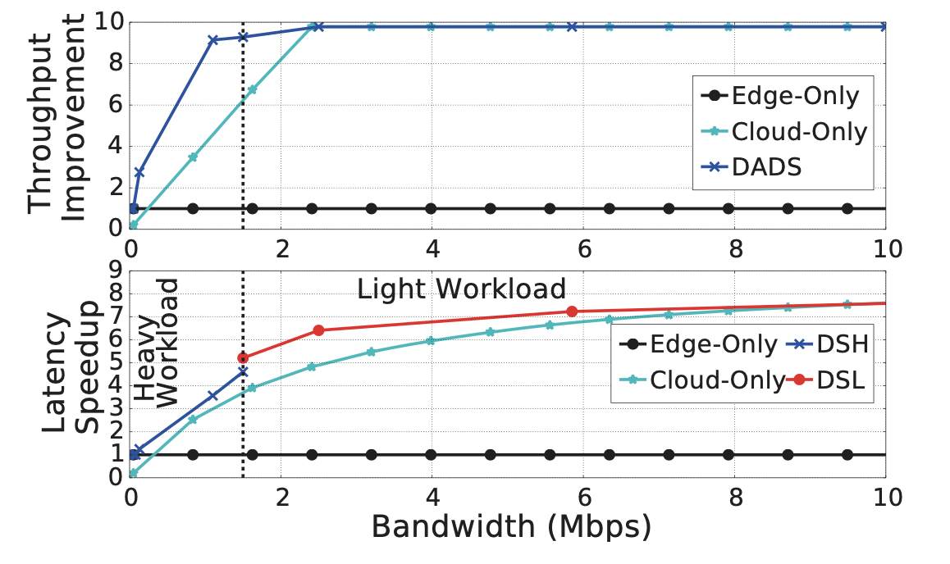
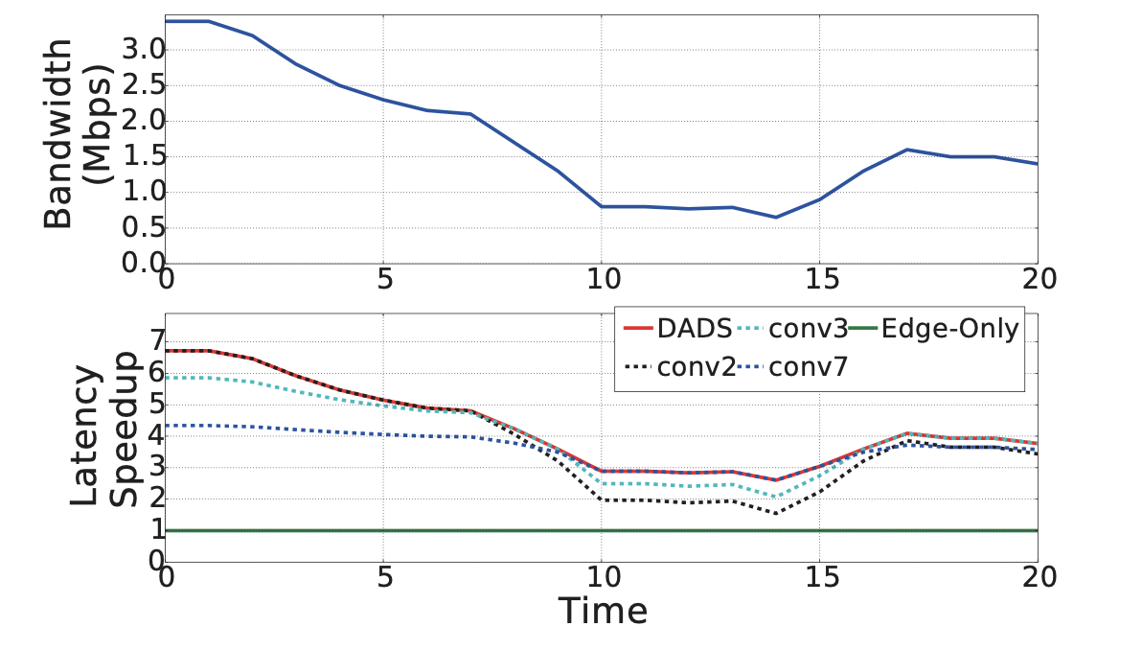
DADS adjusts the partition strategy according to the bandwidth variance successfully

Slide 19
Conclusion
Propose Dynamic Adaptive DNN surgery (DADS) scheme
Present a comprehensive study of the partition problem under the lightly loaded condition and the heavily loaded condition
  Develop an optimal solution to the lightly loaded condition
  Design a 3-approximation ratio algorithm under the heavily loaded condition
DADS can effectively improve latency and throughput

