Slide 1
Mask R-CNN
Kaiming He, Georgia Gkioxari, Piotr Dollar, Ross Girshick
The IEEE International Conference on Computer Vision (ICCV), 2017, pp. 2961-2969

Slide 2
Outline
Intriduction
Background: Faster R-CNN
Mask R-CNN
Network Backbone
  Region Proposal Network
  RoI Pooling
  RoI Align
Network Head
  Classification & Detection
  Segmentation
Experiments

Slide 3
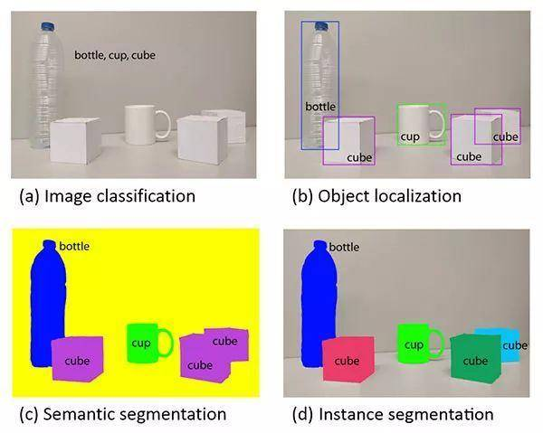
Introduction
Detectron2 from Facebook
an instance segmentation
extension of Faster R-CNN
  each candidate object : class label + bounding-box offset + object mask
designed for pixel-to-pixel alignment between network inputs and outputs

Slide 4
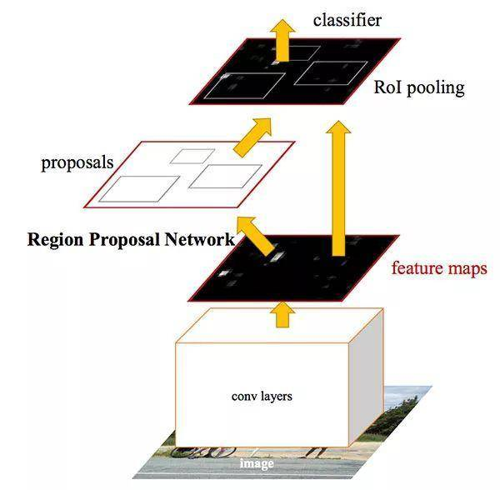
Faster R-CNN
(i) Region Proposal Network (RPN)
(ii) RoIPool: extracts features from each RoI and performs classification and bounding-box regression in parallel
The features used by both stages can be shared for faster inference

Slide 5
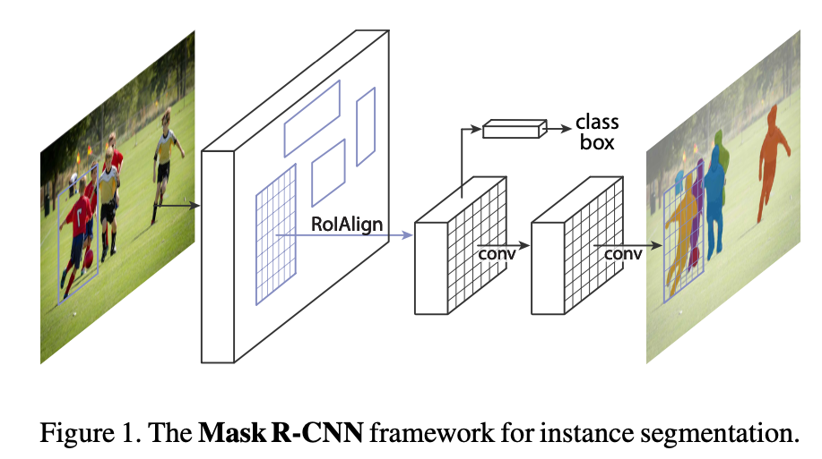
Mask R-CNN
Faster R-CNN with FCN on RoIs
(i) RPN
(ii) RoIAlign: extracts features from each RoI and performs classification, bounding-box regression and a binary mask in parallel
Faster R-CNN
FCN on RoIs

Slide 6
Backbone
-RestNet50
-RestNet100
-FPN
Head

Slide 7
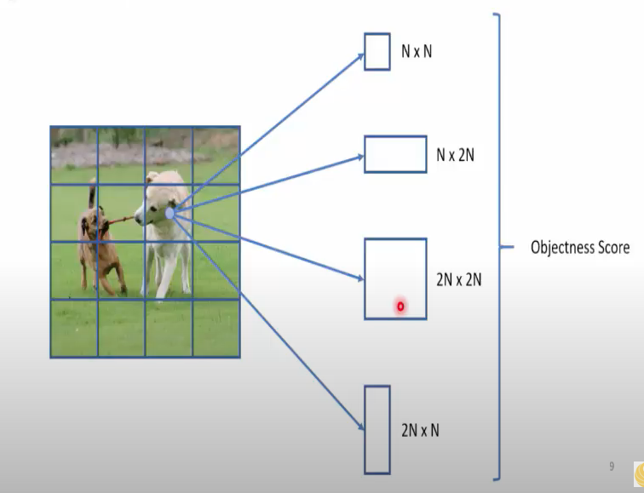
Region Proposal Network

Slide 8
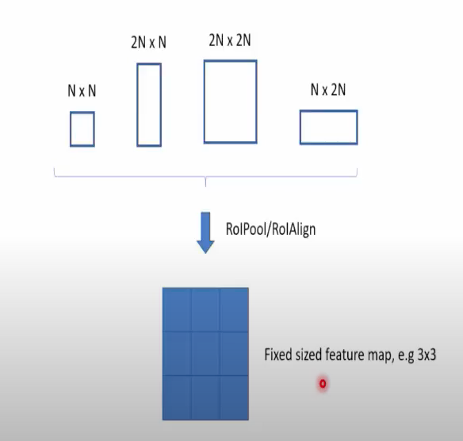
Extract a small feature map from each RoI

Slide 9
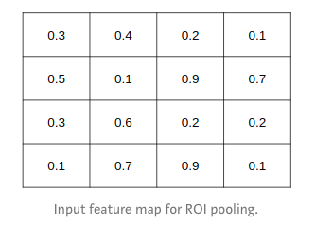
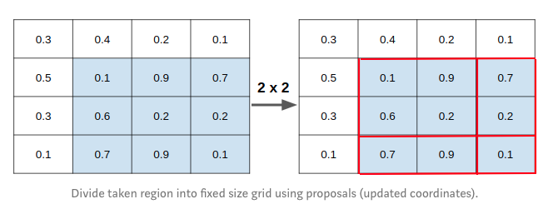
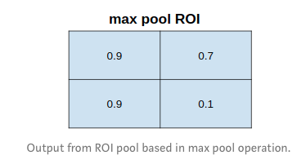
RoIPool
first quantisize a floating-number of RoI to the discrete granularity of the feature map
spatial bins quantisize themselves

Slide 10
RoIPool (Cont.)
misalignment between the RoI and the extracted features
may not impact classification
a large negative effect on predicting pixel-accurate masks

Slide 11
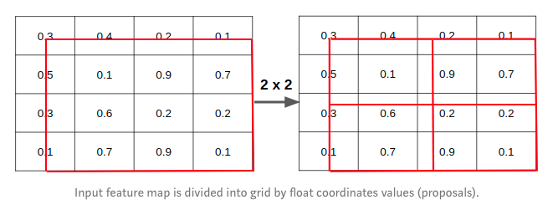
RoIAlign
ROI align divides each coordinate by k: x / k and do NOT take integer part.

Slide 12
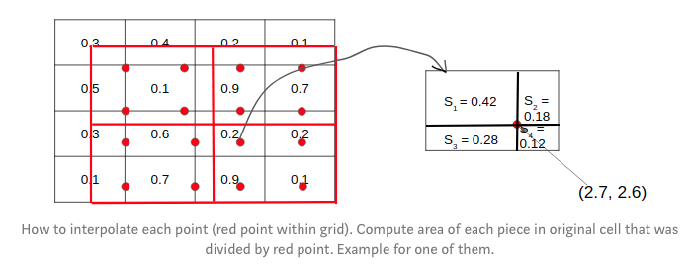
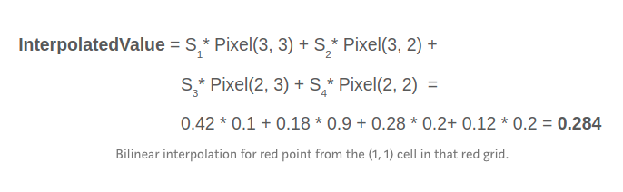
RoIAlign (Cont.)
choose regularly 4 points in each bin using bilinear interpolation

Slide 13
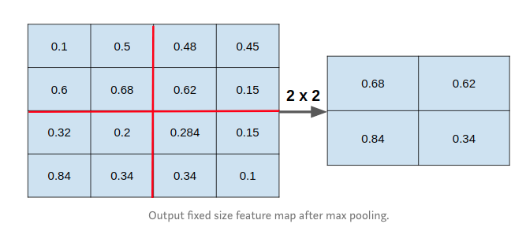
RoIAlign (Cont.)

Slide 14
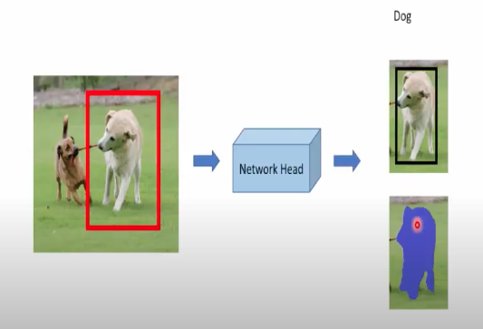
Head

Slide 15
Backbone: feature ex- traction over an entire image
-RestNet50
-RestNet100
-FPN
Head: bounding-box recognition (classification and regression) and mask prediction

Slide 16
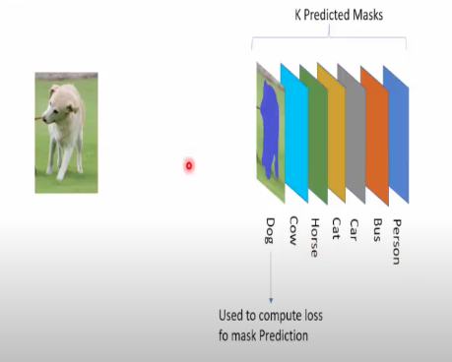
Loss
L = Lcls + Lbox + Lmask
Lmask:
  K * (m * m) dimensional output for each RoI which resolution is m * m with K classes
  apply a per-pixel sigmoid
  the average binary cross-entripy loss
  only defined on the k-th mask (with groundtruth class k)
  generate masks for every class without competition among classes

Slide 17
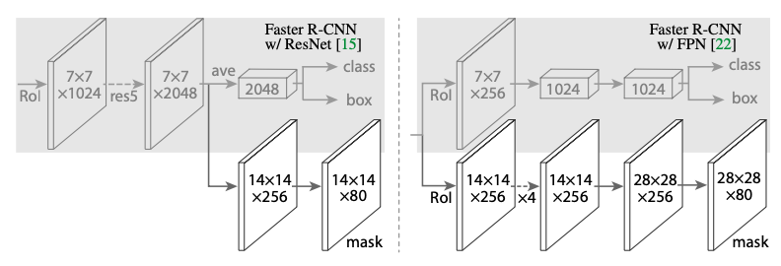
Head
To demonstrate the generality of our approach, we instantiate Mask R-CNN with multiple architectures.
ResNet-C4 backbone: includes the 5-th stage of ResNet, which is compute- intensive.
FPN: the backbone already includes res5 and thus allows for a more efficient head that uses fewer filters

Slide 18
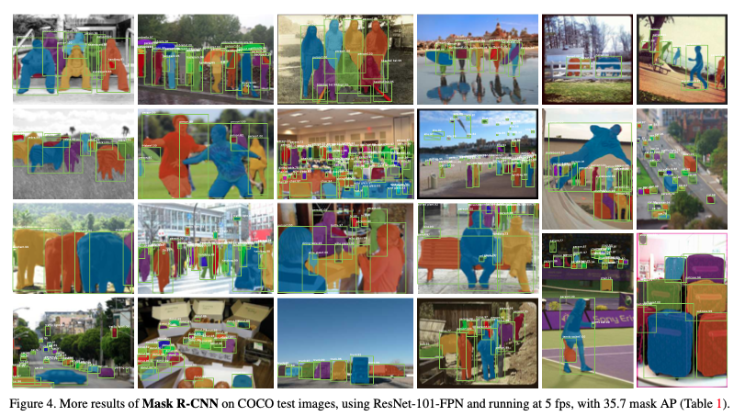
Experiment

Slide 19
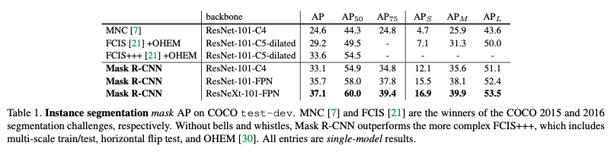
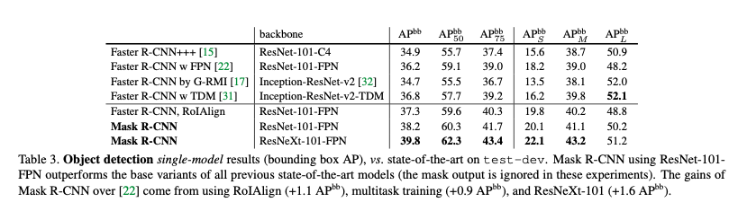

Slide 20
