Slide 1
Edge Caching and Computing in 5G for Mobile AR/VR and Tactile Internet
IEEE MultiMedia ( Volume: 26 , Issue: 1 , Jan.-March 1 2019 )
Author:
Sukhmani Sukhmani (University of Ottawa)
Mohammad Sadeghi (University of Ottawa)
Melike Erol-Kantarci (University of Ottawa)
Abdulmotaleb El Saddik (University of Ottawa)

Slide 2
Introduction
Mobile AR/VR and Tactile Internet need
high bandwidth
high computational resource
low latency
These requirement are not supported by current wireless mobile network
Edge caching and computing can address these challenges
This paper survey the few studies, and discuss the opportunities and challenges of edge caching and computing on mobile AR/VR and Tactile Internet

Slide 3
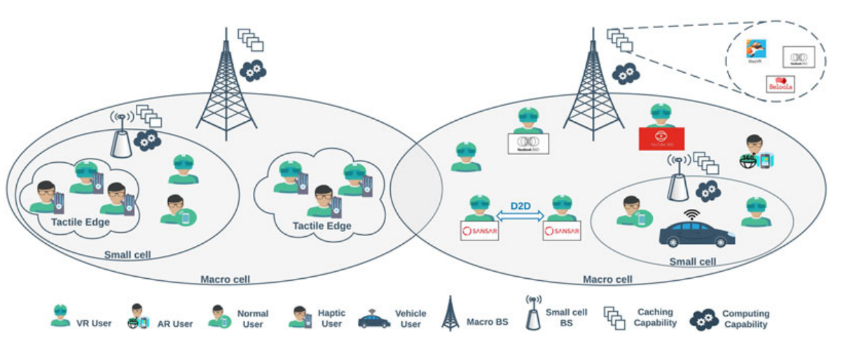
Edge Caching & Computing
Edge caching
Aims to bring frequently accessed content closer to the users
Edge computing
Allow offloading light tasks to the edge device (heavy task be send to cloud)
=> Reduce latency and prevent the unnecessary traffic on backbone network

Slide 4
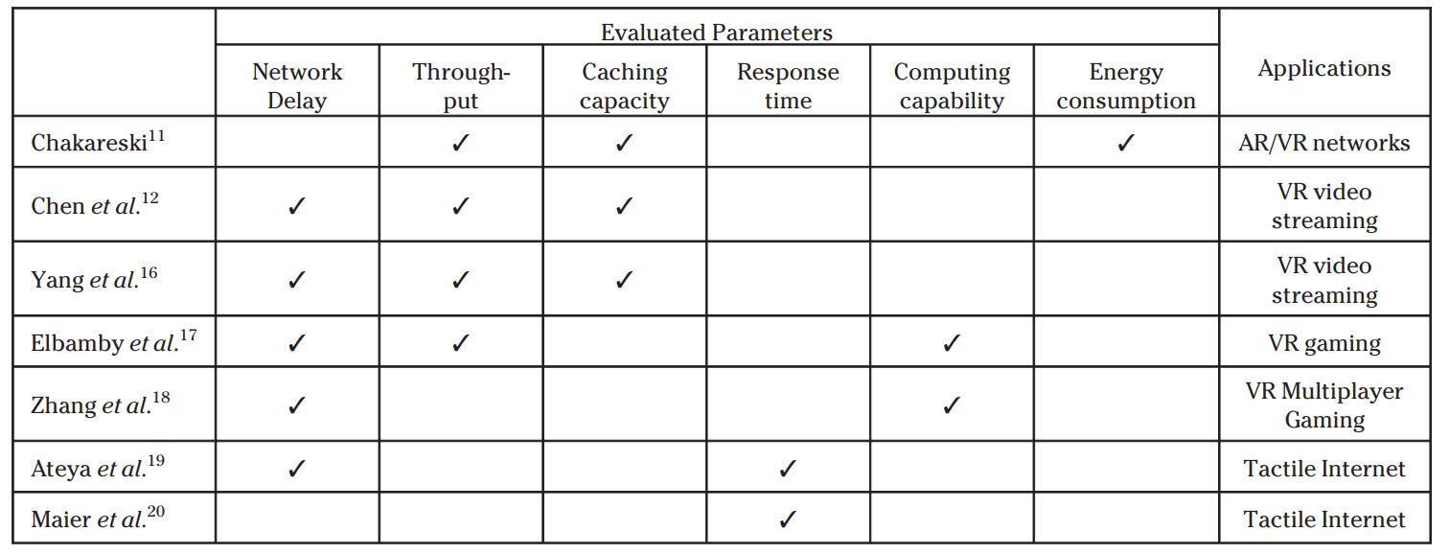
Existing Work
11,12 => edge caching for AR/VR
16~18 => edge computing for AR/VR
19,20 => edge computing for tactile internet

Slide 5
Applications
Entertainment
multiplayer online VR game
Education
remote training
Art and culture
museum, galleries
Health care
remote surgery
Intelligent transportation and autonomous vehicles

Slide 6
Challenges
Cache optimization
Cache size, cache priority, computing cost
QoE model
Current work on edge caching and computing focuses on QoS
QoE haven’t be explored comprehensively
Fairness in offload
Correlated content model
Requested scene and data from different users are highly correlated with location
Heterogeneous users
Different user may have different local computation resource
Flxible networks and SDN
User Privacy

