Slide 1
Window Detection in Facades
for Aerial Texture Files of 3D CityGML Models
Franziska Lippoldt
The IEEE Conference on Computer Vision and Pattern Recognition (CVPR) Workshops, 2019

Slide 2
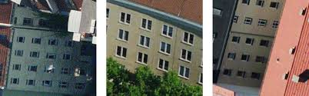
Introduction
The author inspects the optimal way to extract geometric facade features of windows from aerial texture files of CityGML models.
The author uses the Mask R-CNN to segment the facade and analyze the windows.
To improve the scores, two traditional solutions to adjust the results are used.
The results of this paper can also be applied to satellite or drone captures.
Satellite -> super resolution and need to be cropped into suitable parts
Aerial Texture Files -> determined in advance

Slide 3
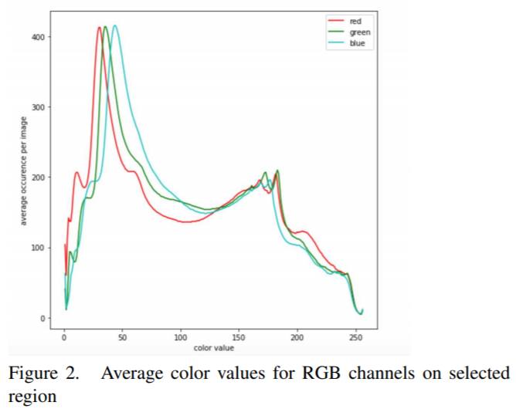
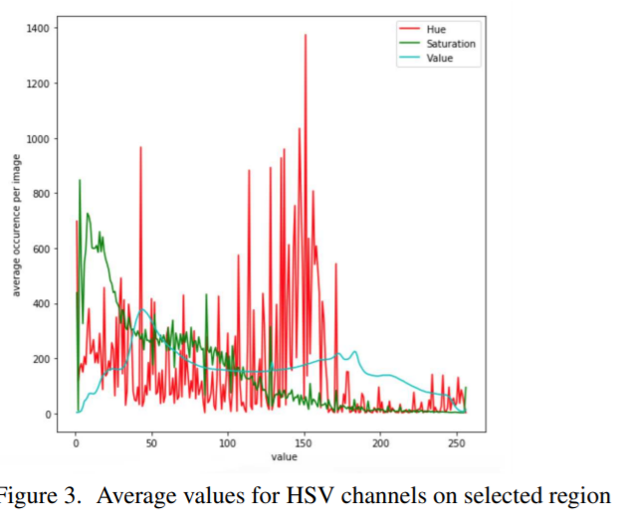
Texture image analysis
The texture image files show the following variations:
Varying exposure settings
Perspective distortion -> mask detection
No fixed orientation (i.e. the roof top of the building can be on any side of the aerial image)

Slide 4
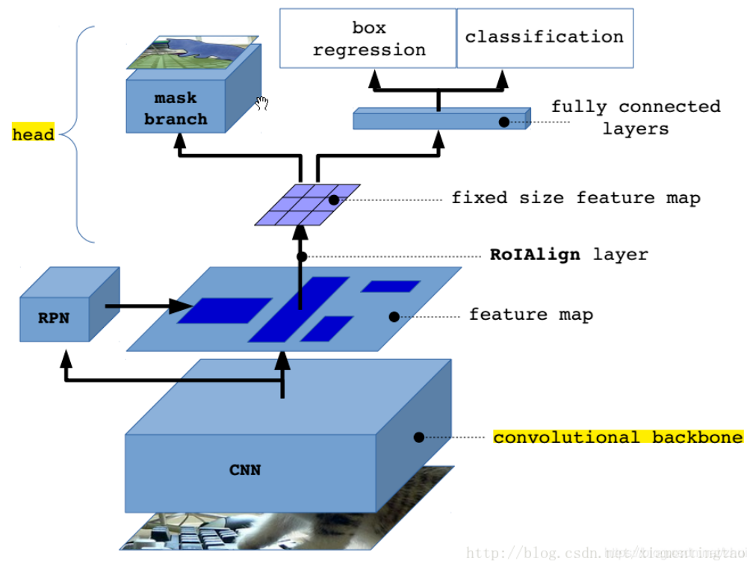
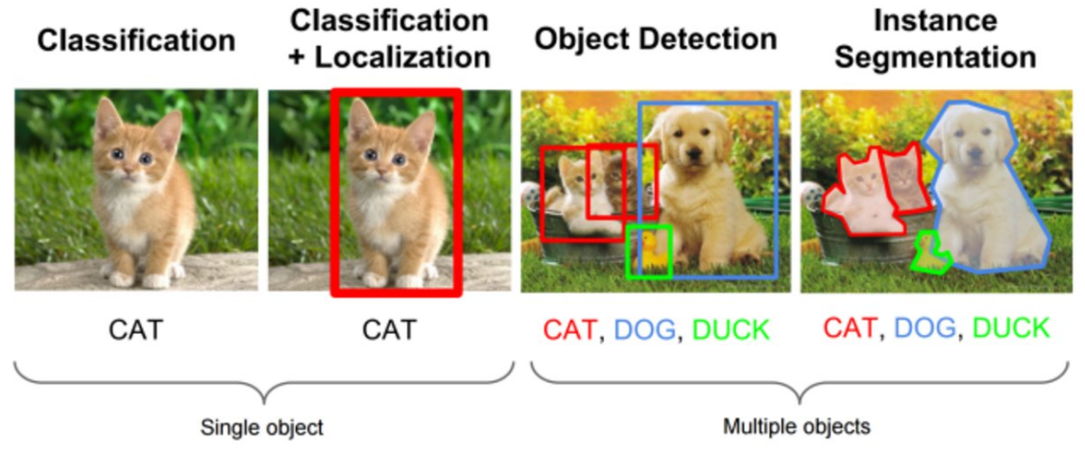
Mask R-CNN

Slide 5
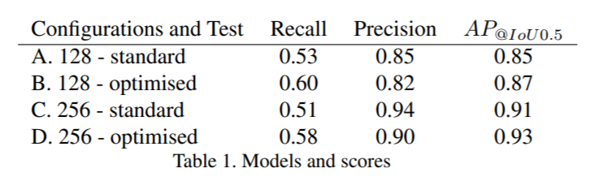
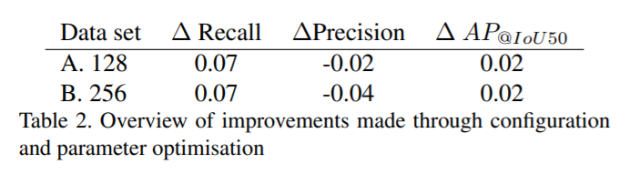
  Results
Detecting every existing window and reducing the number of wrongly detected windows.
For any type of recall and AP improvement, the precision value has slightly decreased by at least 0.02
The precision of the mask results depends strongly on the complete structure of the network and each layer and feature size.

Slide 6
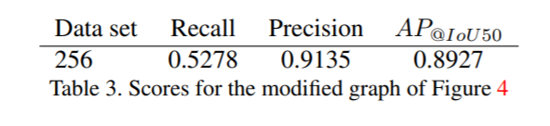
The bad recall and precision ratio arises from either the quality of the images or the mask detection model itself.
The number of possible features to be retrieved from the data set is restricted,
hence the depth of the neural network is not required to be very deep.

Slide 7
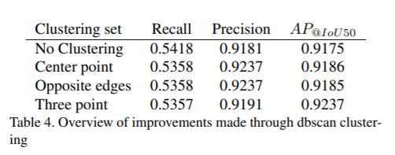
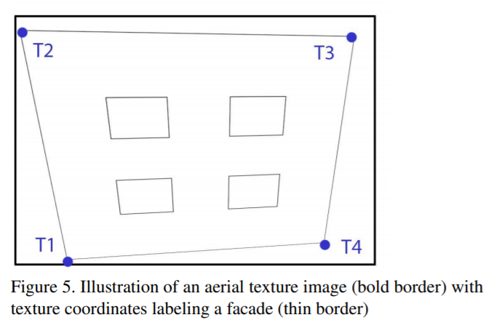
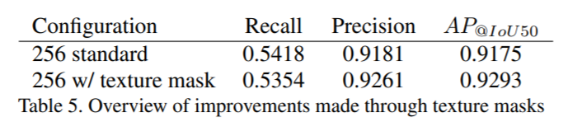
Two traditional solutions to adjust the results
A. Considered traditional clustering
B. Texture coordinate retrieval as a facade label
using the texture coordinates as masks on the results did not encounter any significant change in the scores

Slide 8
Conclusion
This application can detect windows and facades from the Berlin CityGML model by using the original texture image from the CityGML file and the semantic neural network.
Future Work
Neural Network adjustments
Application for privacy preserving images
Detailed 3D modeling from aerial images

