Slide 1
An Image Similarity Measure based on Joint Histogram Entropy for Face Recognition
Mohammed Abdulameer Aljanabi, Noor Abdalrazak Shnain, Song Feng Lu
2017 3rd IEEE International Conference on Computer and Communications

Slide 2
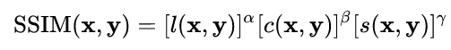
Introduction
Face recognition has become practically applied in many places such as airports, pay money and many other purposes
image similarity measures can be classified into two main directions: Statistical-based(ex. MSE, Structural Similarity Index Measure) and information theoretic based quality measures
This work defines a similarity measure using the entropy of joint histograms of reference and test images after re-shaping the joint histogram into a new 1-dimensional entity
The proposed work presents a new similarity measure that outperforms existing measures(SSIM/FSIM) by far.

Slide 3
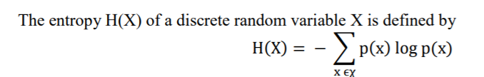
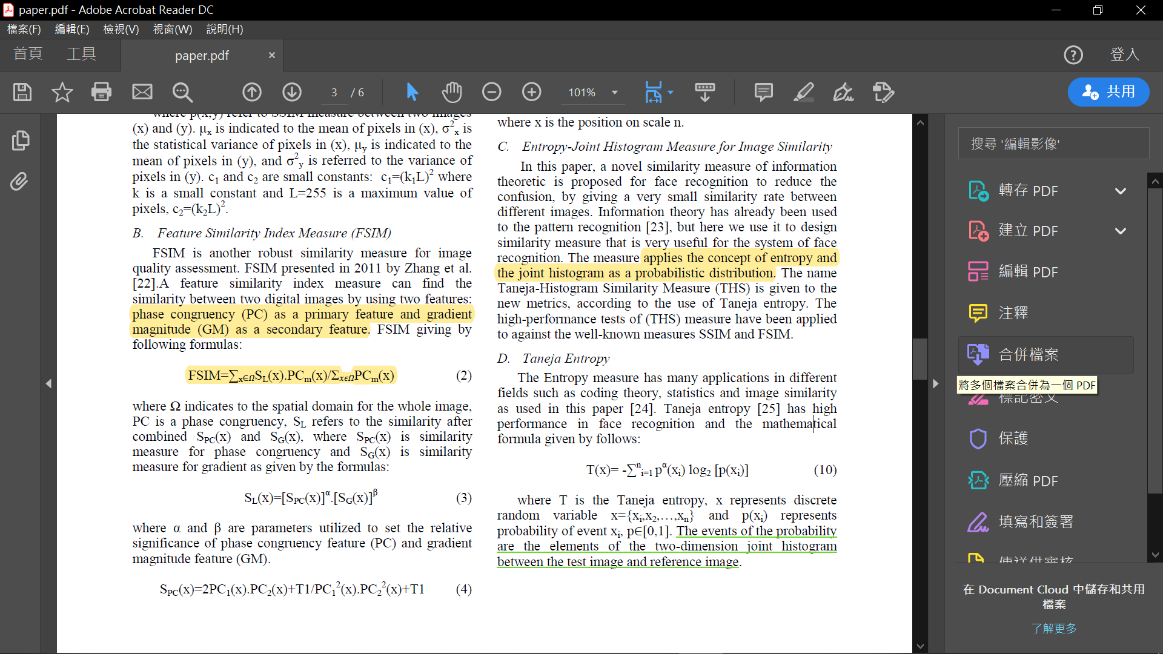
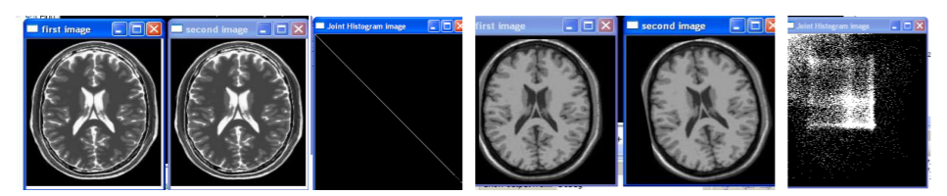
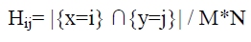
Taneja entropy and the joint histogram as a probabilistic distribution
T is the Taneja entropy,
x represents discrete random variable x = {xi,x2,…,xn}
p(xi) represents probability of event xi, p∈[0,1].
The joint histogram of two images x and y of size M*N
Notes:
The events of the probability are the elements of the two-dimension joint histogram between the test image and reference image

Slide 4
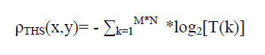
T=H(:) reshapes the two-dimension joint histogram H into a 1D column vector T via the colon operator, as defined in MATLAB, with a new dimension 1×(M*N).

Slide 5
Two popular face database used in this work FEI and ORL
If the measure does not make a big difference in the similarity between different people, then high confusion and low performance

Slide 6
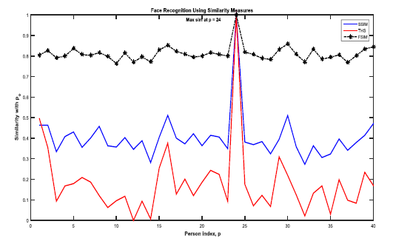
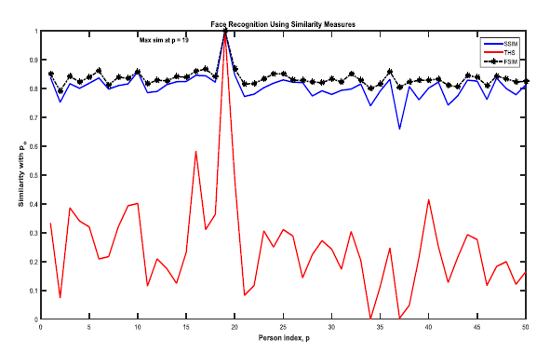

Slide 7
Conclusion
Experimental results proved the proposed measure is superior in terms of right decisions with high confidence in face recognition test

