Slide 1
DeepThings: Distributed Adaptive Deep Learning Inference on Resource-Constrained IoT Edge Clusters
Zhao, Z., Barijough, K.M. and Gerstlauer, A., 2018. DeepThings: Distributed adaptive deep learning inference on resource-constrained IoT edge clusters. IEEE Transactions on Computer-Aided Design of Integrated Circuits and Systems, 37(11), pp.2348-2359.

Slide 2
Motivation
DNN inference on end devices requires large computational resources and memory footprints
Existing layer-based partitioning of DNN inference applications has to process large amount of intermediate feature map data locally
Existing distributed DNN/CNN proposals are based on static partitioning and distributed schemes

Slide 3
Contributions
Propose Fused Tile Partitioning (FTP) method for dividing convolutional layers into independently tasks (current works execute slides layer-by-layer)
Develop a distributed work stealing runtime system, avoids centralized data synchronization overhead
Introduce a work scheduling and distributed method to maxmize reuse of overlapped data

Slide 4
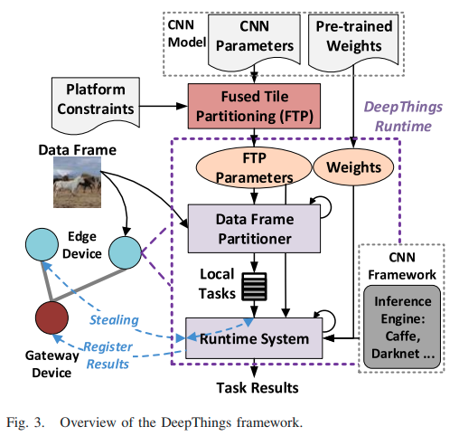
Framework
1. Takes structural parameters of the original CNN model as input and feeds to an Fused Tile Partitioning (FTP)
2. A proper offloading point between gw/edge nodes and partitioning parameters are generated in a offline process
3. FTP parameters and weights are downloaded into each edge device
4. Data Frame Partitioner partition any incoming data frames into distributable and lightweight inference tasks
5. Runtime System load weights and invokes an inference engine to process the tasks
6. If task queue runs empty, the node polls the gateway and steals tasks by directly communicating with other DeepThings runtimes in a peer-to-peer fashion
7. The gateway collects and merges results and finish the remaining offloaded inference layers

Slide 5
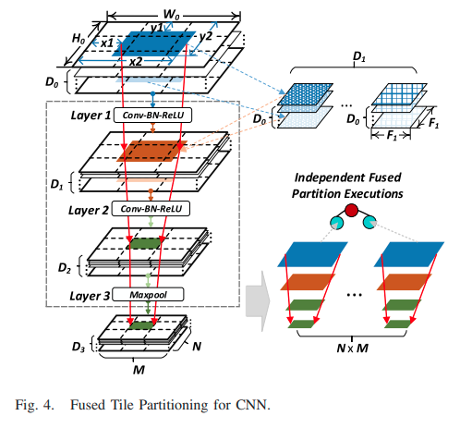
Fused Tile Partitioning
Layer-based partitioning results in large memory footprints and communication overhead
Divide features maps of each layer into small tiles in a grid fashion
Corresponding feature map tiles and operations across layers are vertically fused
Layers are partitioned into NxM independent execution stacks
The intermediate feature maps remains within the edge node, only input feature maps are migrated among edge nodes

Slide 6
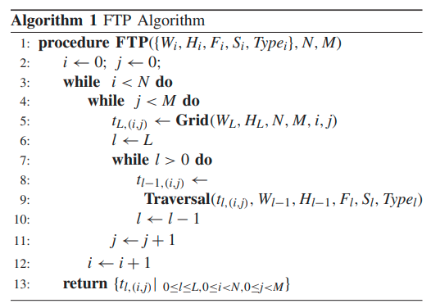
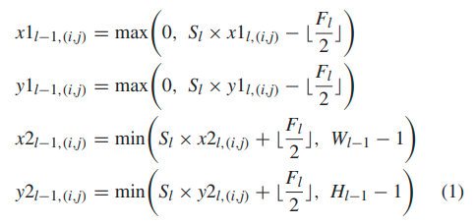
Tiles location
Data regions of different partitions will overlap in the feature space
Each partition's intermediate feature tiles and input region need to be located correctly based on the output partition
The region of a tile at grid location (i, j) in the output map of layer l:
Recursive backward traversal performed for each partition (i, j)
Convolutional layers: Polling layers:
top left corrdinates of original feature maps
bottom right
S: stride

Slide 7
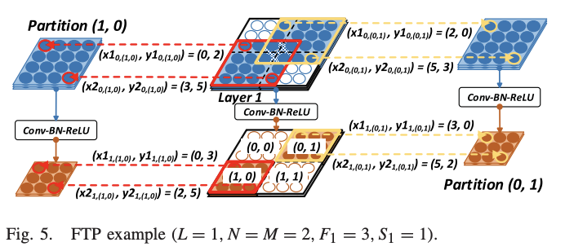
FTP example

Slide 8
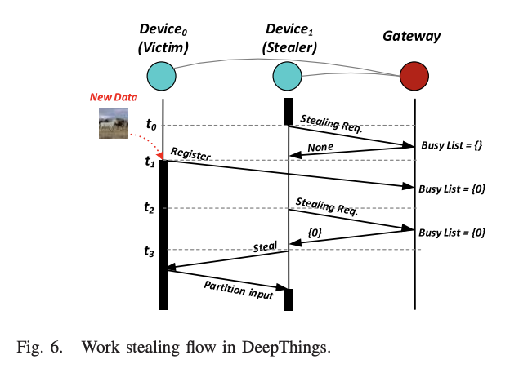
Distributed Work Stealing
Idle device steal tasks from peers
Tasks queue runs empty
Notify and poll the gateway for other devices to steal work from
If no response, sleep for a certain period then ask again
Get victim ID/IP
Sends a request and steals a pending task

Slide 9
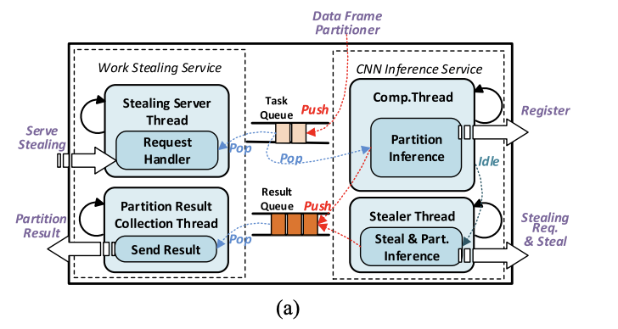
Edge node runtime system
CNN Inference Service
Independent input data partitions are pushed into a task queue
Comp. Thread register itself with the gateway
Comp. Thread fetches work from the queue, if the queue runs empty, report to gateway and notify the Stealer Thread
Stealer Thread start stealing
All output data push to the result queue
Work Stealing Service
Once a steal request received, the Request Handler get a task from the task queue and reply the corresponding input data to the stealer
Partition Result Collection Thread send the results to the gateway

Slide 10
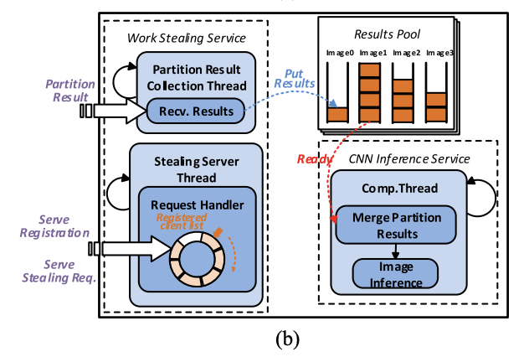
Gateway service system
Work Stealing Service
Stealing Server Thread receives registration from edge nodes
Node IP put into a ring buffer
Round-Robin to choose the victim for s tealing request
Partition Result Collection Thread collects the results from nodes, reorder and merge the results into a poll
CNN Inference Service
Computation Thread fetch the data from pool and concatenate the partitions to reconstruct the original output feature map
Feed the data into the remaining CNN layers

Slide 11
Work scheduling and distribution
The FTP approach requires overlapped input data between adjacent partitions
Overlapped data reuse:
Cache the overlapped partition
Create dependencies among adjacent partitions
Partition scheduling:
Distribute work items in a different stealing order that minimizes dependencies
Distribute and execute the minimal or no overlap partitions first

Slide 12
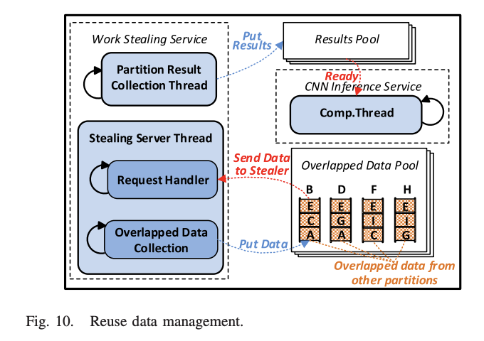
Reuse data management
The node will request any overlapped intermediate or input data from the gateway
If the overlapped data is not collected yet, the partition will execute without reuse
Stealing Server Thread also responsible for the overlapped data collection

Slide 13
Experiment setup
Deploy YOLOv2 on DeepThings on a set of IoT devices in a WLAN
6 edge nodes and a single gateway (all Rpi3)
Apply the partitioning and distribution approach to the first 16 layers of YOLOv2 (12 convolutional layers and 4 maxpool layers)
Compare to:
MoDNN [1]
Biased One-Dimensional Partition (BODP) and a work sharing distribution method (WSH)
WSH: tasks in each layer first collected by a centralized device and equally distributed to edge nodes
[1] J. Mao, X. Chen, K. W. Nixon, C. Krieger, and Y. Chen, “MoDNN: Local distributed mobile computing system for deep neural network,” in Proc. Design Autom. Test Europe Conf. Exhibit. (DATE), 2017, pp. 1396–1401.

Slide 14
Memory Footprints
Overlapped intermediate regions are smaller in later layers
Memory requirements can be reduced by 69%, 79% for FTP 3x3 and 5x5
Compared to BODP, FTP requires extra memory because of the overlapped data

Slide 15
Communication Overhead
FTP-WST-S: with reuse management
WST can reduce 52% communication overhead on average
FTP-WST-S need additional communication for intermediate data transmission
Notes:
WST don’t need to send the data to centralized device for stealing

Slide 16
Latency for single frame
WST has shorter inference latency because of the reduced commiunication overhead
Latency increase by an average of 43% when the grid dimension increase from 3x3 to 5x5
Caused by more overlapped regions
Can largely reduced by reuse-aware partition scheduling
FTP-WST-S reduces latency more than 27% than FTP-WST by reduce the duplicated computations
Reuse management reduce the latency by 16% for 3x3 grid and 33% for a 5x5 grid

Slide 17
Latency and Throughput for multiple data source
The processing latency in WSH-based approaches increases linearly when more data sources are involved
WST-based approaches’ latency are upper bounded by the single-device latency
Max latency increased 6.1x, 6.0x for FTP-WSH and MoDNN, 4.2x and 3.1x for FTP-WST and FTP-WST-S
Reuse-aware scheduling have large benefits under finer partitioning granularity:
20 % and 22% improvement for latency and throughput in 3x3, 32% and 45% in 5x5

Slide 18
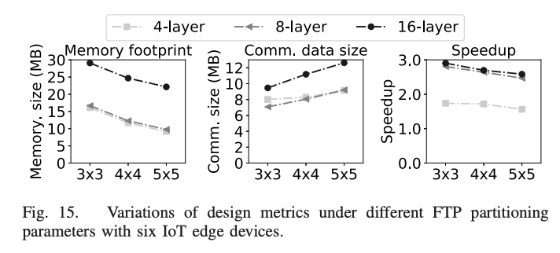
Sensitivity analysis of FTP parameters
FTP-WST-S with first 4, 8, 16 layers executed on the edge devices, others on offloaded gateway
Deeper fusion has a larger speedup on inference latency
Coarser partitioning granularity and deeper fusion provide better inference speedup with larger memory footprint
Communication demand is larger with more partitions and fused layers
With enough communication b/w, finer granularity provice better scalability

Slide 19
Conclusion
FTP significantly reduces memory footprint compared to layer-based partitioning
Combined with distributed work stealing and reuse-aware work scheduling and distribution framework, scalable CNN inference performance improved compared to existing methods
DeepThings are released open-sourced on github: https://github.com/SLAM-Lab/DeepThings

