Slide 1
An Approach to Integrate Quantum Key Distribution Technology into Standard Secure Communication Applications
Y. Tanizawa, R. Takahashi, H. Sato and A. R. Dixon, Ninth International Conference on Ubiquitous and Future Networks (ICUFN), Milan, 2017, pp. 880-886.

Slide 2
Introduction
Communication cryptography broken
Easy to be broken by quantum computing in the future
Quantum key distribution (QKD) unconditional secure cryptography key sharing
Iit cannot be broken even with infinitely computational resources and time (even quantum computing)
It is good to integrate QKD into secure communication applications
Notes:
Current used communication cryptography broken by quantum computing are easily to be break by quantum computing in the future
Quantum key distribution (QKD) provide unconditional secure cryptography key sharing, which means it cannot be broken even with infinitely computational resources and time (even quantum computing)

Slide 3
Introduction
sysmmetric encryption first exchange keys. Then use these keys to encrypt
The problem how to exchange key is called secure key exchange problem
5 method to solve the problem:.... , QKD

Slide 4
The public key method can be broken by quantum computing in the future
QKD cannot be croken by quantum computing
It is good to use it in applications

Slide 5
Contributions
Propose a method decide how to make a trade-off between security and delay
Apply this method to real world applications
Make the method be applicable to existing secure communication applications
Easy to port them to QKD-ready applications
Notes:
Propose a method for providing secure communication decide trade-off between QKD-based and standard security

Slide 6
Design Policy
From the protocol perspective:
The QKD keys storage and timely TLS supplement.
QKD keys can’t last long
Needs to apply in TLS in short time
From library implementation perspective:
Use standard library to minimize the cost and development of applications
From functionality perspective:
The shortage of QKD keys as sharing speed limitation and variation
QKD spread keys in low speed
Key generates in variate speed
Notes:
The keys generated by QKD stored and it should be supplied to Transport Layer Security (TLS) timely
The standard library such as OpenSSL should be used to minimize the development and cost of applications even integrated with QKD.
QKD key sharing speed limitation and variation should be taken into account, which may cause the shortage of QKD keys

Slide 7
Proposed method
QKD Characteristic
QKD communication delay is longer than standard TLS
However, QKD is more secure.
Proposed method
Providing secure communication that selects between different cryptography-based security automatically
Selects between QKD-based and standard cryptography-based security
According to the amount of current stored QKD keys
Choose between QKD and standard methods according to remain QKD keys
Notes:
The QKD secure communication may cause more delay than standard secure communication when there is a shortage of stored QKD keys.
Proposed a method for providing secure communication that selects between QKD-based and standard cryptography-based security automatically
According to the amount of current stored QKD keys

Slide 8
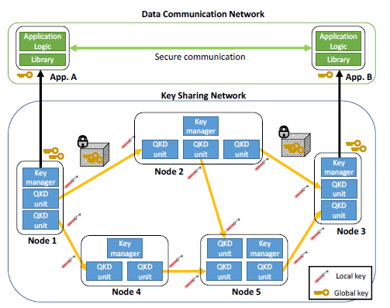
Use case
Key Sharing Network:
Relay keys from one node to multi-hop node.
Use QKD to relay global key
Global key: e.g. master key in TLS
Data Communication Network:
Internet using global key to do encrpytion
Applications communicate in a server-client securely.
Notes:
QKD Unit: Comprised a QKD transmitter, a QKD receiver, a fiber conneting them
QKD transmitter transmits series of photons to QKD receiver through the fiber

Slide 9
Keys Sharing Network
Local key (QKD key):
Shared key by QKD unit in adjacent nodes only
Used for encrypt global key
Global key:
Encryption key generated randomly by key manager
Used as master key
Relay through multi-hop to target node through Key sharing network

Slide 10
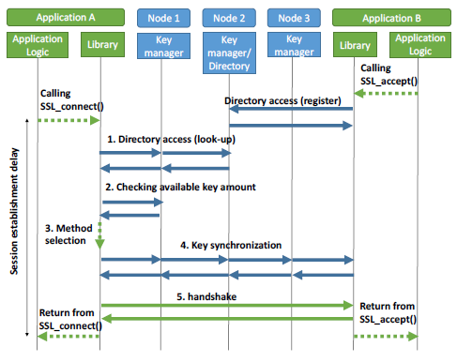
SSL Connection
Client sends a SSL_connect request to server
App performs TLS handshake
Client sends a SSL_connect request to server
Directory access:
Client look up target node on connected node directory
Check available glabal key amount:
Cryptograph method selection
Based on threshold and available key amount
Key synchronization:
Synchronize key ID in both client and server
Handshake:
Establish the secure communication session
Notes:
When library call SSL_connect API, TLS handshake start. Original method perform RSA.
Proposed method add the QKD-based method and check what method should be used

Slide 11
Proposed method-Sequence

Slide 12
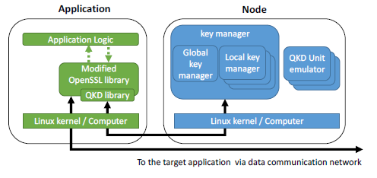
Implementation
The application runs on linux kernel. These software call OpenSSL API. With the proposed method, any software calling OpenSSL can be used.

Slide 13
Implemented QKD library
Directory access session
Key amount check
Method selection:
Compares the amount of the stored keys and threshold value to select different cryptography-based.
Key synchronization

Slide 14
Modified OpenSSL library
OpenSSL API:
Add QKD-based security by calling QKD library functions
QKD-aware SSL/TLS protocol:
Support QKD-based cipher suite for SSL/TLS
QKD-based cipher suite:
Use QKD-based key exchange to get keys and use these key in AES or SHA1 hash encryption algorithm.
Notes:
OpenSSL API: Add QKD-based security by calling QKD library functions
When method selection choose QKD-based security, QKD-based cipher suites add into cipher suites list and has highest priority.

Slide 15
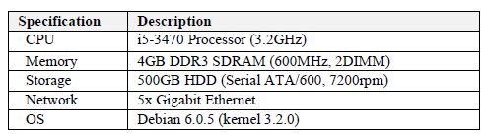
Evaluation-Setup
Node1 and app. A, are seperated from node3 and app. B

Slide 16
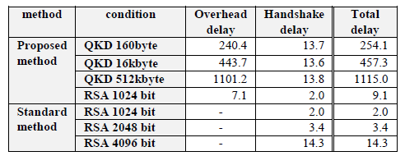
Evaluation-Session Establishment delay
Larger RSA key and QKD key handshake delay than ...:
Larger RSA key means more security
Difference between QKD and RSA of handshake delay is smaller larger Bytes are used
Notes:
Proposed method used three different sizes of global key and consider the situation when method selection select standard method.

Slide 17
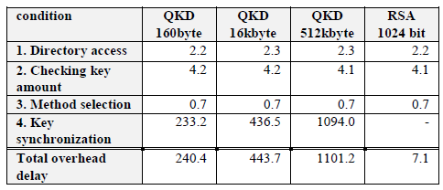
Evaluation Overhead
Larger global Key sizes suffers in larger overhead:

Slide 18
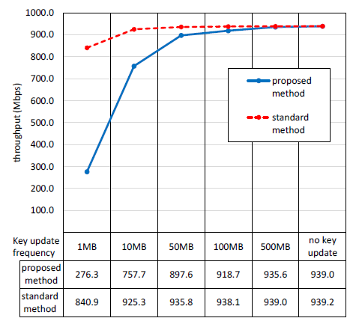
Evaluation-Throughput Impact

Slide 19
Conclusion
Proposed a method of selecting cryptography method between QKD-based and standard cryptography-based security
It provides standard OpenSSL software interface, and it is easy to port to applications using OpenSSL
They didn’t evaluate the secrutiy of proposed methods
They didn’t explain how QKD units work

