Slide 1
ViTrack: Efficient Tracking on the Edge for Commodity Video Surveillance Systems
Linsong Cheng, Jiliang Wang
School of Software and TNList, Tsinghua University, China
IEEE INFOCOM 2018

Slide 2
Motivation & Challenge
Large data size and limited resource on the edge
Time-consuming and resource-consuming to process video on the edge
Compression may not work for scenario such as continuous traffic
Video information missing
Inevitable information missing, especially solely relying on a single camera
Limited or unknown camera and physical information
The location, direction, height may leading to a mismatch between camera and monitor area
i.e. two camera at the same place but point to two different location

Slide 3
Contribution
Propose the design, practical system for efficient tracking for video surveillance system
Propose two layer spatial and temporal compressive target detection to reduce the overhead
Propose camera relationship construction and trajectory derivation while recovering missing information
Evaluate performance on a practically deployed video surveillance system with 110 (exactly 84) cameras

Slide 4
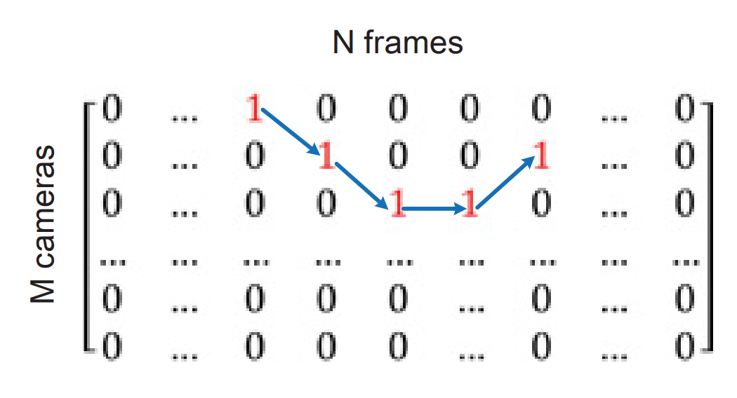
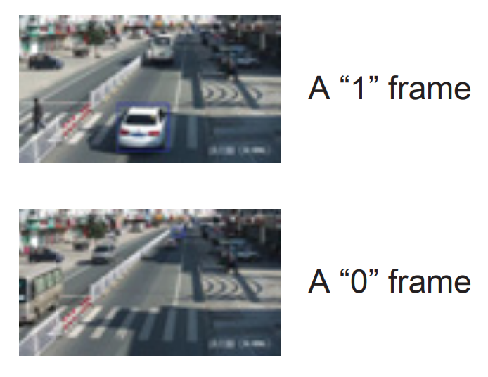
Problem Definition
Appearance matrix $X$
M cameras, N frames
$x_{i,j}=1$ means target appears in the $j^{th}$ video of $i^{th}$ camera and otherwise $x_{i,j}=0$
Sampling policy and recovery policy
Object: find the best sampling and recovery policies to minimize the estimation error

Slide 5
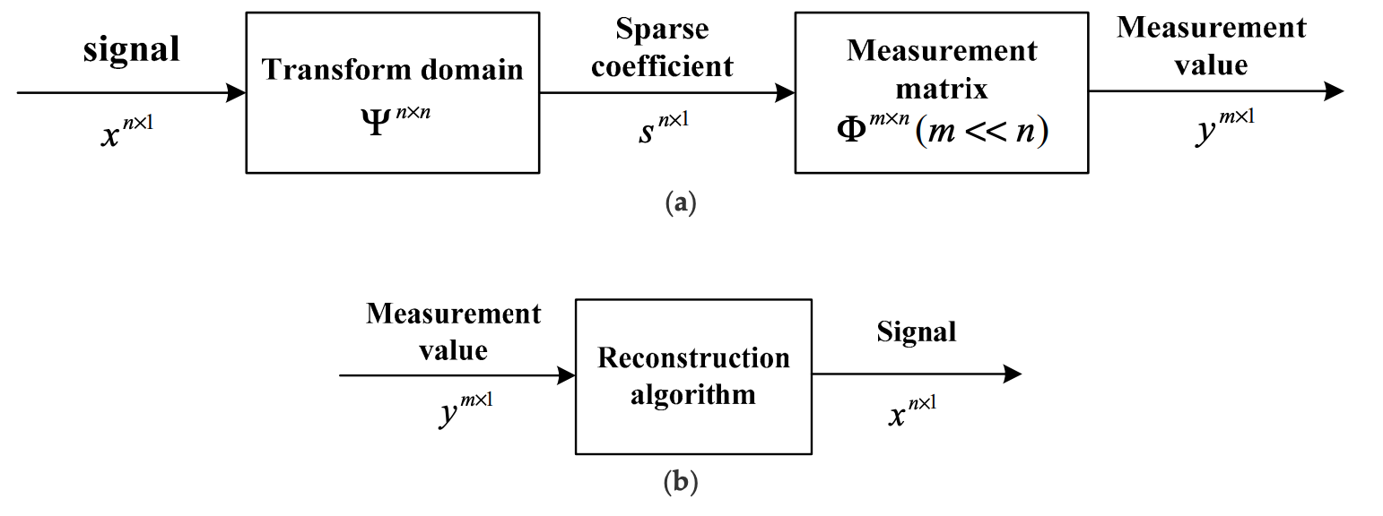
Compressive sensing
We can recovery a sparse signal even if the sampling rate is lower than two times of original signal.
Not limited from Nyquist sampling theorem ( $r=2f$ )
The measurement vector can be written as:
Note that:
Signals have to be in the sparse domain
Transform matrix and measurement matrix is inconherent
Reconstruct:
Solve the $l_{1}$norm minimization problem
Using algorithms like IRWLS, OMP, Linear programming
e.g. i.i.d gaussian random measurement
Input signal
Sparse coefficient
where
Sampled signal
e.g. DCT, DWT

Slide 6
System overview

Slide 7
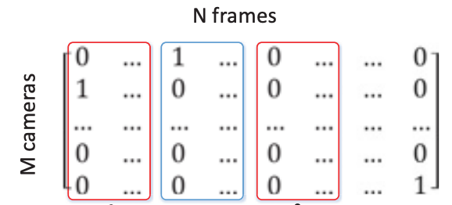
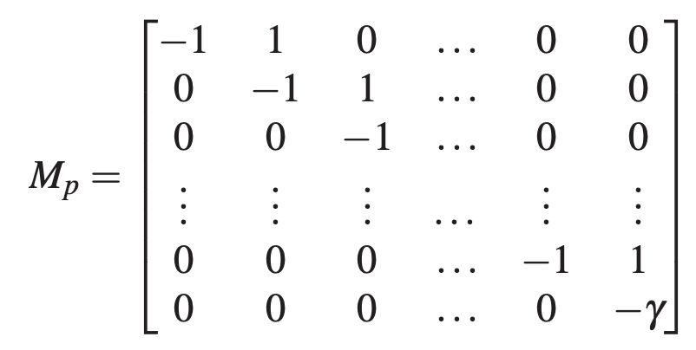
Spatial Compressive Detection (SCD)
Reduce the spatial overhead
1. Sampling:
Measurment matrix:$Φ_{p}(U_{p}× V_{p},where U_{p}<V_{p})$
Periodic sampling schedule: sample every $\left\lfloor \frac{V_{p}}{U_{p}}\right\rfloor$ frames
Adjacent columns and frame contain the target with higher probability
2. Appearance calculation:
Use existing object recognition method
Calculate $y= Φ_{p}S$
3. Recovering:
Select a good transform matrix $Ψ_{p}$
Sparsify $S$
Incoherent with $Φ_{p}$
Use projection of an invertible matrix
$D_{p}=M_{p}S{, Ψ}_{p}={M_{p}}^{−1}$
Recovery 𝑆 by $y= Φ_{p}Ψ_{p}$ $D_{p}$
By recovery of 𝑆, we can obtain target appearance information
Time cell
Reshape (row by row) and sample
$${\left[\begin{matrix}0 \\ 1 \\ ⋮\end{matrix}\right]}_{V_{p}×1}$$
$$S=$$
Spatial matrix

Slide 8
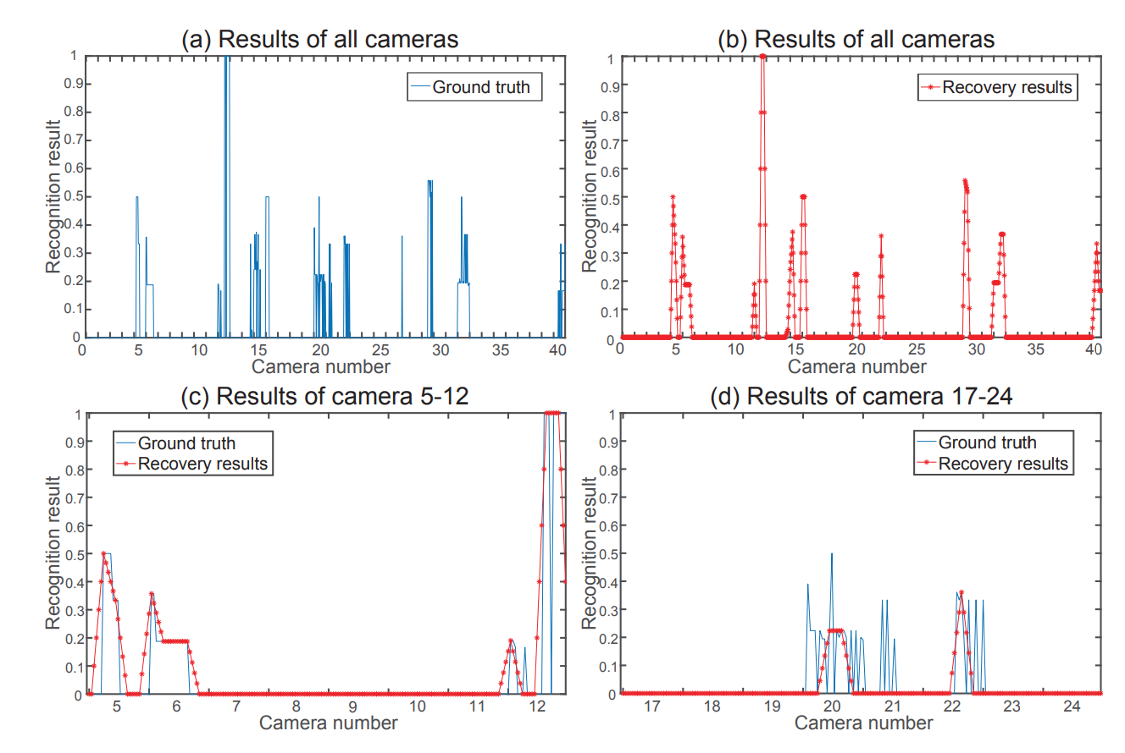
SCD Result
25 video frame for 40 cameras -> $S_{1000×1}$
Use 20% of video frames
Recover most of appearance information with small number of video frames

Slide 9
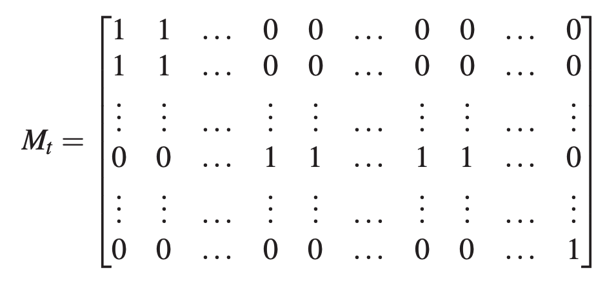
Temporal Compressive Detection
Spatial matrix
Reduce the temporal overhead
1. Abstract appearance probability
Calculate appearance probability $a_{j}$
Higher recognition results get higher value
2. Sampling and recovery
Random sampling schedule
Because $T$is sporadic
Use projection of an accumulation matrix
To make discrete $T$smoother
$D_{t}=M_{p}{T Ψ}_{t}={M_{t}}^{−1}$
Recover $T$ by $y= Φ_{t}Ψ_{t}$ $D_{t}$
By recovery of 𝑇, we can obtain appearance ranges of given targets in time domain
$$\left[\begin{matrix}0 & ⋯ & 1 \\ ⋮ & ⋱ & ⋮ \\ 0 & ⋯ & 0\end{matrix}\right]$$
$$a_{1}$$
$$\left[\begin{matrix}0 & ⋯ & 1 \\ ⋮ & ⋱ & ⋮ \\ 0 & ⋯ & 0\end{matrix}\right]$$
$$a_{1}$$
$$a_{2}$$
……
$$a_{2}$$
$$⋮$$
$$⋮$$
$$\max\left(a_{1},a_{2…}\right)$$
$T=[ 1, , …… , 0$ ]

Slide 10
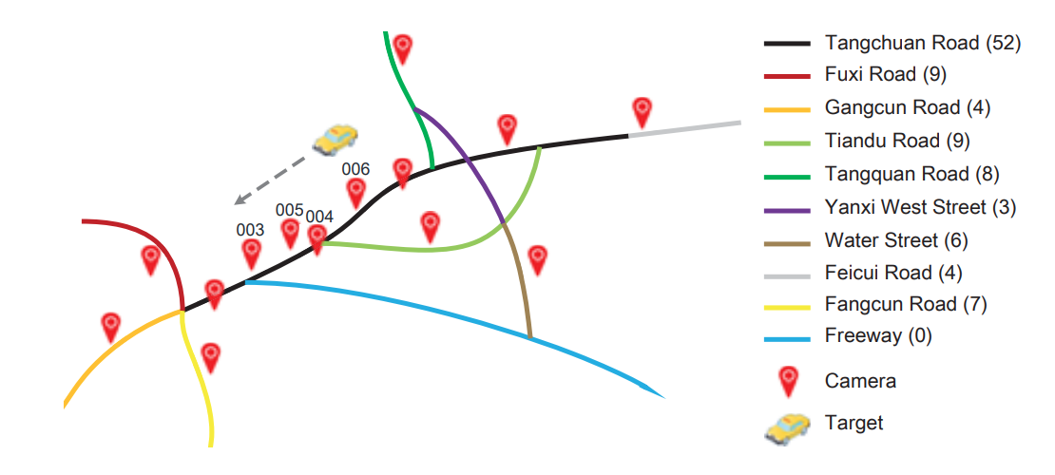
Camera relationship construction
Build Markov Model:
State definition:
$l_{t_{i}}=c_{i}$denotes a target appears under camera $c_{i}$ in time cell $t_{i}$
Next state depend only on current state
Transition probability
Transition frequency from $c_{k}$ to $c_{k+1}$
$α=\left|\left.c_{k+1}−c_{k}\right|\right.$
closer cameras own higher higher transition probability at the same frequency

Slide 11
Trajectory inference
In practice, two appearance may not be atomic
Obtain where the target appear and estimate the appearance time to infer missing appearances
Iterate all time cells
Get candidate queue of cameras
If the target appear in a candidate camera, use this camera to continue the trajectory
Until the inference out of the appearance range
Conduct the algorithm bi-directionally

Slide 12
Evaluation Setup
ViTrack is implement on a practical video surveillance system with 84 cameras
Runs on a Dell OptiPlex 390 with Intel i5 CPU and 8 GB RAM
First process all the video frames to get the groundtruth

Slide 13
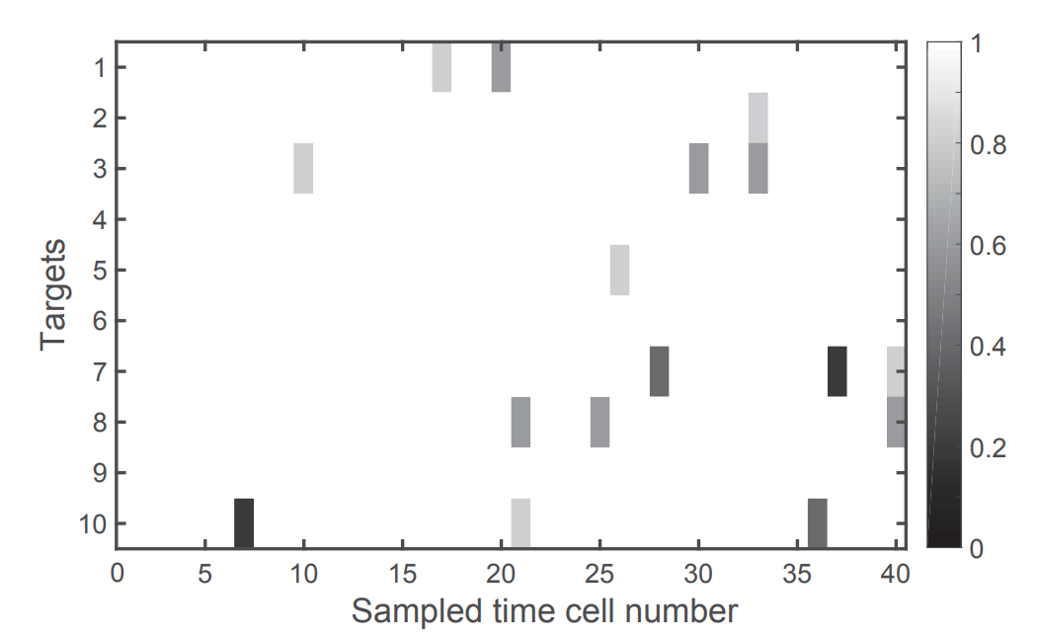
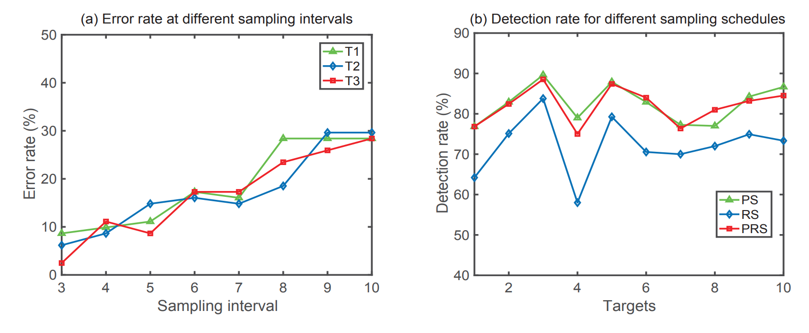
Accuracy for SCD
1
1
SCD achieve high detection rate of all targets, i.e. 85.63% in average
Even if the sampling rate is decreased to 10%, SCD detection ratio is still higher than 70%
PS sampling schedule is more effective than RS
2
3
2
3

Slide 14
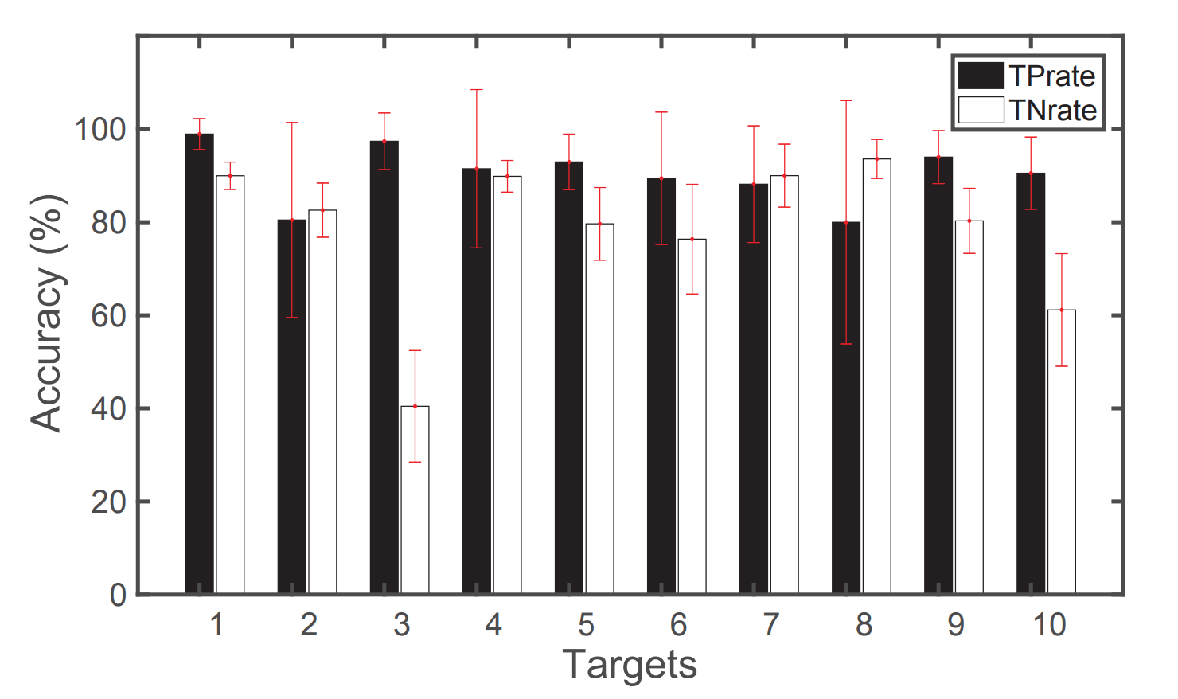
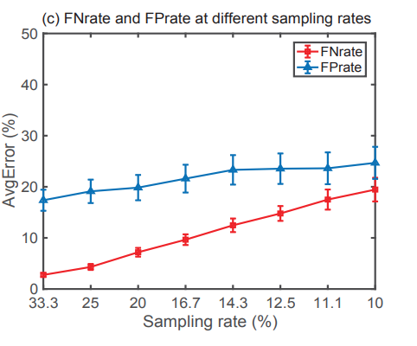
Accuracy for TCD
1
TPrate (True-Positive):
$\frac{\text{I}\text{n} \text{estimated} \text{appearance} \text{range}\text{s} }{\text{In} \text{a}\text{ctual} \text{appearance} \text{ranges}}$
TNrate (True-Negative):
$\frac{\text{Not} \text{in} \text{estimated} \text{appearance} \text{range}\text{s} }{\text{Not} \text{in} \text{a}\text{ctual} \text{appearance} \text{ranges}}$
By using RS as sample schedule($Φ_{p}$), TCD achieves a high TPrate and TNrate
When the sampling rate is more than 16.67%, the FNrate is less than 10% and Fprate is less than 20%
1
2

Slide 15
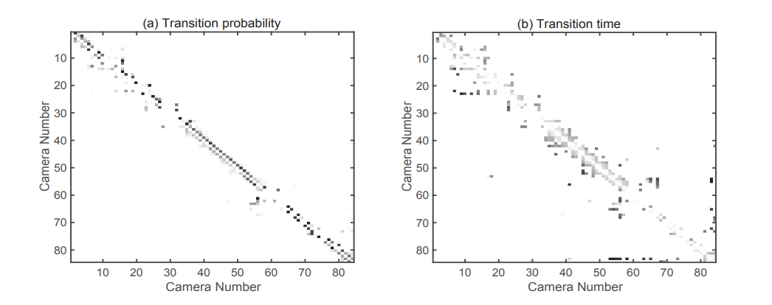
Effective of Trajectory inference
For each road, choose 15 targets to construct camera relation ship
The darker points represent higher probability and close to the diagonal
The darker points represent high transition time Cameras with higher transition probability have less transition time
1
2
1
2

Slide 16
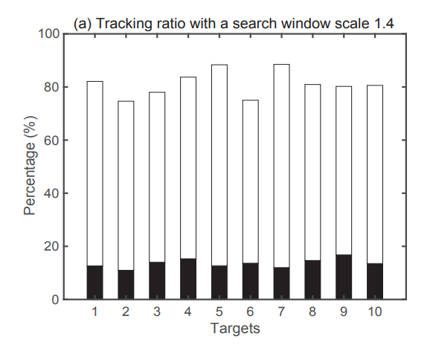
Effective of Trajectory inference
Tracking ratio: $\frac{\text{total} \text{\#} \text{of} \text{detected} \text{appearance} \text{time} \text{cells}}{\text{total} \text{\#} \text{of} \text{actual} \text{appearance} \text{time} \text{cells}}$
Averagely, ViTrack only samples $\frac{1}{13}$ of video frames but achieve a tracking ratio of 81.20%
A x B
Sampled rate of SCD = 1 / A
Sampled rate of TCS = 1 / B
Significantly reduce the overall running time Improve by better objection recognition method
1
1
2

Slide 17
Conclusion
Propose an efficient trajectory tracking framework – ViTrack
Design two-layer spatial and temporal compressive detection to reduce the computation overhead
Leverage Markov Model to recover missing information and trajectory
Implement ViTrack on a real video surveillance system

