Slide 1
Fragmented Patching: New VOD Technique That Supports Client Mobility
Katsuhiko Sato 1, 2, Michiaki Katsumoto 3, Tetsuya Miki 2
1. Japan Radio Co., Ltd, 2. The University of Electro-Communication,
3. National Institute of Information and Communication Technology
sato@lab.jrc.co.jp, katumoto@nict.go.jp, miki@ice.uec.ac.jp

Slide 2
Outline
Introduction
Patching Technigues
Fragment Patching Technigues
Mathemmatical Models
Analysis and Consideration
Conclusion

Slide 3
Introduction
This paper compare Patching and Fragment Patching by using mathemmatical models that present the average usage of link bandwidth with traffic intensity

Slide 4
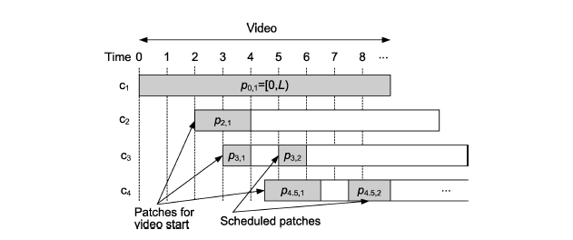
Patching
Serve the user enter in different timing with multicast/unicast streaming

Slide 5
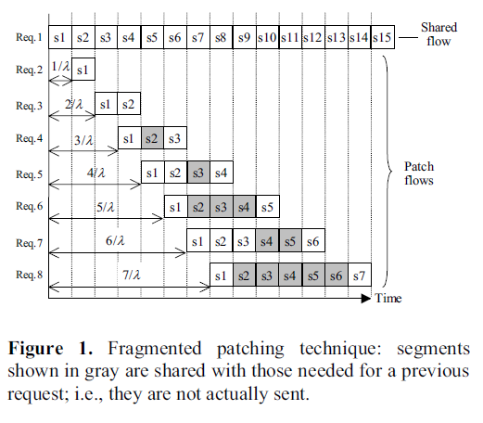
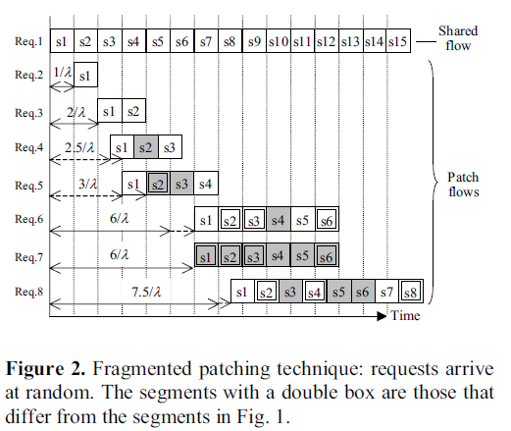
Fragment Patching Technigues
Example:

Slide 6
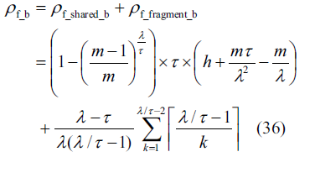
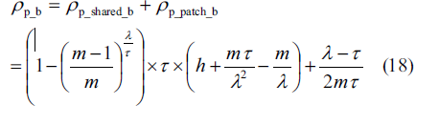
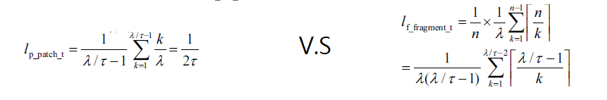
Mathematical Models
Patching VS Fragment Patching
Difference:

Slide 7
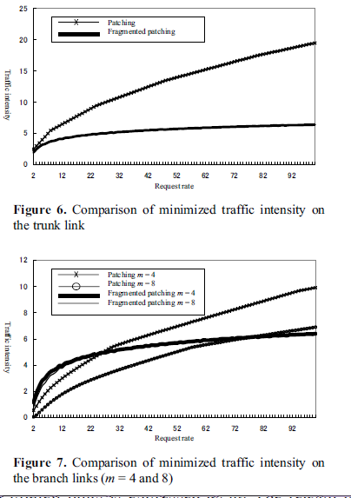
Analysis and Consideration

