Slide 1
Video Streaming Using a Location-based Bandwidth-Lookup Service for Bitrate Planning
Haakon Riiser, Rore Endestad, Paul Vigmostad,
Netview Technology AS, Norway

Slide 2
Introduction
Problem: severe bandwidth fluctuations & networks unresponsive
Solution: receivers equipped with a GPS
Download rate is constantly monitored
Central database (GPS positional data)
Notes:
無線網路的問題有 : 嚴重的頻寬波動 & 網路幾分鐘無反應，這些都會造成視頻的品質影響
Video streaming的接收器上裝有GPS，下載速度被監控，GPS週期性回傳位置給central database

Slide 3
Location-based Bandwidth Lookup Service
It enables all users to query for predicted available bandwidth for given locations based on previous observations
More stable video
Pre-buffering
Early quality adaption
Notes:
可以讓所有可以去查詢 將來可用的頻寬(以位置為基礎)

Slide 4
Bandwidth Monitoring(1/5)
Information
User’s actual location
Intended destination
Route
Expected bandwidths
Four different types
Metro railway
Bus
Ferry
Tram

Slide 5
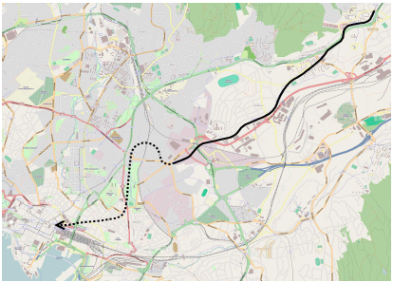
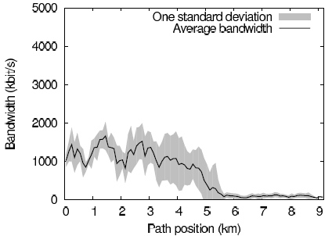
Bandwidth Monitoring(2/5)
Choosing a low video bitrate before entering the tunnels, pre-buffering enough video to last through the tunnels
Notes:
進入地下隧道時，訊號微弱，先切換低成的bitrate，預先儲存到buffer裡

Slide 6
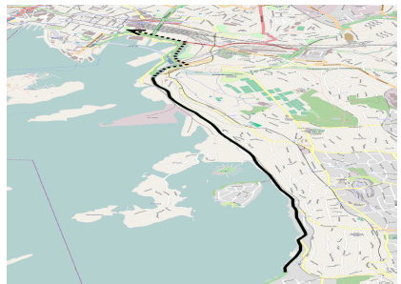
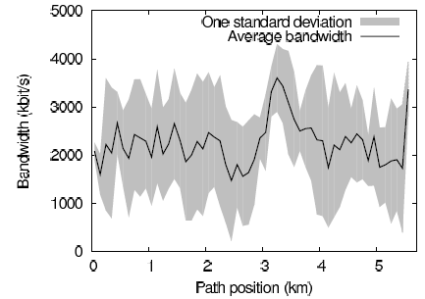
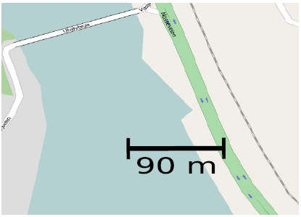
Bandwidth Monitoring(3/5)
The average values vary greatly
GPS satellites

Slide 7
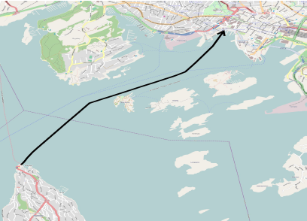
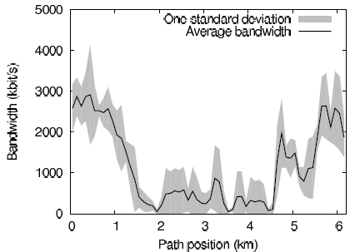
Bandwidth Monitoring(4/5)
Available bandwidth varies quite a lot
The signal is never completely gone
The signal is strongest when the ferry is close to land

Slide 8
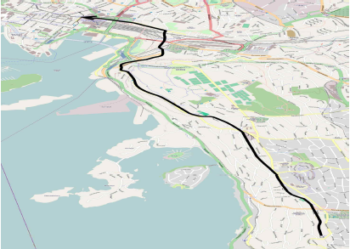
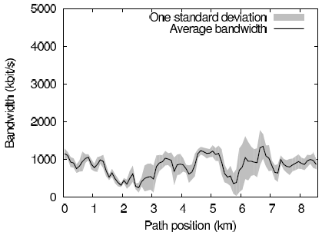
Bandwidth Monitoring(5/5)
Above the bus route
predictable
downslope

Slide 9
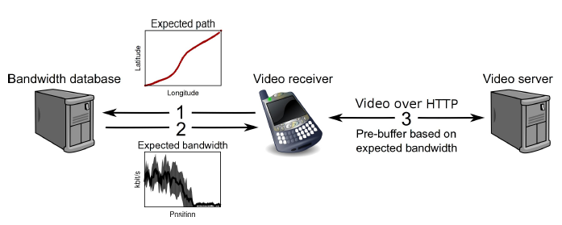
Video Streaming With A GPS-based Bandwidth-lookup Service
route
average bandwidth
standard deviation

Slide 10
Algorithm(1/3)
A buffer-based reactive algorithm
Select the video bitrate based on the number of seconds of video that are preloaded in the buffer
Shortcoming
Quality oscillations
Network outages

Slide 11
Algorithm(2/3)
A history-based prediction algorithm
For every 100 meters along the path, the system queries for a predicted bandwidth(average of historical bandwidth)
Shortcoming
Accuracy of GPS signal
Competition for bandwidth
Base station failure

Slide 12
Algorithm(3/3)
An omniscient prediction algorithm
Optimal result
This a posteriori algorithm has all measurements for a particular test run available

Slide 13
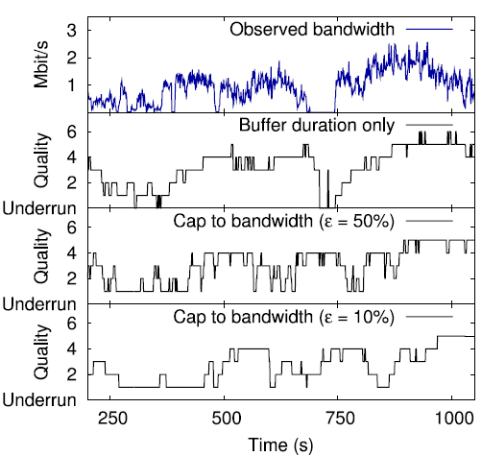
Bandwidth Capping
Notes:
預測頻寬選擇+-10%較好，可以避免劇烈波動&buffer underruns

Slide 14
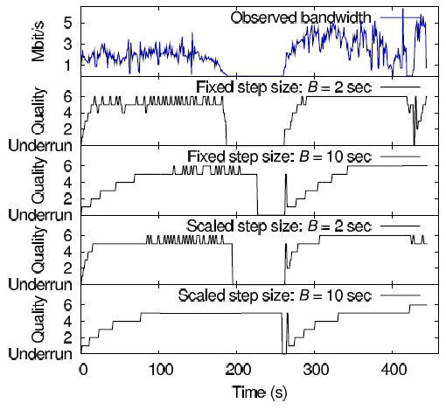
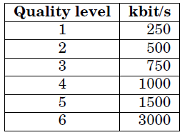
Scaling the buffer step size relative to video bitrate

Slide 15
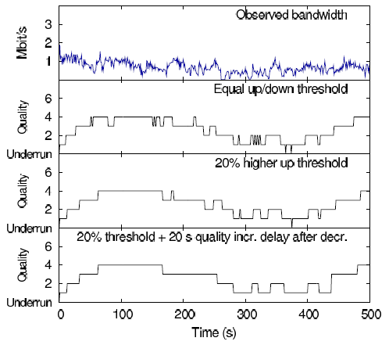
Removing rapid oscillations in quality
Having slightly different step sizes when going up in quality than when going down

Slide 16
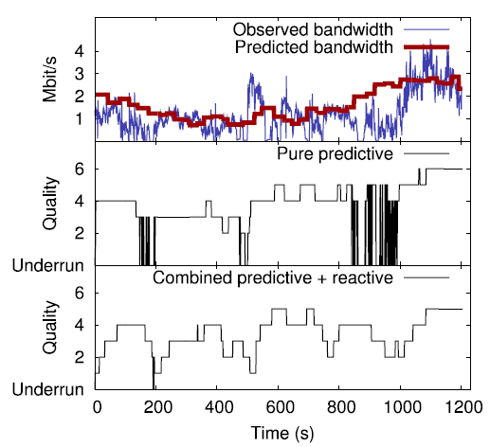
Combination with the reactive algorithm
Both algorithms select a quality level, and choose the lower one

Slide 17
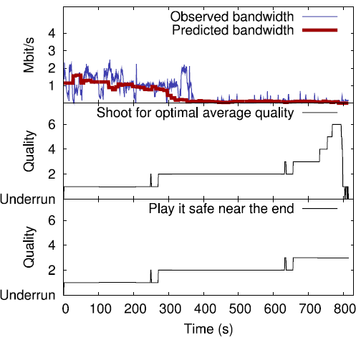
Variable-length travel handling

Slide 18
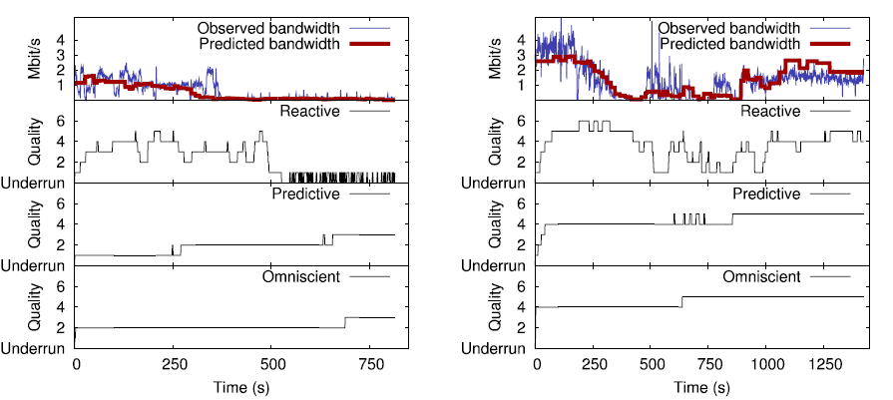
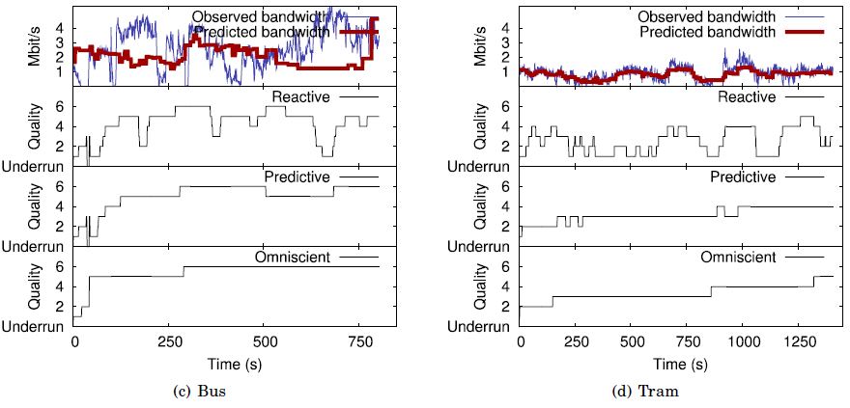
Simulation(1/3)

Slide 19
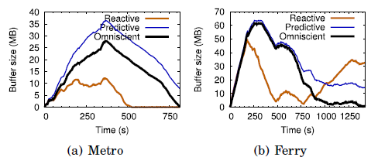
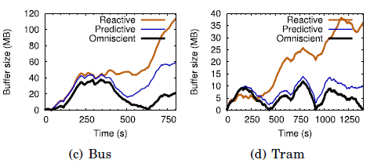
Simulation(2/3)

Slide 20
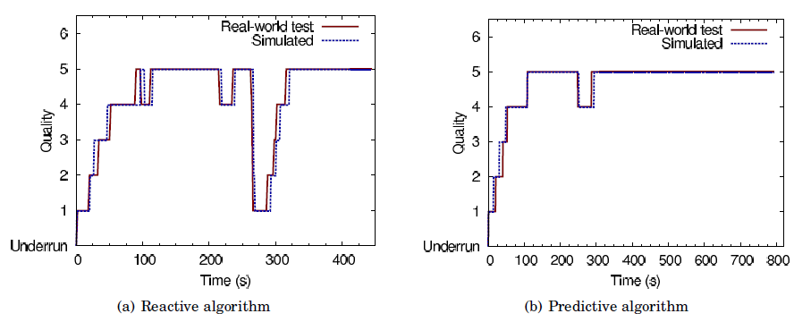
Simulation(3/3)

Slide 21
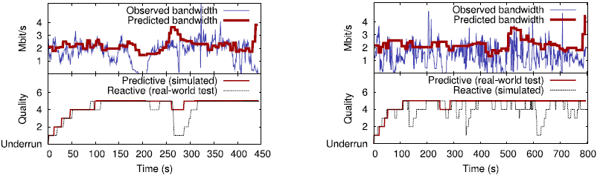
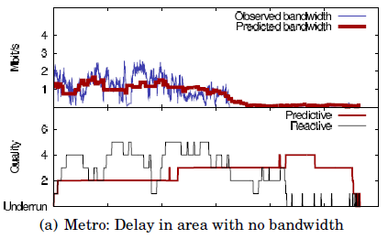
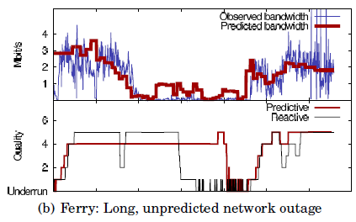
Real World Video Streaming Tests

Slide 22
Discussion and Open Issues
Time of day
Day of week
Competition for bandwidth
Direction and speed is unpredictable(cars)

