Slide 1
ThinkAir: Dynamic resource allocation and parallel execution in cloud for mobile code offloading
S. Kosta, A. Aucinas, P. Hui, R. Mortier, X. Zhang
INFOCOM ‘12

Slide 2
Outline
Introduction
Design and Architecture
Profiling
Evaluation
Summary

Slide 3
Introduction
Smartphone applications are more and more complex
Smartphone users have to continually upgrade their hardware but still experience short battery lifetime.
ThinkAir provide an execution ofﬂoading infrastructure and resource consumption proﬁlers.
It also provides library, compiler, VM manager and parallel processing module in cloud.
Notes:
動機: APP 越來越複雜
硬體必須一直升級
電池壽命

Slide 4
Related work
MAUI [MobiSys ’10][1] work does not address the scaling of execution in cloud.
CloneCloud [EuroSys ’11] [2] only considers limited input/environmental conditions in the ofﬂine pre-processing to determine which parts should be migrated on the cloud.
Virtual Smartphone [WoWMoM ‘10][3] uses Android x86 to execute Android images but does not provide any programmer support.
Existing work does not provide any mechanism to support on-demand resource allocation.
[1] MAUI: making smartphones last longer with code ofﬂoad. (Duke)
[2] Clonecloud: Elastic execution between mobile device and cloud. (intel researsh)
[3] Virtual smartphone over IP. (NTT)

Slide 5
Design objectives
Dynamic adaptation to changing environments
Ease of use for developers
Providing a simple interface.
Performance improvement through cloud computing
Dynamic scaling of computational power
Dynamically scaling the computational power at the server side as well as parallelizing execution

Slide 6
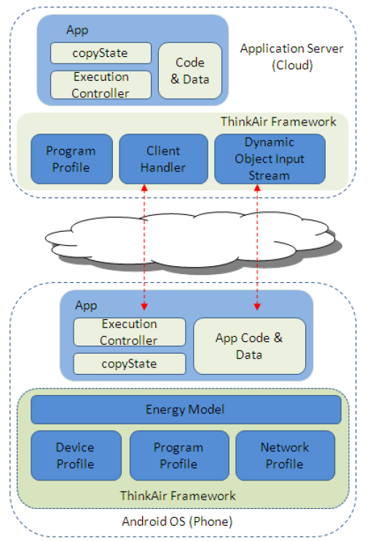

Slide 7
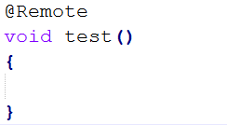
Design for compilation
Programmer API
ThinkAir provides a simple library and compiler support.
Any method to be considered for ofﬂoading is annotated with @Remote.
Compiler
Remoteable Code Generator : translates the annotated codes.
Customized Native Development Kit : provide some native code on the phone (arm base) can be supported on the cloud (x86 base).
Notes:
translates the annotated codes: 處理 @Remote

Slide 8
Design for execution
Execution Controller
The Execution Controller drives the execution of remoteable methods.
Decides whether to ofﬂoad execution of a method.
The decides depends on the current environment as well as that learnt from past executions.
User can also set a policy according to their needs
Execution time
Energy
Execution time and energy
Execution time, energy and cost
Notes:
Cost:使用商業化於雲端service

Slide 9
Design for execution
Exception handle
If the connection fails during remote execution, goes back to the local execution and discard the proﬁle and the Execution Controller initiates asynchronous reconnection to the server.
If an exception is thrown during the remote execution of the method, it is passed back in the execution results and re-thrown on the phone

Slide 10
Design for application server
Client Handler
Communication protocol, managing connections from clients, receiving and executing ofﬂoaded code, and returning results.
The remoteable method is called using Java reﬂection and the result or exception is sent back to client.
In case of OutOfMemoryError, the Client Handler does not send it back to the client directly, it try to execute the method on a more powerful clone.
Client Handler also sends proﬁling data for future ofﬂoading decisions.

Slide 11
Design for application server
Cloud Infrastructure
Build a customized version of Android x86, leaving out unnecessary components and running on VirtualBox.
There are 6 types of VMs with different conﬁgurations of CPU and memory.

Slide 12
Profiling
ThinkAir includes three proﬁlers (hardware, software, and network), which collect variant data and feed into the energy estimation model.
Use Android intents to keep track of important environmental parameters (battery levels, data connectivity and connection types).
Hardware Proﬁler
CPU : The CPU state is idle or have a utilization from 1–100%
Screen : The LCD scree brightness level between 0–255.
WiFi : The power state of WiFi interface is low or high.
3G : The 3G radio can be either idle, or in use with a shared or dedicated channel.

Slide 13
Profiling
Software Proﬁler
Software Proﬁler uses the standard Android Debug API to record the following information.
Overall execution time of the method
Thread CPU time of the method
Number of instructions executed
Number of method calls
Thread memory allocation size
Garbage Collector invocation count, both for the current thread and globally.

Slide 14
Profiling
Network Proﬁler
Account many different sets of parameters, by combining both intent and instrumentation-based proﬁling.
Tracks several other parameters, including the number of packets transmitted and received per second, uplink channel rate and uplink data rate for the WiFi interface, and receiving and transmitting data rate for the 3G interface.
Energy Estimation Model
Use a modified the original PowerTutor [1] model.
The maximum error is 6.27%.
[1] http://ziyang.eecs.umich.edu/projects/powertutor/

Slide 15
Evaluation
Consider four complete benchmark applications : a solver for the classic N-Queens problem, a face detection application, a virus scanning application, and an application combining two pictures into an unique large one.
Run the experiments under four different connectivity scenarios as follows.
Phone : Eexecuted on the phone.
WiFi-Local : Directly connects to a WiFi router attached to the cloud server via WiFi link.
WiFi-Internet : Connects to the cloud server using a normal WiFi access point via the Internet.
3G : Connected to the cloud using 3G data network.

Slide 16
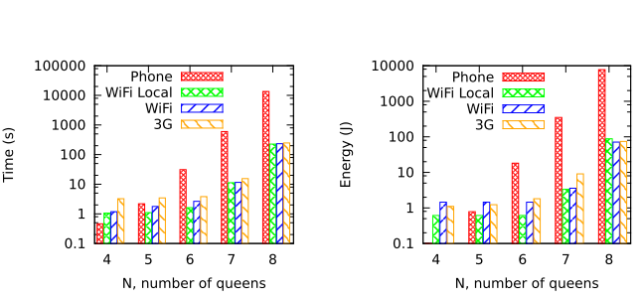
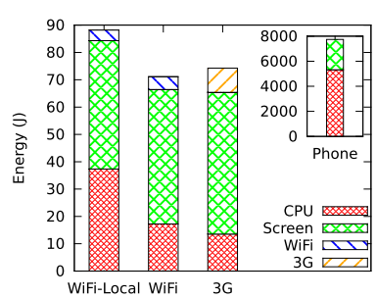
N-Queens puzzle
Implement the algorithm to ﬁnd all solutions for the N-Queens Puzzle and return the number of solutions found.
When N > 5, offloading to cloud is more efficient than executing on phone.
WiFi Local is the most efficient offloading method.

Slide 17
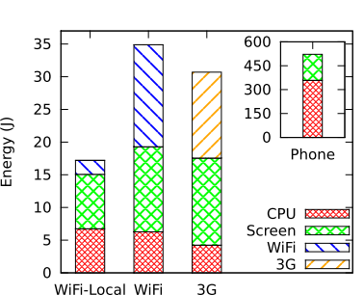
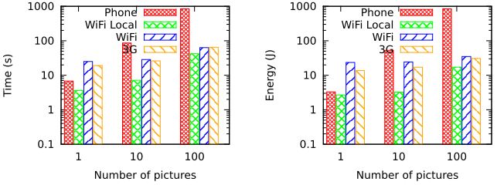
Face detection
A simple face detection program that counts the number of faces in a picture.
When detect multiple picture, offloading to cloud is more efficient than executing on phone.

Slide 18
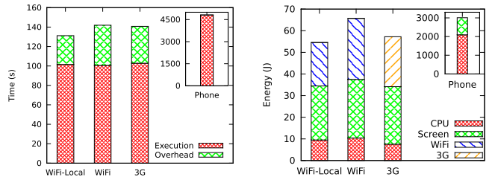
Virus scanning
A virus detection algorithm for Android, which takes a database of 1000 virus signatures.
The number of ﬁles is around 3,500.
Because of the large data transfer, they only consider communication energy consumption.

Slide 19
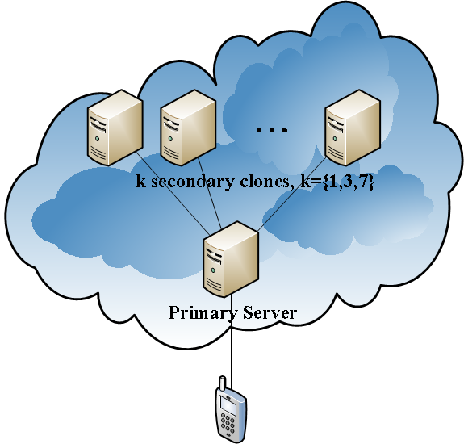
Parallelization with multiple VM clones
The modular architecture of the ThinkAir framework allows programmers to implement many parallel algorithms with no modiﬁcation to the ThinkAir code.

Slide 20
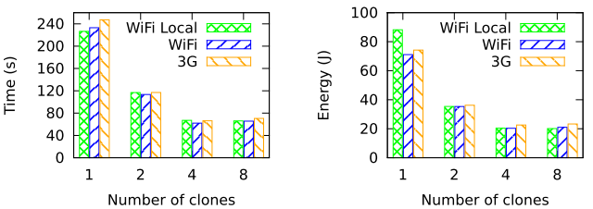
Parallelization with multiple VM clones
8-Queen puzzle
The problem is split by allocating different regions of the board to different clones
The 4-clone case has the most performance beneﬁts.

Slide 21
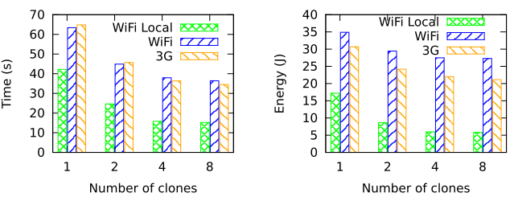
Parallelization with multiple VM clones
Face detection
The100 photos are distributed among the secondary for detection.
The 4-clone case has the most performance beneﬁts.

Slide 22
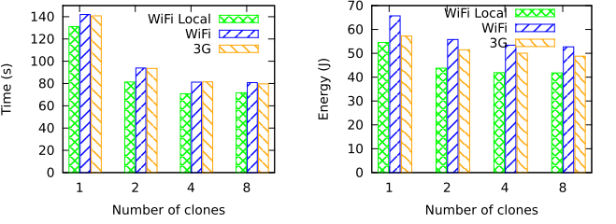
Parallelization with multiple VM clones
Virus Scanning
The ﬁles to be scanned are distributed among the clones.
The 4-clone case has the most performance beneﬁts.

Slide 23
Summary
ThinkAir, a framework for ofﬂoading mobile computation to the cloud.
ThinkAir requires only simple modiﬁcations to an application’s source code coupled with use ThinkAir tool-chain.
They are continuing the development of several key components of ThinkAir : port Android to Xen allowing it to be run on commercial cloud, and continue to work on improving programmer support for parallelizable applications.

