Slide 1
Quality selection for Dynamic Adaptive Streaming over HTTP with Scalable Video Coding
T. Andelin, V. Chetty, D. Harbaugh, S. Warnick, and D. Zappala
ACM Mmsys ’12

Slide 2
Motivation
SVC offers enhancements not provided by traditional DASH architectures
10% increase in the bitrate for spatial and SNR scalability
A segment’s quality can be increased anytime before its playback deadline

Slide 3
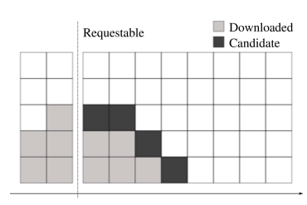
Problem
Determine which block is selected next
Depend on available bandwidth
Under which conditions should a client download with a diagonal policy, and how can it select the slope ?
Solution
Optimal
Simulation

Slide 4

Problem Formulation
Try to maximize:
Left term: mean of qualities
Any zero element → quality score = 0
Right term: quality variation

Slide 5
Optimal Policies – Constant Rate
λ = 0
Discard quality variation
Increase while the cumulative bandwidth can hold additional block
FloorVertical
λ > 0
Consider quality variation
Increase only one time while the cumulative bandwidth can hold additional blocks

Slide 6
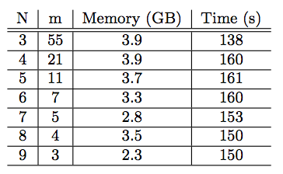
Optimal Policies – Variable Rate
Dynamic programming
N segments
m decisions
w = 0 or 1 block per request
w decided by probability
N * m steps

Slide 7
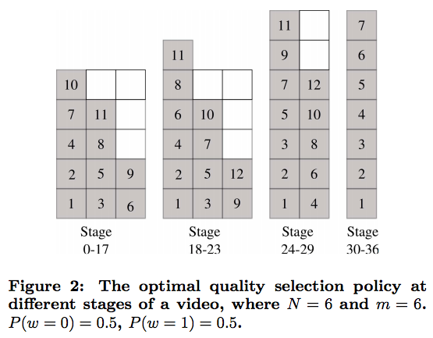
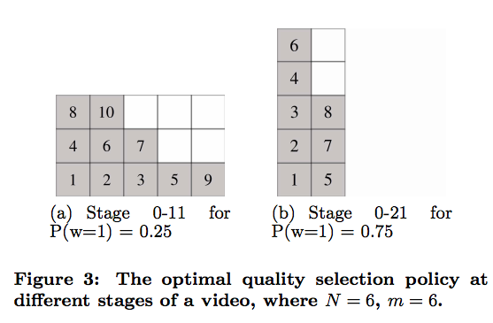
Optimal Policies – Variable Rate (cont.)

Slide 8
Simulation Study
DP limited to small videos
Policies
Vertical
Mean Vertical
Diagonal
Horizontal
Truncated Normal Rate Model
Markov Rate Model

Slide 9
Truncated Normal Rate Model
Download rate
Mean of the normal distribution: μ ( 0.25 <= μ < 6 )
Standard deviation of the distribution: σ (0 <= σ < 3 )
Gets simulated 200 times on a 1 hour video for each pair

Slide 10
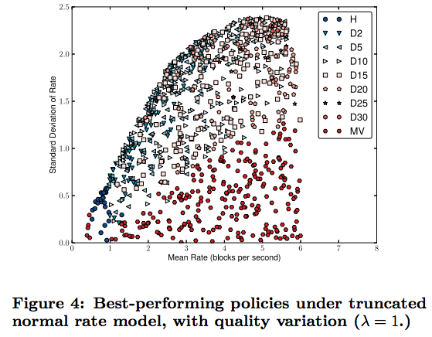
Truncated Normal Rate Results
Horizontal
Low mean
Low SD
MeanVertical

Slide 11
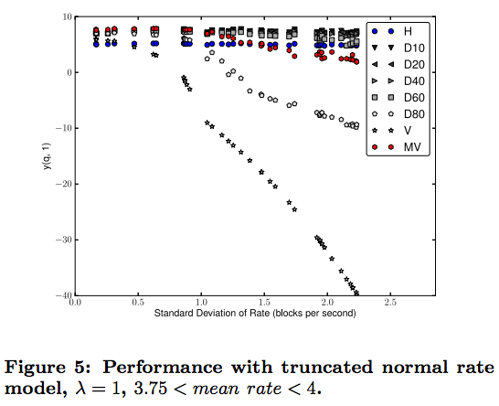
Truncated Normal Rate Results
Horizontal
More buffer space
Vertical
Low performance

Slide 12
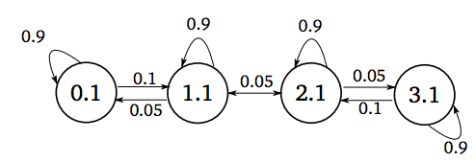
Markov Rate Model
Rate change is somewhat continuous
Nodes represent rates
Rate: αi +ε ( 0.5 <= α <= 2.5, ε=0.1 )
Arcs represent transition probabilities to adjacent nodes
0.02 <= p <= 0.98
7 nodes
200 simulated hours for each pairs

Slide 13
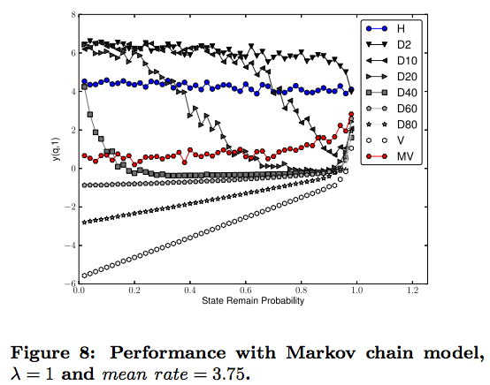
Markov Results
Flattest diagonal does best overall
Horizontal policy requires 10 times buffer than others

Slide 14
Conclusion
Diagonal quality selection policy does a good job of balancing both the quality score and quality variation.
Keep buffer requirements low
Future work is to develop a dynamic diagonal policy

Slide 15
Discussion
How to decide the order of segments?
Different overhead on three dimension in SVC.
It is hard to conduct the real experiment.

