Slide 1
peerTalk: A Peer-to-Peer Multiparty
Voice-over-IP System
X. Gu, Z. Wen, P. Yu and
Z Shae
IEEE TRANSACTIONS ON PARALLEL AND DISTRIBUTED SYSTEMS, VOL. 19, NO. 4, APRIL 2008

Slide 2
Introduction
Present the design and implementation of the P2P MVoIP system called peerTalk
Decoupled distributed processing (DDP) model for MVoIP services has two phase
  mixing phase
  distribution phase
PeerTalk is fully distributed and self-organizing

Slide 3
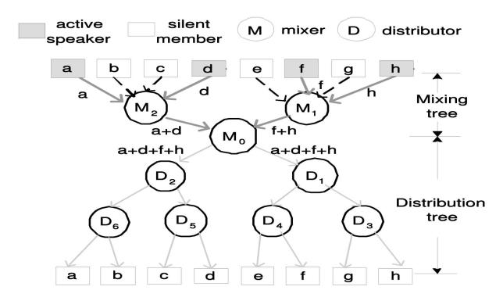
System model

Slide 4
System model
Each peer sends heartbeat messages to its neighbors to indicate its liveness and current stream processing performance
Each peer maintains the routing cost (network delay) to every other peer
The mixing and distribution tree are dynamically constructed

Slide 5
Service Provisioning Protocol
At a session beginning, all participants run an election protocol to select the best rendezvous point as the root of mixing tree and distribution tree
During runtime, the system adaptively grows or shrinks the mixing tree based on the dynamic mixing workload changes

Slide 6
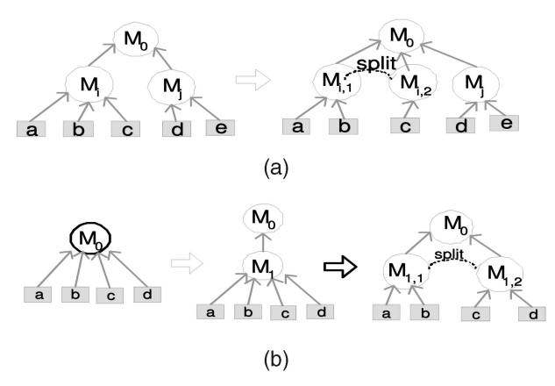

Mixer Splitting
Use the moving average value of the total audio stream number at time $t_{ }$, denoted by $N_{i,t }$

Slide 7
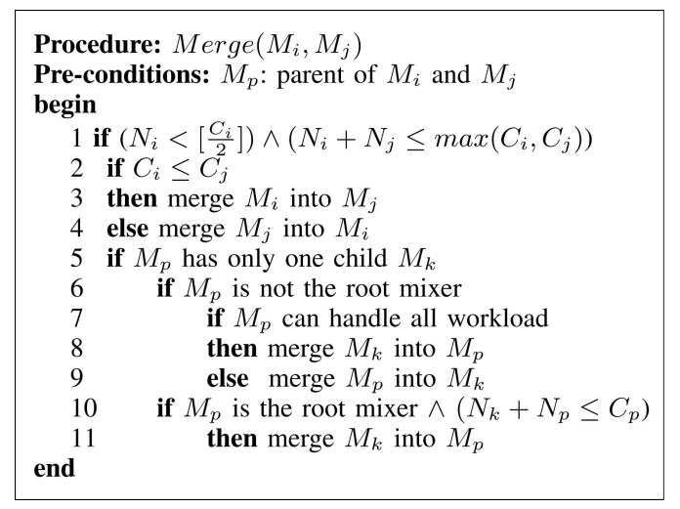
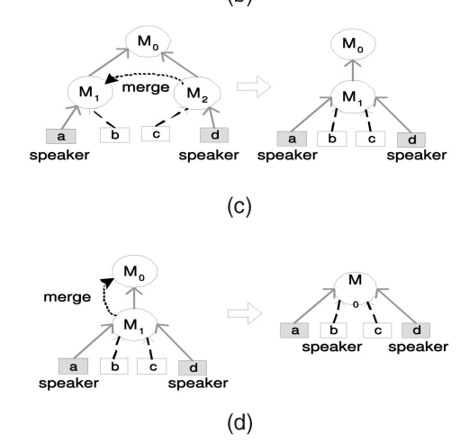
Mixer Merging

Slide 8
Mixer Migration
PeerTalk performs dynamic mixer migration to continuously optimize the audio mixing process
Migrate a mixer from a peer host to one of the neighbors if the neighbor is better in
  CPU, memory, and network bandwidth resources
  Better network connection (less delay and packet lost)

Slide 9
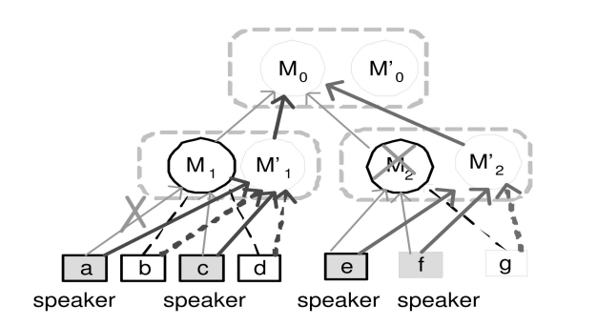
Mixer Replication

Slide 10
Experimental evaluation
Implemented a prototype of the peerTalk system and the PlanetLab Internet testbed
Generate a 5,120-node power-law graph to represent the physical network
The delay of each physical link is in the range of [8, 12] ms
The bandwidth of each network link is in the range of [256k, 10M] bps

Slide 11
Experimental evaluation
Use two different models to emulate the speaking activities
  Explicit ON/OFF model
    each active speaker alternates between ON periods and OFF periods
  Real VoIP conversation data
    use real telephony conversations
    consist of 500 pairs of conversations for a total of 1,000 voice streams.
    Each conversation session lasts 300 seconds

Slide 12
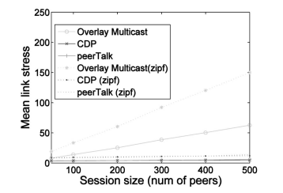
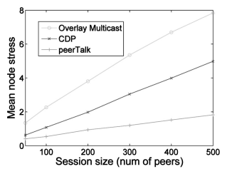
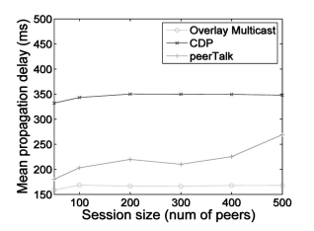
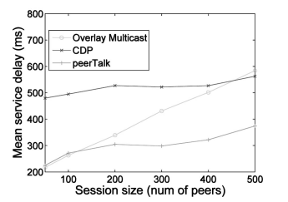
Session size ([50,500] peers)

Slide 13
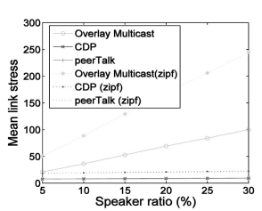
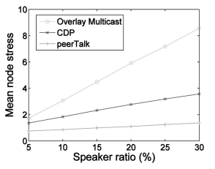
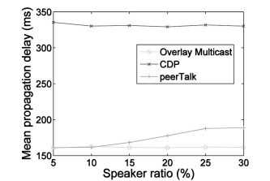
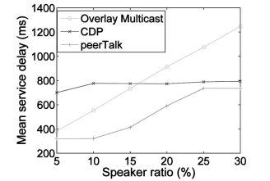
Speaker ratios

Slide 14
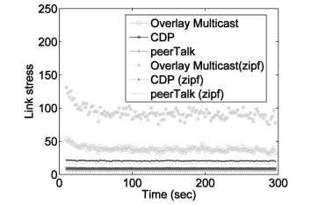
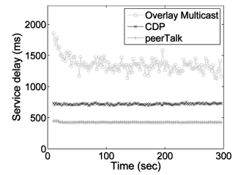
Real VoIP workloads

Slide 15
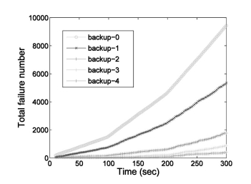
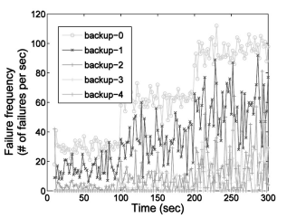
Backup mixers

Slide 16
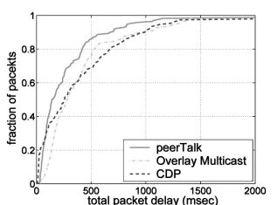
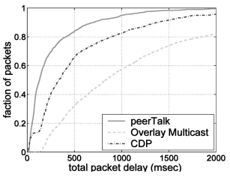

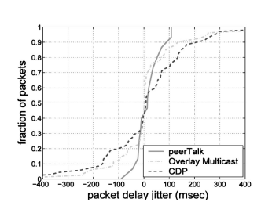
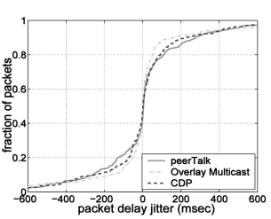

Packet delay and jitter

Slide 17
Conclusion
P2P MVoIP system can achieve better scalability and cost-effectiveness by adaptively and efficiently distributing the stream among different peers
Propose decoupled stream processing model
Provide mixer splitting/merging/migration algorithms
Propose lightweight backup schemes to make peerTalk resilient to peer failures/departures

