Slide 1
EndRE : An End-System Redundancy Elimination Service for Enterprises
Bhavish Aggarwal, Aditya Akella, Ashok Anand, Athula Balachandran, Pushkar Chitnis, Chitra Muthukrishnan, Ramachandran Ramjee and George Varghese
Microsoft Research India;University of Wisconsin-Madison;CMU;UCSD

Slide 2
Introduction
Corporation
Lower administration cost
Increase in network traffic

Slide 3
Introduction
Redundancy Elimination
An alternate approach where RE is provided as an end system service
End-to-end encrypted traffic
Last-hop wireless links to mobile devices

Slide 4
Introduction
Middlebox
Drawback
Encrypted traffic
Can’t improve performance over last-hop links in mobile devices

Slide 5
Design
Goal
Transparent operation
No changes to data
Fine-grained operation
Duplicate byte strings as small as 32-64B
Simple decoding at client
Fast and adaptive encoding at servers
Adapt its use of CPU based on load
Limited memory footprint at servers and clients

Slide 6
Design
Data block
w
minimum redundant string
p
Sampling period
marker
First byte of chosen candidate string
chunk
The string between two markers

Slide 7
Design
Data block
w
minimum redundant string
p
Sampling period
marker
First byte of chosen candidate string
chunk
The string between two markers

Slide 8
Design - Fingerprinting
MODP
Compute fingerprints
Fingerprint table
Packet payload
Window
Packet store
Rabin fingerprinting
Payload-1
Payload-2
Value sampling: sample those fingerprints
whose value is 0 mod p
Lookup fingerprints in Fingerprint table

Slide 9
Design - Fingerprinting
MAXP
Similar to MODP
Only selection criteria changes
MODP
MAXP
Sample those fingerprints whose value is 0 mod p
Choose fingerprints that are local maxima
( or minima) for p bytes region
No fingerprint to represent the shaded region
Gives uniform selection of fingerprints

Slide 10
Design - Fingerprinting
FIXED
Simply select every p^{th} byte as a marker
Content agnostic
SAMPLEBYTE
Content-based
Table: a byte is chosen as a marker if the corresponding entry in the lookup table is set
A marker is chosen, skip p/2 bytes

Slide 11
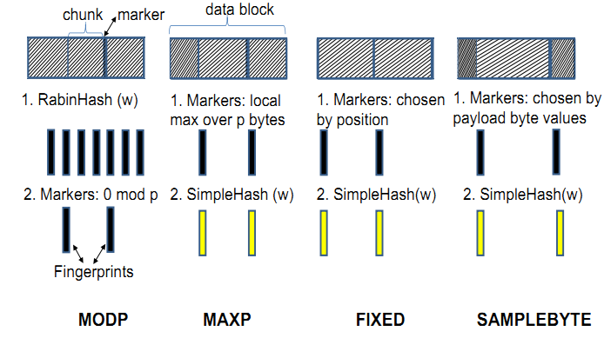
Design - Fingerprinting

Slide 12
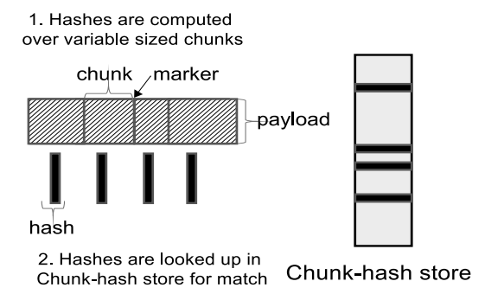
Design - Match
Chunk-Match
Client: fixed-size circular FIFO log
Server: emulate client cache per-client basis
Match → server send 4 bytes <offset, length>

Slide 13
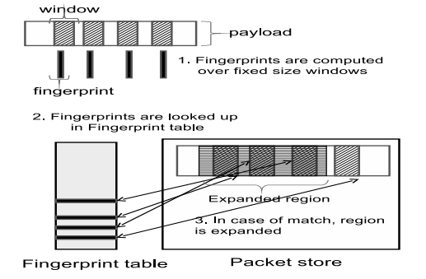
Design - Match
Max-Match
Try to expend matched region

Slide 14
Implementation
EndRE above TCP
Default fingerprinting algorithm
SIMPLEBYTE
Packet cache
1-16MB per pairs
Handle multiple parallel TCP stream
priority queue
Protocol independent
between app layer and transport layer
Windows Filtering Platform
Mobile
User-level proxy

Slide 15
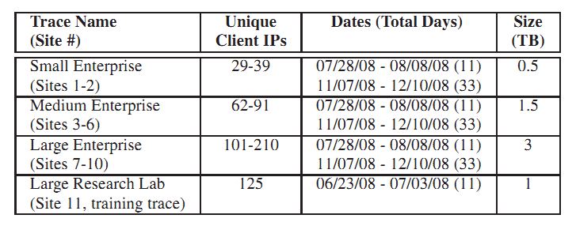
Evaluation approach
Traces
11 corporate enterprise location
Small, medium, large

Slide 16
Evaluation approach
Testbed
Desktop server connected to a client through a router
Router is a WiFi-AP in wireless experiments

Slide 17
CPU Costs
Micro-benchmarks
Fingerprint
Identify marker/fingerprint
InlineMatch
Generate fingerprints
Admin
Updating the fingerprint store

Slide 18
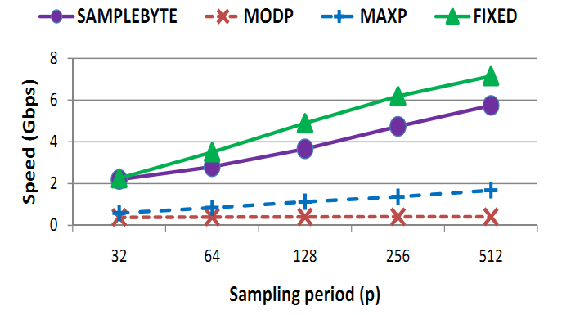
CPU Costs
Trace analysis

Slide 19
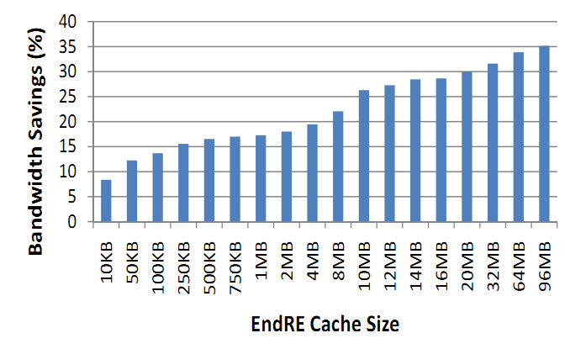
Bandwidth Saving

Slide 20
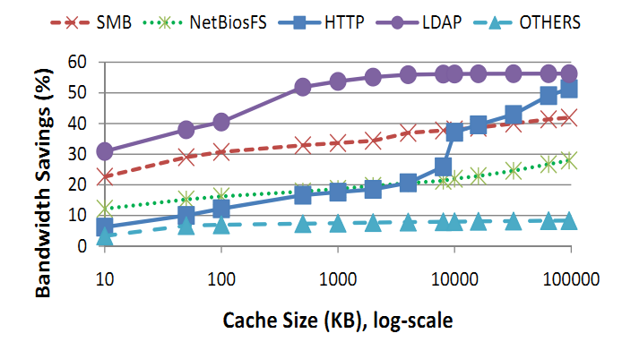
Bandwidth Saving

Slide 21
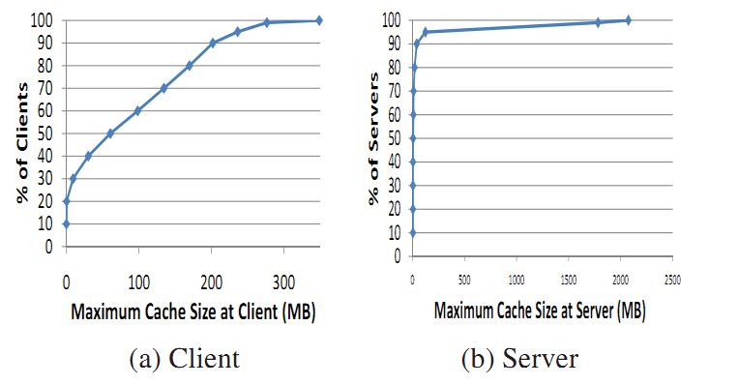
Memory Costs

Slide 22
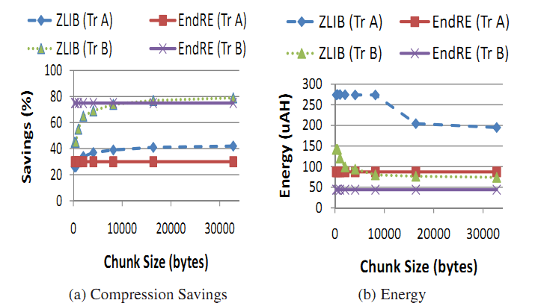
Energy Saving

Slide 23
Conclusion
Avg bandwidth gains 26%
Latency saving 30%
Median memory requirement 60MB
Adapting memory and CPU loading

