Slide 1
Context-Based Network Estimation for Energy-Efficient Ubiquitous
Wireless Connectivity
Ahmad Rahmati, Student Member, IEEE, and Lin Zhong, Member, IEEE
IEEE transactions on mobile computing

Slide 2
Background
There are over 2.5 billion global mobile phone users as of October 2006
80 percent of the world population is covered by cellular networks
There are more than 14 million Wi-Fi access points in US homes

Slide 3
Experimental Platform (1)
Developed and installed logging software on 11 HTC Wizard Pocket PC phones.
It records the cell tower ID, signal strength, and channel of the currently associated GSM cell and up to six other visible cells every 30 seconds.
It also records the BSSID, signal strength and the security property of all visible Wi-Fi access points.

Slide 4
Experimental Platform (2)
Use a sensor board which placed in the phone battery to continuously samples three-axis accelerometer at 32 Hz per channel.
The logger was installed on the phones of all 14 participants and collect log for at least 3 weeks.
Three of the phones equipped with the sensor board.

Slide 5
Data Logger Result
Cellular network availability is extremely high (99.1 %)
On average for all participants, cellular signal strength is above -94 dBm (three or four bars) for more than 75% of time.
Participants spent 49% of their daily lives under Wi-Fi networks and 77% unencrypted Wi-Fi access points.

Slide 6



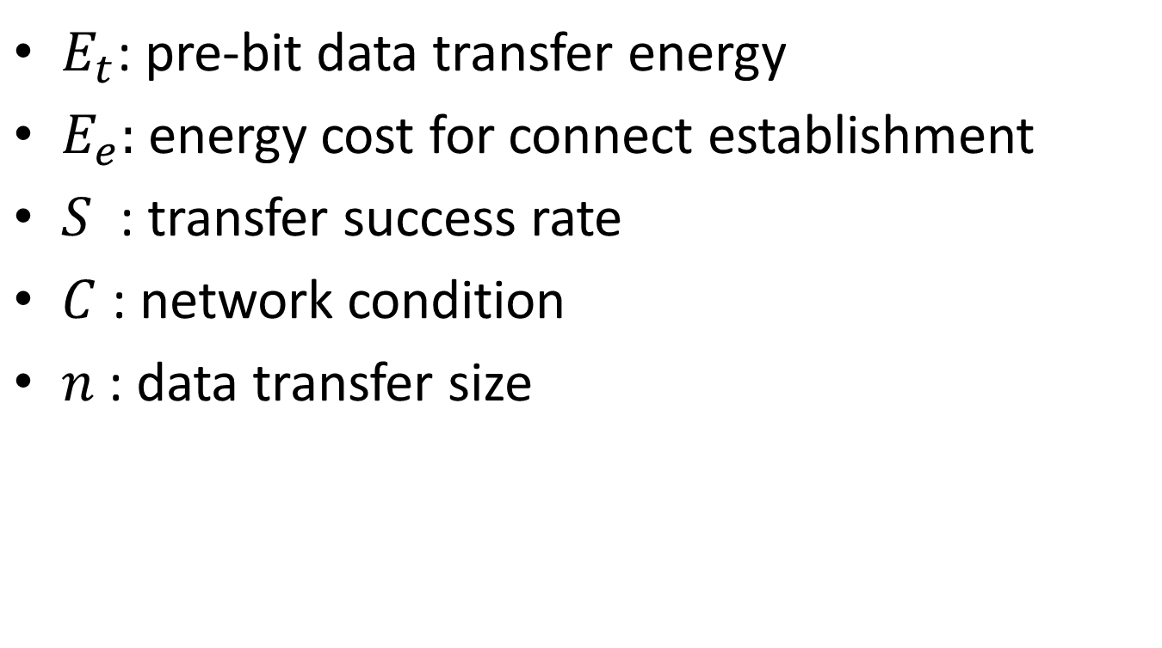
Energy Model for Data Transfers
$E_{t}$: pre-bit data transfer energy
$E_{e}:$ energy cost for connect establishment
$S^{ }$ : transfer success rate
$C$ : network condition
$n$ : data transfer size

Slide 7


Energy Saving
$P_{a}$: probability of WiFi AP accessible
=

Slide 8
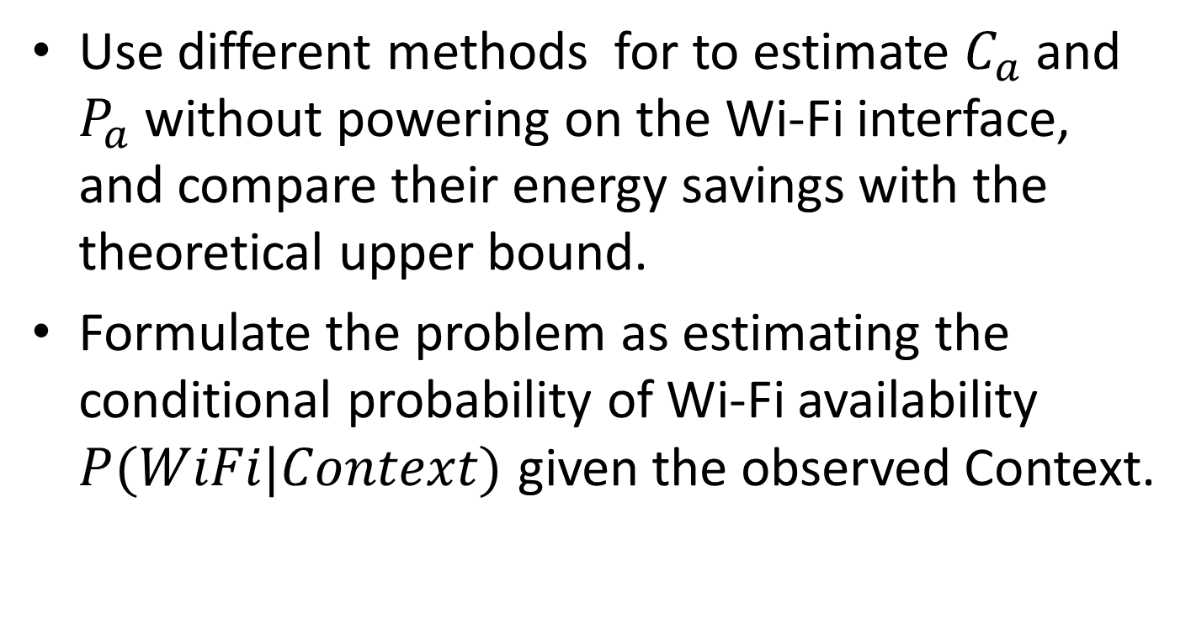
Context-based Network Estimation
Use different methods for to estimate $C_{a}$ and $P_{a}$ without powering on the Wi-Fi interface, and compare their energy savings with the theoretical upper bound.
Formulate the problem as estimating the conditional probability of Wi-Fi availability $P(WiFi|Context)$ given the observed Context.

Slide 9
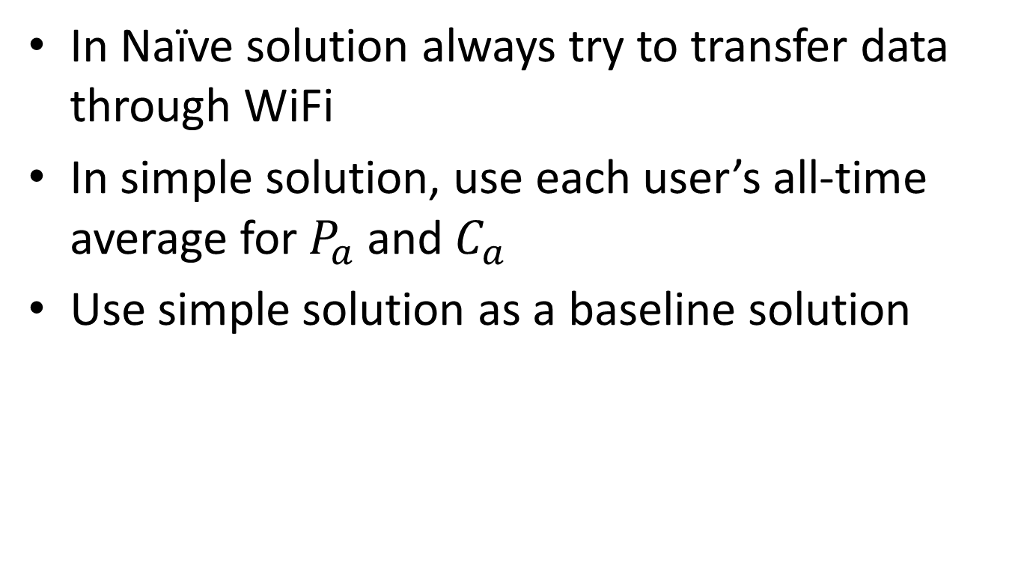
Naïve and Simple Solution
In Naïve solution always try to transfer data through WiFi
In simple solution, use each user’s all-time average for $P_{a}$ and $C_{a}$
Use simple solution as a baseline solution

Slide 10
TimeOfDay Estimation
People often spend days in a predictable fashion
Divide days into 24 one-hour time slots and compute the all-time average Wi-Fi availability and signal strength for each time slot

Slide 11
Hysteretic Estimation
People often stay at a certain location for rather long periods of time
Hysteretic Estimation use previously measured network conditions
The performance of this algorithm depends on the time-out value and how often network conditions change.

Slide 12
Cellular Tower Estimation
Network conditions are highly correlated to geographical location.
GPS energy cost is too high and only work outdoors.
There has been considerable research on using visible cell tower IDs for localization.

Slide 13
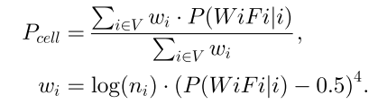
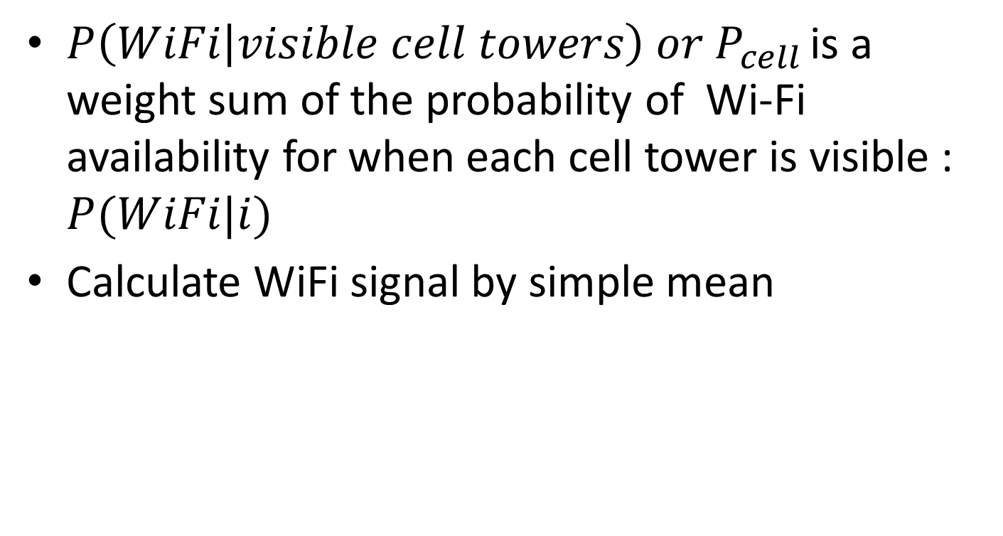
Cellular ID Estimation
$P\left(WiFi | visible cell towers\right) or P_{cell }$is a weight sum of the probability of Wi-Fi availability for when each cell tower is visible : $P(WiFi|i)$
Calculate WiFi signal by simple mean

Slide 14
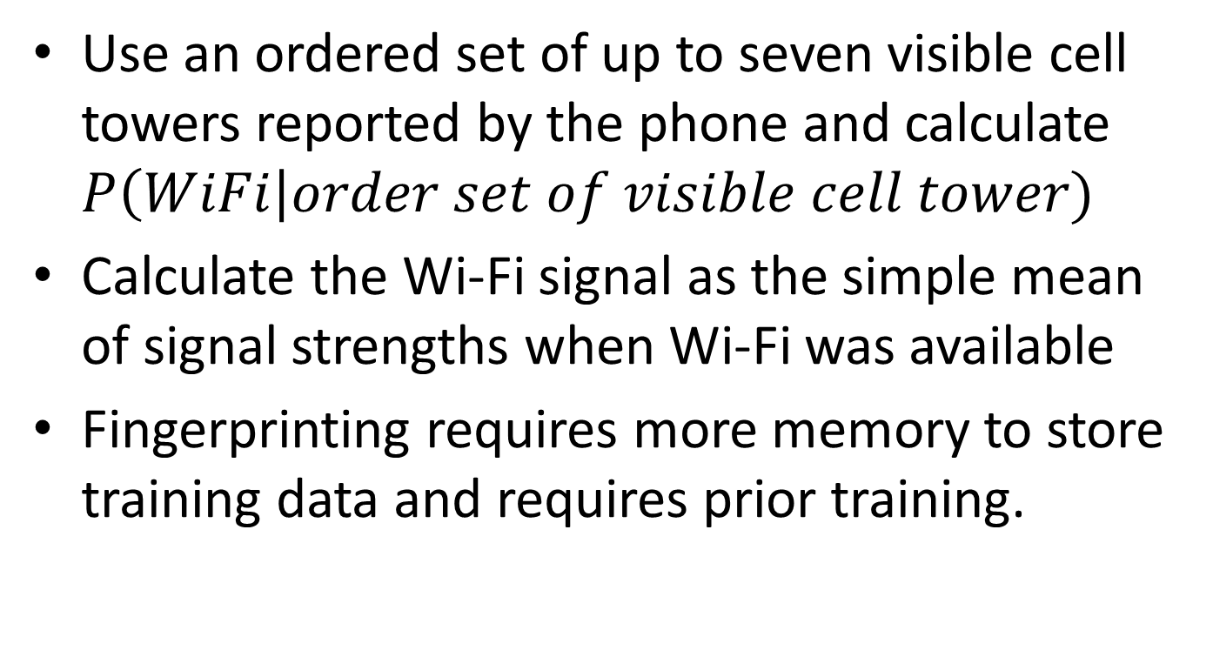
Fingerprinting Estimation
Use an ordered set of up to seven visible cell towers reported by the phone and calculate $P\left(WiFi\right|order set of visible cell tower)$
Calculate the Wi-Fi signal as the simple mean of signal strengths when Wi-Fi was available
Fingerprinting requires more memory to store training data and requires prior training.

Slide 15

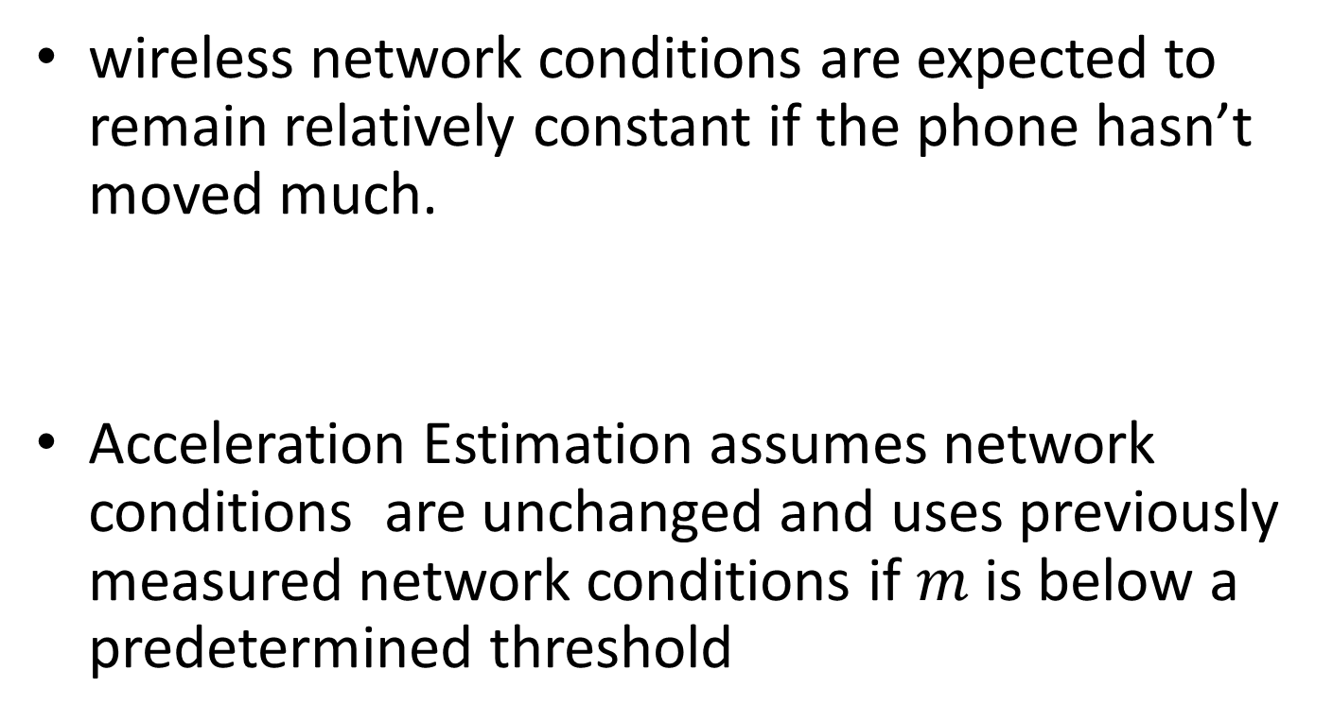
Acceleration Estimation
wireless network conditions are expected to remain relatively constant if the phone hasn’t moved much.
Acceleration Estimation assumes network conditions are unchanged and uses previously measured network conditions if $m$ is below a predetermined threshold

Slide 16
Combination Algorithms
First use either Hysteretic or Acceleration Estimation to determine if we should expect a change in network
If no change is expected, use the previously measured network conditions.
If a change is expected, use Cell ID or Fingerprinting Estimation to calculate network conditions

Slide 17
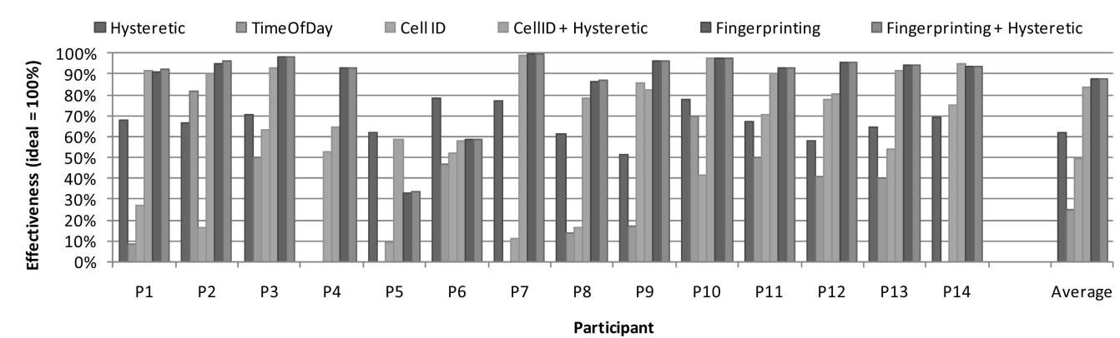
Trace-driven Simulation(1)
Use trace to compute the energy consumption of each algorithm for a typical ECG report application
Transfer 270KB data every 5 minute

Slide 18
Trace-driven Simulation(2)
Fingerprinting is the most effective estimation method.
Fingerprinting requires prior training.
Fingerprinting and Cell ID require detailed cell tower information from a GSM interface.
Hysteretic, TimeOfDay, and Acceleration estimation can work on devices with Wi-Fi but without GSM interfaces

Slide 19
Algorithm Comparison
Hysteretic Estimation works well for short transfer intervals and for participants with high Wi-Fi availability.
TimeOfDay Estimation works very well for participants with regular hours and locations of WiFi availability.
The performance of Cell ID Estimation is improved with increased mobility, which is opposite of Fingerprinting.
Combining different estimation algorithms can further improve performance

Slide 20
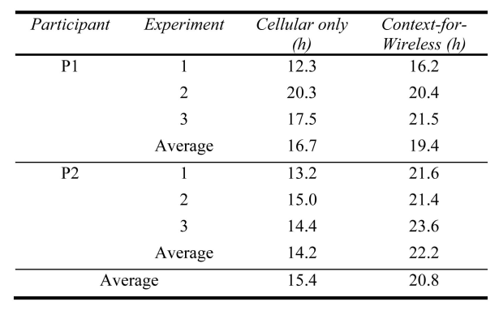
Energy Saving
Compared with Cellular case, the average battery lifetime gain was 35 percent.

Slide 21
Conclusion
Estimating network condition using context information
They formulated data transfer through multiple wireless interfaces as a statistical decision problem
Improve the average battery lifetime by 35%

