Slide 1
SmartSource: A Mobile Q&A Middleware Powered by Crowdsourcing
Y. Zhao, C. Liao, T. Lin, J. Yin, N. Do, C. Hsu, and N. Venkatasubramanian
2015 16th IEEE International Conference on Mobile Data Management

Slide 2
Introduction
Q&A system
Crowdsourcing
Amazon Mechanical Turk
CrowdFlower

Slide 3
Problem
Ensure that users can participate meaningfully (indeed, noisy apps are typically turned off or deleted by the user)
Lower resource consumption in the end-devices and networks.

Slide 4
Key contributions
Design of a generic mobile Q&A architecture.
Formulation of optimization problems (cast as worker selection and assignor selection problems) to balance the multiple design goals of accuracy, trustworthiness and overhead cost, at scale.
Design of stable algorithms for worker selection and assignor selection using the Lyapunov queuing framework.
Implementation of a prototype SmartSource system.

Slide 5
Worker choices
Experts
Friends and family networks
Those in the vicinity of a location are potentially more suitable candidates to answer location-based questions;
A combination of the above.

Slide 6
Context
Geolocation
Social network connections
Expertise and interests
Profiling of device sensors
Device battery levels.

Slide 7
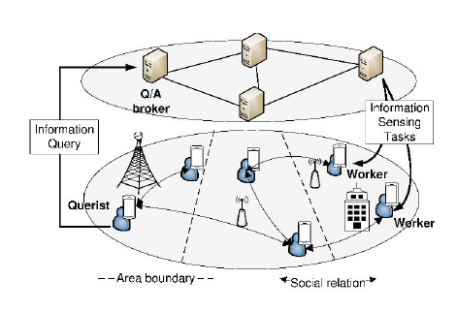
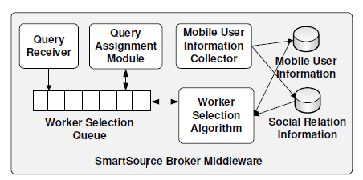
SmartSource Architecture
Querists
Workers
Brokers

Slide 8
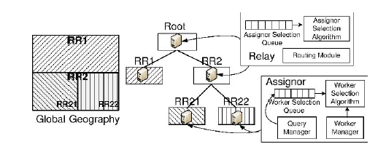
Distributed broker network
RRTree
Relays: non-leaf brokers
Assignors : leaf-brokers
Two forwarding
In spatial Q&A
Non-spatial Q&A

Slide 9
System models
Query model
Task model
Worker model
Task arrival
Task-worker selection and assignment
Task dropping

Slide 10
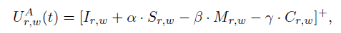
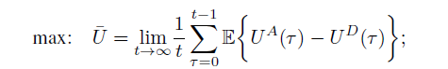
Problem Formulation
Utility function:
Maximizes the long term utility of selecting workers and minimizes the loss of dropping

Slide 11
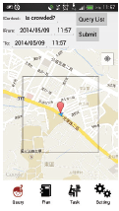
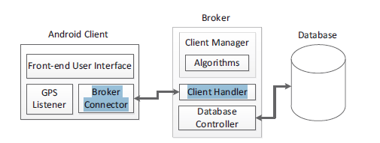
SmartSource Implementation

Slide 12
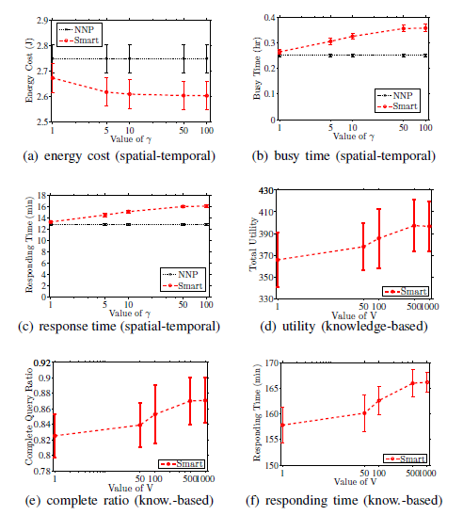
Performance Evaluation
Dataset
PPT
Quora
Experimental Methodology
Nearest
Nearest Neighbor Priority
Least Location Entropy Priority

Slide 13
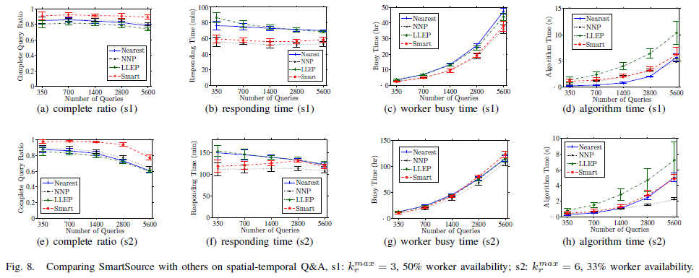
Performance

Slide 14
Questions
I need to study this algorithm.
Can I remove ‘accept’?
Broker communicate to another broker, delay time? table?

Slide 15
Todo
1. Make a demo video of B4G's system.
2. Promote client UI of M40’s project.
3. Add worker selection algorithm to pokemon broker

