Slide 1
OpenFlow: Enabling Innovation in Campus Networks
ACM SIGCOMM 2008

Slide 2
The Need for programmable networks
Introduction

Slide 3
The Need For Programmable Networks
Today, there is almost no practical way to experiment with new network protocols
The scale is not big enough to gain confidence
Kind of a vicious circle
Virtualized programmable networks could lower the barrier to entry for new ideas.
Networking community is working on a nationwide solution
Such as GENI
But it’ll take years to deploy

Slide 4
The Need For Programmable Networks
This paper focus on a shorter-term question
“As researchers, how can we run experiments in campus network?”
Goal: purpose a new switch feature that extend programmability
Commercial solutions are too closed, inflexible
Research solutions either have insufficient performance/fanout, or are too expensive

Slide 5
The Need For Programmable Networks
Solution: compromise on generality
Amenable to high-performance and low-cost implementations
Capable of supporting a board range of research
Assured to isolate experimental traffic from production traffic
Consistent with vendors’ need for closed platforms

Slide 6
The openflow switch

Slide 7
The Openflow Switch
Most Ethernet switch contain flow-tables
Typically built from TCAMs, run at line-rate
Identify a common set of function and exploit them
Openflow is an open protocol to program the flow-table in different switches and routers
Network administrator can isolate experiment traffic from regular ones
Researcher can control their own flow

Slide 8
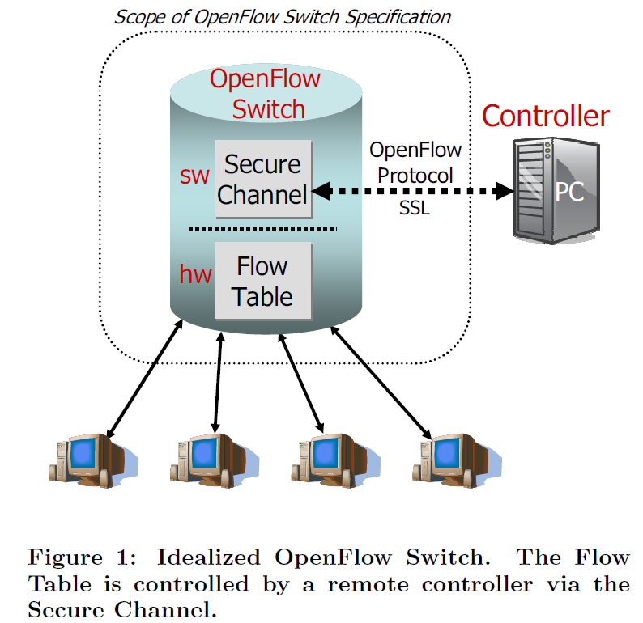
The Openflow Switch
Consist of at least three parts
A flow table
with an action associated with each entry
A secure channel
Connects the switch with a remote control process(Controller)
The OpenFlow Protocol

Slide 9
The Openflow Switch

Slide 10
Flow Entry in Flow Table
Packet header
10-tuple in first generation “Type 0” switch
Each field can be a wildcard
Associated action
Statistics
# of packet, bytes for each flow…etc.

Slide 11
Associated Action
A: Forward this flow’s packet to a given port(s)
Allow packets to be routed through the network
B: Encapsulate and forward to a controller
Delivered to secure channel
Typically for the first packet in a flow
C: Drop this flow’s packets
D: Forward this flow’s packets through normal processing pipeline

Slide 12
Associated Action
Dedicated OpenFlow switches
A dumb datapath element that forwards packets between ports, as defined by remote controller
Support action A to C
OpenFlow-enabled switches
A functional router/switch that’s enhanced with OpenFlow
Reuse some of it’s hardware(such as TCAMs)
Support action A to C
Support action D or use VLANs to differentiate

Slide 13
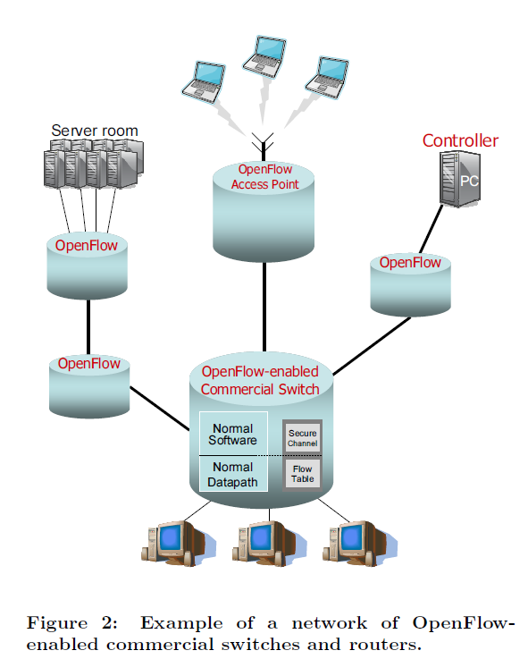
OpenFlow-enabled Switch

Slide 14
Associated Action
Those that supports the minimum required action mentioned earlier is called “type 0” switch.
Some switch will support some extra features, these are called “type 1” switch.

Slide 15
Controller
A controller adds and removes flow-entries
A simple static controller
Just establish flows to interconnect a set of test computers for the duration of the experiment
Isolate experimental traffic from normal ones
Generalization of VLANs
There can be some more sophisticated controllers
Dynamically add/remove flows in the progress of the experiment
Share the network between multiple researchers

Slide 16
Using OpenFlow

Slide 17
Using OpenFlow
Ex: Amy want to test her new Amy-OSPF routing protocol
The Amy-OSPF will run in a controller
Each time a new flow starts, the Amy-OSPF will pick a route
All the following packets will be forwarded accordingly
Amy can limit this action only to the packet coming from her own computer’s port

Slide 18
Using OpenFlow
Question: can such a centralized controller be fast enough to process new flows and program the Flow Switches?
A part of this question is answered in Ethane prototype(ACM SIGCOMM 2007)
A low-cost commodity PC can handle over 10000 new flows per second
Enough for campus

Slide 19
Experiments in a Production Network
Two important properties
Packets belonging to other users should be routed normally
Amy should only be able to add flow entries for the traffic she is allowed to control
First one is achieved by OpenFlow-enabled switches
Second one depends on controller implementation

Slide 20
Some more examples
Network Management and Access control
VLANs
Mobile wireless VOIP clients
User a controller that track the user’s location, and do the handoff by changing the flow-tables
Non-IP network
Can use Ethernet header, Ethernet type or new non-IP protocols

Slide 21
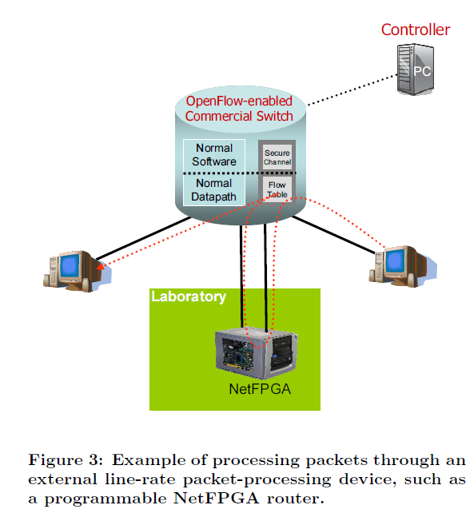
Some more examples
Processing packets rather than flows
Forward every packets to controller at the cost of performance
Route them to a programmable switch, such as NetFPGA

Slide 22
Conclusion
OpenFlow is a pragmatic compromise
Allow researches to run experiments on heterogeneous switches and routers in a uniform way
Vendors don’t have to expose their internal working
Researchers don’t have to write vendor-specific programs
Hoping that new generation of control software will emerges
Accelerating the innovation in networking

Slide 23
Backup Slides
What is VLAN?
http://s90304a123.pixnet.net/blog/post/38793827-ccna%E6%95%99%E5%AD%B8-vlan

