Slide 1
Matador: Mobile Task Detector for Context-aware Crowd-Sensing Campaigns
I. Carreras, D. Miorandi, A. Tamilin, E. R Ssebaggala, and N. Conci
(PerMoby’13 March)

Slide 2
Outline
Introduction
Context-aware crowd-sensing
Energy efficient context sampling
System implementation and experimentation
Conclusions

Slide 3
Introduction
Crowd-sensing
The ubiquitous availability of internet-connected media- and sensor-equipped portable devices
Exploiting the power of crowds to perform sensing tasks in the real world
The intersection of crowd-sourcing and participatory sensing
They present Matador: a context-aware crowd-sensing framework
Maximizing users to participate for relevant tasks
Minimizing the consumption of mobile devices
Notes:
Crowd-sourcing: allows to issue tasks to users requiring human intervention
Participatory sensing: public and professional users to gather, analyze and share local knowledge

Slide 4
Context-aware Crowd-sensing
Each task is further characterized by its context, which can be defined along multiple dimensions
Geographical (e.g., within a circular area, along a street)
Temporal (e.g., in given dates, during given hours)
Demographics (e.g., age, gender)
User activity (e.g., movement speed, no active calls)

Slide 5
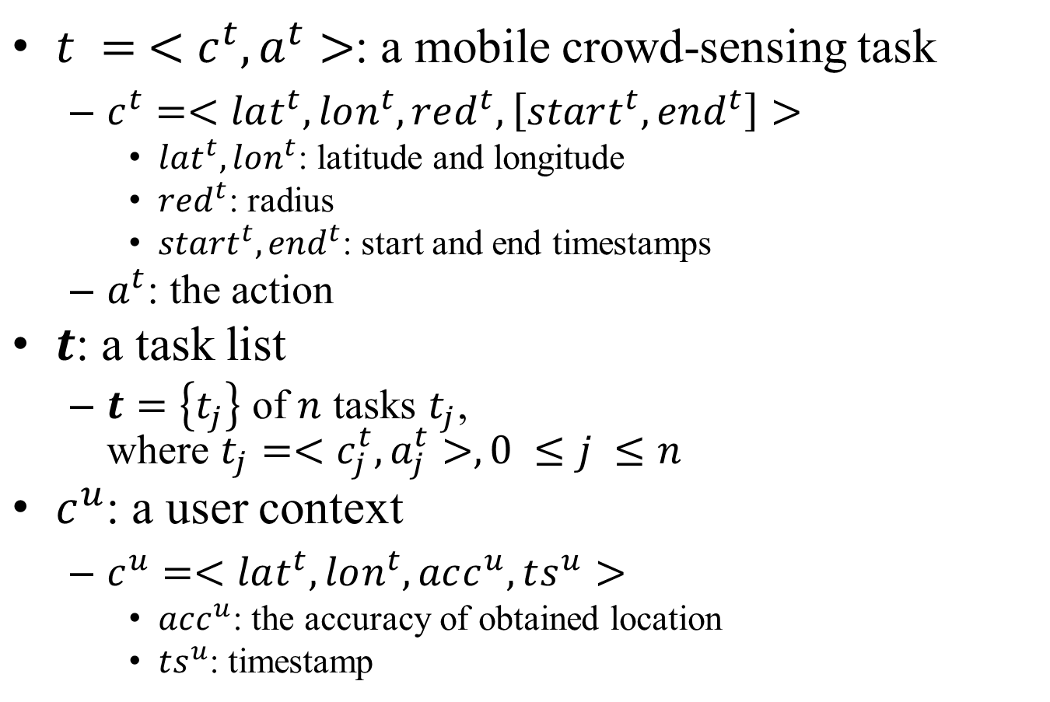
Problem Formulation
$t = <c^{t}, a^{t}>$: a mobile crowd-sensing task
$c^{t}=<lat^{t},lon^{t},red^{t},\left[start^{t}, end^{t}\right]>$
$lat^{t}, lon^{t}$: latitude and longitude
$red^{t}$: radius
$start^{t}, end^{t}$: start and end timestamps
$a^{t}$: the action
$t$: a task list
$t=\left\{t_{j}\right\}$ of $n$ tasks $t_{j}$, where $t_{j}=<c_{j}^{t}, a_{j}^{t}>, 0 ≤j ≤n$
$c^{u}$: a user context
$c^{u}=<lat^{t},lon^{t},acc^{u}, ts^{u}>$
$acc^{u}$: the accuracy of obtained location
$ts^{u}$: timestamp

Slide 6
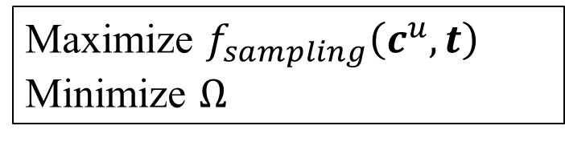
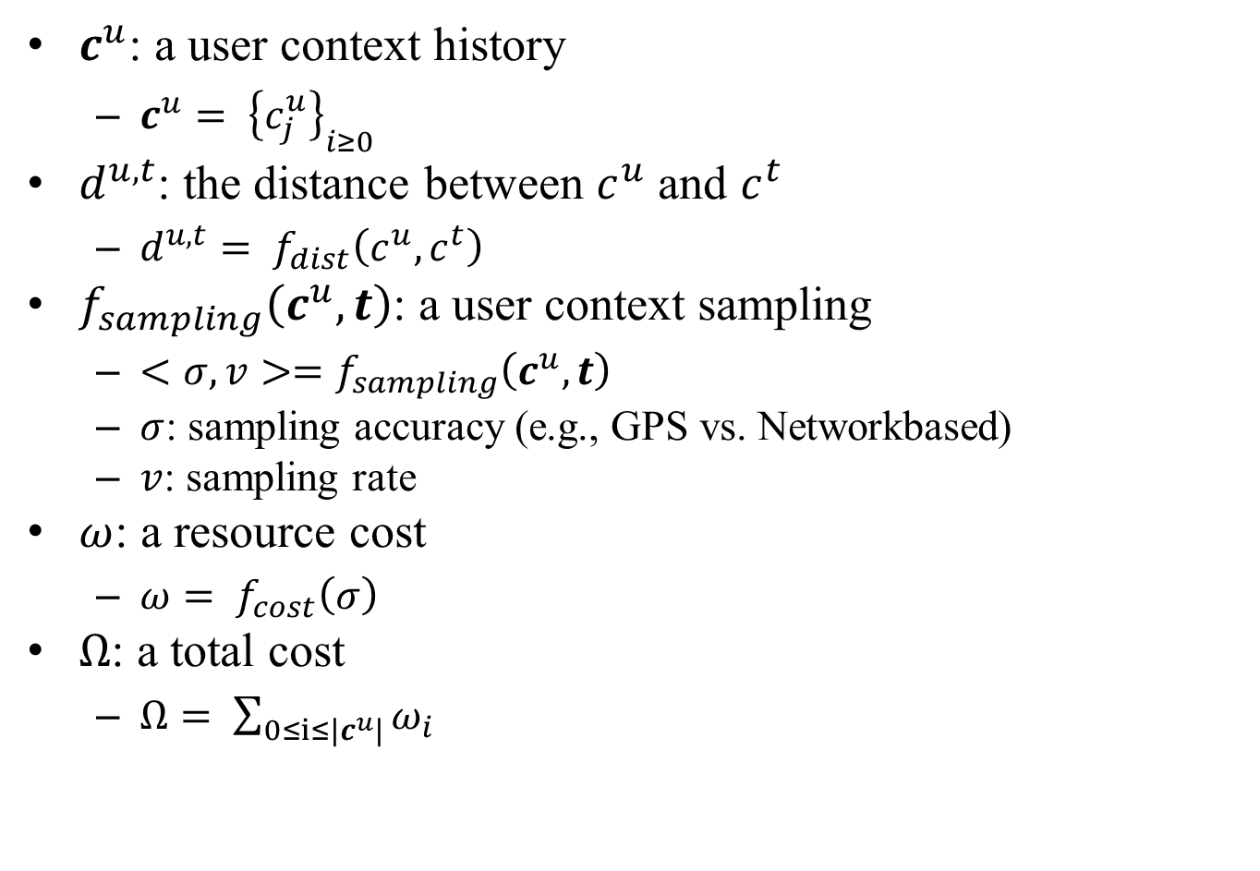
Problem Formulation
$c^{u}$: a user context history
$c^{u}= {\left\{c_{j}^{u}\right\}}_{i≥0}$
$d^{u,t}$: the distance between $c^{u}$ and $c^{t}$
$d^{u,t}= f_{dist}\left(c^{u},c^{t}\right)$
$f_{sampling}\left(c^{u},t\right)$: a user context sampling
$<σ,v>=f_{sampling}\left(c^{u},t\right)$
$σ$: sampling accuracy (e.g., GPS vs. Networkbased)
$v$: sampling rate
$ω$: a resource cost
$ω= f_{cost}\left(σ\right)$
$Ω$: a total cost
$Ω= \sum_{0≤i≤|c^{u}|}{ω_{i}}$
Maximize $f_{sampling}\left(c^{u},t\right)$
Minimize $Ω$

Slide 7
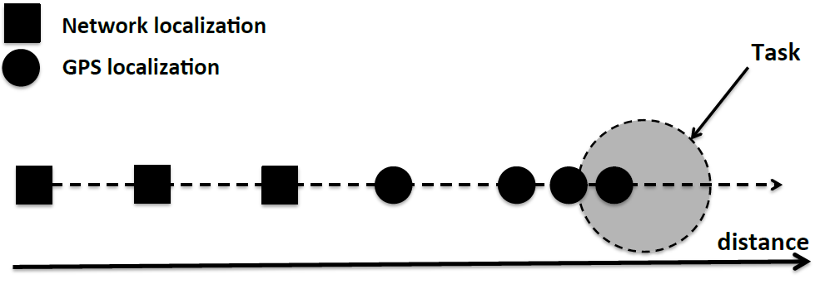
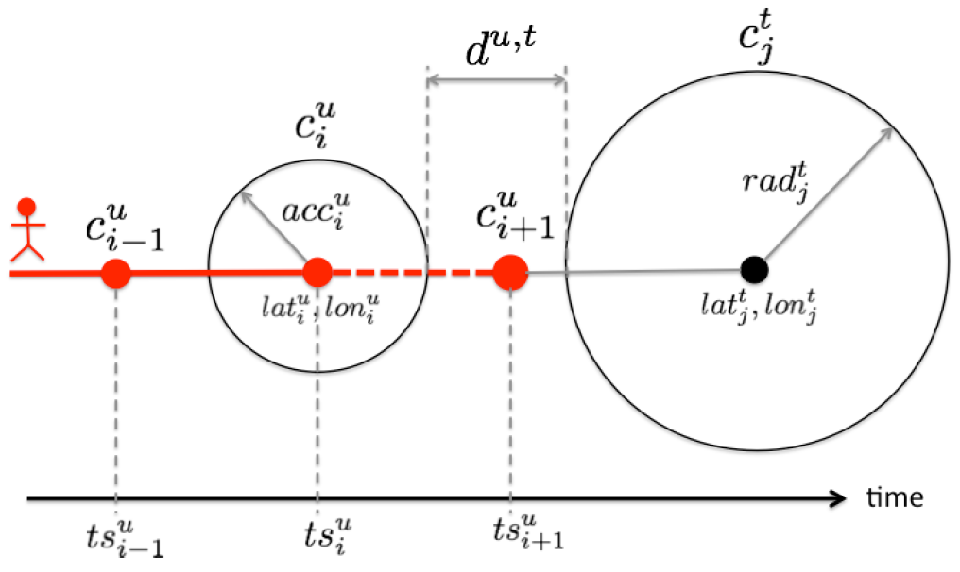
Energy Efficient Context Sampling
$f_{dist}= \left\{\begin{aligned}hurs^{∗}\left(c^{u},c^{t}\right)−acc^{u}−rad^{t}, if ts^{u}∈[start^{t}, end^{t}] \\ ∞, otherwise\end{aligned}\right.$

Slide 8
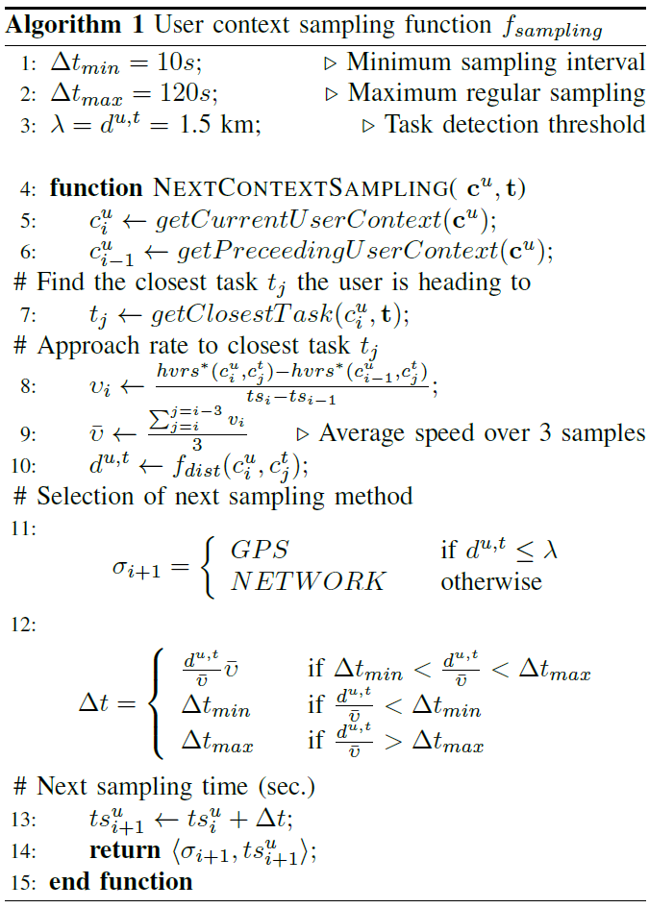
The Sampling Algorithm

Slide 9
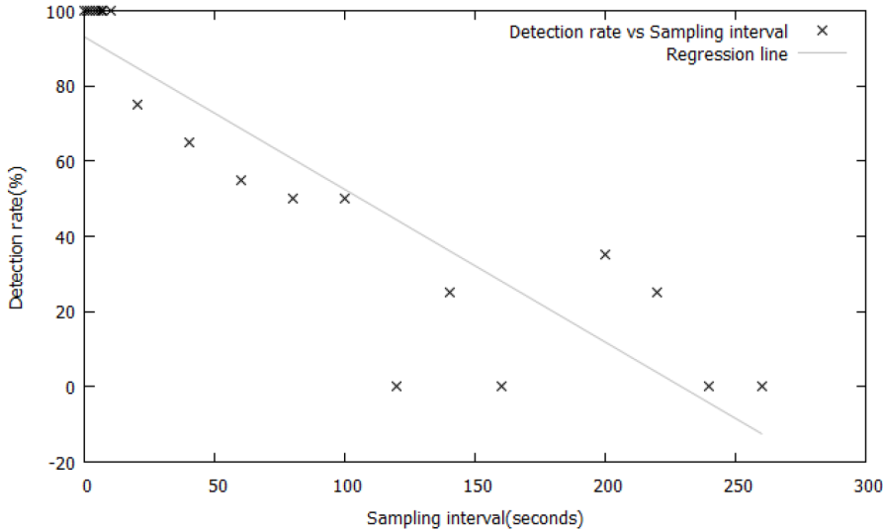
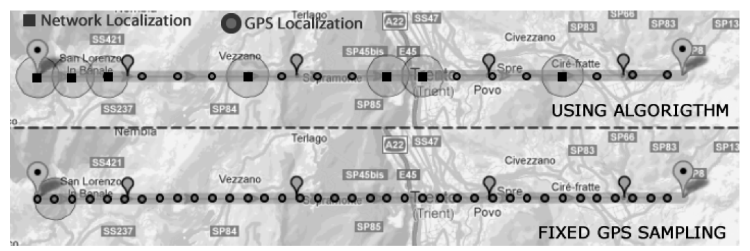
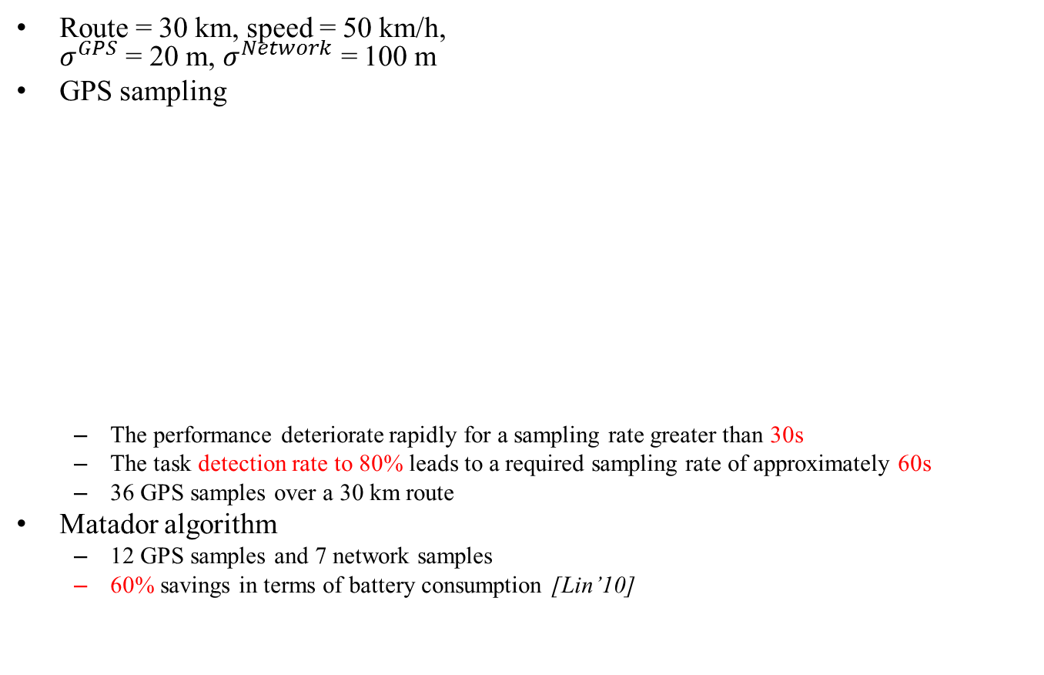
Simulation Study
Route = 30 km, speed = 50 km/h, $σ^{GPS}$ = 20 m, $σ^{Network}$ = 100 m
GPS sampling
The performance deteriorate rapidly for a sampling rate greater than 30s
The task detection rate to 80% leads to a required sampling rate of approximately 60s
36 GPS samples over a 30 km route
Matador algorithm
12 GPS samples and 7 network samples
60% savings in terms of battery consumption [Lin’10]

Slide 10
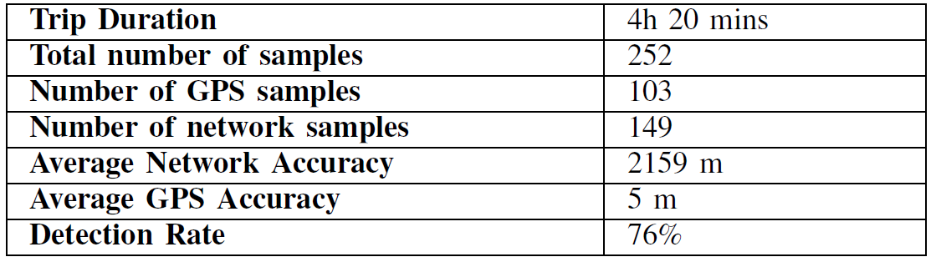
System Implementation and Experimentation
Prototype implementation
A server-side web application
A smartphone mobile application
Experimental validation (a small field test)
Path = 400 km
40 tasks
Radius = 250 ~ 500 m
Task interval = 30 ~ 40 km
Speed = 25 ~ 130 km/h
Experiment result
.

Slide 11
Conclusion
They presented Matador system
Exploit user context
Optimally deliver tasks
Preserve mobile device resources
Current work
Extend the context
Implement and evaluate a large-scale experimentation

