Slide 1
Manycraft: Scaling Minecraft to Millions
NetGames 2013
R. Diaconu, J. Keller, M. Valero

Slide 2
Introduction

Slide 3
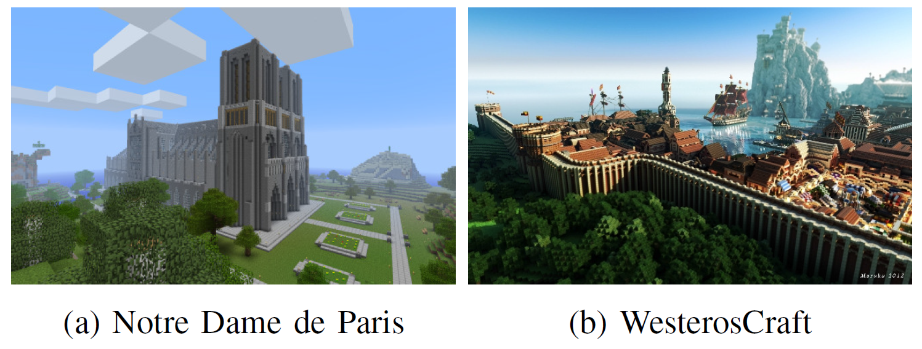
Introduction

Slide 4
Introduction
Author try to modify a popular game called “Minecraft”
Called “Manycraft”
They claim that it can support unlimited number players
The largest current server can only support thousands
No clear evaluation is given on their final implementation

Slide 5
Related work

Slide 6
Typical Scale Up Solutions
Zoning
Sharding
“全新伺服器火熱加開”
Instancing
Dungeon in WoW
P2P solutions
Not suited for frequent player movement

Slide 7
Kiwano
Author use “Kiwano”
A distributed infrastructure for virtual worlds by the some of the authors
High Performance Computing and Simulation (HPCS), 2013 International Conference on. IEEE, 2013

Slide 8
Minecraft

Slide 9
Minecraft
Server
50ms tick
Update world physics, mobs’ behavior, change in the surrounding of each specific player
Client
Send position, block destruction…e.t.c to server

Slide 10
Minecraft Protocol
Three type
Map(Only difference, only to close enough)
Player changes position
Blocks around the player is changed
Entities(Only to close enough)
When a player or mob moves, chat, other actions
Control
Keep alive message, cycle events(day-night alter)

Slide 11
Evaluating minecraft scalability

Slide 12
Experimental Setup
Make a very simple world
No mobs
All flat, simple world
Simulated player don’t chat, mine, craft
Set view distance to minimum
Player movements
Slowly randomly walking
Moving fast in a given direction

Slide 13
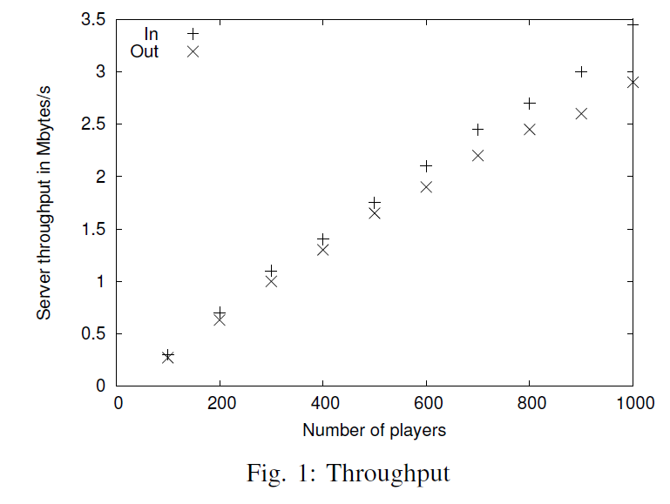
Throughput
3.5KBps/3KBPS per client
20K players for 500Mbps(Less when map is more complicated)

Slide 14
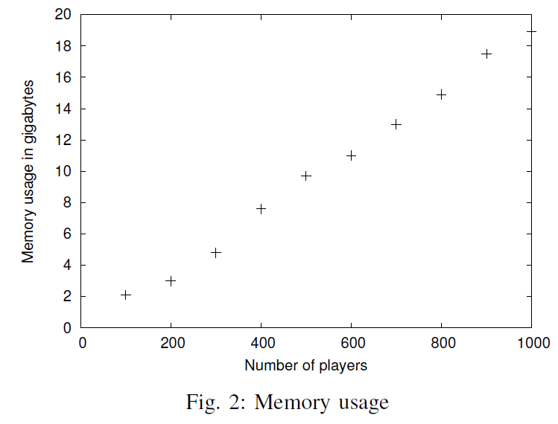
Memory Usage
1500 player for 24G RAM

Slide 15
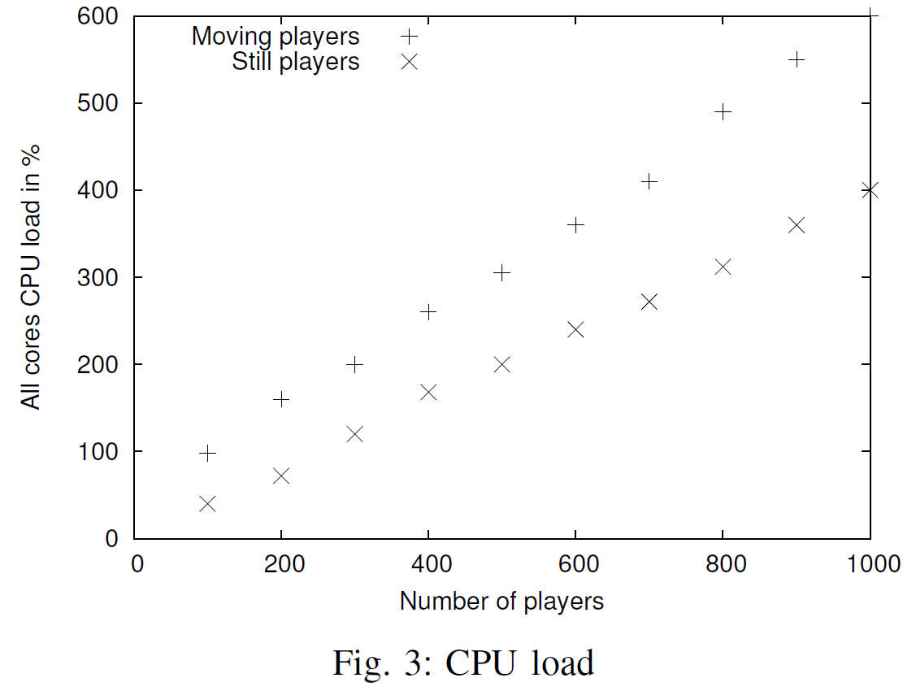
CPU Load
Both grow linearly
About 1000 players for 8-core CPU

Slide 16
Conclusion
Map complexity is not the major bottleneck
To reach above ten thousand players
Go distributed

Slide 17
Manycraft

Slide 18
Manycraft
Each player runs both server and client
With a proxy used by Kiwano
Minecraft server modded with “Bukkit”
A add-on to modify the server behavior
Divert the entity messages to Kiwano

Slide 19
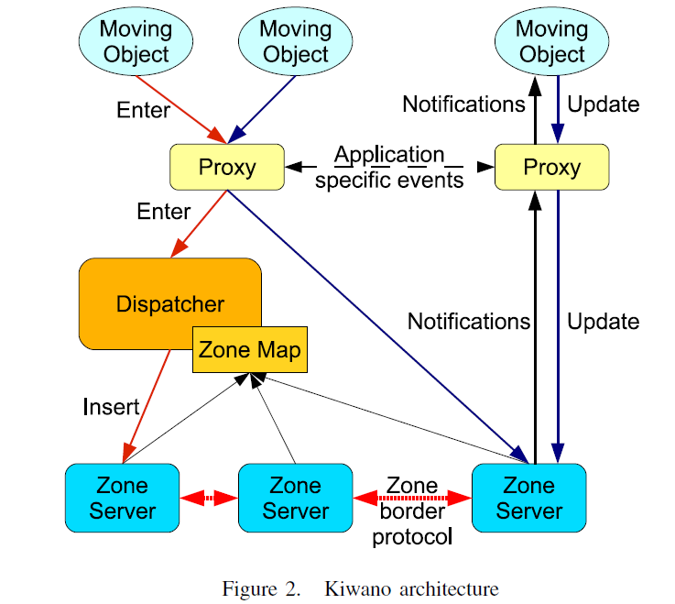
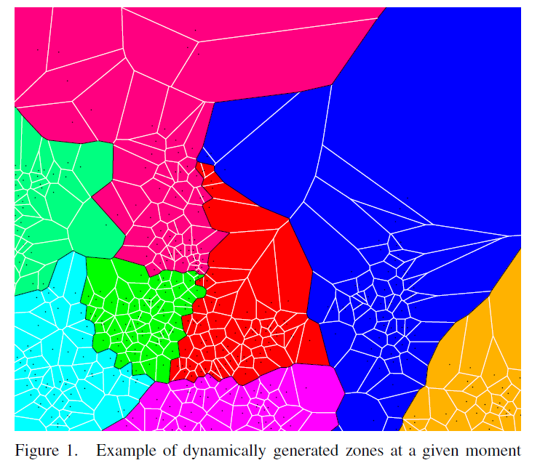
Kiwano
Split entities according to their geographical proximity
User distributed Delaunay triangulation
Provide API to hide the distributed nature from developer

Slide 20
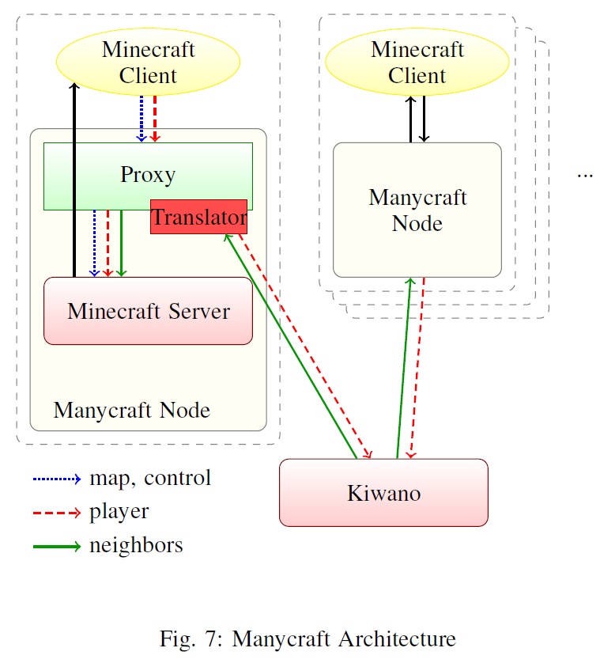
Architecture

Slide 21
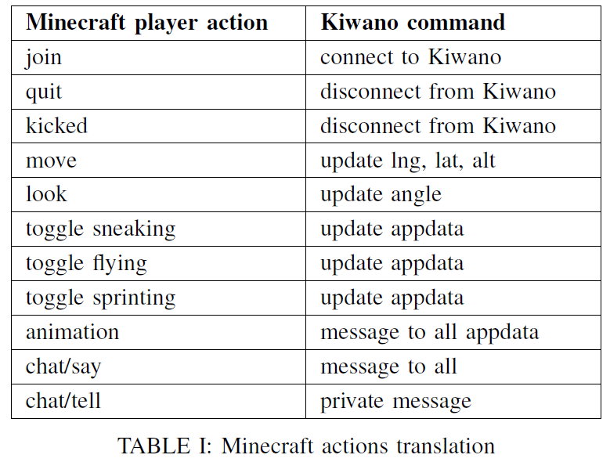
Bridging Minecraft to Kiwano
Other entities are all viewed as mobs
Including other players

Slide 22
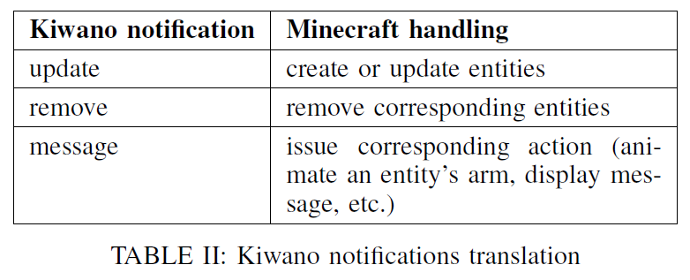
Bridging Minecraft to Kiwano(cont.)

Slide 23
Conclusion
Author claims that they support unlimited number of players
Assumption based on Kiwano
No evaluation is given
No evaluation on extra overhead caused by Kiwano
No overall system evaluation
Neither in the Kiwano paper
Fun to read

