Slide 1
Implementation and Validation of Multimedia
Broadcast Multicast Service for LTE/LTE-Advanced in OpenAirInterface Platform
Ngoc-Duy Nguyen, Raymond Knopp, Navid Nikaein, Christian Bonnet
Department of Mobile Communications
EURECOM
Sophia Antipolis, France
In Proc. of IEEE International Workshop on Performance and Management of Wireless and Mobile Networks, 2013

Slide 2
Motivation
Higher multimedia capabilities together with the deployment of high capacity mobile network have made an immense growth in user data traffic especially multimedia content
Thanks to the inherent benefits of OFDM and Single Frequency Network technologies, eMBMS in LTE can provide better services than MBMS did in 3G network.

Slide 3
Issues of Related Work
Some researches have used WCDMA as air-interface technology rather than OFDMA that is used in current cellular networks
most of them used regular simulation tools which have abstraction in some crucial parts of the network stack that can hide important issues
more realistic performance evaluation and be able to implemented in a real system is in need

Slide 4
eMBMS overviews
Still in the state of standardization until 2013
From 3GPP specification Rel-9, together with the appearance of LTE, MBMS over SFN was included in E-UTRAN under the name of Evolved MBMS (eMBMS).

Slide 5
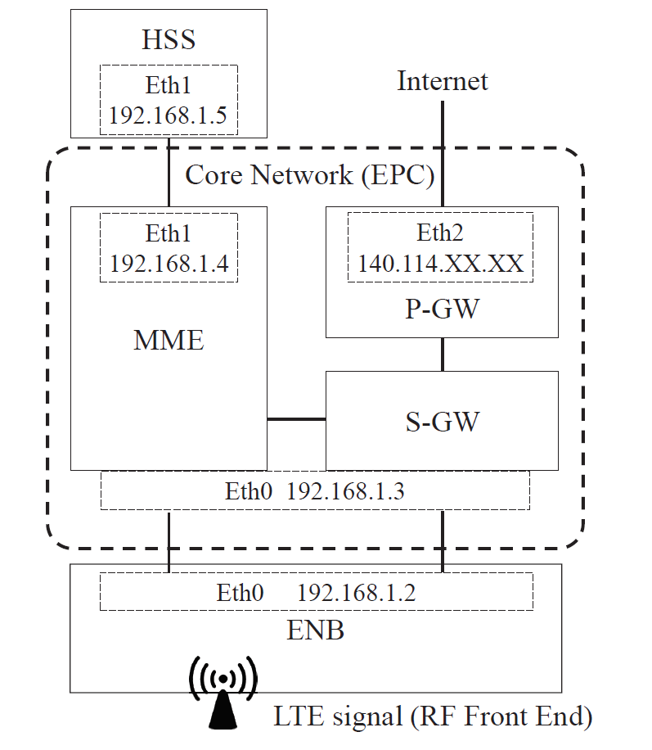
Network Architecture of LTE

Slide 6
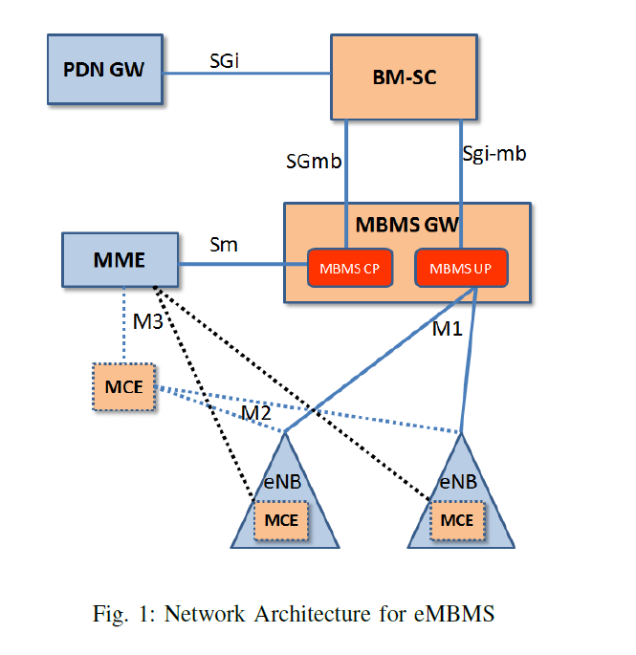

Slide 7
Broadcast Multicast Service Center
Broadcast Multicast Service Center (BM-SC): entity that connects the Content Provider and the Evolved Packet Core (EPC).
Plays the role of traffic shaper and authorizing content provider/terminal request
In charge of SYNC protocol to synchronize transmitted data among eNBs
  SYNC protocol associates a specific header to IP packets, providing Time Stamps and session information.

Slide 8
eMBMS Gateway
located between BMSC and all eNBs
Deliver MBMS user data packets to eNBs by means of IP Multicast
When an MBMS session arrives, it allocates IP multicast address to which the eNB should join to receive MBMS data and maintains the IP Multicast group
Performs MBMS Session control Signaling (Session Start/Stop) toward EUTRAN

Slide 9
Multi-cell Coordination Entity (MCE)
Doing admission control and allocation of the radio resource using for MBSFN operation.
Distributed MCE architecture: MCE is either part of eNB
Centralized MCE architecture: a stand-alone MCE

Slide 10
Interfaces
M1: user plane interface connecting eMBMS-GW and eNB
  IP multicast is used to deliver point-to-multipoint MBMS data packets over the M1 interface
M2: control plane interface locates between MCE and eNBs
  An Application Protocol (M2AP) is defined for this interface to convey at least radio configuration data for the multi-cell transmission mode eNBs and Session Control Signaling. (not exist in distributed MCE)
M3: connects MME and MCE
  MBMS session initiation and termination

Slide 11
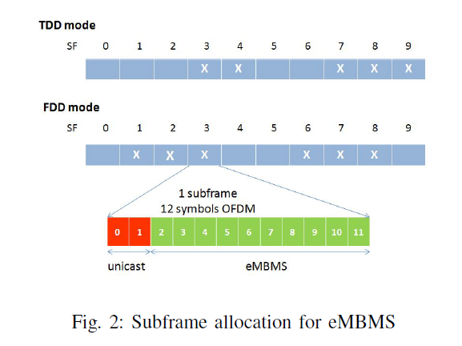
Resource Allocation for eMBMS
As specified in the standard, in one radio frame (10ms), there are up to 6 out of 10 subframes can be allocated to eMBMS services.

Slide 12
Resource Allocation for eMBMS Cont.
Through SIB13/MCCH, the terminal is informed about the position of subframes assigned to eMBMS (also called MBSFN subframes) in one radio frame
Inside one Multicast-Broadcast Single Frequency Network (MBSFN) subframe, 1 or 2 first symbols are reserved for the unicast transmission in physical downlink control channel (PDCCH), which are mainly used for the uplink scheduling grant purpose.

Slide 13
MBSFN area
Group of cells that are synchronized to transmit the same broadcast/multicast content in a geographical region
One or more services are provided in a certain MBSFN area
Services are classified into different groups base on their requirement in Quality of Service

Slide 14
Multicast Channel (MCH)
Transmit all services in one group using one modulation coding scheme
The exact position and number of subframes allocated for an MCH are provided periodically in Multicast Control CHannel (MCCH) message (control information message).

Slide 15
Resources Allocations Steps
Each service corresponds to a Multicast Traffic Channel (MTCH)
eNB multiplexes these MTCHs at MAC layer
Scheduling information is provided repeatedly in a MAC control element called MCH Scheduling Information (MSI)
The MSI is transmitted at the beginning of an MCH

Slide 16
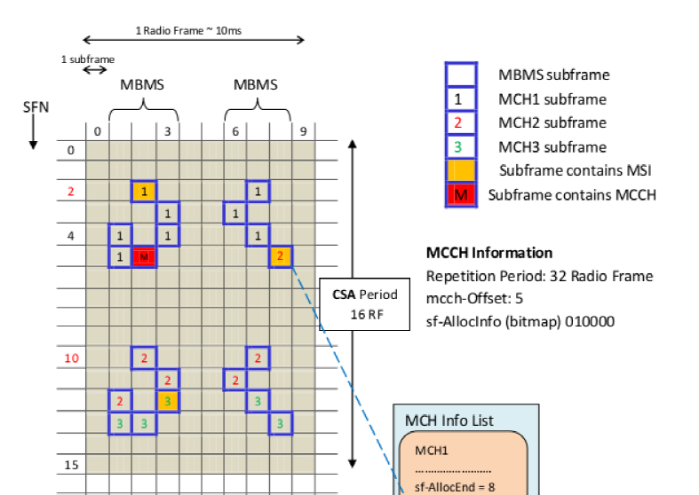
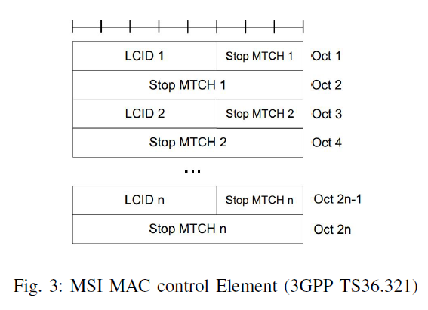

Slide 17
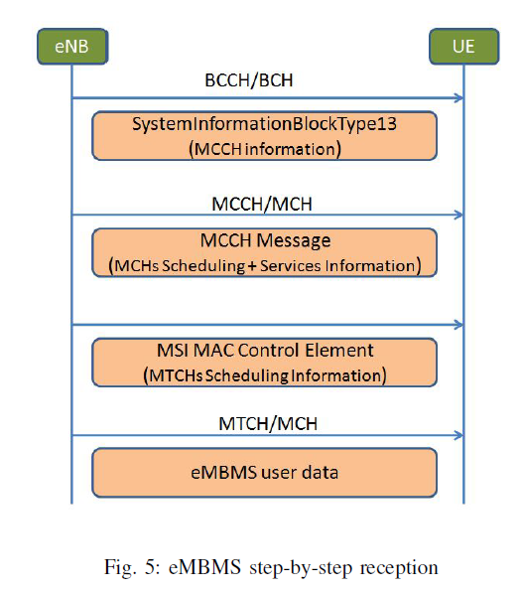
Service Reception in eMBMS
The position (which frame, subframe) and configuration (repeated period, mcs) of MCCH message are conveyed in SIB13.

Slide 18
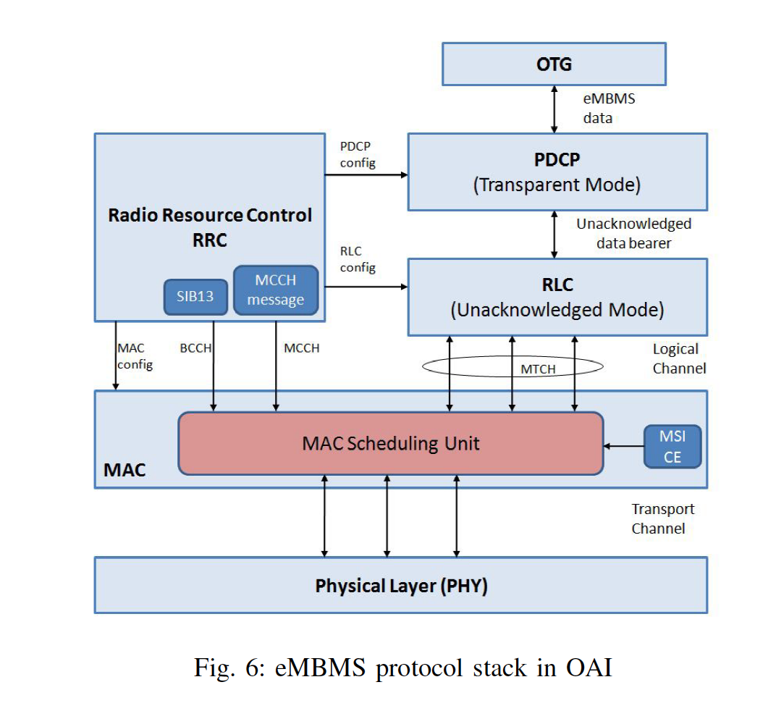
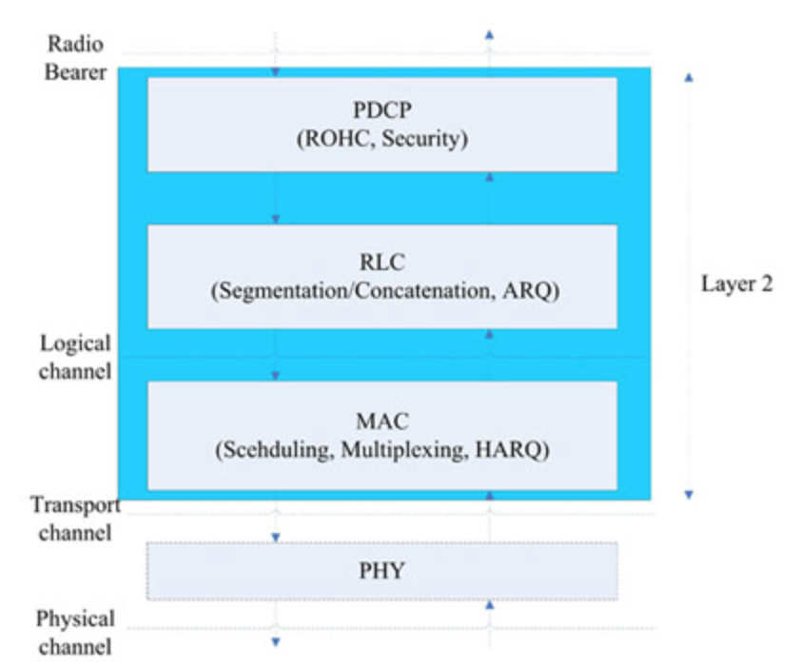

Slide 19
Implementation of eMBMS in OAI - RRC
distributed MCE where the MCE resides at eNB (the actual design choice depends on the operators’ requirements and type of network deployment)
Specified system information SIB13 and MCCH message are generated at Radio Resource Control unit in eNB side
Another task of RRC is configuring the data bearers for eMBMS services at Packet Data Convergence Protocol and Radio Link Control using the parameters given in SIB13 and MCCH message

Slide 20
Data plane
fully implement the protocol stack for eMBMS user data according to the standard at layer 2 including PDCP, RLC and MAC sublayer
Packet Data Convergence Protocol (PDCP) is not used when eMBMS service is broadcasted in the E-UTRAN, therefore, PDCP in OAI operates in transparent mode.

Slide 21
Radio Link Control
eMBMS uses the Unacknowledged Mode (UM) and one RLC-UM instant is created for one data bearer (or an eMBMS service).
Segmenting the received Service Data Units into smaller packets
Add RLC header in these packets and then send them to MAC via MTCH logical channels
The inverse procedure is applied in receiver side to reassemble these segments.

Slide 22
Mac Layer
the MCCH and MTCHs will be mapped onto different MCHs at this sublayer.
one or more MSI control elements are periodically created for each MCH channel.
MAC will create the control element MSI or get the MCCH control information and MTCH user data from RRC and RLC, respectively
MAC header is generated and added to the Service Data Unit (SDU) to complete the Protocol Data Unit and send it to PHY through MCH transport channel

Slide 23
PHY Layer
At physical layer, most of PHY procedures for eMBMs are the same with those for unicast downlink transmission.

Slide 24
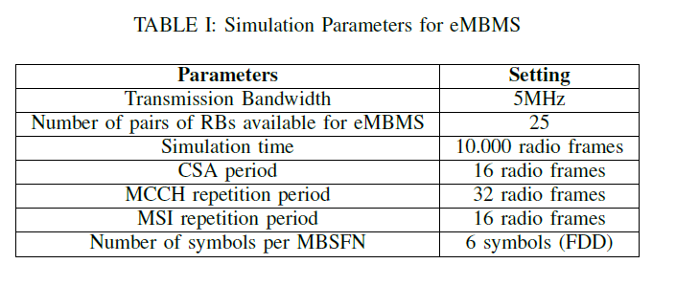
Simulation result
The hardware platform is a laptop equipped with an Intel core i7 CPU running OAI emulator and protocol stack using Linux on Ubuntu 12.04.
OpenAirInterface Traffic Generator (OTG) : a realistic packet-level traffic generation tool for emerging application scenarios.

Slide 25
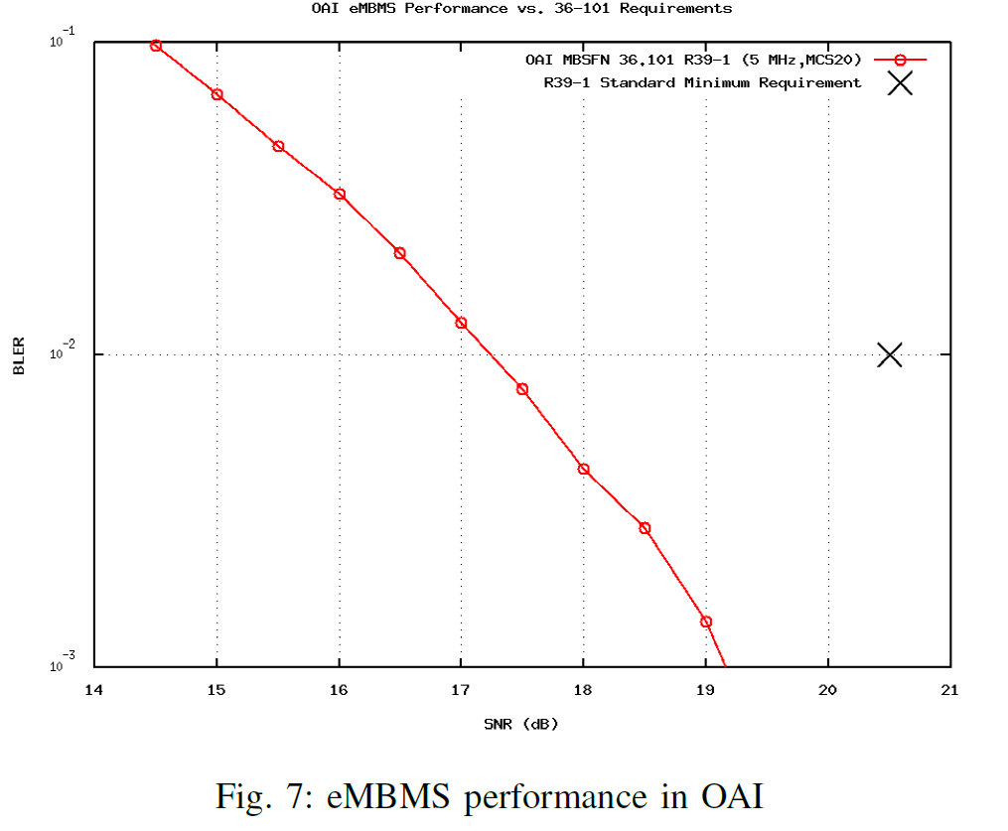
Block Error Rate
According to 3GPP standard , the minimum requirement for eMBMS transmission’s BLER in both FDD and TDD configuration is 1% at SNR=20.5(dB) with the R.39-1

Slide 26
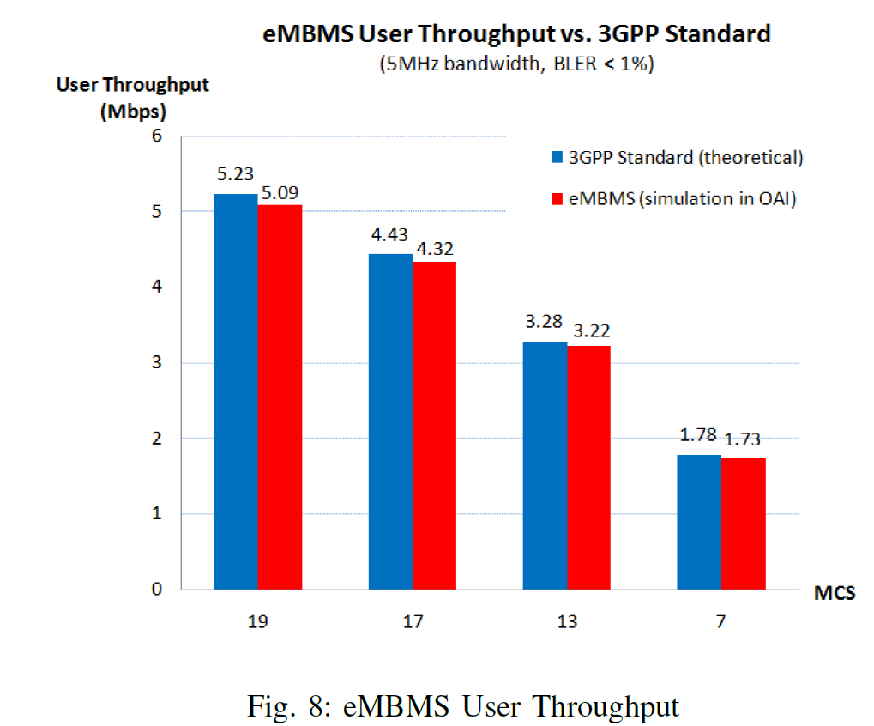

Slide 27
Conclusion
the implementation of eMBMS in LTE network based on release 10 of 3GPP standard on our real-time OAI platform
The BLER result better than the minimum requirement about 3dB
Future works
The mobility management for eMBMS or the service continuity in mobile, heterogeneous environment should be investigated as well.
Although eMBMS in OAI works with TDD frame configuration only in mode 3 at this moment

Slide 28
Progress
New USIM cards are arrived and tested.
Study the GTPU and GTPC protocols and the corresponding implementations in OAI.
Study kernel module code, GTPUSP
Todo:
Study and check the network protocols in OAI
Study eMBMS in OAI source code

