Slide 1
Jetway: Minimizing Costs on Inter-Datacenter Video Traffic
Yuan Feng, Baochun Li
Department of Electrical and Computer
Engineering
Bo Li
Department of Computer Science
Hong Kong University of Science and
Technology
ACM MM’ 12

Slide 2
Background
Cloud providers
HD videos real time streaming
CDN services

Slide 3
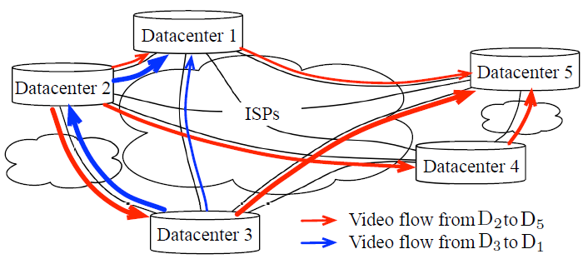
Introduction
Cloud providers rely on multiple ISPs to connect their geographically dispersed datacenters
How to minimize costs on inter-datacenter traffic?

Slide 4
Charging Model
q-th percentile charging model
Predominantly used by ISPs today
Sort charging volumes in descending order
Pick the first q-th percentile one as charging volume
Ex: 100-th percentile: pick the largest one
How to assign data flow?

Slide 5
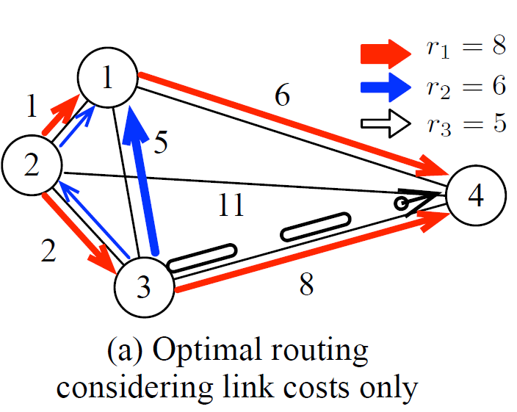
Challenge
Time slot 1: r1, r2
Time slot 2: r3
Each link capacity: 5
R1
D2->D1->D4: 4
D2->D3->D4: 4
R2
D3->D1: 5
D3->D2->D1: 1
R3
D3->D4: 5

Slide 6
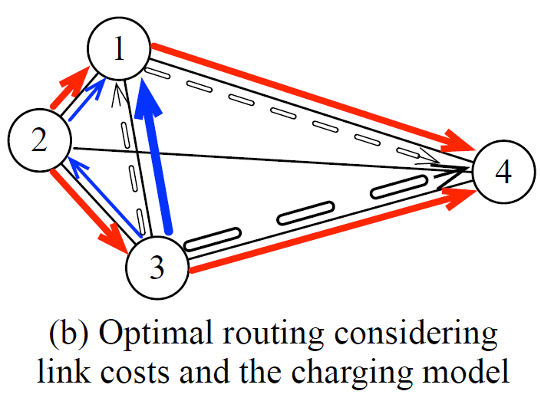
Challenge (cont.)
Time slot 1: r1, r2
Time slot 2: r3
Each link capacity: 5
R1
D2->D1->D4: 4
D2->D3->D4: 4
R2
D3->D1: 5
D3->D2->D1: 1
R3
D3->D4: 5
D3->D1->D4: 1
D3->D4: 4

Slide 7
Formulating problem
Cost on one charging period
Amount of flow assigned on link {i, j}
Transmission rate of video flow k

Slide 8
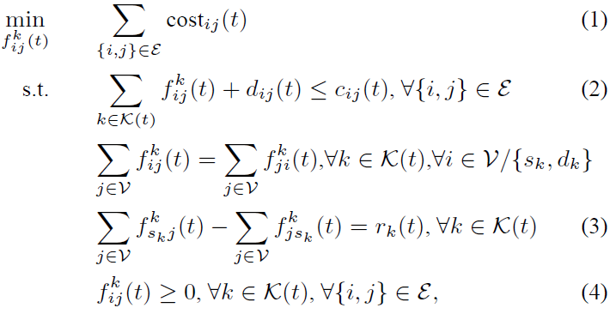
Formulating problem (cont.)

Slide 9
Formulating problem (cont.)
100-th percentile charging model
Cost function on interval t
Which is equivalent to

Slide 10
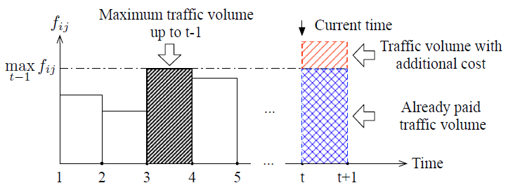
Formulating problem (cont.)
The optimization problem is equivalent to
But we need to utilize the already paid traffic volume as much as possible

Slide 11
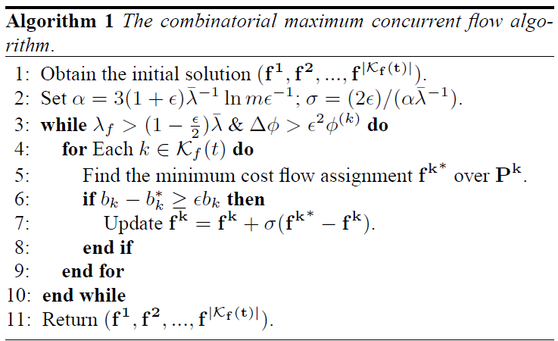
Fully utilizing already paid
Disperse the congestion of flows

Slide 12
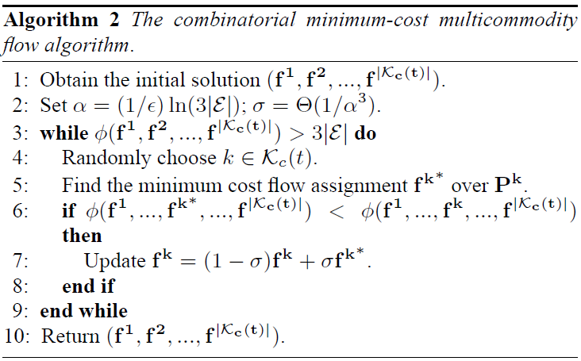
Minimize additional cost
Try to minimize cost on each flow

Slide 13
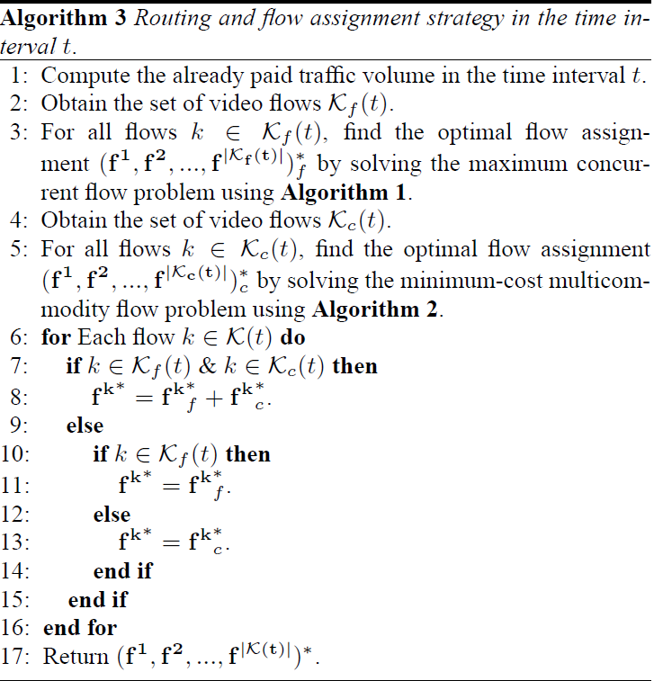
Jetway

Slide 14
q-th percentile
q * Ith value

Slide 15
Evaluation
Implementation
Experiments in the Amazon EC2
Simulation

Slide 16
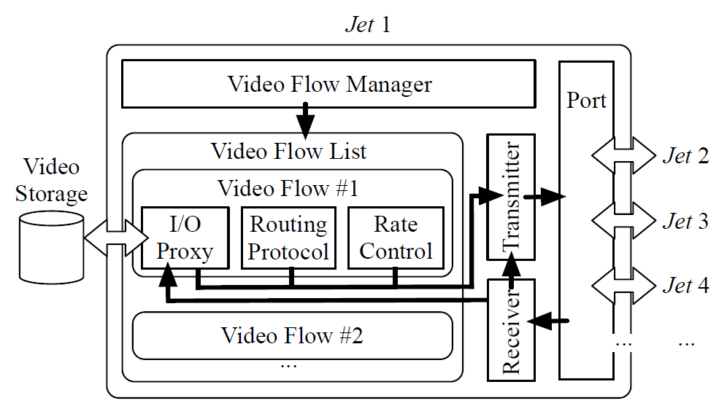
Implementation
C++
Actual video traffic
Paths: single-hop, multi-hop

Slide 17
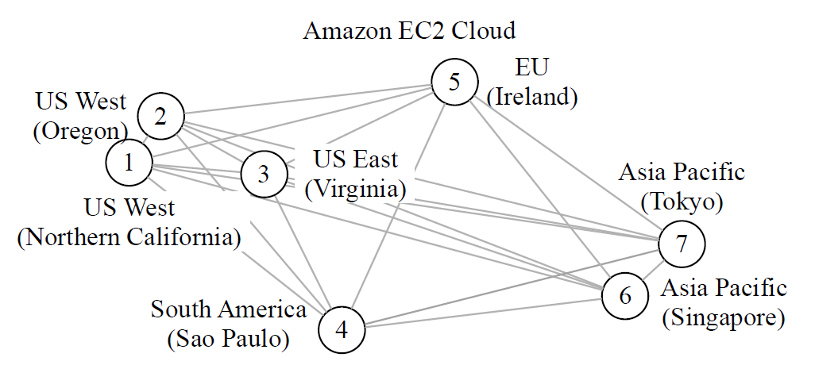
Experiments
Amazon EC2 Cloud
7 standard on-demand medium instances
2 compute unit
1.7 GB memory
Self defined capacities and costs

Slide 18
Experiments (cont.)
Videos
3 SD between [500, 800] MB
7 HD between [2, 4] GB
Transmission rate [2.22, 17.78] Mbps
Source and destination random selected from all datacenters

Slide 19
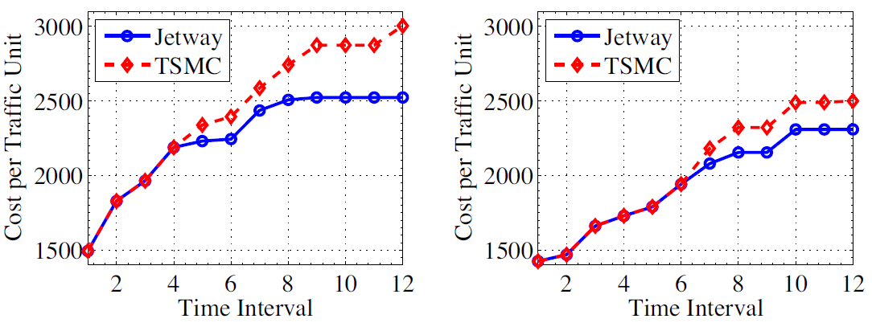
Experiment result
Time slotted minimum cost algorithm (TSMC)
Algorithm 2

Slide 20
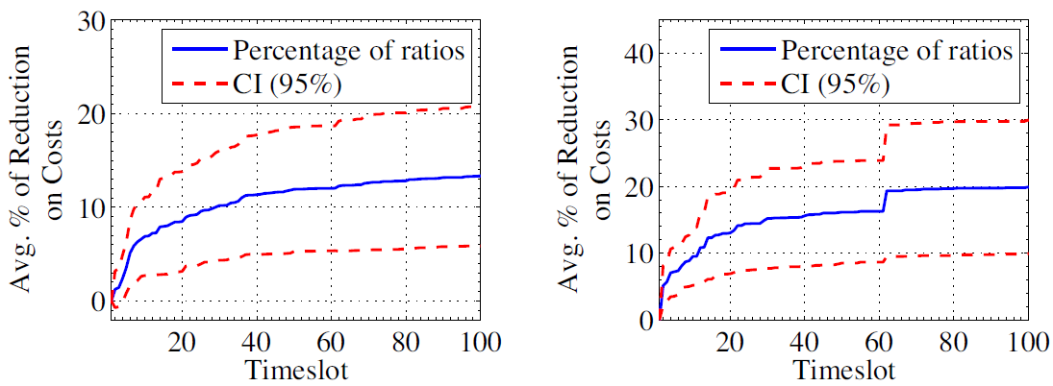
Simulation result
20 datacenters
Run 20 times
100th-percentile v.s. 95th-percentile

Slide 21
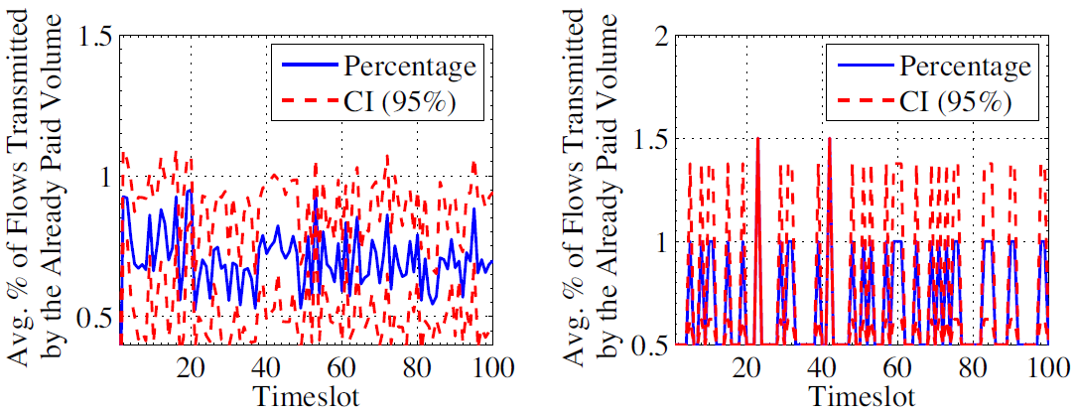
Simulation result (cont.)
100th-percentile v.s. 95th-percentile

Slide 22
Conclusion
Some of traffic volumes can be transferred for free
Minimize costs on inter-datacenter video traffic

