Slide 1
Exploiting Just-Noticeable Difference of Delays for
Improving Quality of Experience in Video Conferencing
Jingxi Xu and Benjamin W. Wah
Dept. of Computer Science and Engineering
The Chinese University of Hong Kong
Statin, Hong Kong
jxxu@cse.cuhk.edu.hk,
bwah@cuhk.edu.hk

Slide 2
Introduction
The quality of a video conferencing system is often measured by its quality of experience (QoE)
  network loss rate, traffic jitter, link delay, conversational condition, and loss concealment mechanisms in the codec
To achieve good QoE in a video conferencing system under given network and conversational conditions
  Compare in a relative sense the perceptual quality of two operating points and to identify whether one is better than or indistinguishable from another
  Entails tradeoffs among the objective metrics

Slide 3
Introduction(cont.)
In comparing operating points of existing systems, Some overly emphasize interactivity without sufficient attention to signal quality
  the MED(mouth-to-ear delay) is not sufficient to cover the network delay as well as the buffering time to smooth delay jitters and to recover lost packets
Without proper trade-offs between signal quality and interactivity, the overall QoE will be low
  Signal quality can be significantly improved if MED is slightly extended
  Just Noticeable Difference(JND)
  the maximum MED

Slide 4
Introduction(cont.)
Problem statement
  study the JND in video conferencing under various network and conversational conditions
  use it to guide the improvement in QoE of the default operating point of existing video-conferencing systems
Approach
  Use JND to help improve QoE in video conferencing under various network
  Study the current Internet conditions from a large set of network traces and investigate when the increase in MED can help mitigate network losses and jitters

Slide 5
Introduction(cont.)
Contributions
  A study of network conditions in the Internet with respect to buffering delays and packet sending rates
  The properties of JND in video conferencing under various network and conversational conditions
  The improvement of existing proprietary video conferencing systems, without knowing their operating parameters.

Slide 6
Problem Illustration
Video Quality Metric (VQM)
  One-way video quality
  Higher correlation to the subjective mean opinion score(MOS) than traditional signal quality metrics(ex.PSNR)
  [0.0, 1.0] (the smaller the better)
Perceptual Evaluation of Speech Quality (PESQ)
  One-way audio quality
  High correlation to perceptual MOS
  [−0.5, 4.5] (the larger the better)

Slide 7
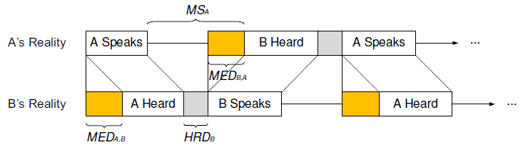


Problem Illustration(cont.)
Interactivity is an important quality metric in video conferencing
  MED, conversational symmetry (CS), conversational efficiency (CE)

Slide 8
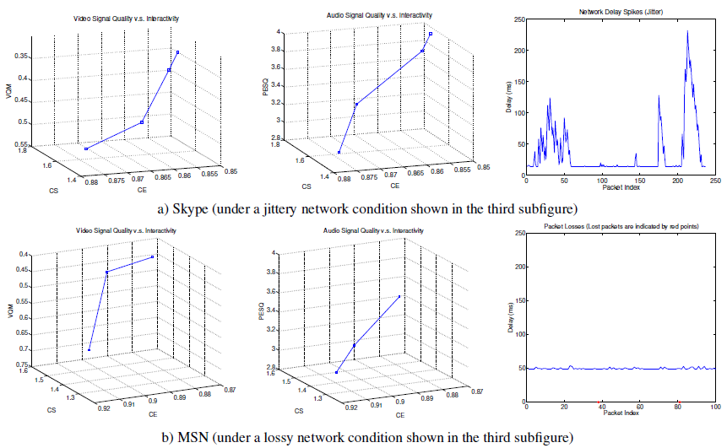
Problem Illustration(cont.)

Slide 9
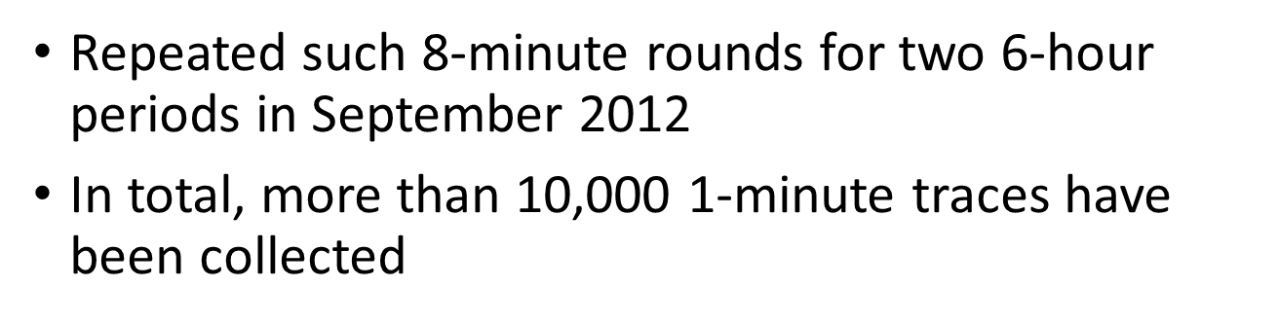
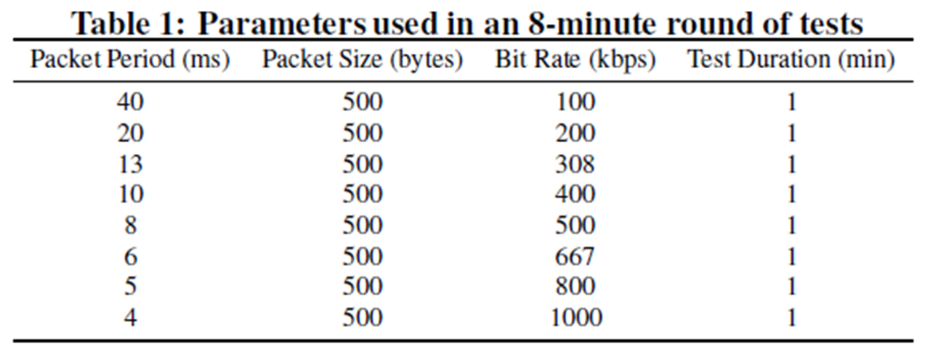
Traffic Measurements in the PlanetLab
Randomly select a pair of nodes from a set of 180 nodes and collected a set of traces from 46 different links
Collected 1-minute network traces with sending bit rates ranging from 100 kbps to 1000 kbps

Slide 10
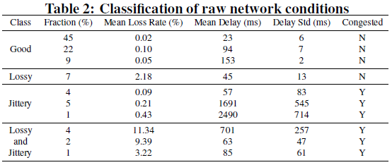
Traffic Measurements in the PlanetLab(cont.)
K-Means algorithm
Manually merge the clusters into 4 classes of network conditions according to their loss rate, delay, jitter and whether there is significant congestion when bit rate is increased

Slide 11
Traffic Measurements in the PlanetLab(cont.)
Loss rate, delay and jitter
  Monotonically non-decreasing with increasing sending rate(hypothesis test)
A large proportion of links where reducing the traffic rate does not affect the average loss rate and jitters

Slide 12

Concealing Impairments by Buffering
Define UPR in the receiver as the ratio of unavailable packets within the MED
  Packets arriving later than the prescribed MED
  packets that cannot be recovered after performing FEC using those packets received in time

Slide 13
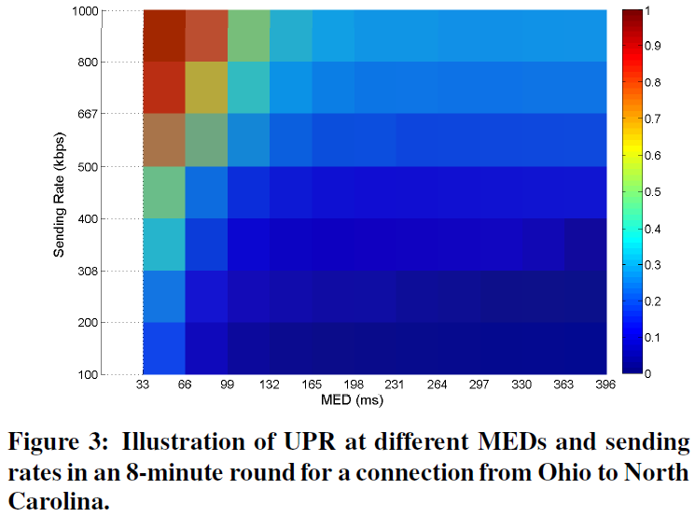
Concealing Impairments by Buffering(cont.)

Slide 14
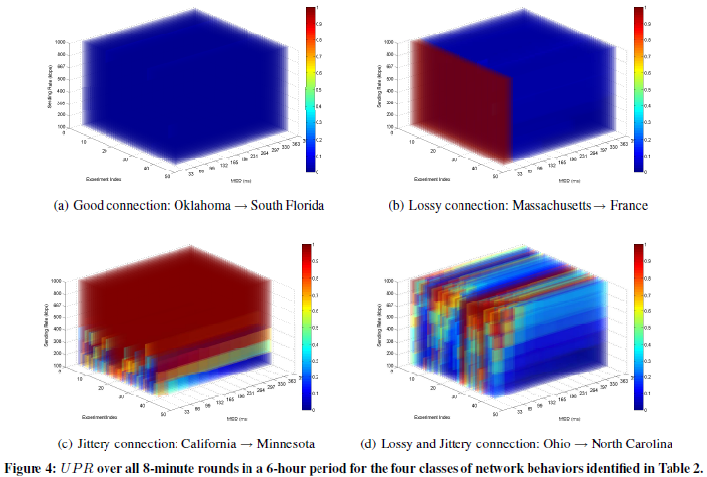
Concealing Impairments by Buffering(cont.)

Slide 15
Concealing Impairments by Buffering(cont.)
Increasing MED
  Reduce UPR and provides significant improvements even with a small increase
  Will not change the network behavior and is applicable under any network condition
Rate control
  help reduce UPR under certain conditions
  In non-congested links, the average loss rate and delay jitter do not change much when the sending rate is reduced → not help improve congestion

Slide 16
Concealing Impairments by Buffering(cont.)
Propose to increase MED as the method for reducing UPR in existing video conferencing systems
Increase MED in such a way that human cannot perceive the difference in interactivities
Signal quality will either be improved or remains the same → the overall QoE will be improved or remains the same

Slide 17
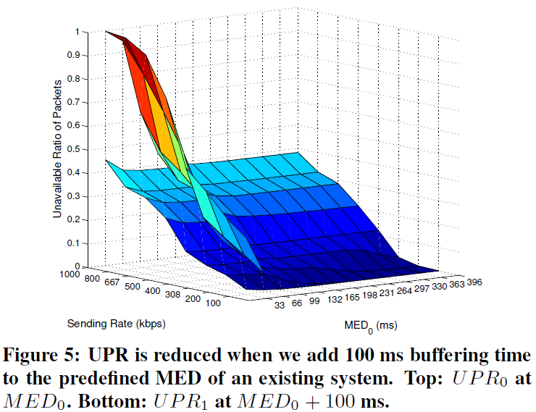
Concealing Impairments by Buffering(cont.)

Slide 18
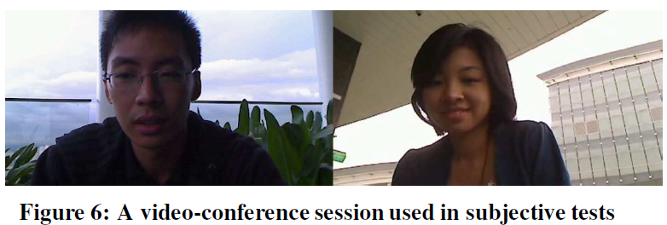
Comparative Subjective Tests
A two-way video conference session A is presented to a test subject, who is asked to compare to B(with a different MED)

Slide 19
Comparative Subjective Tests(cont.)
Assuming the MED in A is fixed, we increase the MED in B and ask the test subject to determine which of the two sessions has a longer MED
JND is the difference between the MED in A and the MED in B
Finding the JND of an existing system and use it to extend the system’s MED to within JND in order to conceal its losses, while not incurring significant perceptual difference in interactivities

Slide 20
Comparative Subjective Tests(cont.)
Following Sat and Wah’s definition on JND [32], let p₀ be the fraction of subjects who correctly identify which of the two sessions has a longer MED
Definition 1: The 75% JND of MED_{A} is the maximum |MED_{B} −MED_{A}| where p₀ ≤ 0.75
Definition 2: A is perceptually the same as B (MED_{B} ≈ MED_{A}) if MED_{B} is within the 75% JND region of MED_{A}

Slide 21
Comparative Subjective Tests(cont.)
Axiom 1. Reflectivity: The MED of any session is within its own JND region, since both are perceptually the same. This allows us to omit the comparison of a session with itself.
Axiom 2. Symmetry: ≈ is symmetric, since |MED_{B} − MED_{A}| = |MED_{B} − MED_{A}|. This allows the sessions to be presented in any order.
Axiom 3. IID: The subjects have the same level of expertise, and their ability to discover the difference in MED is independent and identically distributed (IID). This allows us to get the statistics of responses by repeated tests using multiple subjects

Slide 22
Comparative Subjective Tests(cont.)
Corollary 1. Non-transitivity: ≈ is not transitive. That is, A ≈ B and B ≈ C does not imply A ≈ C. Hence, it will be necessary to carry out all pairwise comparisons with respect to A in order to determine the JND of A
similar to Constant stimuli

Slide 23
Experimental Results
Increase MEDs every 34 ms in the [0, 136] ms interval on top of the original MEDs of 102 ms, 238 ms and 374 ms
Invited eight subjects to participate, and the entire set of tests took about 40 minutes for every subject
A test session with a longer MED
  Play the last few frames back and forth in real time (video)
  Insert silence during this period (audio)

Slide 24
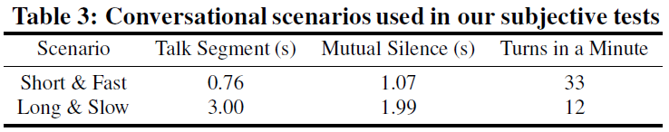
Experimental Results(cont.)
To answer the following questions
  Does JND change as MED is increased?
  Does JND change under losses and delay jitters?
  Does JND change with the type of conversation?

Slide 25
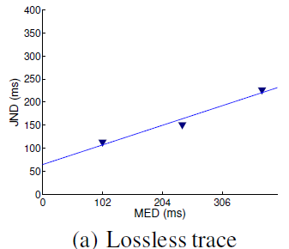
Experimental Results(cont.)
JND under lossless networks

Slide 26
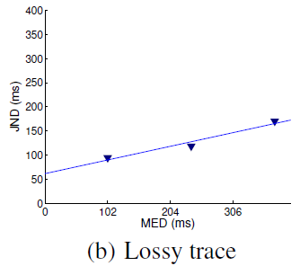
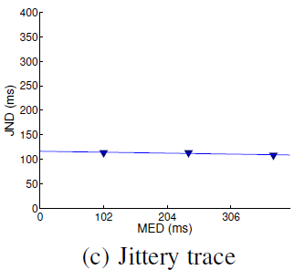
Experimental Results(cont.)
JND in lossy and jittery networks
4.3% random losses
31ms average delay jitters

Slide 27
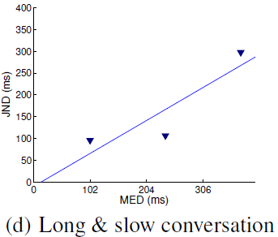
Experimental Results(cont.)
JND under a conversational scenario with a slow turn frequency

Slide 28
Experimental Results(cont.)
JND is reasonably large under various network and conversational conditions
By increasing MED to within JND, we can implement additional loss concealments for recovering lost or delayed packets, without affecting the interactivity of a conversation

Slide 29

Loss Concealments by Extending MED
A longer playout buffer can be used to smooth out jitters and recover lost packets
The probability for a packet arriving late
The probability that a packet is lost
The minimal buffering time for packets in an FEC block
The number of redundant packets that can be used in FEC

Slide 30
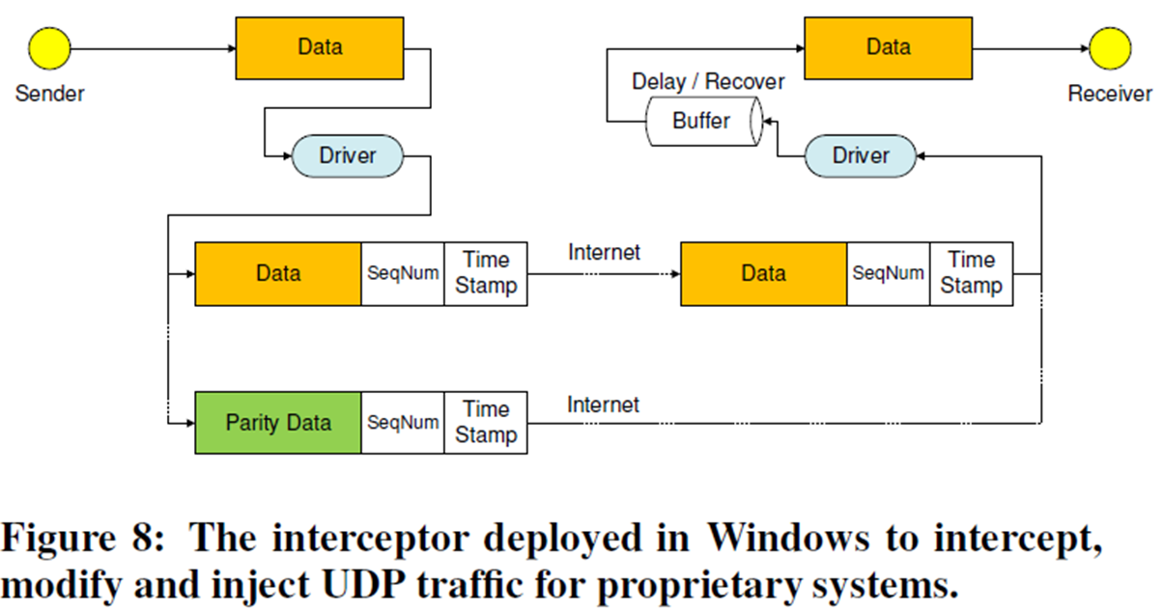
Design of a Packet Interceptor
Skype and MSN
Developed a kernel driver using the Windows Filtering Platform

Slide 31
RealTalk: A Testbed for Evaluating QoE in Proprietary Systems
Two Windows 7 machines serving as the video conferencing clients
The clocks of these machines are synchronized by Net Time Protocol (NTP)
An additional Linux machine serving as a network emulator is connected to the two clients, where Trace Control for Netem [24] was installed to emulate different network conditions using the traces collected.

Slide 32
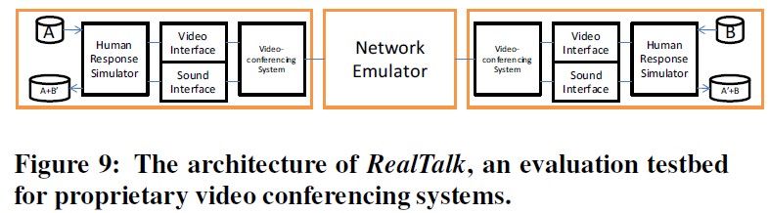
RealTalk: A Testbed for Evaluating QoE in Proprietary Systems(cont.)
Developed a virtual camera program with Microsoft DirectShow.
Audio is injected by Virtual Audio Cable

Slide 33
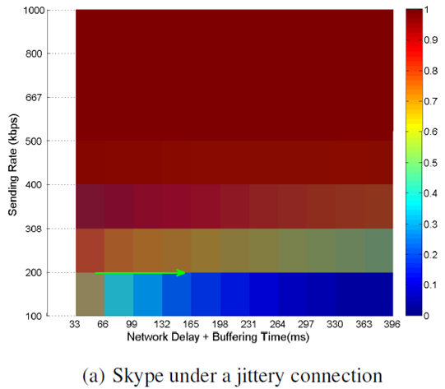
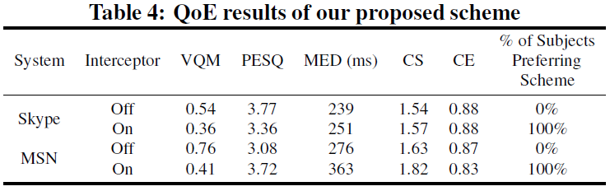
Experimental Results
Skype
  Performs poorly under a jittery connection
  Adds a 100-ms buffer to Skype to smooth its jitters
  VQM has improved by 33%, and audio quality is decreased slightly by 11%

Slide 34
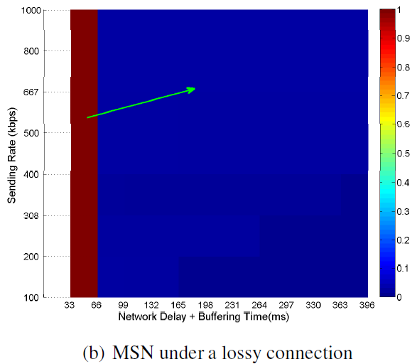
Experimental Results
MSN
  Performed poorly under lossy conditions
  Adds a 138-ms buffer to conceal those lost packets using FEC
  Video quality is improved by 46% and the audio quality is improved by 21%

Slide 35
Conclusions
Proposed a novel method for improving existing video conferencing systems by increasing MED
Future work
  Study trade-offs between improvements on signal quality and perceptible degradations on interactivity
  Study the run-time monitoring of network behaviors, which will allow JND to be determined dynamically in real time

