Slide 1
Streaming on Twitch: Fostering Participatory Communities of Play within Live Mixed Media
W. Hamilton, O. Garretson, A. Kerne
Interface Ecology Lab, Texas A&Muniversity
CHI’14

Slide 2
Outline
Intro & Contribution
Methodology
Sensitizing concepts
Findings & Discussions
Implication for Design
Related Work
Conclusion

Slide 3
Intro & contribution

Slide 4
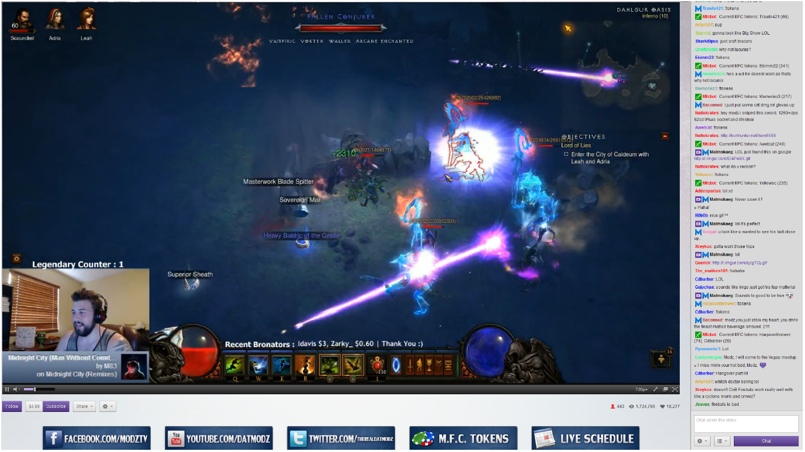
Twitch Stream

Slide 5
Intro
Live game streaming is a popular new medium
  Mix of different media
  Study the participatory community
  Two main motivation
    Unique content
    Interaction and participation in the community
Still problems in the current platform
  As the stream scales up, information overload the streamer and viewer
  The sense of participating collapse

Slide 6
Contribution
An ethnographic investigation of the live game streaming on Twitch
  Describe how communities form
  Motivation of members
  Emergent issues
Implications for design to cope the issue

Slide 7
Methodology

Slide 8
Methodology
Participate streams starting from early 2010
Interviewed 11 streamers and 4 viewers
  3 of the viewers are moderator
Use grounded theory analysis
  A common technique used in Sociology

Slide 9
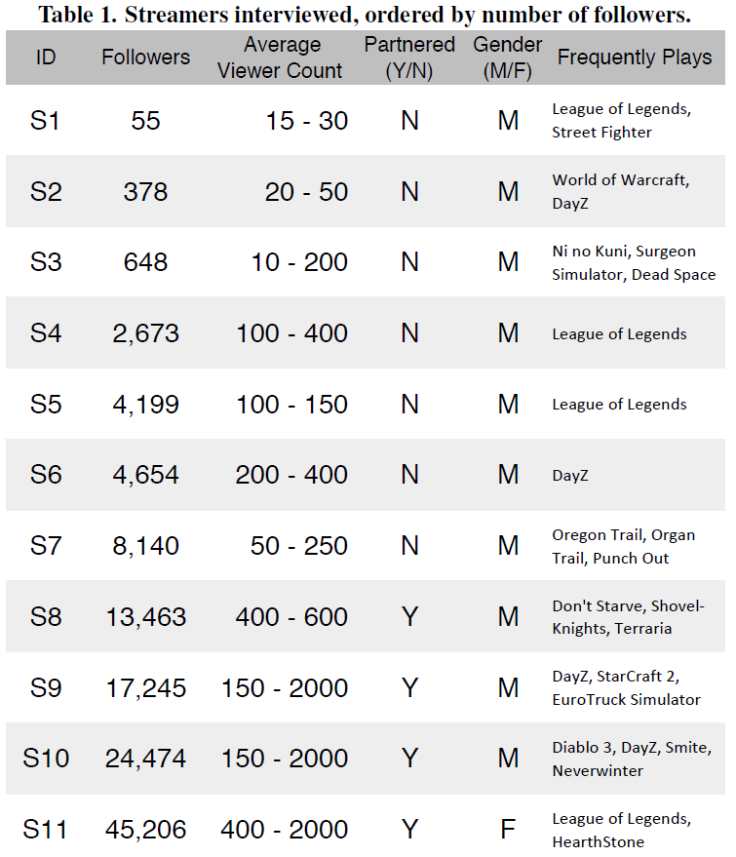
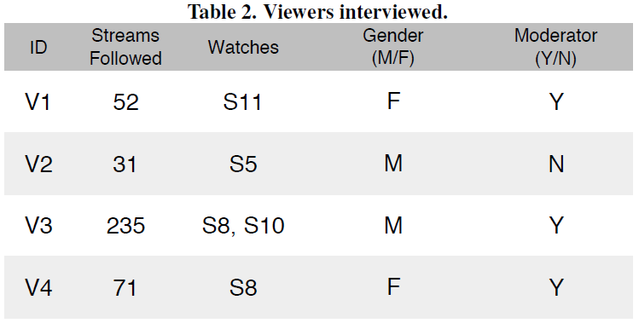
Interviewed Streamer and Viewer

Slide 10
Sensitizing Concept
Third places
Sense of Community
Hot & Cool Media

Slide 11
Third places
Realms other than home and work
Host the regular, voluntary, informal and happily anticipated gathering individual
From and maintain community through informal public social interactions
Conversation is the main activity
Regulars strongly define the place

Slide 12
Sense of Community - Four component
Membership
  Developed through personal investment
Influence
  Participants are attracted to groups they can impact
Fulfillment of needs
  Emotional reward such as sociability
Emotional connection
  Through shared history and identification with other members

Slide 13
Hot & Cool Media
Hot media afford spectating
Cool media afford participation

Slide 14
Mix of Hot & Cool
Streaming is a mix of hot and cool media

Slide 15
Mix of Hot & Cool
Streaming is a mix of hot and cool media

Slide 16
Mix of Hot & Cool
Streaming is a mix of hot and cool media

Slide 17
Finding & Discussion
Identification with Content, Streamer and Community
The importance of interaction and influence
Becoming a Regular
Regulars encouraging participation and sociability
Shared History through Hot & Cool Media
Big streams and the breakdown of participation

Slide 18
Identification
Content
  Want to learn something about a particular game
Streamer & Community
  Streamer attract similar crowd
  Friendliness and congeniality

Slide 19
Interaction and Influence
Interaction
  Many people watch streams for social interaction
  Many streamers stream because they want to build community
Influence
  People are drawn to communities they can influence
  Streamers also make effort to give participants chance to influence the stream
    Polls, fan art display…etc.

Slide 20
Shared History
Very important in the formation of community
Witness something surprising
Two part
  Witness something surprising – hot
  Chat goes crazy – cool
A mix of both type of media

Slide 21
Breakdown of Participation
Smaller stream
  Focus on participation
Massive stream (over 1000 viewers)
  Focus on unique content
  Chat can not be recognized
  Ruinous in third places perspective
Max number of viewers to interact effectively
  Average: 100 ~ 150
  Max: 500

Slide 22
Implication for Design

Slide 23
Subdivision
Prevent information overload
Preserve meaningful interaction
Putting audience into socially viable subgroups
Do not give any detailed suggestion on the implementation of the system

Slide 24
Related Work

Slide 25
Related Work
IRC communities and info overload
  IRC can support around 300 concurrent users
Participation in online game communities
  Two difference
  Viewer lack agency in the game world
  Accessibility is lower
eSports and live streaming

Slide 26
conclusion

Slide 27
Conclusion
Provides an ethnographic investigation
Propose subdivision to preserve meaningful participation
The mixed media concept can help TV shows/sport and MOOC education

