Slide 1
Location-based Crowdsourcing: Extending Crowdsourcing to the Real World
F. Alt, A . Shirazi, A. Schmidt, U. Kramer, Z. Nawaz
University of Duisburg-Essen
NordiCHI '10 Proceedings of the 6th Nordic
Conference on Human-Computer Interaction:
Extending Boundaries

Slide 2


Introduction
World Wide Web
  Wikipedia
  OpenStreetMap

Slide 3
Idea
Extend crowdsourcing by combining
  User-generated content
  Web-based crowdsourcing
  Mobile electronic coordination
The author studied about user behavior in mobile crowdsourcing system.

Slide 4
User-Generated Content
Explicit content generation
  Wikipedia
  Product reviews
  Experience reports
Implicit content generation
  Most popular articles
  Track user location

Slide 5


Related Work - WWW
Labeling Images game.
Amazon’s Mechanical Truk
iStockPhoto
Threadsless
Natural language processing, summarization and translation

Slide 6

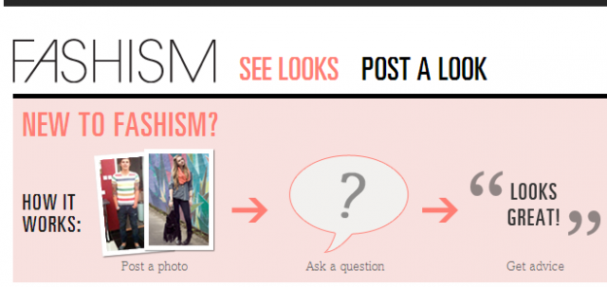

Related Work - Mobile
Txteagle
Fashism
Google Map

Slide 7
Crowdsourcing Scenarios
Recommendation on demand
Recording on demand
Remotely looking around
Real-time weather information
Translations on demand

Slide 8
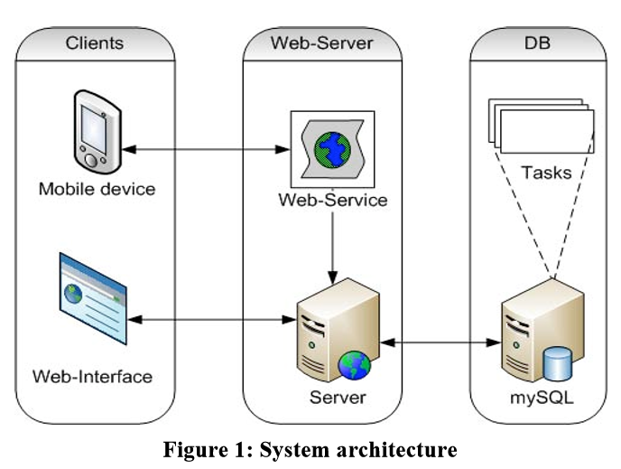
Platform
Web interface
Server
Client application

Slide 9
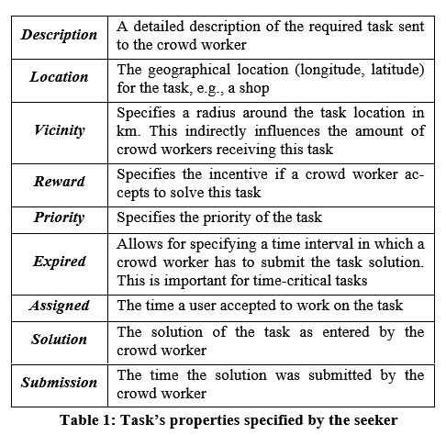
Task Data

Slide 10
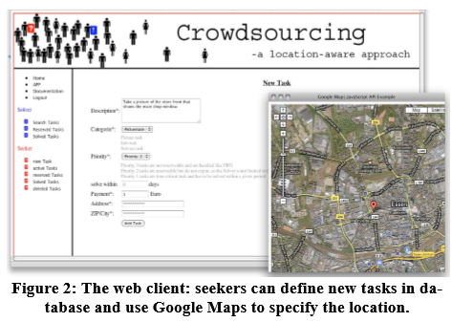
Web

Slide 11
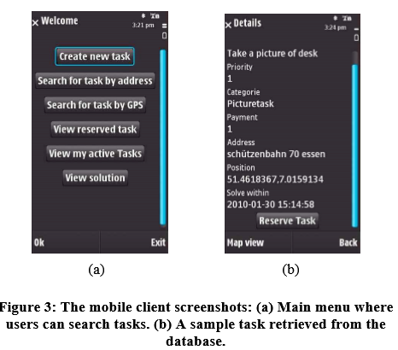
Mobile App

Slide 12
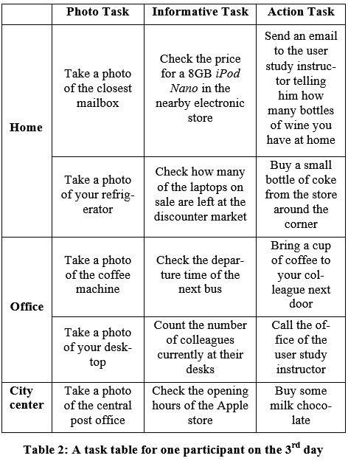
User Sturdy
9 + 9 volunteers

Slide 13
Result
Users prefer address-base task selection
Picture tasks are most popular
Tasks were mainly solved at or close to home
Tasks are solved after work
Response time vary

Slide 14
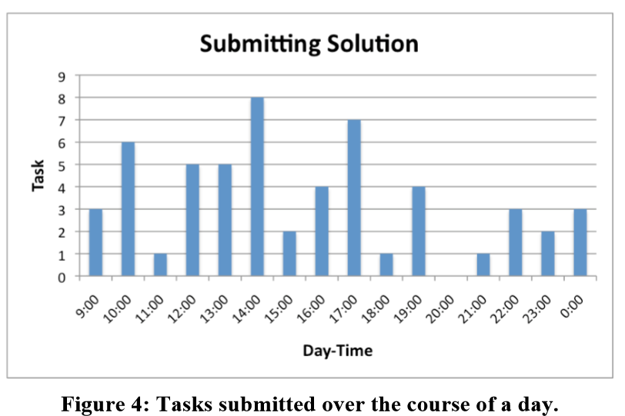
Feedback
Solving a task can take up to one day
Tasks are still solved after work
Midday breaks are good times to search for task

Slide 15
Feedback
Informative tasks are as popular as Picture task
Time-critical tasks are out of interest
Solution should be achievable in 10 minutes
Home and surrounding areas are the most favorite places for solving tasks
Voluntary tasks have lower chance
Users search for tasks in their current location

Slide 16
Challenges
Users prefer to retrieve tasks by themselves
Provide means for easily choosing the task location
Provide means for specifying priorities
Minimal effort for the crowd worker
Privacy

Slide 17
Features
Enhance our applications with video and audio features
“Targeting” tasks might increase the potential of crowdsourcing if the client application is able to learn
Plan to explore how the crowdsourcing application impacts on the uptake and the user behavior among communities

