Slide 1
A Detour Planning Algorithm in Crowdsourcing Systems for Multimedia Content Gathering & SAIS: Smartphone Augmented Infrastructure Sensing for Public Safety and Sustainability in Smart Cities
Chen-Chih Liao, Cheng-Hsin Hsu
&
Chen-Chih Liao, Ting-Fang Hou, Ting-Yi Lin, Yi-Jun Cheng, Aiman Erbad, Cheng-Hsin Hsu, and Nalini Venkatasubramanian

Slide 2
Introduction
The popularity of smartphones changes the landscape of sensing systems.
Crowdsourcing system for serious applications of multimedia content gathering.

Slide 3
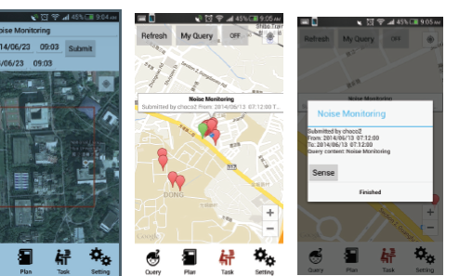
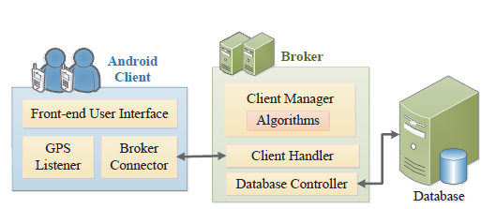
System
Server
Requesters
Worker

Slide 4
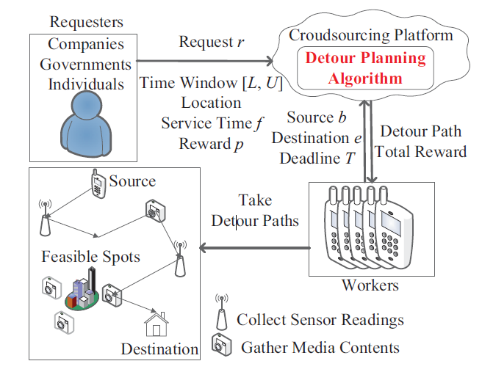
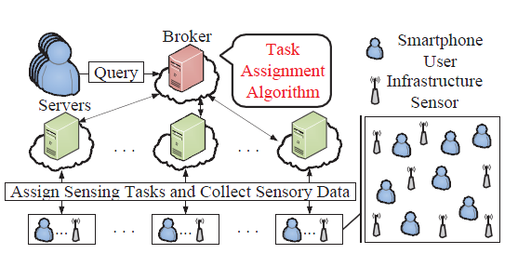
Problem
SAIS: solve task assignment problem
Detour Planning Algorithm generates a detour path for each other.

Slide 5
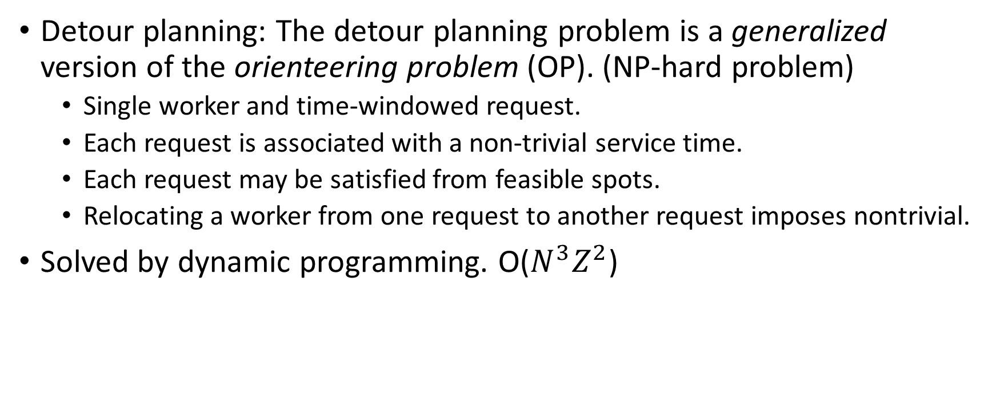
Hardness
Detour planning: The detour planning problem is a generalized version of the orienteering problem (OP). (NP-hard problem)
Single worker and time-windowed request.
Each request is associated with a non-trivial service time.
Each request may be satisfied from feasible spots.
Relocating a worker from one request to another request imposes nontrivial.
Solved by dynamic programming. O($N^{3}Z^{2}$)

Slide 6
Hardness
SAIS: maximize the utilization of the sensing energy and moving energy.
Optimal algorithm using CPLEX and the cycle elimination technique.
But it take too much time to compute.
Efficient Task Assignment Algorithm.
Compute energy utilization.
Check energy budget.
Loop until no query or low energy.

Slide 7
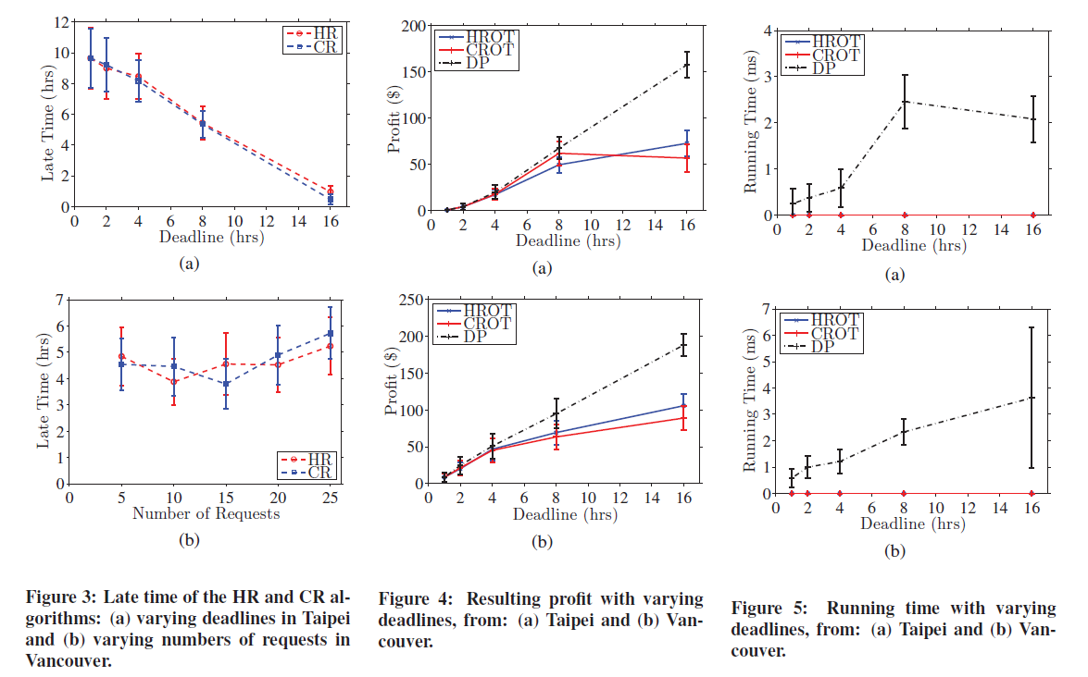
Evaluation

Slide 8
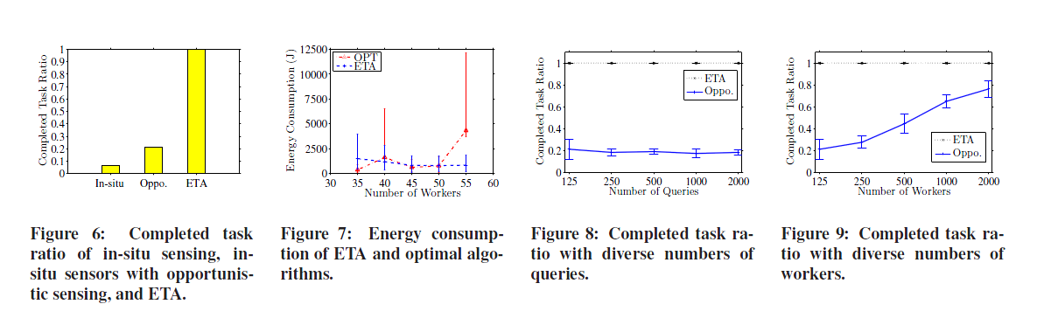
Evaluation

Slide 9
Conclusions
Detour Planning algorithm
Runs fast and terminates in 82ms.
Scale to large problems with up to 162 feasible spots.
ETA algorithm
Results in up 6 times of responding time reduction.
Performs better with more workers.

