Slide 1
Self-Organized Inter-Destination Multimedia Synchronization for Adaptive Media Streaming
Benjamin Rainer
Institute of Information Technology Alpen-Adria-Universität Klagenfurt 9020 Klagenfurt, Austria benjamin.rainer@itec.aau.at
Christian Timmerer
Institute of Information Technology Alpen-Adria-Universität Klagenfurt 9020 Klagenfurt, Austria christian.timmerer@itec.aau.at

Slide 2
Introduction
The traditional TV scenario as we know it, watching TV with friends and family, is becoming increasingly location independent
  Utilize communication channel, e.g., text, voice and video
Playback synchronization
  Inter-Destination Multimedia Synchronization (IDMS)
Notes:
People watching tv with friends and family is becoming increasingly location independent, which means they can experience multimedia together even if they are geographically distributed. This can be done by utilizing communication channel.
These kinds of real-time communication channel require a synchronized playback of the multimedia among the participants, which is a key feature.
In general, we call the playback synchronization among geographically distributed users as inter-destination multimedia synchronization (idms).

Slide 3
Challenges of IDMS
appropriate synchronization point
where asynchronism does occur
smoothly and imperceptibly synchronize the multimedia playback at the peers
existing push-based IDMS approaches
  utilize RTP/RTCP receiver reports to signal timing and control information
extends IDMS to pull-based over-the-top streaming by
adopting MPEG Dynamic Adaptive Streaming over HTTP
(MPEG-DASH)
Notes:
There are several challenges for idms:
How to find/select an appropriate synchronization point
We need to know where does asynchronism occur.
The system should be able to smoothly and imperceptibly synchronize the multimedia playback at the peers
There are existing work for push based IDMS approaches that utilize RTP/RTCP receiver reports to signal timing and control information
Instead, they extends IDMS to support pull-based streaming system, such as DASH

Slide 4
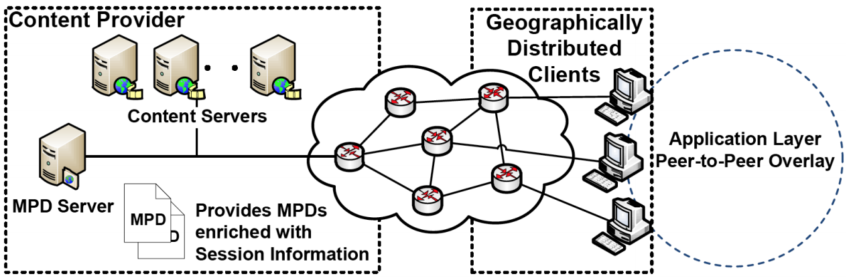
Architecture of IDMS for DASH
Session management
  Defining IDMS Session Objects (ISOs)
  Stored at Multimedia Presentation Description (MPD) server
Notes:
This is the architecture of their proposed IDMS for DASH.
Instead of modifying the server side for IDMS, they introduce session management by defining IDMS session objects (ISOs)
Stored at MPD Server, which provides the MPD and handles MPD request from peers.
MPD is multimedia presentation description, which describe the spatial, temporal and quality dimensions of the multimedia content. (as well as different encodings)

Slide 5
Session Management
Inter-Destination Multimedia Synchronization Session Object (ISO)
  Time bounded entity containing a set of peers
  uniquely identifiable (IP, port) and the type of the Network Address Translator (NAT)
ISO is identified by session key
  Provided by 3rd party application or the user
Integrated into the MPD of MPEG-DASH
Server imports the corresponding ISO when requested
  E.g., a peer requests the MPD with a session key
Notes:
They define IDMS session objects (ISOs) as a time bounded entity containing a set of peers.
Each ISO should have an unique identifier for a certain multimedia content.
As peers may use Network Address Translation (NAT), Session Traversal Utilities for NAT (STUN, RFC 5389) is applied
to determine the public IP address and port number to be used during the synchronization
The ISO is integrated into the MPD of MPEG-DASH
The MPD server adds the peers that request a certain MPD with a specific session key to the corresponding ISO
When a peer requests a MPD, the MPD Server adds the peer to the ISO associated with the session key and returns both. As peers may join the session at different points in time, each peer may only have partial information about the actual number of peers in an IDMS session

Slide 6
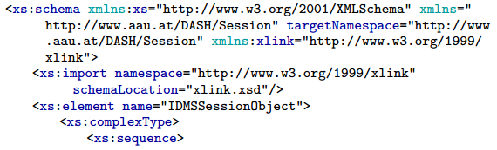
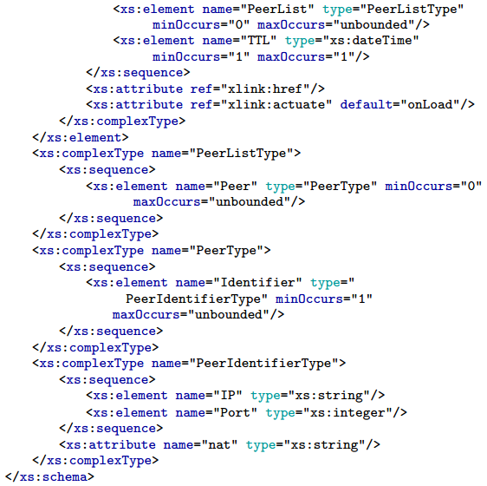
IDMS Session Object for DASH
Notes:
The ISO includes a list of peers (represented by @PeerListType) in the IDMS session and a Time-To-Live (TTL). The maximum TTL for an IDMS session is the duration of the requested multimedia content.
The @PeerIdentifierType contains the public IP address, port number, and the NAT type of a specific peer

Slide 7
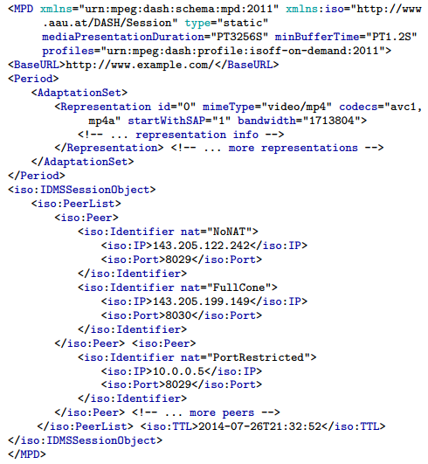
an Example MPD with an ISO
Notes:
Listing 2 shows an excerpt of an MPD comprising an ISO.
Peers requesting the MPD will be added to the ISO

Slide 8


Two phase Synchronization
Coarse synchronization
  request the segments which are currently played by other peers within the IDMS session → Overlay creation
  Strategies for selecting the segment to start with (e.g., minimum, maximum, or average)
  starts with a segment that is as closest as possible to the segment the other peers are currently playing
Fine synchronization
  Distributed algorithm – Merge and Forward
  Periodical sends constants sized message to neighbors
  Negotiate on reference playback timestamp
Notes:
They propose to determine the playback timestamp to which the peers shall synchronize their playback in two steps.
coarse synchronization and fine synchronization
In coarse synchronization, Each peer that receives the ISO requests the current playback timestamp from all peers it lists
The NTP Timestamp is used to align all received time stamp to the same point.
The timestamp from the responses may be combined to calculate the start segment by some strategies, such as the minimum of them, or the acerage of them.
The coarse synchronization ensures that if a peer joins an IDMS session it starts with a segment that is as closest as possible to the segment the other peers are currently playing.
The second synchronization phase starts once playback commences at the segment determined by coarse synchronization
They propose merge and forward algo to negotiate on reference playback timestamp.

Slide 9
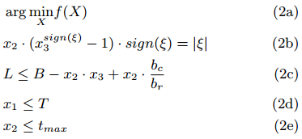
Dynamic AMP for IDMS
Overcome asynchronism by increasing or decreasing the playback rate
  Select those content sections which mask the playback rate variation
Content features for measuring the distortion caused by AMP
  Audio: spectral energy of audio frames
  Video: motion intensity between consecutive video frames
Notes:
Adaptive media playout
f(X) can be any function that models the impact of changing the playback rate for the given duration on the QoE
x1 denotes the starting time of the playback rate change relative to the current buffer, x2 denotes the duration of the playback rate change, and x3 denotes the target playback rate
2b the given asynchronism should be compensated for by selecting appropriate values for x2 and x3
Equation 2c avoids buffer underflows and, thus, stalls in the multimedia playback
L denotes the lower buffer threshold in seconds, B the current buffer fill state in seconds, bc the client’s bandwidth, and br the bit-rate of the selected representation
constrain the starting time (T) of the playback rate variation by bounding x1 (cf. Equation 2d). Equation 2e limits the duration (tmax) of the playback variation

Slide 10
Evaluation
Overhead of Merge and Forward (simulated the algorithms on Erd¨os-Renyi random networks implemented using OMNeT++)
  Traffics
  Time
Subjective quality assessment using crowdsourcing
  A/V metrics
  AMP approach
Notes:
traffic generated
during the negotiation on the reference playback timestamp
and the time needed until all peers have the necessary
information for calculating the average playback timestamp
a subjective quality assessment for evaluating the introduced A/V metric and the dynamic AMP approach

Slide 11
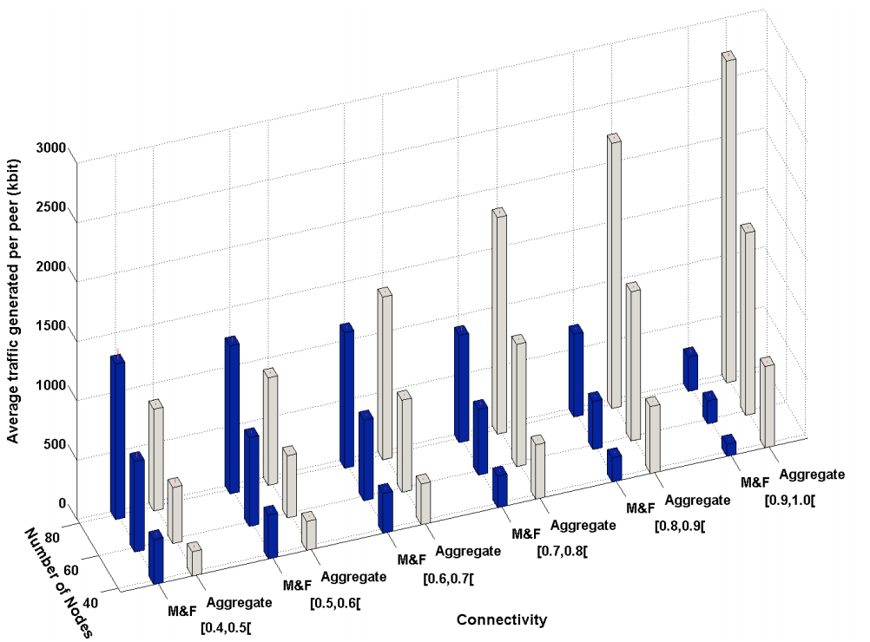
Evaluation of Merge and Forward
Aggregates
  each peer aggregates all received playback timestamps into a single message and sends them periodically to its neighbors using unicast
Notes:
illustrates the average network traffic (in kbit)
generated at each peer by both algorithms during the agreement
phase with respect to the overall connectivity of the
Network
With low connectivity, Merge and Forward generates more traffic than Aggregate but this is due to the time required to compute the average playback timestamp among all peers. If the connectivity increases the fixed length messages of Merge and Forward start to outperforms the Aggregate algorithm

Slide 12
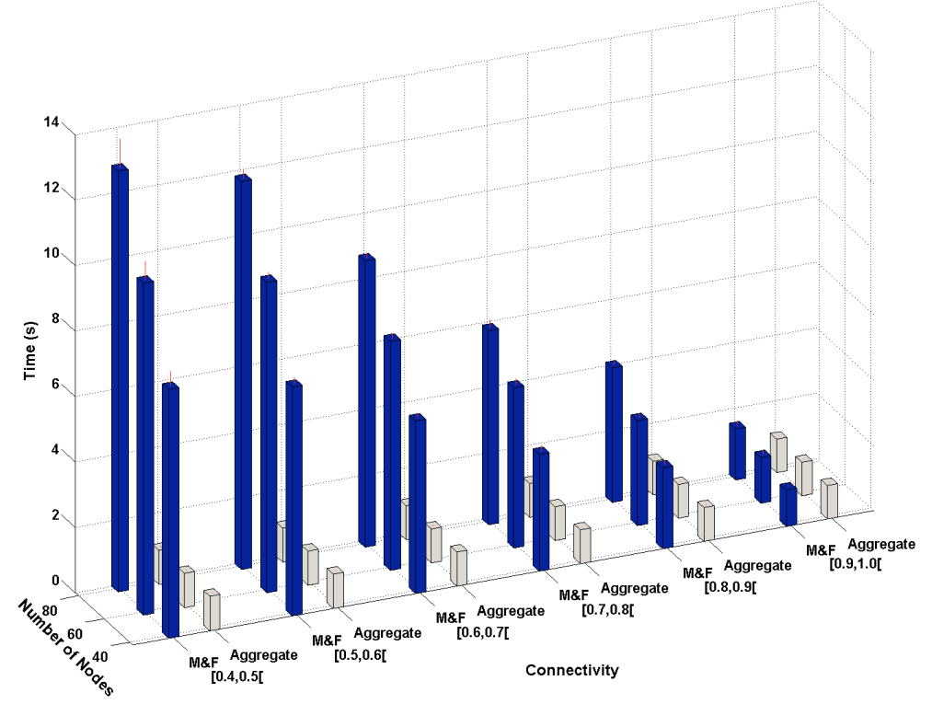
Evaluation of Merge and Forward
the time for the distributed calculation of the average playback timestamp
Notes:
depicts Aggregate represents the optimum case because lists of timestamps can be merged even if they overlap because the contribution of each peer can be clearly identified
with an increase in the connectivity, the time needed by Merge and Forward converges to the time needed by Aggregate. This shows that the negotiation time required by Merge and Forward does not solely depend on the number of peers in the overlay

Slide 13
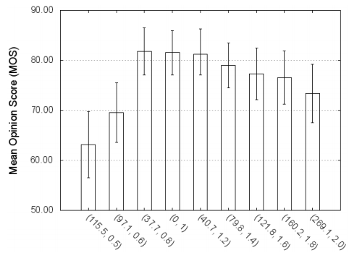
Evaluation of the dynamic AMP
15 minutes and offered $0.25 as a reward
(g(X), µ)
Notes:
average distortion g(X)
depicts the assessed Mean Opinion Score (MOS) for each tuple (g(X), µ)
These results indicate that the subjects could not notice a significant difference for playback rates within the range of [0.8, 1.8]. For the other playback rates, the QoE significantly degrades

Slide 14
Conclusion
Introduced IDMS to Adaptive Streaming
  MPEG-DASH
Distributed Control Scheme that scales with the number of peers
  Can be combined with any streaming protocol
  Not coupled with the session management or the overlay creation
Dynamic AMP for carrying out the actual synchronization
  (General) Optimization problem that aims on finding appropriate content sections
Demo video available on YouTube
  https://www.youtube.com/watch?v=2V9rO5SbI7A
  Search for: MergeAndForward
  Source Code available at: https://github.com/grishnagkh/mf

Slide 15
Self-Organized Inter-Destination Multimedia Synchronization (IDMS)
Session management
Signalling of timing and control information
Negotiation on a reference playback timestamp
Carrying out the synchronization
Notes:
In Their proposed self-organized inter-destination multimedia synchronization
They introduce the session management

Slide 16
Synchronization
Two phase synchronization using non reliable communication (UDP)
  Coarse synchronization
  Fine synchronization
Coarse synchronization
  Overlay creation
  Educated guess where to start downloading
Fine synchronization
  Distributed algorithm – Merge and Forward
  Periodical sends constants sized message to neighbors
  Negotiate on reference playback timestamp
Overcome the identified asynchronism
  Dynamic Adaptive Media Playout

Slide 17
Coarse Synchronization
Overlay creation
  Ask peers in the ISO for their current Playback Timestamp (PTS) + NTP TS
    If the response is received, the peer is added to the list of known peers
  May lead to a not fully connected network
    E.g., due to packet loss
Strategies for selecting the segment to start with
  Maximum PTS from peers
  Minimum PTS from peers
  Average PTS from peers
  Weighted average PTS from peers

Slide 18
Self-organized Fine Synchronization
Merge and forward (flooding-based)
  calculates the average playback timestamp among the peers in a distributed and self-organized manner
Periodical sends constants sized message to neighbors
Negotiate on reference playback timestamp

