Slide 1
Server Selection and Topology Control for Multi-Party Video Conference
Shuopeng Zhang, Di Niu,
Yaochen Hu, Fangming Liu
University of Waterloo, Canada
University of Alberta, Canada
Huazhong University of Science and Technology, China

Slide 2
Outline
Introduction
Multi-server topology
Algorithms
  D-Grouping based on PINGs
  Server location optimization
Simulations
Implementation
Conclustion

Slide 3
proposal
This paper proposes new methods for multi-server placement and topology control in multi-party video conferences.

Slide 4
Introduction
Existing multi-party conferencing solutions
  P2P
  Centralized servers
Utilization
  Large cloud of proprietary
  Third-party CDN nodes and datacenters
Lightweight practical solutions
  Based on only the RTTs between the few clients and some geo-information.

Slide 5
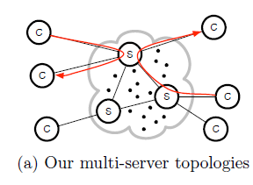
Multi-server topology

Slide 6
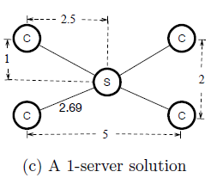
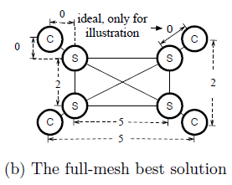
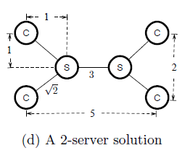
Full-mesh servers

Slide 7
Algorithms
A three-steps procedure to minimize the mean end-to-end delay between all pairs of clients.
  Use D-Grouping to cluster the clients.
  Convex optimization to find the ideal server location that minimize the total length of all client-to-client paths.
  Map the server to closest server candidate that really achieves the minimum mean end-to-end delay.

Slide 8
D-Grouping based on PINGs
Similar to k-means, however, it depends on not clients coordinates but the pairwise round-trip times(RTTs).
Two steps
  Initial grouping
  Iterative grouping

Slide 9
Server location optimization
Geo-Center
Local Convex Optimization
Global Convex Optimization
Naïve Server Search(NaiSS)
Local Server Search(LclSS)
Global Server Search(GlbSS)

Slide 10
Simulation
Best performance combination
  The method of using D-Grouping + Global Convex Optimization + Global Server Search is the best method that incurs the lowest delay.

Slide 11
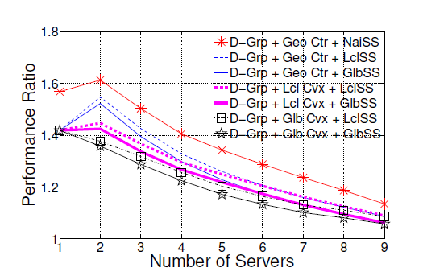
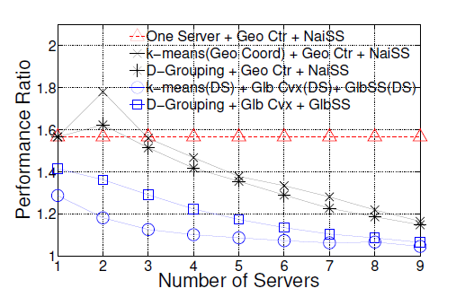

Slide 12
Implementation
Measuring end-to-end packet delays
  Tcircle – RTTAB/2
Real-world experiments
  6 nodes as clients
  Best method

Slide 13
Conclusion
The placement of multi-servers and topology control in multi-party video conferencing applications.

