Slide 1
Cloud SLAs: Present and Future
Salman A. Baset
sabaset@us.ibm.com
IBM Research

Slide 2
Introduction
This paper compares current SLAs of cloud providers and guidance on future SLAs
- Amazon, Rackspace, Microsoft Windows Azure, Terremark vCloud Express and Storm on Demand
Cloud-based services include IaaS, PaaS and Saas
- all considered providers offer IaaS services, some offer PaaS services
None of them offer performance guarantees for the compute services

Slide 3
Anatomy of a Typical Cloud SLA
A typical cloud SLA has the following components
Service guarantee: metrics that provider strives to meet
Service guarantee time period: duration over which a service guarantee should be met
Service guarantee granularity: resource scale on a service guarantee
Service guarantee exclusions
Service credit: the amount credited to customer if service guarantee is not met
Service violation measurement and reporting
Notes:
Service guarantee: availability, response time, disaster recovery and fault resolution time
Service guarantee granularity: per service, per data center, per instance, or per transaction basis
Service violation measurement and reporting: defines how and who measures and reports the violation

Slide 4
Cloud Providers Considered
Amazon
Windows Azure
Rackspace
Terremark vCloud Express
Storm on Demand

Slide 5
Cloud Providers Considered
Amazon (IaaS provider)
- offer compute (EC2) and storage (S3) services
- provide remote disk capability, called Elastic Block Store (EBS)
- provide a SimpleDB, a simplified database service
- Only EC2 and S3 are backed by SLAs
Picture resource: https://www.amazon.com/clouddrive/home/
Notes:
EBS is not backed by and SLA

Slide 6
Cloud Providers Considered
Windows Azure (PaaS and IaaS provider)
- offer compute (Azure Compute) and storage (Azure Storage) services
- Azure Compute offers three types of services: web, worker and a VM
- provide remote disks (Azure Drive)
Picture resource: https://www.facebook.com/microsoftazure
Notes:
Web: a web based front end for an application
Worker: for generalized deployment, can run Apache Tomcat and Java Virtual Machines

Slide 7
Cloud Providers Considered
Rackspace (IaaS provider)
- provide compute instances similar to Amazon EC2 and VM role of Azure (Cloud Servers)
- responsible for applying software and security patches
- provide storage service (Cloud Files), stored files are internally replicated by Rackspace
Picture resource: http://www.rackspace.com/

Slide 8
Cloud Providers Considered
Terremark vCloud Express (IaaS provider)
- similar to EC2, VM role of Azure, and Rackspace
- does not provide specialized storage service
Picture resource: https://community.vcloudexpress.terremark.com/en-us/

Slide 9
Cloud Providers Considered
Storm on Demand (IaaS provider)
- similar to EC2, VM role of Azure, Rackspace, and Terremark vCloud Express
Picture resource: http://www.stormondemand.com/

Slide 10
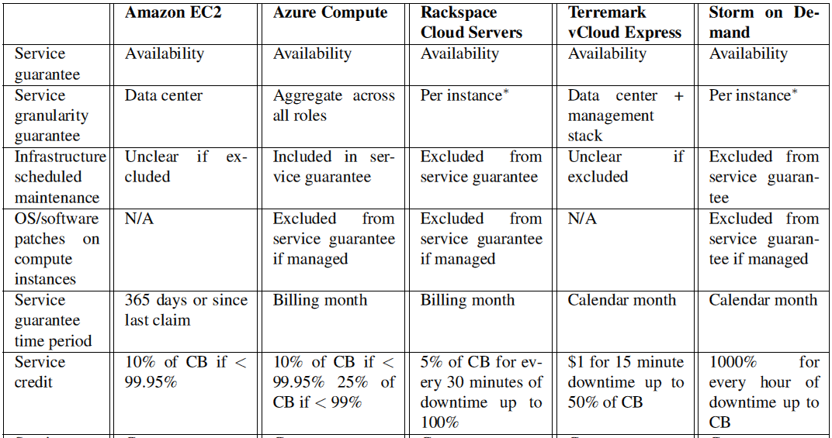

Slide 11
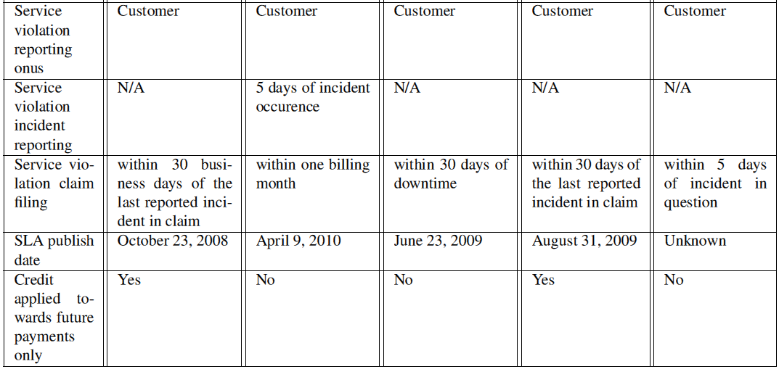

Slide 12
Highlights of SLA Comparison
Weak uptime guarantees for compute
No performance guarantees for compute
Customer should detect SLA violation
Service credit

Slide 13
Future of Cloud SLAs
Service guarantees: not only uptime guarantees, but also performance or security
Service violation detection and credit: providers should detect the service violation
Outcome based SLAs: providers need to define SLAs for promised outcomes
Standardization of SLAs

