Slide 1
Context Processing: A Distributed Approach
P. Chen, S. Sen, H. Pung, and W. Wong
National University of Singapore
INTELLI 2013

Slide 2
Introduction
More and more applications are using context to provide service
Context processing efficiency is important
Most of the context processing architecture is centralized
Centralized architecture cannot service large number of context queries

Slide 3
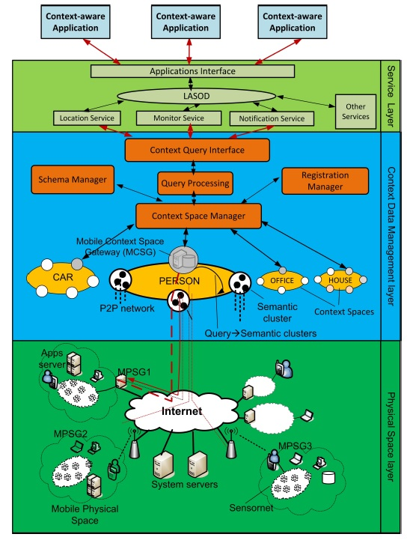
System Architecture
The system which is named Coalition is proposed in their previous work
Using a proposed structure (Query Plan) to make the context processing can be distributed

Slide 4
Context Query Language (CQL)
A good CQL can significantly affect the system efficiency
There are many different types of context query language
  RDF based
  XML based
  SQL based
  Graph based
SQL based and RDF based languages are better (from other work)
CQL is SQL based language
It can only handle one context attribute and one context domain
SELECT (context attribute) FROM (context domain) [WHERE (constraints)]
  E.g. SELECT preference FROM PERSON WHERE location = “shop A”

Slide 5
Context Processing Operation (CPO)
Predefined data processing operations
  Filtering
  Aggregating
  Reasoning
  Matching
  Sorting
  Merging

Slide 6
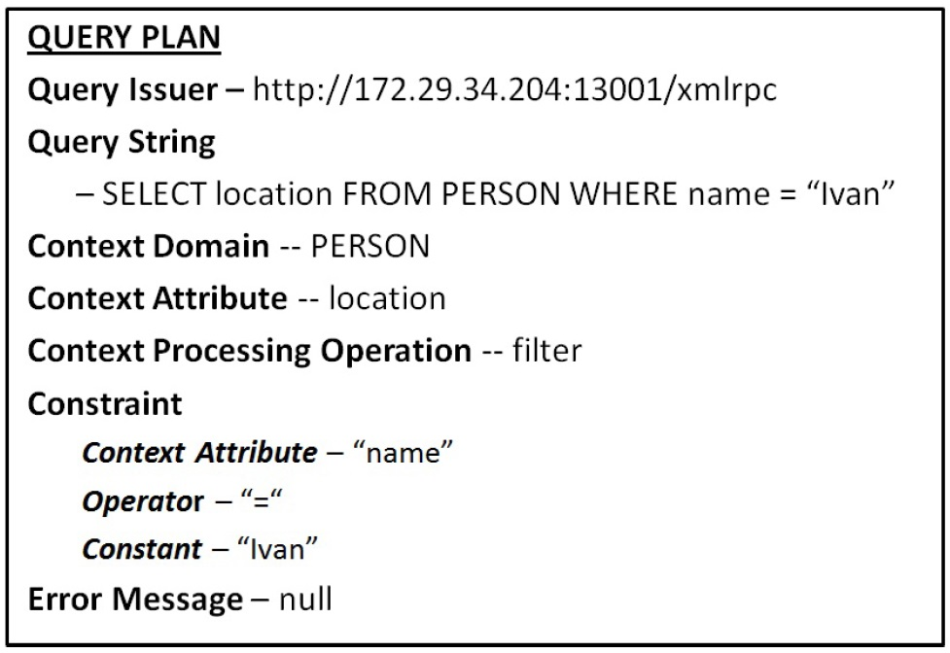
Query Plan
They aim to provide a generic representation of context query
Query issuer indicates which PSD issues this query

Slide 7
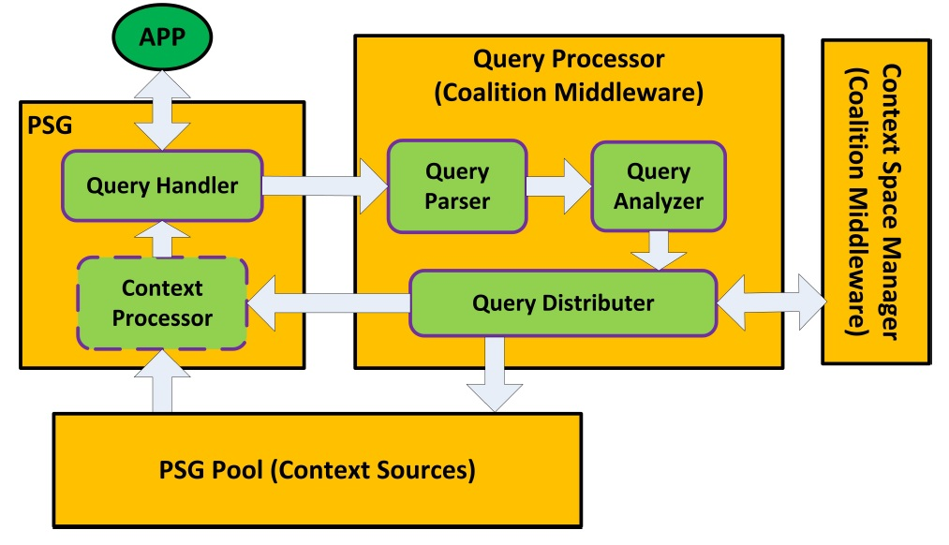
Architecture of Distributed Context Processing

Slide 8
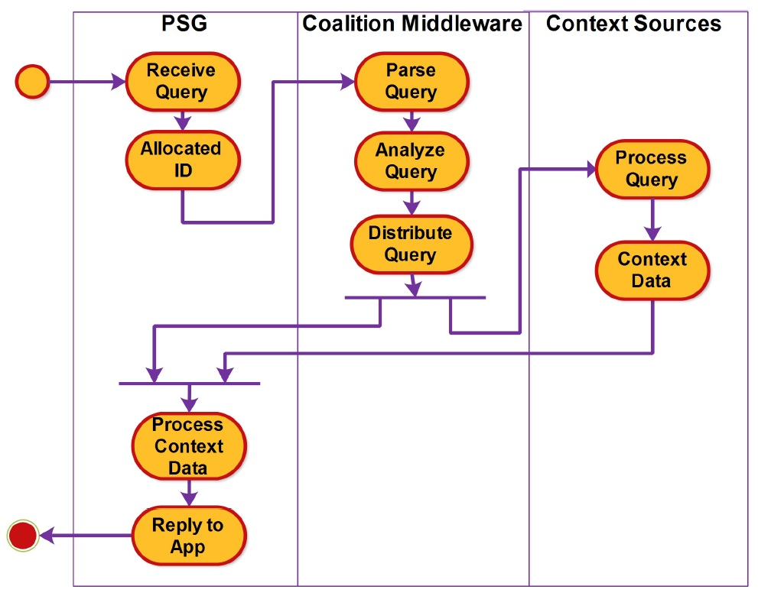
Work Flow Diagram

Slide 9
Evaluation setup
Server
  Dell PowerEdge T300
PSG
  Simulated by desktop PC
Using centralized processing to be the baseline

Slide 10
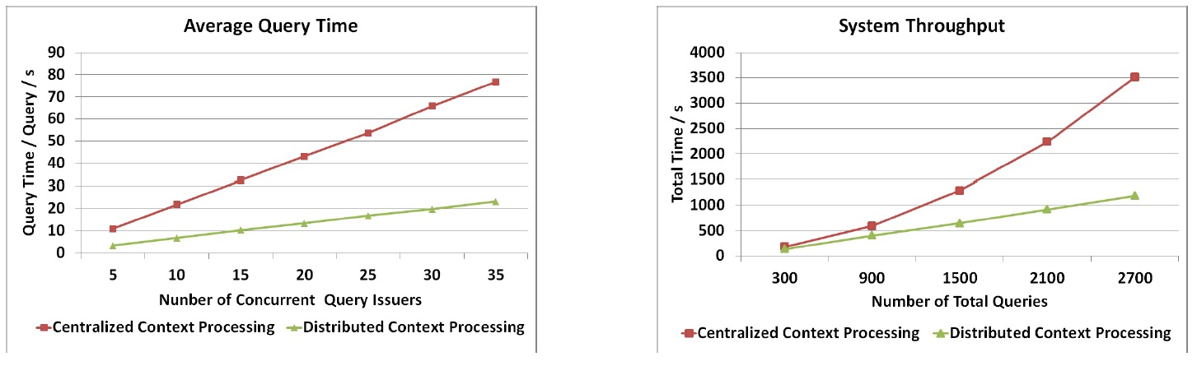
Average Query Time and System Throughput

Slide 11
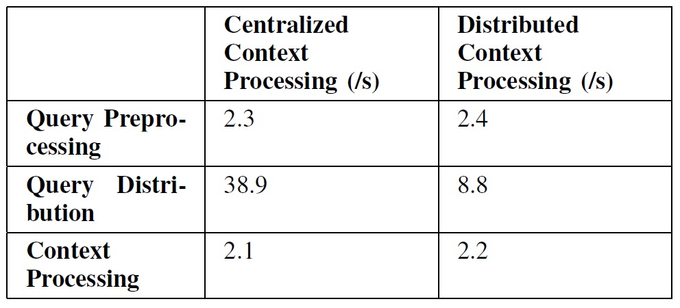
Query Time Breakdown
Query preprocessing time and context processing time remains the same
Query distribution time improved

Slide 12
Conclusion
They proposed a distributed context processing mechanism
They plan to extend the query capability

