Slide 1
OpenSession: SDN-based Cross-layer Multi-stream Management Protocol for 3D Teleimmersion

Slide 2
Outline
Introduction
3D Teleimmersion
Motivations
Challenges
OpenSession: Framework
OpenSession: Protocol and Functionalities
Evaluation
Real 3DTI Setup
PlanetLab

Slide 3
Introduction
A surge of interest on telepresence video collaborative technologies over the past years.
The emerging of 3D teleimmersion (3DTI) technology provides full-body interation of physical activities in a shared virtual environment.
OpenSession decouples application layer data and control plane functionalities and partially offloads the data plane functionalities to network layer switches
OpenSession leverages support from Software-defined network

Slide 4
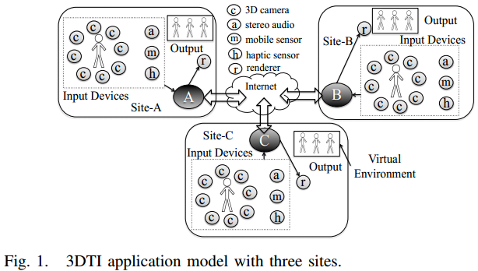
3D Teleimmersion
3DTI application model

Slide 5
Motivations
Benefits
Local bandwidth
OpenSession introduces a significant reduction of 3DTI bandwidth within local network of participating sites since the stream replication and forwarding is done by OpenFlow switch.
End-to-end delay
Since the forwarding of stream is done by network switch, the end-to-end delays are reduced.
Processing load
In OpenSession, the network layer is responsible for streams replication and forwarding, so the application layer is not impacted by the increase of number of participants of a stream.
System resiliency
Since the multicast forwarding is separated from the application layer, the failure of an application gateway does not interfere the real-time collaborative experience among other participating sites.

Slide 6
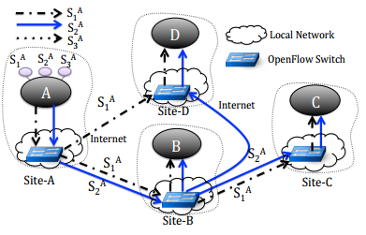
Challenges
Per-stream differentiation
To forward stream at OpenFlow switches according to multi-stream overlay distribution graphs, OpenSession must ensure differentiation of network packets at the switches.
Overlay to flow table mapping
Ensure that flow table rules are consistently installed at all the participating OpenFlow switches.
Seamless view change
The creation of new topology and the removal of old topology for streams should be performed concurrently to ensure no transient bandwidth overloading and network disconnectivity.

Slide 7
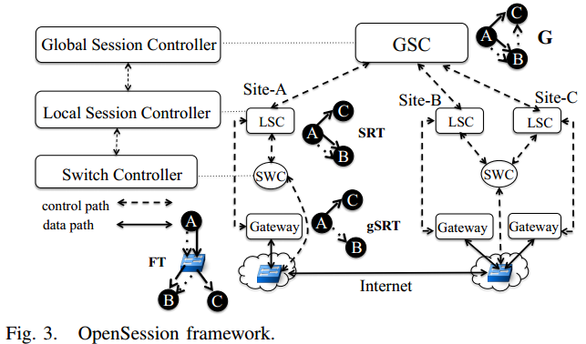
OpenSession: Framework
OpenSession control plane consists of a three-layer session management hierarchy.

Slide 8
OpenSession: Framework (cont.)
Global session controller (GSC)
Construct an optimized multi-stream overlay content distribution topology during session initiation and update (such as view changes) and send the overlay routing to the corresponding LSC.
The information is represented by a session routing table or SRT
Local session controller (LSC)
Update session routing table (gSRT) at local gateway
Forward SRT to local SWC to map it to the switch flow table (FT)
Switch controller (SWC)
Communicate with the OpenFlow switches
Data plane

Slide 9
OpenSession: Protocol and Functionalities
Multi-stream overlay mapping
Overlay topology to SRT mapping
Define the forwarding actions for each stream at each participating sites
Consist of three fields: (1) Match field. (2) Forwarding action which contains a list of gateway IPs to forward the matching streams to. (3) Dirty bits which indicates whether an entry has been modified.
SRT to gSRT mapping
Define the forwarding responsibility for the application layer data plane at gateway
SRT to FT mapping
Prune SRT entry: map only dirty SRT entries and prune entries that are already in gSRT
Update match field
Update action list

Slide 10


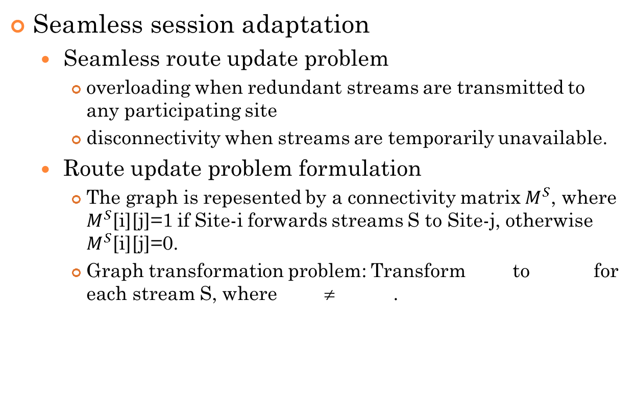
OpenSession: Protocol and Functionalities (cont.)
Seamless session adaptation
Seamless route update problem
overloading when redundant streams are transmitted to any participating site
disconnectivity when streams are temporarily unavailable.
Route update problem formulation
The graph is repesented by a connectivity matrix $M^{S}$, where $M^{S}$[i][j]=1 if Site-i forwards streams S to Site-j, otherwise $M^{S}$[i][j]=0.
Graph transformation problem: Transform to for each stream S, where ≠ .

Slide 11
OpenSession: Protocol and Functionalities (cont.)
Seamless session adaptation
Route update solution overview
Consider an additional packet header field (η) in the FT match entry.
Deleting obsolete rules: old rule that become obsolete are automatically deleted using OpenFlow-defined timeout primitive.
OpenSession route update algorithm
First, we need to specify η each time when a route update happens
Secondly, FT entries in the remote sites should be updated before updating FT entries at the source site.
Multi-stream route update
All modified streaming paths are done in parallel
Route update can be dependent if the update routes overlap at any sites

Slide 12
Evaluation: Real 3DTI Setup
Setup 4 3DTI sites in different types of network
Each site contains 8 video streams
Read streams from stored files of a 1-hour session
Implement SWC as a module of Floodlight controller
Initially, all sites request the same set of the streams
Compare the OpenSession performance with a no OpenSession case

Slide 13
Evaluation: Real 3DTI Setup (cont.)
Performance metrics
Local bandwidth
How much bandwidth we use within local network between gateway and the OpenFlow switch at each site. (55% reduction)
How much bandwidth we use within local network for remote streams (35% reduction)
Processing load
Processing load of the gateway include stream receiving, scheduling, and forwarding load of the application. (improve by 42%)
End-to-end delay
Network transmission delay. (45% gain)

Slide 14
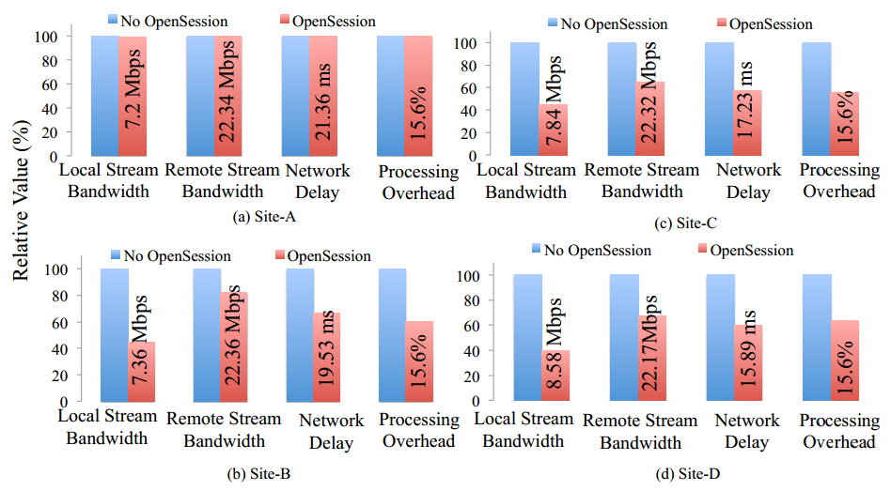
Evaluation: Real 3DTI Setup (cont.)

Slide 15
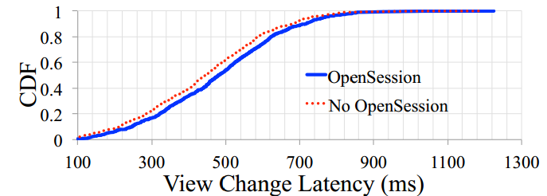
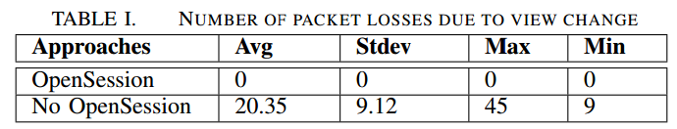
Evaluation: Real 3DTI Setup (cont.)
Impact of view changes
View change latency
In OpenSession, the view change latency involves some setups for updating considering the impact on victim sites.
View change resiliency

Slide 16
Evaluation: PlanetLab
Consider three overlay construction approaches
Random
A random multi-stream topology is constructed during initial session.
During view changes, streaming sources are selected randomly
ViewCast
Multi-stream topology is constructed considering the stream priority during initial session.
During view changes, the higher priority streams are restored first.
OSM
The initial multi-stream topology is constructed using evolutionary optimization to ensure optimized overlay considering stream priority
Optimal streaming paths are selected during view changes

Slide 17
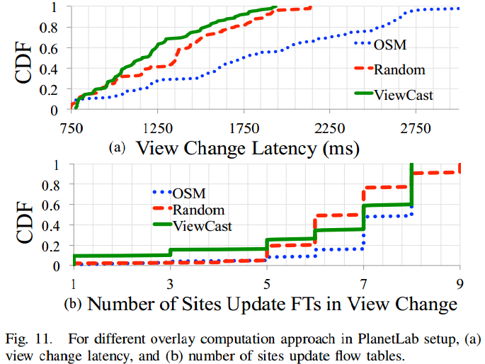
Evaluation: PlanetLab (cont.)

Slide 18
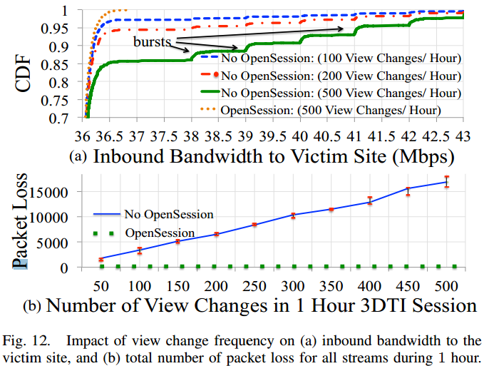
Evaluation: PlanetLab (cont.)

