Slide 1
Efficient Multiparty Video Conferencing Using Smartphones

Slide 2
Introduction
Smartphone becomes more popular
More and more people use multiparty video conferencing applications
Network traffic is an important issue
Providing an efficient algorithm for sharing video with low bandwidth requirement using 3G and wifi interfaces

Slide 3
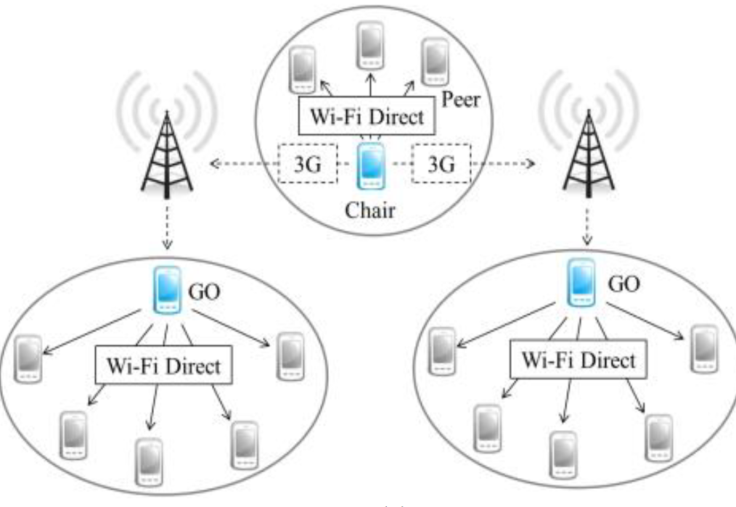
System Architecture
Chair communicates with Group Owners
Group Owners communicate with peers in the same group

Slide 4
Create conferencing environment
Step 1:
All peer send the register message to Chair
Chair receives all register messages and decides which peers are GOs.
Step 2:
Each GO connects adjacent peers form a group
Chair connects all GOs and shares video to all peers

Slide 5
Token Mechanism
Peer request Token through GO to chair
Chair decides which peer can get the Token
After peer receiving the Token, this peer can sharing the video to all peers

Slide 6
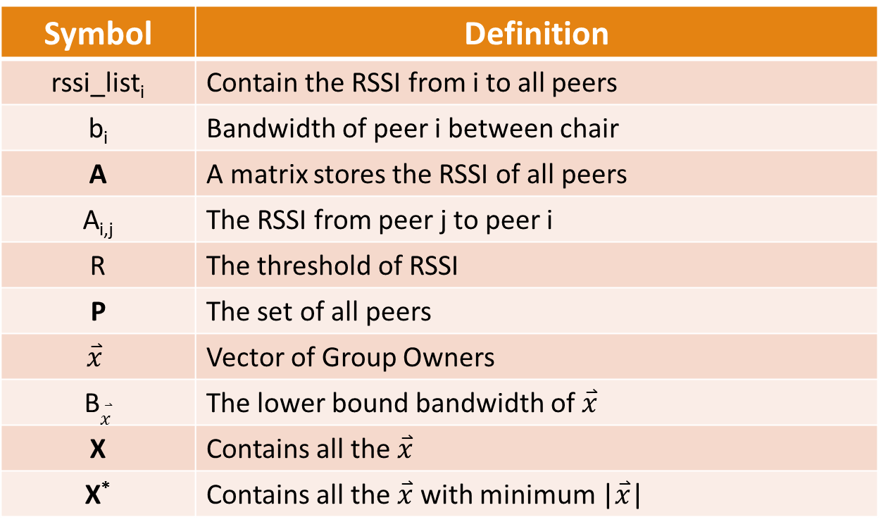
Notation
Symbol | Definition
rssi_list_{i} | Contain the RSSI from i to all peers
b_{i} | Bandwidth of peer i between chair
A | A matrix stores the RSSI of all peers
A_{i,j} | The RSSI from peer j to peer i
R | The threshold of RSSI
P | The set of all peers
$$\overset{⃑}{x}$$ | Vector of Group Owners
B$\overset{⃑}{x}$ | The lower bound bandwidth of $\overset{⃑}{x}$
X | Contains all the $\overset{⃑}{x}$
X* | Contains all the $\overset{⃑}{x}$ with minimum |$\overset{⃑}{x}$|

Slide 7
Two Steps Formulation
Step 1:
Select minimum number of Group Owners
Step 2:
Select maximum bandwidth bottleneck from step 1 feasible solutions

Slide 8
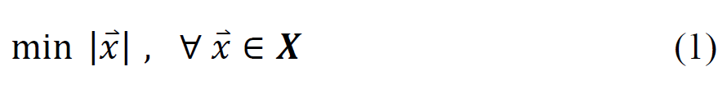
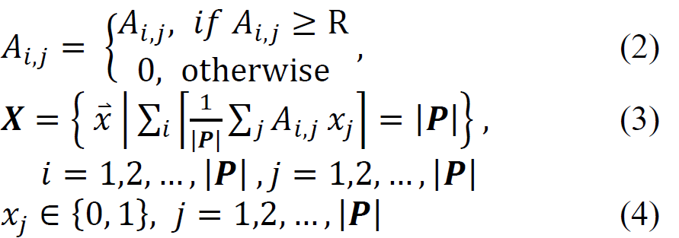
Step 1 Formulation
Objective:
Subject to:

Slide 9

Step 2 Formulation
Objective:
Subject to:

Slide 10
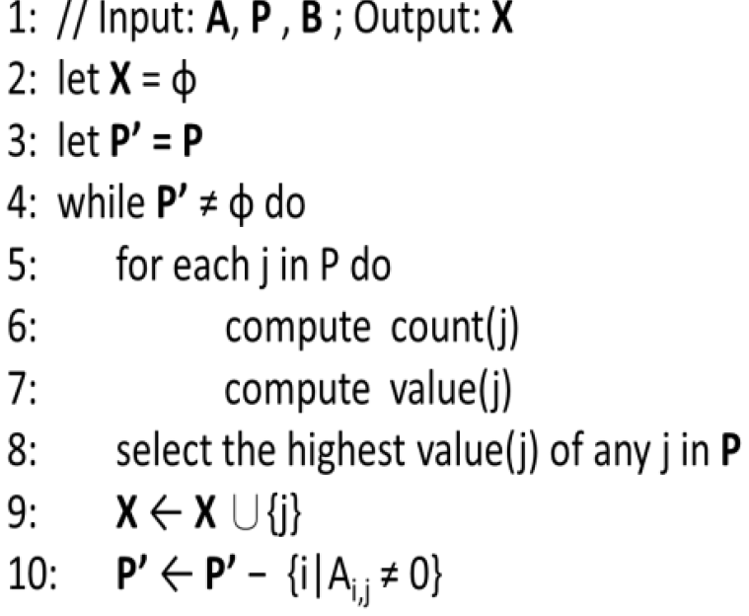
Algorithm
Minimum Group Algorithm (MGA)
It takes 2^{|P|} time, which |P| is number of peers.
Efficient Minimum Group Algorithm (EMGA)
EMGA

Slide 11
Simulation
100x100 space as world-wide map
Consider wifi cover range and cluster ratio
Compared to MGA and EMGA
Each simulation run 50 times

Slide 12
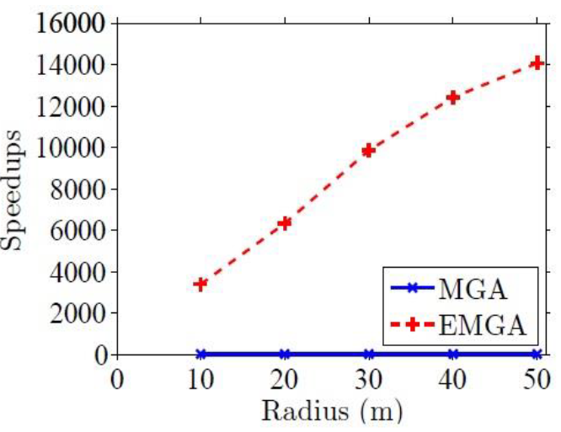
Simulation: Speedup
EMGA faster than MGA 14,000 times

Slide 13
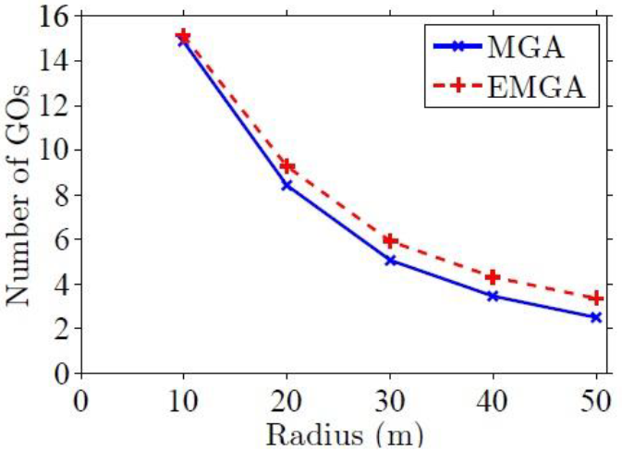
Simulation: Number of GOs
EMGA no more than MGA 2 GOs

Slide 14
Conclusion
Propose an efficient multiparty video conferencing system that leverages WiFi direct to reduce the usage of 3G network.
We propose the EMGA algorithm to speedup to pick up GOs and the performance is approximate to optimal solution.

