Slide 1
Predicting Resource Availability in a Multimedia Fog Computing Platform
Yi-Ying Huang
October, 2016

Slide 2
Outline
Motivation
Research Problem
System Overview
Proposed Solution
Trace-Driven Simulations
  Trace Collection & Used Datasets
  Setup
  Results
Conclusion & Future Work

Slide 3
Outline
Motivation
Research Problem
System Overview
Proposed Solution
Trace-Driven Simulations
  Trace Collection & Used Datasets
  Setup
  Results
Conclusion & Future Work

Slide 4









Motivation
Increasing demands of resource-hungry multimedia jobs
Expensive cloud service
Advancing personal devices
⇨ Possible solution: fog computing

Slide 5
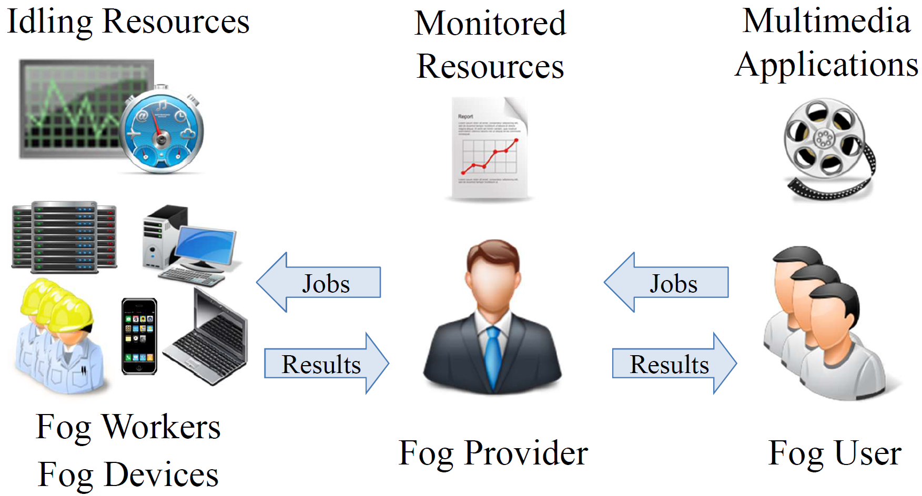
Multimedia Fog Computing Platform

Slide 6



Application: Animation Rendering
In 1995, Toy Story required 800,000 machine hours to render at 2 to 15 hours per frame ^{[1]}
In 2001, Pixar spent about 12 hours to render a single frame with the main character in it ^{[2]}
In 2014, Disney even needed to render Big Hero 6 on a 55,000-core supercomputer ^{[3]}
[1] http://collider.com/pixar-numbers-toy-story-brave/.
[2] http://collider.com/pixar-numbers-monsters-university/.
[3] https: //www.engadget.com/2014/10/18/disney-big-hero-6/.

Slide 7
Outline
Motivation
Research Problem
System Overview
Proposed Solution
Trace-Driven Simulations
  Trace Collection & Used Datasets
  Setup
  Results
Conclusion & Future Work

Slide 8
Research Problem
Accurate prediction of resource availability helps job scheduling in our multimedia fog computing platform
Each fog user may have his own usage pattern, which leads to daily and weekly regular pattern
We use machine learning predictors to predict the available resource of a future time period

Slide 9
Outline
Motivation
Research Problem
System Overview
Proposed Solution
Trace-Driven Simulations
  Trace Collection & Used Datasets
  Setup
  Results
Conclusion & Future Work

Slide 10
System Overview
Fog User
Fog Device
Monitoring Data
Main System
Completion Time Predictor
Available Resource Predictor
Job Scheduler
Completed Result

Slide 11
System Overview
Fog User
Fog Device
Job
Monitoring Data
Main System
Completion Time Predictor*
Available Resource Predictor
Prediction Result
Prediction Result
Job Scheduler
Completed Result
* H. Hong et al., Animation rendering on multimedia fog computing platforms. In IEEE 8th CloudCom. 2016.

Slide 12
System Overview
Job
Completed Result
Fog User
Fog Device
Job
Monitoring Data
Main System
Completion Time Predictor
Available Resource Predictor
Prediction Result
Prediction Result
Job Scheduler
Completed Result

Slide 13
System Overview
Job
Completed Result
Fog User
Fog Device
Job
Monitoring Data
Main System
Completion Time Predictor
Available Resource Predictor
Prediction Result
Prediction Result
Job Scheduler
Completed Result

Slide 14
System Overview
Fog Devices
Job Scheduler
Monitoring Data
Available Resource Predictor
Historical Data Storage
Available Resource Predictor
Prediction Result
Predictor
Historical Data
Parameter Tuner

Slide 15
System Overview
Fog Devices
Job Scheduler
Monitoring Data
Available Resource Predictor
Historical Data Storage
Available Resource Predictor
Prediction Result
Store monitoring data
Transform timestamp into features
Predictor
Historical Data
Parameter Tuner

Slide 16
System Overview
Fog Devices
Job Scheduler
Monitoring Data
Available Resource Predictor
Historical Data Storage
Available Resource Predictor
Prediction Result
Tune hyperparameters for different prediction algorithms
Re-tune hyperparameters when accuracy decreases
Predictor
Historical Data
Parameter Tuner

Slide 17
System Overview
Fog Devices
Job Scheduler
Monitoring Data
Available Resource Predictor
Historical Data Storage
Available Resource Predictor
Prediction Result
Predict available resource for job scheduling
Send back prediction results for monitoring accuracy
Predictor
Historical Data
Parameter Tuner

Slide 18
Outline
Motivation
Research Problem
System Overview
Proposed Solution
Trace-Driven Simulations
  Trace Collection & Used Datasets
  Setup
  Results
Conclusion & Future Work

Slide 19
Proposed Solution
Random Forest (RF)
  Construct a multitude of decision trees
  Average all trees’ prediction results
Gradient Boosting Tree (GBT)
  Consists a sequence of trees
  Each successive tree is to predict the residuals of the preceding one
Neural Network (NN)
  Consists input layer, hidden layers, and output layer
  Each layer contains multiple neurons
Lack of representative instances incurs high negative impact for GBT
With large enough training dataset, GBT often outperforms RF
RF and GBT have complementary properties

Slide 20
Outline
Motivation
Research Problem
System Overview
Proposed Solution
Trace-Driven Simulations
  Trace Collection & Used Datasets
  Setup
  Results
Conclusion & Future Work

Slide 21
Trace Collection & Used Datasets
Dataset 1: Datacenter Dataset*
  # of nodes: 500
  Period: Jul.~Sep. 2013 (3 months)
  Sampling frequency: 1 record/5 minutes
  Contents: VM resource usage
Dataset 2: Desktop Dataset
  # of volunteers: 25
  Period: late May~Jun. 2016 (1 month)
  Sampling frequency: 1 record/10 seconds
  Contents: real users’ resource usage
  Resource usage includes CPU usage, memory usage, disk usage, and network rx/tx throughput
* Datacenter dataset resource: http://www.bitbrains.nl/solvinity-en

Slide 22
Sample Statistics of Datasets
 | Datacenter Dataset | Desktop Dataset
Total # of nodes | 500 | 25
Period | 3 months | 1 month
Total # of records | 12,496,728 | 2,967,335
Avg. # of records | 24,993 | 118,693
size of training set | 9,997,696 | 2,373,909
size of testing set | 2,499,032 | 593,426
# of features | 9 | 9
Features | id, epoch, dayInMonth, dayInWeek, isWeekend, hourInWeek, hourInDay, minute, daySlot | id, epoch, dayInMonth, dayInWeek, isWeekend, hourInWeek, hourInDay, minute, daySlot
Prediction Target | cpuUsagePercent | cpuUsagePercent
We split each dataset into (a) training set (80%) and (b) testing set (20%)*
* Abu-Mostafa et al., Learning from data, volume 4. AMLBook Singapore, 2012.
Notes:
daySlot, cpuCore, cpuSpeed, totalVirMem, usedVirMem, totalPhyMem, usedPhyMem, totalDisk, usedDisk, diskRead, diskWrite, ntwkSpeed, ntwkRx, ntwkTx

Slide 23
Procedure of Generating Model
D

Slide 24
Procedure of Generating Model (Cont.)
1. Divide the data into training and testing set
D_{train}
D_{test}

Slide 25
Procedure of Generating Model (Cont.)
2. Test different combination of hyperparameters
D_{train}
D_{test}
H₁
H₂
……
H_{h}

Slide 26
Procedure of Generating Model (Cont.)
3. Perform 10-fold cross validation for each combination of hyperparameter using training set
D_{train}
D_{test}
H₁
H₂
……
H_{h}

Slide 27
Procedure of Generating Model (Cont.)
a. Divide training set into 10 portions
1
2
3
4
5
6
7
8
9
10
D_{test}
H₁
H₂
……
H_{h}

Slide 28
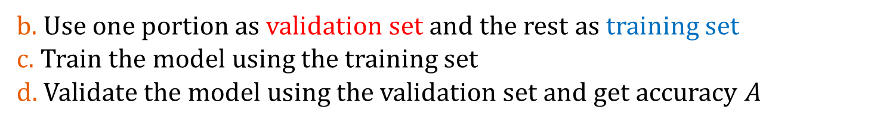
Procedure of Generating Model (Cont.)
b. Use one portion as validation set and the rest as training set
c. Train the model using the training set
d. Validate the model using the validation set and get accuracy $A$
D_{v}
D_{train}
D_{test}
A₁
H₁
H₂
……
H_{h}

Slide 29
Procedure of Generating Model (Cont.)
e. Repeat c. and d. 10 times until every portion has been used for validation
D_{v}
D_{train}
D_{test}
A₁
H₁
Round 1
H₂
D_{train}
Round 2
D_{v}
D_{test}
A₂
……
……
H_{h}
D_{train}
Round 10
D_{v}
D_{test}
A₁₀

Slide 30
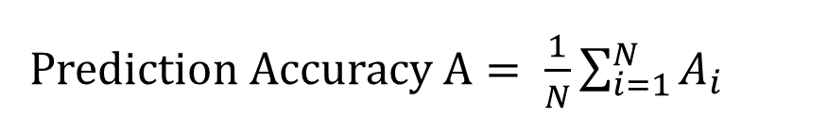
Procedure of Generating Model (Cont.)
f. Average all 10 accuracy scores as the result
D_{v}
D_{train}
D_{test}
A₁
H₁
Round 1
H₂
D_{train}
Round 2
D_{v}
D_{test}
A₂
……
……
H_{h}
D_{train}
Round 10
D_{v}
D_{test}
A₁₀
Prediction Accuracy $A= \frac{1}{N}\sum_{i=1}^{N}{A_{i}}$

Slide 31
Procedure of Generating Model (Cont.)
4. Select the combination of hyperparameter with the highest accuracy score
D_{v}
D_{train}
D_{test}
A₁
H₁
Round 1
H₂
D_{train}
Round 2
D_{v}
D_{test}
A₂
……
……
H_{h}
D_{train}
Round 10
D_{v}
D_{test}
A₁₀
H_{best}
Prediction Accuracy $A= \frac{1}{N}\sum_{i=1}^{N}{A_{i}}$

Slide 32
Procedure of Generating Model (Cont.)
5. Generate model with the selected combination using the training set
6. Test the model using testing set and report the final accuracy
D_{train}
H_{best}
5
Model
6
D_{test}
A_{final}

Slide 33
Procedure of Generating Model (Cont.)
Divide the data into training and testing set
Test different combination of hyperparameters
Perform 10-fold cross validation for each combination of hyperparameter using training set
  Divide training set into 10 portions
  Use one portion as validation set and the rest as training set
  Train the model using the training set
  Validate the model using the validation set and get accuracy score
  Repeat c. and d. 10 times until every portion has been used for validation
  Average all 10 accuracy scores as the result
Select the combination of hyperparameter with the highest accuracy score
Generate model with the selected combination using the training set
Test the model using testing set and report the final accuracy

Slide 34
Hyperparameters of the Predictors
RF-based predictor
  The number of trees
  The number of considered features
GBT-based predictor
  The number of trees
  The maximal depth of each tree
  The shrinkage (i.e., the learning rate)
Metrics: execution time and r² score

Slide 35
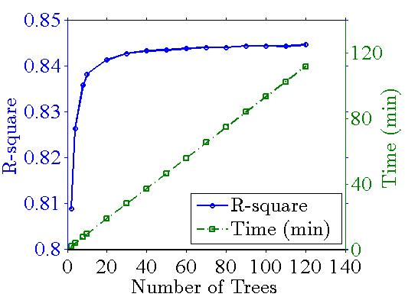
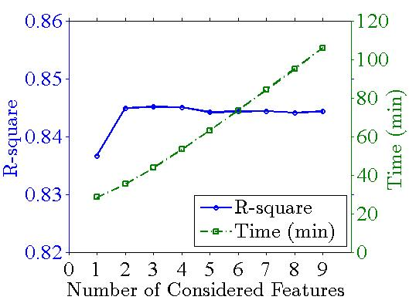
Tuning Hyperparameters of RF
Desktop dataset
  The number of trees [2, 4, 8, 10, 20, …, 150]
  The number of features [1, 2, …, 9]
Chosen trees = 80
Chosen features = 9

Slide 36
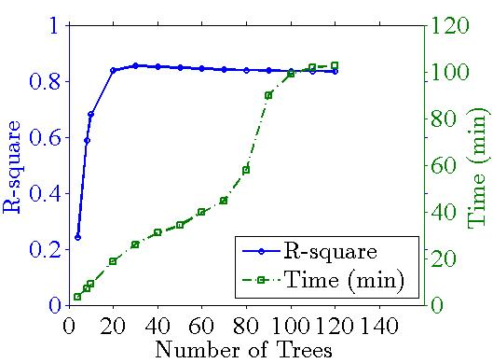
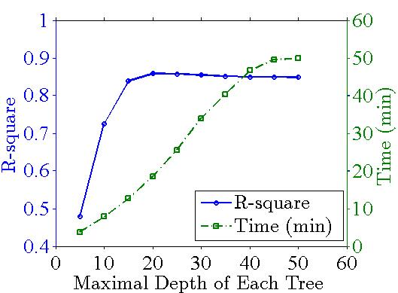
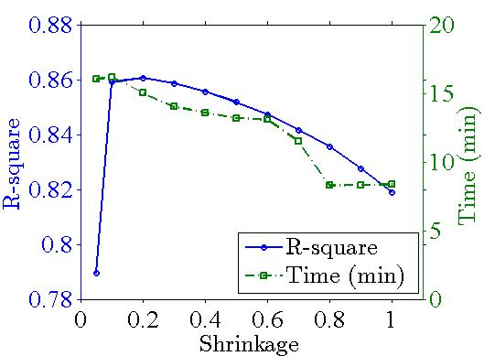
Tuning Hyperparameters of GBT
Desktop dataset
  The number of trees [2, 4, 8, 10, 20, …, 130]
  The maximal depth of each tree [5, 10, …, 50]
  The shrinkage [0.05, 0.1, 0.2, …, 1]
Chosen trees = 30
Chosen depth = 20
Chosen shrinkage = 0.2

Slide 37
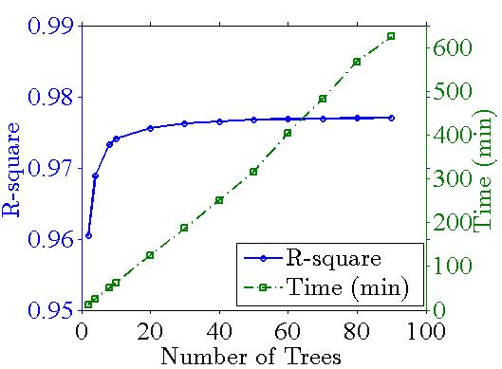
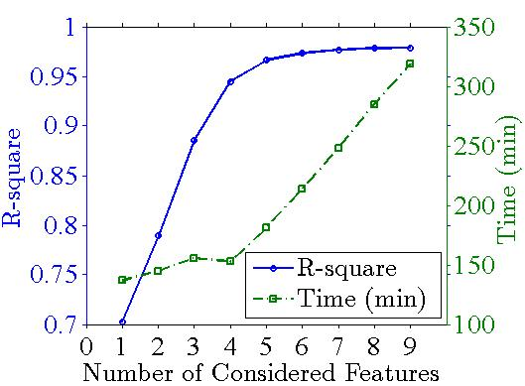
Tuning Hyperparameters of RF
Datacenter dataset
  The number of trees [2, 4, 8, 10, 20, …, 90]
  The number of features [1, 2, …, 9]
Chosen trees = 40
Chosen features = 9

Slide 38
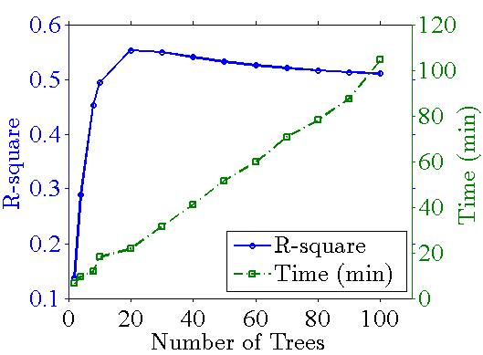
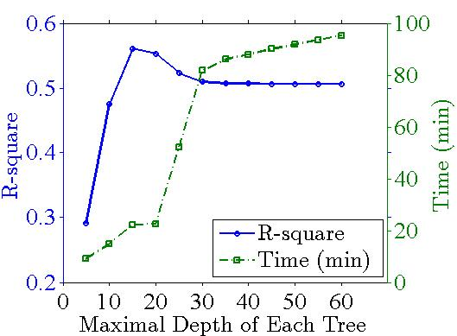
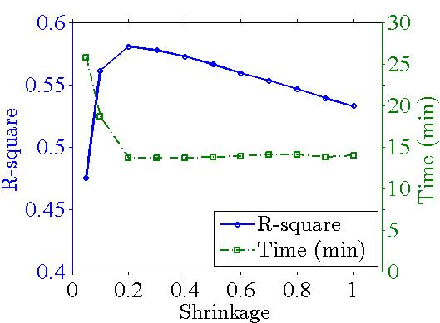
Tuning Hyperparameters of GBT
Datacenter dataset
  The number of trees [2, 4, 8, 10, 20, …, 100]
  The maximal depth of each tree [5, 10, …, 60]
  The shrinkage [0.05, 0.1, 0.2, …, 1]
Chosen trees = 20
Chosen depth = 15
Chosen shrinkage = 0.2

Slide 39
The Chosen Hyperparameters
RF-based predictor
GBT-based predictor
 | Datacenter Dataset | Desktop Dataset
Number of Trees | 40 | 80
Number of Features | 9 | 9
 | Datacenter Dataset | Desktop Dataset
Number of Trees | 20 | 30
Depth of Trees | 15 | 20
Shrinkage | 0.2 | 0.2

Slide 40
Outline
Motivation
Research Problem
System Overview
Proposed Solution
Trace-Driven Simulations
  Trace Collection & Used Datasets
  Setup
  Results
Conclusion & Future Work

Slide 41
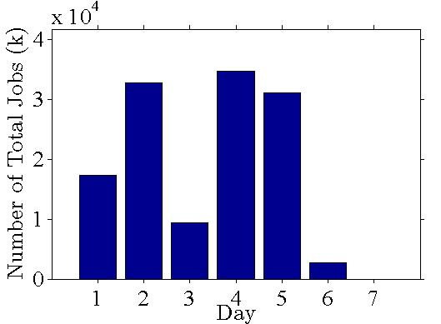
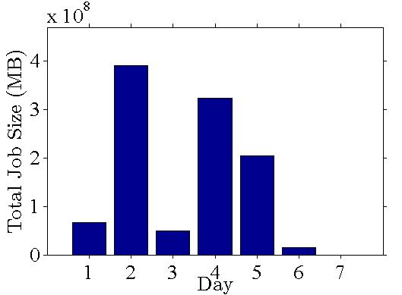
Setup
Input: Animation job rendering dataset
  127,791 records collected between Sep. and Nov. 2015
  Job’s arrival time and size
Feature | Mean | Std.
CPU Usage (%) | 19.7 | 11.7
RAM Usage (KB) | 380.7 | 147.5
# of Frames | 113.9 | 76.7
# of Polygons | 63512.6 | 332868.8
Image Size (Pixels) | 131161.6 | 17453.5
Completion Time (s) | 104.1 | 194.2

Slide 42
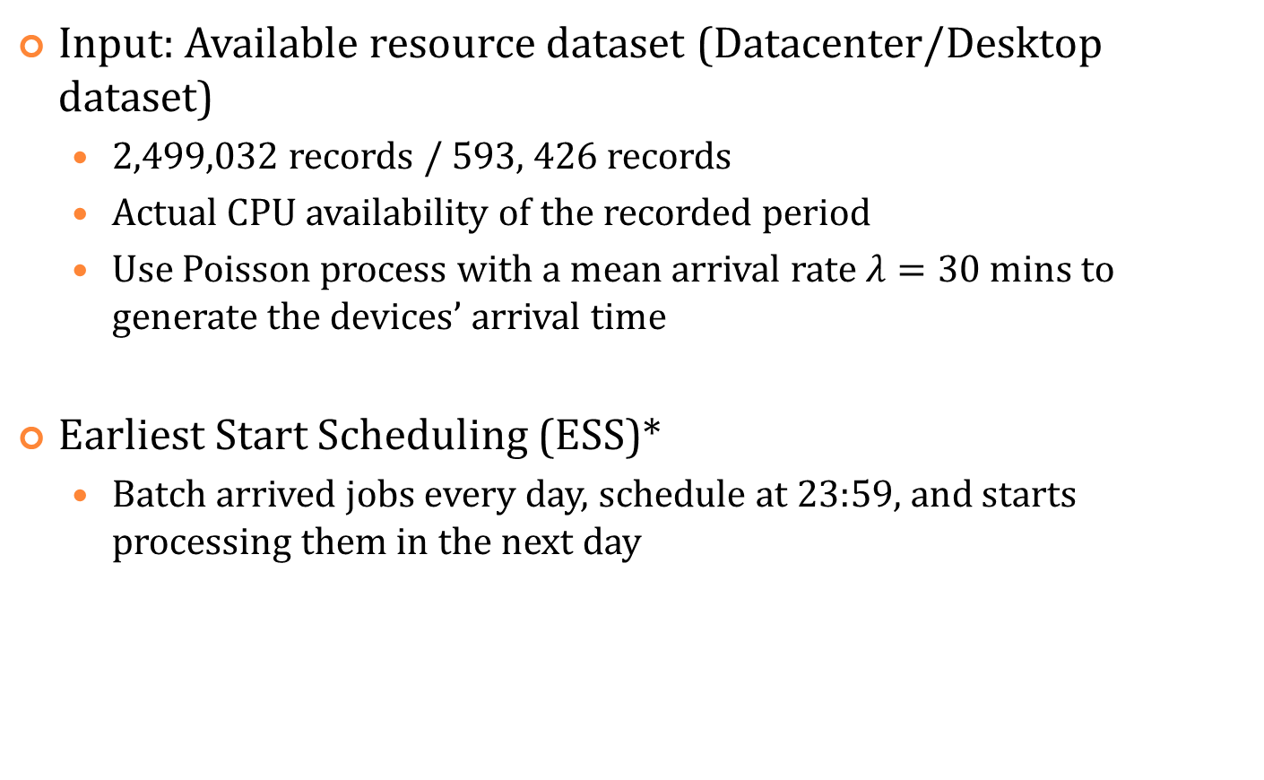
Setup (Cont.)
Input: Available resource dataset (Datacenter/Desktop dataset)
  2,499,032 records / 593, 426 records
  Actual CPU availability of the recorded period
  Use Poisson process with a mean arrival rate $λ=30$ mins to generate the devices’ arrival time
Earliest Start Scheduling (ESS)*
  Batch arrived jobs every day, schedule at 23:59, and starts processing them in the next day
* P. Brucker and S. Knust. Complex Scheduling. Springer, 2012.

Slide 43
Setup (Cont.)
Implement the perfect scheduling, Oracle
Implement the simulator using Java, run simulations for each solution and each dataset for 10 times and present the 95% confidence intervals whenever applicable
Implement the algorithms using open-source libraries, scikit-learn ^{[1]} and xgboost ^{[2]}
[1] http://scikit-learn.org/
[2] https://github.com/dmlc/xgboost/

Slide 44
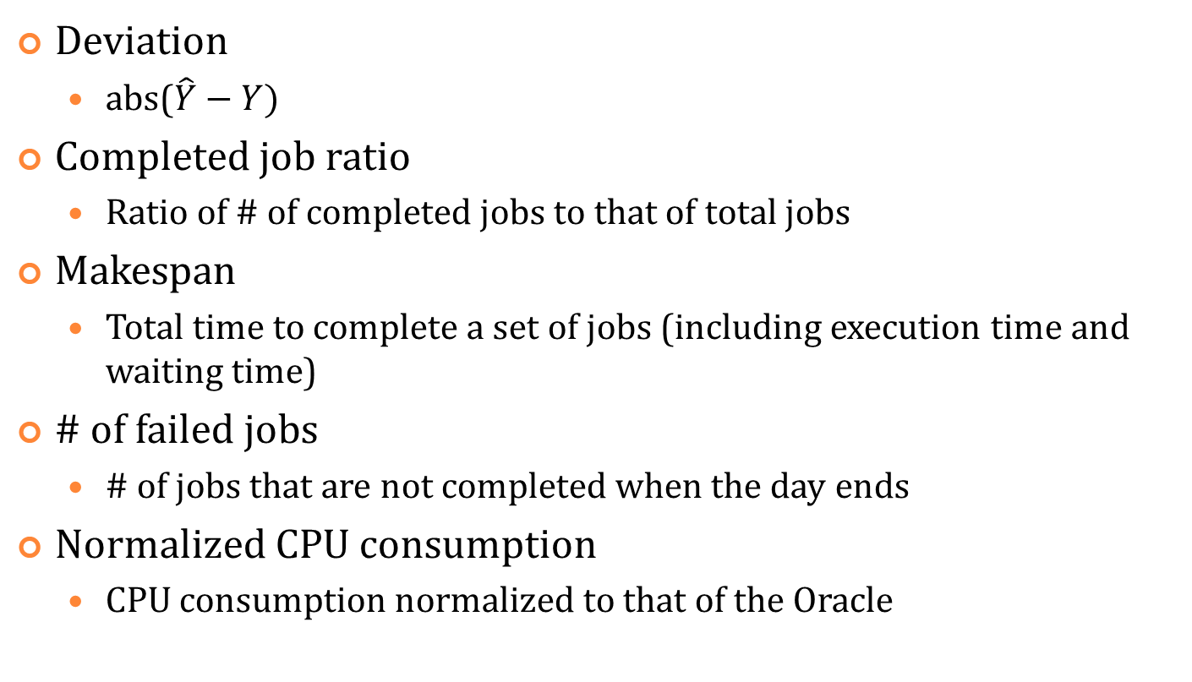
Performance Metrics
Deviation
  abs($\hat{Y}−Y)$
Completed job ratio
  Ratio of # of completed jobs to that of total jobs
Makespan
  Total time to complete a set of jobs (including execution time and waiting time)
# of failed jobs
  # of jobs that are not completed when the day ends
Normalized CPU consumption
  CPU consumption normalized to that of the Oracle

Slide 45
Outline
Motivation
Research Problem
System Overview
Proposed Solution
Trace-Driven Simulations
  Trace Collection & Used Datasets
  Setup
  Results
Conclusion & Future Work

Slide 46
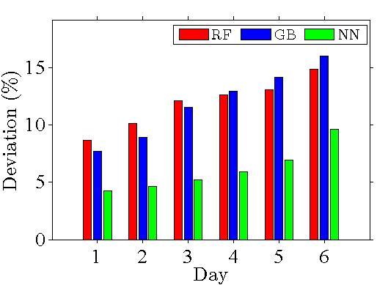
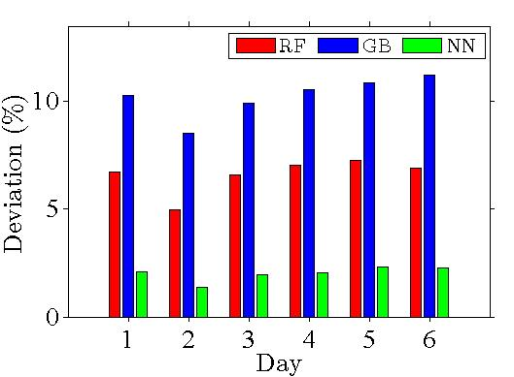
Results – Deviation
Deviation of three solutions for desktop / datacenter dataset
⇨ NN-based algorithm performs the most accurate prediction for both datasets

Slide 47
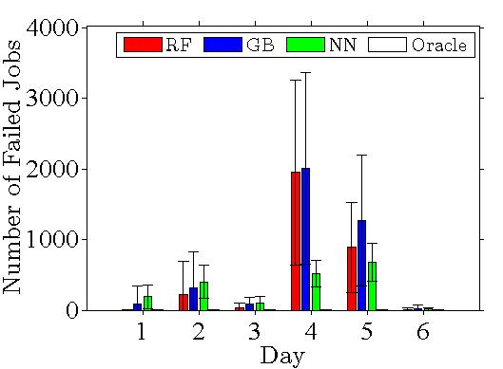
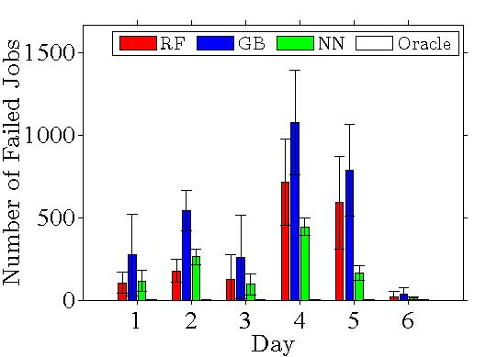
Results – # of Failed Jobs
# of failed jobs of three solutions for desktop / datacenter dataset
⇨ More accurate prediction leads to less failed jobs

Slide 48
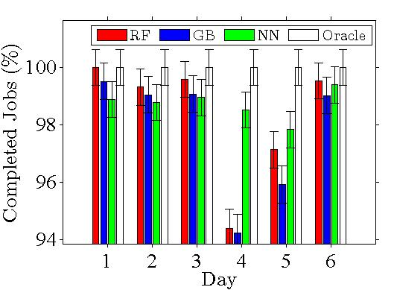
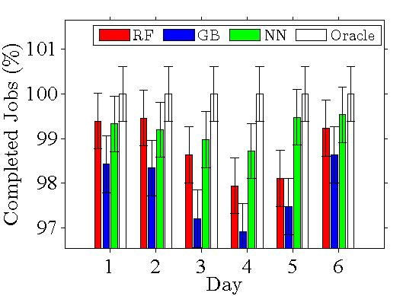
Results – Completed Jobs Ratio
Completed jobs ratio of three solutions for desktop / datacenter dataset
⇨ Three solutions perform close to Oracle

Slide 49
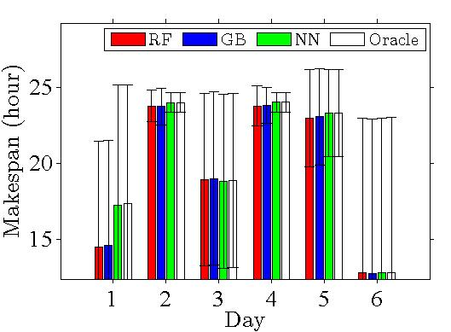
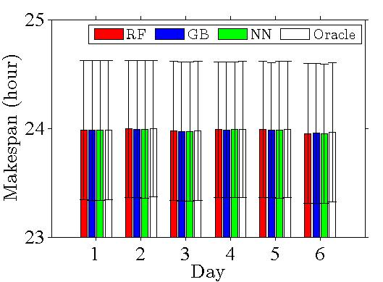
Results – Makespan
Makespan of three solutions for desktop / datacenter dataset
⇨ Three solutions perform close to Oracle

Slide 50
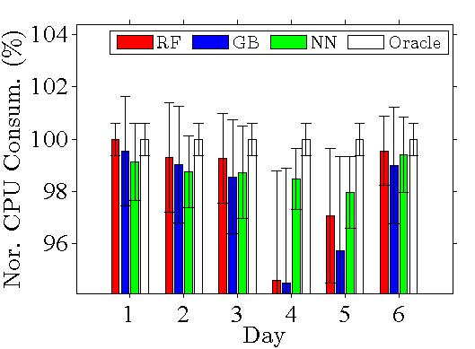
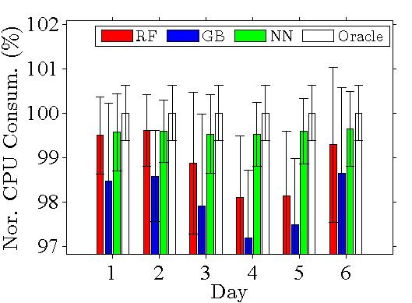
Results – Nor. CPU Consumption
Normalized CPU consumption of three solutions for desktop / datacenter dataset
⇨ Three solutions perform close to Oracle

Slide 51
Outline
Motivation
Research Problem
System Overview
Proposed Solution
Trace-Driven Simulations
  Trace Collection & Used Datasets
  Setup
  Results
Conclusion & Future Work

Slide 52
Conclusion
Propose the multimedia fog computing platform
  Utilize idling resources of fog devices
Use three machine learning algorithms: RF, GBT, and NN
  NN-based algorithm performs the most accuracy prediction results
Simulation results show that more accurate prediction leads to fewer failed jobs

Slide 53
Future Work
For predicting the resource availability
  Collect more user/device information as features
  Adopt more machine learning algorithms suitable for time series prediction
For the multimedia fog computing platform
  Study the scheduling problem
  Deal with the dynamicity of fog users’ requests
  Provide QoS guarantees on the resource limited fog devices

Slide 54

Performance Metrics
Mean Square Error: R² = $1−\frac{RSS}{TSS}$
  RSS: the residual sum of squares, $\sum{{(\hat{Y}−Y)}^{2}}$
  TSS: the total sum of squares, $\sum{{(\hat{Y}−mean(Y))}^{2}}$

Slide 55
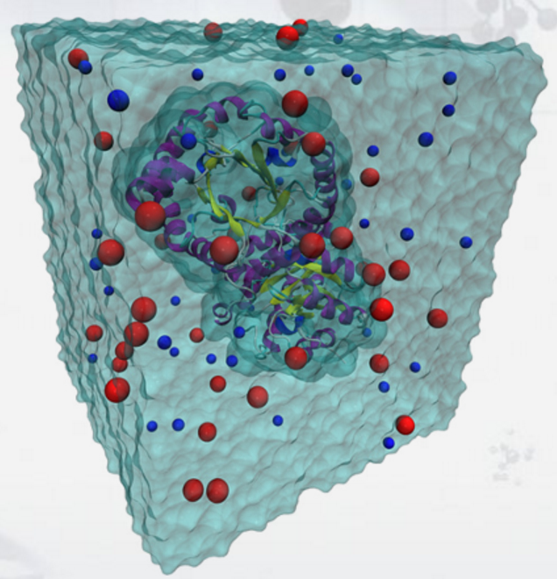


Related Work – Volunteer Computing
SETI@Home ^{[1]}
  BOINC ^{[2]} : a generalized platform of volunteer computing
[1] D. Anderson et al., SETI@home: An experiment in public-resource computing. ACM Transactions on Communications, 45(11):56–61, November 2002.
[2] D. Anderson. Boinc: A system for public-resource computing and storage. In Proc. of IEEE/ACM Grid Computing (GC), pages 4 – 10, Pittsburgh, PA, November 2004.

